Slide 1
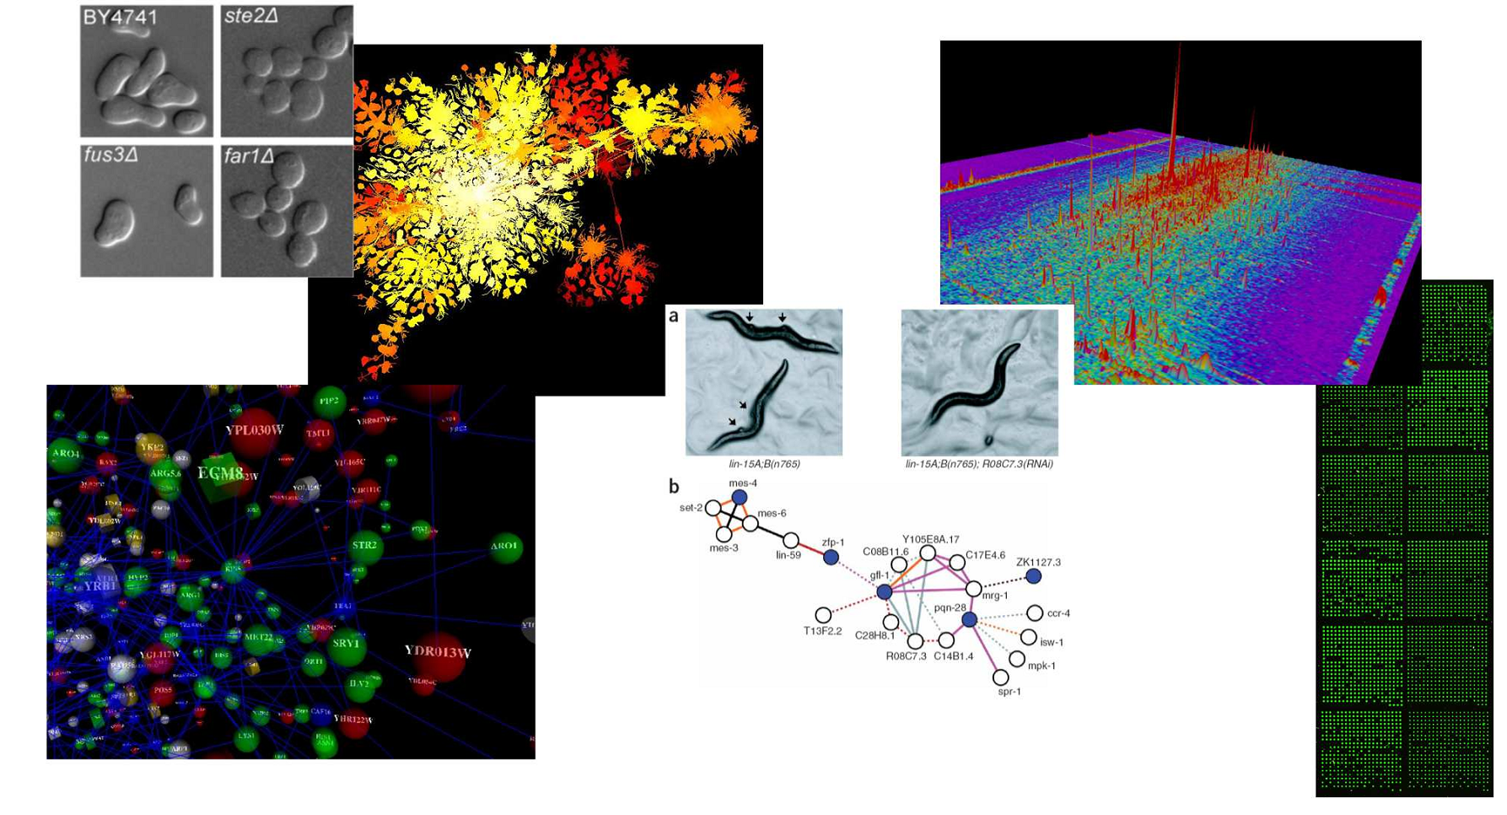
BCH339N Systems Biology/Bioinformatics
(course # 54040)
Spring 2016 Tues/Thurs 11 – 12:30 PM BUR 212

Slide 2
Instructor: Prof. Edward Marcotte marcotte@icmb.utexas.edu
Office hours: Mon 4 PM – 5 PM MBB 3. 148BA
TA: Claire McWhite claire.mcwhite@utexas.edu
Office hours: Wed/Thurs 4 – 5 PM MBB 3.128A
Phone: 512-232-3919

Slide 3
Probably the most important slide today!
Course web page: http://www.marcottelab.org/index.php/BCH339N_2016
Open to biochemistry majors.
Prerequisites: Biochemistry 339F or Chemistry 339K with a grade of at least C-.
Requires basic familiarity with molecular biology & basic statistics, although varied backgrounds are expected.
Note that this is an UNDERGRADUATE class. There is a different version intended for graduate students in alternate years (CH391L).

Slide 4
An introduction to systems biology and bioinformatics, emphasizing quantitative analysis of high-throughput biological data, and covering typical data, data analysis, and computer algorithms.
Topics will include introductory probability and statistics, basics of Python programming, protein and nucleic acid sequence analysis, genome sequencing and assembly, proteomics, synthetic biology, analysis of large-scale gene expression data, data clustering, biological pattern recognition, and gene and protein networks.
** NOT a course on practical sequence analysis or using web-based tools (although we’ll use a few), but rather on algorithms, exploratory data analyses and their applications in high-throughput biology. **

Slide 5
Books
Most of the lectures will be from research articles and slides. For sequence analysis, there will be an Optional text:
Biological sequence analysis, Durbin, Eddy, Krogh, Mitchison, Cambridge Univ. Press (available from Amazon, used from $26.85)
For biologists rusty on their stats, The Cartoon Guide to Statistics (Gonick/Smith) is very good (really!).
We will also be learning some Python programming.
I highly recommend…
Python programming for beginners: http://www.codecademy.com/tracks/python

Slide 6
Grading
No exams. Instead, grades will be based on:
Online programming homework
  (10 points each and counting 30% of the final grade)
3 problem sets
  (15 points each and counting 45% of the final grade)
A course project that you will develop over the semester & present in the last 3 days of class (25% of final grade)
The course project will be focused on a specific gene & will involve bioinformatics research (e.g. calculation, programming, database analysis, etc.) developed over the semester in 5 mini-assignments (4% each) and presented in class (5%).
The project will be emailed as a web URL to the TA & I, developed through the semester and finished by midnight, April 27, 2016. The last three classes will be spent presenting your projects to each other.

Slide 7
Late policy
All projects and homework will be turned in electronically and time-stamped.
No makeup work will be given.
Instead, all students have 5 days of free “late time”.
  This is for the entire semester, NOT per project, and counting weekends/holidays just like any other day.
  For projects turned in late, days will be deducted from the 5 day total (or what remains of it) by the # of days late.
  Deductions are in 1 day increments, rounding up
    e.g. 10 minutes late = 1 day deducted.
  Once the 5 days are used up, assignments will be penalized 10% / day late (rounding up), e.g., a 50 point assignment turned in 1 ½ days late would be penalized 20%, or 10 points.

Slide 8
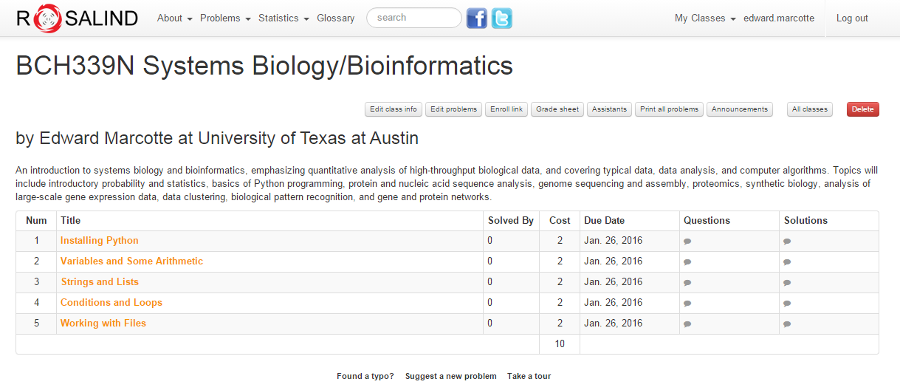
Online homework will be via Rosalind: http://rosalind.info/faq/
Enroll specifically for BCH339N at:
http://rosalind.info/classes/enroll/c5be9c4629
The first homework will be due (in Rosalind) by midnight, Jan 26.

Slide 9
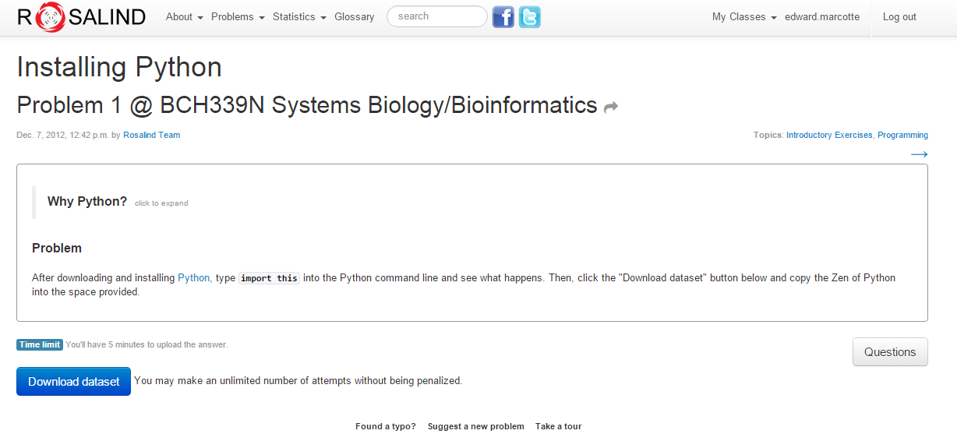

Slide 10
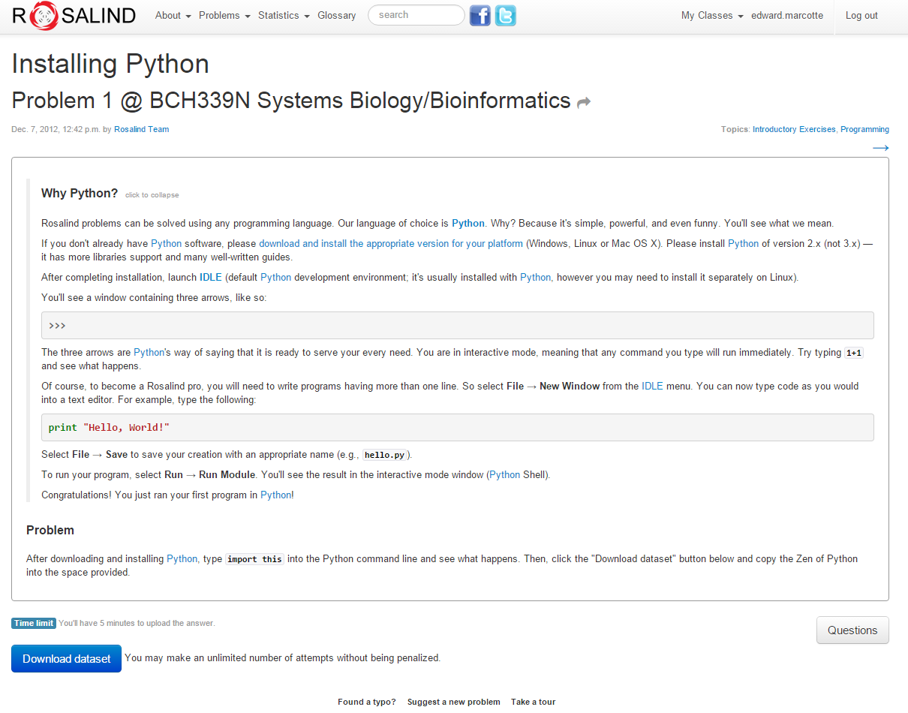
If you’re feeling restless/adventurous…
Click here to turn in your answer

Slide 11
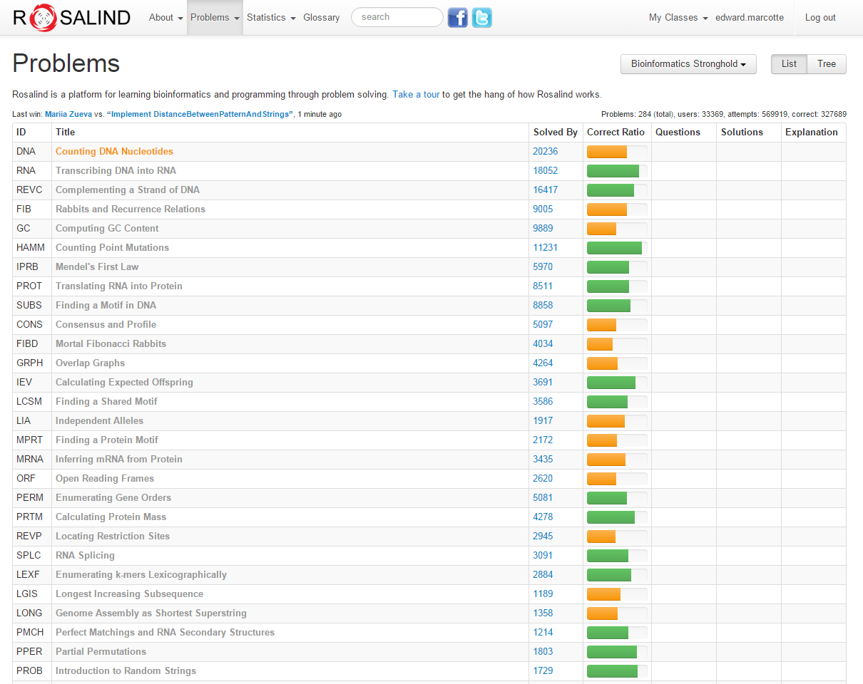
…there are quite a few good bioinformatics problems in the archives.
…
…
…

Slide 12
Expectations on working together
Students are welcome to discuss ideas and problems with each other, but all programs, Rosalind homework, and written solutions should be performed independently (except the final presentation).
tl;dr: study/discuss together
do your own programming/writing/project
collaborate on the final presentation

Slide 13
Why are we here? (practically, not existentially)

Slide 14
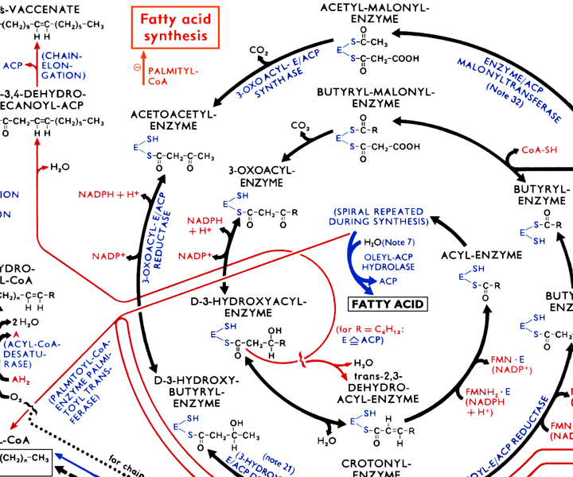
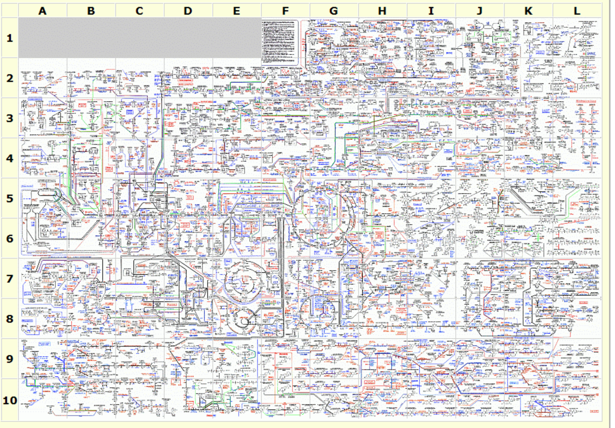
The metabolic wall chart…
http://web.expasy.org/cgi-bin/pathways/show_thumbnails.pl

Slide 15
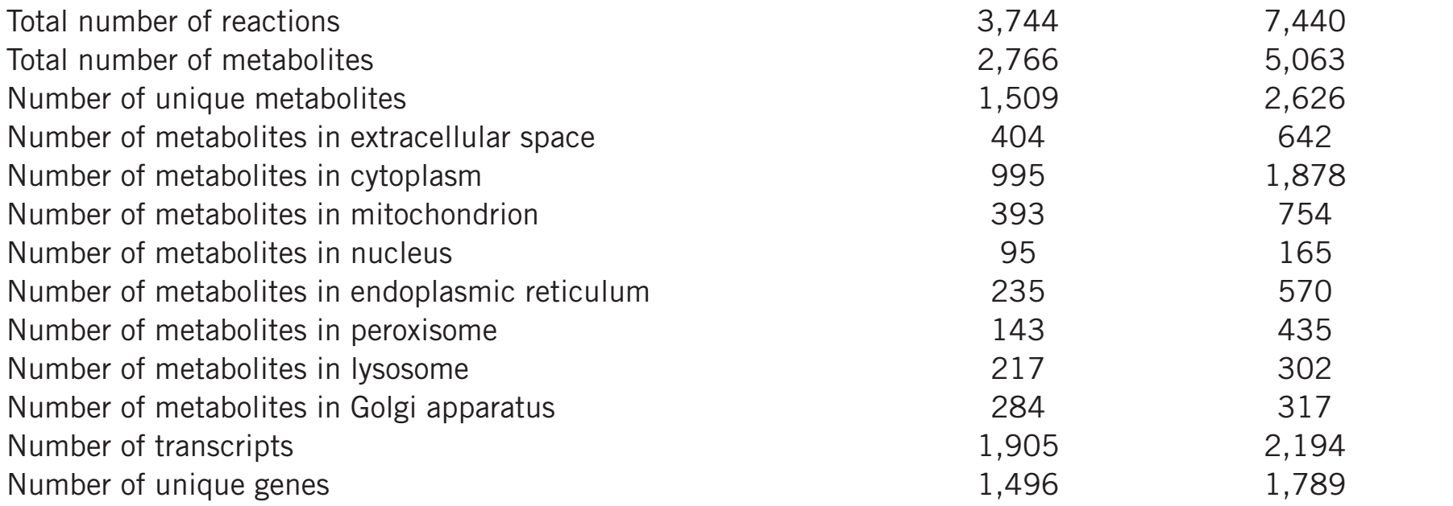
Our current knowledge of human metabolism…
Nat Biotechnol. 2013 May;31(5):419-25

Slide 16
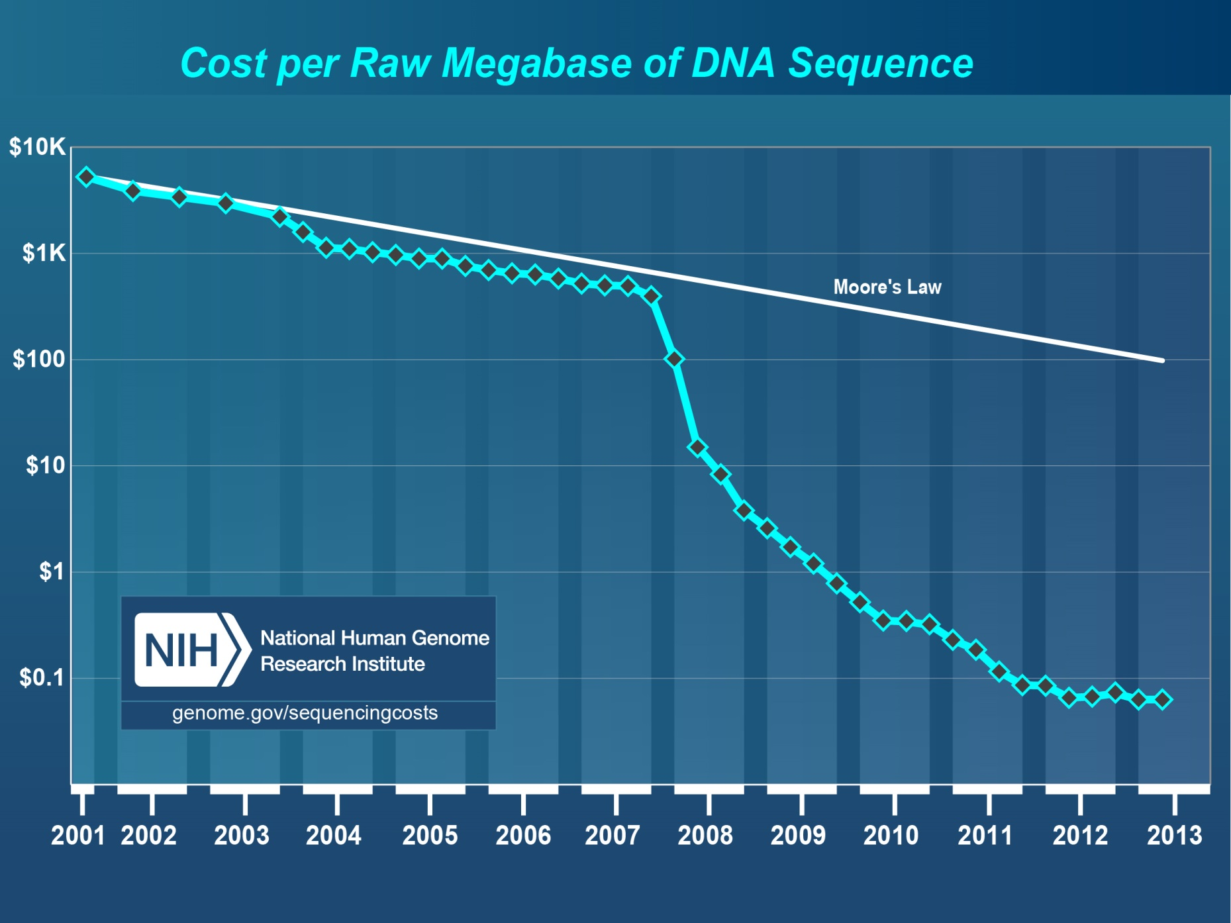
Pales beside the phenomenal drop in DNA sequencing costs…

Slide 17
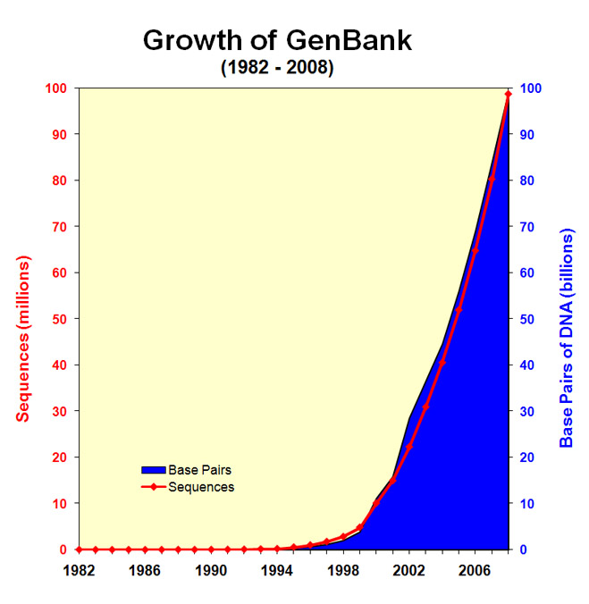
& the corresponding explosion of DNA sequencing data…
http://www.ncbi.nlm.nih.gov/genbank/genbankstats-2008/
ftp://ftp.ncbi.nih.gov/genbank/gbrel.txt

Slide 18
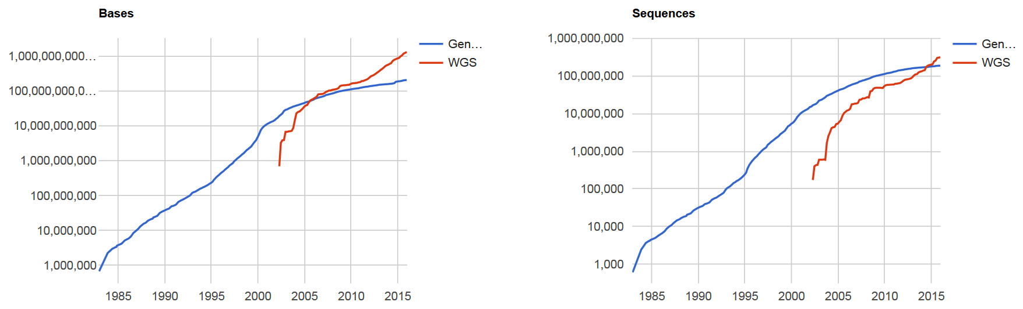
& the corresponding explosion of DNA sequencing data…
GenBank
December 2015:
203 billion bp
+
1.3 trillion bp DNA
whole genome
shotgun sequencing
Here are the latest
statistics…
Which basically means GenBank is falling behind more every year!
http://www.ncbi.nlm.nih.gov/genbank/statistics

Slide 19
We have no choice!
Biologists are now faced with a staggering deluge of data, growing at exponential rates.
Bioinformatics offers tools and approaches to understand these data and work productively, and to build algorithmic models that help us better understand biological systems.
We’ll learn some of the important basic concepts in this field, along with getting exposed to key technologies driving the field forward.

Slide 20
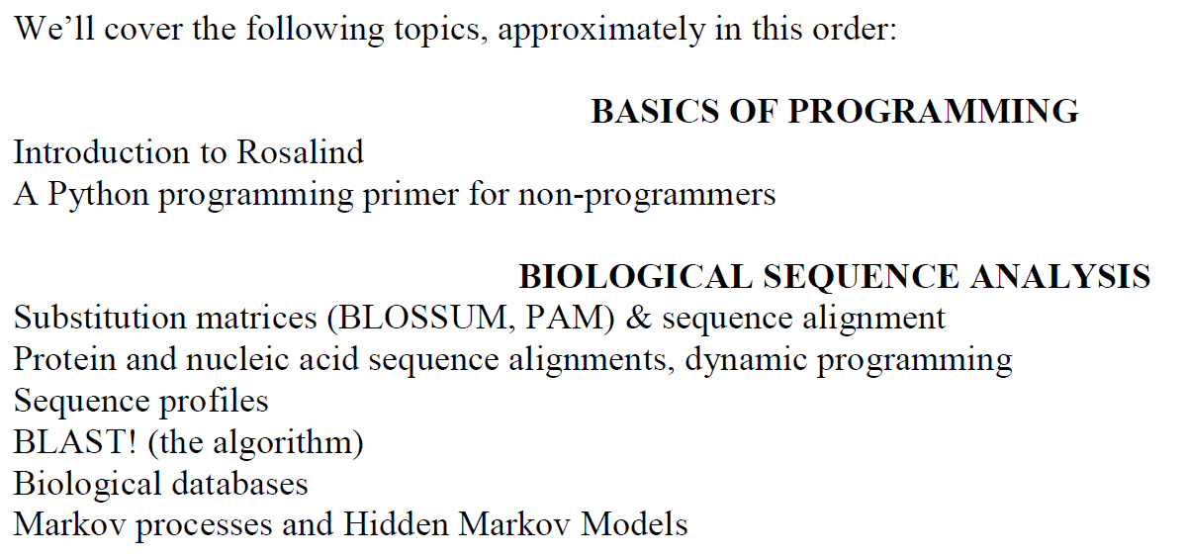
Specifically…

Slide 21
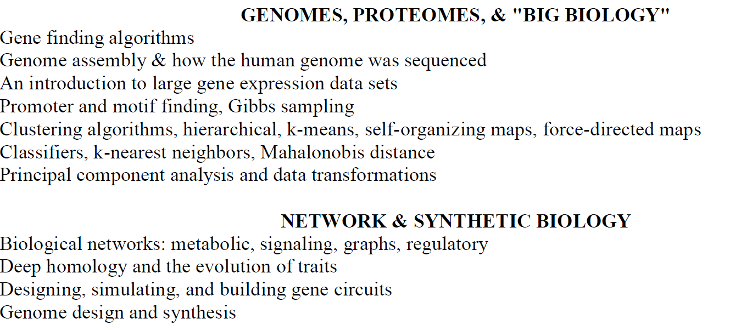

Slide 22
