Slide 1
A Python programming primer for biochemists
(Named after Monty Python’s Flying Circus & designed to be fun to use)
BCH364C/391L Systems Biology/Bioinformatics
Edward Marcotte, Univ of Texas at Austin
Edward Marcotte/Univ. of Texas/BCH391L/Spring 2015

Slide 2
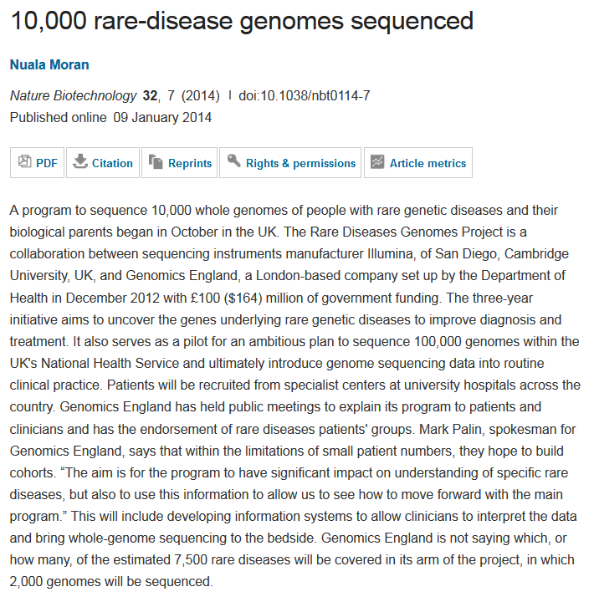
Science news of the day (2014 edition):
will be
“…serves as a pilot for an ambitious plan to sequence 100,000 genomes within the UK’s National Health Service and ultimately introduce genome sequencing into routine clinical practice.”
Edward Marcotte/Univ. of Texas/BCH391L/Spring 2015

Slide 3

Science news of the day (2015 update):

Slide 4
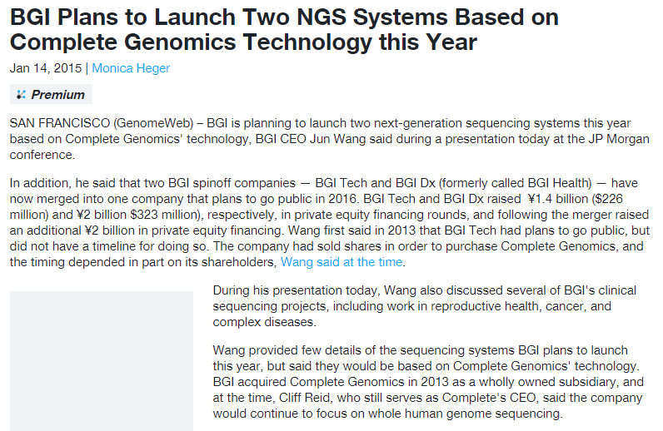
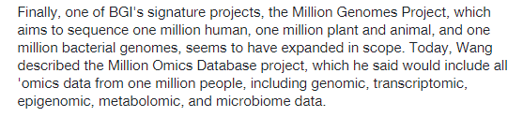
Science news of the day (2015 update):

Slide 5
In bioinformatics, you often want to do completely new analyses. Having the ability to program a computer opens up all sorts of research opportunities. Plus, it’s fun.
Most bioinformatics researchers use a scripting language, such as Python, Perl, or Ruby.
These languages are not the fastest, not the slowest, nor best, nor worst languages, but they’re easy to learn and write, and for many reasons, are well-suited to bioinformatics.
We’ll spend the next 2 lectures giving an introduction to Python. This will give you a sense for the language and help us introduce the basics of algorithms
Edward Marcotte/Univ. of Texas/BCH391L/Spring 2015

Slide 6
Python documentation: http://www.python.org/doc/
& tips: http://www.tutorialspoint.com/python
Good introductory Python books:
Learning Python, Mark Lutz & David Ascher, O’Reilly Media
Bioinformatics Programming Using Python: Practical Programming for Biological Data, Mitchell L. Model, O'Reilly Media
Good intro videos on Python:
CodeAcademy: http://www.codecademy.com/tracks/python
& the Kahn Academy:
https://www.khanacademy.org/science/computer-science
A bit more advanced: Programming Python, 4th ed.
Mark Lutz, O’Reilly Media
Edward Marcotte/Univ. of Texas/BCH391L/Spring 2015

Slide 7
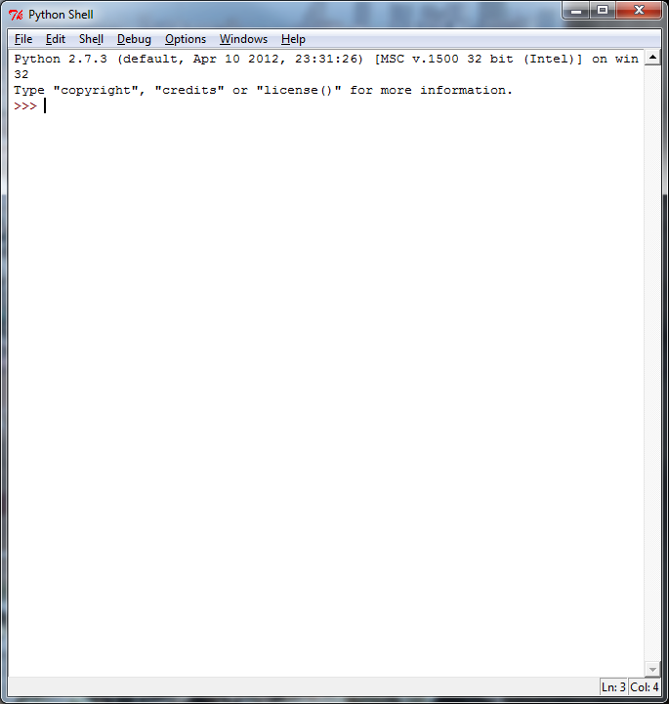

By now, you should have installed Python on your computer,
following the instructions in Rosalind Homework problem #1.
Launch IDLE:
You can test out commands here
to make sure they work…
Type in your program, save the file, and
run it….
…but to actually write your programs,
open a new window.
This window will serve as a command line
interface & display your program output.
This window will serve as a text editor for programming.
Edward Marcotte/Univ. of Texas/BCH391L/Spring 2015

Slide 8
Let’s start with some simple programs in Python:
A very simple example is:
print("Hello, future bioinformatician!") # print out the greeting
Let’s call it hello.py
Save & run the program. The output looks like this:
Hello, future bioinformatician!
Edward Marcotte/Univ. of Texas/BCH391L/Spring 2015

Slide 9
A slightly more sophisticated version:
name = raw_input("What is your name? ") # asks a question and saves the answer
# in the variable "name"
print("Hello, future bioinformatician " + name + "!") # print out the greeting
When you run it this time, the output looks like:
What is your name?
If you type in your name, followed by the enter key, the program will print:
Hello, future bioinformatician Alice!
Edward Marcotte/Univ. of Texas/BCH391L/Spring 2015

Slide 10
GENERAL CONCEPTS
Names, numbers, words, etc. are stored as variables.
Variables in Python can be named essentially anything except words Python uses as command.
For example:
BobsSocialSecurityNumber = 456249685
mole = 6.022e-23
password = "7 infinite fields of blue"
Note that strings of letters and/or numbers are in quotes, unlike numerical values.
Edward Marcotte/Univ. of Texas/BCH391L/Spring 2015

Slide 11
LISTS
Groups of variables can be stored as lists.
A list is a numbered series of values,
like a vector, an array, or a matrix.
Lists are variables, so you can name them just as you would name any other variable.
Individual elements of the list can be referred to using [] notation:
The list nucleotides might contain the elements nucleotides[0] = "A"
nucleotides[1] = "C"
nucleotides[2] = "G"
nucleotides[3] = "T"
(Notice the numbering starts from zero. This is standard in Python.)
Edward Marcotte/Univ. of Texas/BCH391L/Spring 2015

Slide 12
DICTIONARIES
A VERY useful variation on lists is called a dictionary or dict (sometimes also called a hash).
Groups of values indexed not with numbers (although they could be) but with other values.
Individual hash elements are accessed like array elements:
For example, we could store the genetic code in a hash named codons, which might contain 64 entries, one for each codon, e.g.
codons["ATG"] = "Methionine"
codons["TAG"] = "Stop codon"
etc…
Edward Marcotte/Univ. of Texas/BCH391L/Spring 2015

Slide 13
Now, for some control over what happens in programs.
There are two very important ways to control the logical flow of your programs:
if statements
and
for loops
There are some other ways too, but this will get you going for now.
Edward Marcotte/Univ. of Texas/BCH391L/Spring 2015

Slide 14
if statements
if dnaTriplet == "ATG":
# Start translating here. We’re not going to write this part
# since we’re really just learning about IF statements
else:
# Read another codon
Python cares about the white space (tabs & spaces) you use!
This is how it knows where the conditional actions that follow begin and end. These conditional steps must always be indented by the same number of spaces (e.g., 4).
I recommend using a tab (rather than spaces) so you’re always consistent.
Edward Marcotte/Univ. of Texas/BCH391L/Spring 2015

Slide 15
Note: in the sense of performing a comparison, not as in setting a value.
== equals
!= is not equal to
< is less than
> is greater than
<= is less than or equal to
>= is greater than or equal to
Can nest these using parentheses and Boolean operations, such as and, not, or or, e.g.:
if dnaTriplet == "TAA" or dnaTriplet == "TAG" or dnaTriplet == "TGA":
print("Reached stop codon")
Edward Marcotte/Univ. of Texas/BCH391L/Spring 2015

Slide 16
for loops
Often, we’d like to perform the same command repeatedly or with slight variations.
For example, to calculate the mean value of the number in an array, we might try:
Take each value in the array in turn.
Add each value to a running sum.
Divide the total by the number of values.
Edward Marcotte/Univ. of Texas/BCH391L/Spring 2015

Slide 17
In Python, you could write this as:
grades = [93, 95, 87, 63, 75] # create a list of grades
sum = 0.0 # variable to store the sum
for grade in grades: # iterate over the list called grades
sum = sum + grade # indented commands are executed on
# each cycle of the loop.
mean = sum / 5 # now calculate the average grade
print ("The average grade is "),mean # print the results
Python cares whether numbers are integers or floating point (also long integers and complex numbers).
Tell Python you want floating point by defining your variables accordingly
(e.g., X = 1.0 versus X = 1)
Edward Marcotte/Univ. of Texas/BCH391L/Spring 2015

Slide 18
In general, Python will perform most mathematical operations, e.g.
multiplication (A * B)
division (A / B)
exponentiation (A ** B)
etc.
There are lots of advanced mathematical capabilities you can explore later on.
Edward Marcotte/Univ. of Texas/BCH391L/Spring 2015

Slide 19
READING FILES
You can use a for loop to read text files line by line:
count = 0 # Declare a variable to count lines
file = open("mygenomefile", "r") # Open a file for reading (r)
for raw_line in file: # Loop through each line in the file
line = raw_line.rstrip("\r\n") # Remove newline
words = line.split(" ") # split the line into a list of words
# Print the appropriate word:
print "The first word of line {0} of the file is {1}".format(count, words[0])
count += 1 # shorthand for count = count + 1
file.close() # Last, close the file.
print "Read in {0} lines\n".format(count)
Stands for “read”
\r = carriage return
\n = newline
Increment counter by 1
Placeholders (e.g., {0}) in the print statement indicate variables listed at the end of the line after the format command
Edward Marcotte/Univ. of Texas/BCH391L/Spring 2015

Slide 20
WRITING FILES
Same as reading files, but use "w" for ‘write’:
file = open("test_file", "w")
file.write("Hello!\n")
file.write("Goodbye!\n")
file.close() # close the file as you did before
Unless you specify otherwise, you can find the new text file you created (test_file) in the default Python directory on your computer.
Edward Marcotte/Univ. of Texas/BCH391L/Spring 2015

Slide 21
PUTTING IT ALL TOGETHER
seq_filename = "Ecoli_genome.txt"
total_length = 0
nucleotide = {} # create an empty dictionary
seq_file = open(seq_filename, "r")
for raw_line in seq_file:
line = raw_line.rstrip("\r\n")
length = len(line) # Python function to calculate the length of a string
for nuc in line:
if nucleotide.has_key(nuc):
nucleotide[nuc] += 1
else:
nucleotide[nuc] = 1
total_length += length
seq_file.close()
for n in nucleotide.keys():
fraction = 100.0 * nucleotide[n] / total_length
print "The nucleotide {0} occurs {1} times, or {2} %".format(n, nucleotide[n], fraction)
Edward Marcotte/Univ. of Texas/BCH391L/Spring 2015

Slide 22
Let’s choose the input DNA sequence in the file to be the genome of E. coli, available from the Entrez genomes web site or the BCH391L web site.
The format of the file is ~77,000 lines of A’s, C’s, G’s and T’s:
AGCTTTTCATTCTGACTGCAACGGGCAATATGTCTCTGTGTGGATTAAAAAAAGAGTGTC
TGATAGCAGCTTCTGAACTGGTTACCTGCCGTGAGTAAATTAAAATTTTATTGACTTAGG
TCACTAAATACTTTAACCAATATAGGCATAGCGCACAGACAGATAAAAATTACAGAGTAC
ACAACATCCATGAAACGCATTAGCACCACCATTACCACCACCATCACCATTACCACAGGT
etc…
Running the program produces the output:
The nucleotide A occurs 1142136 times, or 24.6191332553 %
The nucleotide C occurs 1179433 times, or 25.423082884 %
The nucleotide T occurs 1140877 times, or 24.5919950785 %
The nucleotide G occurs 1176775 times, or 25.3657887822 %
So, now we know that the four nucleotides are present in roughly equal numbers in the E. coli genome.
Edward Marcotte/Univ. of Texas/BCH391L/Spring 2015

