Slide 1
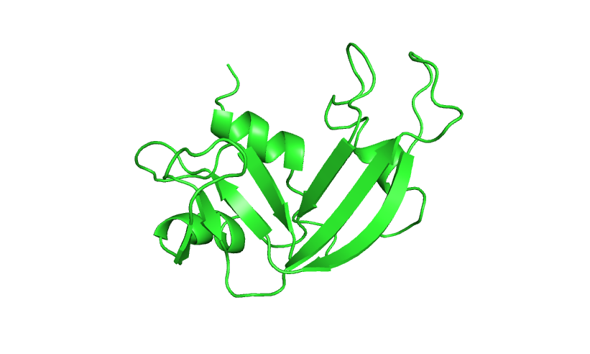
Computational Structure Prediction
Kevin Drew
Systems Biology/Bioinformatics
3/28/19

Slide 2
Outline
Structural Biology Basics
Torsion angles,
secondary structure,
Ramachandran plots
Comparative Modeling – create a model for a protein of interest
Find templates - HHPRED
build model - MODELLER
evaluate - PyMol

Slide 3
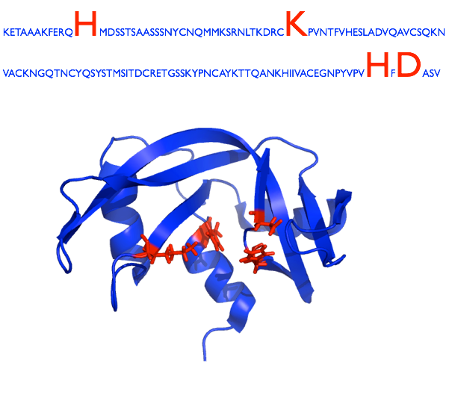
Sequence defines Structure
Structure defines Function

Slide 4
Protein Data Bank (PDB)
http://www.rcsb.org/pdb/
PDBid: 1DFJ
Molecules, Resolution, Publication, Download Links, etc.
Experimental method:
X-ray crystallography
NMR
Electron Microscopy

Slide 5
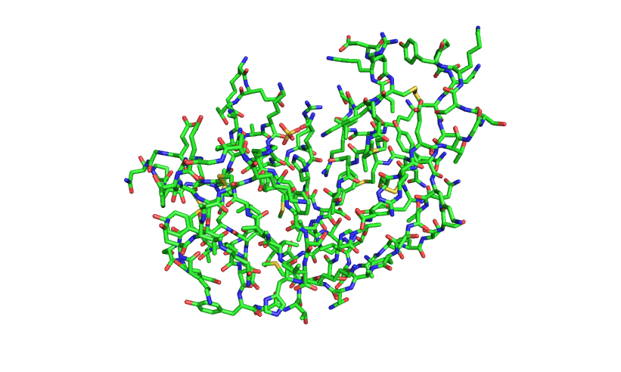
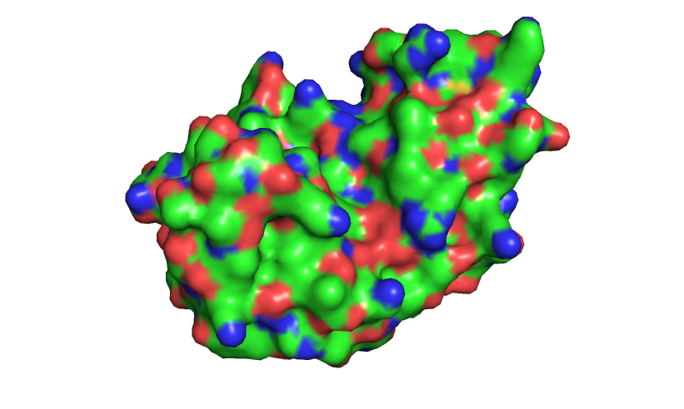
What is a 3D structure?
Representation of a molecule.
Static snapshot of a dynamic object
Coordinates
Atoms and Bonds
ATOM 1 N LYS E 1 15.101 25.279 -11.672 1.00 97.78 N
ATOM 2 CA LYS E 1 14.101 24.190 -11.496 1.00 95.96 C
ATOM 3 C LYS E 1 13.269 24.511 -10.248 1.00 94.22 C
ATOM 4 O LYS E 1 12.861 25.671 -10.051 1.00 94.62 O
ATOM 5 CB LYS E 1 14.792 22.807 -11.375 1.00 97.64 C
ATOM 6 CG LYS E 1 13.854 21.594 -11.530 1.00102.46 C
ATOM 7 CD LYS E 1 14.278 20.409 -10.652 1.00109.05 C
ATOM 8 CE LYS E 1 13.220 19.304 -10.681 1.00108.13 C
ATOM 9 NZ LYS E 1 13.536 18.165 -9.780 1.00106.31 N
Secondary Structure
Surface

Slide 6

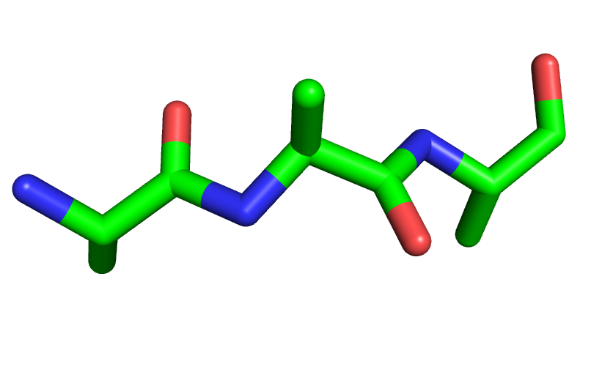
What is a 3D structure?
Atoms and Bonds
Red = Oxygen
Blue = Nitrogen
Green = Carbon
Ignore Hydrogens for now
R
PSI
R = 1 of 20 amino acids
PHI / PSI rotatable
Omega =180
(sometimes 0 for proline)
PHI
Omega

Slide 7
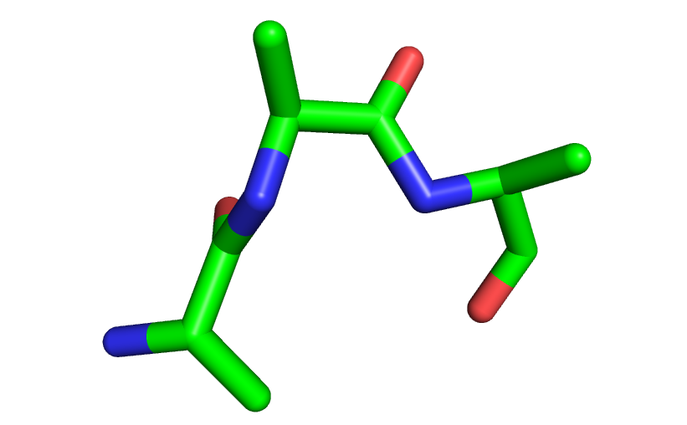
Phi / Psi torsion angles
0
135
-90
-140

Slide 8
Ramachandran Plot
Propensity for phi/psi value combinations (statistics from PDB)
Relationship between phi/psi angles and secondary structure
S.C. Lovell et al. 2003

Slide 9
Levinthal’s Paradox – thought experiment
Want to find lowest energy conformation of a protein (values of all phi and psi angles)
RiboA = 124 residues = 123 peptide bonds
2 torsion angles per peptide bond (phi and psi) = 246 degrees of freedom
Assume 3 stable conformations per torsion angle
= 3^(246) = 10^118 possible states
Assume each state takes a picosecond to sample.
= 10^20 years to test all states
> 13.8 x 10^9 age of universe
Proteins take millisecs to microsecs to fold < the age of the universe
More importantly, how are we going to do it?
Thus a paradox, how do proteins do it?

Slide 10
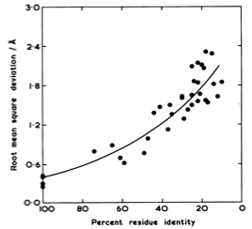
Structure is more conserved than sequence
Chothia, C. and A.M. Lesk, 1986.
Structure Similarity
Pair of homologues
Sequence Similarity
Use similar proteins with known structure

Slide 11
Comparative Modeling
Predict structure of a protein using the structure of a closely related protein.
1) Identify related proteins with known structure (templates)
2) Align protein sequence with template sequence
3) Build model based on alignment with template
4) Evaluate
Eswar et al. 2006

Slide 12
Comparative Modeling
Predict structure of a protein using the structure of a closely related protein.
1) Identify related proteins with known structure (templates)
Generally both done by the same tool:
- Single sequence (previous lectures): ex. Blast
- Seq vs Profile = frequencies in multiple seq alignment: ex. PSI-Blast
- Profile vs profile: ex. COMPASS
- Hidden Markov Models (HMM): ex. HMMER
- HMM vs HMM: ex. HHPRED
2) Align protein sequence with template sequence
3) Build model based on alignment with template
4) Evaluate

Slide 13
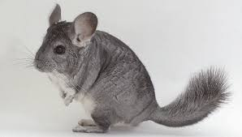
HHPRED
Demo!
https://toolkit.tuebingen.mpg.de/#/tools/hhpred
Chinchilla Ribonuclease
>gi|533199034|ref|XP_005412130.1| PREDICTED: ribonuclease pancreatic [Chinchilla lanigera] MTLEKSLVLFSLLILVLLGLGWVQPSLGKESSAMKFQRQHMDSSGSPSTNANYCNEMMKGRNMTQGYCKP VNTFVHEPLADVQAVCFQKNVPCKNGQSNCYQSNSNMHITDCRLTSNSKYPNCSYRTSRENKGIIVACEG NPYVPVHFDASV

Slide 14
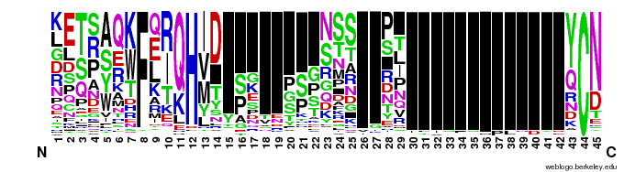
Sequence Profiles
Profiles can be built from multiple sequence alignments and contain frequencies of all amino acids in each column. This has more information than a single sequence.
Hidden Markov Models (HMM) are like profiles but model insertions and deletions.
HHPRED is HMM vs HMM with secondary structure prediction comparisons
+
Soding 2005

Slide 15
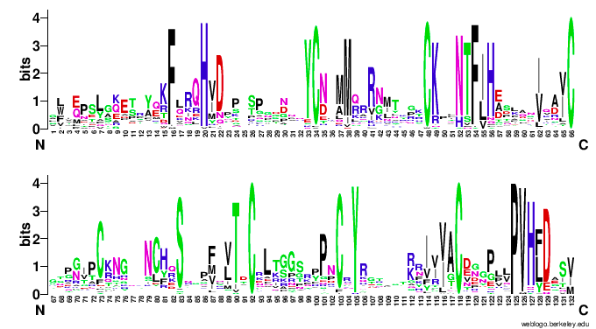
Sequence Profiles
Profiles can be built from multiple sequence alignments and contain frequencies of all amino acids in each column. This has more information than a single sequence.
Hidden Markov Models (HMM) are like profiles but model insertions and deletions.
HHPRED is HMM vs HMM with secondary structure prediction comparisons
+
Soding 2005

Slide 16
HHPRED
+
Soding 2005
Emission Probabilities
Transition Probabilities
Soding Bioinformatics 2005
Notes:
Fa = background aa frequencies
Sigma = DSSP secondary structure
Ro = PSIpred secondary structure prediction
C = PSIpred confidence
Sss is added to Saa in Smm equation.

Slide 17
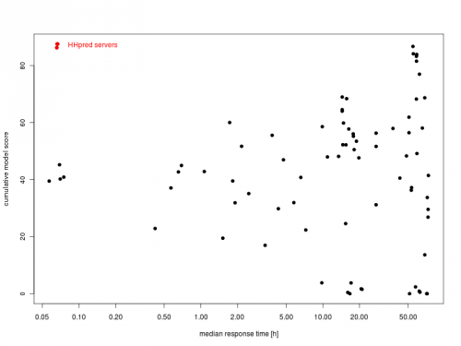
HHPRED
Performance

Slide 18
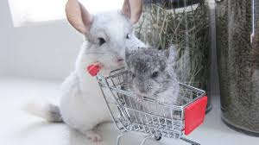
HHPRED
Demo!
Chinchilla Ribonuclease
>gi|533199034|ref|XP_005412130.1| PREDICTED: ribonuclease pancreatic [Chinchilla lanigera] MTLEKSLVLFSLLILVLLGLGWVQPSLGKESSAMKFQRQHMDSSGSPSTNANYCNEMMKGRNMTQGYCKP VNTFVHEPLADVQAVCFQKNVPCKNGQSNCYQSNSNMHITDCRLTSNSKYPNCSYRTSRENKGIIVACEG NPYVPVHFDASV

Slide 19
Comparative Modeling
Predict structure of a protein using the structure of a closely related protein.
1) Identify related proteins with known structure (templates)
2) Align protein sequence with template sequence
3) Build model based on alignment with template
4) Evaluate
Eswar et al. 2006

Slide 20
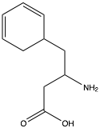
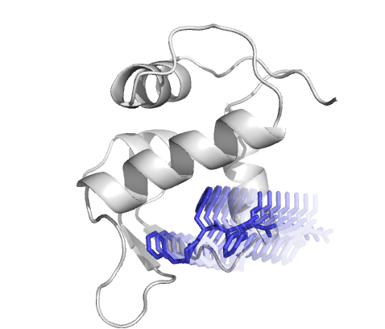
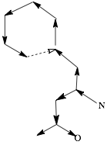
3) Build Model: Computational Modeling
Representation
Sampling Procedures
Energy Function
Energy =
van der Waals (Lennard-Jones) +
Implicit Solvent (LK model) +
Residue Pair Interactions (PDB) +
Hydrogen Bonding +
Side chains (Dunbrack) +
Torsion Parameters (PDB)
Monte Carlo
Molecular Dynamics
Minimization
Simulated Annealing
…
Internal
Cartesian
Full Atom
Centroid
Molecular Mechanics
Knowledge Based (Stats from PDB)
Specific knowledge (restraints)

Slide 21
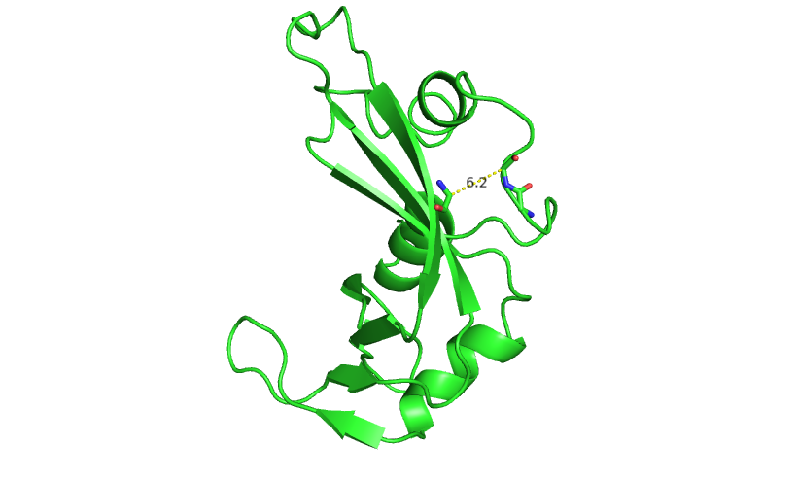
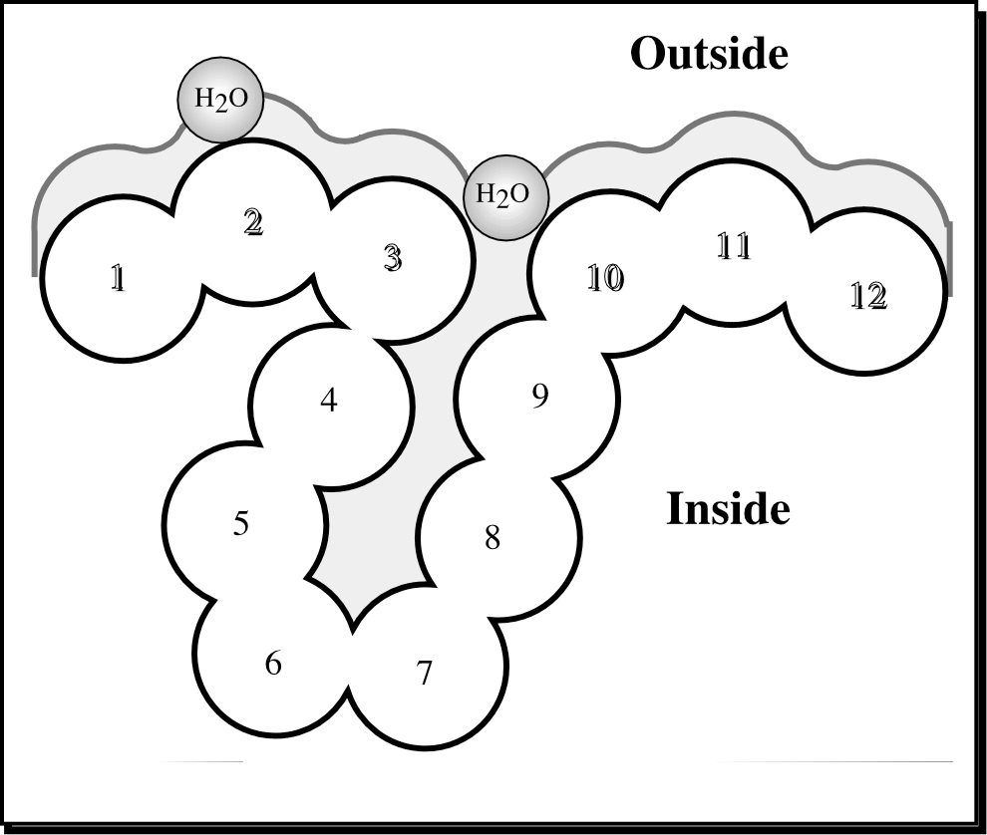
MODELLER
Modeling by satisfaction of spatial restraints
3) Build model based on alignment with template
A. Gather spatial restraints
  Residue - Residue distance
  Main chain PHI / PSI angles
  Solvent Accessibility
  Side chain angles
  H-bonds
  Residue neighborhood
  Secondary Structure
  B-factor
  Resolution of template
  …
S.C. Lovell et al. 2003
Rost 2007

Slide 22
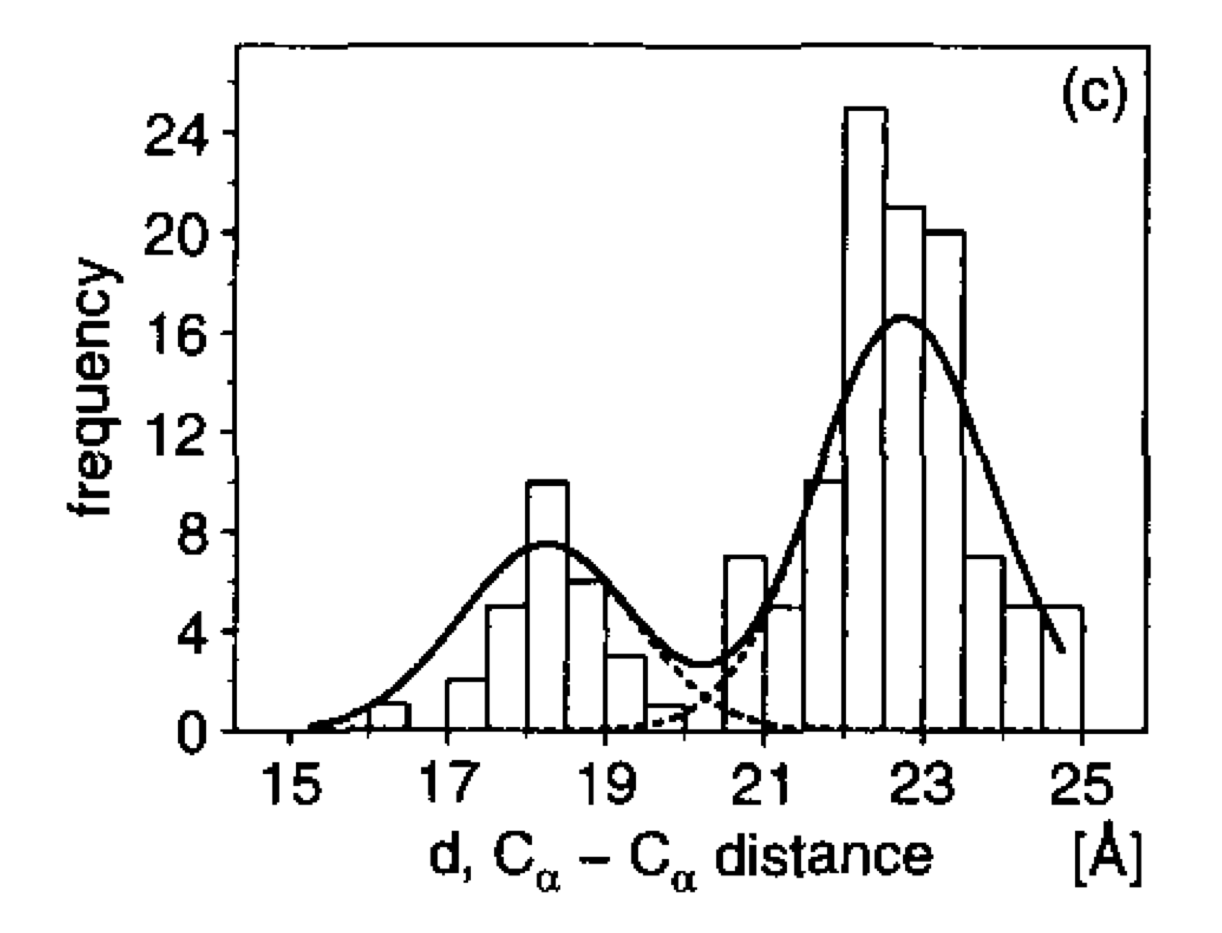
MODELLER
Modeling by satisfaction of spatial restraints
https://salilab.org/modeller/
3) Build model based on alignment with template
A. Gather spatial restraints
B. Convert restraints to probability density function (pdf)
C. Satisfy spatial restraints
Sample pdf for model that maximizes probability, P
Sample using Molecular Dynamics, Conjugate Gradient Minimization and Simulated Annealing
Sali 1993
Notes:
Target aligns to two template structures. Calpha calpha distance pdf of a residue pair in target is made up of residue pair distances in two templates. The alignment of target to t1 is centered around 18A and target to t2 is around 22. Search pdb (or database) for homologous proteins to templates t1 and t2 for frequency counts. Build probability density function from frequency counts for each template (dashed lines) and combine (weighted linearly by similarity to template neighborhood) into one pdf (solid line).

Slide 23
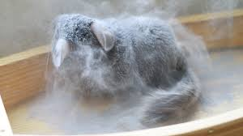
MODELLER
Demo!
Chinchilla Ribonuclease
>gi|533199034|ref|XP_005412130.1| PREDICTED: ribonuclease pancreatic [Chinchilla lanigera] MTLEKSLVLFSLLILVLLGLGWVQPSLGKESSAMKFQRQHMDSSGSPSTNANYCNEMMKGRNMTQGYCKP VNTFVHEPLADVQAVCFQKNVPCKNGQSNCYQSNSNMHITDCRLTSNSKYPNCSYRTSRENKGIIVACEG NPYVPVHFDASV

Slide 24
Comparative Modeling
Predict structure of a protein using the structure of a closely related protein.
1) Identify related proteins with known structure (templates)
2) Align protein sequence with template sequence
3) Build model based on alignment with template
4) Evaluate
Eswar et al. 2006

Slide 25
Comparative Modeling
4) Evaluate
Eswar et al. 2006

Slide 26
Comparative Modeling
4) Evaluate
Common Errors:
A. Side Chain packing
B. Alignment shift
C. No template
D. Misalignment
E. Wrong template
Eswar et al. 2006

Slide 27
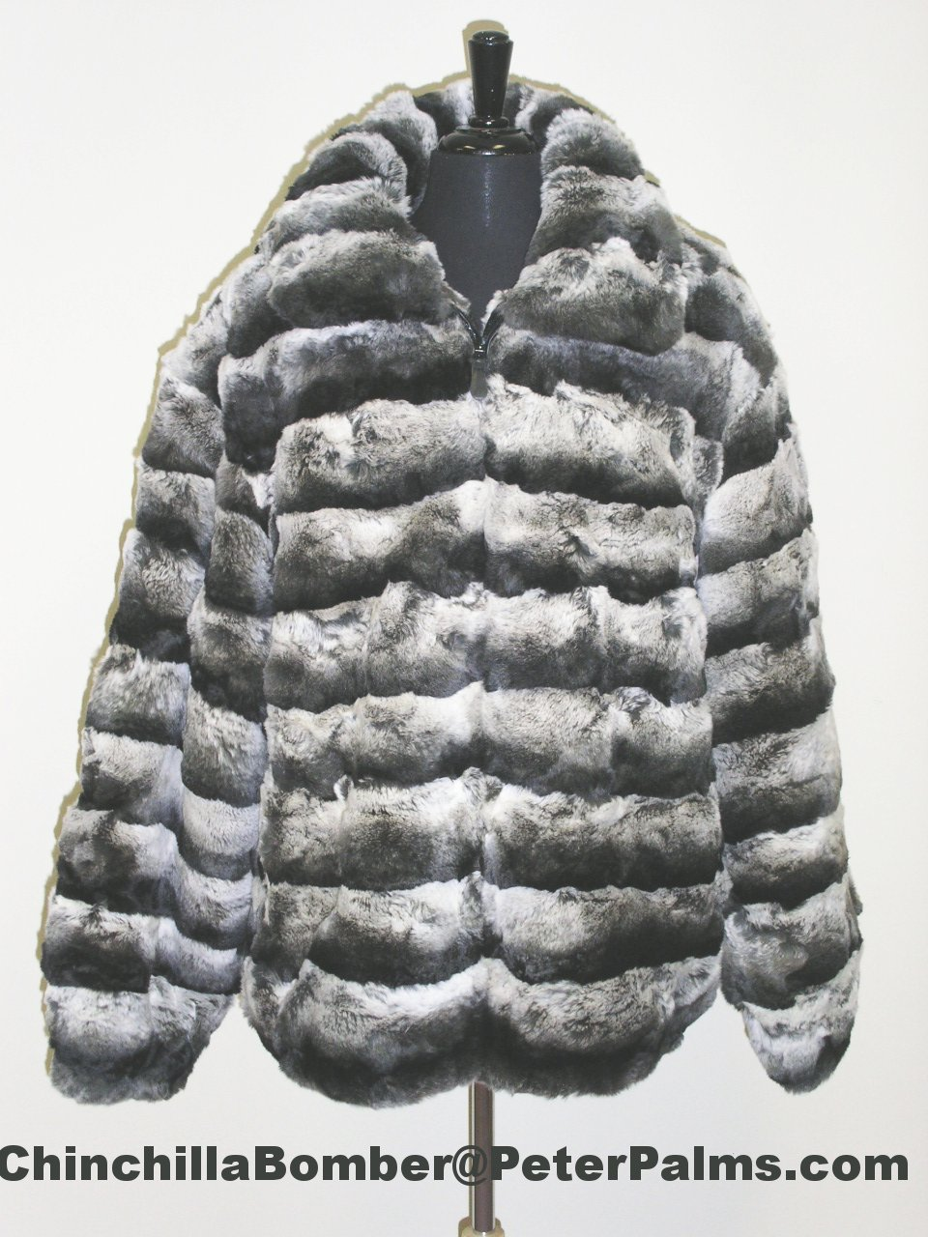
Pymol
Demo!
Chinchilla Ribonuclease
>gi|533199034|ref|XP_005412130.1| PREDICTED: ribonuclease pancreatic [Chinchilla lanigera] MTLEKSLVLFSLLILVLLGLGWVQPSLGKESSAMKFQRQHMDSSGSPSTNANYCNEMMKGRNMTQGYCKP VNTFVHEPLADVQAVCFQKNVPCKNGQSNCYQSNSNMHITDCRLTSNSKYPNCSYRTSRENKGIIVACEG NPYVPVHFDASV

