Slide 1
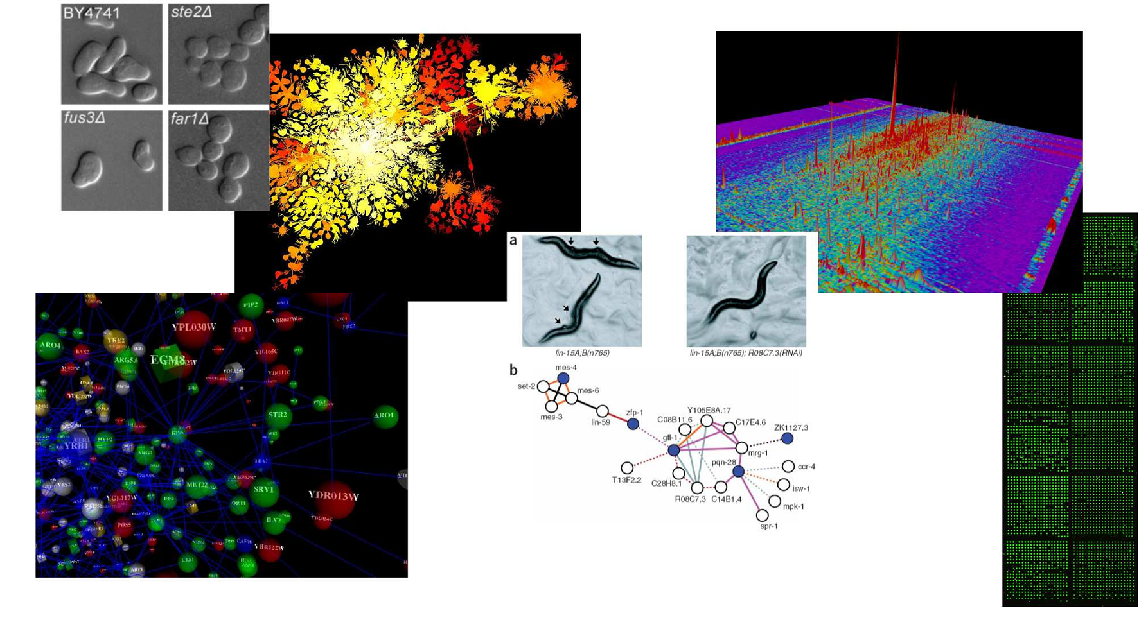
BIO337 Systems Biology/Bioinformatics (course # 50524)
Spring 2014 Tues/Thurs 11 – 12:30 PM BUR 212
Edward Marcotte/Univ. of Texas/BIO337/Spring 2014

Slide 2
Instructor: Prof. Edward Marcotte marcotte@icmb.utexas.edu
Office hours: Wed 11 AM – 12 Noon MBB 3. 148BA
TA: Dakota Derryberry dakotaz@utexas.edu
Office hours: Mon 4-5 PM/Fri 9 – 10 AM MBB 3.304
TA Phone: 512-232-2459
Edward Marcotte/Univ. of Texas/BIO337/Spring 2014

Slide 3
Probably the most important slide today!
Course web page: http://www.marcottelab.org/index.php/BIO337_2014
Open to upper division undergraduates in natural sciences and engineering
Prerequisites: Biochem I or equivalent (e.g. CH339J or CH339K/L)
Basic familiarity with molecular biology
This is NOT the mixed undergrad/ graduate course in bioinformatics (CH364C/CH391L)!
Edward Marcotte/Univ. of Texas/BIO337/Spring 2014

Slide 4
An introduction to systems biology and bioinformatics, emphasizing quantitative analysis of high-throughput biological data, and covering typical data, data analysis, and computer algorithms.
Topics will include introductory probability and statistics, basics of Python programming, protein and nucleic acid sequence analysis, genome sequencing and assembly, proteomics, synthetic biology, analysis of large-scale gene expression data, data clustering, biological pattern recognition, and gene and protein networks.
** NOT a course on practical sequence analysis or using web-based tools (although we’ll use a few), but rather on algorithms, exploratory data analyses and their applications in high-throughput biology. **
Edward Marcotte/Univ. of Texas/BIO337/Spring 2014

Slide 5
Books
Most of the lectures will be from research articles and slides. For sequence analysis, there will be an Optional text:
Biological sequence analysis, Durbin, Eddy, Krogh, Mitchison, Cambridge Univ. Press (available from Amazon, used from $21.36)
For biologists rusty on their stats, The Cartoon Guide to Statistics (Gonick/Smith) is very good (really!).
We will also be learning some Python programming.
I highly recommend…
Python programming for beginners: http://www.codecademy.com/tracks/python
Edward Marcotte/Univ. of Texas/BIO337/Spring 2014

Slide 6
Grading
No exams. Instead, grades will be based on:
Online programming homework
(10 points each and counting 30% of the final grade)
3 problem sets
(15 points each and counting 45% of the final grade)
A final collaborative course project
(25% of final grade, 3-4 students/project)
The course project will consist of a research project on a topic chosen by you (approved by me) & containing some element of independent bioinformatics research (e.g. calculation, programming, database analysis, etc.).
The final project is due (by emailing a web URL to the TA & I) by midnight, April 28, 2014. The last two classes will be spent presenting your projects to each other.
Edward Marcotte/Univ. of Texas/BIO337/Spring 2014

Slide 7
Late policy
All projects and homework will be turned in electronically and time-stamped.
No makeup work will be given.
Instead, all students have 5 days of free “late time”.
This is for the entire semester, NOT per project, and counting weekends/holidays just like any other day.
For projects turned in late, days will be deducted from the 5 day total (or what remains of it) by the # of days late.
Deductions are in 1 day increments, rounding up
e.g. 10 minutes late = 1 day deducted.
Once the 5 days are used up, assignments will be penalized 10% / day late (rounding up), e.g., a 50 point assignment turned in 1 ½ days late would be penalized 20%, or 10 points.
Edward Marcotte/Univ. of Texas/BIO337/Spring 2014

Slide 8
Online homework will be via Rosalind: http://rosalind.info/faq/
Enroll specifically for BIO337 at:
http://rosalind.info/classes/enroll/32e1671726/
The first homework will be due (in Rosalind) by midnight, Jan 21.
Edward Marcotte/Univ. of Texas/BIO337/Spring 2014

Slide 9
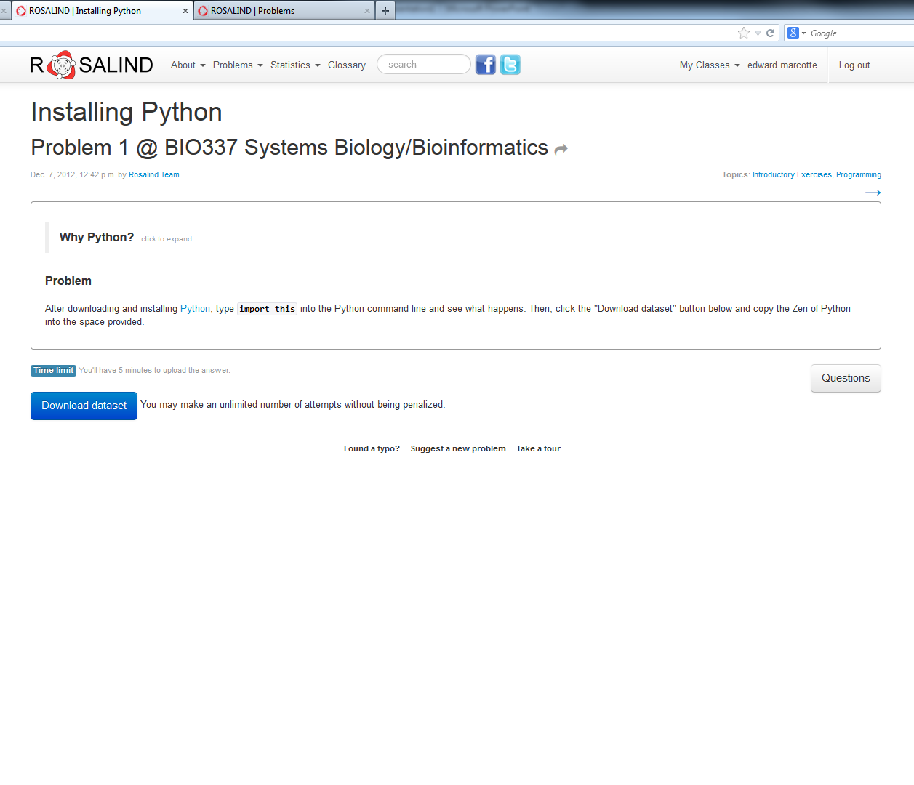
Edward Marcotte/Univ. of Texas/BIO337/Spring 2014

Slide 10
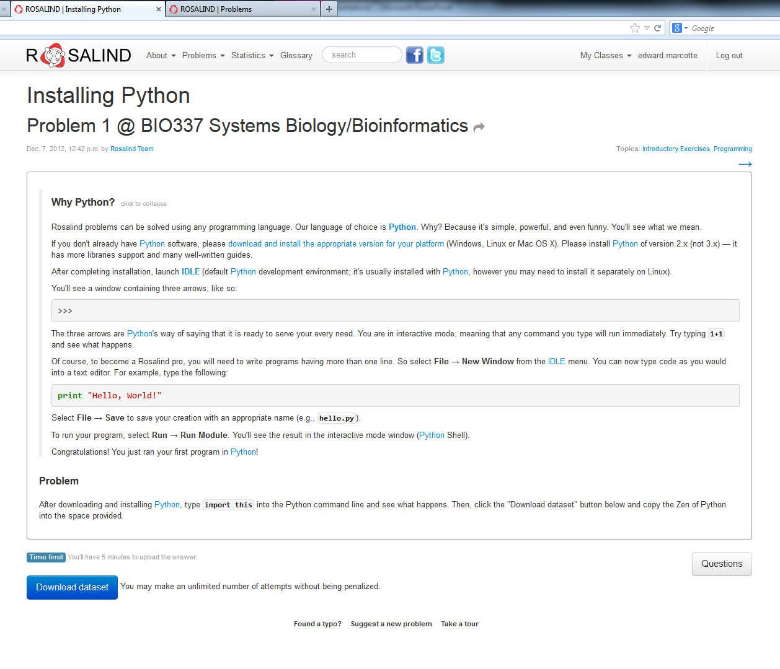
If you’re feeling restless/adventurous…
Click here to turn in your answer
Edward Marcotte/Univ. of Texas/BIO337/Spring 2014

Slide 11
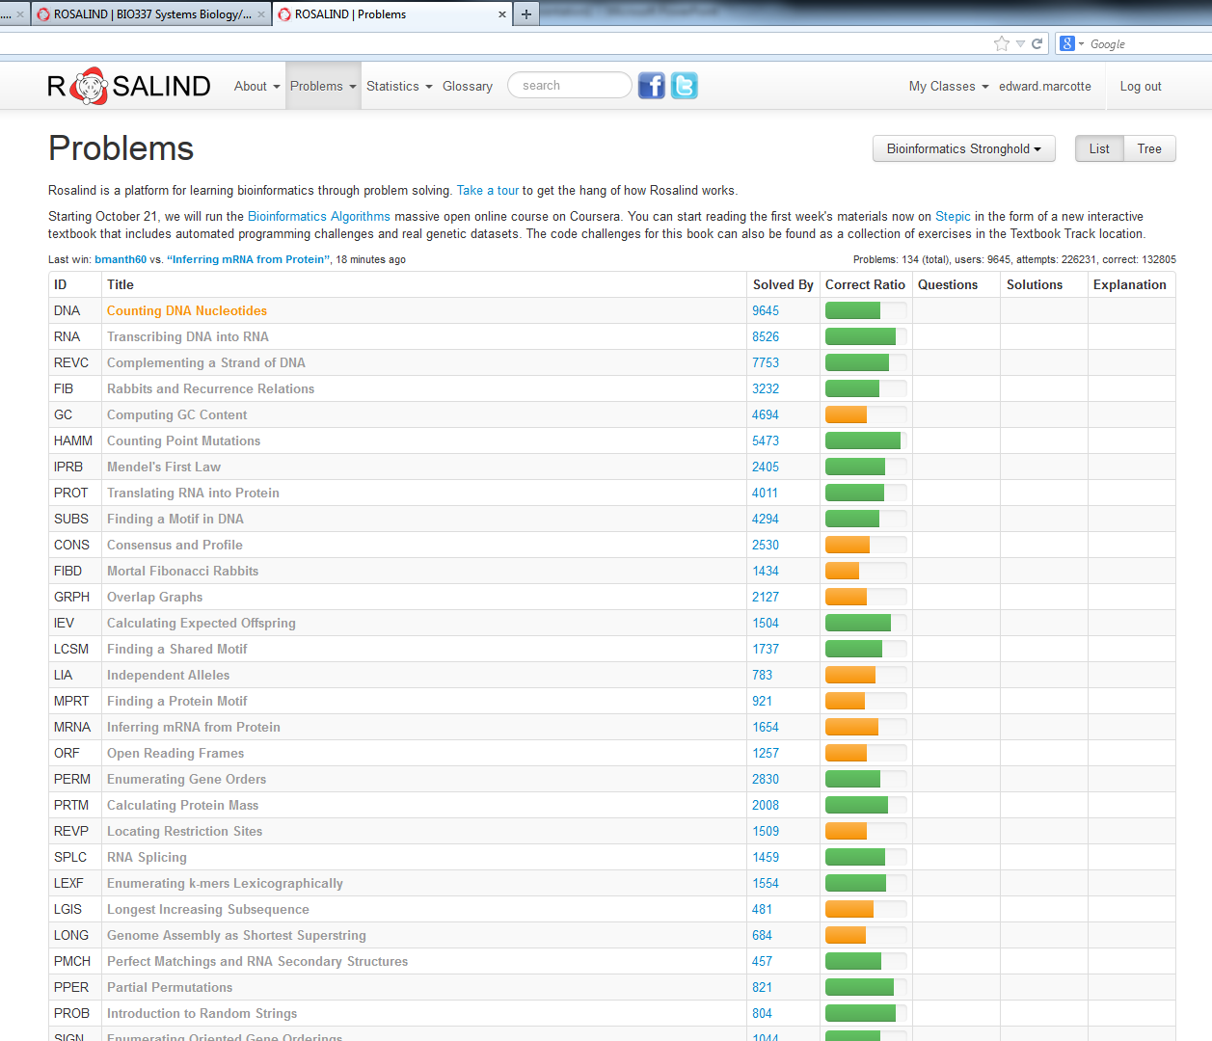
…there are quite a few good bioinformatics problems in the archives.
…
…
…
Edward Marcotte/Univ. of Texas/BIO337/Spring 2014

Slide 12
Expectations on working together
Students are welcome to discuss ideas and problems with each other, but all programs, Rosalind homework, and written solutions should be performed independently (except the final collaborative project).
tl;dr: study/discuss together
do your own programming/writing
collaborate on the final project
Edward Marcotte/Univ. of Texas/BIO337/Spring 2014

Slide 13
Why are we here? (practically, not existentially)
Edward Marcotte/Univ. of Texas/BIO337/Spring 2014

Slide 14
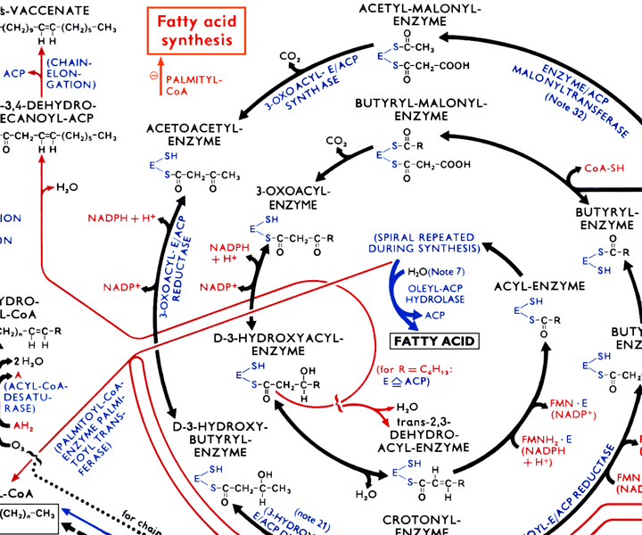
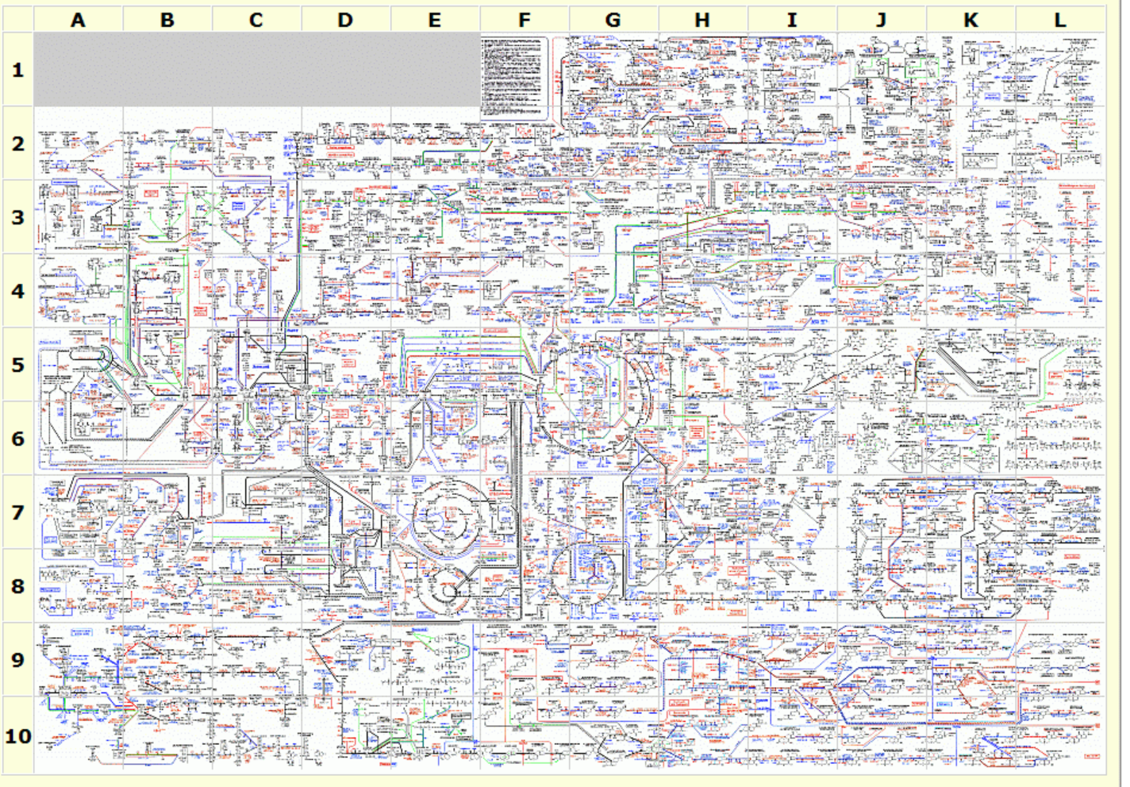
The metabolic wall chart…
http://web.expasy.org/cgi-bin/pathways/show_thumbnails.pl
Edward Marcotte/Univ. of Texas/BIO337/Spring 2014

Slide 15
Our current knowledge of human metabolism…
Nat Biotechnol. 2013 May;31(5):419-25
Edward Marcotte/Univ. of Texas/BIO337/Spring 2014

Slide 16
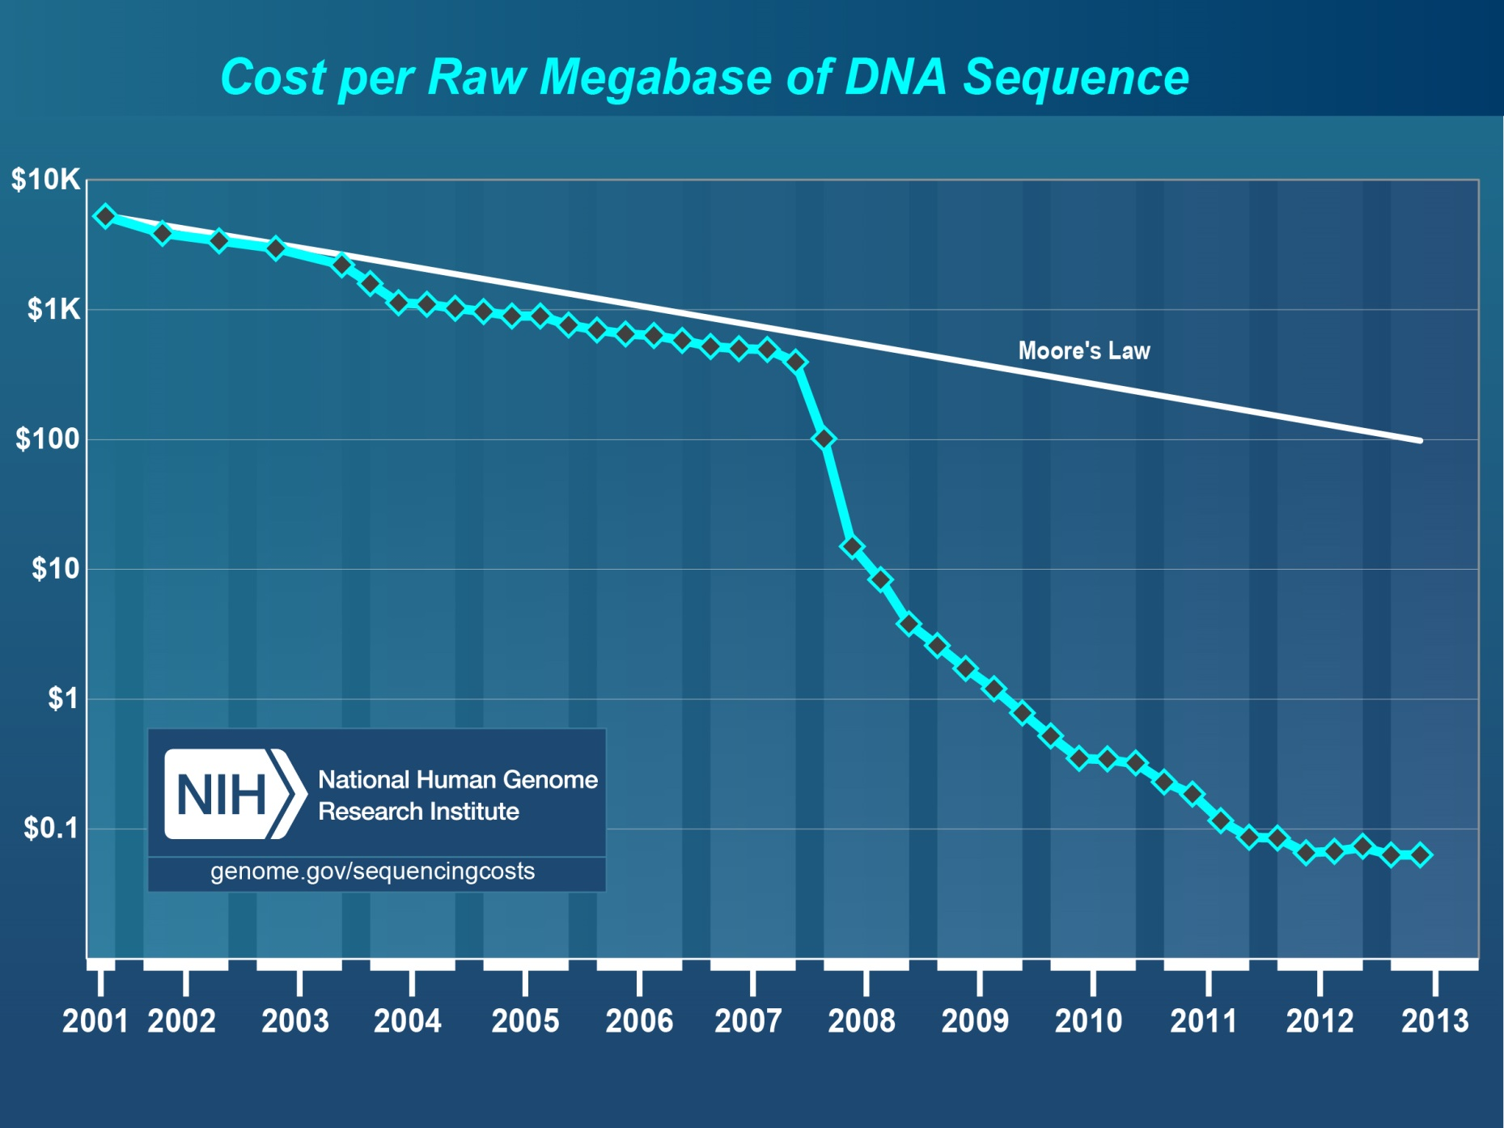
Pales beside the phenomenal drop in DNA sequencing costs…
Edward Marcotte/Univ. of Texas/BIO337/Spring 2014

Slide 17
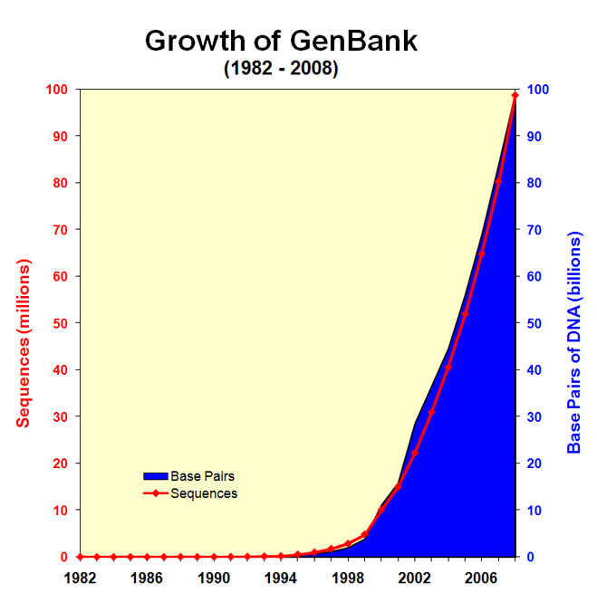
& the corresponding explosion of DNA sequencing data…
Edward Marcotte/Univ. of Texas/BIO337/Spring 2014
http://www.ncbi.nlm.nih.gov/genbank/genbankstats-2008/

Slide 18
We have no choice!
Biologists are now faced with a staggering deluge of data, growing at exponential rates.
Bioinformatics offers tools and approaches to understand these data and work productively, and to build algorithmic models that help us better understand biological systems.
We’ll learn some of the important basic concepts in this field, along with getting exposed to key technologies driving the field forward.
Edward Marcotte/Univ. of Texas/BIO337/Spring 2014

Slide 19
Specifically…
Edward Marcotte/Univ. of Texas/BIO337/Spring 2014

Slide 20
Edward Marcotte/Univ. of Texas/BIO337/Spring 2014

