Slide 1
Phenologs
A case study of using bioinformatics to find new genes for genetic traits
BCH339N Systems Biology / Bioinformatics – Spring 2016
Edward Marcotte, Univ of Texas at Austin

Slide 2
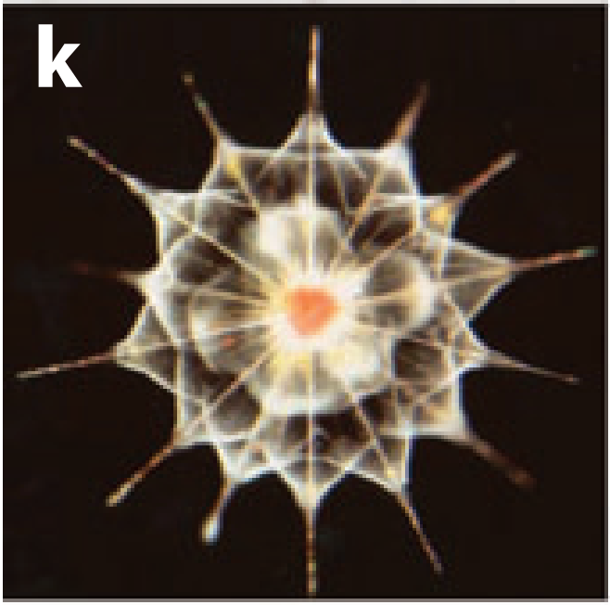
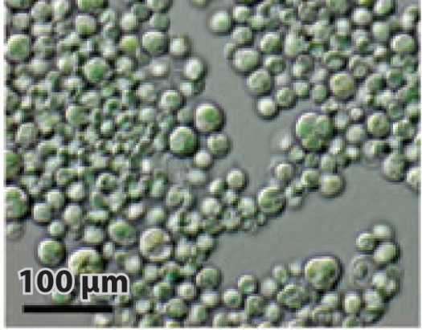

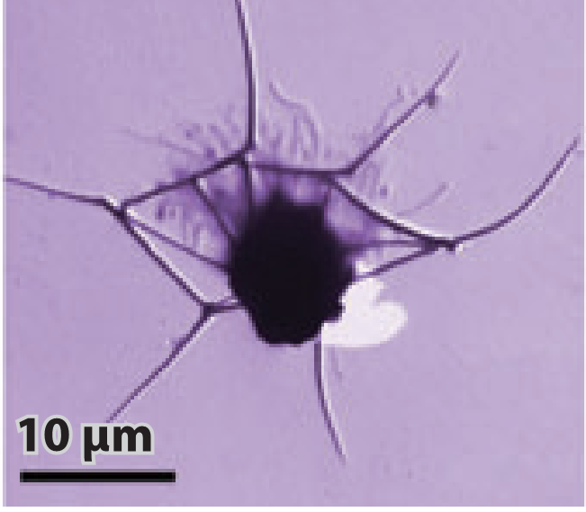
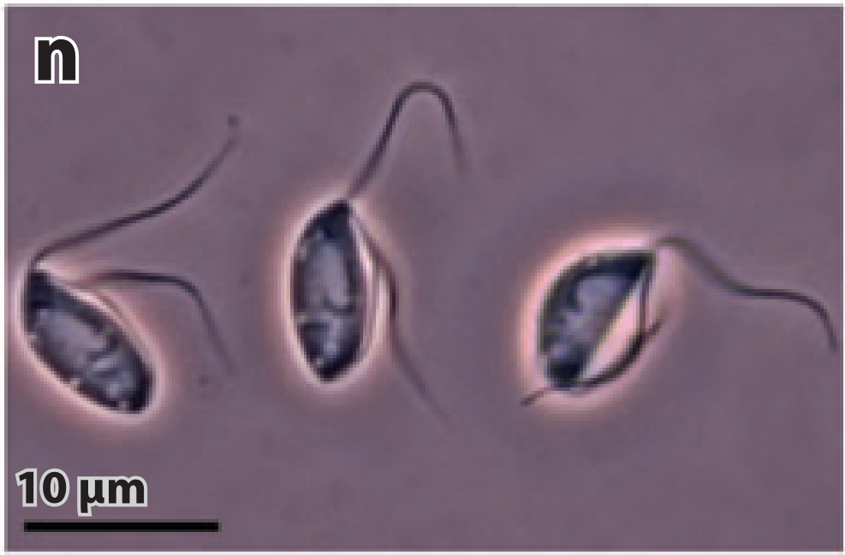
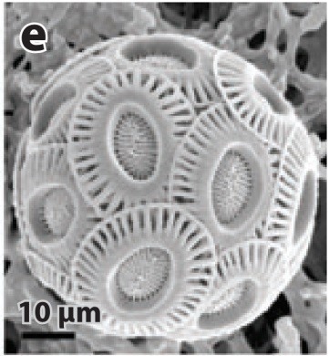


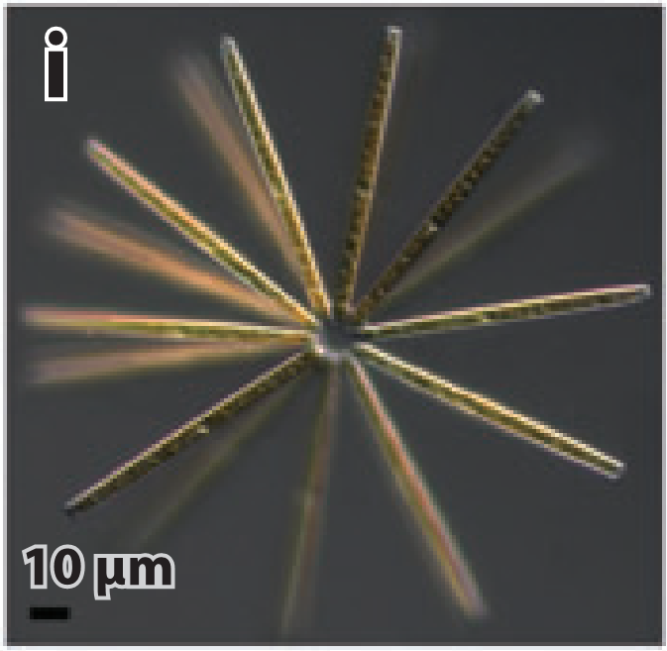
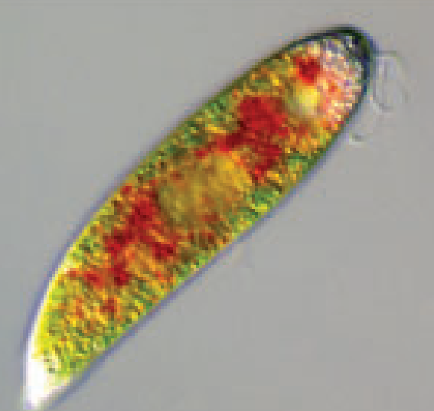
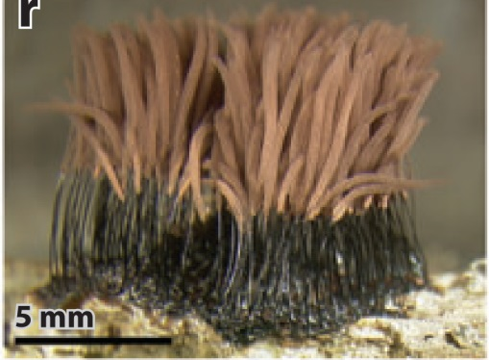

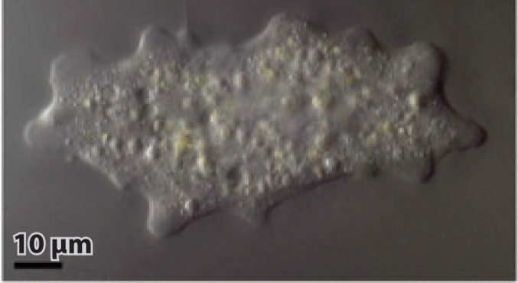

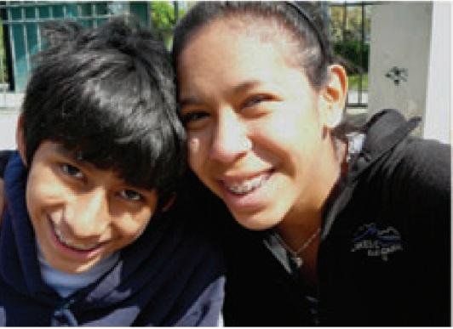
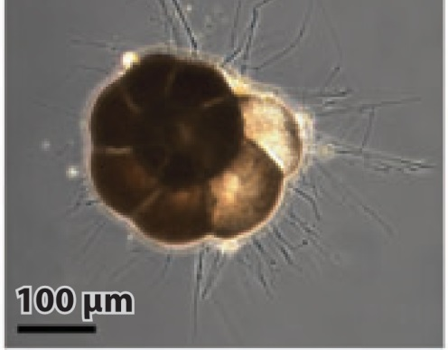
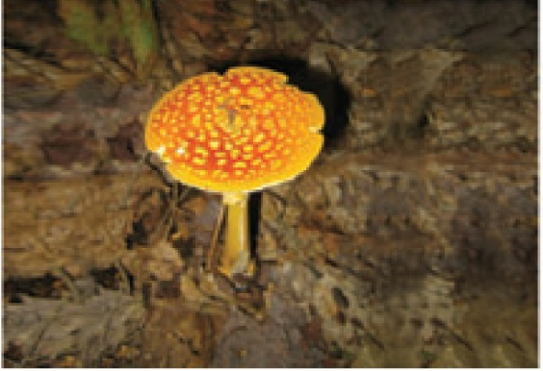
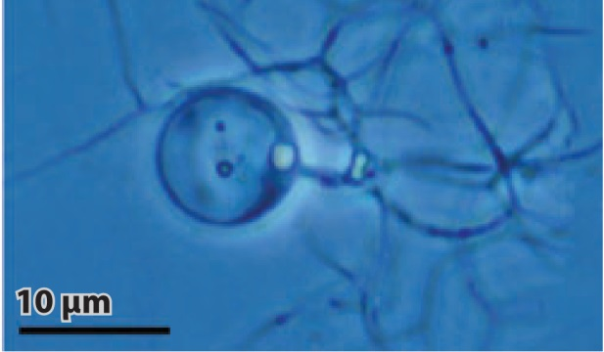
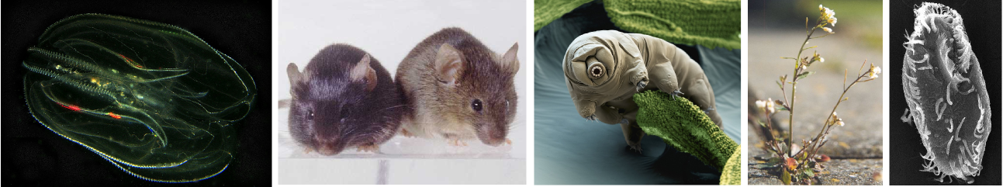
Adapted from Katz, Annu Rev Microbiol (2012), Wikipedia, Phys.org, Science Photo Library

Slide 3

Extraordinary Relatedness
Extraordinary Diversity
Adapted from Katz, Annu Rev Microbiol (2012), Wikipedia, Phys.org, Science Photo Library

Slide 4
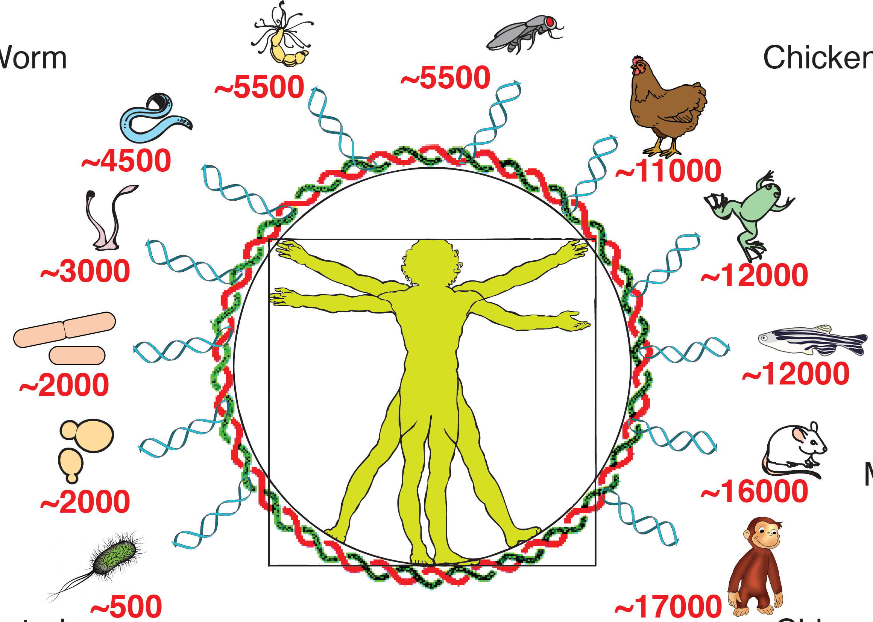
We share genes with almost
every known organism
~9000
~9000
~8800
~12000
~5900
~12000
~4200
~13000
~4300
~16000
~1100
~18000
Image: Aashiq Kachroo, #’s from InParanoid

Slide 5
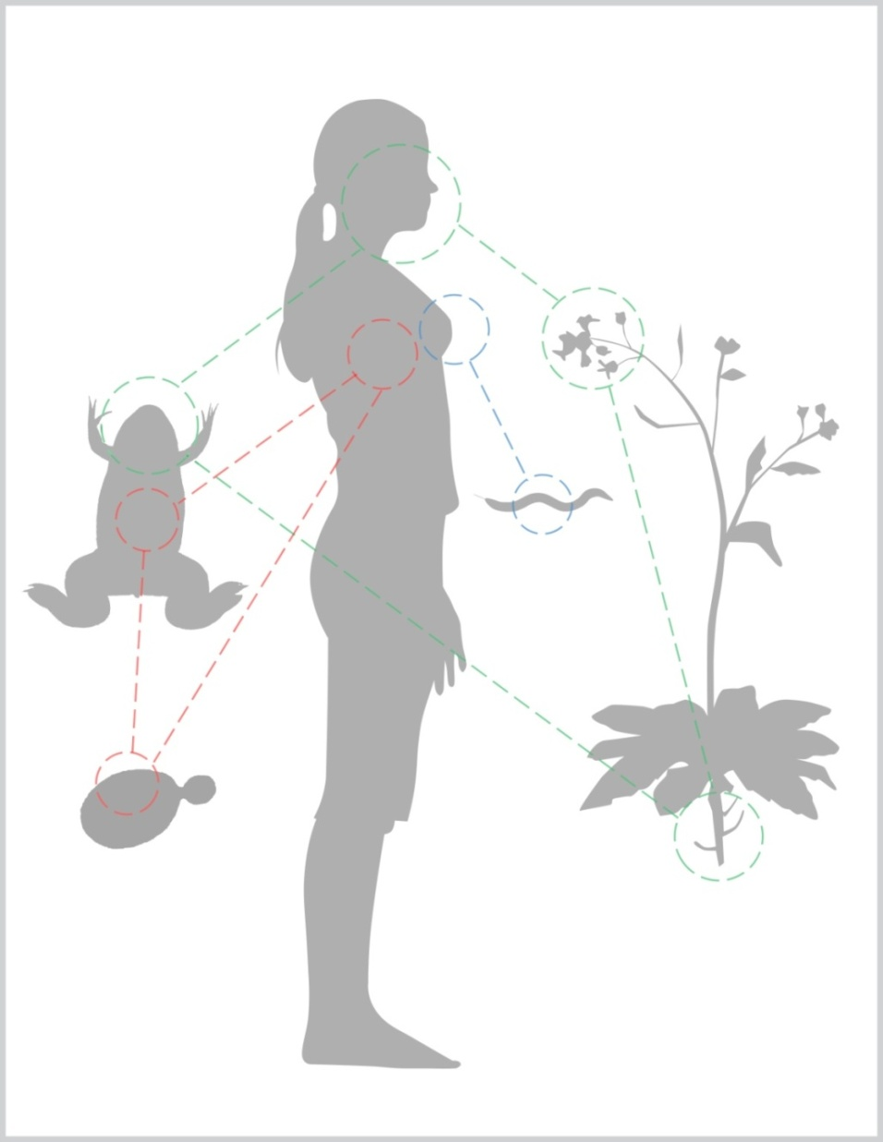
All genetic traits and diseases affect molecular structures that are evolutionarily conserved.
Illustration by Kathryn Weir

Slide 6
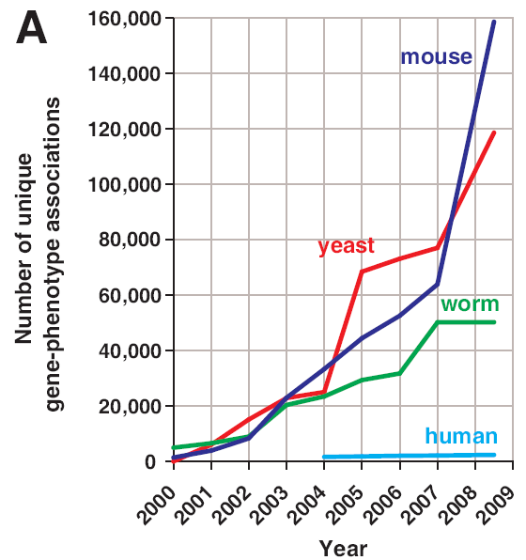
We know far more about genes & traits in lower organisms than in us. Can we transfer that knowledge to us?
Can these tell
us about us?
…
McGary, Park et al. PNAS 107:6544-9 (2010)

Slide 7
Comparative evolution studies rely on finding orthologs
Orthologs = genes from different species that derive from a single gene in the last common ancestor of the species
Paralogs = genes that derive from a single gene that was duplicated within a genome

Slide 8
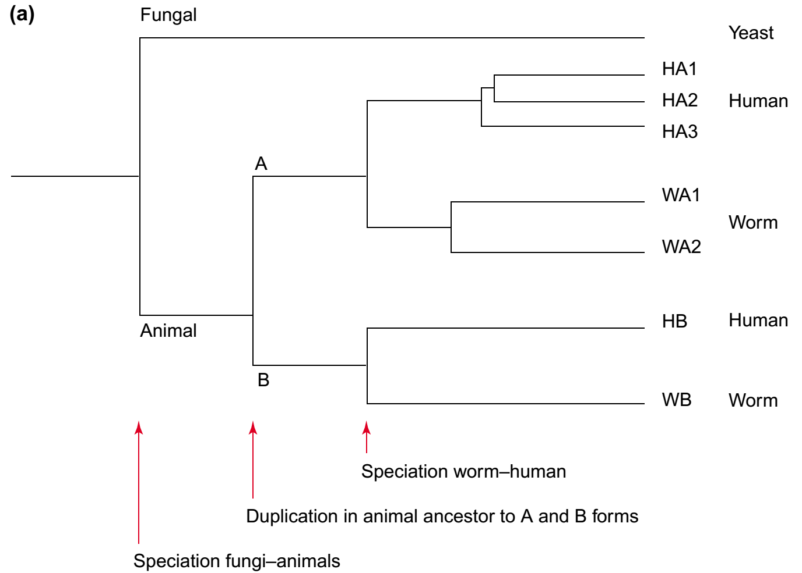
Comparative evolution studies rely on finding orthologs
Ortholog to all the rest
Paralogs
Co-
orthologs
Paralogs
Orthologs
In/out-paralogs: paralogs that evolved by gene duplication after/before the speciation event separating the lineages under consideration
Trends in Genetics 18:619–620 (2002)

Slide 9
Phenologs = significantly overlapping sets of
orthologous genes, such that each gene in a given set
gives rise to the same phenotype in that organism
(e.g., human)
(e.g., worm)
(e.g., breast cancer)
(e.g., specific worm phenotype)
McGary, Park et al. PNAS 107:6544-9 (2010)

Slide 10
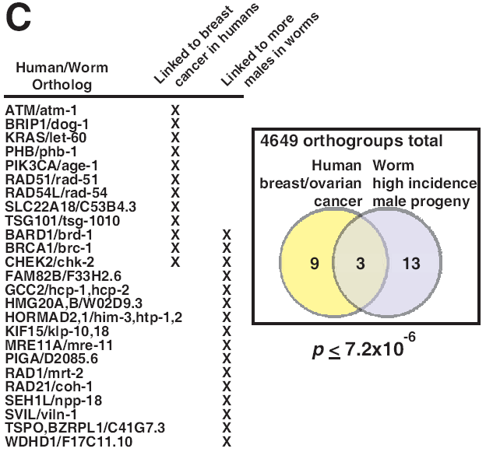
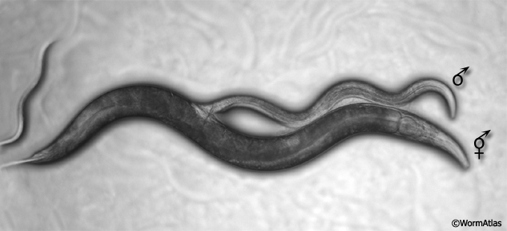
E.g., ‘high incidence of male’ C. elegans genes predict human breast/ovarian cancer genes
includes
BRCA1
McGary, Park et al. PNAS 107:6544-9 (2010)

Slide 11
Building & searching a collection of phenotypes
Mining available databases +
manual collection from the primary literature
Organism | # gene-phenotype associations
human | 1,923
mouse | 74,250
worm | 27,065
yeast | 86,383
Arabidopsis | 22,921
Spanning ~300 human diseases,
>7,000 model organism mutational phenotypes
Computational scan phenotypes for novel models of a disease of interest,
identify significant phenologs using permutation tests
McGary, Park et al. PNAS 107:6544-9 (2010)

Slide 12
Discovering phenologs
McGary, Park et al. PNAS 107:6544-9 (2010)

Slide 13
Computationally, we find many genes shared between human diseases and
mouse, yeast, worm, and even plant traits
A defect in... suggests genes for ...
yeast lovastatin sensitivity angiogenesis defects
worm abnormal body wall gastrointestinal
muscle cell polarization hemorrhage
yeast hydroxyurea sensitivity hemolytic anemia
plant cotyledon mental
development defects retardation
McGary, Park et al. PNAS 107:6544-9 (2010)
Woods, Blom et al. BMC Bioinformatics, 14:203 (2013)

Slide 14
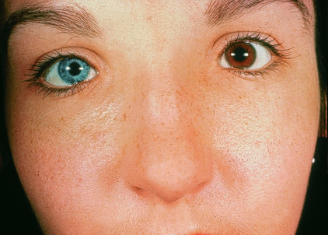
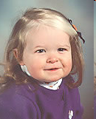

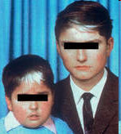
Waardenburg syndrome accounts for ~2-5% of cases of deafness
Michael Murphy, M.D.
Assorted websites, incl. www.verywell.com/waardenburg-syndrome-1048692, http://stephaniemariesanchez.blogspot.com/

Slide 15
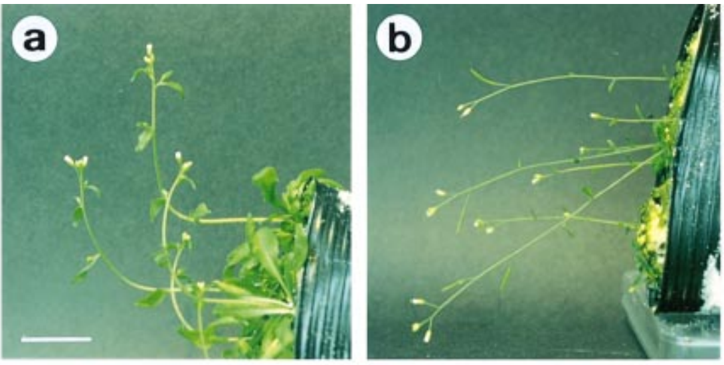
Plants sense and respond to gravity → gravitropism
Fukaki et al., The Plant Journal
14, 425–430 (1998)

Slide 16
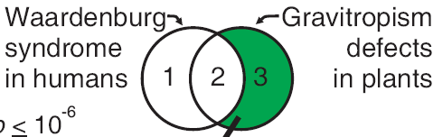
Plant gravitropism predicts genes for Waardenburg syndrome, a human congenital deafness syndrome
The human versions of these plant genes are candidate Waardenburg genes
Michael Murphy, M.D.
~
~
Fukaki et al., The Plant Journal
14, 425–430 (1998)
Assorted websites
Waardenburg syndrome
Gravitropism defects

Slide 17
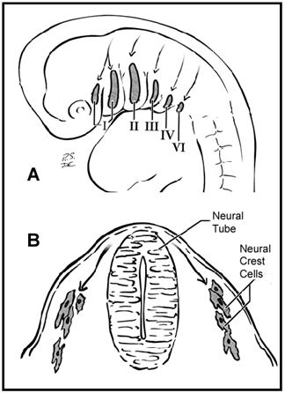
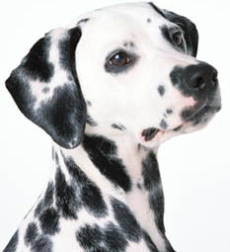
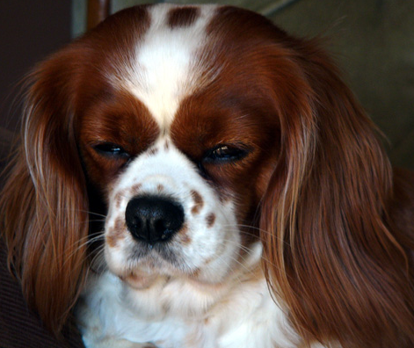
Waardenburg syndrome is a defect of neural crest cells
Neural crest cells migrate
during embryonic development
Some WS correlates in other animals:
Deafness in Dalmatian dogs (22% unilaterally deaf)
Variations in the Blenheim spot of
Cavalier King Charles Spaniels
Association between white blue-eyed cats and deafness (noted by Darwin in 1859)
White forelock and deafness/bowel blockage in foals & many more...
www.petplanet.co.uk
www.silvarcea.co.uk
Heike & Hing, Gene Reviews (2009)

Slide 18
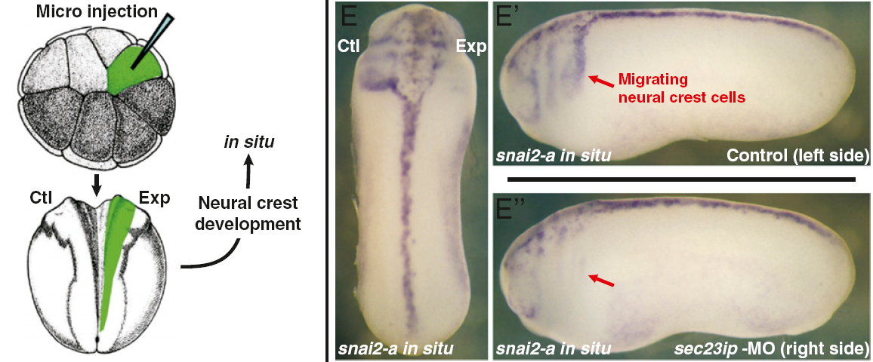
Sure enough, inactivating one of the genes—predicted from plants—in a tadpole disrupts neural crest cells, consistent with Waardenburg syndrome
Frog embryo
McGary, Park et al. PNAS 107:6544-9 (2010)

Slide 19


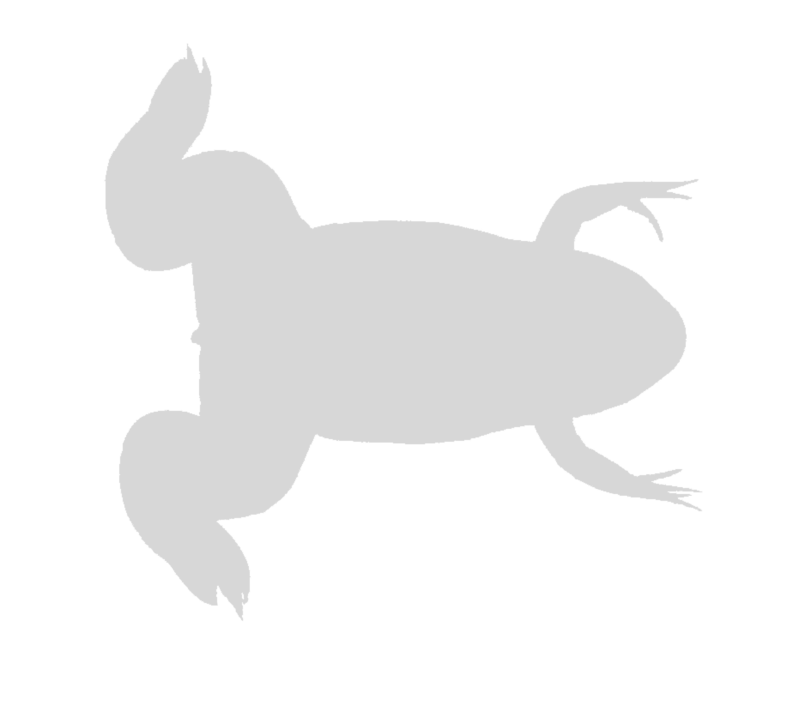
VALIDATE
CANDIDATE GENE
in frog, CONFIRM
PLANT MODEL
BEGIN WITH KNOWN GENES
for Waardenburg syndrome
FIND PLANT ORTHOLOGS that
share mutant phenotypes (gravitropism)
PREDICT novel Waardenburg genes
…suggest new WS genes,
confirmed in frogs,
validating the plant model.
Waardenburg syndrome
genes…
…suggest a relevant plant
system. Plant genes…
?
?
PREDICT AND
VALIDATE
new gravitropism
genes
SEARCH FOR
MUTATIONS
in humans

Slide 20
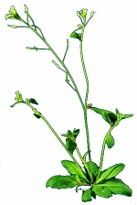
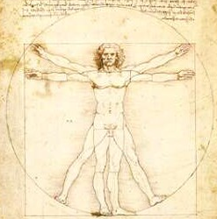
Phenologs identify evolutionarily conserved systems of proteins relevant to particular traits/diseases.
Last common
ancestor
Set of genes in LCA
Plant
Human
arabidopsis.info
Genes now
used to direct
polarized growth
in gravitropism
Orthologous
genes
Genes now
used to direct
neural crest
cell migration
McGary, Park et al. PNAS 107:6544-9 (2010)

Slide 21
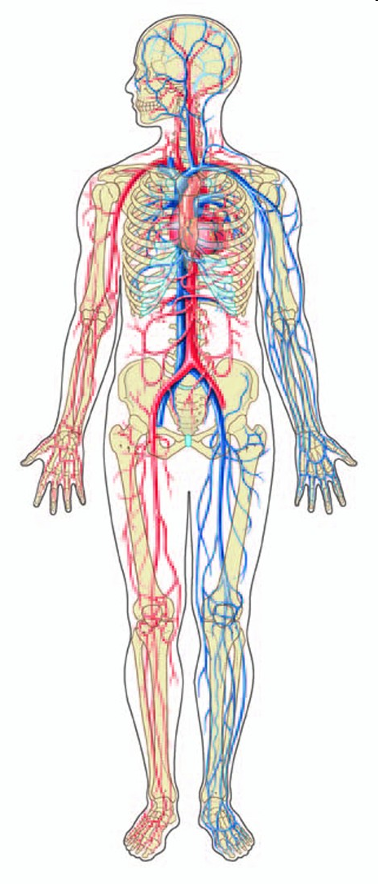
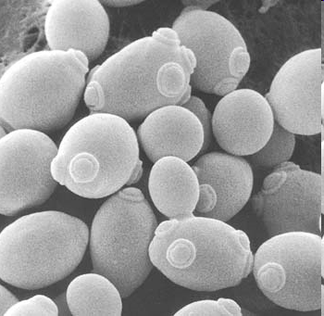
Example #3: Yeast genes linked to statin sensitivity
predict blood vessel defects
The human versions of these yeast genes are candidate angiogenesis genes
Can these really tell us about these?
McGary, Park et al.
PNAS 107:6544-9 (2010)
www.chemistryland.com
Dorling Kindersley

Slide 22
Disrupting the SOX13 gene causes strong blood vessel defects
hemorrhaging in later stage embryos
& angiogenesis defects in cultured
human umbilical vein cells
McGary, Park et al.
PNAS 107:6544-9 (2010)

Slide 23
A yeast model of angiogenesis = example of a deeply conserved, but “repurposed” gene module
Last common
ancestor
Gene module
in LCA
Human
Yeast
Genes
form blood
vessels
Orthologs
Genes
maintain cell
walls
McGary, Park et al. PNAS (2010)

Slide 24
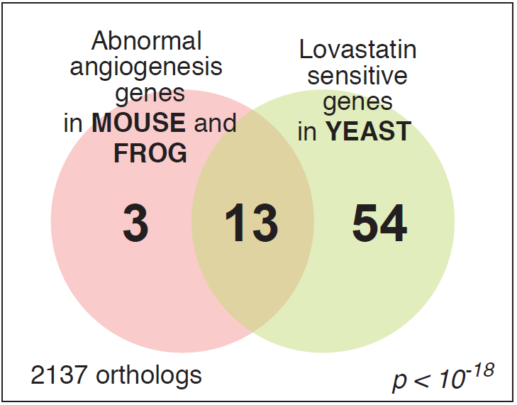
The yeast/angiogenesis gene module

Slide 25
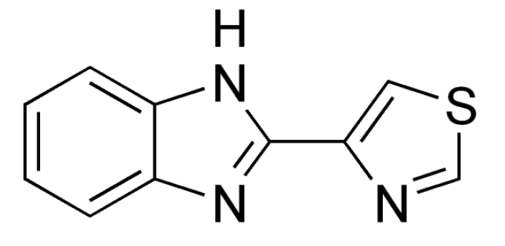
Screening for drugs that interact genetically with this yeast module led us to identify a new angiogenesis inhibitor
TBZ = thiabendazole
FDA-approved antifungal drug with 40 years of safety data
Approved by U.S. Food and Drug Administration in 1967
Fungicide and parasiticide
Not mutagenic or carcinogenic; 2 year dog safety trials
- Off-patent, marketed as a generic

Slide 26
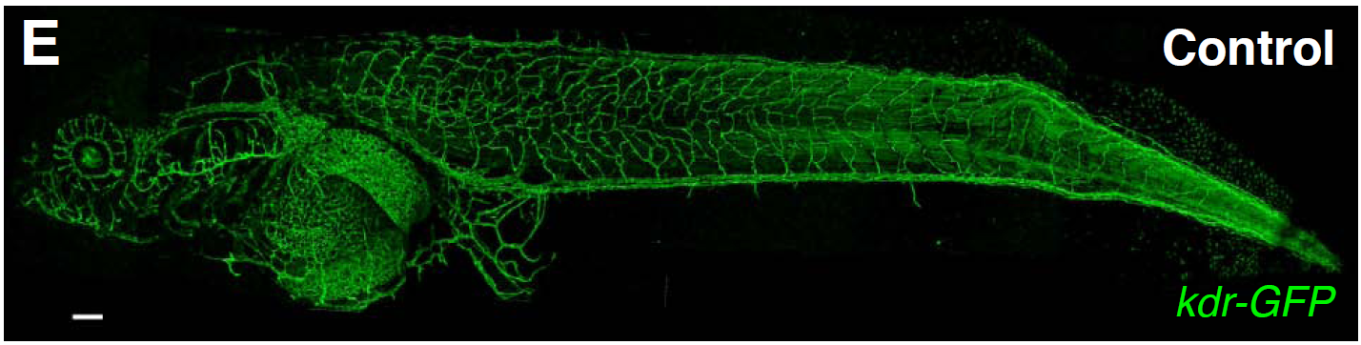
Imaging the blood vessels of a living, transgenic tadpole in a dish of water
200 μm
kdr:GFP transgenic Xenopus laevis

Slide 27

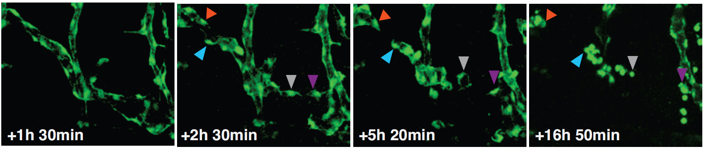
TBZ disrupts vascular integrity, making
vascular endothelial cells retract & round up
Control (DMSO carrier)
+ TBZ
Cha et al., PLoS Biology (2012)

Slide 28
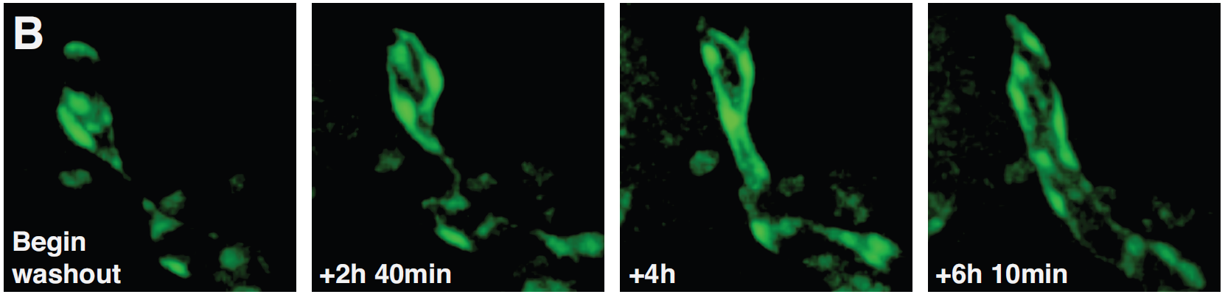
reversibly…

Slide 29
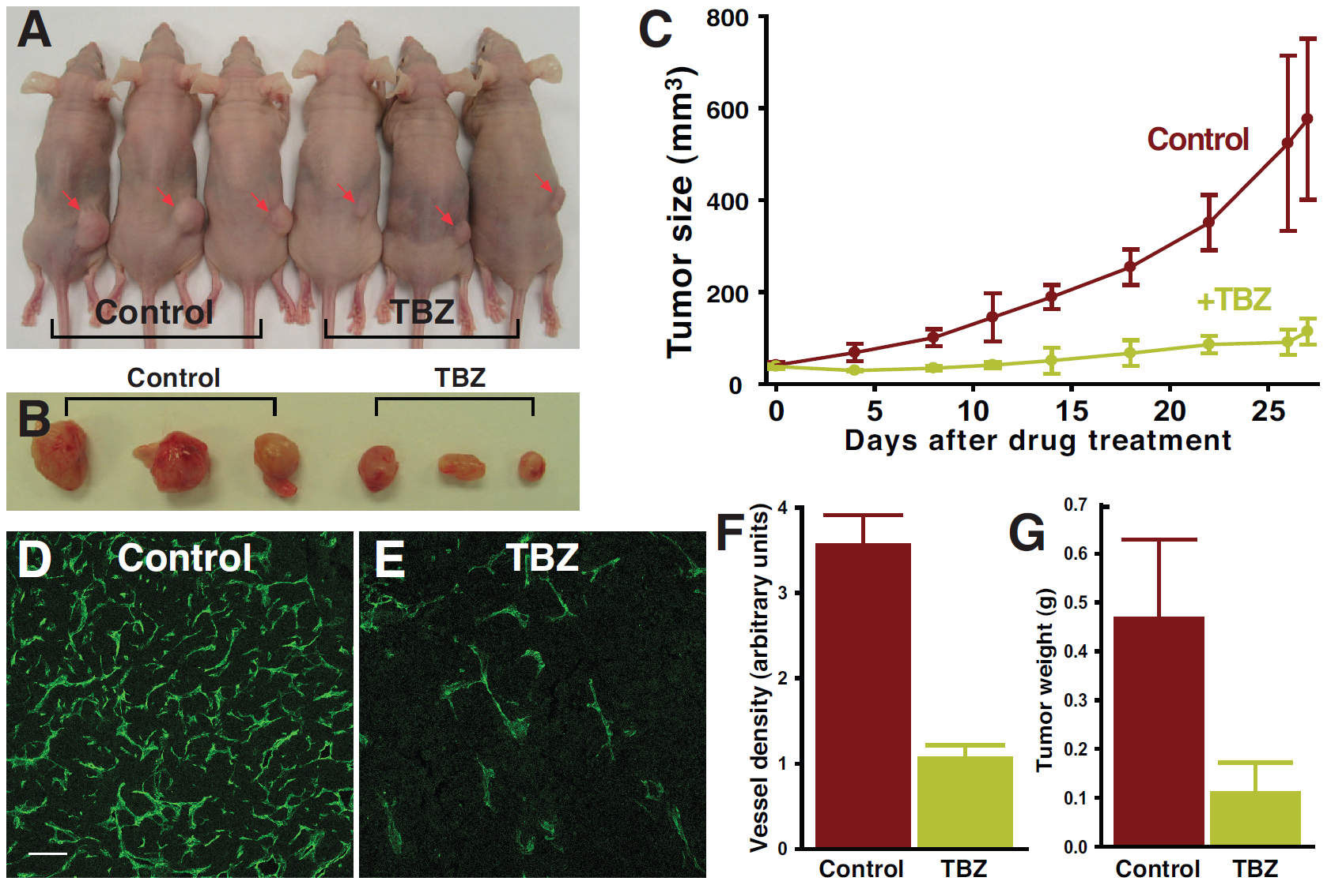
TBZ slows human fibrosarcoma tumors
transplanted into immune-compromised mice
Control
TBZ
Vasculature in tumor sections
Cha et al., PLoS Biology (2012)

Slide 30
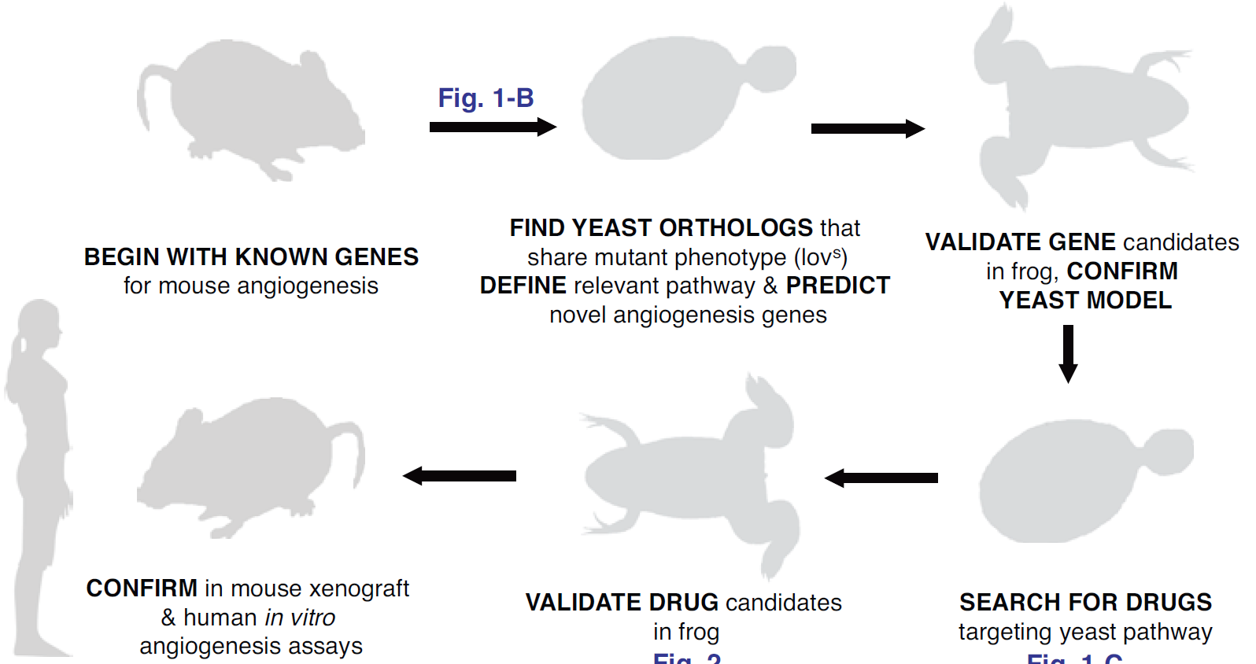
“Road map” to a new vascular disrupting agent, by mapping phenotypes across species
Mouse genes linked to
angiogenesis…
…suggest a yeast
system. Yeast genes…
…suggest angiogenesis
genes, confirmed in frogs,
validating the method.
…mouse tumor trials,
and humans
…confirmed in frogs…
Drug screens in yeast
suggest angiogenesis
drugs…
Cha et al., PLoS Biology (2012)

