Slide 1
Network biology
(& predicting gene function)
BCH364C/391L Systems Biology / Bioinformatics – Spring 2015
Edward Marcotte, Univ of Texas at Austin

Slide 2
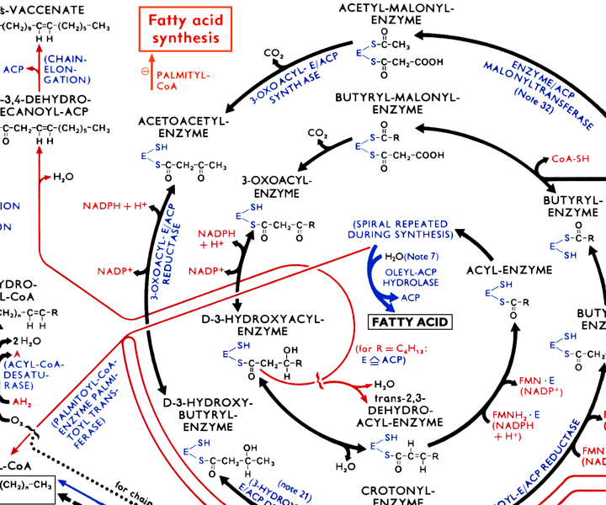
There are many types of biological networks.
Here’s a small portion of a large metabolic network.

Slide 3
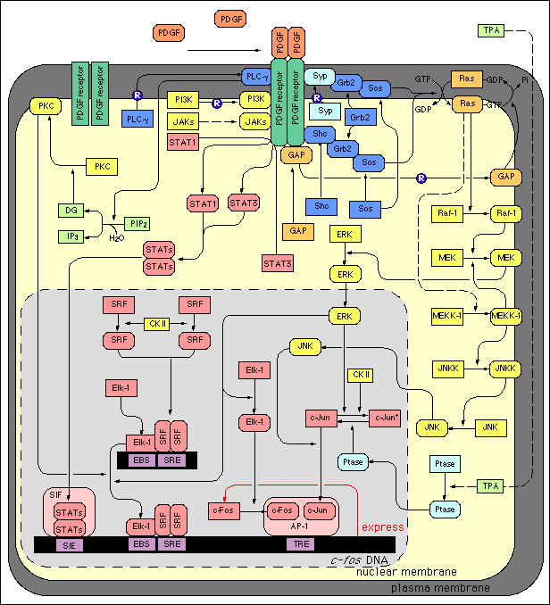
A typical
genetic
network

Slide 4
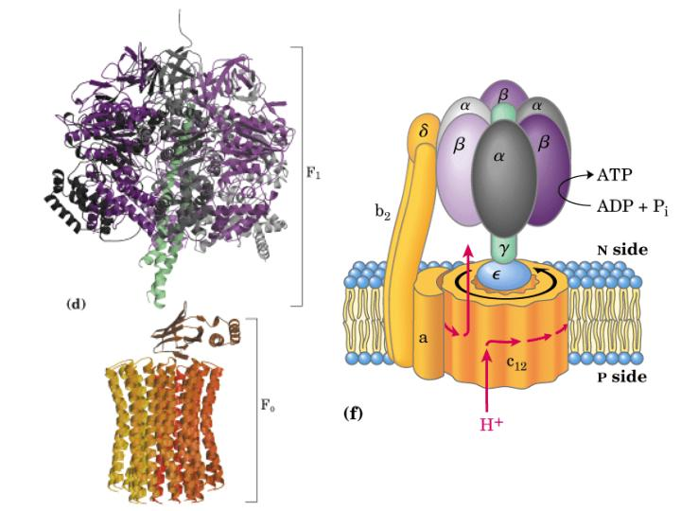
Contacts between proteins define protein interaction networks
X-ray structure
of ATP synthase
Schematic
version
Network
representation
α
β
δ
γ
b2
ε
a
c12
Total set = protein complex
Sum of direct + indirect
interactions

Slide 5
Let’s look at some of the types of interaction data in more detail.
Some of these capture physical interactions, some genetic, some informational or logical.

Slide 6
Pairwise protein interactions
In general, purifying proteins one at a time, mixing them, and assaying for interactions is far too slow & laborious. We need something faster! Hence, high-throughput screens, e.g. yeast two-hybrid assays
DBD
Bait
+
Prey
Act
DNA binding
domain
Transcription
activation
domain
Prey
Act
Core transcription
machinery
DBD
Bait
Transcription
Operator or
upstream activating
sequence
Reporter gene

Slide 7
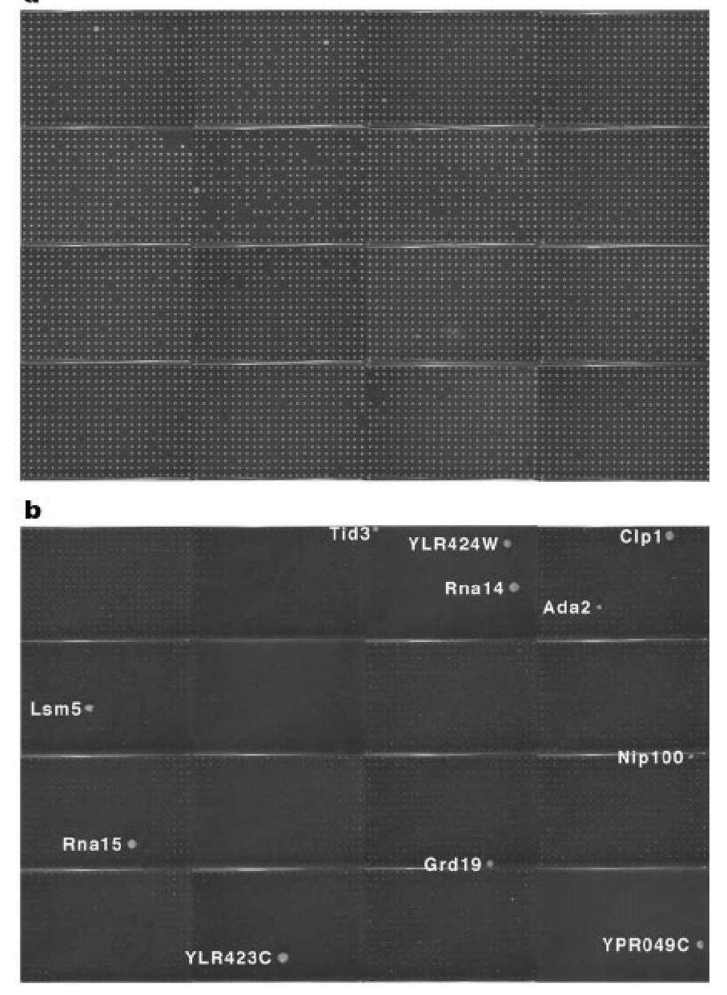
High-throughput yeast two-hybrid assays
Haploid yeast
cells expressing
activation domain-
prey fusion proteins
Diploid yeast
probed with
DNA-binding domain-
Pcf11 bait
fusion protein
Uetz, Giot, et al. Nature (2000)

Slide 8

Protein complexes
High-throughput complex mapping by mass spectrometry
Tag
Bait
Affinity
column
protein 1
protein 2
SDS-
page
protein 3
Trypsin digest,
identify peptides by
mass spectrometry
protein 4
protein 5
protein 6

Slide 9
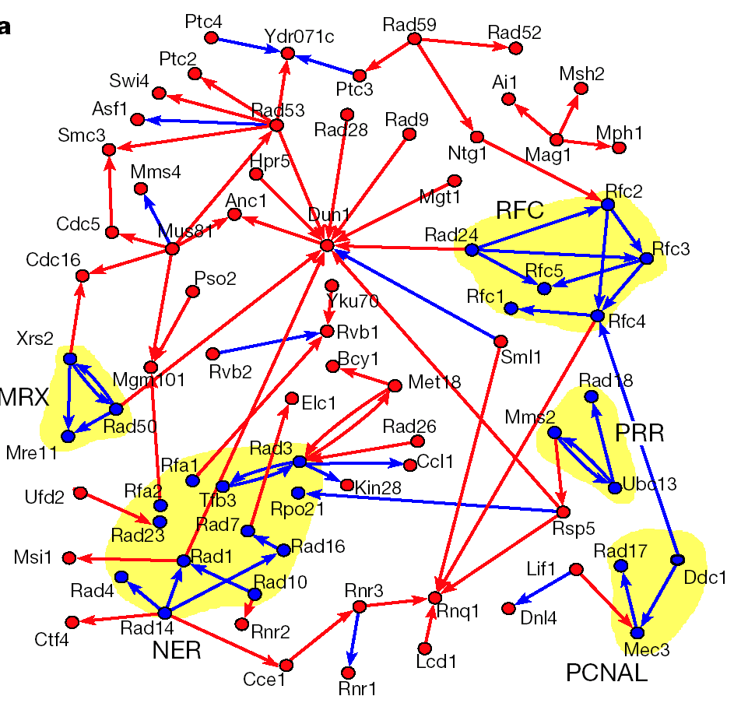
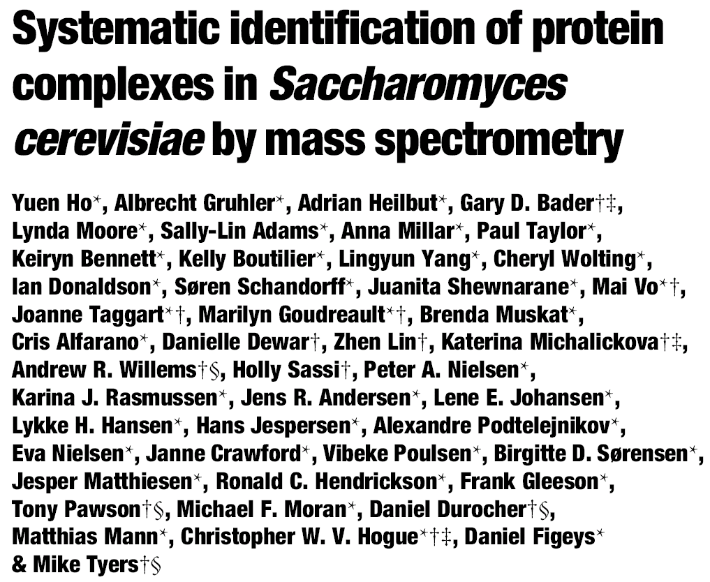
493 bait proteins
3617 interactions

Slide 10
A variant: tandem affinity purification (TAP)
Tag1
Tag2
Bait
Affinity
column2
protein 1
Affinity
column1
protein 2
SDS-
page
protein 3
protein 4
+ protease
protein 5
protein 6
Trypsin digest,
identify peptides by
mass spectrometry
Affinity
column1

Slide 11
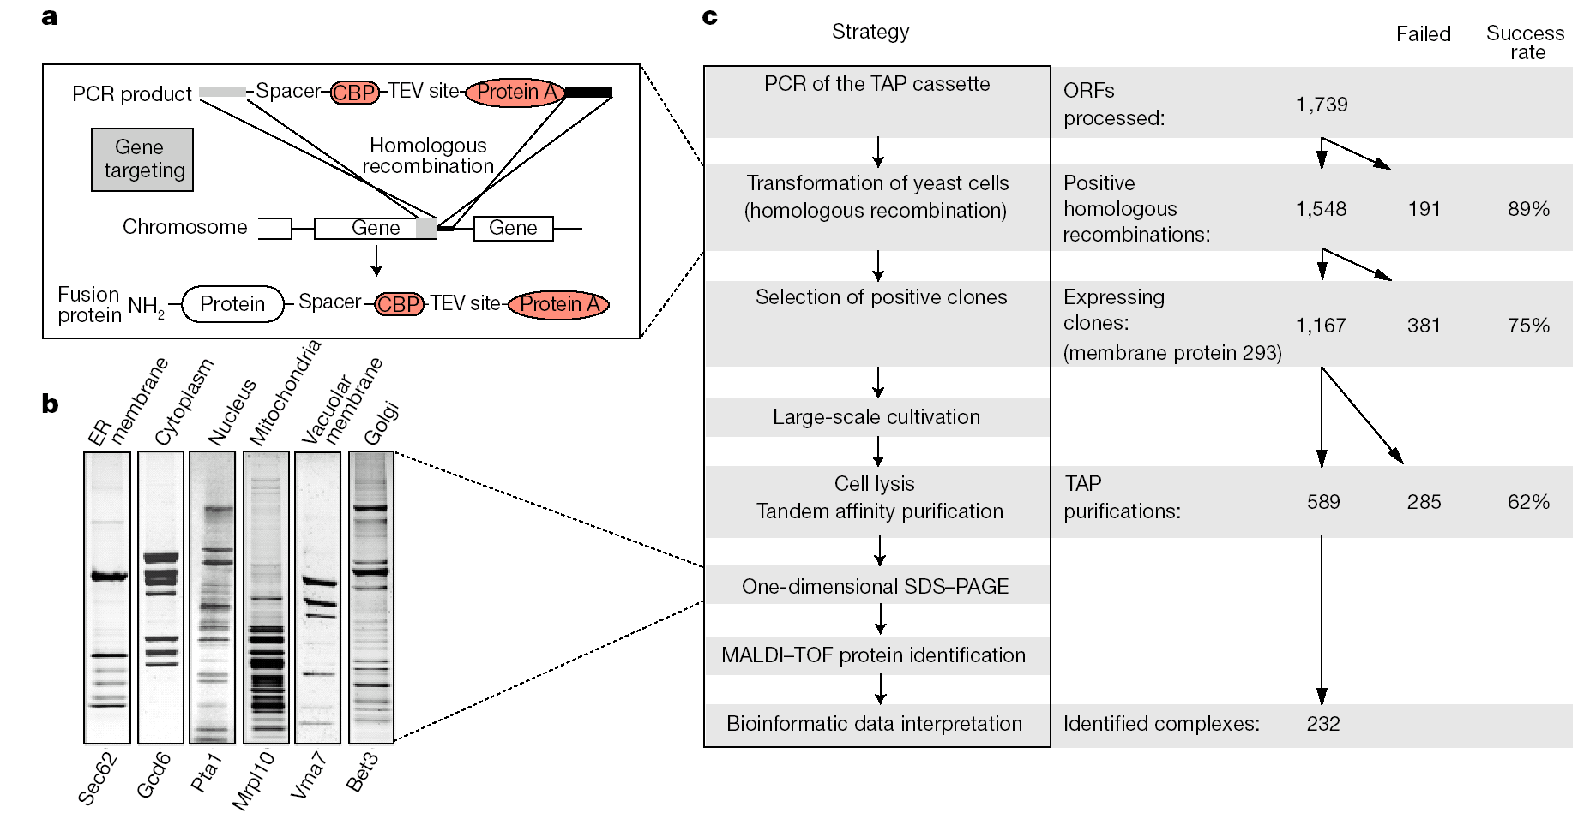
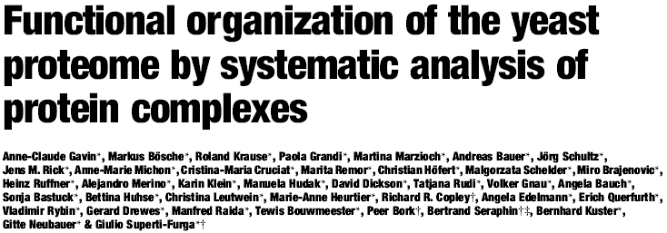


Slide 12
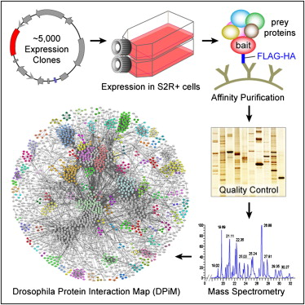
The current state-of-the-art in animal PPI maps – AP/MS
~3,500 affinity purification
experiments
~11K interactions /
~2.3K proteins
→ spans 556 complexes
Still daunting for the
human proteome
Guruharsha et al. (2011) Cell 147, 690–703

Slide 13
The current state-of-the-art in animal PPI maps – co-fractionation/MS
>2,000 biochemical fractions,
including replicates
>9,000 hours
mass spec machine time
Havugimana,
Hart, et al.,
Cell (2012)

Slide 14
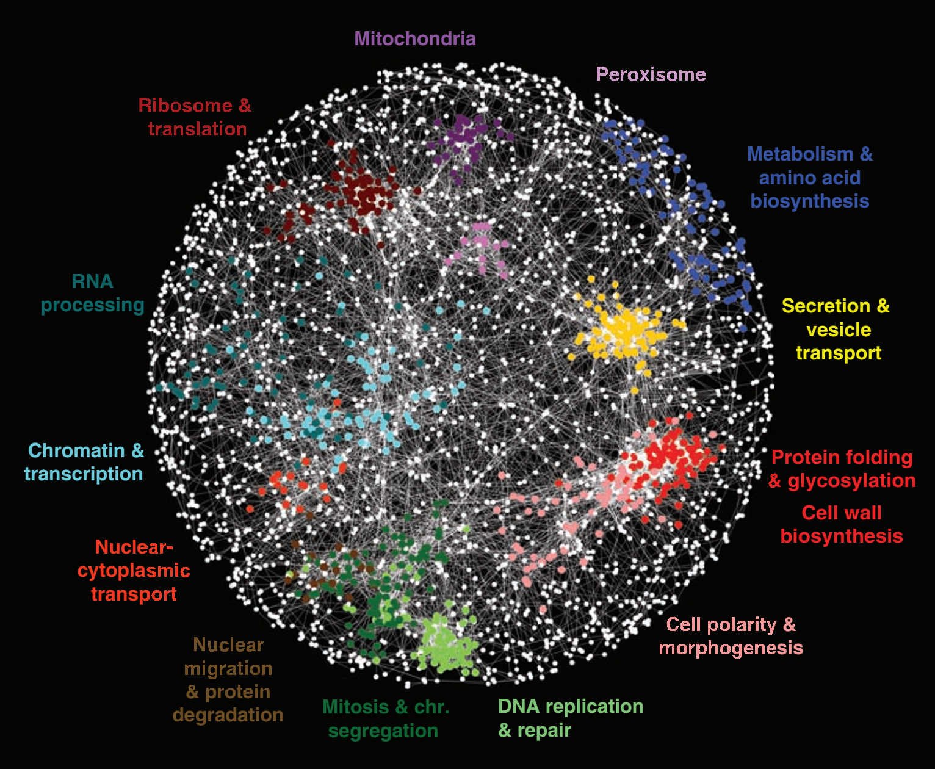
Genetic interactions
5.4 million gene-gene pairs assayed for synthetic genetic interactions in yeast
Costanzo et al., Science 327: 425 (2010)

Slide 15
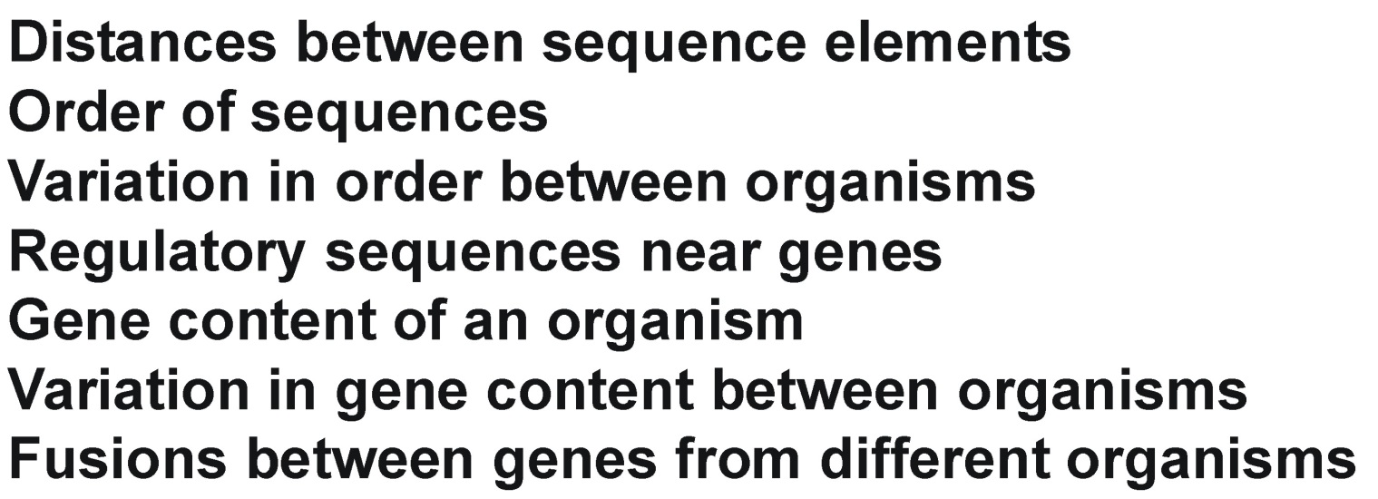
Comparative genomics
Functional relationships between genes impose subtle constraints upon genome sequences. Thus, genomes carry intrinsic information about the cellular systems and pathways they encode.
Linkages can be found from aspects of gene context, including:

Slide 16
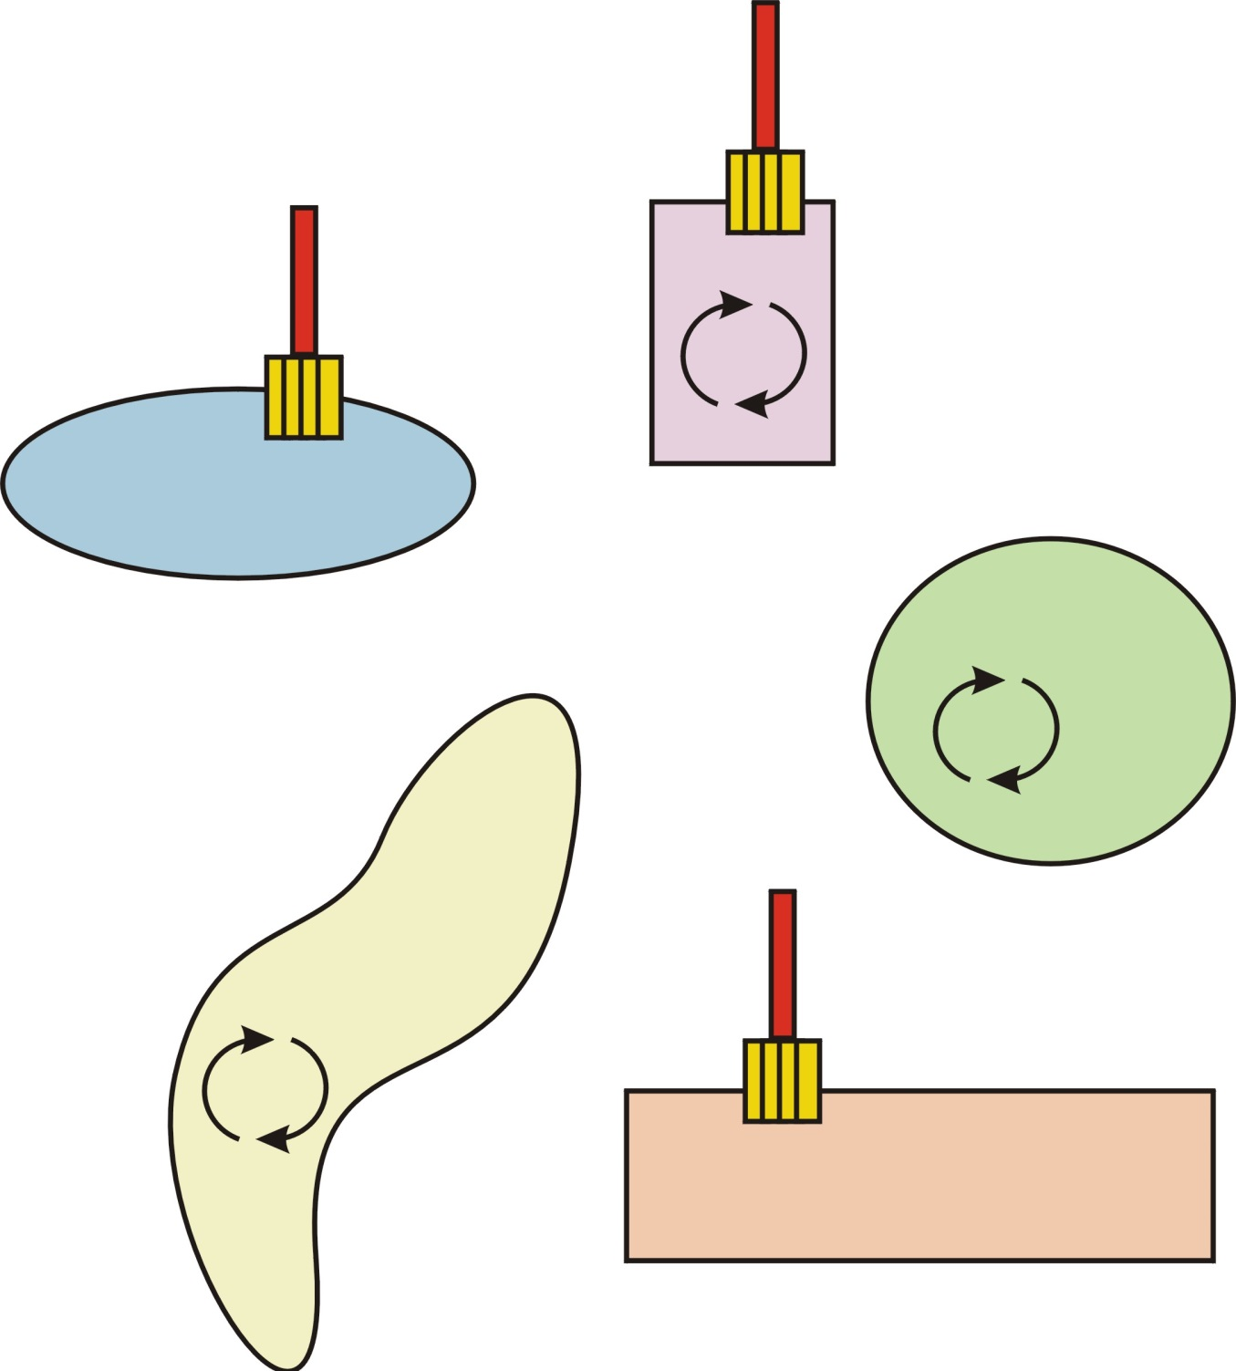
Phylogenetic profiles
Organisms with e.g. a flagellum have the necessary genes; those without tend to lack them.
Specific trends of gene presence/absence thus inform about biological processes.
PNAS 96, 4285-4288 (1999)

Slide 17

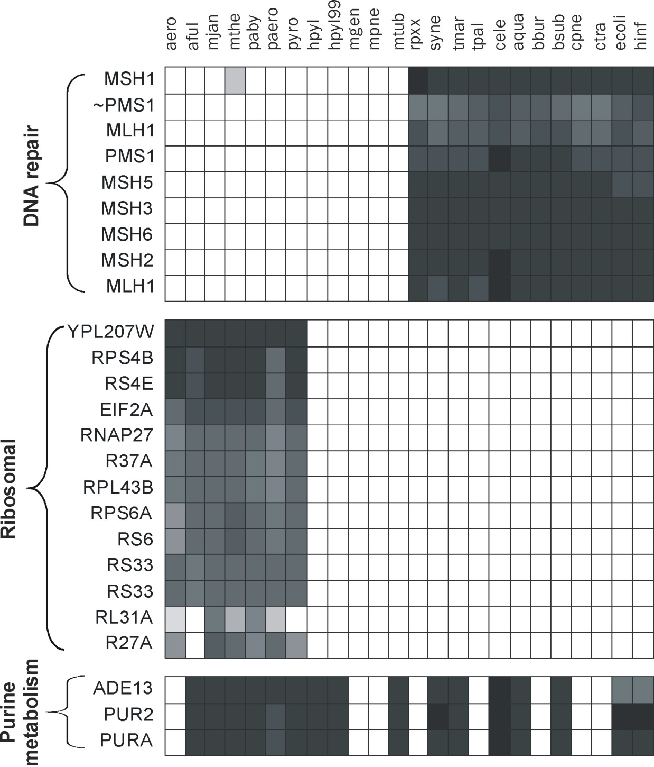

Phylogenetic profiles
Grayscale indicates sequence similarity to closest homolog in that genome
Nature 402, 83-86 (1999)

Slide 18
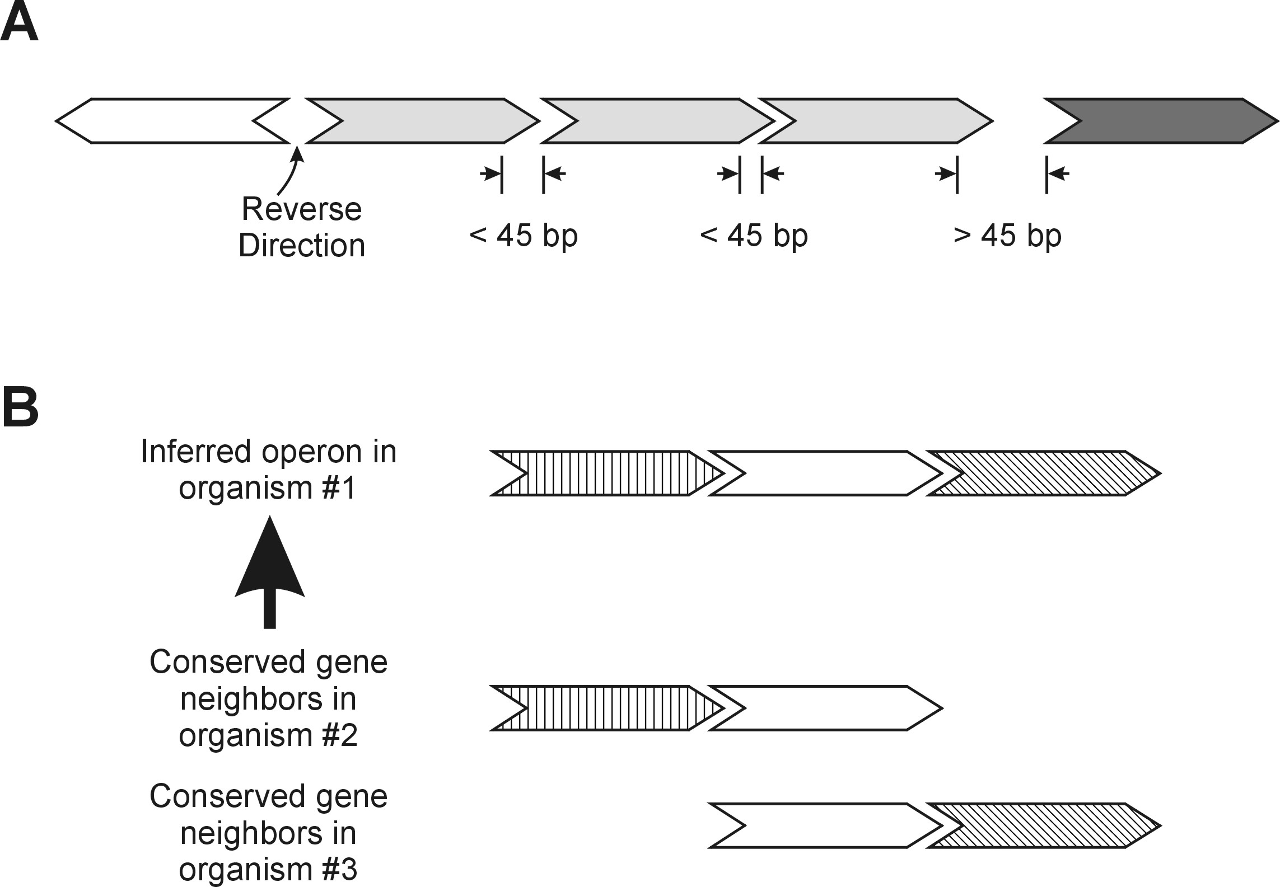
Operons and evolutionary conservation of gene order
Prokaryotic operons tend to favor certain intergenic distances
Conserved gene neighbors also reveal functional relationships

Slide 19
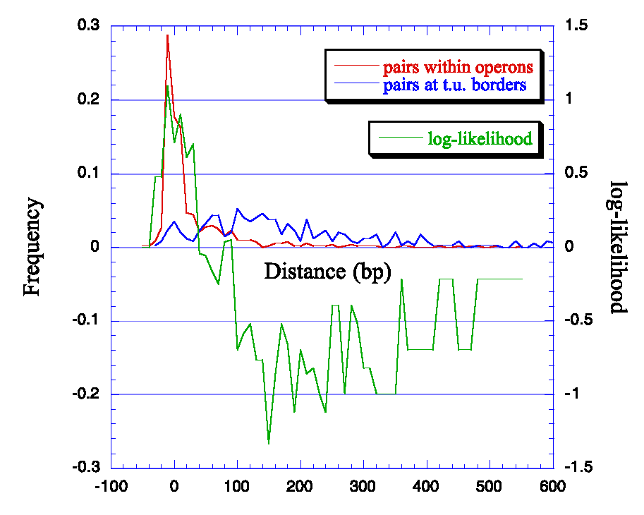

Again, such observations can be turned into pairwise scores:

Slide 20
To summarize so far:
Data about gene interactions comes many sources but is dominated by several major ones:
mRNA co expression. Historically microarrays & ESTs, increasingly RNAseq. Typically very high coverage data.
Comparative genomics. Available for free for all organisms (typically phylogenetic profiles & operons)
Protein interactions, especially co-complex interactions from mass spectrometry
Genetic interactions (more so matching profiles of interaction partners than the interactions themselves)
Transfer from other species

Slide 21
More abstractly, we might consider all of these as indicating “functional linkages” between genes
Protein-protein interactions
Participating in consecutive metabolic reactions
Sharing genetic interactors
Forming the same protein complex
Giving rise to similar mutational phenotypes
Exhibiting similar biological function
    and so on…

Slide 22
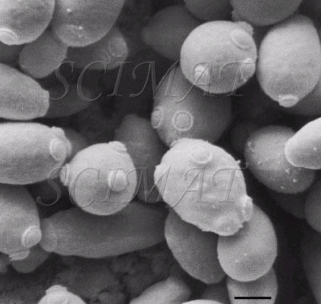
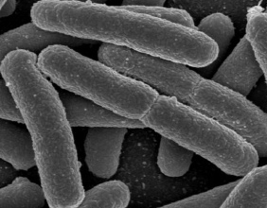
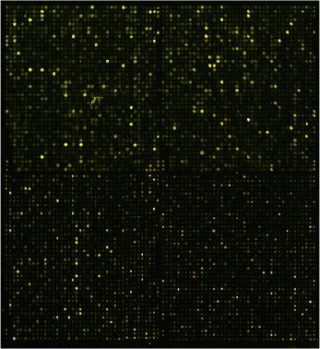
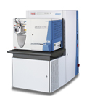
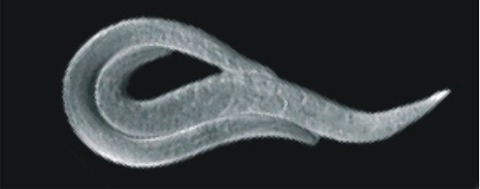
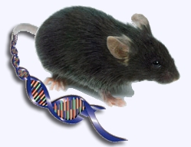
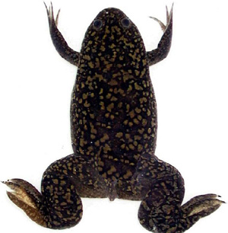

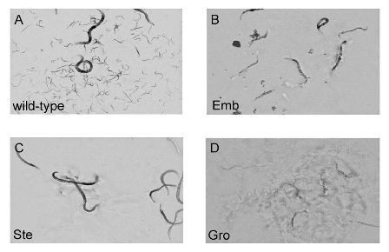
These sorts of data can be combined into
functional gene networks
Yeast
Bacteria
Including measurements of...
Gene expression
(RNA-seq/arrays)
C. elegans
nematodes
Protein expression
and interactions
(Mass spectrometry)
Xenopus
frogs
Mouse
Sanger Ctr
AAACTGCATCGA
ATCGCGCATCGC
AGCTCTAGCTCCC...
Gene organization
(Genome sequences)
Gene-gene interactions
(Genetic assays)
Humans

Slide 23
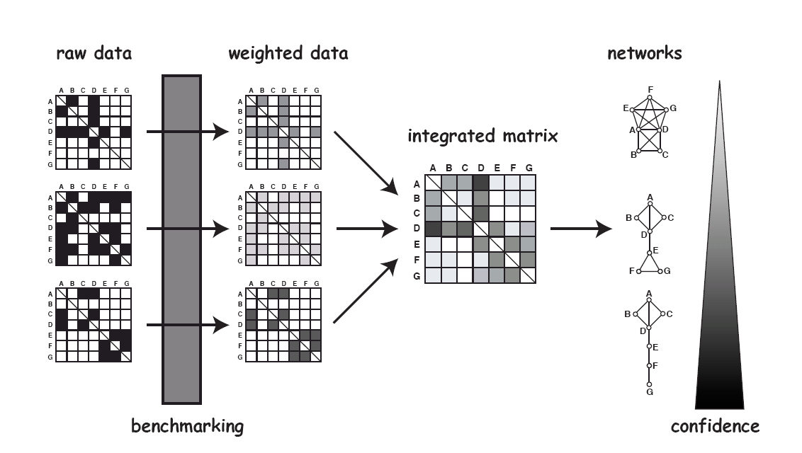
These sorts of data can be combined into
functional gene networks
Networks
Gene expression
(RNA-seq/arrays)
Genes
Genes
Protein expression
and interactions
(Mass spectrometry)
=
AAACTGCATCGA
ATCGCGCATCGC
AGCTCTAGCTCCC...
Gene organization
(Genome sequences)
Likelihood of 2 genes
working in the same
biological process
Confidence
Gives an estimate of cell’s “wiring diagram”
Gene-gene interactions
(Genetic assays)
Adapted from Fraser & Marcotte, Nature Genetics (2004)

Slide 24
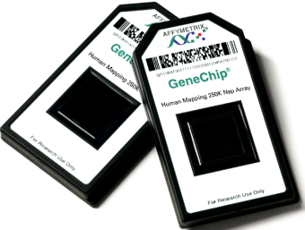
These sorts of data can be combined into
functional gene networks
Networks
Genes
Genes
Bayesian statistics
Genes
Genes
Integrated matrix
AAACTGCATCGA
ATCGCGCATCGC
AGCTCTAGCTCCC...
=
Likelihood of 2 genes
working in the same
biological process
Primary or derived interaction data
Confidence
Adapted from Fraser & Marcotte, Nature Genetics (2004)

Slide 25
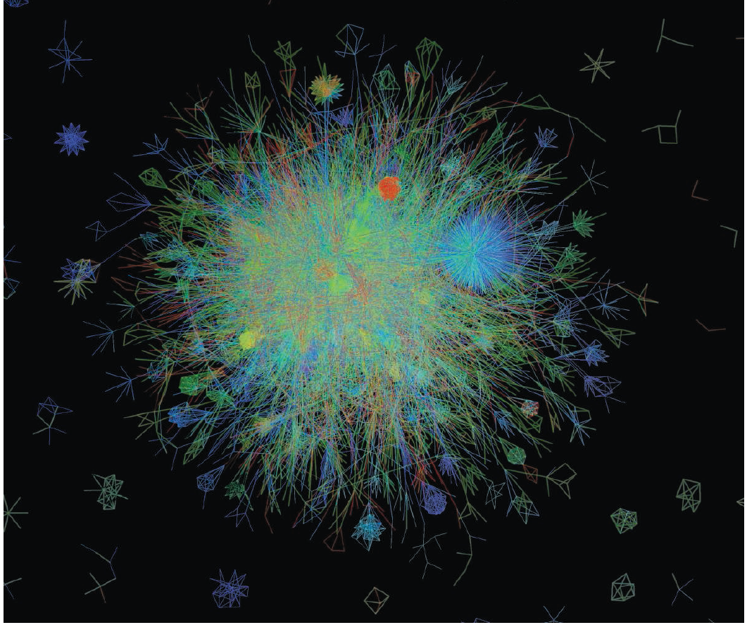



Slide 26
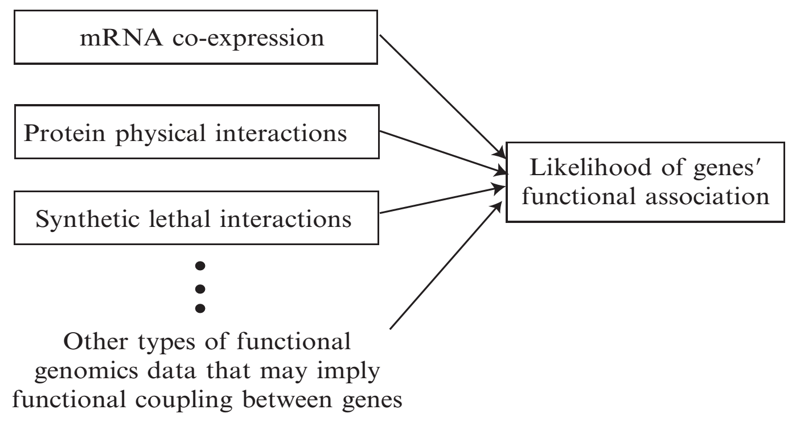
In more detail: Constructing a functional gene network
(Infer associations by
regression models
in supervised
Bayesian framework)
Lee & Marcotte, Methods Mol Biol. 453:267-78. (2008)

Slide 27
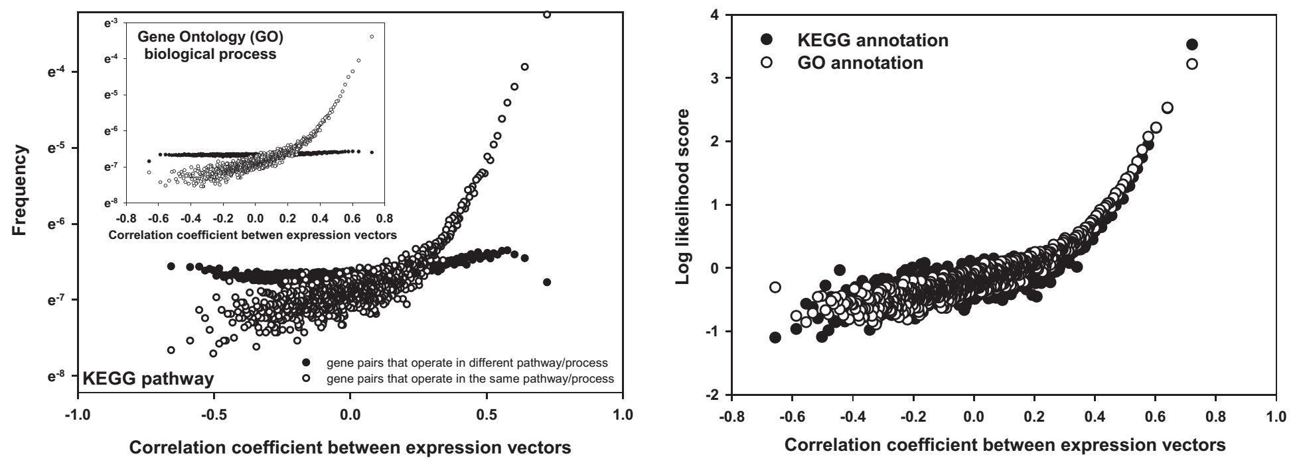
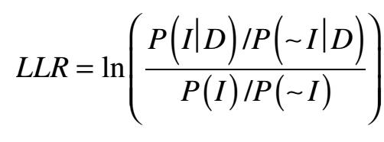
e.g., inferring functional linkages from mRNA co-expression
across a given set of conditions
bins of 20K gene pairs
Frequencies in the dataset (D) of gene pairs sharing pathway annotations (I) and not sharing annotations (~I), calculated per bin
LLS
Background frequencies of gene pairs sharing and not sharing annotations
Fit regression model, score all expressed gene pairs (annotated + unannotated)
Repeat for other datasets
Integrate scores for each link
Assess performance by cross-validation or bootstrapping
Lee et al. Science, 306:1555-8 (2004)

Slide 28
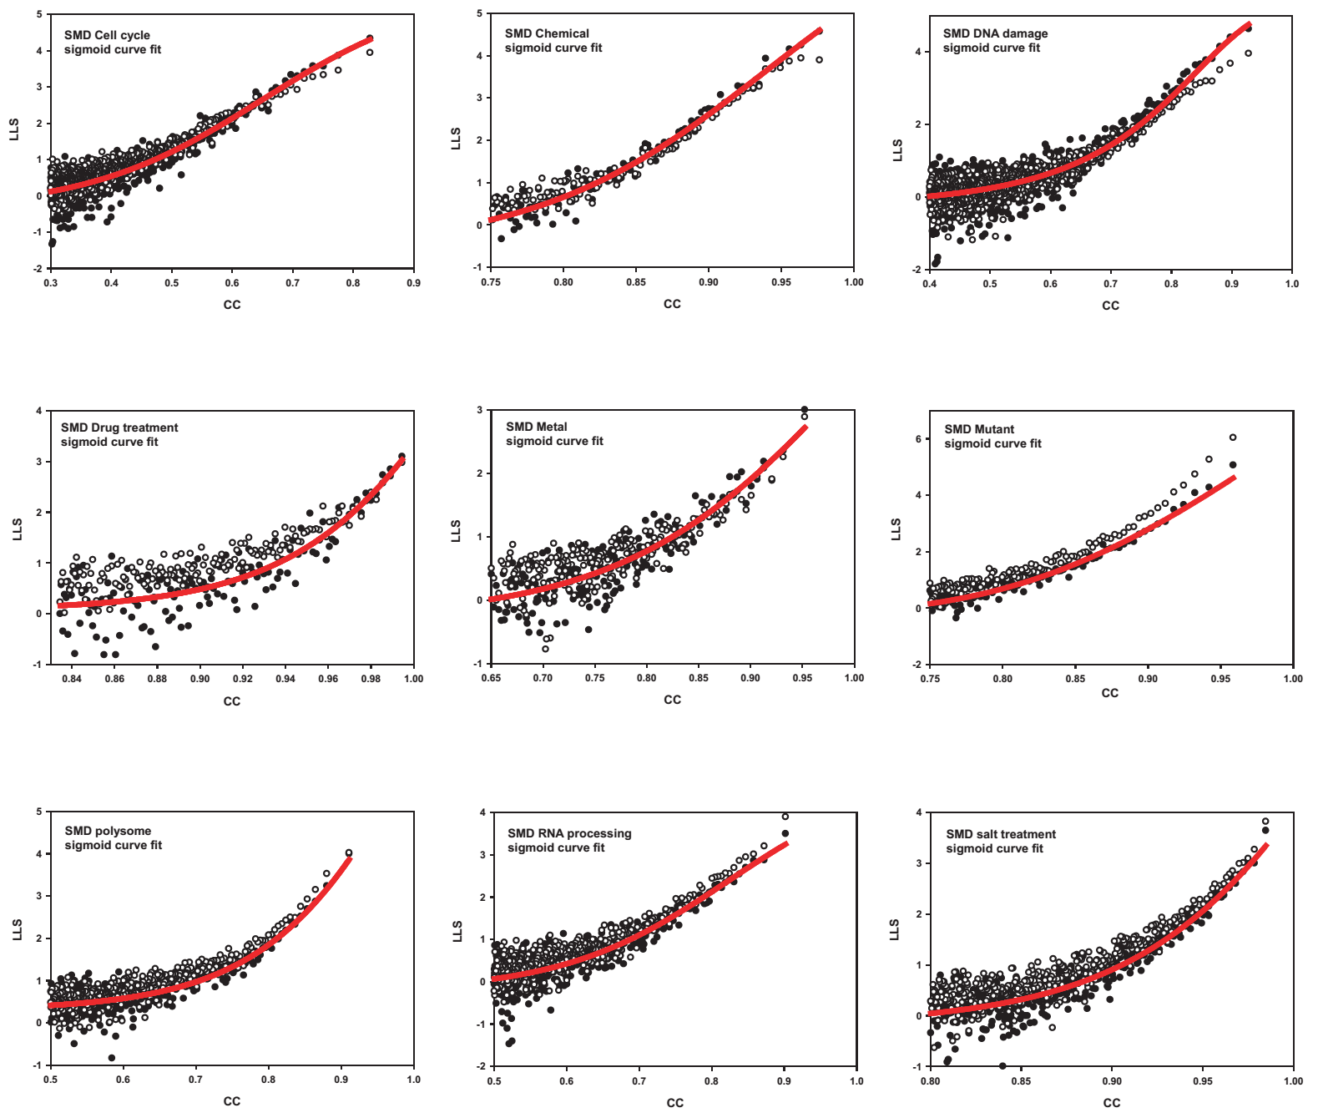
Typically calculated for many different sets of experiments
sampling many different conditions…
Each represents a different set of mRNA abundance profiling experiments (here, DNA microarrays) interrogating a given set of conditions.
Different gene pairs may be correlated in each condition.
… and so on
Lee et al. Science, 306:1555-8 (2004)

Slide 29
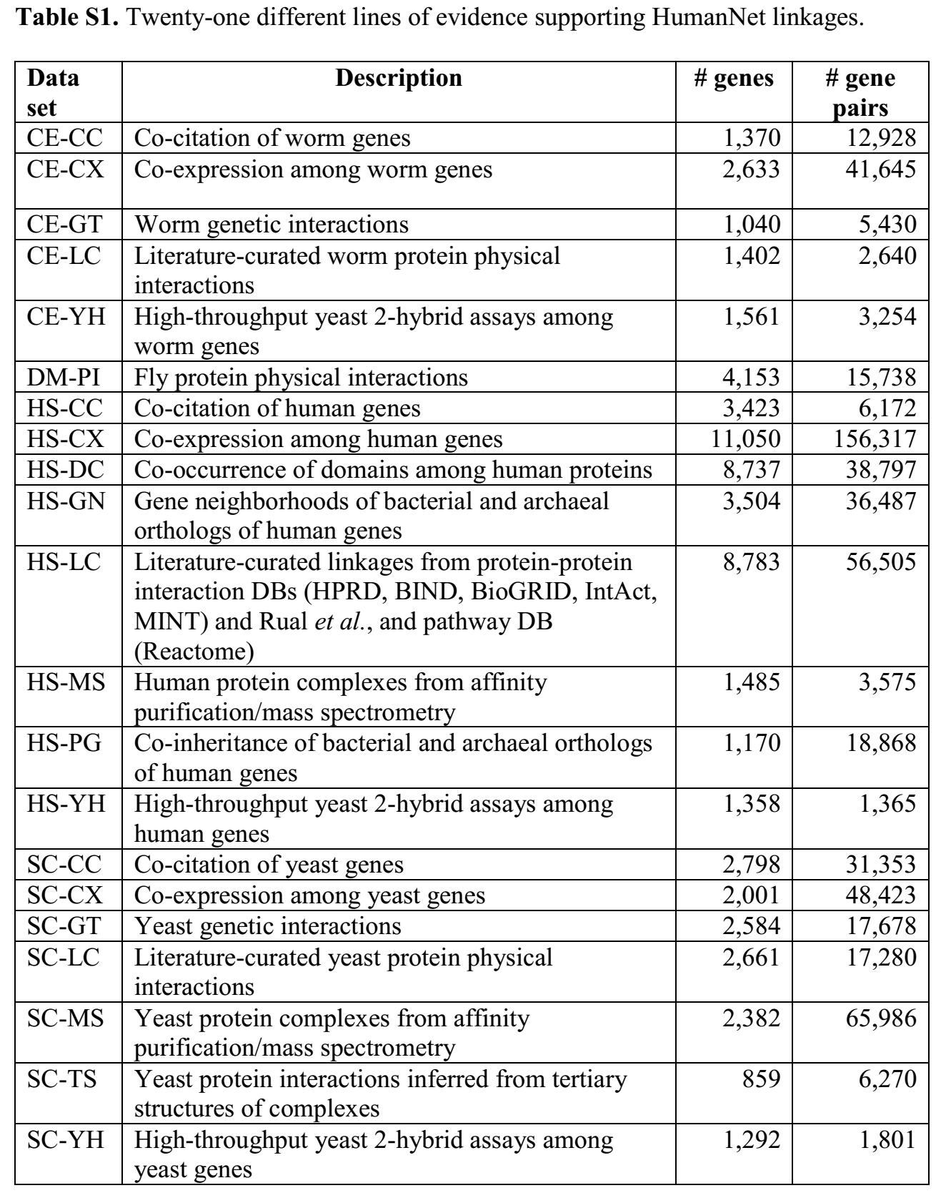
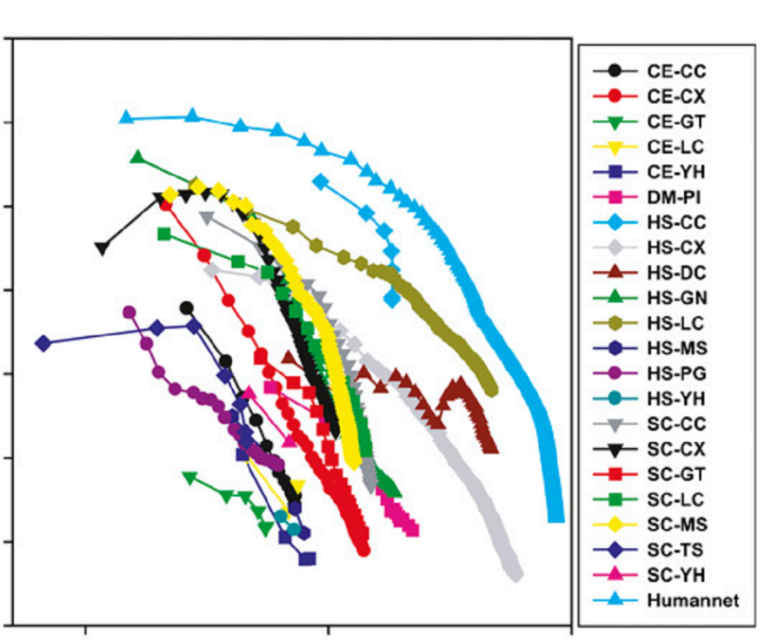
21 evidence types contribute to the HumanNet human gene network
Note: many are not human!
90
55
33
20
Likelihood ratio of participating in same biological process
12
7
4
3
1
10
100
Coverage of 18,714 human
validated protein-coding genes (%)
Lee, Blom et al., Genome Research 21:1109-21 (2011)
Edward Marcotte/Univ. of Texas/BIO337/Spring 2014

Slide 30
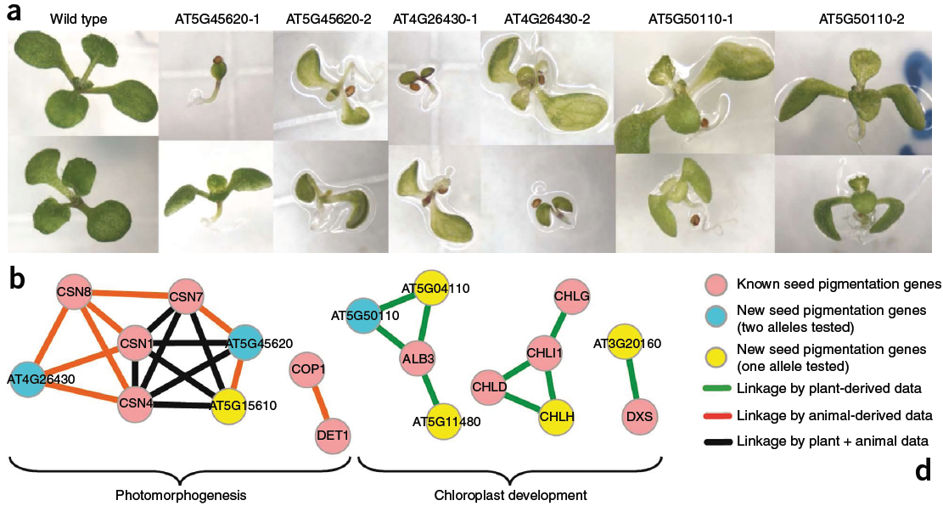
Evolutionary information is usually a key predictor– e.g., predictions for plant-specific traits often use fungal & animal data
For example, new seedling pigmentation genes…
…were predicted from both plant and animal data:
Lee, Ambaru, et al. Nature Biotech 28(2):149-156 (2010)

Slide 31
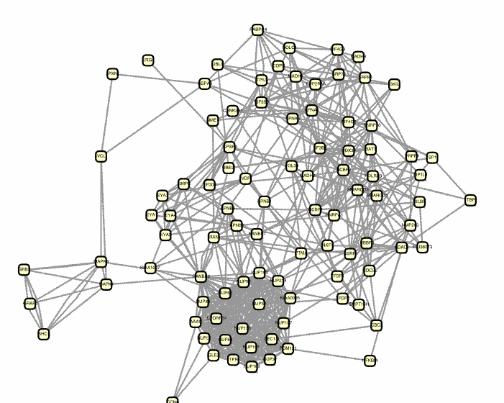
These networks are hypothesis generators.
Given a gene, what other genes does it function with?
What do they do?
Guilt-by-association
in the gene network
Genes already linked
to a disease or function
New candidate genes
for that process

Slide 32
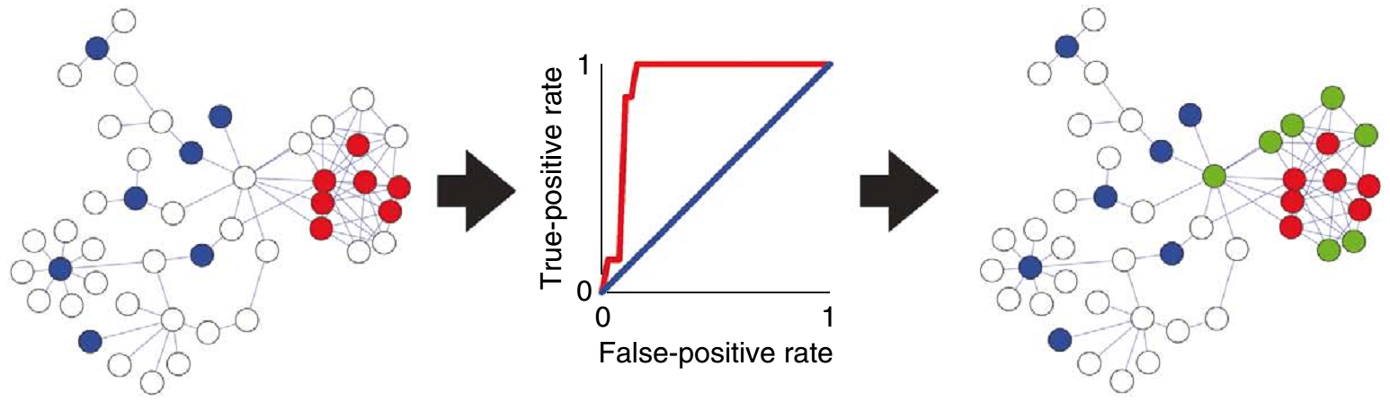
We can propagate annotations across the graph to infer new annotations for genes (network “guilt-by-association”, or GBA). Measuring how well this works on hidden, but known, functions gives us an idea how predictive it will be for new cases.
Query with genes already linked to a disease or function, e.g. the red or blue function
Assess the network’s predictive ability for that function using cross-validated ROC or recall/precision analysis
Infer new candidate genes for that process (e.g. predicting the green genes for the red function)
Lee, Ambaru et al. Nature Biotechnology 28:149-156 (2010)
Edward Marcotte/Univ. of Texas/BIO337/Spring 2014

Slide 33
Calculating ROC curves
Actual
P
N
Basic idea: sort predictions from best to worst, plot TPR vs. FPR as you traverse the ranked list
True
Positive
False
Positive
P’
Prediction
False
Negative
True
Negative
TPR = TP / P = TP / (TP + FN)
= True Positive Rate
= Sensitivity, Recall
FPR = FP / N = FP / (FP + TN)
= False Positive Rate
= 1 - Specificity
N’
Also useful to plot Precision [ = TP / (TP + FP) ] vs. Recall ( = TPR)

Slide 34
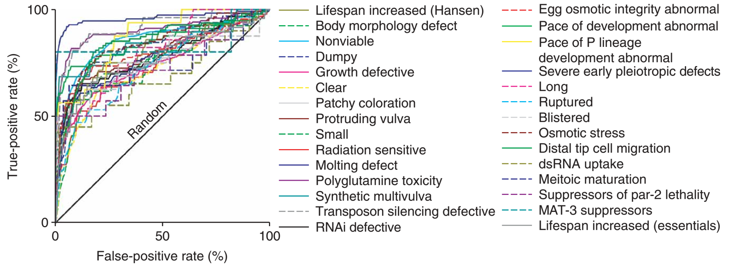
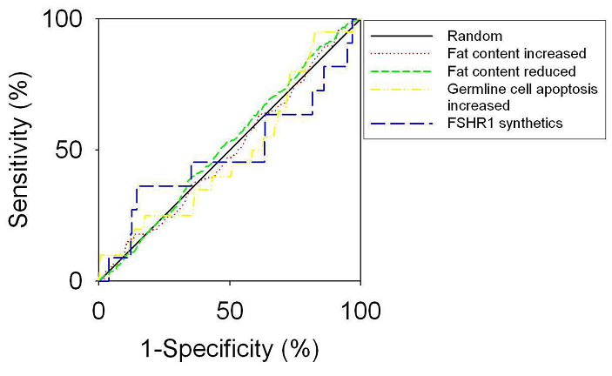
For example, predicting genes linked with worm phenotypes in genome-wide RNAi screens
ROC analysis indicates the likely predictive power of the network for a system of interest.
A poor ROC → no better
than random guessing.
Some very poorly predicted pathways:
Lee, Lehner et al., Nat Genet, 40(2):181-8 (2008)

Slide 35
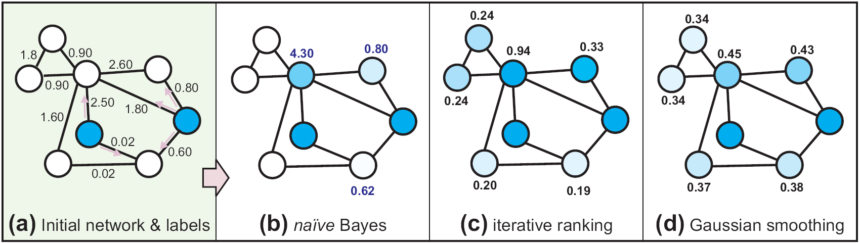
A variety of algorithms have been developed for GBA
McGary, Lee, Marcotte
Genome Biol. (2007)
Related to
Google’s PageRank
Ramakrishnan et al.
Bioinformatics (2009)
GeneMANIA
Mostafavi et al.,
Genome Biol. (2008)
The score of a gene is the sum of LLS edge weights to the query genes
The score of a gene is the combination of the initial seeds and the weighted average of scores of the protein's neighbors, defined iteratively.
Prediction strength
(Area under ROC curve)
Predicting genes for 318
C. elegans RNAi phenotypes
Wang & Marcotte, J. Proteomics (2010)

Slide 36
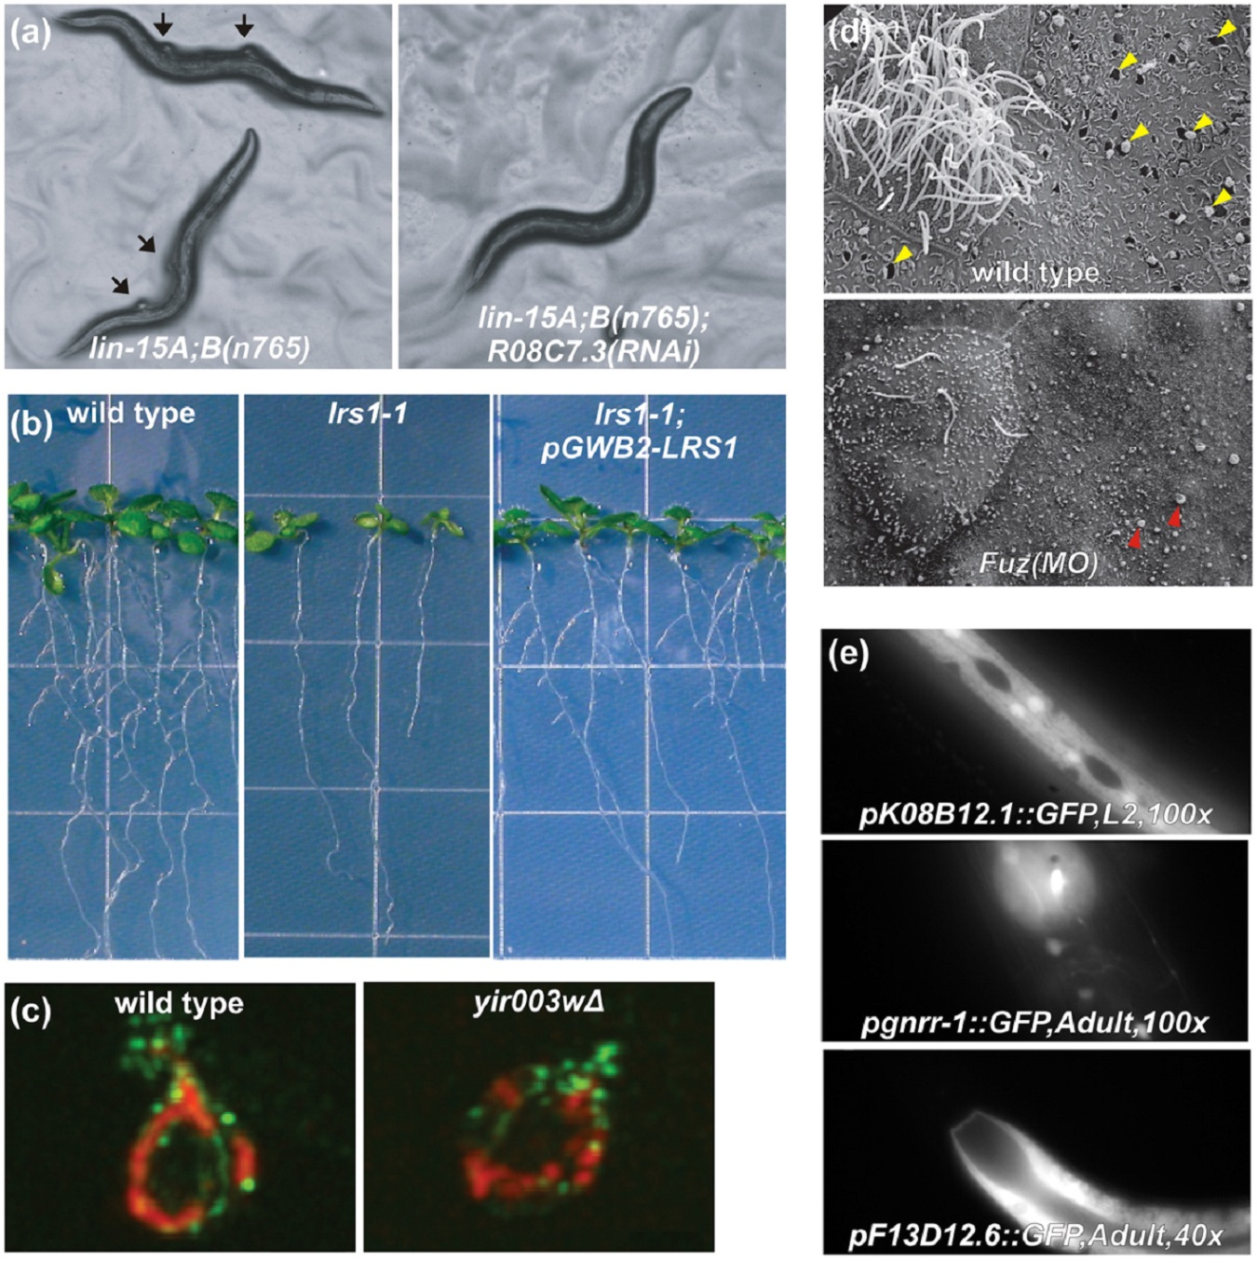
Remarkably, this strategy works quite well
Some examples of network-guided predictions:
In worms:
Genes that can reverse ‘tumors’ in a nematode model of tumorigenesis
In mice/frogs:
Functions for a
birth defect gene
Lee, Lehner et al.
Nature Genetics (2008)
Gray et al., Nature Cell Biology (2009)
In Arabidopsis:
New genes regulating root formation
Lee, Ambaru et al.
Nature Biotech (2010)
In worms:
Predicting tissue
specific gene
expression
In yeast: New mitochondrial
biogenesis genes
Chikina et al., PLoS Comp Biology (2009)
Hess et al., PLoS Genetics (2009)
Reviewed in Wang & Marcotte, J Proteomics (2010)

Slide 37
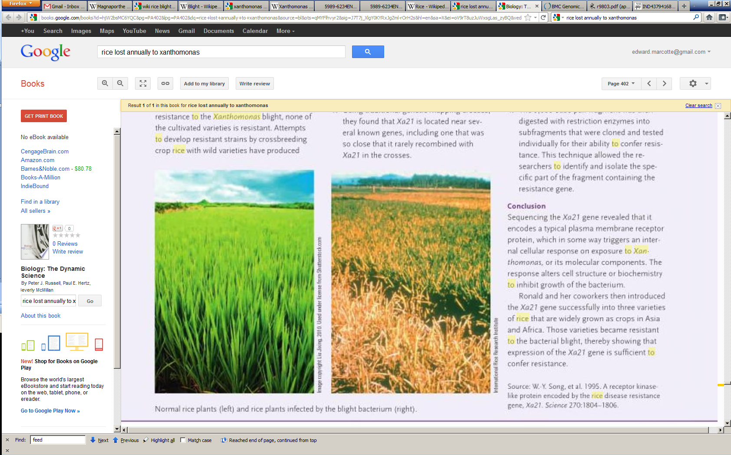
Applicable to non-model organisms:
In rice: Identifying genes regulating
resistance to Xanthomonas oryzae
infection …
A new gene promoting
resistance to rice blight
Infection with Xoo
Rice is the primary food source for >2 billion people worldwide
>500 million tons rice/year are grown
Bacterial rice blight destroys up to 10-50% / year in Africa/Asia
Normal
Infected
Source: Russell, Hertz, McMillan
Biology: The Dynamic Science
wild type
resistant
resistant +
RNAi
Lee, Seo, et al. PNAS 108:18548–18553 (2011)
Edward Marcotte/Univ. of Texas/BIO337/Spring 2014

Slide 38
Summary of the major themes
Gene networks serve as general frameworks for studying gene function
Functional gene networks can be (re)constructed based upon millions of experimental observations via integrating these data into statistical models of functional connectivity among genes
Guilt-by-association in such a network allows association of genes with functions, and genes with phenotypic traits, even highly polygenic ones
Functional gene networks have been constructed for yeast, C. elegans, Arabidopsis, rice, mice, humans, many prokaryotes, and many other organisms…

Slide 39
Live demo of
functional networks and Cytoscape

