Slide 1
Phenologs
An example of using bioinformatics to find new genes for genetic traits
BCH364C/391L Systems Biology / Bioinformatics – Spring 2015
Edward Marcotte, Univ of Texas at Austin

Slide 2
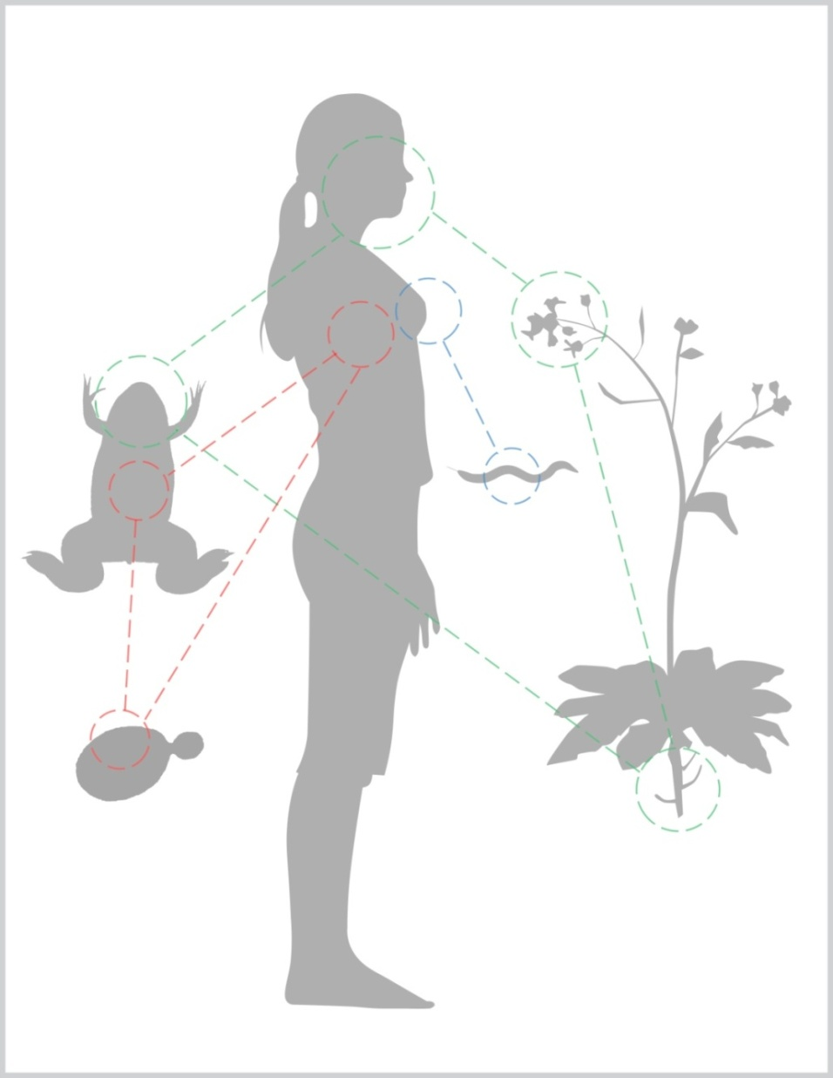
Virtually all genetic traits and diseases affect molecular structures that are evolutionarily conserved.
Consequently, human traits and diseases often have equivalents in other species, even distant ones.

Slide 3
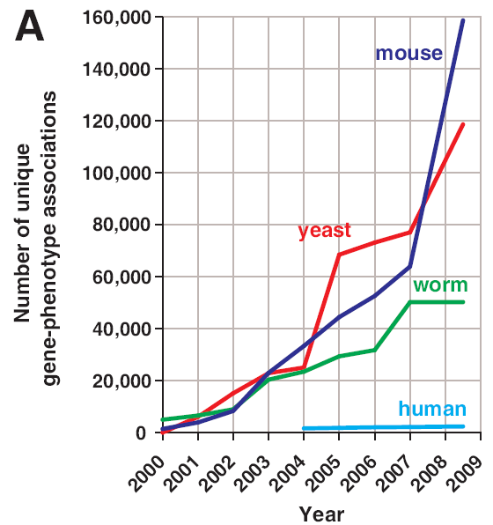
We know far more about genes & traits in lower organisms than in us.
How do deeply conserved gene networks relate to traits, structures, and diseases in different organisms?
Can these tell
us about these?
…
McGary, Park et al.
PNAS (2010)

Slide 4
Comparative evolution studies rely on finding orthologs
Orthologs = genes from different species that derive from a single gene in the last common ancestor of the species
Paralogs = genes that derive from a single gene that was duplicated within a genome

Slide 5
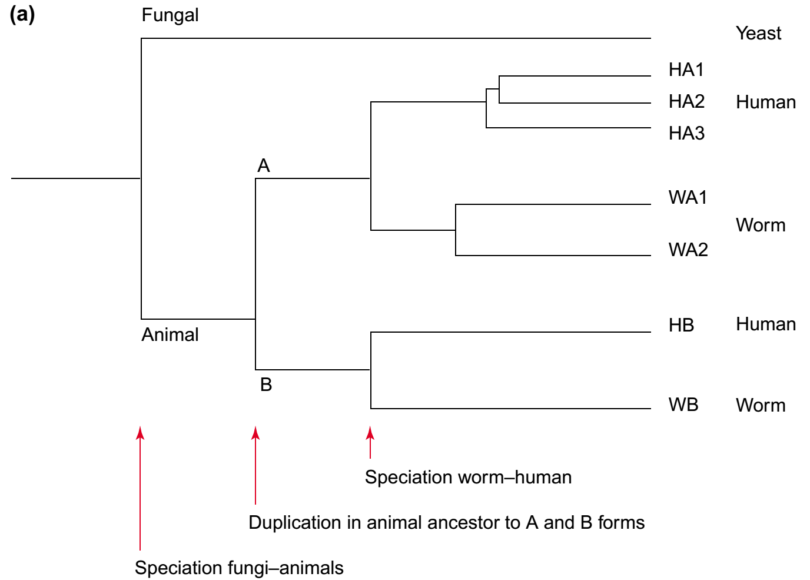
Comparative evolution studies rely on finding orthologs
Ortholog to all the rest
Paralogs
Co-
orthologs
Paralogs
Orthologs
In/out-paralogs: paralogs that evolved by gene duplication after/before the speciation event separating the lineages under consideration
Trends in Genetics 18:619–620 (2002)

Slide 6
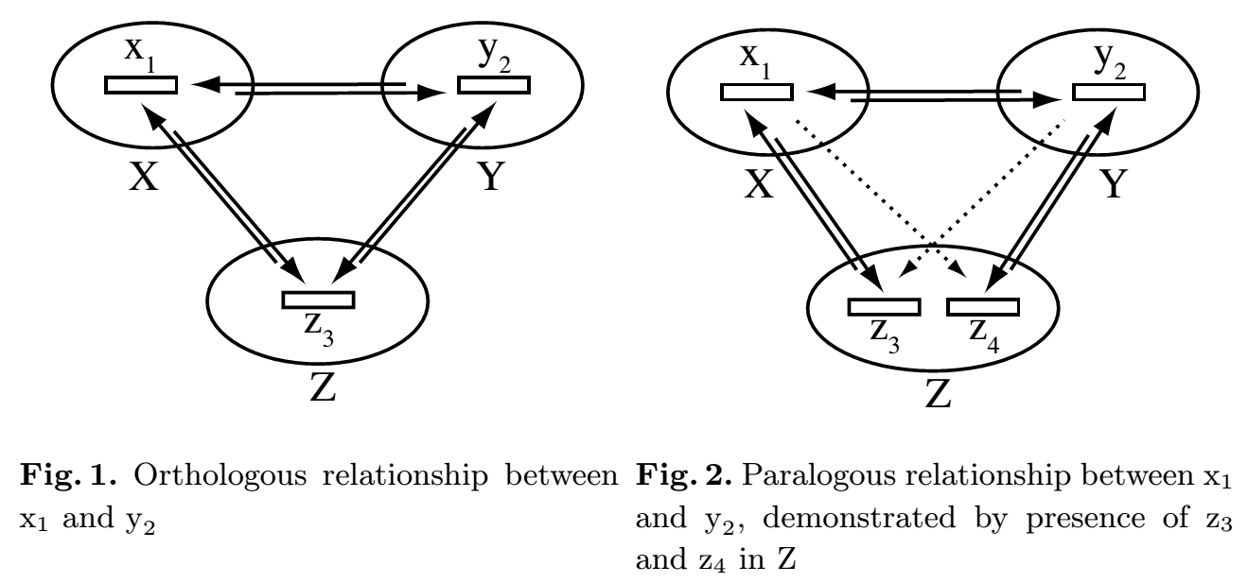
Comparative evolution studies rely on finding orthologs
OMA: http://omabrowser.org/oma/home/
InParanoid: http://inparanoid.sbc.su.se/cgi-bin/index.cgi
PhylomeDB: http://phylomedb.org/
MOSAIC: http://pythonhosted.org/bio-MOSAIC/
Bidirectional
Best Hits

Slide 7
Phenologs = significantly overlapping sets of
orthologous genes, such that each gene in a given set
gives rise to the same phenotype in that organism
(e.g., human)
(e.g., worm)
(e.g., breast cancer)
(e.g., specific worm phenotype)
McGary, Park et al. PNAS 107:6544-9 (2010)

Slide 8
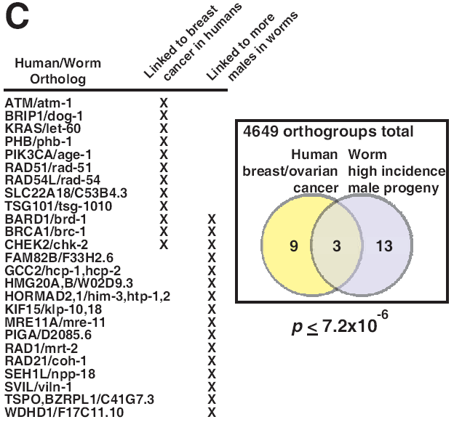
An example phenolog: a high incidence of male C. elegans
maps to human breast/ovarian cancers
includes
BRCA1
McGary, Park et al. PNAS 107:6544-9 (2010)

Slide 9
Building & searching a collection of phenotypes
Mining available databases +
manual collection from the primary literature
Organism | # gene-phenotype associations
human | 1,923
mouse | 74,250
worm | 27,065
yeast | 86,383
Arabidopsis | 22,921
Spanning ~300 human diseases,
>7,000 model organism mutational phenotypes
Computational scan phenotypes for novel models of a disease of interest,
identify significant phenologs using permutation tests
McGary, Park et al.
PNAS (2010)

Slide 10
Discovering phenologs
McGary, Park et al.
PNAS (2010)

Slide 11
There are 1,000’s of phenologs between human diseases and mouse, yeast, worm, and even plant traits
Some cases we knew about already, serving as positive controls…
For example, genes for mouse cataracts suggest genes for human cataracts...
But many cases were surprising!
A defect in... suggests genes for ...
yeast lovastatin sensitivity angiogenesis defects
worm abnormal body wall muscle cell polarization gastrointestinal hemorrhage
yeast hydroxyurea sensitivity hemolytic anemia
plant cotyledon development defects mental retardation
E. coli chemical sensitivies chemically-induced seizures
McGary, Park et al. PNAS 107:6544-9 (2010)
Woods, Blom et al. BMC Bioinformatics, 14:203 (2013)

Slide 12
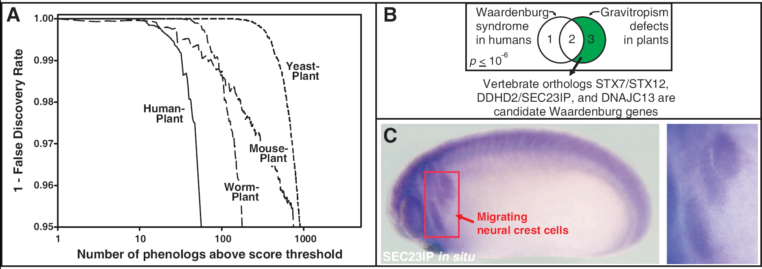
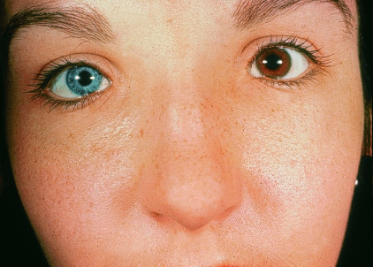
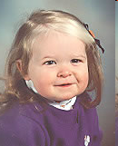

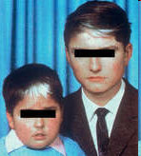
Example #2: plant negative gravitropism defects predict
Waardenburg syndrome, a congenital disease with
characteristic craniofacial, hearing, and pigmentation alterations
Michael Murphy, M.D.
~
~
Fukaki et al., The Plant Journal
14, 425–430 (1998)
Assorted websites
Waardenburg syndrome
(accounts for ~2-5% of cases of deafness)
Plants failing to grow upwards

Slide 13
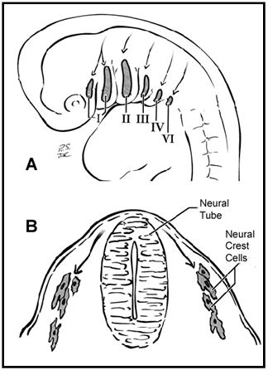
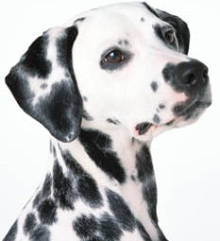
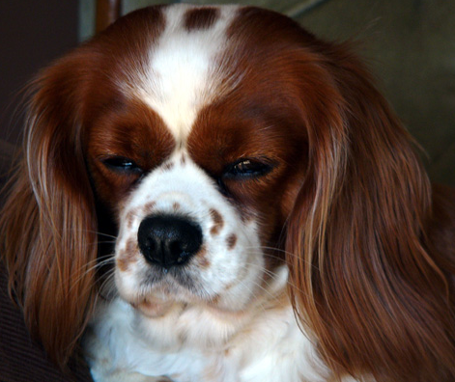
Waardenburg syndrome is a defect of neural crest cells
Neural crest cells migrate
during embryonic development
Some WS correlates in other animals:
Deafness in Dalmatian dogs (22% unilaterally deaf)
Variations in the Blenheim spot of
Cavalier King Charles Spaniels
Association between white blue-eyed cats and deafness
(noted by Darwin in 1859)
White forelock and deafness/bowel bowel blockage in foals
& many more...
www.petplanet.co.uk
www.silvarcea.co.uk
Heike & Hing, Gene Reviews (2009)

Slide 14
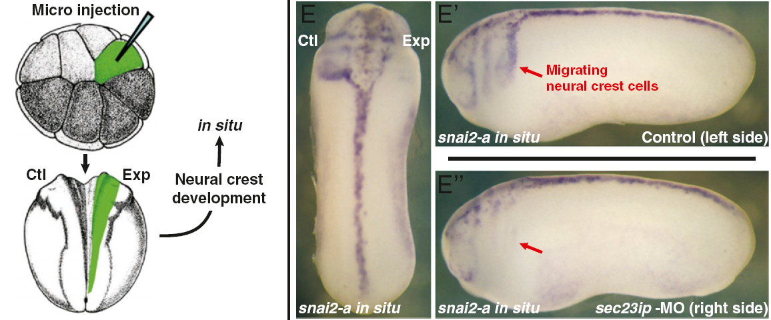
Inactivating SEC23IP—predicted from Arabidopsis—in a tadpole disrupts neural crest cells, consistent with Waardenburg syndrome
SEC23IP localizes to the
neural crest cells & induces
neural crest defects upon knockdown
McGary, Park et al. PNAS 107:6544-9 (2010)

Slide 15
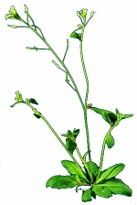
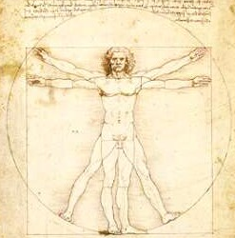
Phenologs identify evolutionarily conserved systems of proteins relevant to particular traits/diseases.
Last common
ancestor
Set of genes in LCA
Plant
Human
arabidopsis.info
Genes now
used to direct
polarized growth
in gravitropism
Orthologous
genes
Genes now
used to direct
neural crest
cell migration
McGary, Park et al.
PNAS (2010)

Slide 16
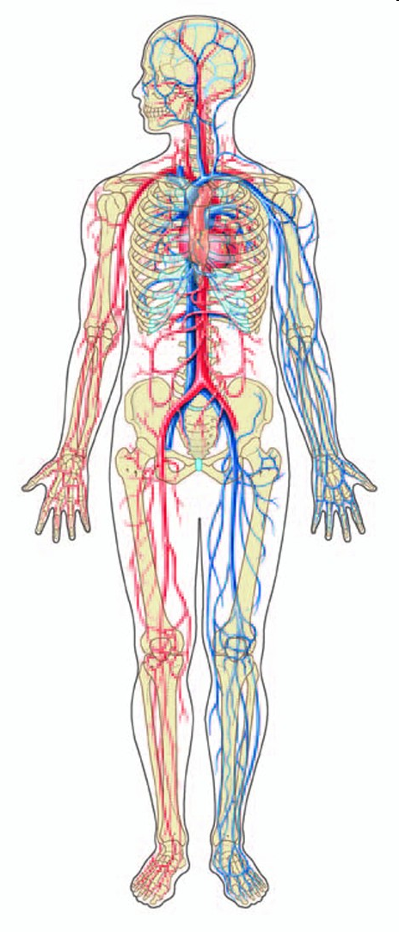
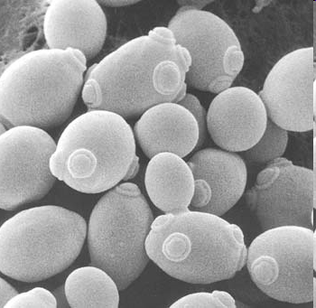
Example #3: Yeast genes linked to statin drug sensitivity predict mammalian blood vessel defects
The human versions of these yeast genes are candidate angiogenesis genes
Can these really tell us about these?
www.chemistryland.com
McGary, Park et al.
PNAS (2010)
Dorling Kindersley

Slide 17
Disrupting the SOX13 gene causes strong blood vessel defects
hemorrhaging in later stage embryos
& angiogenesis defects in cultured
human umbilical vein cells
McGary, Park et al.
PNAS (2010)

Slide 18
Last common
ancestor
Set of genes in LCA
Yeast
Human
Genes now
used to
maintain cell
walls
Orthologous
genes
Genes now
used to
form blood
vessels

Slide 19
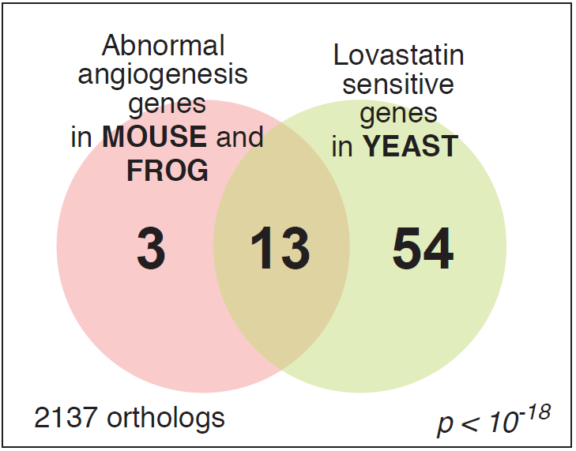
The yeast/angiogenesis gene module

Slide 20
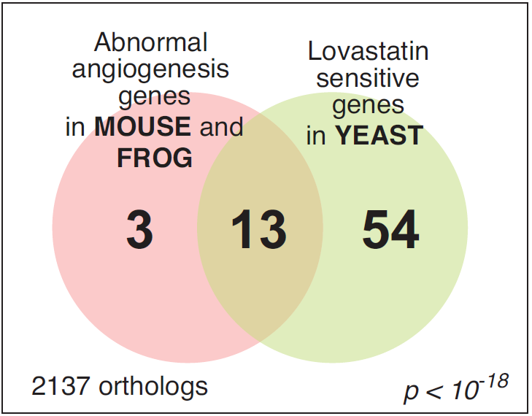
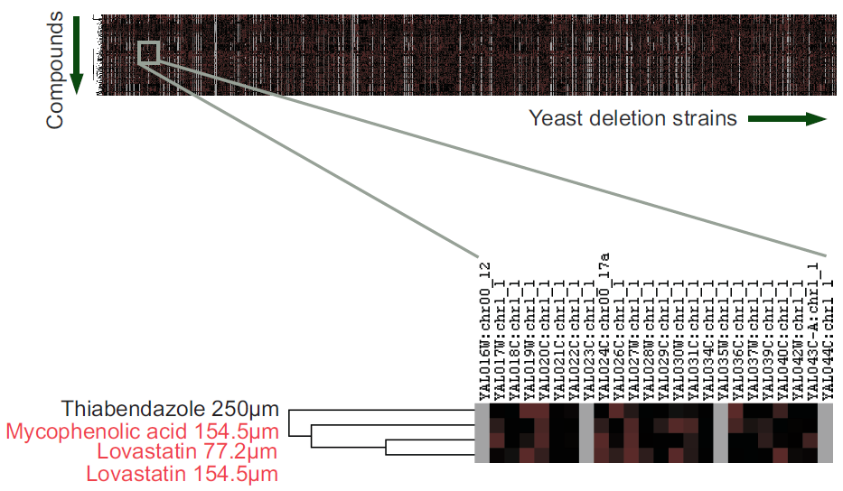
Chemicals that interact genetically with this module are candidate angiogenesis inhibitors
1144 assays from
Hillenmeyer et al.,
Science (2008)
www.chemistryland.com
Cha et al., PLoS Biology (2012)

Slide 21
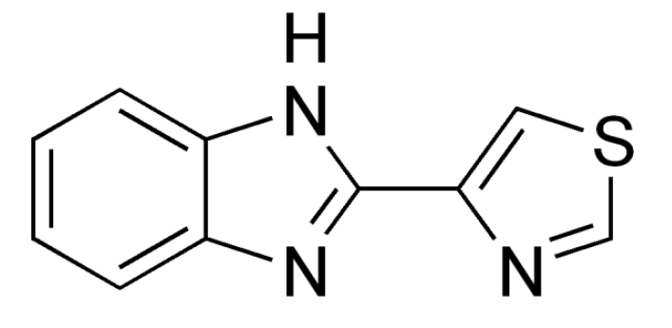
Screening for drugs that interact genetically with this yeast module led us to identify a new angiogenesis inhibitor
TBZ = thiabendazole
An FDA-approved antifungal drug with 40 years of safety data
Approved by the U.S. Food and Drug Administration in 1967
fungicide and parasiticide
No mutagenic or carcinogenic effects
2 year safety trials in animals
- Off-patent, now marketed as a generic drug

Slide 22
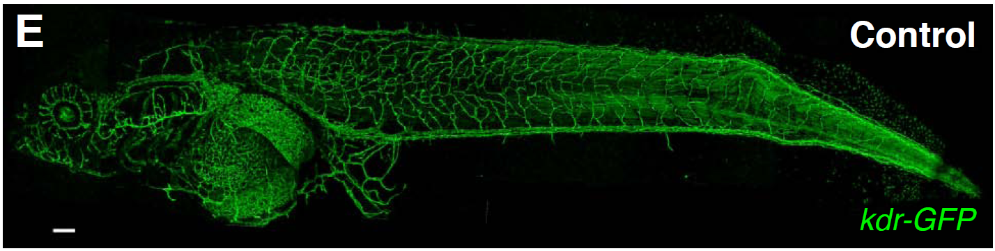
Imaging the blood vessels of a living, transgenic tadpole in a dish of water
200 μm
kdr:GFP transgenic Xenopus laevis
Image: Hye Ji Cha

Slide 23

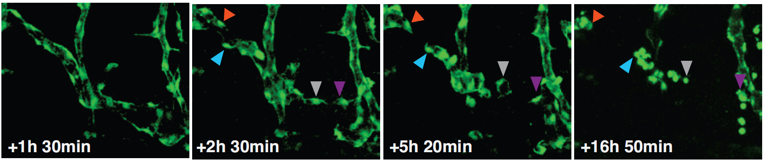
Thiabendazole disrupts vascular integrity,
causing retraction and rounding of vascular endothelial cells
Control (DMSO carrier)
+ TBZ
Cha et al., PLoS Biology (2012)

Slide 24
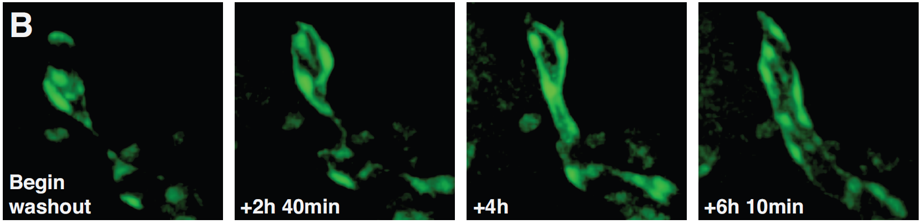
reversibly…

Slide 25
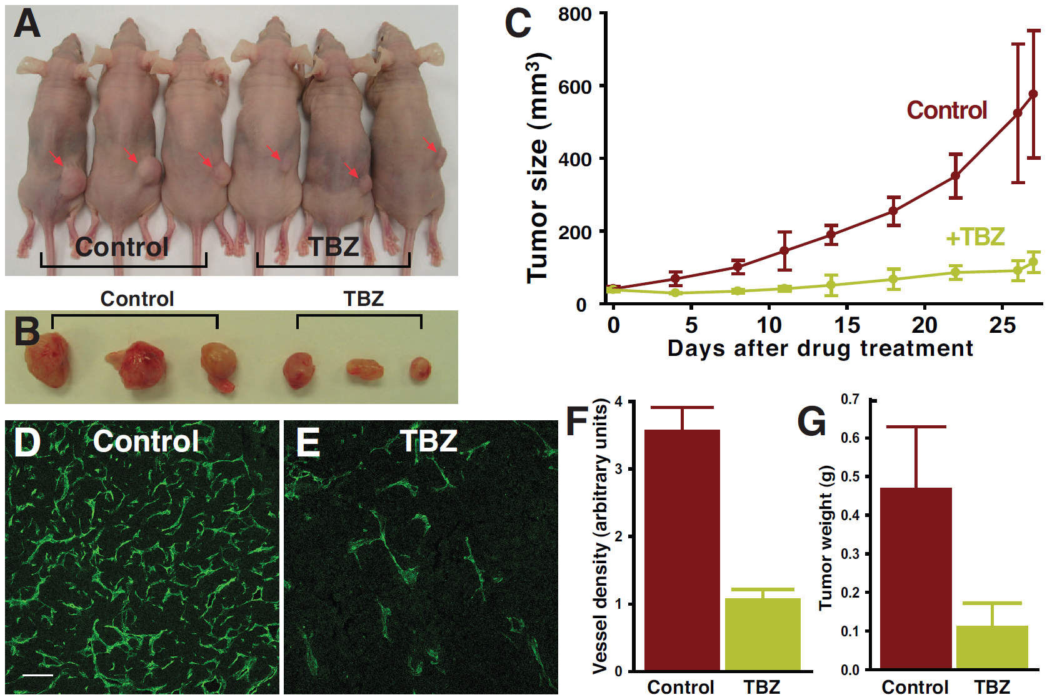
TBZ slows the growth of human fibrosarcoma tumors transplanted into immune-compromised mice
Vasculature in tumor sections
Cha et al., PLoS Biology (2012)

Slide 26
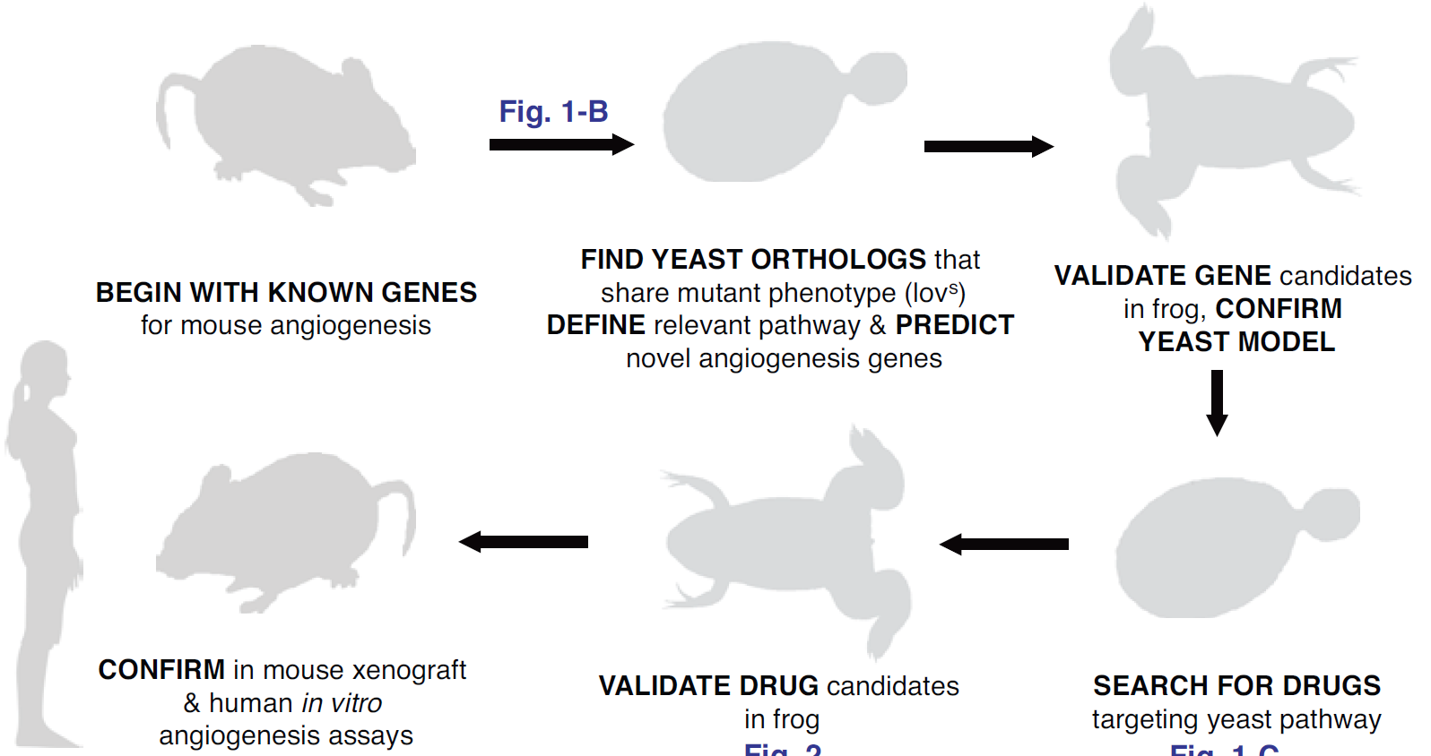
Summarizing the “road map” to a new
vascular disrupting agent
Mouse genes linked to
angiogenesis…
…suggest a relevant yeast
system. Yeast genes…
…suggest new angiogenesis
genes, confirmed in frogs,
validating the method.
…mouse tumor trials,
and human cell assays.
…confirmed in frogs…
Drug screens in yeast
suggest candidate
angiogenesis drugs…
Cha et al., PLoS Biology (2012)

