Slide 1

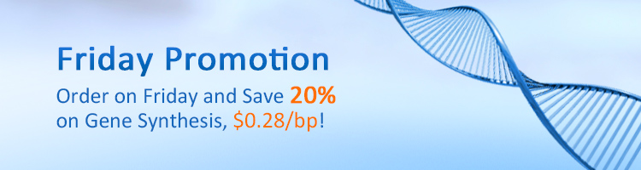
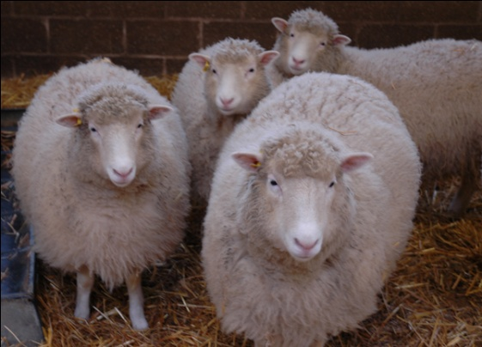
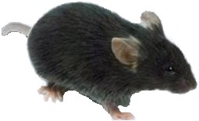
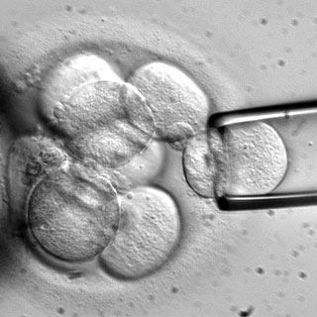
A few advances in biology are really opening up new territories, especially…
We can sequence a genome
for a few $K in a few days
We can manufacture a genome
from commodity chemicals
Cian O'Luanaigh
Amazing advances
in cloning
Robert Lanza, ACT
Stem cells!
Edward Marcotte/Univ. of Texas/BCH364C-391L/Spring 2015

Slide 2
Who needs nature?
Made-to-order, designer organisms
We can now manufacture a complete genome
from commodity chemicals
Therefore, we can program whatever changes we want,
assuming we can get it into cells…
Edward Marcotte/Univ. of Texas/BCH364C-391L/Spring 2015

Slide 3
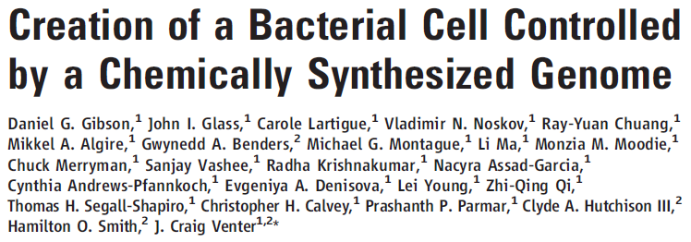
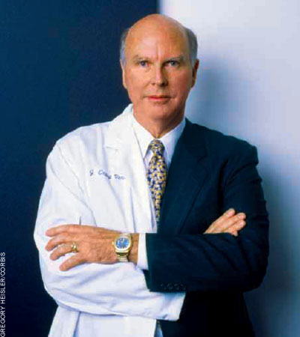
We report the design, synthesis, and assembly of the 1.08–mega–base pair Mycoplasma mycoides JCVI-syn1.0 genome starting from digitized genome sequence information and its transplantation into a M. capricolum recipient cell to create new M. mycoides cells that are controlled only by the synthetic chromosome.
http://science.docuwat.ch/
2 JULY 2010 VOL 329 SCIENCE
Edward Marcotte/Univ. of Texas/BCH364C-391L/Spring 2015

Slide 4
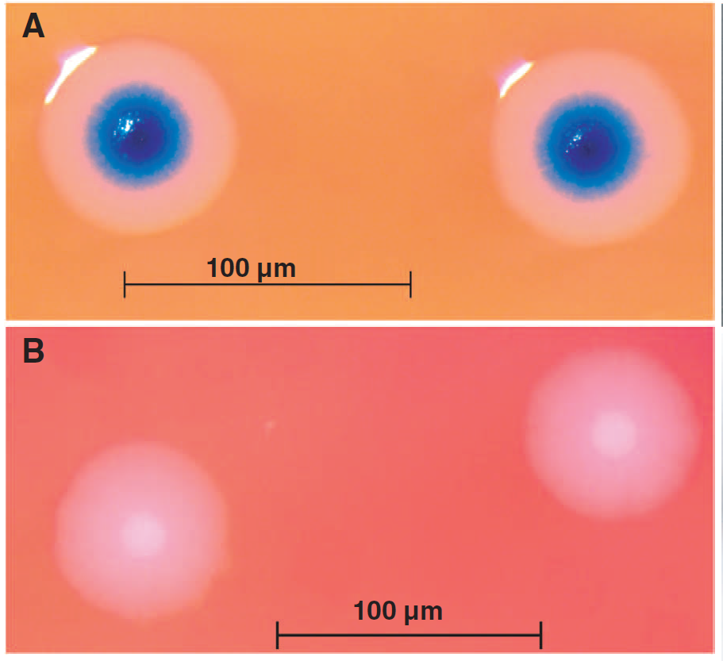
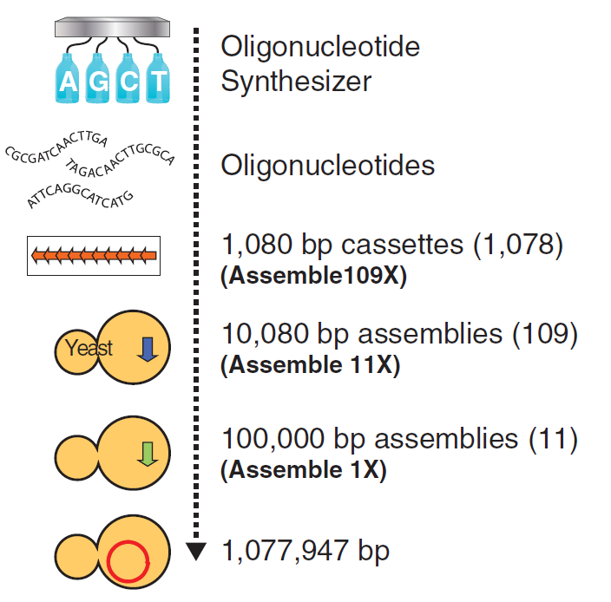
“Rebooting” bacteria with synthetic genomes
Genome transplant
2 JULY 2010 VOL 329 SCIENCE
Edward Marcotte/Univ. of Texas/BCH364C-391L/Spring 2015

Slide 5
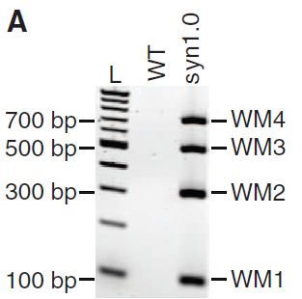
“The only DNA in the cells is the designed synthetic DNA sequence, including “watermark” sequences and other designed gene deletions and polymorphisms, and mutations acquired during the building process. The new cells have expected phenotypic properties and are capable of continuous self-replication.”
PCR of 4 engineered “watermarks”
2 JULY 2010 VOL 329 SCIENCE
Edward Marcotte/Univ. of Texas/BCH364C-391L/Spring 2015

Slide 6
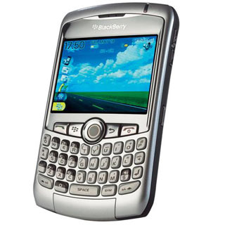
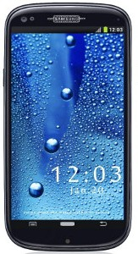
But, wait! They only changed DNA, not the rest of the cell!
However…
In biology, software encodes the hardware.
Most (all?) of the cell is specified by the DNA.
It’s as though you bought a Blackberry…
installed the Android operating system…
& your phone physically morphed
into a Galaxy S4…
Edward Marcotte/Univ. of Texas/BCH364C-391L/Spring 2015

Slide 7
Some good quotes from the paper:
“If the methods described here can be generalized, design, synthesis, assembly, and transplantation of synthetic chromosomes will no longer be a barrier to the progress of synthetic biology.”
“We expect that the cost of DNA synthesis will follow what has happened with DNA sequencing and continue to exponentially decrease. Lower synthesis costs combined with automation will enable broad applications for synthetic genomics.”
“As synthetic genomic applications expand, we anticipate that this work will continue to raise philosophical issues that have broad societal and ethical implications.”
Edward Marcotte/Univ. of Texas/BCH364C-391L/Spring 2015

Slide 8
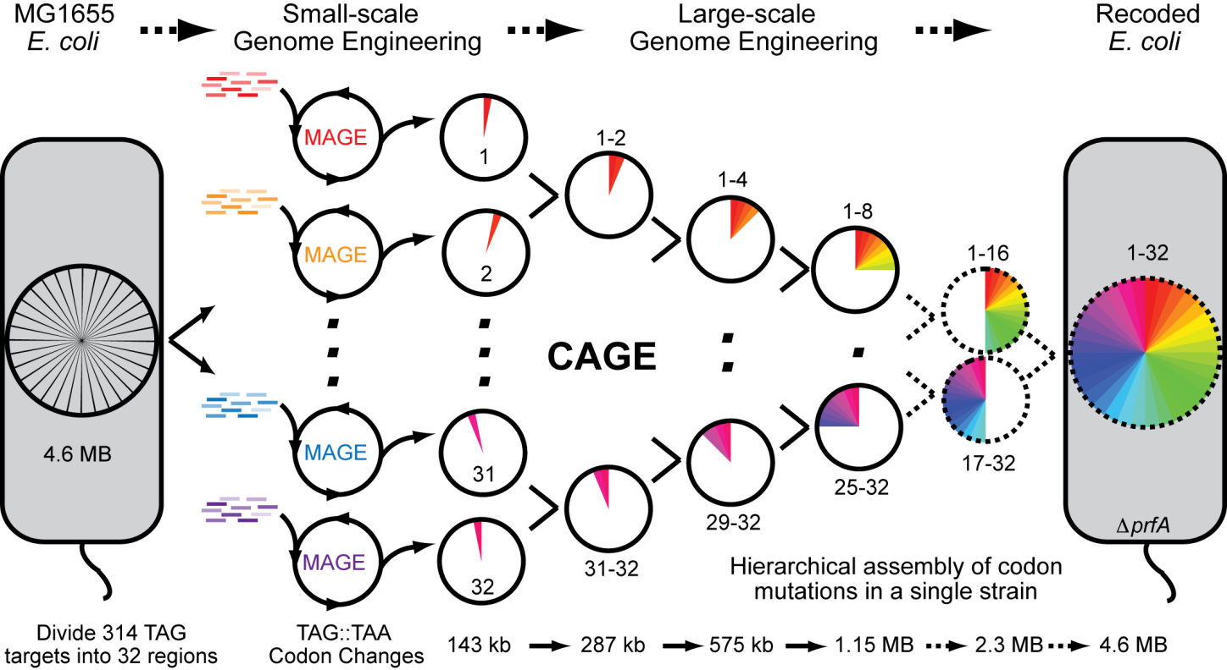
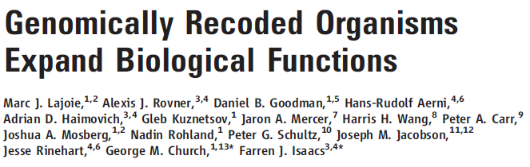
In parallel, methods were developed to edit genomes at many locations in parallel, e.g. reassigning all amber (TAG) stop codons in E. coli to ochre (TAA)
http://isaacs.commons.yale.edu/files/2012/07/rE.coli_.Fig1_.png

Slide 9
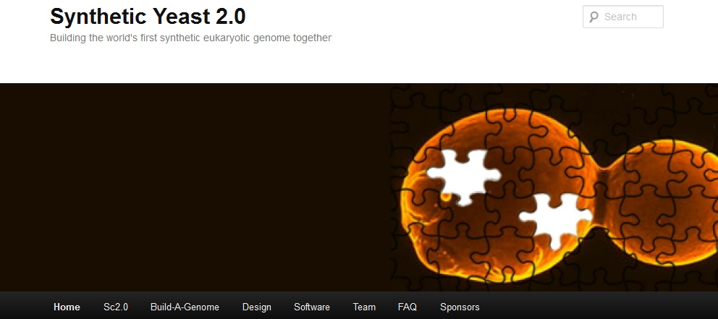
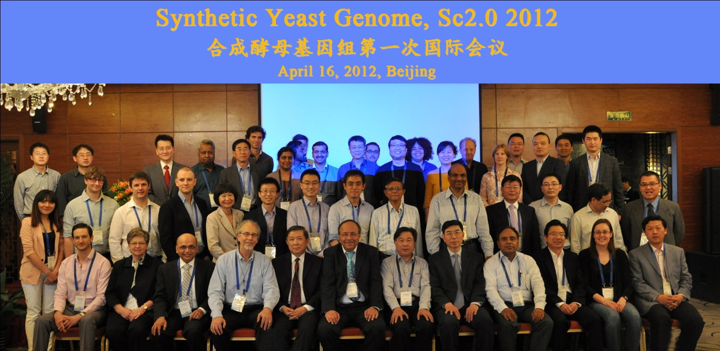
& now, “rebooting” yeast with synthetic chromosomes
Turns out chromosomes can be synthesized and replaced for yeast too…
& China is pushing for a completely synthetic yeast genome…

Slide 10
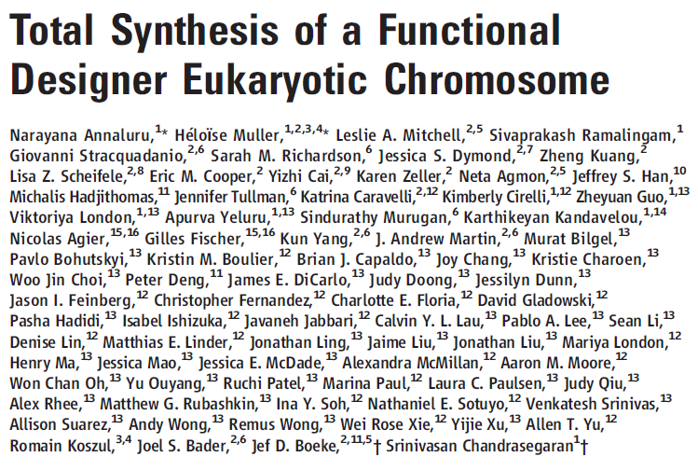
Just published! Science April 4, 2014: Vol. 344 no. 6179 pp. 55-58
“Here, we report the synthesis of a functional 272,871–base pair designer eukaryotic chromosome, synIII, which is based on the 316,617–base pair native Saccharomyces cerevisiae chromosome III. Changes to synIII include TAG/TAA stop-codon replacements, deletion of subtelomeric regions, introns, transfer RNAs, transposons, and silent mating loci as well as insertion of loxPsym sites to enable genome scrambling.”
Edward Marcotte/Univ. of Texas/BCH364C-391L/Spring 2015

Slide 11
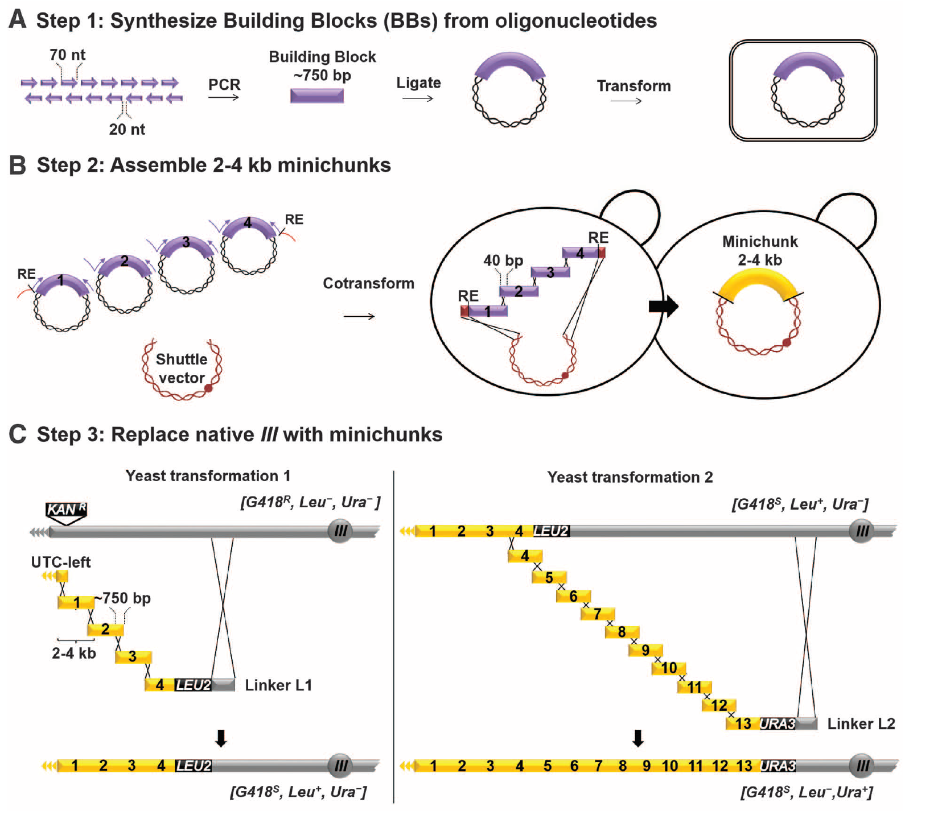
Edward Marcotte/Univ. of Texas/BCH364C-391L/Spring 2015

Slide 12
Changes engineered into chromosome III
~2.5% of sequence changed
Recoded all amber (TAG) stop codons to ochre (TAA)
Introduced 98 Cre/Lox recombination sites
Introduced unique sequences for PCR and new restriction enzyme sites
Standardized telomeres
Reduced size from 316,617 bp to 272,871 bp (~14% reduction)
Deleted 10 tRNA genes, 21 Ty elements/LTRs, silent mating loci
(only one tRNA was essential, moved to a plasmid)
Removed leucine biosynthesis gene LEU2 to be an auxotrophic marker
Deleted all introns (affected 7 genes)
Deleted subtelomeric DNA
Only 10 errors in assembly: 9 single base changes and 1 lost recombinase site
Edward Marcotte/Univ. of Texas/BCH364C-391L/Spring 2015

Slide 13
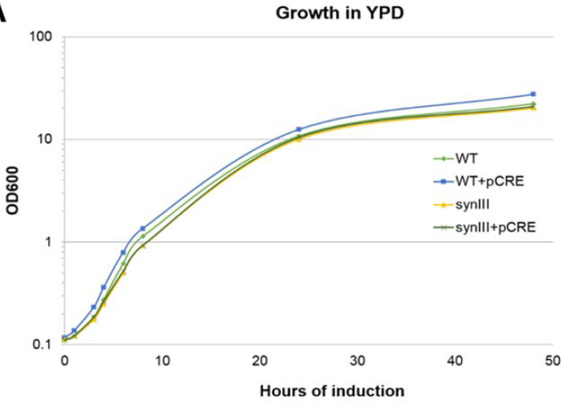
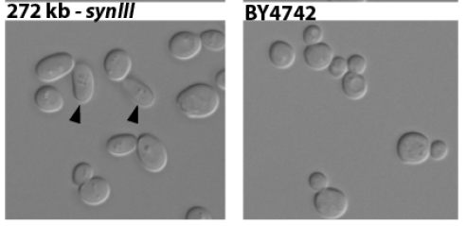
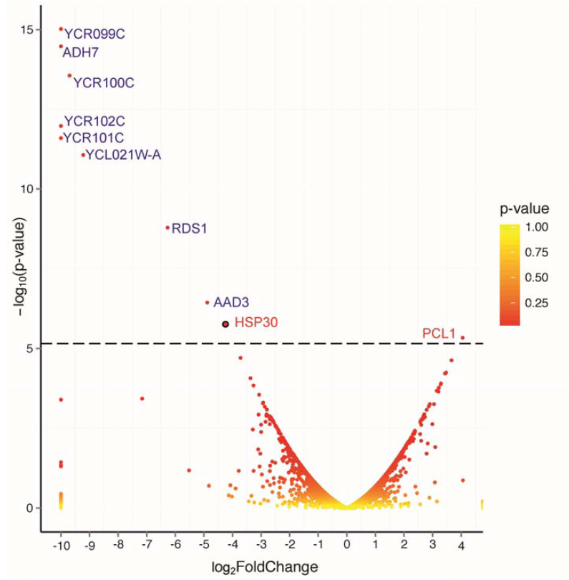
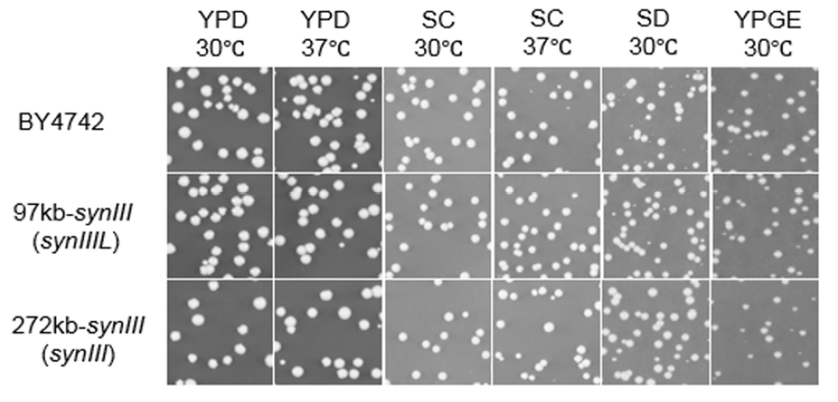
No significant fitness difference between wt and synIII strain
Only 2 genes are differentially expressed (HSP30 & PCL1)
Deleted genes
RNAseq of wt vs synIII
Edward Marcotte/Univ. of Texas/BCH364C-391L/Spring 2015

Slide 14
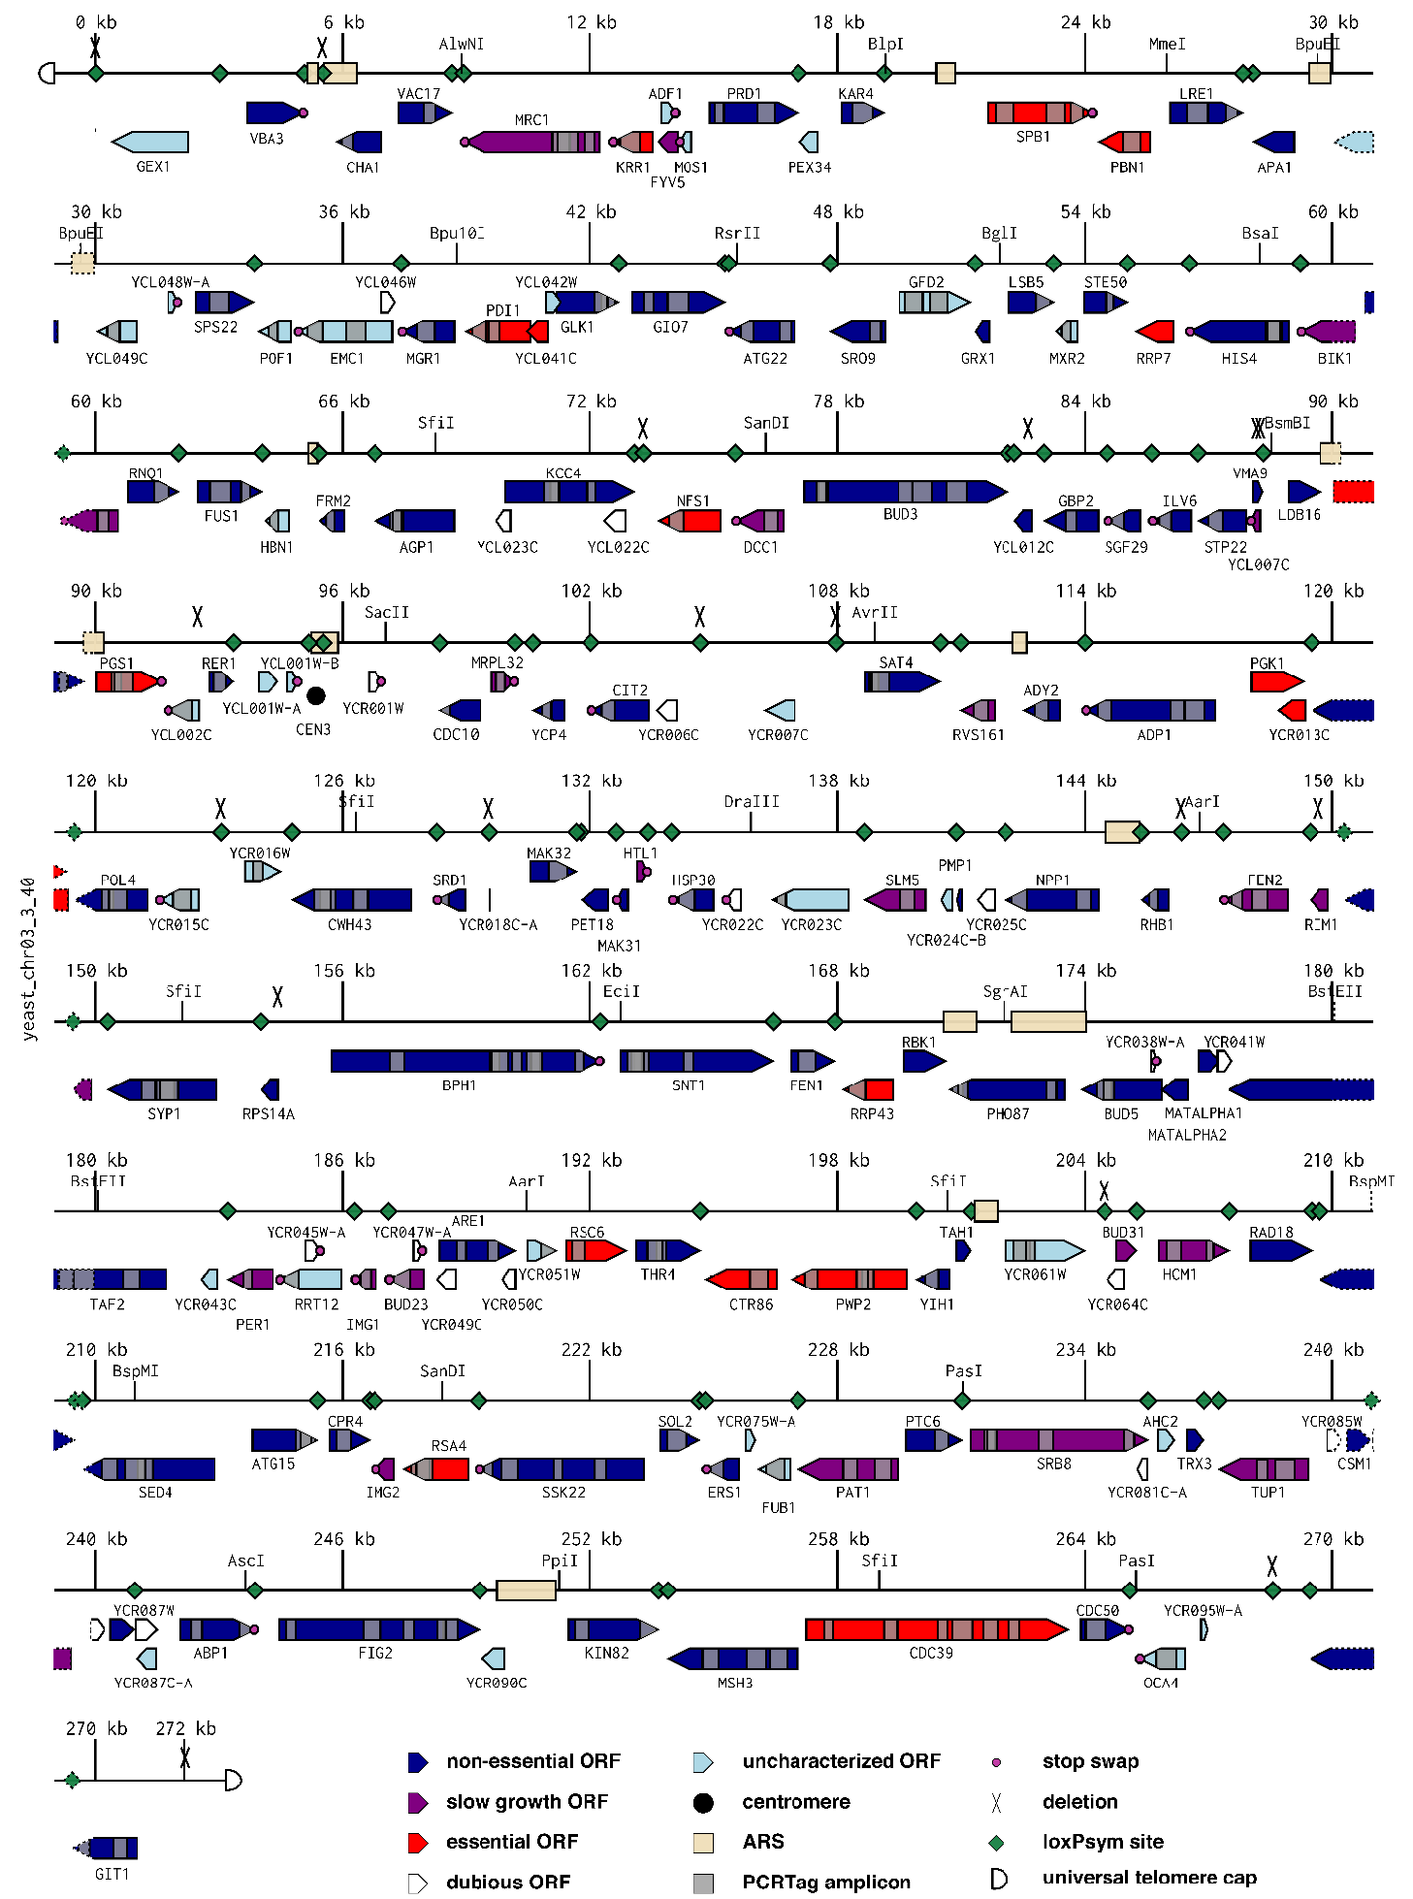
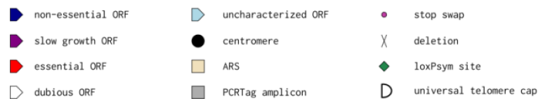
Edward Marcotte/Univ. of Texas/BCH364C-391L/Spring 2015

Slide 15

Let’s end the lectures on a fun note, with some speculative near-future synthetic biology experiments
Science fiction? or not?
You be the judge!
Edward Marcotte/Univ. of Texas/BCH364C-391L/Spring 2015

Slide 16
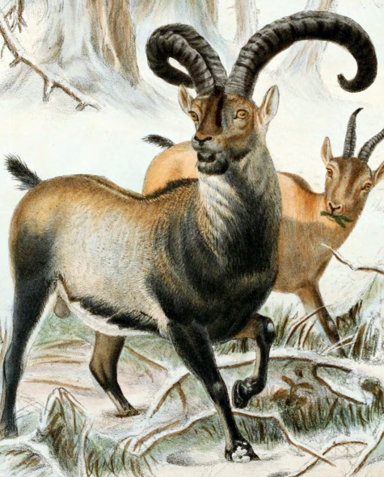
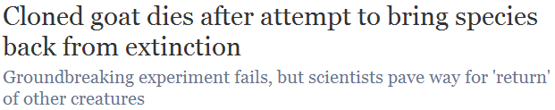
“De-extincting” extinct species
What if the cells being cloned came
from an extinct animal and were put into a surrogate mother?
Would that resurrect the species?
Cian O'Luanaigh
Remember Dolly,
the cloned sheep?
This was tried in 2009 for the Pyrenean ibex, and almost worked…
wikipedia
Edward Marcotte/Univ. of Texas/BCH364C-391L/Spring 2015

Slide 17
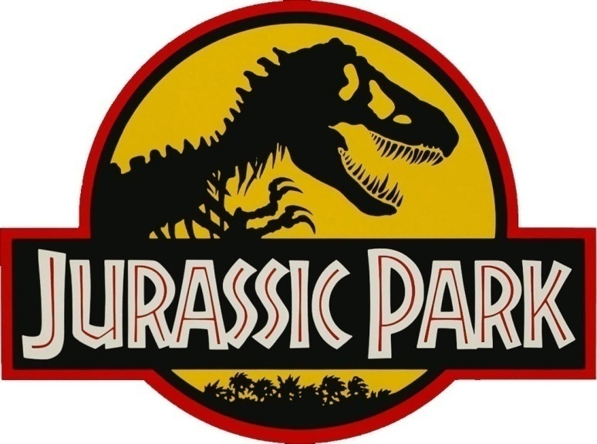
But now there’s another way!
  We can sequence a genome in a few days for a few $K
  We can synthesize or alter big pieces of the DNA
  We can (almost) “reboot” cells with this DNA
  We can convert cells to stem cells to embryos
  We can in vitro fertilize animals
So why not just “edit” the genomes of the closest living animals to be like their extinct relatives?
Sound familiar?
Edward Marcotte/Univ. of Texas/BCH364C-391L/Spring 2015

Slide 18
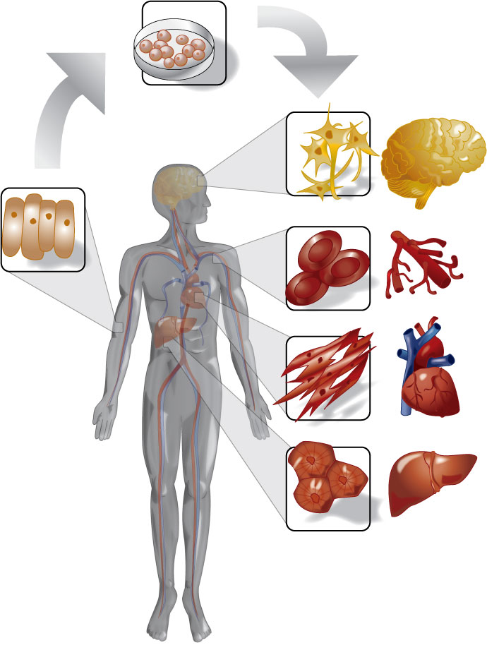
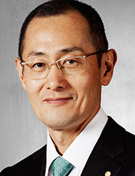
Besides the genome engineering, this hinges on iPS:
From embryonic stem cells, we can grow an entire organism
or any cells/tissues in it
Robert Lanza, ACT
& thanks to Yamanaka, we can convert skin cells back into stem cells
Shinya Yamanaka
Nobel Prize, 2012
Edward Marcotte/Univ. of Texas/BCH364C-391L/Spring 2015
www.regenexx.com

Slide 19
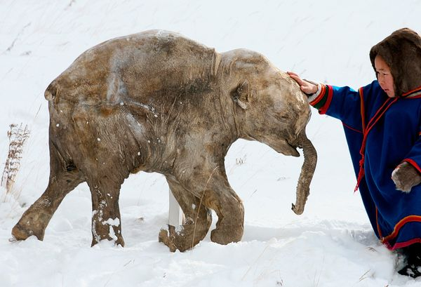
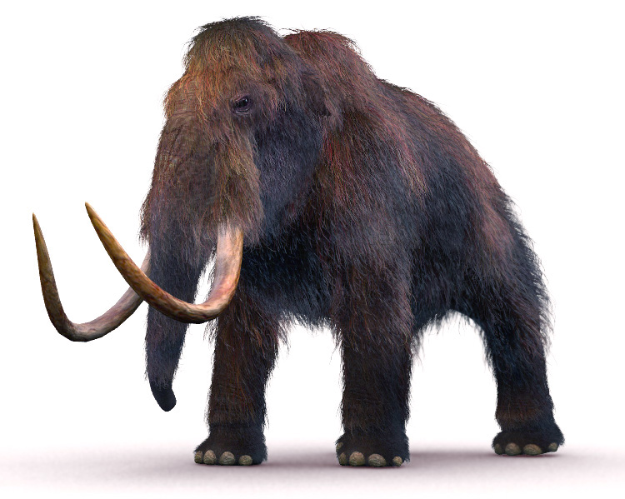
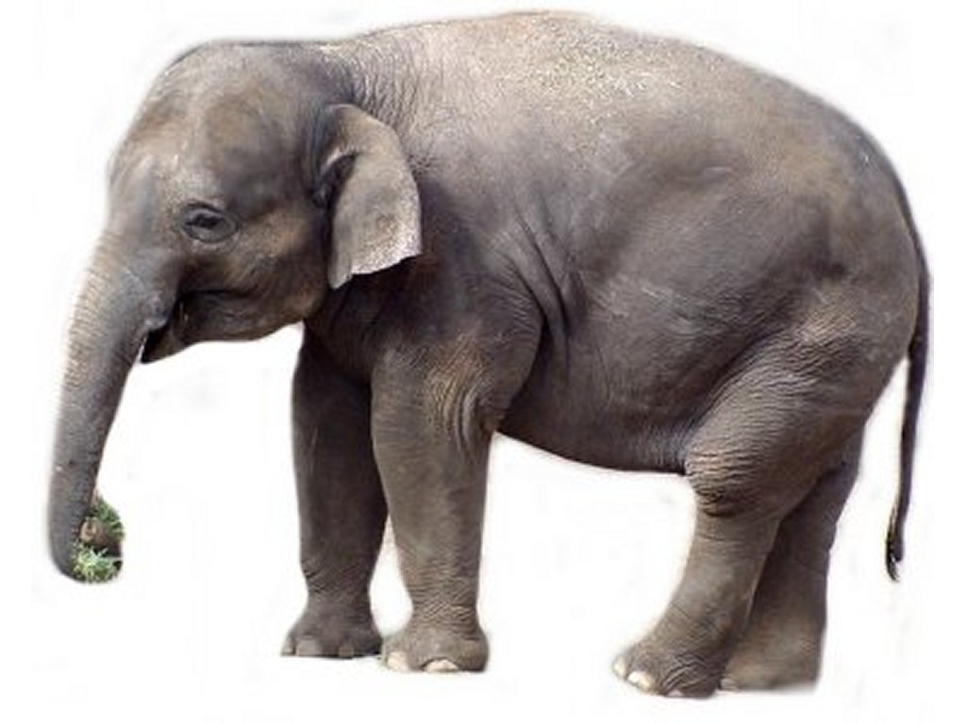
There’s a serious proposal to resurrect the woolly mammoth. Here’s the process:
  Mammoth genome sequence
  Make ~100K DNA changes in elephant skin cells to convert elephant skin cells→ mammoth skin cells
  Convert skin cells to stem cells
  Convert stem cells to embryos
  In vitro fertilize elephants
This might be a
hard step.
Actual frozen mammoth!
nationalgeographic.com
Edward Marcotte/Univ. of Texas/BCH364C-391L/Spring 2015
www.interestingtopics.net

Slide 20
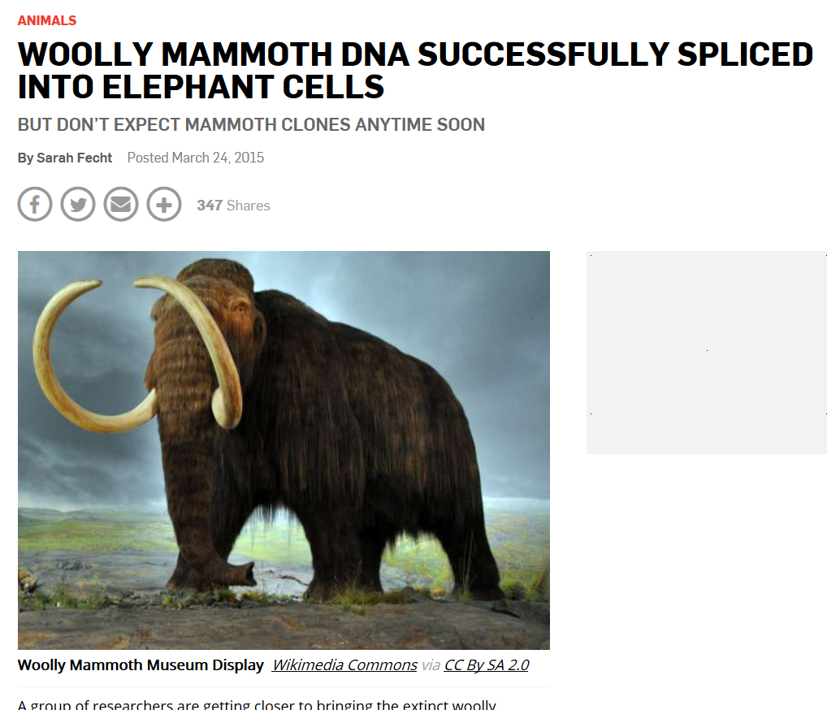
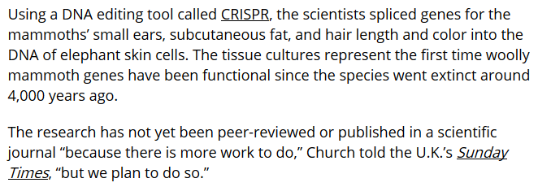
As of April 2015…
http://www.popsci.com/woolly-mammoth-dna-brought-life-elephant-cells

Slide 21
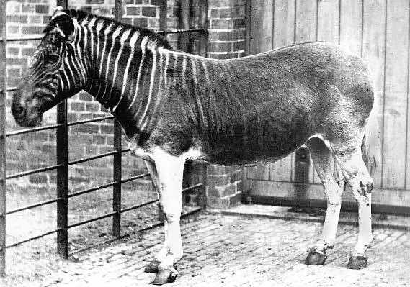
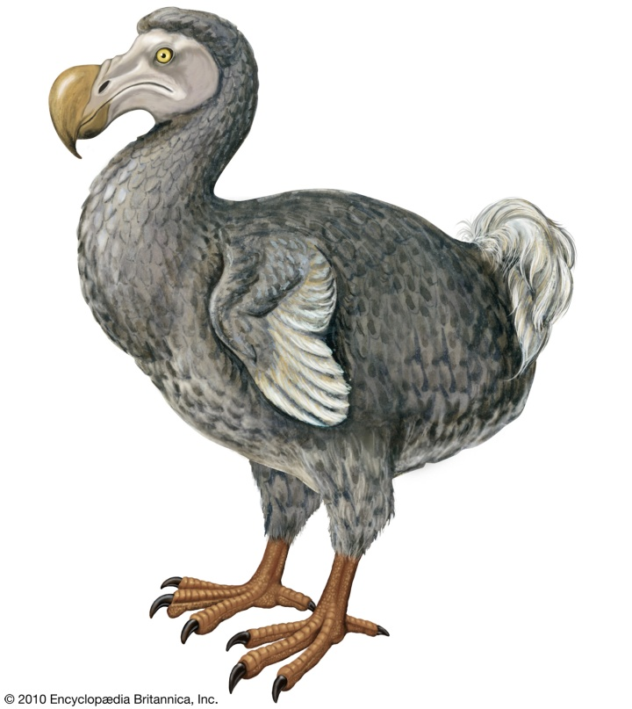
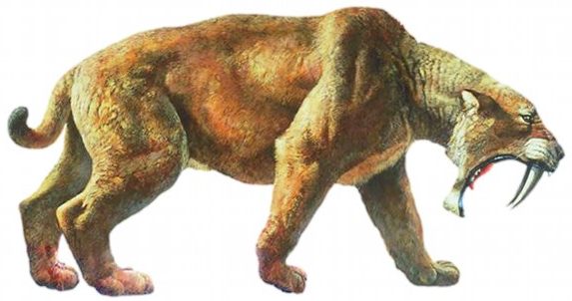
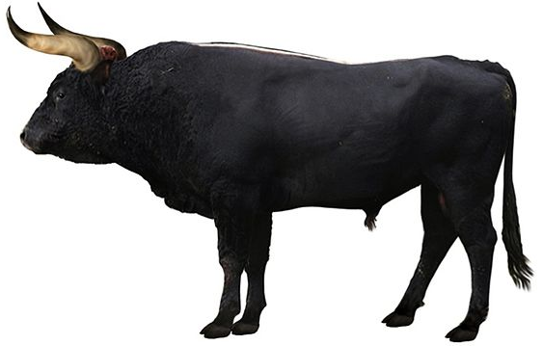
Which animal would you resurrect?
The dodo?
The quagga?
wikipedia
Saber-toothed tiger?
techandle.com
In principle, only need the DNA sequence (so, no dinosaurs)
Aurochs?
Edward Marcotte/Univ. of Texas/BCH364C-391L/Spring 2015
wiki

Slide 22
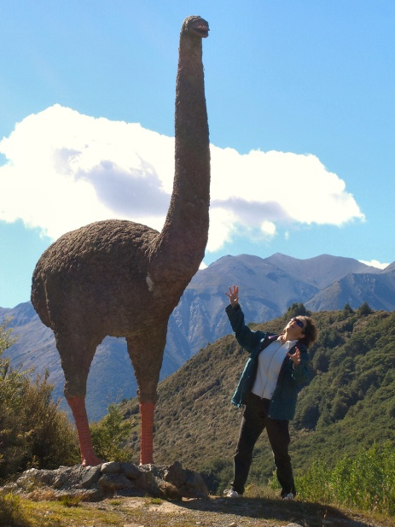
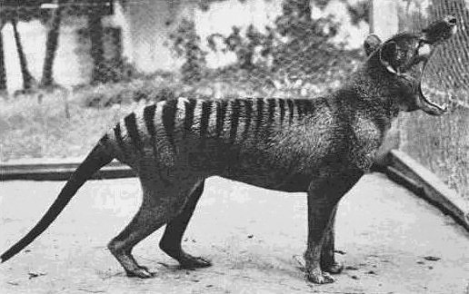

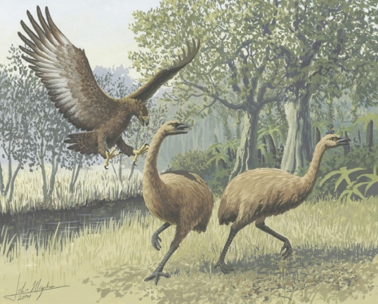
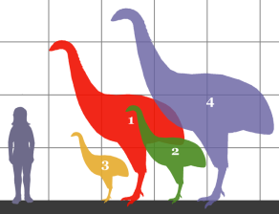

I vote for some crazy Australasian animals:
The 12’
tall
moa
& of, course, the marsupial Tasmanian tiger
>90° !!!
http://www.sandianet.com/kiwi/moabarb.jpg
The moa-eating
Haast’s eagle
wikipedia
Actual
scale!
wikipedia
wikipedia
Edward Marcotte/Univ. of Texas/BCH364C-391L/Spring 2015

Slide 23
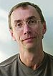
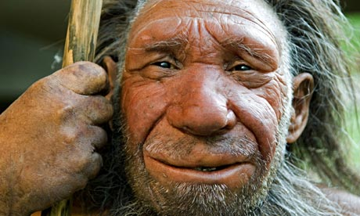
What about neanderthal?
Should we do it?
  Human and neanderthal genome sequence
  Edit DNA in human skin cells to convert convert human skin cells→ neanderthal skin cells
  → I give this step 10 years max before we can do this
  Convert skin cells to stem cells
  Convert stem cells to embryos
  In vitro fertilize
  a surrogate mother
Svante
Pääbo
Edward Marcotte/Univ. of Texas/BCH364C-391L/Spring 2015
Action Press/Rex Features

