Slide 1
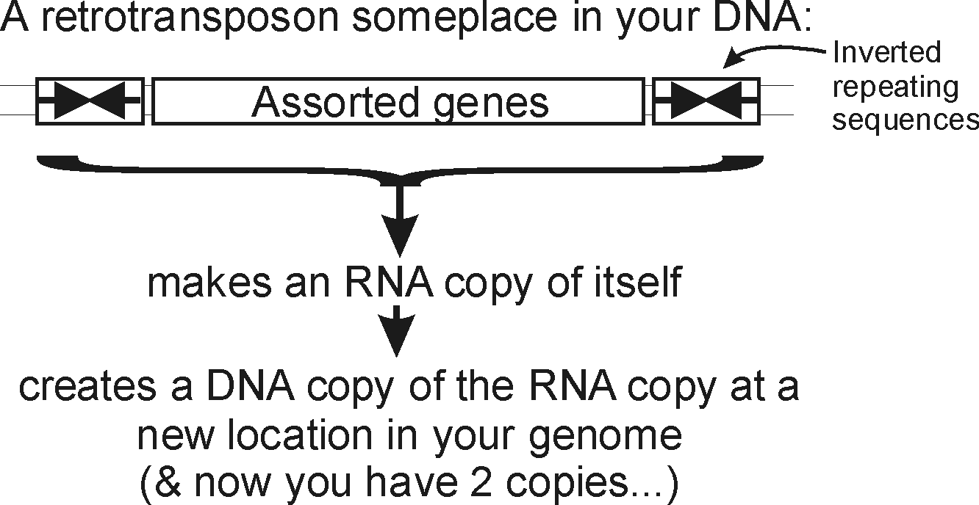
You and your (DNA) parasites
Events like these, happening over and over again, have led to…

Slide 2
You and your (DNA) parasites
Major types of repeats in the human genome
Fraction of
genome
Length
Copies
LINEs
Autonomous
ORF1 ORF2 (pol)
AAA
6-8 kb
850,000
21%
Non-autonomous
A B
100-300 bp
1,500,000
13%
SINEs
AAA
Retrovirus-like
elements
Autonomous
gag pol (env)
6-11 kb
450,000
8%
Non-autonomous
(gag)
1.5-3 kb
DNA
transposon
fossils
Autonomous
transposase
2-3 kb
300,000
3%
Non-autonomous
80-3,000 bp
~45%
Bottom line: Roughly half of your (and my) genome is the fossil wreckage of genomic parasites.
We know this (in part) from sequence alignments.

Slide 3
So far, we’ve talked about
DNA, RNA and protein sequences
How to compare sequences to decide if they are related
Having databases full of sequences and comparing them rapidly (BLAST)
In fact, many such databases exist, so today we’ll start with a brief tour of some of the biological data on the web.

Slide 4
Database | Records | Address
BioGRID | 1.6 M protein interactions | https://thebiogrid.org
EcoCyc/MetaCyc | >2,600 pathways | http://www.ecocyc.org, http://www.metacyc.org
Ensembl | Major repository of DNA sequences, genomes, genes, proteins, and transcripts | http://useast.ensembl.org/index.html
Entrez Genome | Thousands of genome sequences | http://www.ncbi.nlm.nih.gov/genome?db=genome
Genbank | >285 billion bases sequenced; > 3 trillion bases as whole genome shotgun data | https://www.ncbi.nlm.nih.gov/genbank/
Gene Expression Omnibus (GEO) | >2.8M mRNA or protein expression data sets | http://www.ncbi.nlm.nih.gov/geo/
Genomes Online Database (GOLD) | >150K genome sequences, many in progress | https://gold.jgi.doe.gov/index
Human Protein Atlas | millions of high-res images of ~17K human proteins across tissues, cancers, & cell lines | http://www.proteinatlas.org/
KEGG | Most known pathways, in 530 graphical diagrams and >6K organisms (via homology) | http://www.genome.ad.jp/kegg/
Medline | >29 million references | https://www.ncbi.nlm.nih.gov/PubMed/
Mouse Genome Informatics | ~20,000 mouse genes, diverse associated data & annotations | http://www.informatics.jax.org/
Online Mendelian Inheritance in Man (OMIM) | Compendium of human genes and genetic phenotypes, data for >16,000 human genes | https://www.ncbi.nlm.nih.gov/omim/
Pride | > 342 million peptide mass spectra from 27K experiments | https://www.ebi.ac.uk/pride/archive/
Reactome | >2K pathways involving >10K human proteins, also other organisms | https://www.reactome.org/
SGD | ~6,000 yeast genes, diverse associated data & annotations | https://www.yeastgenome.org/
UniProtKB/SWISS-PROT | >500K hand-curated sequence entries from >9K organisms | https://www.uniprot.org/
Just some of the resources available for bioinformatics
Think of these as the raw data for new discoveries

Slide 5
Biogrid has 1.6 M protein-protein interactions (https://thebiogrid.org/)
Database | Records | Address
BioGRID | 1.6 M protein interactions | https://thebiogrid.org
EcoCyc/MetaCyc | >2,600 pathways | http://www.ecocyc.org, http://www.metacyc.org
Ensembl | Major repository of DNA sequences, genomes, genes, proteins, and transcripts | http://useast.ensembl.org/index.html
Entrez Genome | Thousands of genome sequences | http://www.ncbi.nlm.nih.gov/genome?db=genome
Genbank | >285 billion bases sequenced; > 3 trillion bases as whole genome shotgun data | https://www.ncbi.nlm.nih.gov/genbank/
Gene Expression Omnibus (GEO) | >2.8M mRNA or protein expression data sets | http://www.ncbi.nlm.nih.gov/geo/
Genomes Online Database (GOLD) | >150K genome sequences, many in progress | https://gold.jgi.doe.gov/index
Human Protein Atlas | millions of high-res images of ~17K human proteins across tissues, cancers, & cell lines | http://www.proteinatlas.org/
KEGG | Most known pathways, in 530 graphical diagrams and >6K organisms (via homology) | http://www.genome.ad.jp/kegg/
Medline | >29 million references | https://www.ncbi.nlm.nih.gov/PubMed/
Mouse Genome Informatics | ~20,000 mouse genes, diverse associated data & annotations | http://www.informatics.jax.org/
Online Mendelian Inheritance in Man (OMIM) | Compendium of human genes and genetic phenotypes, data for >16,000 human genes | https://www.ncbi.nlm.nih.gov/omim/
Pride | > 342 million peptide mass spectra from 27K experiments | https://www.ebi.ac.uk/pride/archive/
Reactome | >2K pathways involving >10K human proteins, also other organisms | https://www.reactome.org/
SGD | ~6,000 yeast genes, diverse associated data & annotations | https://www.yeastgenome.org/
UniProtKB/SWISS-PROT | >500K hand-curated sequence entries from >9K organisms | https://www.uniprot.org/
Just some of the resources available for bioinformatics
Think of these as the raw data for new discoveries
GEO has millions of experiments, each measuring 1000’s of mRNA or protein abundances
Medline has >29 million research articles, many with complete text online
OMIM = the most important resource for human genetic disease
Uniprot = a frequent
first step to learn about genes

Slide 6
Live demo OMIM,
Reactome,
Human Protein Atlas

Slide 7
It’s nice to know that all of this exists, but ideally, you’d like to be able to so something constructive with the data.
That means getting the data inside your own programs.
All of these databases let you download data in big batches, but this isn’t always the case, so….

Slide 8
Let’s empower your Python scripts to grab data from the web.
We’ll use Python library/module = an optional, specialized set of Python methods
This particular Python module is called urllib2.
urllib2 is:
A collection of programs/tools to let you to surf the web from inside your programs.
Much more powerful than the simple tasks we’ll do with it.
More details: http://docs.python.org/2/library/urllib2.html

Slide 9
The basic idea:
We first set up a “request” by opening a connection to the URL.
We then save the response in a variable and print it.
If it can’t connect to the site, it’ll print out a helpful error message instead of the page.
You can more or less use the commands in a cookbook fashion….

Slide 10
For example:
import urllib2 # include the urllib2 module
url = "http://www.marcottelab.org/index.php/BCH394P_BCH364C_2019"
try: # this 'try' statement tells Python that we might expect an error.
request = urllib2.urlopen(url) # setup a request
page = request.read() # save the response
print page # show the result to the user
except urllib2.HTTPError: # handle a page not found error
print "Could not find page."
→ Run this…

Slide 11
→ We just captured the class web page and printed it out…
>>>
<!DOCTYPE html>
<html lang="en" dir="ltr" class="client-nojs">
<head>
<title>BCH394P BCH364C 2019 - Marcotte Lab</title>
<meta charset="UTF-8" />
<meta name="generator" content="MediaWiki 1.21.2" />
<link rel="shortcut icon" href="/favicon.ico" />
<link rel="search" type="application/opensearchdescription+xml" href="/opensearch_desc.php" title="Marcotte Lab (en)" />
<link rel="EditURI" type="application/rsd+xml" href="http://www.marcottelab.org/api.php?action=rsd" />
<link rel="copyright" href="http://creativecommons.org/licenses/by-nc-nd/3.0/" />
<link rel="alternate" type="application/atom+xml" title="Marcotte Lab Atom feed“
…and so on, and on, and on…

Slide 12
That was a static web page.
Let’s try one that requires some sort of action,
for example by entering a document id or an id code for a sequence.
Many web pages pass this information along in the web URL itself…

Slide 13
Here’s a complete Python program to retrieve a single entry from Medline:
import urllib2
pmid = 11237011
# Insert the pmid where the {} are in the following URL:
url = "https://www.ncbi.nlm.nih.gov/pubmed/{0}?report=medline&format=text".format(pmid)
try: # there might be an error!
request = urllib2.urlopen(url)
page = request.read()
print page
except urllib2.HTTPError: # handle page not found error
print "Could not connect to Medline!"

Slide 14
If you run that program, you should get back…
>>>
<?xml version="1.0" encoding="utf-8"?>
<!DOCTYPE html PUBLIC "-//W3C//DTD XHTML 1.0 Transitional//EN" "http://www.w3.org/TR/xhtml1/DTD/xhtml1-transitional.dtd">
<pre>
PMID- 11237011
OWN - NLM
STAT- MEDLINE
DA - 20010309
DCOM- 20010322
LR - 20061115
IS - 0028-0836 (Print)
IS - 0028-0836 (Linking)
VI - 409
IP - 6822
DP - 2001 Feb 15
TI - Initial sequencing and analysis of the human genome.
PG - 860-921
AB - The human genome holds an extraordinary trove of information about human
development, physiology, medicine and evolution. Here we report the results of an
international collaboration to produce and make freely available a draft sequence
of the human genome. We also present an initial analysis of the data, describing
some of the insights that can be gleaned from the sequence.
FAU - Lander, E S
AU - Lander ES
AD - Whitehead Institute for Biomedical Research, Center for Genome Research,
Cambridge, Massachusetts 02142, USA. lander@genome.wi.mit.edu [and so on]
the Medline entry for the human genome sequence paper

Slide 15
If you run that program, you should get back…
>>>
<?xml version="1.0" encoding="utf-8"?>
<!DOCTYPE html PUBLIC "-//W3C//DTD XHTML 1.0 Transitional//EN" "http://www.w3.org/TR/xhtml1/DTD/xhtml1-transitional.dtd">
<pre>
PMID- 11237011
OWN - NLM
STAT- MEDLINE
DA - 20010309
DCOM- 20010322
LR - 20061115
IS - 0028-0836 (Print)
IS - 0028-0836 (Linking)
VI - 409
IP - 6822
DP - 2001 Feb 15
TI - Initial sequencing and analysis of the human genome.
PG - 860-921
AB - The human genome holds an extraordinary trove of information about human
development, physiology, medicine and evolution. Here we report the results of an
international collaboration to produce and make freely available a draft sequence
of the human genome. We also present an initial analysis of the data, describing
some of the insights that can be gleaned from the sequence.
FAU - Lander, E S
AU - Lander ES
AD - Whitehead Institute for Biomedical Research, Center for Genome Research,
Cambridge, Massachusetts 02142, USA. lander@genome.wi.mit.edu [and so on]
We just printed it. We could have saved it or extracted data from it.
For example…

Slide 16
Here’s our Python program again to retrieve a single entry from Medline. How would we modify this to count the authors?
import urllib2
pmid = 11237011
# Insert the pmid where the {} are in the following URL:
url = "https://www.ncbi.nlm.nih.gov/pubmed/{0}?report=medline&format=text".format(pmid)
try: # there might be an error!
request = urllib2.urlopen(url)
page = request.read()
print page
except urllib2.HTTPError: # handle page not found error
print "Could not connect to Medline!"

Slide 17
Here’s our Python program again to retrieve a single entry from Medline. How would we modify this to count the authors?
import urllib2
pmid = 11237011
# Insert the pmid where the {} are in the following URL:
url = "https://www.ncbi.nlm.nih.gov/pubmed/{0}?report=medline&format=text".format(pmid)
try: # there might be an error!
request = urllib2.urlopen(url)
page = request.read()
print page.count("AU - ")
except urllib2.HTTPError: # handle page not found error
print "Could not connect to Medline!"
Medline begins author lines with "AU - " , so…
So, there were 256 authors on one (of the two) human genome papers
→ Run this, & get …
>>>
256

Slide 18
Queries to Medline or any other NCBI database, including GenBank, are described at: http://www.ncbi.nlm.nih.gov/books/NBK3862/
(& for that matter, all of medline is downloadable)
You can often figure out the form of the URL just by looking something up in a database, then noting the address of the web page with the data.
This very simple approach could easily be the basis for:
  a home-made web browser
  a program to consult biological databases in real time
  a program to map the internet, etc.
Of course, with this kind of power available to you, the imagination reels...

