Slide 1
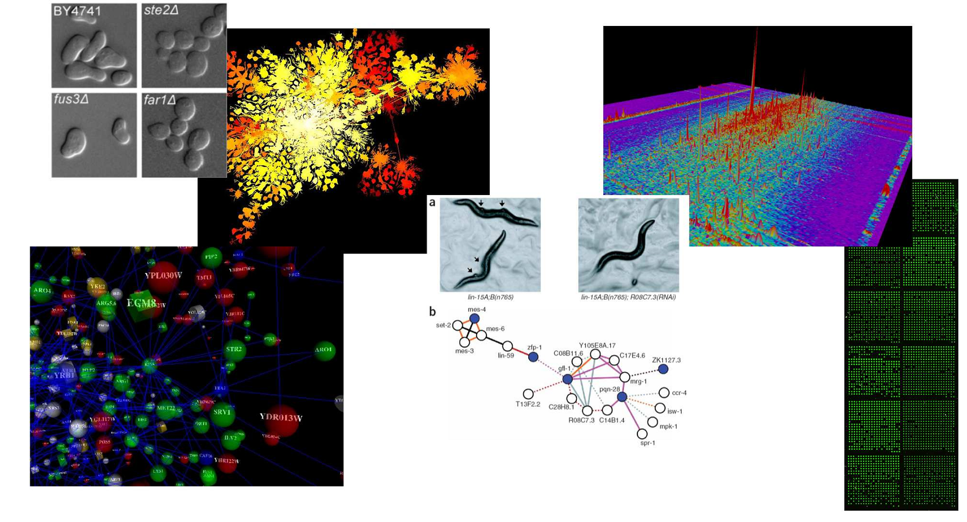
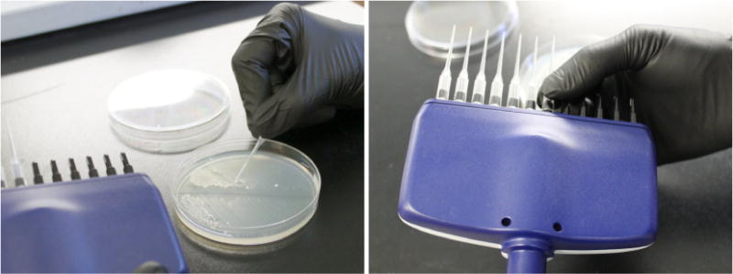
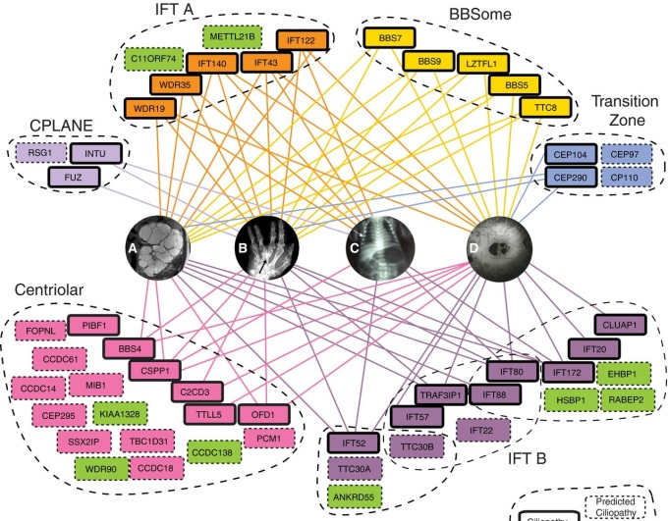
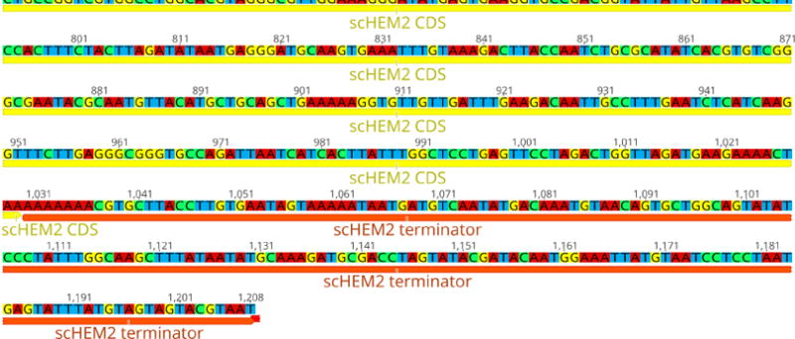
BCH394P/BCH364C Systems Biology & Bioinformatics
(course # 55680/55580)
Spring 2021 Tues/Thurs 11 – 12:30 PM Virtual

Slide 2
Instructor: Prof. Edward Marcotte marcotte@utexas.edu
Zoom office hours: Fri 11 – 12
TA: Vy Dang vyqtdang@utexas.edu
Zoom office hours: Mon 3 – 4/Wed 1 – 2
Class Slack channel: bch394pbch364c2021.slack.com
The class zoom channel will be posted on Canvas.
It will be the same zoom for class and office hours.

Slide 3
Probably the most important slide today!
Course web page:
http://www.marcottelab.org/
index.php/BCH394P_BCH364C_2021
This is a graduate student class!
It is open to a small # of upper division undergrads in natural sciences and engineering.
UG prerequisites: Biochemistry 339F with a grade of at least B; Computer Science 303E and Statistics and Data Sciences 328M (or Statistics and Scientific Computation 318M, 328M) with a grade of at least C-; and consent of the instructor.

Slide 4
An introduction to systems biology and bioinformatics, emphasizing quantitative analysis of high-throughput biological data, and covering typical data, data analysis, and computer algorithms.
Topics will include introductory probability and statistics, basics of Python programming, protein and nucleic acid sequence analysis, genome sequencing and assembly, proteomics, synthetic biology, analysis of large-scale gene expression data, data clustering, biological pattern recognition, and gene and protein networks.
** NOT a course on practical sequence analysis or using web-based tools (although we’ll use those too), but rather on algorithms, exploratory data analyses and their applications in high-throughput biology. **

Slide 5
Books
Most of the lectures will be from research articles and slides. For sequence analysis, there will be an Optional text:
Biological sequence analysis, Durbin, Eddy, Krogh, Mitchison, Cambridge Univ. Press (available from Amazon, used & ebook)
For biologists rusty on their stats, The Cartoon Guide to Statistics (Gonick/Smith) is very good (really!).
We will also be learning some Python programming.
I highly recommend…
Python programming for biologists: https://pythonforbiologists.com/introduction/

Slide 6
Grading
No exams. Instead, grades will be based on:
Online programming homework
  (10 points each and counting 30% of the final grade)
3 problem sets
  (15 points each and counting 45% of the final grade)
A course project that you will develop over the semester & present in the last 2.5 days of class (25% of final grade)
The course project will consist of a research project on a bioinformatics topic chosen by the student (with approval by the instructor) containing an element of independent computational biology research (e.g. calculation, programming, database analysis, etc.) turned in as a web URL (20%) and presented in class (5%).
The project will be emailed as a web URL to the TA & I, developed through the semester and finished by midnight, April 26, 2021. The last few classes will be spent presenting your projects.

Slide 7
Late policy
All projects and homework will be turned in electronically and time-stamped.
No makeup work will be given.
Instead, all students have 5 days of free “late time”.
  This is for the entire semester, NOT per project, and counting weekends/holidays just like any other day.
  For projects turned in late, days will be deducted from the 5 day total (or what remains of it) by the # of days late.
  Deductions are in 1 day increments, rounding up
    e.g. 10 minutes late = 1 day deducted.
  Once the 5 days are used up, assignments will be penalized 10% / day late (rounding up), e.g., a 50 point assignment turned in 1 ½ days late would be penalized 20%, or 10 points.

Slide 8
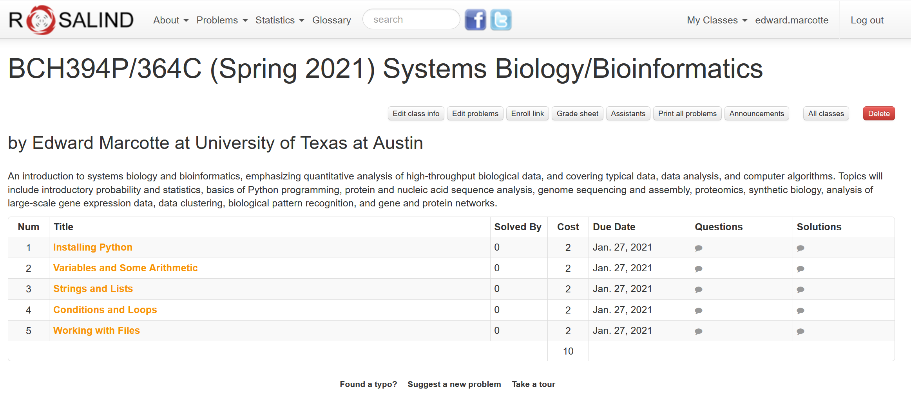
Online homework will be via Rosalind: http://rosalind.info/faq/
Enroll specifically for BCH394P/364C at:
http://rosalind.info/classes/enroll/8e60607640/
The first homework will be due (in Rosalind) by midnight, Jan 27.

Slide 9
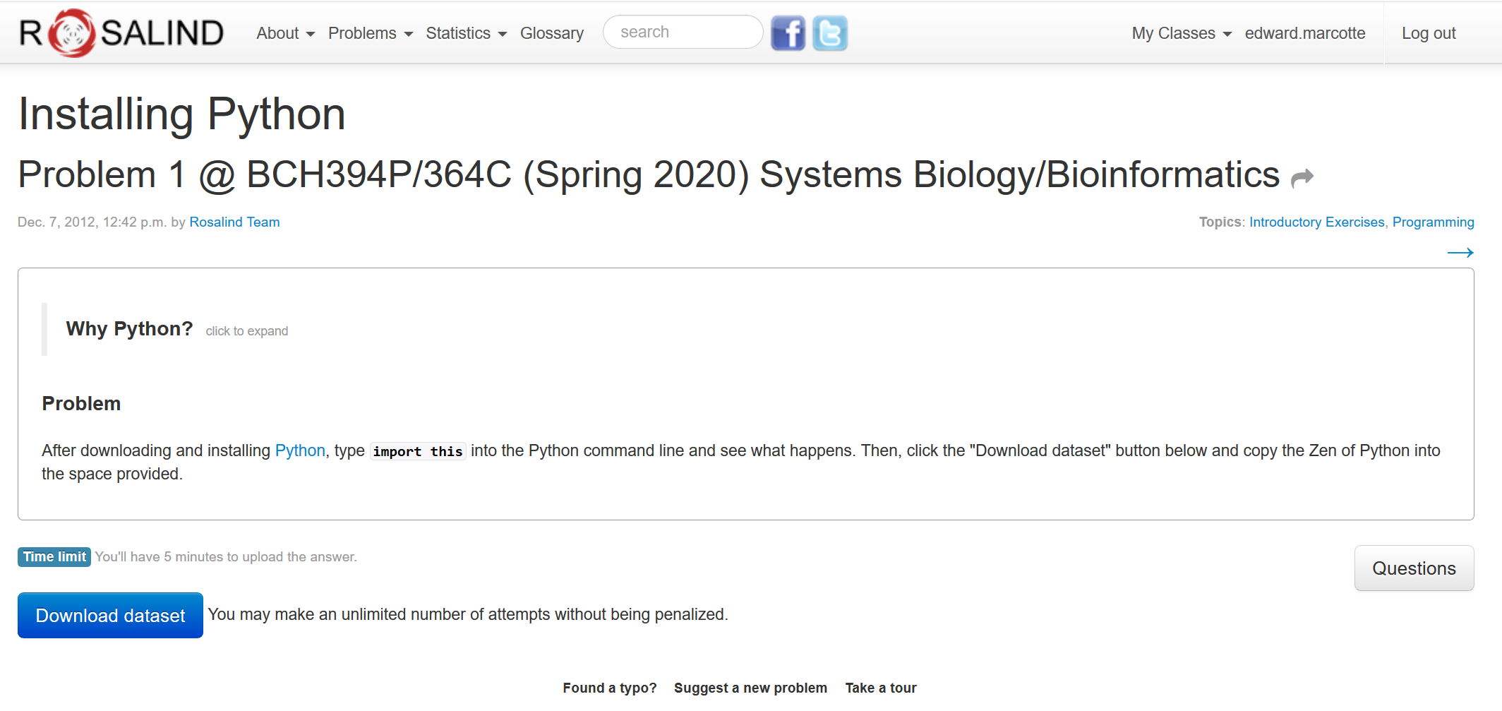
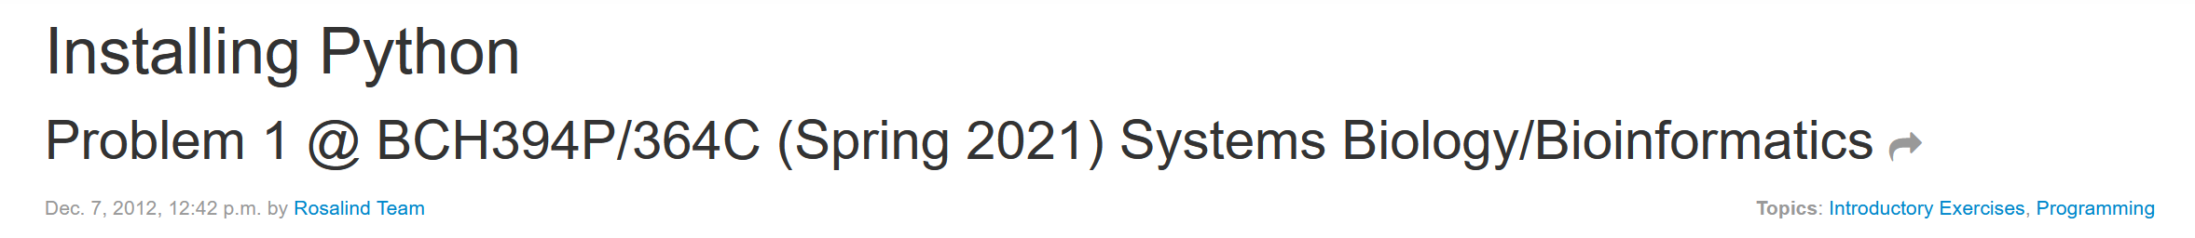

Slide 10
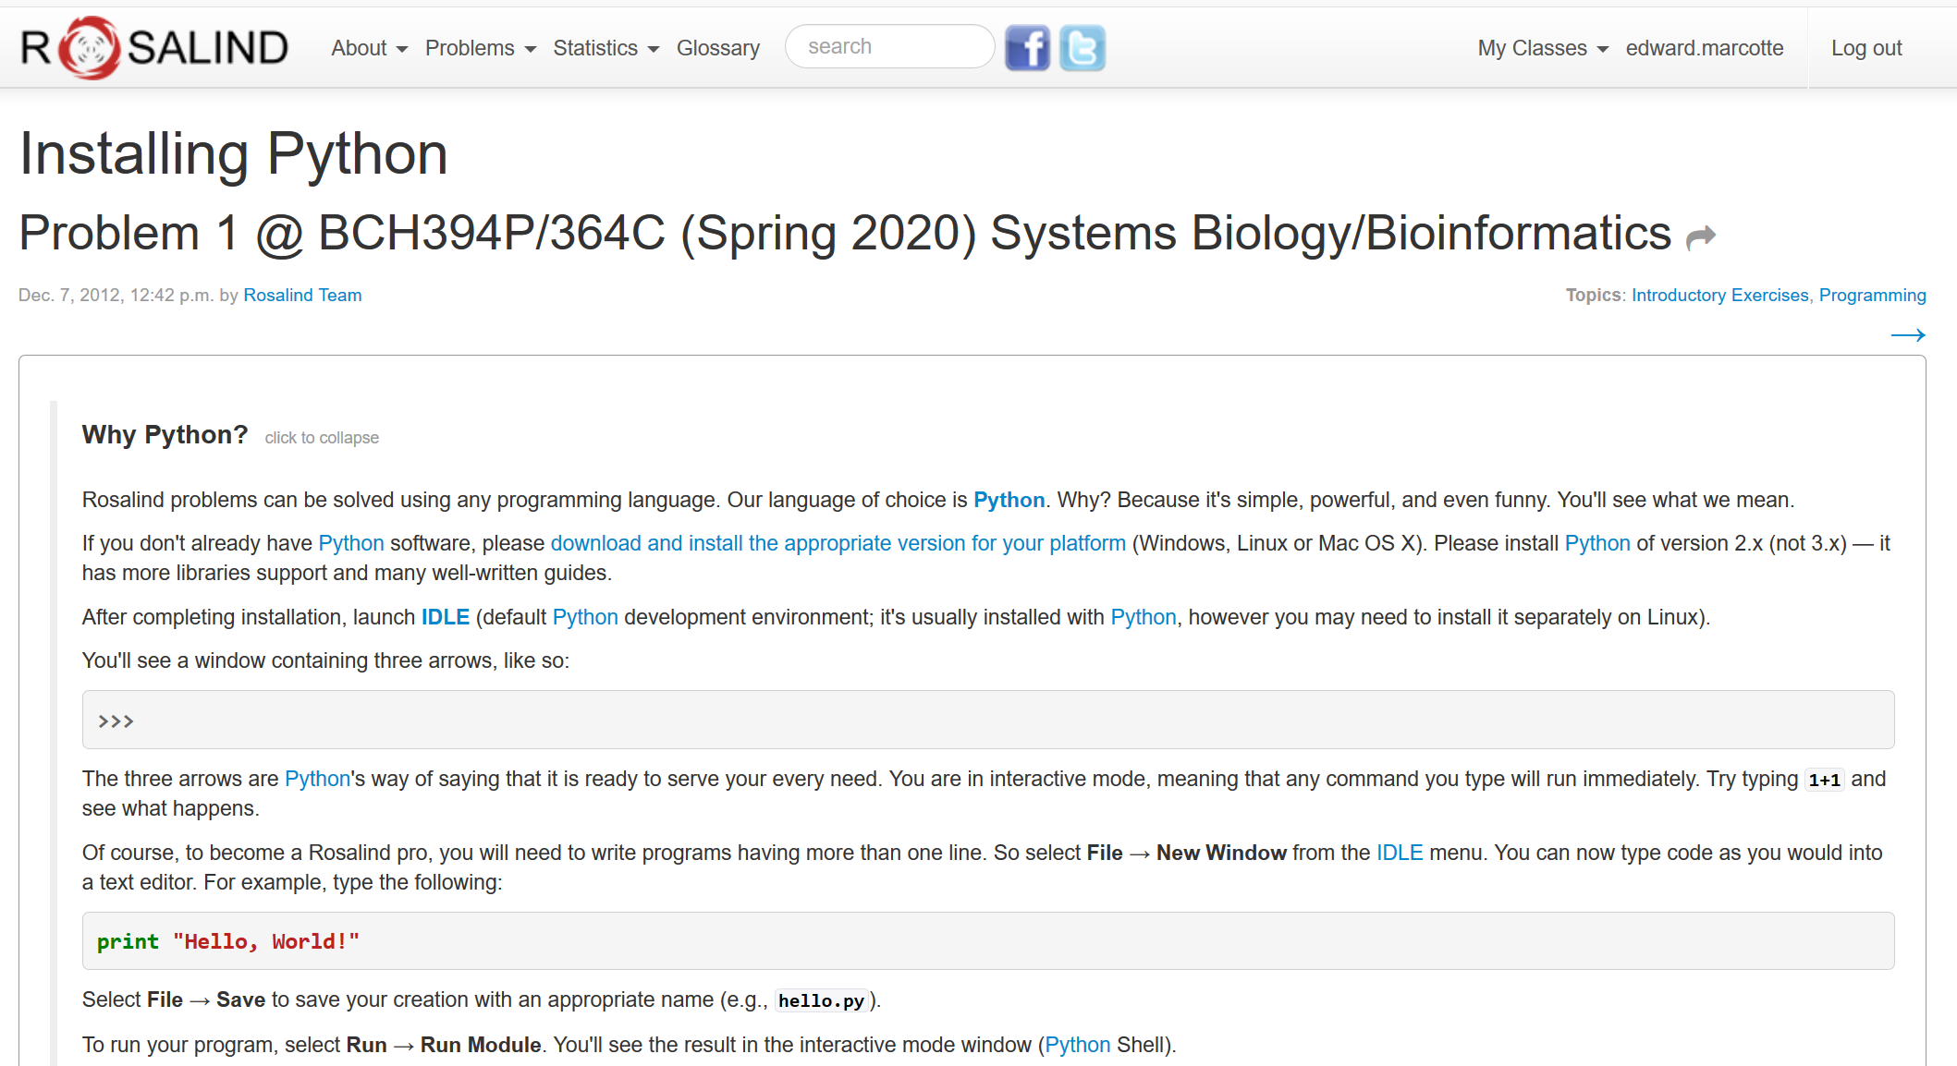
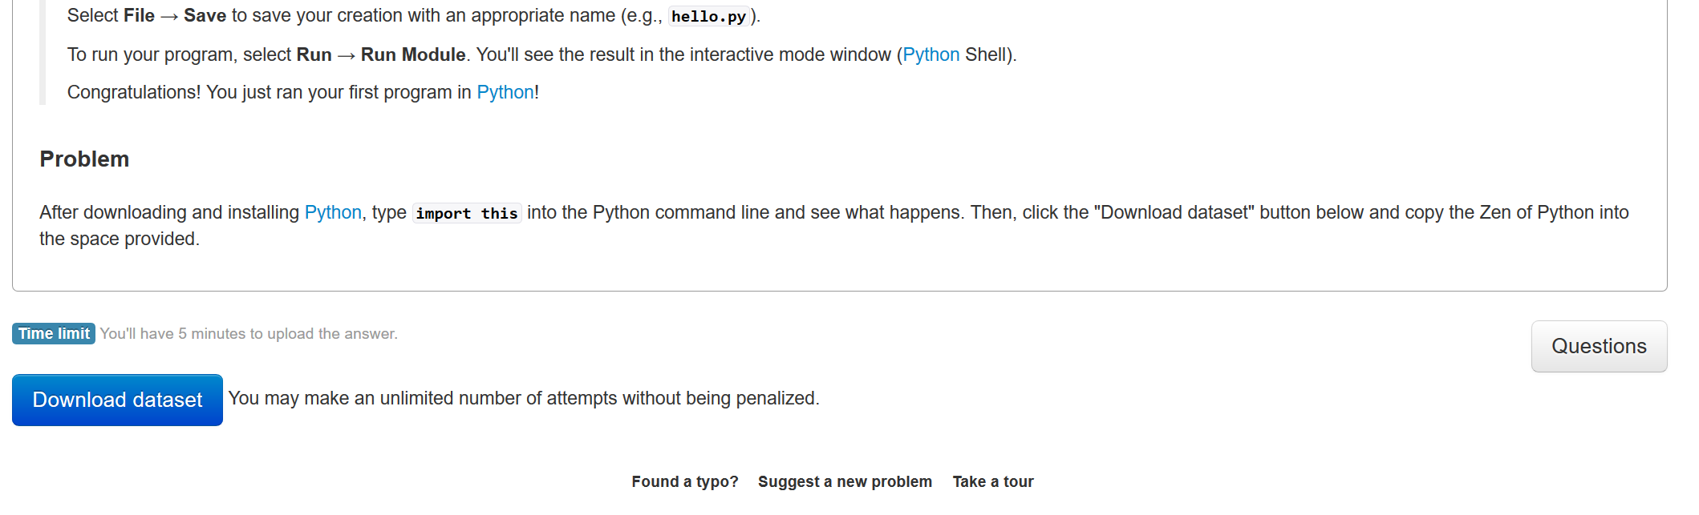
If you’re feeling restless/adventurous…
Rosalind uses Python version 2,
but we’ll use version 3
Click here to turn in your answer

Slide 11
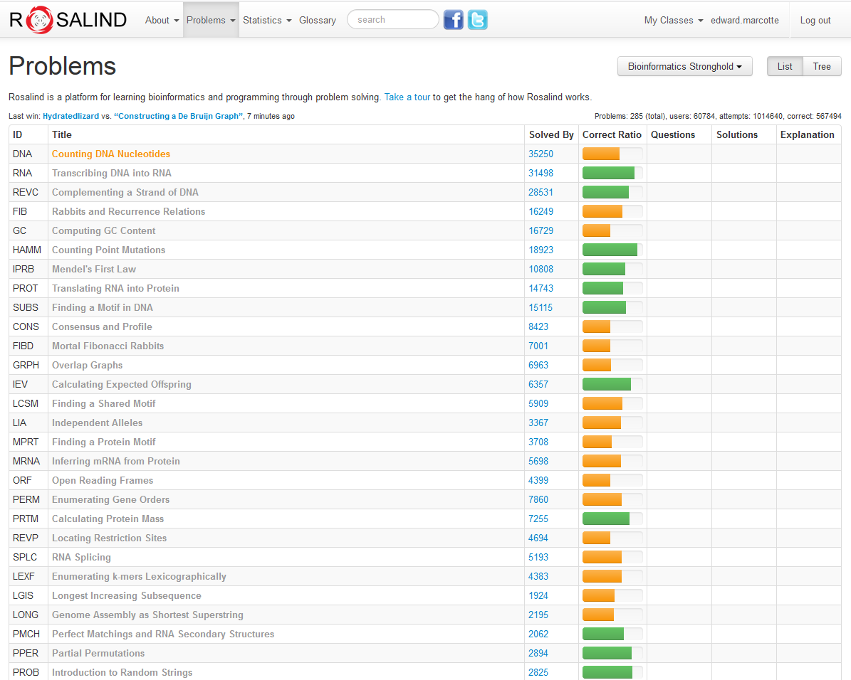
…there are quite a few good bioinformatics problems in the archives.
…
…
…

Slide 12
Expectations on working together
Students are welcome to discuss ideas and problems with each other, but all programs, Rosalind homework, problem sets, and written solutions
should be performed independently,
→ except the final presentation.
tl;dr: study/discuss together
do your own programming/writing/project
collaborate on the final presentation

Slide 13
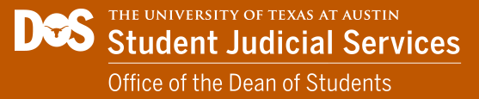

https://deanofstudents.utexas.edu/conduct/academicintegrity.php

Slide 14
By submitting as your own work any unattributed material that you obtained from other sources, you have committed plagiarism.
Copying homework solutions from other students or internet sources (e.g. CourseHero) is cheating, collusion, and/or plagiarism.
Software and computer code are legally considered in the same framework as other written works. Copying code directly without attribution is plagiarism.

Slide 15
Any materials found online (e.g. CourseHero) that are associated with you, or any suspected unauthorized sharing of materials, will be reported to Student Conduct and Academic Integrity in the Office of the Dean of Students. These reports can result in sanctions, including failure in the course.
See the university’s official policy on plagiarism here: https://catalog.utexas.edu/general-information/appendices/appendix-c/student-discipline-and-conduct/

Slide 16
You can use the internet to get ideas, programming suggestions and syntax, but downloading completed answers to assigned questions and submitting these as your own work is cheating/plagiarism.
Copying entire programs verbatim from marked repositories offering Rosalind homework solutions is cheating and plagiarism.

Slide 17
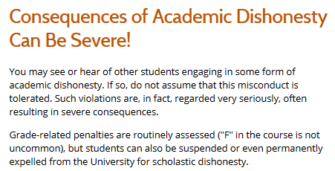
http://deanofstudents.utexas.edu/sjs/acadint_conseq.php

Slide 18
Why are we here? (practically, not existentially)

Slide 19
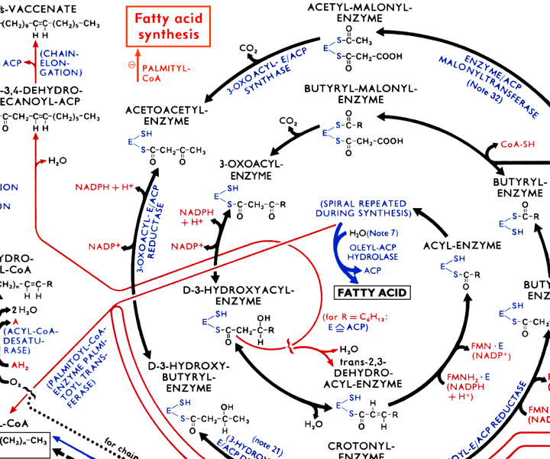
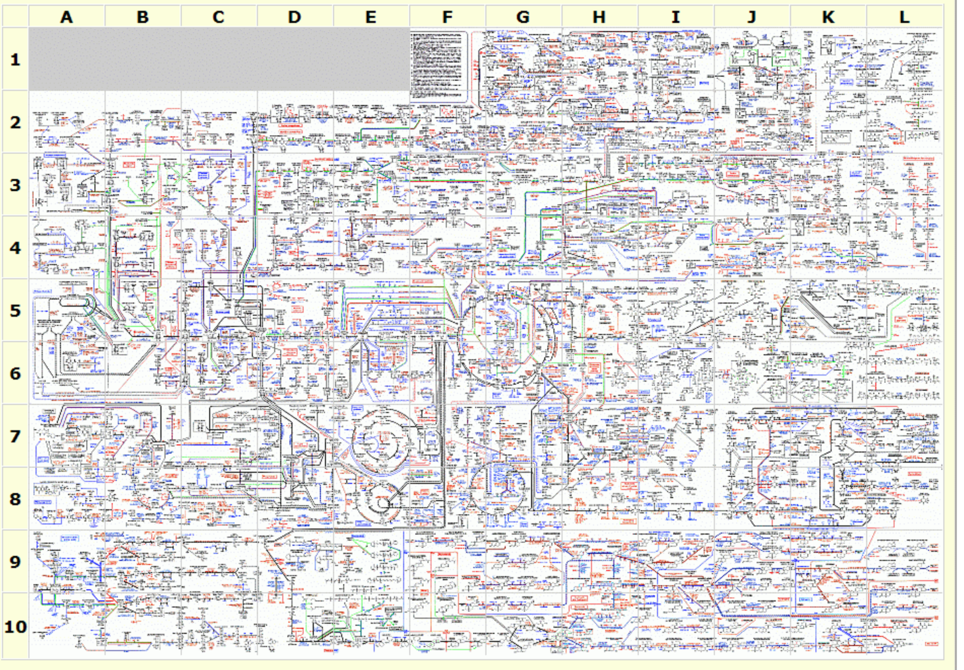
The metabolic wall chart…
http://web.expasy.org/cgi-bin/pathways/show_thumbnails.pl

Slide 20
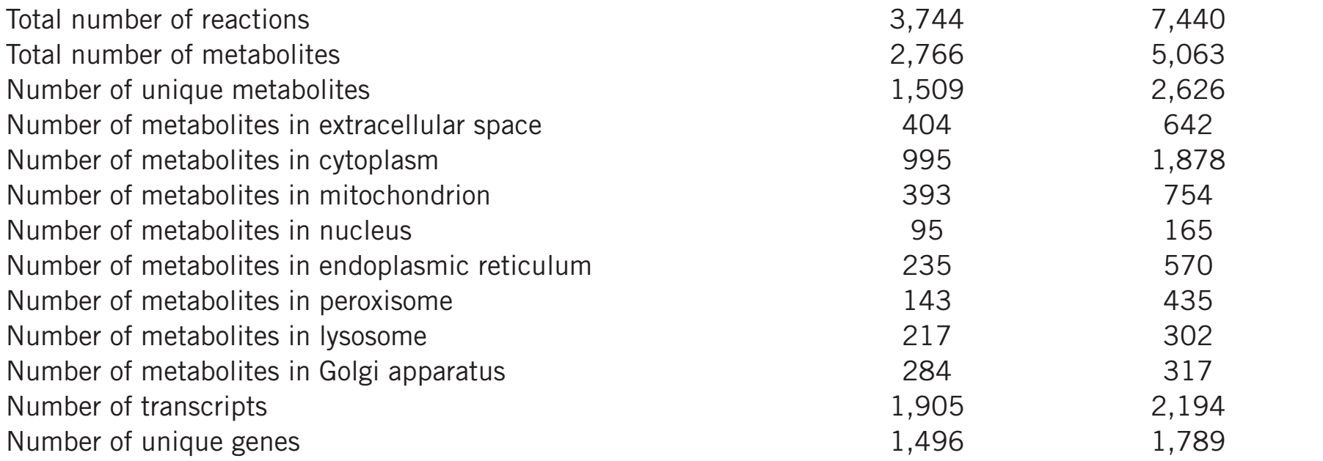
Our current-ish knowledge of human metabolism…
Nat Biotechnol. 2013 May;31(5):419-25
Updated in Metabolomics 2016 12:109

Slide 21
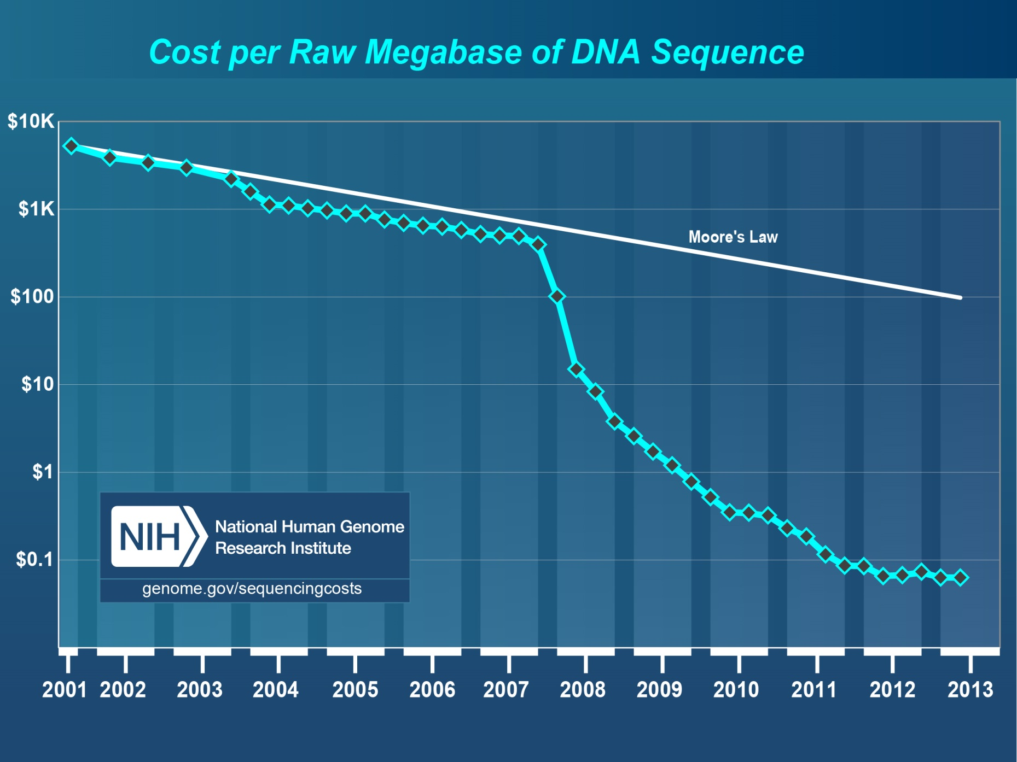
Pales beside the phenomenal drop in DNA sequencing costs…

Slide 22
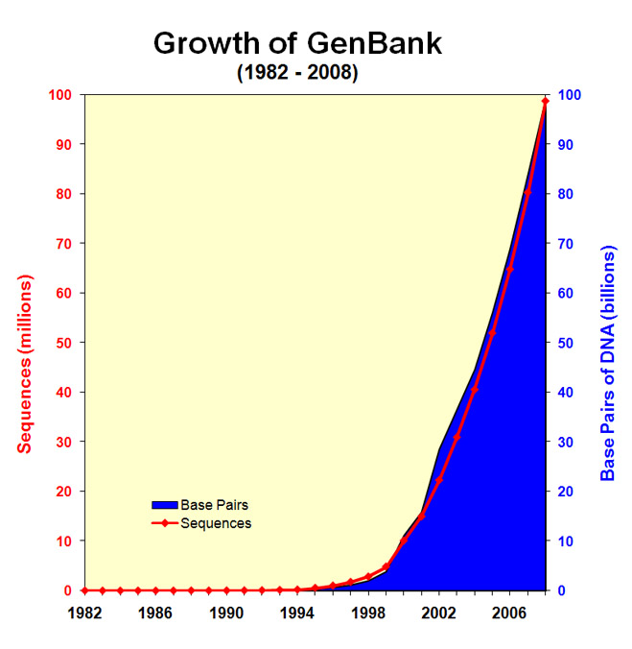
& the corresponding explosion of DNA sequencing data…
!!!!
http://www.ncbi.nlm.nih.gov/genbank/genbankstats-2008/
ftp://ftp.ncbi.nih.gov/genbank/gbrel.txt

Slide 23
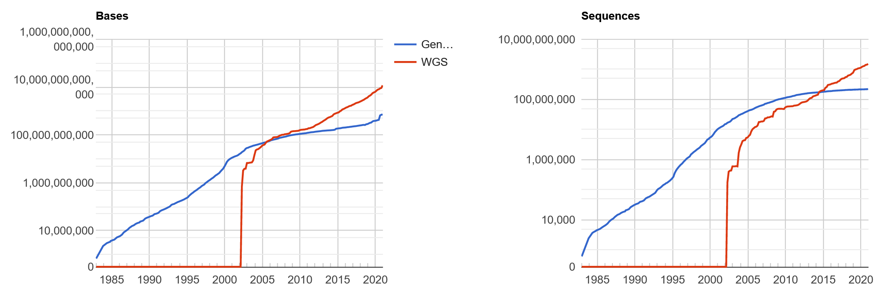
& the corresponding explosion of DNA sequencing data…
GenBank
December 2020:
723 billion bp
+
11.8 trillion bp DNA
whole genome
shotgun sequencing
Here are the latest
statistics…
Which basically means GenBank is falling behind more every year!
http://www.ncbi.nlm.nih.gov/genbank/statistics

Slide 24
We have no choice!
Biologists are now faced with a staggering deluge of data, growing at exponential rates.
Bioinformatics offers tools and approaches to understand these data and work productively, and to build algorithmic models that help us better understand biological systems.
We’ll learn some of the important basic concepts in this field, along with getting exposed to key technologies driving the field forward.

Slide 25
Specifically…
We’ll cover the following topics, approximately in this order:
BASICS OF PROGRAMMING
Introduction to Rosalind
A Python programming primer for non-programmers
Rosalind help & programming Q/A
BIOLOGICAL SEQUENCE ANALYSIS
Substitution matrices (BLOSSUM, PAM) & sequence alignment
Protein and nucleic acid sequence alignments, dynamic programming
Sequence profiles
BLAST! (the algorithm)
Biological databases
Markov processes and Hidden Markov Models

Slide 26
GENOMES, PROTEOMES, & "BIG BIOLOGY"
Gene finding algorithms
Genome assembly & how the human genome was sequenced
An introduction to large gene expression data sets
Promoter and motif finding, Gibbs sampling
Clustering algorithms, hierarchical, k-means, self-organizing maps,
force-directed maps
Classification algorithms
Principal component analysis and data transformations
NETWORK & SYNTHETIC BIOLOGY
Biological networks: metabolic, signaling, graphs, regulatory
Deep homology and the evolution of traits
Designing, simulating, and building gene circuits
Genome design and synthesis

Slide 27
Plus, expert guest lectures on:
NGS best practices
Overview of mass spectrometry shotgun proteomics
Protein 3D structural modeling
Plus, plus:
we’ll attempt a “live” (on zoom) demo in-class
of nanopore sequencing….
THE FINAL COURSE PROJECT IS DUE by midnight, April 26, 2021
The last 3 class days will be devoted to presenting your projects to the rest of the class.

