Slide 1
A Python programming primer for biochemists
(Named after Monty Python’s Flying Circus & designed to be fun to use)
Systems Biology/Bioinformatics
Edward Marcotte, Univ of Texas at Austin

Slide 2
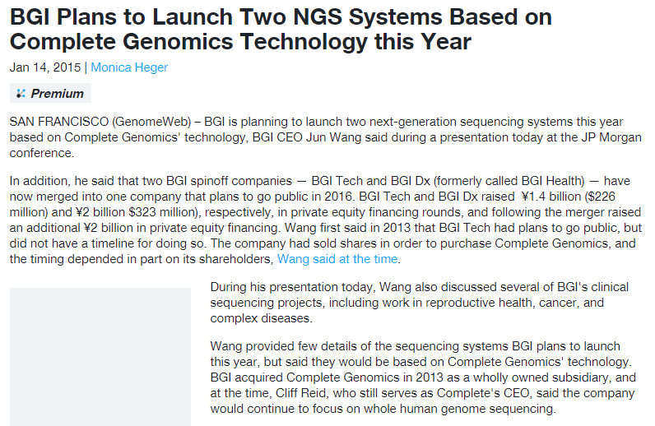
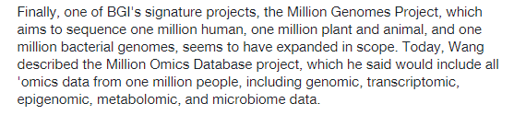
Science news of the day (2015 edition):

Slide 3
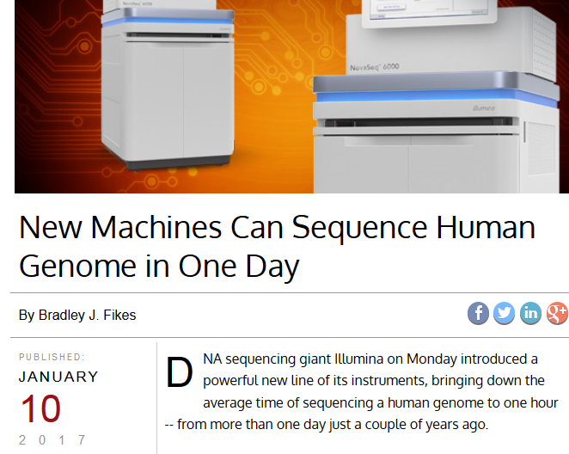
Science news of the day (2017 update):

Slide 4
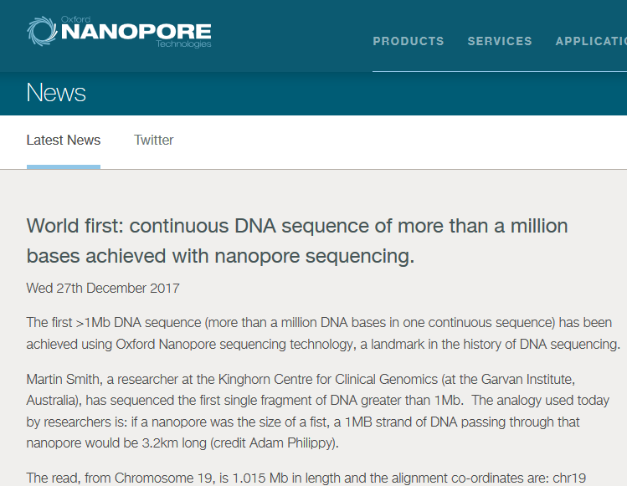
Science news of the day (2018 update):

Slide 5

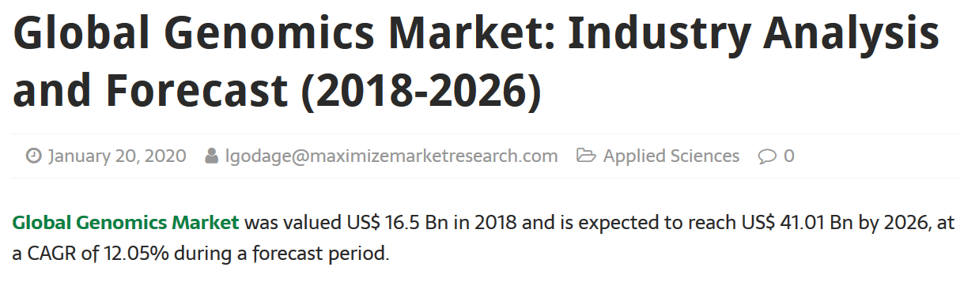
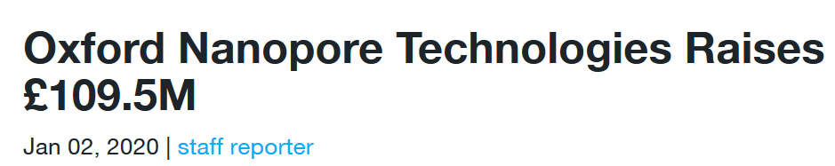
Science news of the day (2020 update):

Slide 6
In bioinformatics, you often want to do completely new analyses. Having the ability to program a computer opens up all sorts of research opportunities. Plus, it’s fun.
Most bioinformatics researchers use a scripting language, such as Python or Perl, or a programming language such as R.
These languages are not the fastest, not the slowest, nor best, nor worst languages, but they’re easy to learn and write, and for many reasons, are well-suited to bioinformatics.
We’ll spend the next 2 lectures giving an introduction to Python. This will give you a sense for the language and help us introduce the basics of algorithms

Slide 7
Python documentation: http://www.python.org/doc/
& tips: http://www.tutorialspoint.com/python
Good introductory Python books:
Learning Python, Mark Lutz & David Ascher, O’Reilly Media
Bioinformatics Programming Using Python: Practical Programming for Biological Data, Mitchell L. Model, O'Reilly Media
Good intro videos on Python:
CodeAcademy: https://www.codecademy.com/learn/learn-python
& an online Python tutor:
http://www.pythontutor.com/
A bit more advanced: Programming Python
Mark Lutz, O’Reilly Media

Slide 8
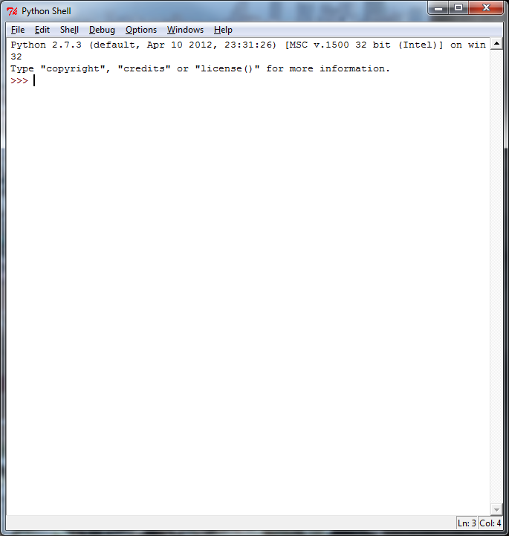

By now, you should have installed Python on your computer,
following the instructions in Rosalind Homework problem #1.
Launch IDLE:
You can test out commands here
to make sure they work…
Type in your program, save the file, and
run it….
…but to actually write your programs,
open a new window.
This window will serve as a command line
interface & display your program output.
This window will serve as a text editor for programming.

Slide 9
Let’s start with some simple programs in Python:
A very simple example is:
print("Hello, future bioinformatician!") # print out the greeting
Let’s call it hello.py
Save & run the program. The output looks like this:
Hello, future bioinformatician!
FYI: This is version agnostic. Python 3 takes print(“X”). Python 2 also takes print “X” as in Rosalind

Slide 10
A slightly more sophisticated version:
name = raw_input("What is your name? ") # asks a question and saves the answer
# in the variable "name"
print("Hello, future bioinformatician " + name + "!") # print out the greeting
When you run it this time, the output looks like:
What is your name?
If you type in your name, followed by the enter key, the program will print:
Hello, future bioinformatician Alice!
FYI: Python 3 uses input() instead of raw_input()

Slide 11
GENERAL CONCEPTS
Names, numbers, words, etc. are stored as variables.
Variables in Python can be named essentially anything except words Python uses as command.
For example:
BobsSocialSecurityNumber = 456249685
mole = 6.022e-23
password = "7 infinite fields of blue"
Note that strings of letters and/or numbers are in quotes, unlike numerical values.

Slide 12
LISTS
Groups of variables can be stored as lists.
A list is a numbered series of values,
like a vector, an array, or a matrix.
Lists are variables, so you can name them just as you would name any other variable.
Individual elements of the list can be referred to using [] notation:
The list nucleotides might contain the elements nucleotides[0] = "A"
nucleotides[1] = "C"
nucleotides[2] = "G"
nucleotides[3] = "T"
(Notice the numbering starts from zero. This is standard in Python.)

Slide 13
DICTIONARIES
A VERY useful variation on lists is called a dictionary or dict (sometimes also called a hash).
Groups of values indexed not with numbers (although they could be) but with other values.
Individual hash elements are accessed like array elements:
For example, we could store the genetic code in a hash named codons, which might contain 64 entries, one for each codon, e.g.
codons["ATG"] = "Methionine"
codons["TAG"] = "Stop codon"
etc…

Slide 14
Now, for some control over what happens in programs.
There are two very important ways to control the logical flow of your programs:
if statements
and
for loops
There are some other ways too, but this will get you going for now.

Slide 15
if statements
if dnaTriplet == "ATG":
# Start translating here. We’re not going to write this part
# since we’re really just learning about IF statements
else:
# Read another codon
Python cares about the white space (tabs & spaces) you use!
This is how it knows where the conditional actions that follow begin and end. These conditional steps must always be indented by the same number of spaces (e.g., 4).
I recommend using a tab (rather than spaces) so you’re always consistent.

Slide 16
Note: in the sense of performing a comparison, not as in setting a value.
== equals
!= is not equal to
< is less than
> is greater than
<= is less than or equal to
>= is greater than or equal to
Can nest these using parentheses and Boolean operations, such as and, not, or or, e.g.:
if dnaTriplet == "TAA" or dnaTriplet == "TAG" or dnaTriplet == "TGA":
print("Reached stop codon")

Slide 17
for loops
Often, we’d like to perform the same command repeatedly or with slight variations.
For example, to calculate the mean value of the number in an array, we might try:
Take each value in the array in turn.
Add each value to a running sum.
Divide the total by the number of values.

Slide 18
In Python, you could write this as:
grades = [93, 95, 87, 63, 75] # create a list of grades
sum = 0.0 # variable to store the sum
for grade in grades: # iterate over the list called grades
sum = sum + grade # indented commands are executed on
# each cycle of the loop.
mean = sum / 5 # now calculate the average grade
print ("The average grade is "),mean # print the results
Python cares whether numbers are integers or floating point (also long integers and complex numbers).
Tell Python you want floating point by defining your variables accordingly
(e.g., X = 1.0 versus X = 1)
Python 2 Python 3
>>> 2 / 3 >>> 2 / 3
0 0.666666
Python 3: print ("The average grade is ",mean)

Slide 19
In general, Python will perform most mathematical operations, e.g.
multiplication (A * B)
division (A / B)
exponentiation (A ** B)
etc.
There are lots of advanced mathematical capabilities you can explore later on.

Slide 20
READING FILES
You can use a for loop to read text files line by line:
count = 0 # Declare a variable to count lines
file = open("mygenomefile", "r") # Open a file for reading (r)
for raw_line in file: # Loop through each line in the file
line = raw_line.rstrip("\r\n") # Remove newline
words = line.split(" ") # split the line into a list of words
# Print the appropriate word:
print ("The first word of line {0} of the file is {1}".format(count, words[0]))
count += 1 # shorthand for count = count + 1
file.close() # Last, close the file.
print ("Read in {0} lines\n".format(count))
Stands for “read”
\r = carriage return
\n = newline
Increment counter by 1
Placeholders (e.g., {0}) in the print statement indicate variables listed at the end of the line after the format command

Slide 21
WRITING FILES
Same as reading files, but use "w" for ‘write’:
file = open("test_file", "w")
file.write("Hello!\n")
file.write("Goodbye!\n")
file.close() # close the file as you did before
Unless you specify otherwise, you can find the new text file you created (test_file) in the default Python directory on your computer.

Slide 22
PUTTING IT ALL TOGETHER
seq_filename = "Ecoli_genome.txt"
total_length = 0
nucleotide = {} # create an empty dictionary
seq_file = open(seq_filename, "r")
for raw_line in seq_file:
line = raw_line.rstrip("\r\n")
length = len(line) # Python function to calculate the length of a string
for nuc in line:
if nucleotide.has_key(nuc):
nucleotide[nuc] += 1
else:
nucleotide[nuc] = 1
total_length += length
seq_file.close()
for n in nucleotide.keys():
fraction = 100.0 * nucleotide[n] / total_length
print ("The nucleotide {0} occurs {1} times, or {2} %".format(n, nucleotide[n], fraction))

Slide 23
Let’s choose the input DNA sequence in the file to be the genome of E. coli, available from the Entrez genomes web site or the class web site.
The format of the file is ~77,000 lines of A’s, C’s, G’s and T’s:
AGCTTTTCATTCTGACTGCAACGGGCAATATGTCTCTGTGTGGATTAAAAAAAGAGTGTC
TGATAGCAGCTTCTGAACTGGTTACCTGCCGTGAGTAAATTAAAATTTTATTGACTTAGG
TCACTAAATACTTTAACCAATATAGGCATAGCGCACAGACAGATAAAAATTACAGAGTAC
ACAACATCCATGAAACGCATTAGCACCACCATTACCACCACCATCACCATTACCACAGGT
etc…
Running the program produces the output:
The nucleotide A occurs 1142136 times, or 24.6191332553 %
The nucleotide C occurs 1179433 times, or 25.423082884 %
The nucleotide T occurs 1140877 times, or 24.5919950785 %
The nucleotide G occurs 1176775 times, or 25.3657887822 %
So, now we know that the four nucleotides are present in roughly equal numbers in the E. coli genome.

