Slide 1
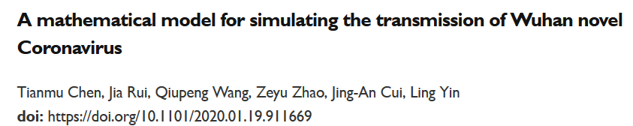
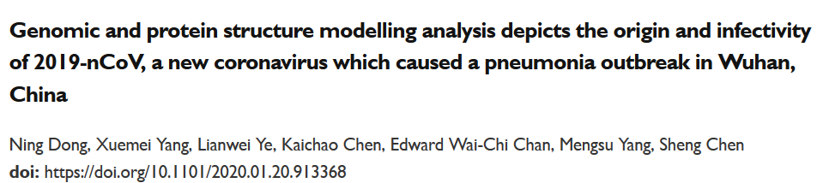
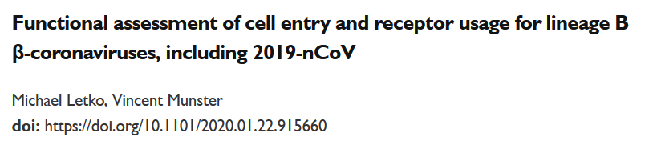
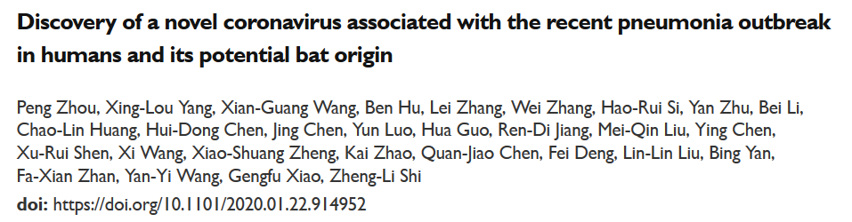
Wuhan coronavirus 2019-nCoV, DNA sequencing, bioinformatics, and the bioRxiv
Id’d as causative agent by Chinese authorities & reported by WHO on January 7, 2020
1st model of transmission
Jan 19
Id’d as bat → human
Jan 22
Id’d human receptor ACE2
Jan 22
Genome sequence
(one of several papers)
Jan 23

Slide 2
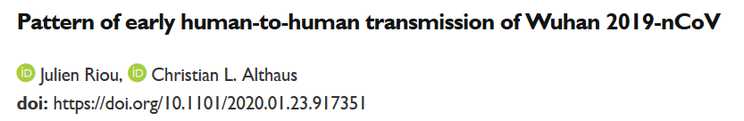
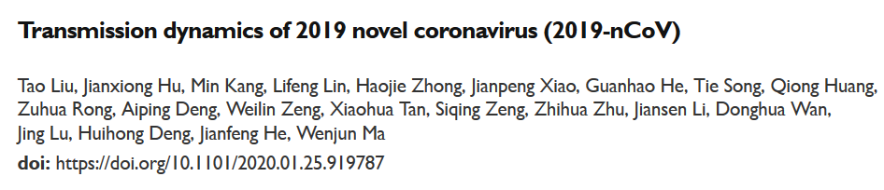
Wuhan coronavirus 2019-nCoV, DNA sequencing, bioinformatics, and the bioRxiv
Transmission dynamics
Jan 24, 26, …
→ as of Feb 4, already up to 33 preprints on 2019-nCov

Slide 3
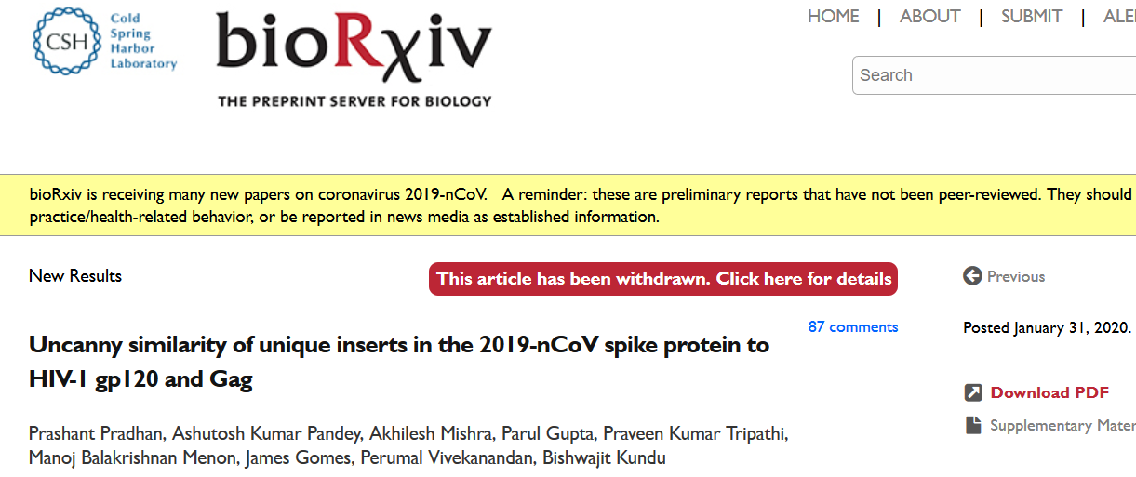
Posted January 31, 2020
& then there was this paper…

Slide 4
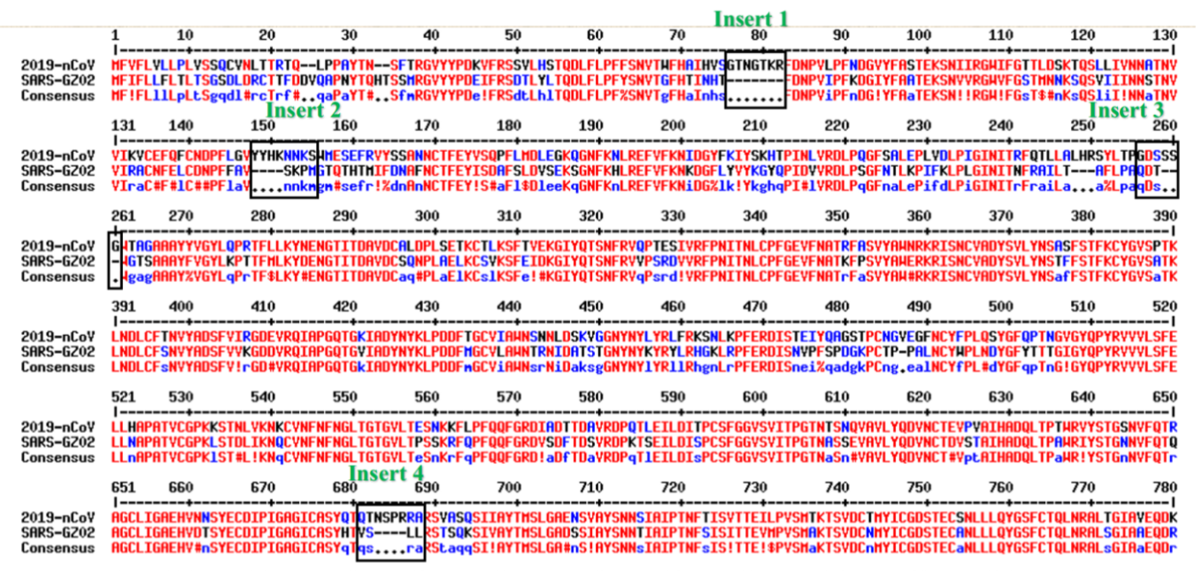
The authors claim that:
“we identified 4 unique inserts in the 2019-nCoV spike glycoprotein that are not present in any other coronavirus reported till date.”
“To our surprise, all the 4 inserts in the 2019-nCoV mapped to short segments of amino acids in the HIV-1 gp120 and Gag among all annotated virus proteins in the NCBI database.”
“This uncanny similarity of novel inserts in the 2019- nCoV spike protein to HIV-1 gp120 and Gag is unlikely to be fortuitous.”
Based on this multiple sequence alignment

Slide 5
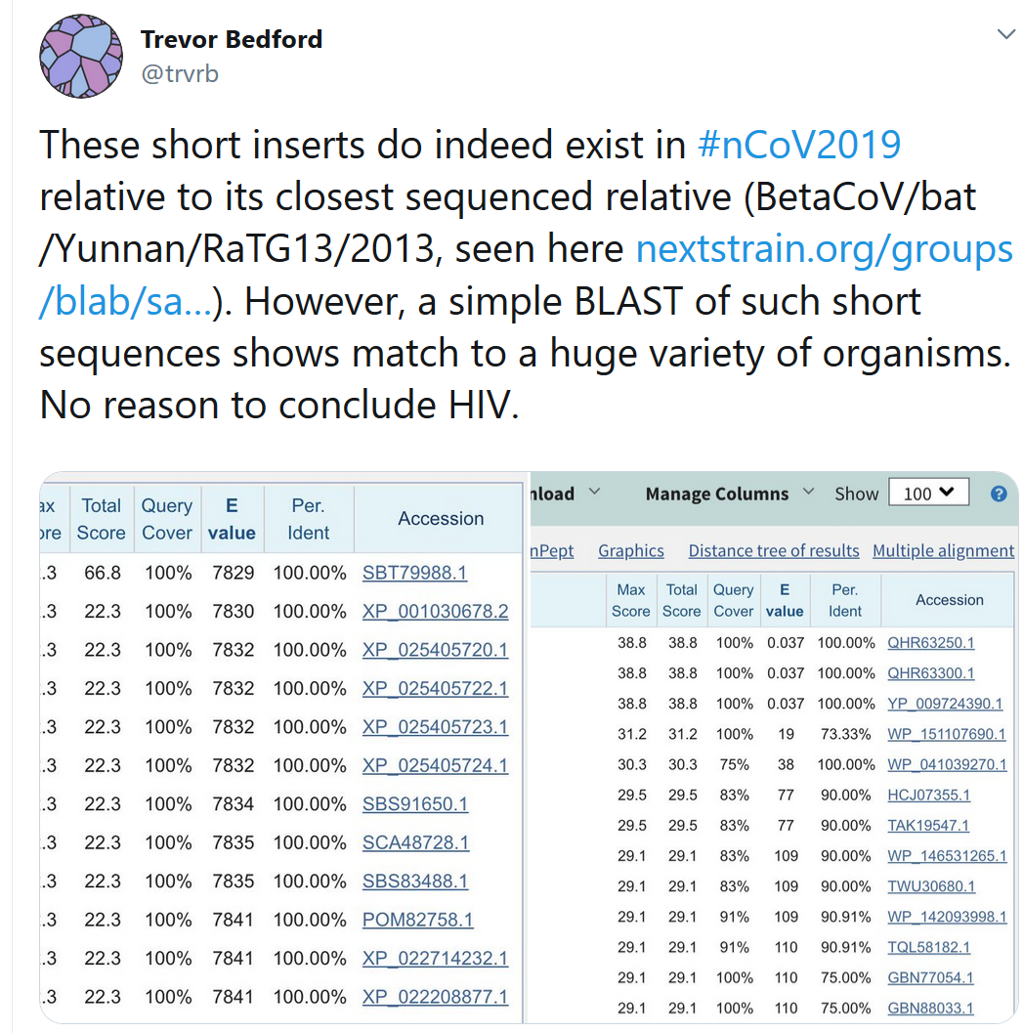
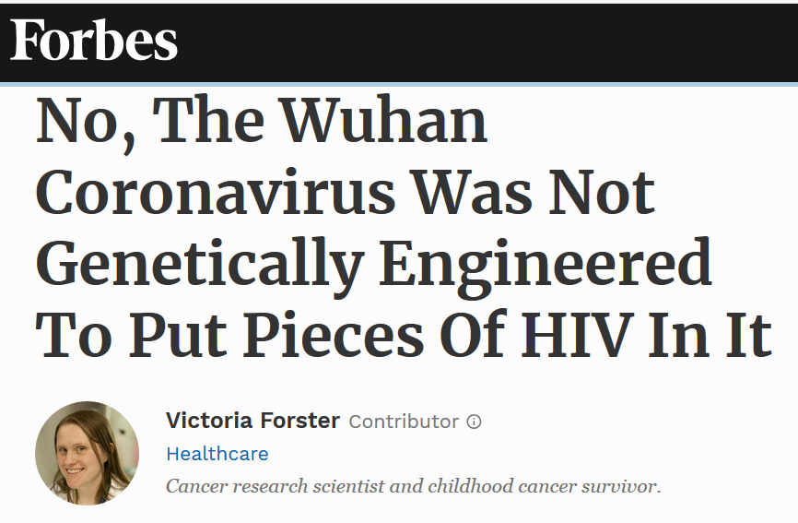
This was debunked (and widely ridiculed) on Twitter

Slide 6
Posted January 31, 2020
Note that withdrawn bioRxiv papers are still visible & in the permanent scientific record, just marked as withdrawn

Slide 7
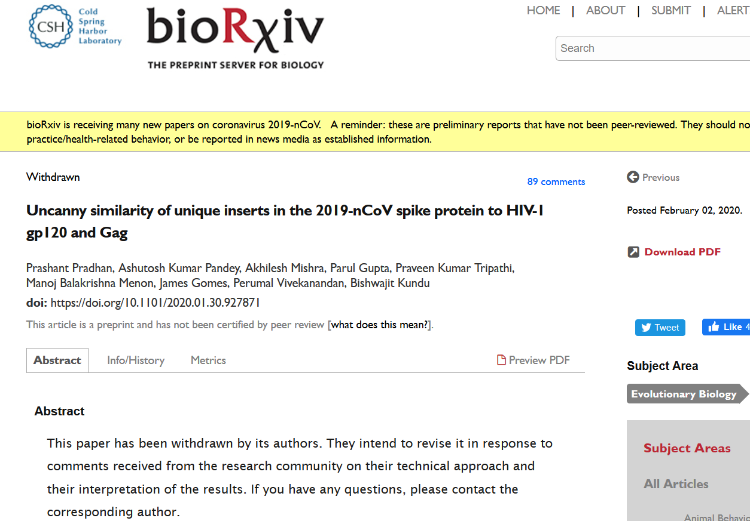
Posted February 2, 2020
Note that withdrawn bioRxiv papers are still visible & in the permanent scientific record, just marked as withdrawn

