Slide 1
Principal Component Analysis (PCA)
BCH394P/364C Systems Biology / Bioinformatics
Edward Marcotte, Univ of Texas at Austin

Slide 2
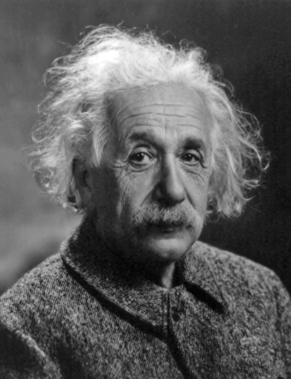
What is Principal Component Analysis? What does it do?
So, first let’s build some intuition.
“You do not really understand something unless you can explain it to your grandmother”, Albert Einstein
wikipedia
With thanks for many of these explanations to http://stats.stackexchange.com/questions/2691/making-sense-of-principal-component-analysis-eigenvectors-eigenvalues

Slide 3
What is Principal Component Analysis? What does it do?
A general (and imprecise) political example:
Suppose you conduct a political poll with 30 questions, each answered by 1 (strongly disagree) through 5 (strongly agree). Your data is the answers to these questions from many people, so it’s 30-dimensional, and you want to understand what the major trends are.
You run PCA and discover 90% of your variance comes from one direction, corresponding not to a single question, but to a specific weighted combination of questions. This new hybrid axis corresponds to the political left-right spectrum, i.e. democrat/republican spectrum.
Now, you can study that, or factor it out & look at the remaining more subtle aspects of the data.
So, PCA is a method for discovering the major trends in data, simplifying the data to focus only on those trends, or removing those trends to focus on the remaining information.
Example: Christian Bueno, http://stats.stackexchange.com/questions/2691/making-sense-of-principal-component-analysis-eigenvectors-eigenvalues

Slide 4
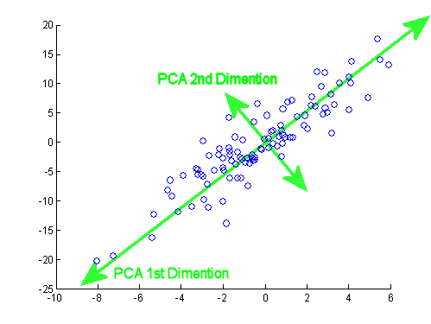
What is Principal Component Analysis? What does it do?
A more precise graphical example:
In a general sense,
PCA rotates your axes to “line up” better with your data.
PCA 2nd dimension
Because rotation is a kind of linear transformation, your new dimensions will be weighted sums of the old ones, like
⟨1⟩=23%⋅[1]+46%⋅[2]+39%⋅[3]
PCA 1st dimension
Quotes & image adapted from Isomorphismes, http://stats.stackexchange.com/questions/2691/making-sense-of-principal-component-analysis-eigenvectors-eigenvalues

Slide 5
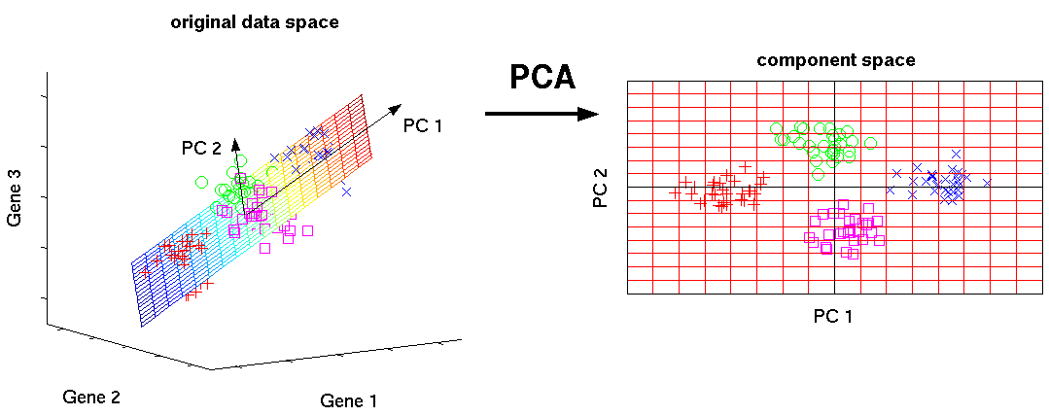
PCA finds new variables which are linear combinations of the original variables such that in the new space, the data has fewer dimensions.
Imagine a data set consisting of points in 3D on the surface of a flat plate held up at an angle. In the original x, y, z axes you need 3 dimensions to represent the data, but with the correct linear transformation, you only need 2.
Quotes: Shlomo Argamon, from http://stats.stackexchange.com/questions/2691/making-sense-of-principal-component-analysis-eigenvectors-eigenvalues
Image: http://phdthesis-bioinformatics-maxplanckinstitute-molecularplantphys.matthias-scholz.de/

Slide 6
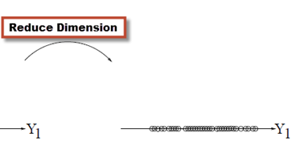
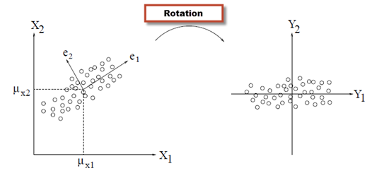
To summarize so far:
PCA is a technique to reduce dimension by:
  Taking linear combinations of the original variables.
  Each linear combination explains the most variance in the data it can.
  Each linear combination is uncorrelated (orthogonal) with the others
4. Plot the data in terms of only the most important (principal) dimensions
Image: http://blog.equametrics.com/2013/02/an-introduction-to-principal-component-analysis
Quote: http://stats.stackexchange.com/questions/2691/making-sense-of-principal-component-analysis-eigenvectors-eigenvalues

Slide 7
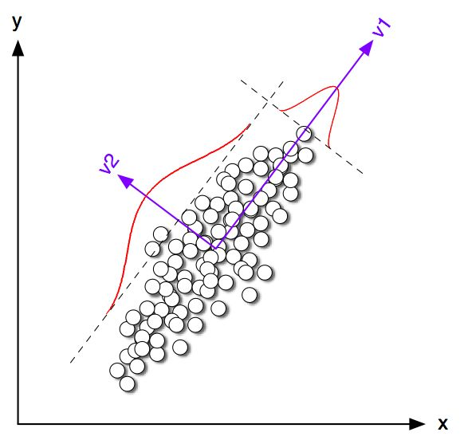
The first principal component (PC1) corresponds to the widest spread of the data.
PC1
PC2
Spread along PC2 vector
The next principal component (PC2) is perpendicular to the 1st, and corresponds to the next widest spread of the data.
Spread along PC1 vector
& so on. There will be as many PCs as data dimensions, but ranked by diminishing importance.
http://web.media.mit.edu/~tristan/phd/dissertation/chapter5.html

Slide 8
Linear Transformations
Scaling
x₂
X
X
X
a₂x₂
X
X
X
X
X
X
O
X
X
X
X
X
O
O
X
X
X
O
O
O
O
O
O
O
O
O
O
O
O
O
O
O
O
O
x₁
a₁x₁
Adapted from http://www.engr.sjsu.edu/~knapp/HCIRODPR/PR_Mahal/linear_tr.htm

Slide 9
Linear Transformations
Scaling & Rotating
x₂
X
X
X
a₂₁x₁ + a₂₂x₂
X
X
X
X
X
X
X
X
X
X
X
X
X
X
O
O
O
O
O
O
O
O
O
O
O
O
O
O
O
O
O
O
O
O
x₁
a₁₁x₁ + a₁₂x₂
If we can stretch & rotate this way…
Adapted from http://www.engr.sjsu.edu/~knapp/HCIRODPR/PR_Mahal/linear_tr.htm

Slide 10
Linear Transformations
Scaling & Rotating
x₂
X
X
a₂₁x₁ + a₂₂x₂
X
X
X
X
X
X
X
X
X
X
X
X
X
X
X
O
O
O
O
O
O
O
O
O
O
O
O
O
O
O
O
O
O
O
O
a₁₁x₁ + a₁₂x₂
x₁
...then we can also go the other way.
To do this, we need to learn about covariance…
Adapted from http://www.engr.sjsu.edu/~knapp/HCIRODPR/PR_Mahal/linear_tr.htm

Slide 11
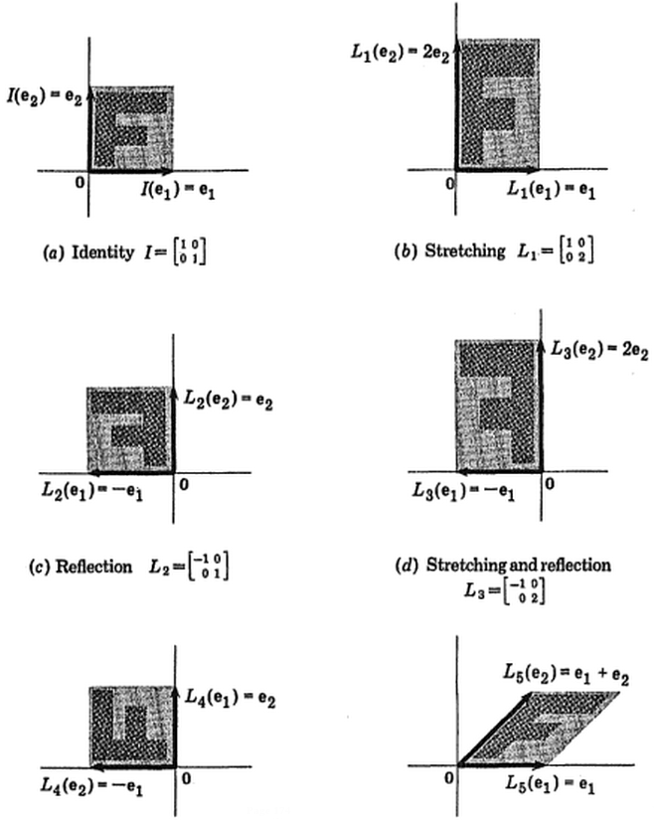
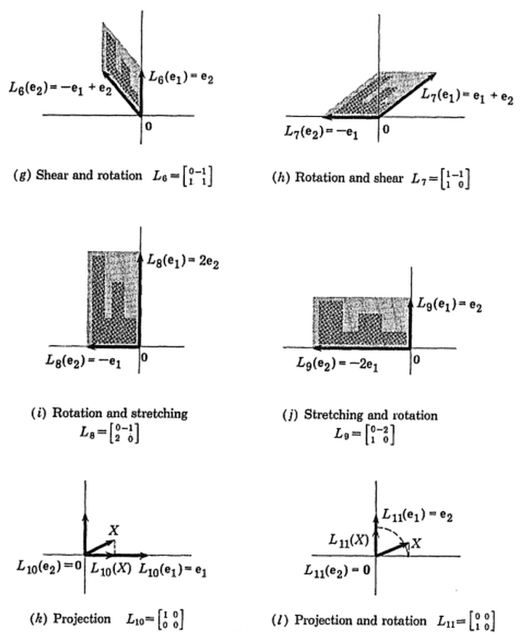
More examples of different linear transformations:
http://isomorphismes.tumblr.com/post/11407834056/matrices-linear-algebra

Slide 12
Covariance = measures tendency to vary together (to co-vary). Similar to correlation.
x_{j}
x_{j}
x_{j}
x_{j}
x_{j}
X
X
X
X
X
X
X
X
X
X
X
X
X
X
X
X
X
X
X
X
X
X
X
X
X
X
X
X
X
X
X
X
X
X
X
X
X
X
X
X
x_{i}
x_{i}
x_{i}
x_{i}
x_{i}
c = -s_{i}s_{j}
c = -0.5 s_{i}s_{j}
c = 0
c = 0.5 s_{i}s_{j}
c = s_{i}s_{j}
Anti-correlated
Uncorrelated
Correlated
Variance = average of the squared deviations of a feature from its mean
= μ² = (std deviation)² = covar(i,i)
Covariance = average of the products of the deviations of feature values from their means
covar(i,j) = [ x(1,i) - m(i) ] [ x(1,j) - m(j) ] + ... + [ x(n,i) - m(i) ] [ x(n,j) - m(j) ]
n [or use (n-1) if sampling from a larger population]
Adapted from http://www.engr.sjsu.edu/~knapp/HCIRODPR/PR_Mahal/cov.htm

Slide 13
All of the covariances c(i,j) between features can be collected together into a covariance matrix C.
This summarizes all of the correlation structure among all pairs of features.
covariance between feature 1 and 2
covariance between feature 2 and n
c(1,1)
c(1,2)
. . .
c(1,n)
c(2,1)
c(2,2)
. . .
c(2,n)
etc.
C =
. . .
. . .
. . .
c(n,1)
c(n,2)
. . .
c(n,n)

Slide 14
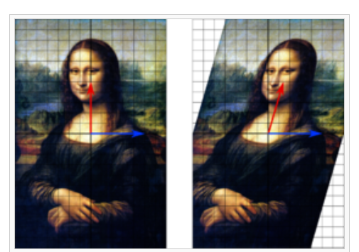
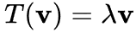
We need one last concept:
Eigenvectors and eigenvalues
An eigenvector v of a linear transformation T is a nonzero vector that, when T is applied to it, does not change direction. Applying T to the eigenvector only scales the eigenvector by the scalar value λ, called an eigenvalue.
That is:
eigenvalue
(scalar)
square transformation
matrix
eigenvector
The blue arrow is an eigenvector of this linear transformation matrix, since it doesn’t change direction.
Its scale is also unchanged, so its eigenvalue is 1.
The eigenvector answers the question:
In which direction does my
transformation matrix stretch?
& the eigenvalue indicates by how much
Wikipedia

Slide 15
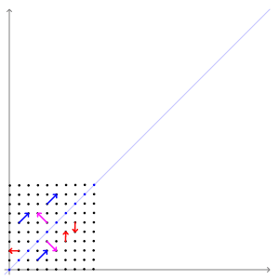

Transformation matrix A =
Eigen vectors = purple & blue (not red)
Eigen values = 1 & 3, respectively
wikipedia

Slide 16
Calculating the PCA
1. Calculate the covariation matrix C between features of the data
2. Calculate the eigenvectors and eigenvalues of C
3. Order the eigenvectors according to the eigenvalues
PC1 is the eigenvector corresponding to the largest eigenvalue,
PC2 is the eigenvector corresponding to the next largest, etc.
The data can be plotted as projections along the PCs of interest.
genes
PCs
PCA
patients
patients
mRNA abundances
mRNA abundances
Linear combinations of gene features
All orthogonal
Ranked from most important to least
Now:

Slide 17
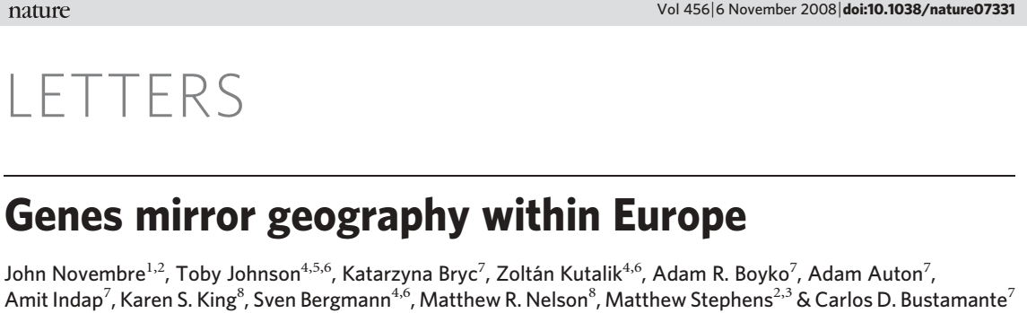
Here’s a beautiful application of PCA that illustrates how it can simplify complicated datasets:
Men
1
…
3000
1
What do you think are the most important genetic trends among European men?
What might this picture → look like?
Table of SNPs
Genotype ~3,000 European men
(measure ~500K SNPs each using DNA microarrays)
…
SNPs
…
Calculate the most important “trends” in the data
using Principal Component Analysis
500,000
PCA
Visualize their genetic relationships by plotting each man as a point in “genotype space”,
emphasizing only the most dominant genetic trends
Plot of main genetic trends among European men

Slide 18
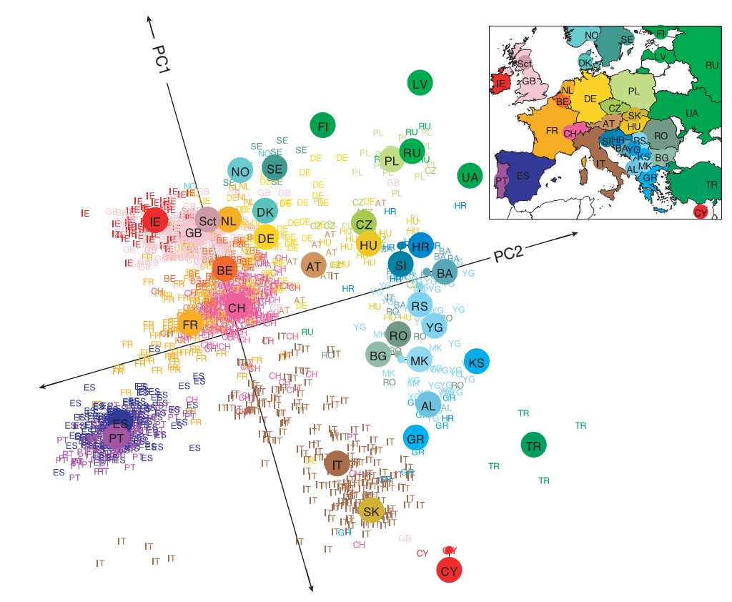

Slide 19
This is a map of their DNA. It recapitulates the map of Europe.
In other words, the strongest genetic trends across European men relate directly to their geographic locations
(note: not nationality)

Slide 20
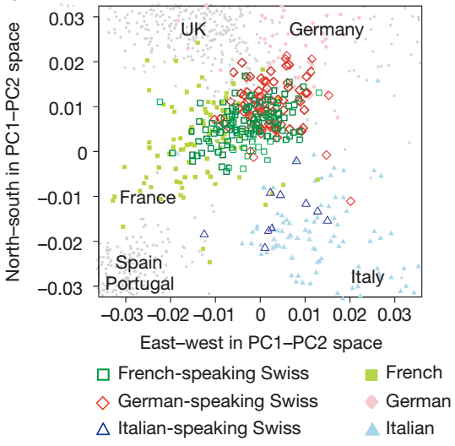
The trend even holds up within a country, e.g. Switzerland:

Slide 21
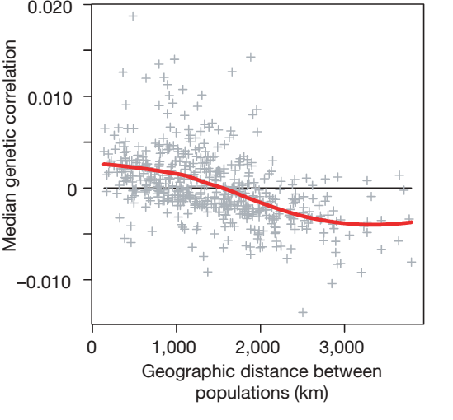
Why? Genetic similarity is strongly distance dependent in Europe, presumably because people tend to live near where they were born and tend to marry locally.

Slide 22
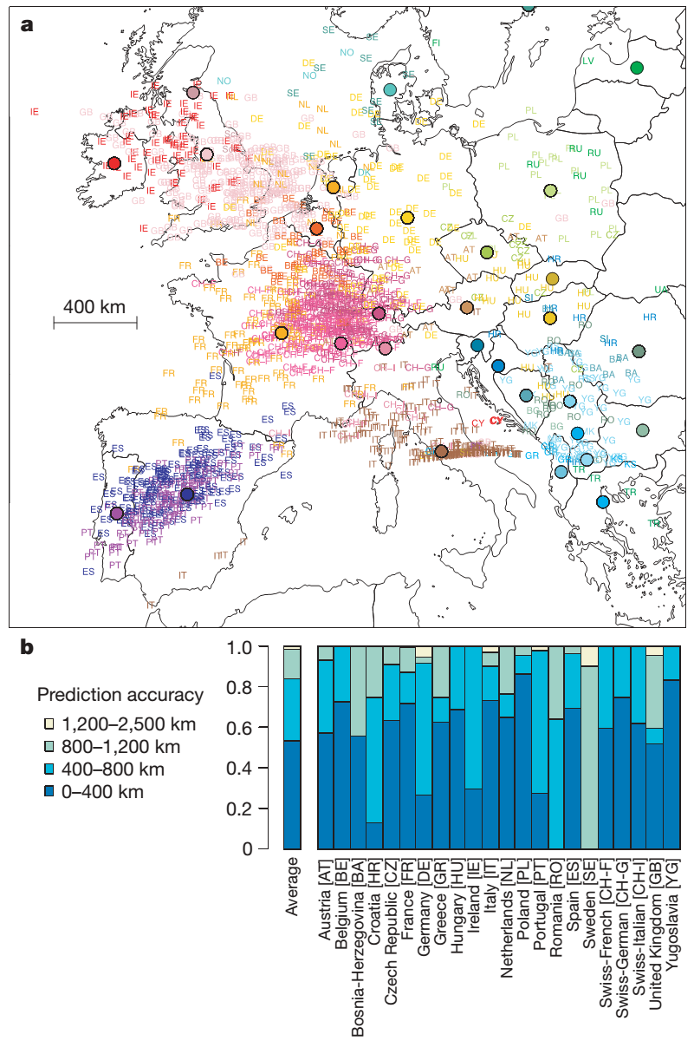
The trend is so strong that it can be used to predict where the men are from, e.g. shown here by leave-one-out cross-validation:

Slide 23
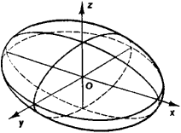
SUMMARY
In a sense, PCA fits a (multidimensional) ellipsoid to the data
Described by directions and lengths of principal (semi-)axes, e.g. the axis of a cigar or egg or the plane of a pancake
encyclopedia2.thefreedictionary.com
No matter how an ellipsoid is turned, the eigenvectors point in those principal directions. The eigenvalues give the lengths.
The biggest eigenvalues correspond to the fattest directions (having the most data variance). The smallest eigenvalues correspond to the thinnest directions (least data variance).
Ignoring the smallest directions (i.e., collapsing them) loses relatively little information.
Adapted from whuber, http://stats.stackexchange.com/questions/2691/making-sense-of-principal-component-analysis-eigenvectors-eigenvalues

