Slide 1


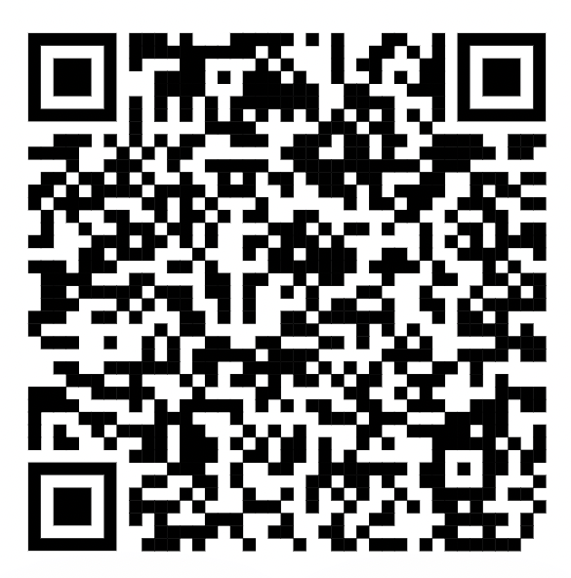










STEM MUSE + SAGES PRESENT
STEM MENTORSHIP PROGRAM!
SCAN THE QR CODE TO SIGN UP AS A MENTEE AND/OR MENTOR
Serves women & underrepresented-gendered people in STEM: undergrads, grad students, research staff, postdocs
One-on-One mentorship: Mentees choose mentors
Opportunity to connect with STEM companies & mentors
Networking and professional development opportunities: group mentorship, workshops, socials, and resume/CV-bolstering events
Flexible scheduling: pairs set schedule at kick-off (1 mtg./mo. for 6 months from February to July)
Option for in-person or virtual interactions
Conversation guides facilitate productive conversations
Testimonials: “10/10 would recommend”, “best and most organized”, “helped me figure out where I wanted to go and how to get there”
Mentors from more than 60 companies participated in our past programs (2020-2022), including:

Slide 2
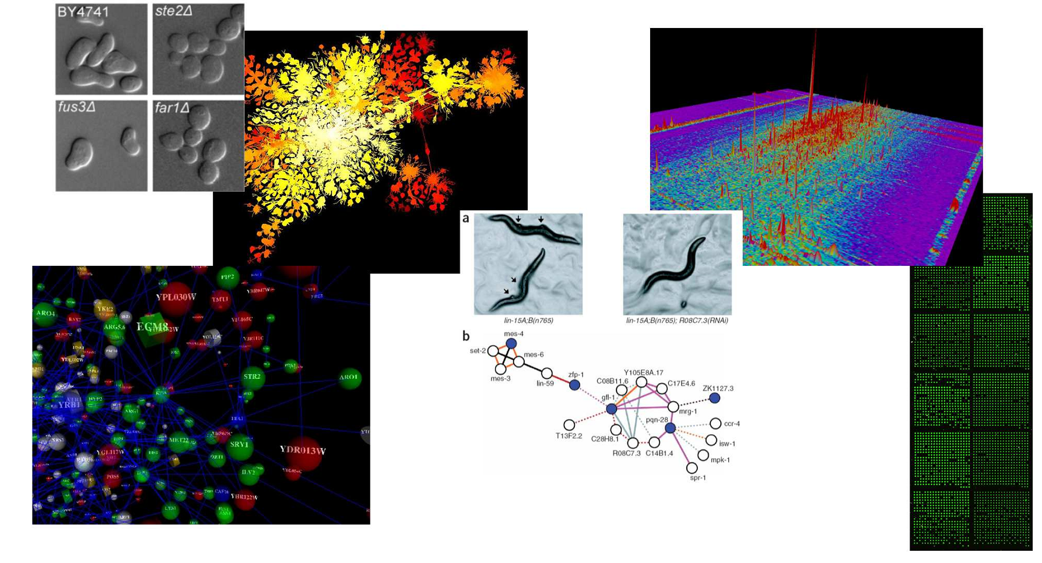
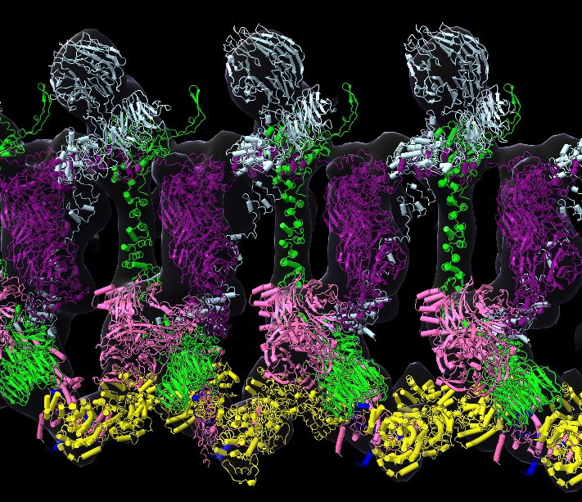
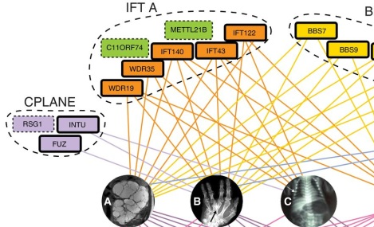
BCH394P/BCH364C Systems Biology & Bioinformatics
(course # 55425 / 55330)
Spring 2023 Tue/Thu 11 – 12:30 PM WEL 2.110

Slide 3
Instructor: Prof. Edward Marcotte marcotte@utexas.edu
Zoom office hours: Mon 4 – 5
TA: Matt McGuffie mmcguffie@utexas.edu
Coding/problem set help hours:
Wed 3 – 4/Thu 12:30 – 1:30 in MBB 1.448BA
or by appointment on zoom
After hours Q/A, discussion: Canvas
The class zoom channel will be posted on Canvas.
It will be the same zoom for class and office hours.

Slide 4
Probably the most important slide today!
Course web page:
http://www.marcottelab.org/
index.php/BCH394P_BCH364C_2023
This is a graduate student class!
It is open to a small # of upper division undergrads in natural sciences and engineering.
UG prerequisites: Biochemistry 339F with a grade of at least B; Computer Science 303E and Statistics and Data Sciences 328M (or Statistics and Scientific Computation 318M, 328M) with a grade of at least C-; and consent of the instructor.

Slide 5
An introduction to systems biology and bioinformatics, emphasizing quantitative analysis of high-throughput biological data, and covering typical data, data analysis, and computer algorithms.
Topics will include introductory probability and statistics, basics of Python programming, protein and nucleic acid sequence analysis, genome sequencing and assembly, proteomics, synthetic biology, analysis of large-scale gene expression data, data clustering, biological pattern recognition, and gene and protein networks.

Slide 6
Note: it’s NOT a course on practical sequence analysis or using web-based tools. We’ll use these occasionally, but the focus will be on learning the underlying algorithms, exploratory data analyses, and their applications, esp. in high-throughput biology.
By the end of the course, you’ll know the fundamentals of important algorithms in bioinformatics and systems biology, be able to design and run computational studies in biology, and have performed an element of original computational biology research

Slide 7
Books
Most of the lectures will be from research articles and slides. For sequence analysis, there will be an Optional text:
Biological sequence analysis, Durbin, Eddy, Krogh, Mitchison, Cambridge Univ. Press (available from Amazon, used & ebook)
For biologists rusty on their stats, The Cartoon Guide to Statistics (Gonick/Smith) is very good (really!).
We will also be learning intro Python programming.
The course web site lists some recommendations to help you out, such as the free web course Practical Python Programming
https://dabeaz-course.github.io/practical-python/
Important: There are bi-weekly coding/problem set help sessions.
Plan to attend at least one per week!

Slide 8
Grading
No exams. Grades will be based on:
Online programming homework
  (10 points each and counting 30% of the final grade)
3 problem sets
  (15 points each and counting 45% of the final grade)
A course project that you will develop over the semester & present in the last 3 days of class (25% of final grade)
The course project will consist of a research project on a bioinformatics topic chosen by the student (with approval by the instructor) containing an element of independent computational biology research (e.g. calculation, programming, database analysis, etc.) turned in as a web URL (20%) and presented in class (5%).
The project will be emailed as a web URL to the TA & I, developed through the semester and finished by 10 PM, April 12, 2023.
The last few classes will be spent presenting your projects.

Slide 9
Late policy
All projects and homework will be turned in electronically and time-stamped.
No makeup work will be given.
Instead, all students have 5 days of free “late time”.
  This is for the entire semester, NOT per project, and counting weekends/holidays just like any other day.
  For projects turned in late, days will be deducted from the 5 day total (or what remains of it) by the # of days late.
  Deductions are in 1 day increments, rounding up
    e.g. 10 minutes late = 1 day deducted.
  Once the 5 days are used up, assignments will be penalized 10% / day late (rounding up), e.g., a 50 point assignment turned in 1 ½ days late would be penalized 20%, or 10 points.

Slide 10
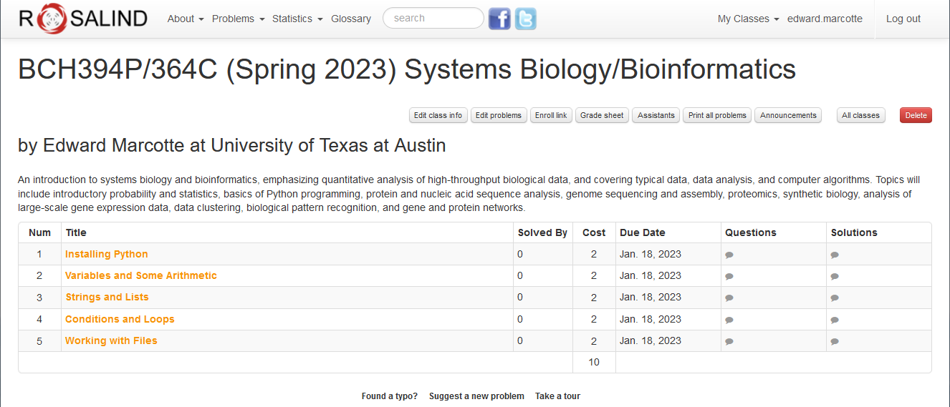
Online homework will be via Rosalind: http://rosalind.info/faq/
Enroll specifically for BCH394P/364C at:
https://rosalind.info/classes/enroll/fb013a1910/
The first homework will be due (in Rosalind) by 10 PM, Jan 18

Slide 11
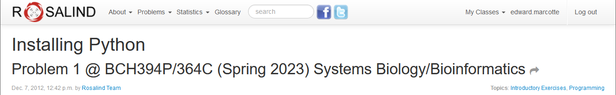
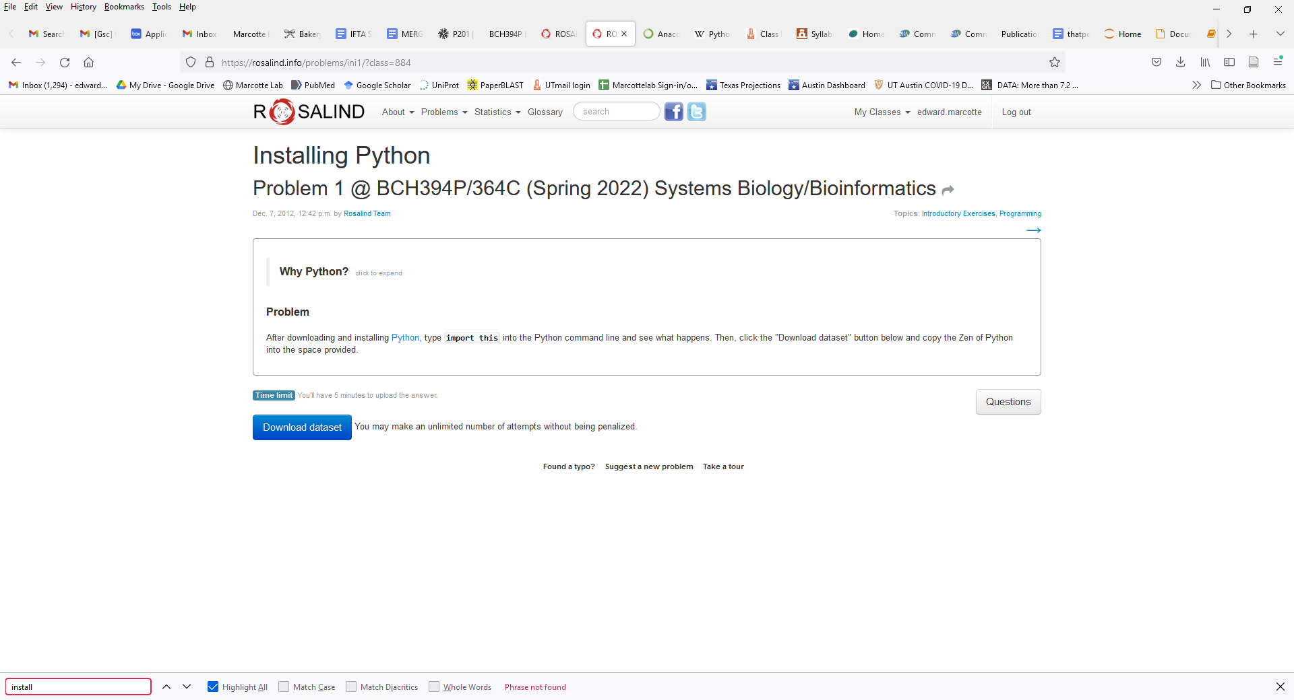

Slide 12
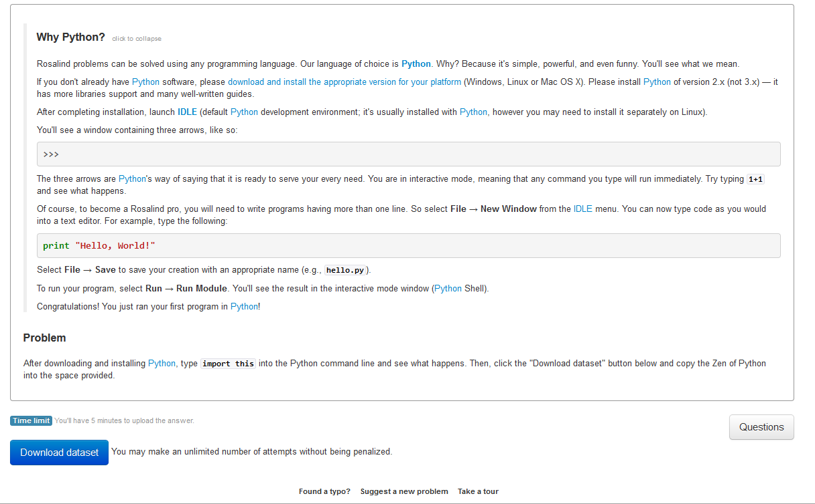
Rosalind uses Python version 2,
but we’ll use version 3
Rosalind uses the “vanilla” installation of Python.
You’re welcome to do it this way, but I
recommend Anaconda/Jupyter as a nicer option
Click here to turn in your answer

Slide 13
Installing Anaconda/Jupyter
My recommendation for a good, all-round Python installation is Anaconda, available free to individuals here:
https://www.anaconda.com/products/individual
***Get the latest Python 3 version***
(currently 3.9 in Anaconda, but any version >3 is probably fine)
Anaconda is a general management system for the various Python libraries and packages you might need, with >7,500 data science, visualization, and machine learning packages
Anaconda also provides multiple Python interfaces. For this course, I recommend using Jupyter Notebook, which can be launched directly from the main Anaconda navigation window.

Slide 14
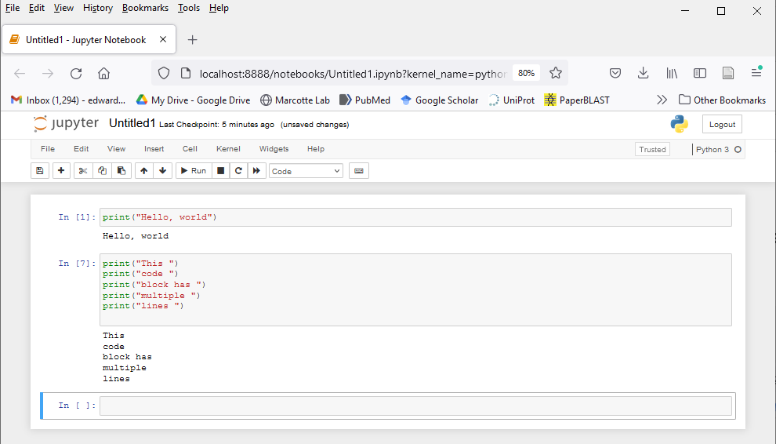
Jupyter is an interactive Python interface that shows your code & its output in successive entries in a shareable, archivable notebook viewable in any web browser, e.g.
Just type your command or code block
& press “Shift-Enter” (or any of the various
alternatives in the “cell” pulldown menu)
It’s widely used in bioinformatics and data visualization.

Slide 15
Back to Rosalind, for those of you that are a bit more advanced:
If you’re feeling restless/adventurous…

Slide 16
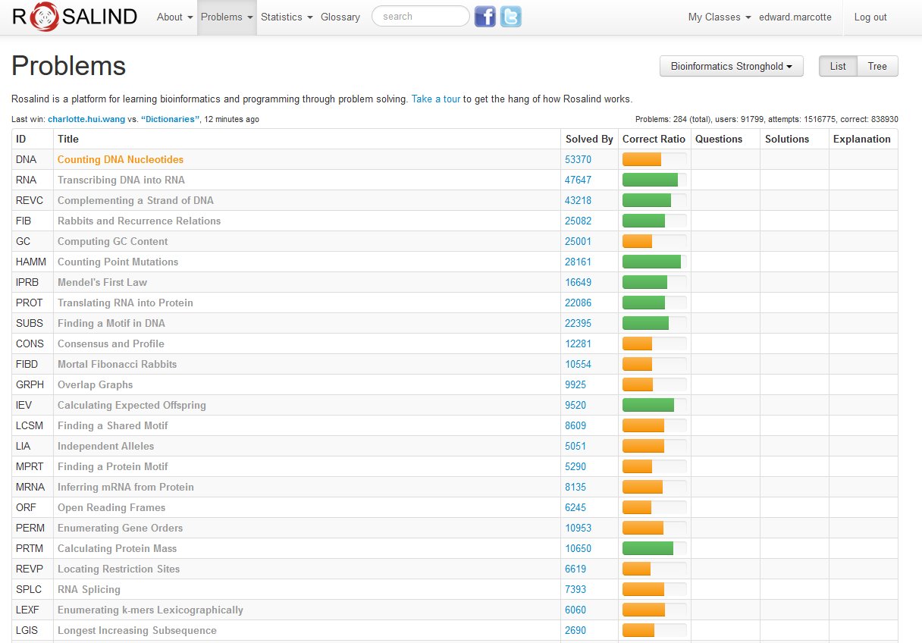
…there are quite a few good bioinformatics problems in the archives.
…
…
…

Slide 17
Expectations on working together
Students are welcome to discuss ideas and problems with each other, but all programs, Rosalind homework, problem sets, and written solutions
should be performed independently,
→ except the final presentation.
tl;dr: study/discuss together
do your own programming/writing/project
collaborate on the final presentation

Slide 18
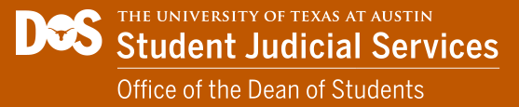

https://deanofstudents.utexas.edu/conduct/academicintegrity.php

Slide 19
By submitting as your own work any unattributed material that you obtained from other sources, you have committed plagiarism.
Copying homework solutions from other students or internet sources (e.g. CourseHero) is cheating, collusion, and/or plagiarism.
Software and computer code are legally considered in the same framework as other written works. Copying code directly without attribution is plagiarism.

Slide 20
Any materials found online (e.g. CourseHero) that are associated with you, or any suspected unauthorized sharing of materials, will be reported to Student Conduct and Academic Integrity in the Office of the Dean of Students. These reports can result in sanctions, including failure in the course.
See the university’s official policy on plagiarism here: https://catalog.utexas.edu/general-information/appendices/appendix-c/student-discipline-and-conduct/

Slide 21
You can use the internet to get ideas, programming suggestions and syntax, but downloading completed answers to assigned questions and submitting these as your own work is cheating/plagiarism.
Copying entire programs verbatim from marked repositories offering Rosalind homework solutions is cheating and plagiarism.

Slide 22
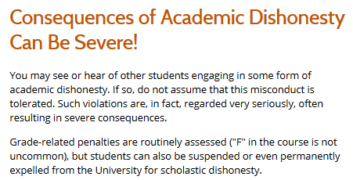
https://deanofstudents.utexas.edu/conduct/academicintegrity.php

Slide 23
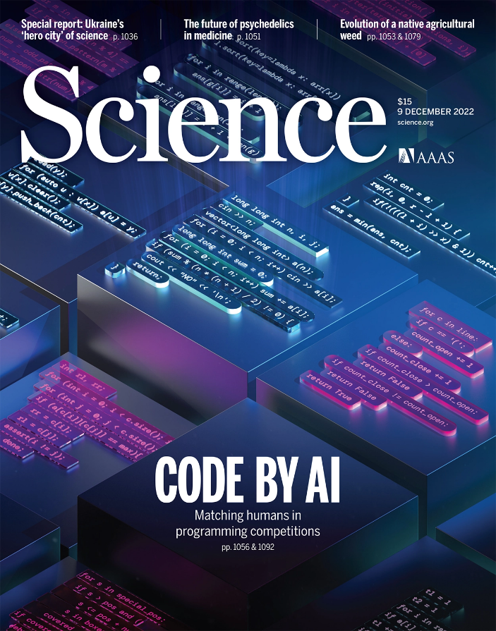
But there’s always an exception!
Later in the semester, we’ll try co-programming with AI using chatGPT, where the goal is to make the computer write the code for you

Slide 24
Why are we here?
(practically, not existentially)

Slide 25
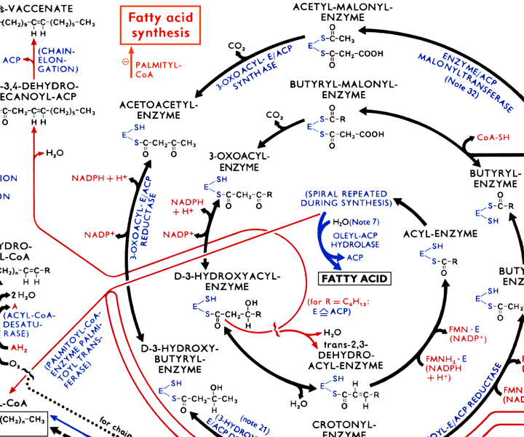
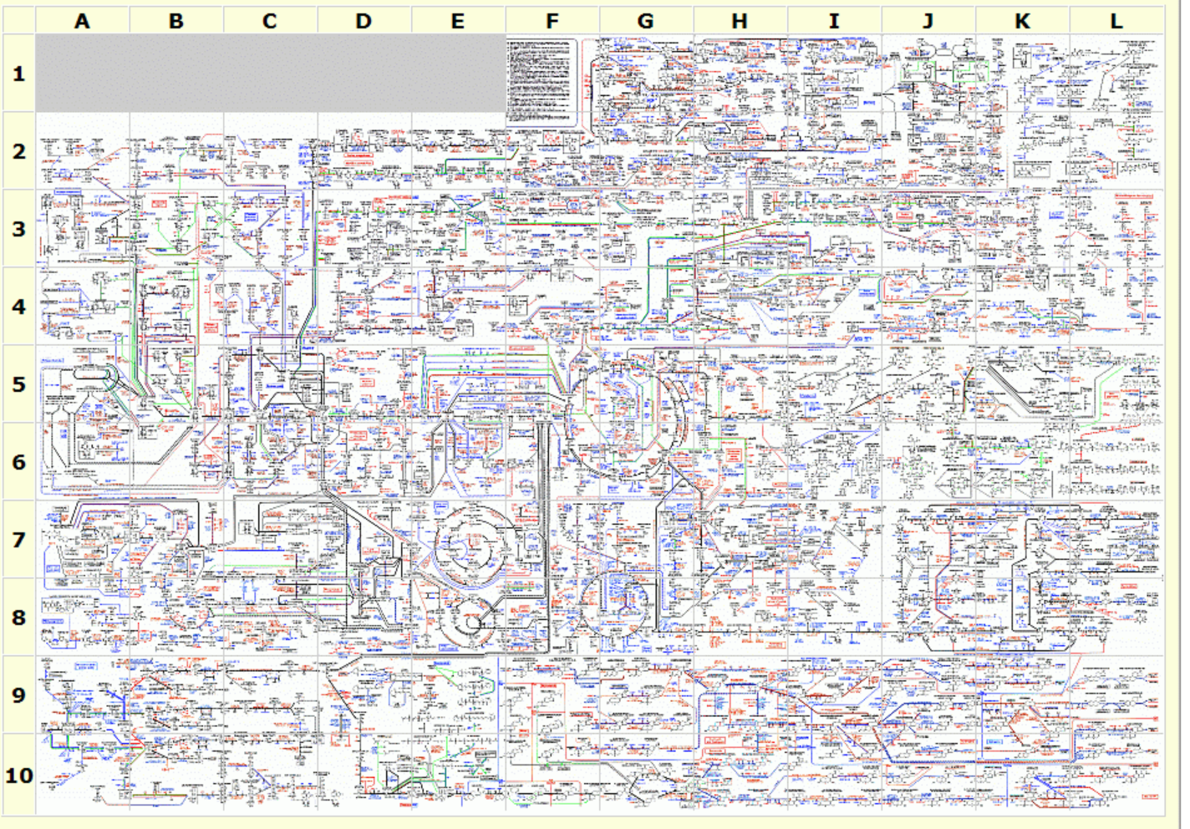
The metabolic wall chart…
http://web.expasy.org/cgi-bin/pathways/show_thumbnails.pl

Slide 26
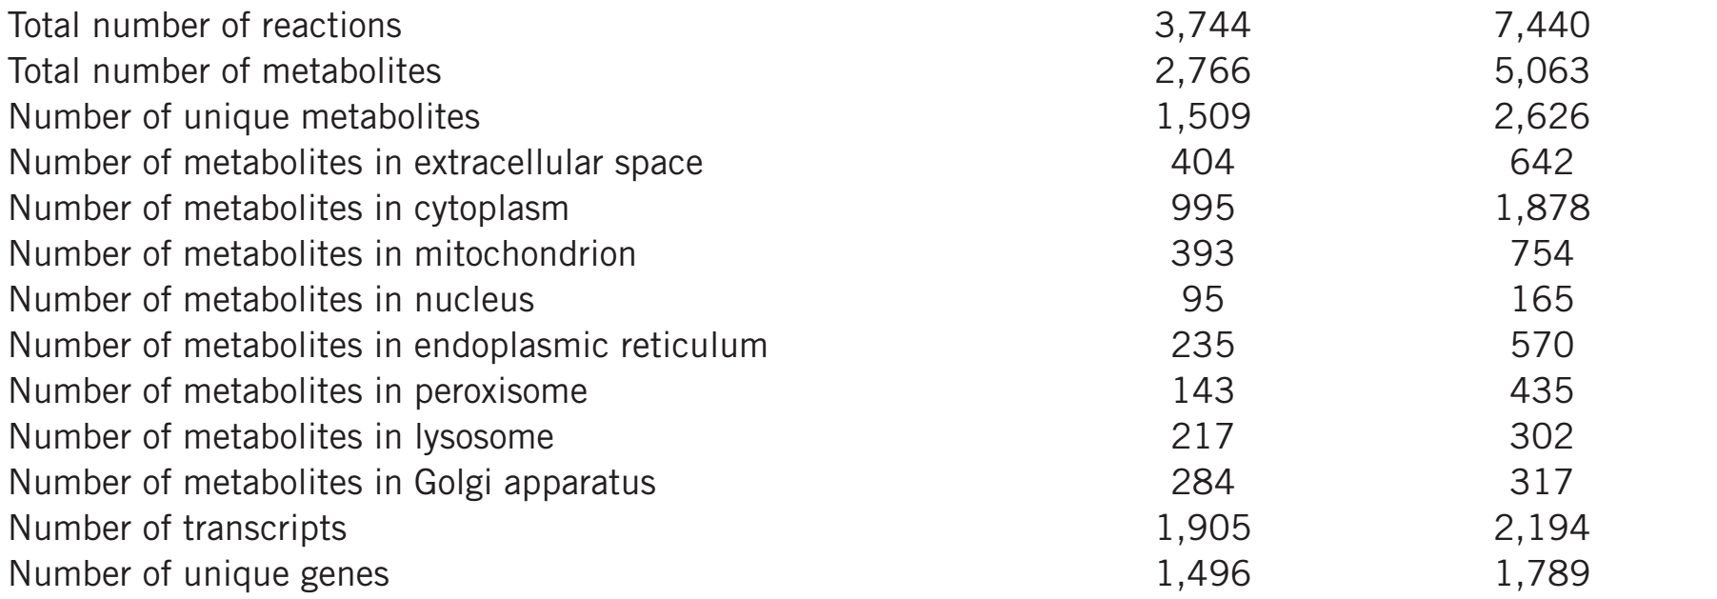
Our current-ish knowledge of human metabolism…
Nat Biotechnol. 2013 May;31(5):419-25
Updated in Metabolomics 2016 12:109

Slide 27
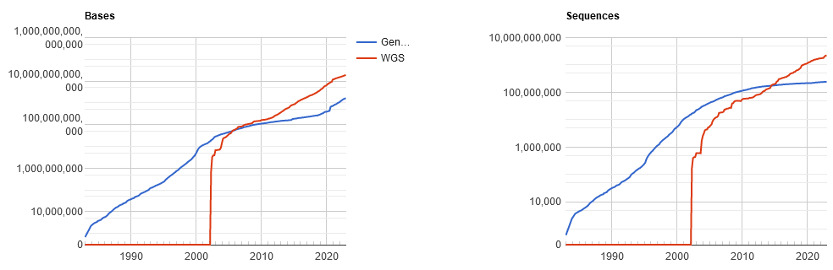
Pales beside the phenomenal explosion of DNA sequencing:
GenBank
December 2022:
1.6 trillion bp Genbank
+
19 trillion bp DNA
whole genome
shotgun sequencing
Here are the latest
statistics…
Which basically means GenBank is falling behind more every year!
http://www.ncbi.nlm.nih.gov/genbank/statistics

Slide 28
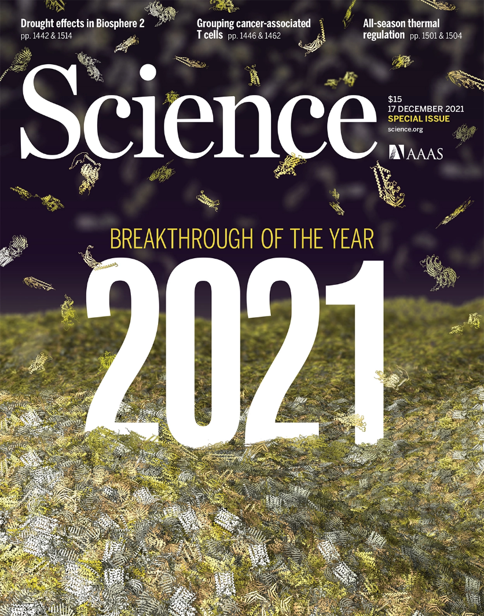
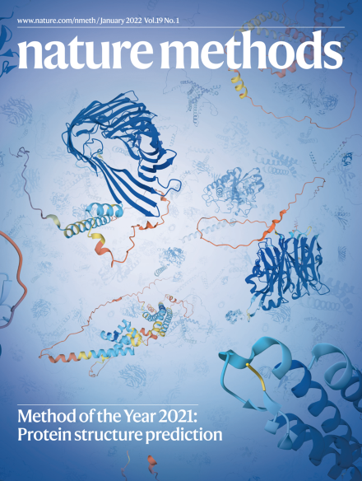
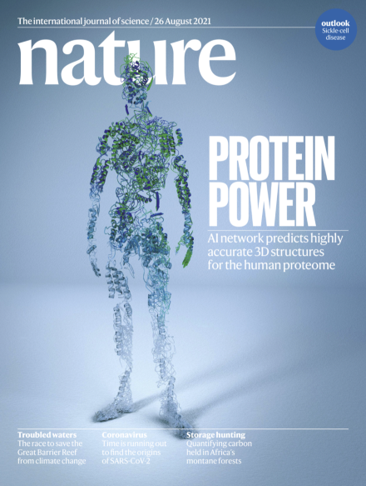
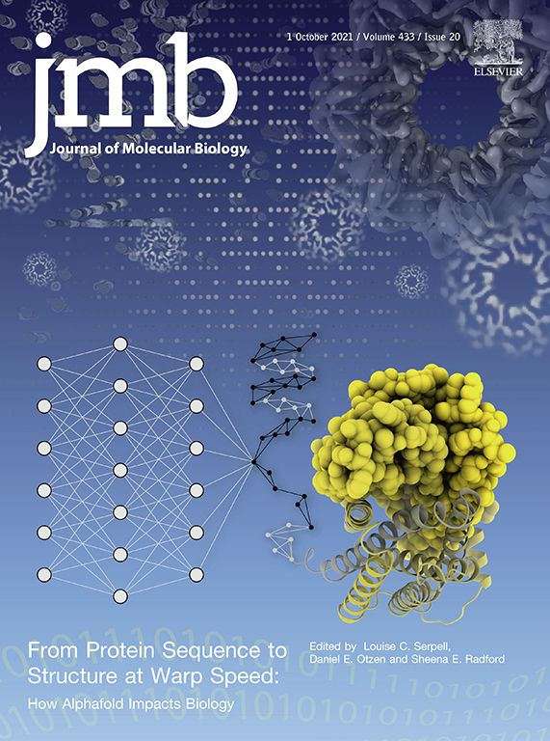
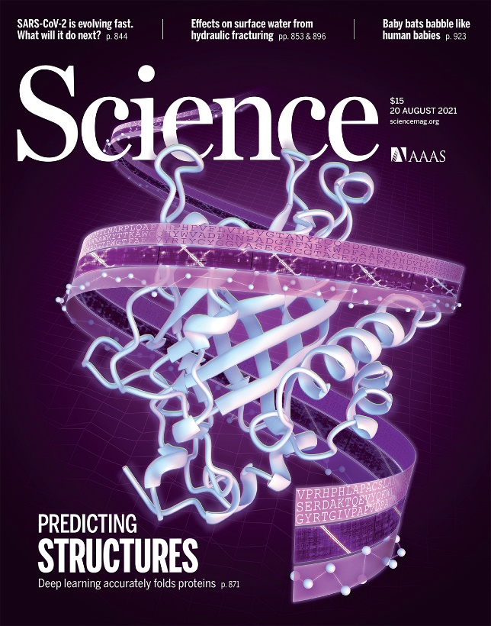

Slide 29
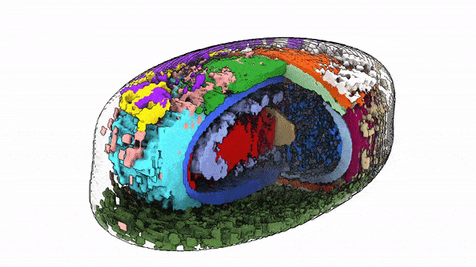
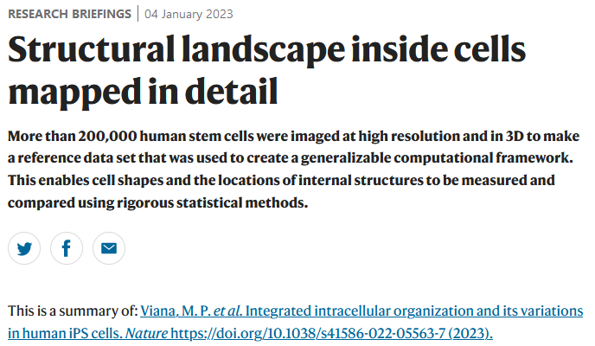
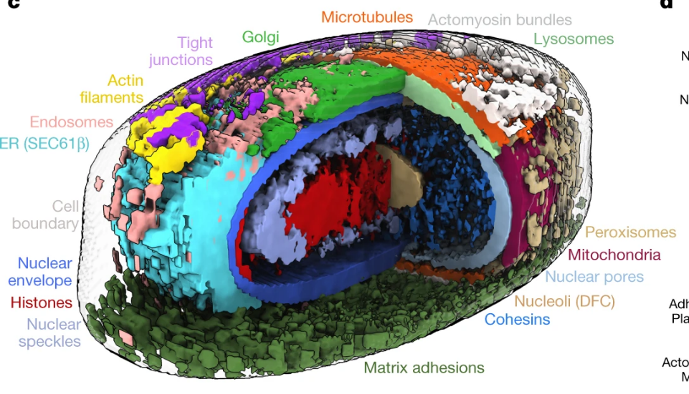
Just last week:

Slide 30
Why are we here? We have no choice!
Biologists are faced with a staggering deluge of data, growing exponentially
Bioinformatics/comp bio tools and approaches help us understand these data and work productively, and to build increasingly powerful models of biological systems
We’ll learn important basic concepts in this field and get exposed to key technologies driving the field

Slide 31
Specifically…
We’ll cover the following topics, approximately in this order:
BASICS OF PROGRAMMING
Introduction to Rosalind
A Python programming primer for non-programmers
Rosalind help & programming Q/A
BIOLOGICAL SEQUENCE ANALYSIS
Substitution matrices (BLOSSUM, PAM) & sequence alignment
Protein and nucleic acid sequence alignments, dynamic programming
Sequence profiles
BLAST! (the algorithm)
Biological databases
Markov processes and Hidden Markov Models

Slide 32
GENOMES, PROTEOMES, & "BIG BIOLOGY"
Gene finding algorithms
Genome assembly & how the human genome was sequenced
An introduction to large gene expression data sets
Promoter and motif finding, Gibbs sampling
Clustering algorithms, hierarchical, k-means, self-organizing maps,
force-directed maps
Classification algorithms
Principal component analysis and data transformations
NETWORK & SYNTHETIC BIOLOGY
Biological networks: metabolic, signaling, graphs, regulatory
Deep homology and the evolution of traits
Designing, simulating, and building gene circuits
Genome design and synthesis

Slide 33
Plus, expert guest lectures on:
More advanced Python techniques
NGS best practices
Protein mass spectrometry / proteomics
Protein 3D structural modeling
THE FINAL COURSE PROJECT IS DUE by 10 PM, April 12, 2023
The last 3 class days will be for presenting your projects

