Slide 1
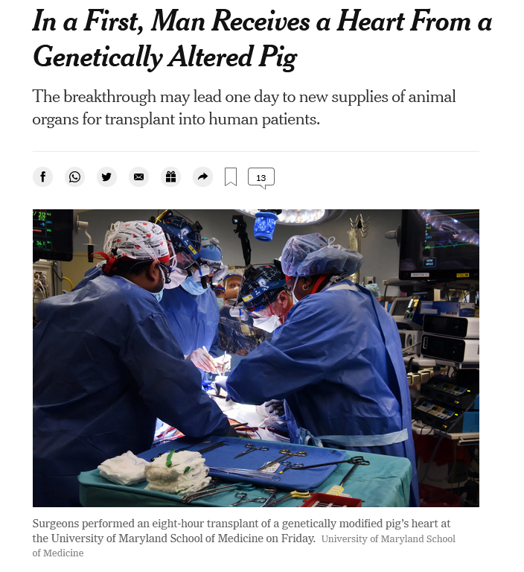
Science news of the day: “humanized” pigs!
“The heart transplanted into Mr. Bennett came from a genetically altered pig provided by Revivicor, a regenerative medicine company based in Blacksburg, Va.”
“The pig had 10 genetic modifications. Four genes were knocked out, or inactivated, including one that encodes a molecule that causes an aggressive human rejection response.”
“A growth gene was … inactivated to prevent the pig’s heart from continuing to grow...”
“In addition, six human genes were inserted into the genome of the donor pig — modifications designed to make the porcine organs more tolerable to the human immune system.”
https://www.nytimes.com/2022/01/10/health/heart-transplant-pig-bennett.html

Slide 2


Slide 3
A Python programming primer for biologists
(Named after Monty Python’s Flying Circus & designed to be fun to use)
Systems Biology/Bioinformatics
Edward Marcotte, Univ of Texas at Austin

Slide 4
In bioinformatics, you often want to do completely new analyses. Having the ability to program a computer opens all sorts of research opportunities. Plus, it’s fun!
Most bioinformatics researchers use a scripting language, such as Python, Perl, or R, rather than a compiled language like C++
These languages are not the fastest, not the slowest, nor best, nor worst languages, but they’re easy to learn and write, and for many reasons, are well-suited to bioinformatics.
We’ll spend the next 2 lectures introducing Python to give you a sense for the language and help introduce the basics of algorithms.

Slide 5
Python documentation: http://www.python.org/doc/
& tips: http://www.tutorialspoint.com/python
Good introductory Python books:
Learning Python, Mark Lutz & David Ascher, O’Reilly Media
Bioinformatics Programming Using Python: Practical Programming for Biological Data, Mitchell Model, O'Reilly
Good intro video (from a 2 day intro class at Google):
https://www.youtube.com/playlist?list=PLC8825D0450647509
Practical Python, a self-paced online intro course:
https://dabeaz-course.github.io/practical-python/
An online Python tutor with a nice interactive code viewer:
http://www.pythontutor.com/

Slide 6
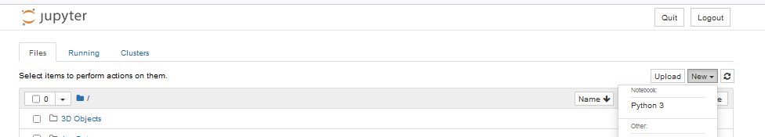
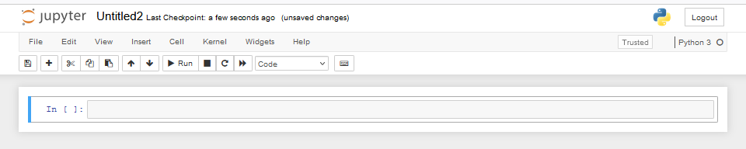
By now, you should have installed Python on your computer.
If you’re using Anaconda/Jupyter, it runs in a web browser:
Launch a new notebook
You can write your commands and programs here and they will be evaluated when you press Shift-Enter (or other options from the Cell pulldown menu)

Slide 7
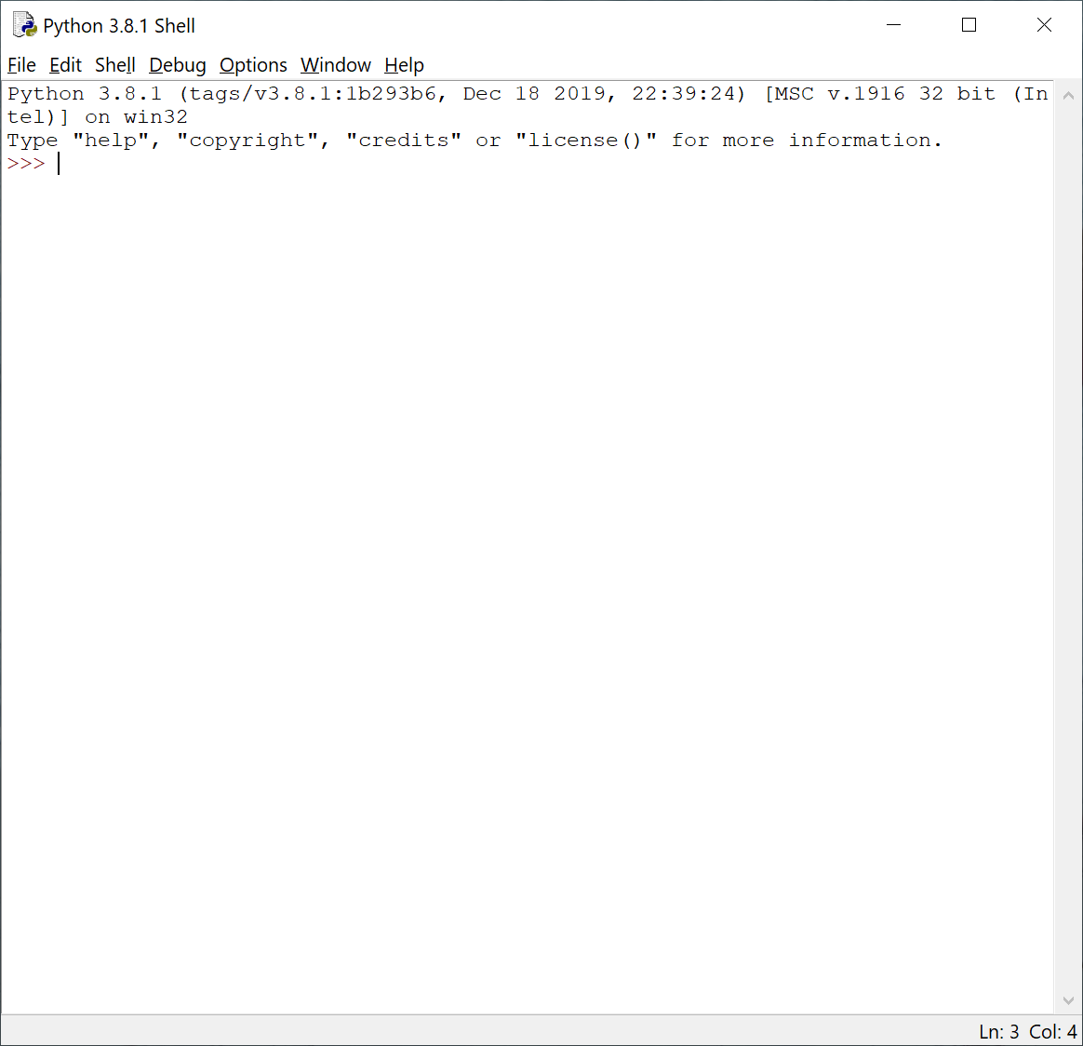
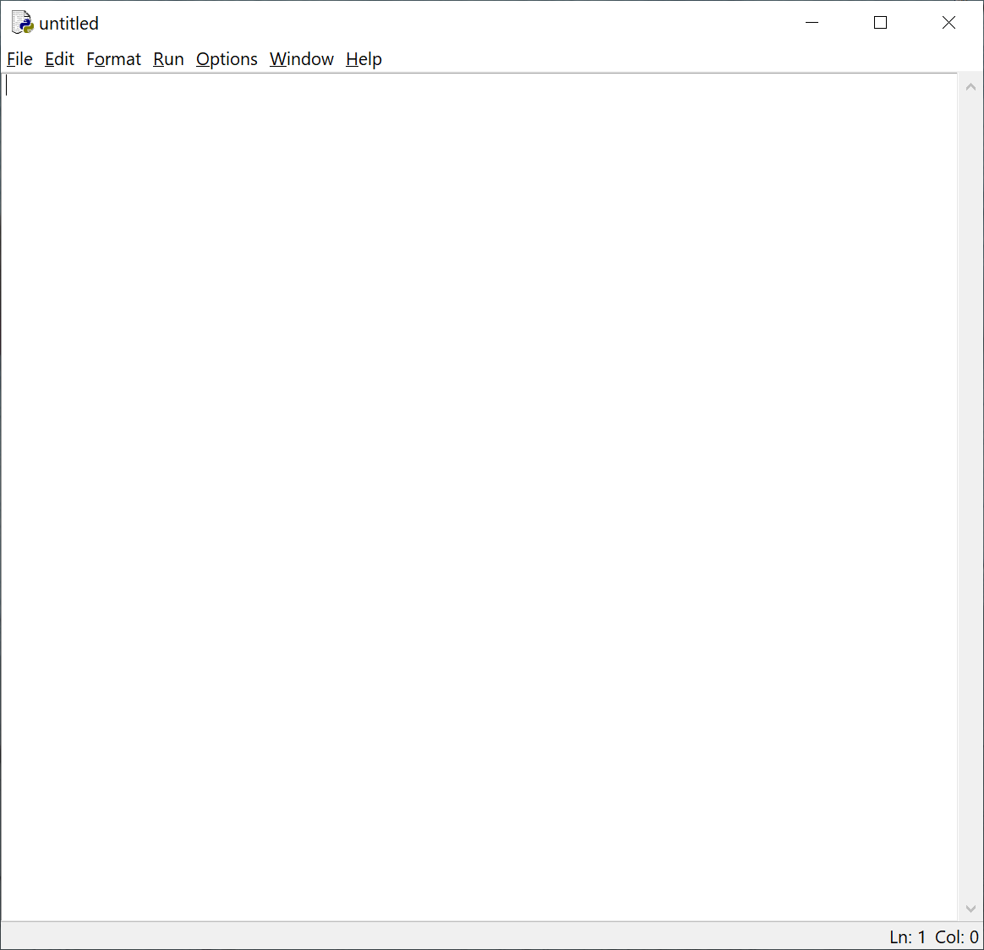
Or if you installed IDLE by following the instructions in Rosalind Homework problem #1:
Launch IDLE:
You can test out commands here
to make sure they work…
…but to actually write your programs,
open a new window.
This window will serve as a command line
interface & display your program output.
This window will serve as a text editor for programming.

Slide 8
Let’s start with some simple programs in Python:
A very simple example is:
print("Hello, future bioinformatician!") # print out the greeting
Run the program. In Jupyter, you can just type Shift-Enter & the output will appear below this cell of the notebook.
The output looks like this:
Hello, future bioinformatician!
FYI: This is version agnostic. Python 3 takes print(“X”). Python 2 also takes print “X” as in Rosalind

Slide 9
A slightly more sophisticated version:
name = input("What is your name? ") # asks a question and saves the answer
# in the variable "name"
print("Hello, future bioinformatician " + name + "!") # print out the greeting
When you run it this time, the output looks like:
What is your name?
If you type in your name, followed by the enter key, the program will print:
Hello, future bioinformatician Alice!
FYI: Python 2.x uses raw_input() instead of input()

Slide 10
GENERAL CONCEPTS
Names, numbers, words, etc. are stored as variables.
Variables in Python can be named essentially anything except words Python uses as command.
For example:
BobsSocialSecurityNumber = 456249685
mole = 6.022e-23
password = "7 infinite fields of blue"
Note that strings of letters and/or numbers are in quotes, unlike numerical values.

Slide 11
LISTS
Groups of variables can be stored as lists.
A list is a numbered series of values,
like a vector, an array, or a matrix.
Lists are variables, so you can name them just as you would name any other variable.
Individual elements of the list can be referred to using [] notation:
The list nucleotides might contain the elements nucleotides[0] = "A"
nucleotides[1] = "C"
nucleotides[2] = "G"
nucleotides[3] = "T"
(Notice the numbering starts from zero. This is standard in Python.)

Slide 12
DICTIONARIES
A VERY useful variation on lists is called a dictionary or dict (sometimes also called a hash).
Groups of values indexed not with numbers (although they could be) but with other values.
Individual hash elements are accessed like array elements:
For example, we could store the genetic code in a hash named codons, which might contain 64 entries, one for each codon, e.g.
codons["ATG"] = "Methionine"
codons["TAG"] = "Stop codon"
etc…

Slide 13
Now, for some control over what happens in programs.
There are two very important ways to control the logical flow of your programs:
if statements
and
for loops
There are some other ways too, but this will get you going for now.

Slide 14
if statements
if dnaTriplet == "ATG":
# Start translating here. We’re not going to write this part
# since we’re really just learning about IF statements
else:
# Read another codon
Python cares about the white space (tabs & spaces) you use!
This is how it knows where the conditional actions that follow begin and end. These conditional steps must always be indented by the same number of spaces (e.g., 4).
I recommend using a tab (rather than spaces) so you’re always consistent.

Slide 15
Note: in the sense of performing a comparison, not as in setting a value.
== equals
!= is not equal to
< is less than
> is greater than
<= is less than or equal to
>= is greater than or equal to
Can nest these using parentheses and Boolean operations, such as and, not, or or, e.g.:
if dnaTriplet == "TAA" or dnaTriplet == "TAG" or dnaTriplet == "TGA":
print("Reached stop codon")

Slide 16
for loops
Often, we’d like to perform the same command repeatedly or with slight variations.
For example, to calculate the mean value of the number in an array, we might try:
Take each value in the array in turn.
Add each value to a running sum.
Divide the total by the number of values.

Slide 17
In Python, you could write this as:
grades = [93, 95, 87, 63, 75] # create a list of grades
sum = 0.0 # variable to store the sum
for grade in grades: # iterate over the list called grades
sum = sum + grade # indented commands are executed on
# each cycle of the loop.
mean = sum / 5 # now calculate the average grade
print ("The average grade is ",mean) # print the results
In general, Python cares whether numbers are integers or floating point (also long integers and complex numbers).
You can tell Python you want floating point by defining your variables accordingly
(e.g., X = 1.0 versus X = 1)
Python 2 Python 3
>>> 2 / 3 >>> 2 / 3
0 0.666666
Python 2.x: print ("The average grade is "),mean

Slide 18
In general, Python will perform most mathematical operations, e.g.
multiplication (A * B)
division (A / B)
exponentiation (A ** B)
etc.
There are lots of advanced mathematical capabilities you can explore later on.

Slide 19
READING FILES
You can use a for loop to read text files line by line:
count = 0 # Declare a variable to count lines
file = open("mygenomefile", "r") # Open a file for reading (r)
for raw_line in file: # Loop through each line in the file
line = raw_line.rstrip("\r\n") # Remove newline
words = line.split(" ") # split the line into a list of words
# Print the appropriate word:
print ("The first word of line {0} of the file is {1}".format(count, words[0]))
count += 1 # shorthand for count = count + 1
file.close() # Last, close the file.
print ("Read in {0} lines\n".format(count))
Stands for “read”
\r = carriage return
\n = newline
Increment counter by 1
Placeholders (e.g., {0}) in the print statement indicate variables listed at the end of the line after the format command
Note: Python expects the file to be in your working directory or that you give it a full path.

Slide 20
WRITING FILES
Same as reading files, but use "w" for ‘write’:
file = open("test_file", "w")
file.write("Hello!\n")
file.write("Goodbye!\n")
file.close() # close the file as you did before
Unless you specify otherwise, you can find the new text file you created (test_file) in the default Python directory on your computer. In Jupyter, you should see now it appear in the Jupyter home page directory.

Slide 21
PUTTING IT ALL TOGETHER
seq_filename = "Ecoli_genome.txt"
total_length = 0
nucleotide = {} # create an empty dictionary
seq_file = open(seq_filename, "r")
for raw_line in seq_file:
line = raw_line.rstrip("\r\n")
length = len(line) # Python function to calculate the length of a string
for nuc in line:
if nuc not in nucleotide:
nucleotide[nuc] = 1
else:
nucleotide[nuc] += 1
total_length += length
seq_file.close()
for n in nucleotide.keys():
fraction = 100.0 * nucleotide[n] / total_length
print ("The nucleotide {0} occurs {1} times, or {2} %".format(n, nucleotide[n], fraction))

Slide 22
Let’s choose the input DNA sequence in the file to be the genome of E. coli, available the class web site (& originally from the Entrez genomes web site)
The format of the file is ~77,000 lines of A’s, C’s, G’s and T’s:
AGCTTTTCATTCTGACTGCAACGGGCAATATGTCTCTGTGTGGATTAAAAAAAGAGTGTC
TGATAGCAGCTTCTGAACTGGTTACCTGCCGTGAGTAAATTAAAATTTTATTGACTTAGG
TCACTAAATACTTTAACCAATATAGGCATAGCGCACAGACAGATAAAAATTACAGAGTAC
ACAACATCCATGAAACGCATTAGCACCACCATTACCACCACCATCACCATTACCACAGGT
etc…
Running the program produces the output:
The nucleotide A occurs 1142136 times, or 24.619133255346103 %
The nucleotide G occurs 1176775 times, or 25.365788782211496 %
The nucleotide C occurs 1179433 times, or 25.42308288395832 %
The nucleotide T occurs 1140877 times, or 24.591995078484082 %
So, now we know that the four nucleotides are present in roughly equal numbers in the E. coli genome.

