Slide 1
Motifs
BCH394P/364C - Systems Biology / Bioinformatics
Edward Marcotte, Univ of Texas at Austin

Slide 2
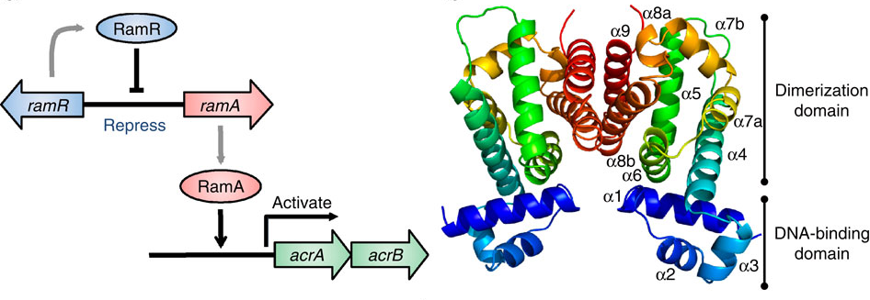
An example transcriptional regulatory cascade
Here, controlling Salmonella bacteria multidrug resistance
Sequence-specific DNA binding
RamR represses the ramA gene, which encodes the activator protein for the acrAB drug efflux pump genes.
RamR dimer
Nature Communications 4, Article number: 2078 doi:10.1038/ncomms3078

Slide 3
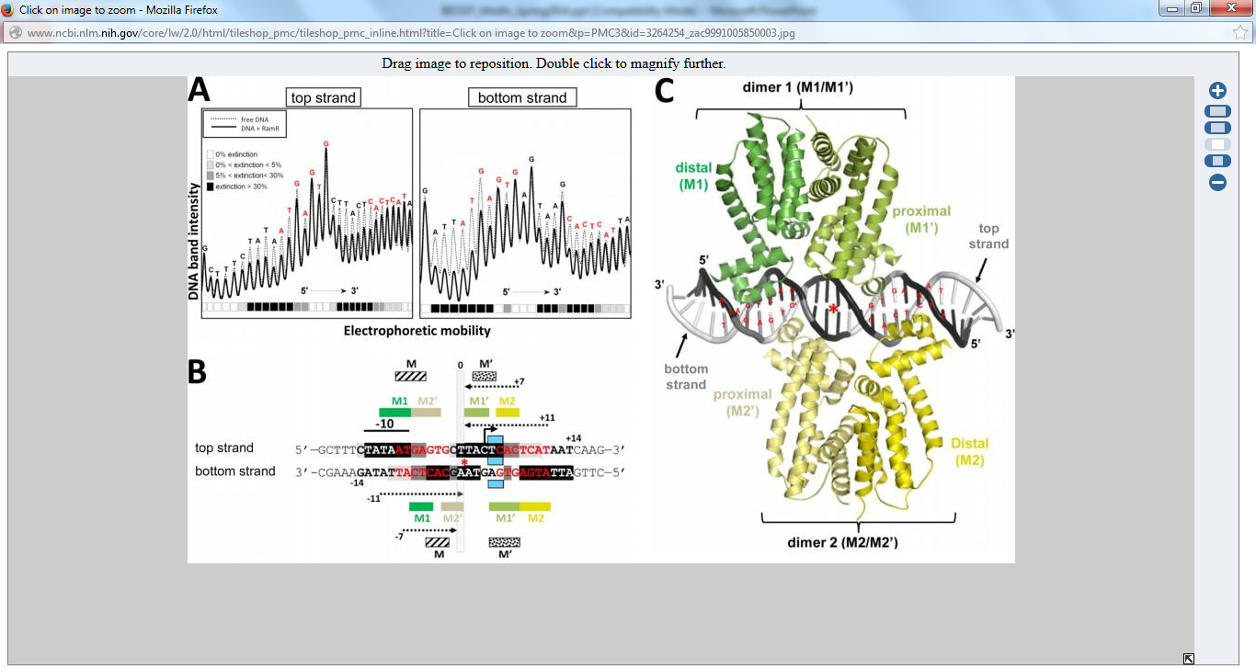
Historically, DNA and RNA binding sites were defined biochemically (DNAse footprinting, gel shift assays, etc.)
Hydroxyl radical footprinting of ramR-ramA intergenic region with RamR
Antimicrob Agents Chemother. Feb 2012; 56(2): 942–948.

Slide 4
Historically, DNA and RNA binding sites were defined biochemically (DNAse footprinting, gel shift assays, etc.)
Now, many binding motifs are discovered bioinformatically
Isolate different nucleic acid segments bound by copies of the protein
(e.g. all sites bound across a genome)
Sequence
Search computationally for recurring motifs
Image: Antimicrob Agents Chemother. Feb 2012; 56(2): 942–948.

Slide 5
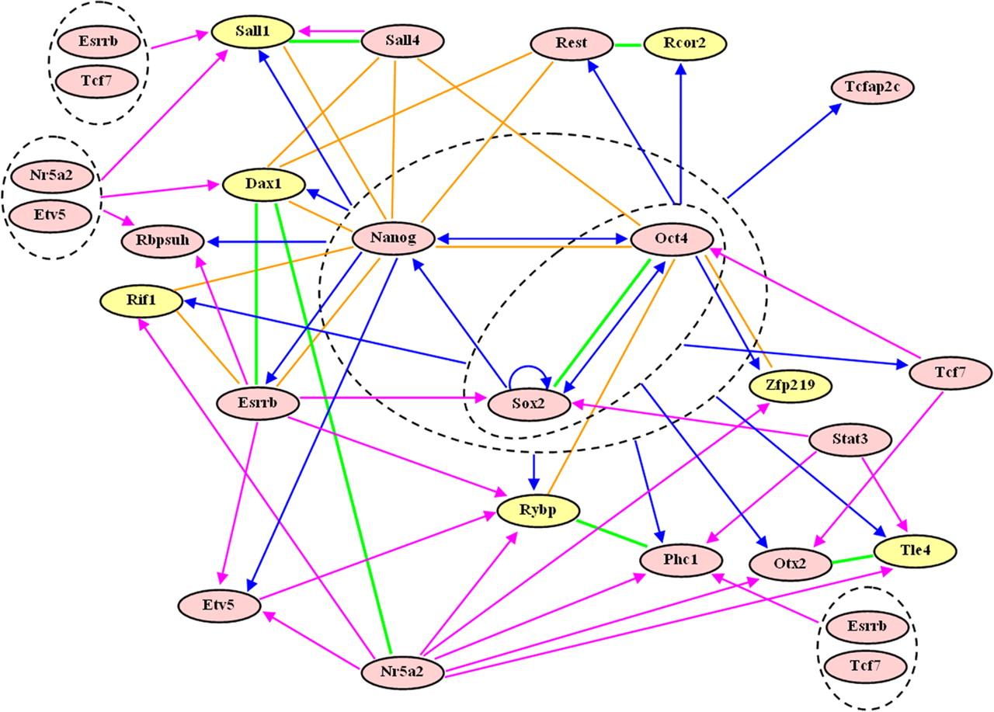
Transcription factor regulatory networks can be highly complex, e.g. as for embryonic stem cell regulators
TF
TF
target
PPI
http://www.pnas.org/content/104/42/16438

Slide 6
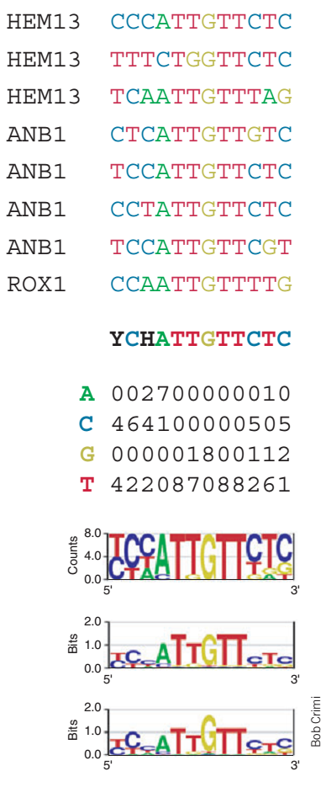
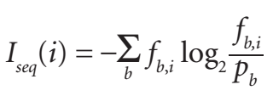
MOTIFS
Binding sites of the transcription factor ROX1
consensus
frequencies
frequency of nuc b at position i
scaled by information
content
freq of nuc b in genome

Slide 7
So, here’s the challenge:
Given a set of DNA sequences that contain a motif (e.g., promoters of co-expressed genes), how do we discover it computationally?

Slide 8
Could we just count all instances of each k-mer?
Why or why not?
→ promoters and DNA binding sites are not well conserved

Slide 9
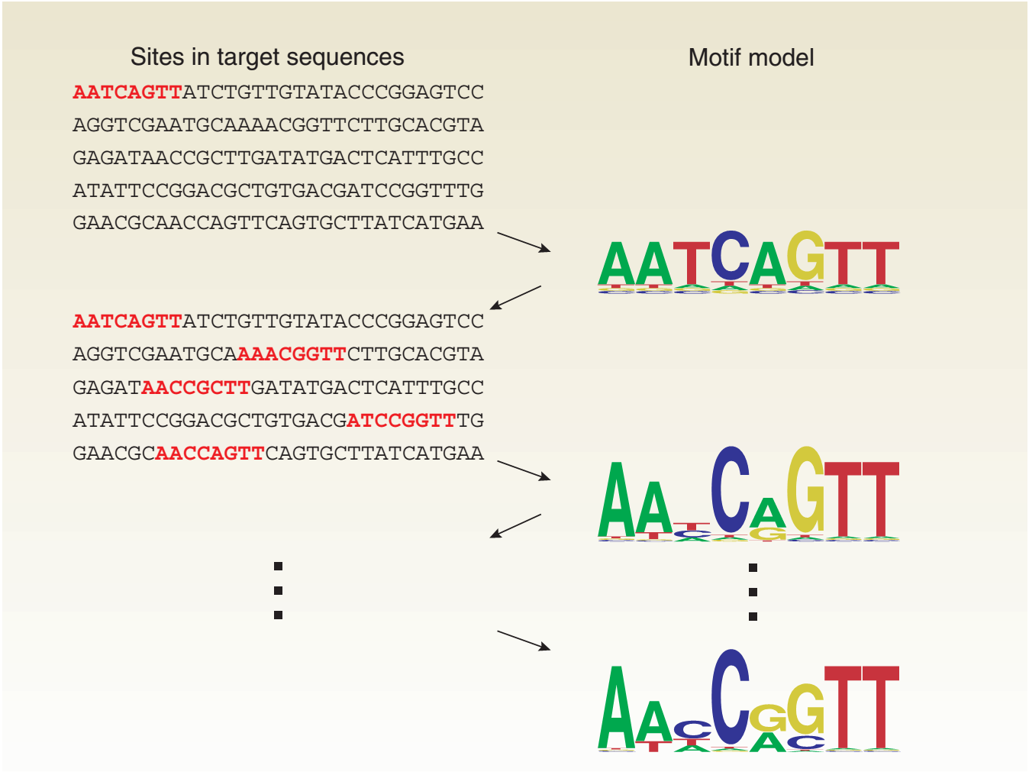
How does motif discovery work?

Slide 10
How does motif discovery work?
Assign sites to motif
Update the motif model
Assign sites to motif
Update the motif model
Assign sites to motif
Update the motif model
etc.

Slide 11
How does motif discovery work?
Motif finding often uses expectation-maximization
i.e. alternating between building/updating a motif model and assigning sequences to that motif model.
Searches the space of possible motifs for optimal solutions without testing everything.
Most common approach = Gibbs sampling

Slide 12
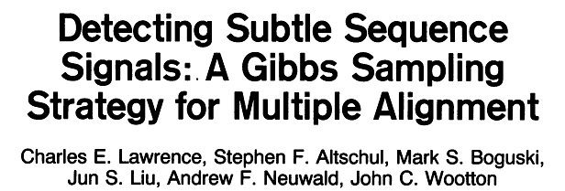
We will consider N sequences, each with a motif of length w:
A_{k} = position in seq k of motif
k
N seqs
w
q_{ij} = probability of finding nucleotide (or aa) j at position i in motif
i ranges from 1 to w
j ranges across the nucleotides (or aa)
p_{j} = background probability of finding nucleotide (or aa) j

Slide 13
NOTE: You won’t give any information at all about what or where the motif should be!
Start by choosing w and randomly positioning each motif:
A_{k} = position in seq k of motif
k
N seqs
Completely randomly positioned!
q_{ij} = probability of finding nucleotide (or aa) j at position i in motif
i ranges from 1 to w
j ranges across the nucleotides (or aa)
p_{j} = background probability of finding nucleotide (or aa) j

Slide 14

Predictive update step: Randomly choose one sequence,
calculate q_{ij} and p_{j} from N-1 remaining sequences
Randomly choose
background frequency of symbol j
Update model w/ these
count of symbol j at position i
Σb_{j}
q_{ij} = probability of finding nucleotide (or aa) j at position i in motif
i ranges from 1 to w
j ranges across the nucleotides (or aa)
p_{j} = background probability of finding nucleotide (or aa) j
p_{j} is calculated similarly from the counts outside the motifs

Slide 15
Stochastic sampling step: For withheld sequence, slide motif down sequence & calculate agreement with model
Withheld sequence
Odds ratio of agreement with model vs. background
c_{xij}
Π(q_{ij})
c_{xij}
Π(p_{j})
Position in sequence
(see the paper for details)

Slide 16
Stochastic sampling step: For withheld sequence, slide motif down sequence & calculate agreement with model
Withheld sequence
Odds ratio of agreement with model vs. background
c_{xij}
Π(q_{ij})
c_{xij}
Π(p_{j})
Position in sequence
(see the paper for details)
Here’s the cool part: DON’T just choose the maximum.
INSTEAD, select a new A_{k} position proportional to this odds ratio.
Then, choose a new sequence to withhold, and repeat everything.

Slide 17
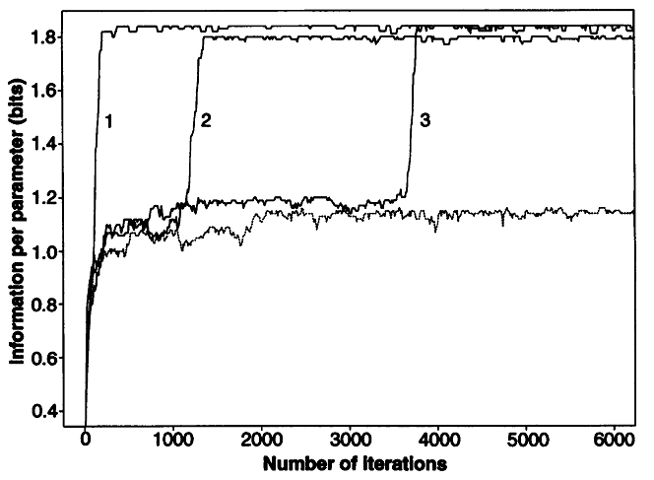
Over many iterations, this magically converges to the most enriched motifs. Note, it’s stochastic:
3 runs on the same data

Slide 18
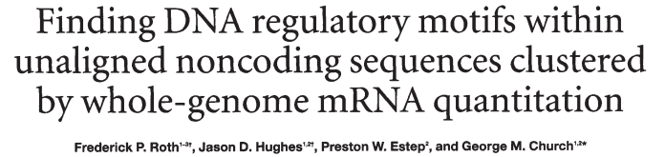
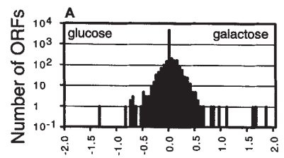

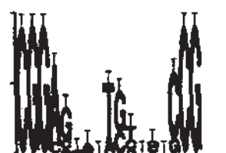

galactose
vs.
glucose
Measure mRNA abundances using DNA microarrays
Search for motifs in promoters of glucose vs galactose controlled genes
Discovered motifs
Known motif
Galactose upstream activation sequence
“AlignAce”

Slide 19
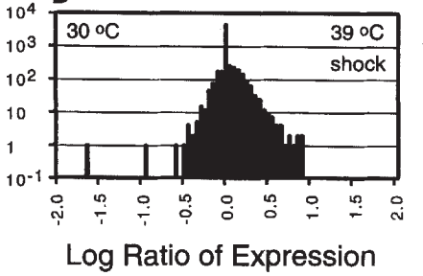
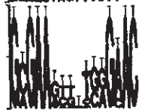


heat shock
vs.
30 °C
Measure mRNA abundances using DNA microarrays
Search for motifs in promoters of heat-induced and repressed genes
Discovered motifs
Known motif
Cell cycle activation motif, histone activator
“AlignAce”

Slide 20
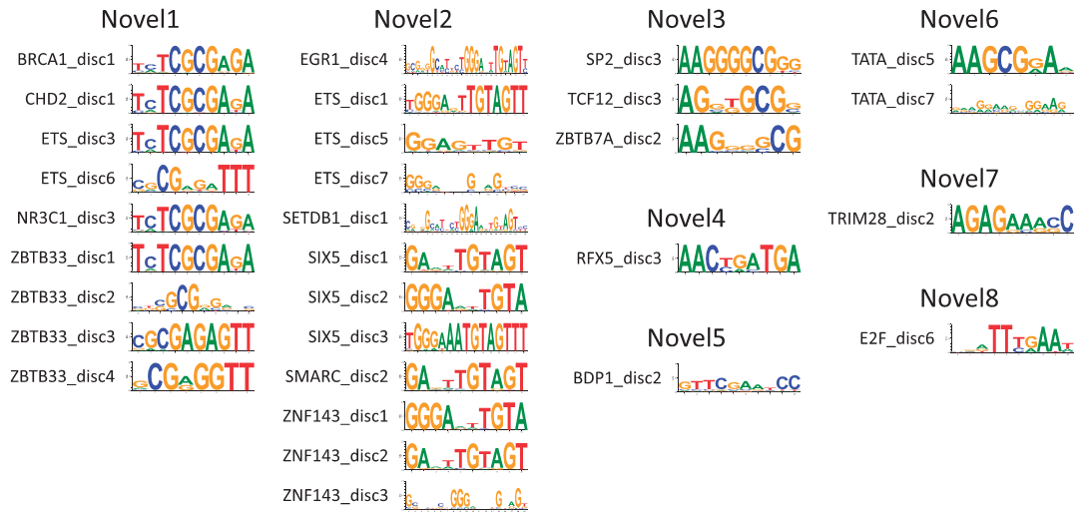
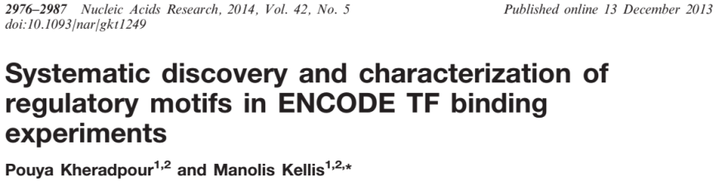
If you need them, we now know the binding motifs for 100’s of transcription factors at 1000’s of distinct sites in the human genome, including many new motifs.
e.g., http://compbio.mit.edu/encode-motifs/

Slide 21
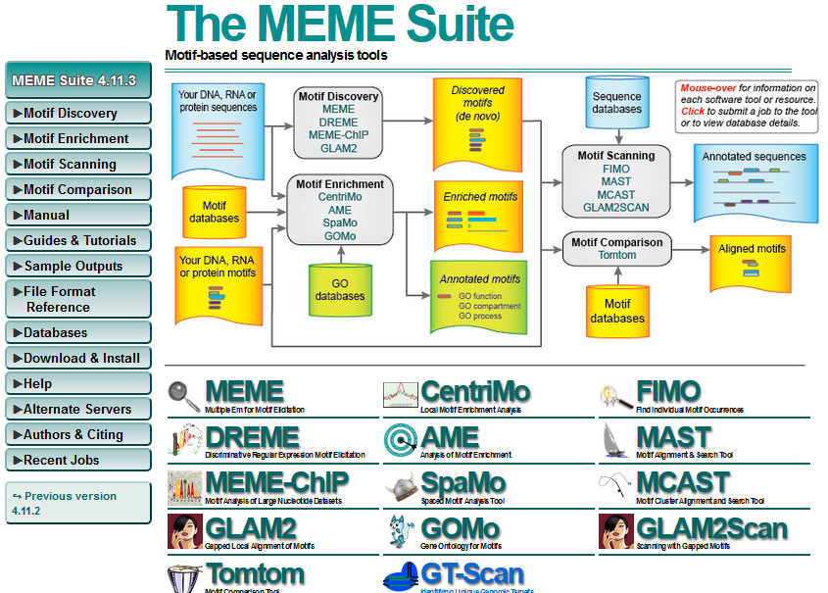
Here’s a good place to start if you want to do this practically: http://meme-suite.org/

Slide 22
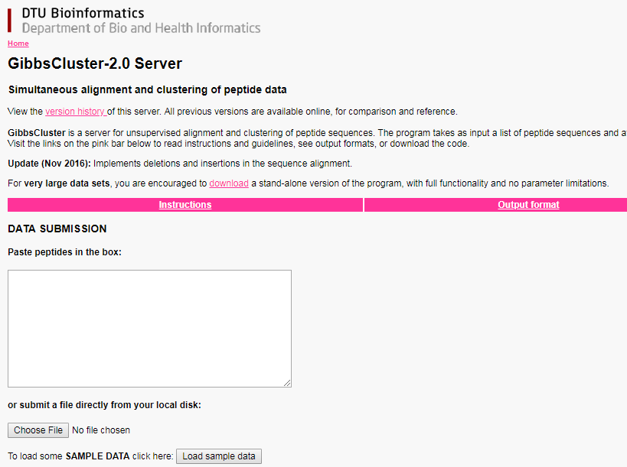
Note: online MEME suite can sometimes be quite laggy.
GibbsCluster is a good alternative for peptide motifs: https://services.healthtech.dtu.dk/service.php?GibbsCluster-2.0
Both can also be installed on your own computer

