Slide 1
Network biology
(& predicting gene function)
BCH394P/364C Systems Biology / Bioinformatics
Edward Marcotte, Univ of Texas at Austin

Slide 2
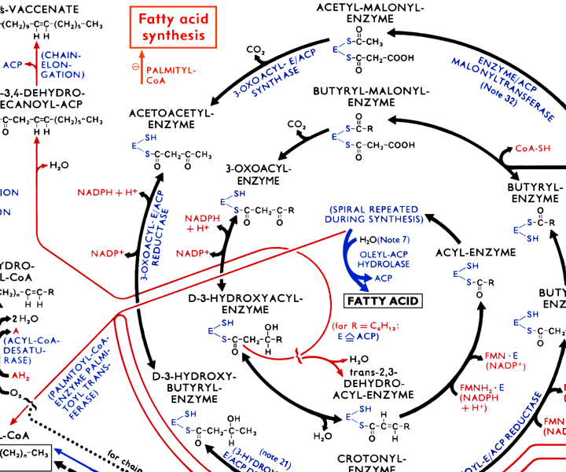
There are many types of biological networks.
Here’s a small portion of a large metabolic network.

Slide 3
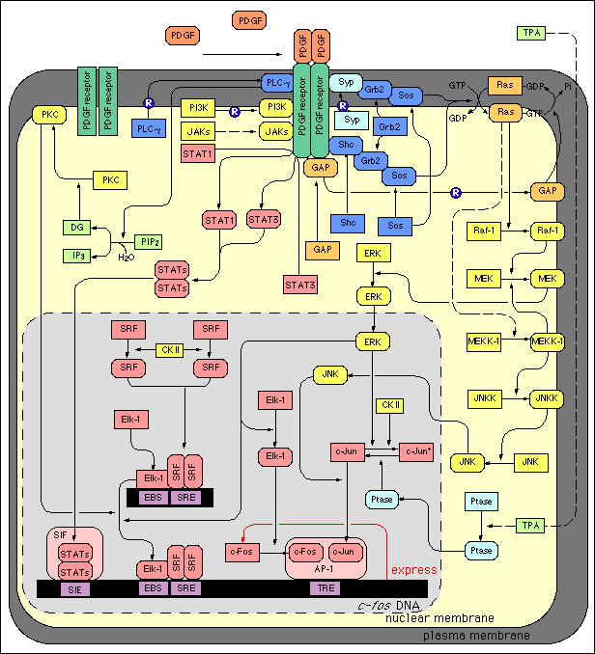
A typical
genetic
network

Slide 4
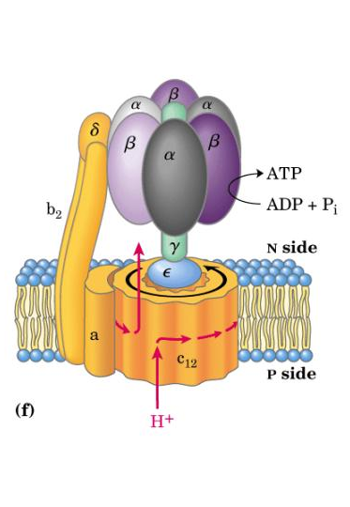
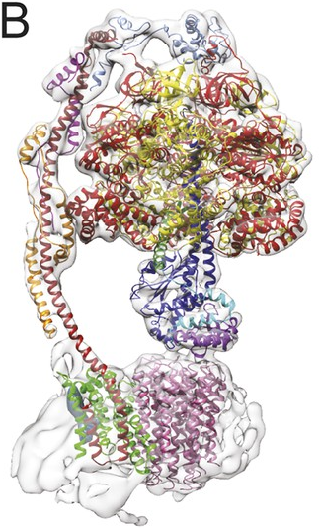
Contacts between proteins define protein interaction networks
CryoEM structure
of ATP synthase
Schematic
version
Network
representation
α
β
δ
γ
b2
ε
a
c12
Direct contacts
α
β
δ
γ
b2
ε
Total set = protein complex
Sum of direct + indirect
interactions
a
c12
eLife 2015;4:e10180
Co-complex PPIs

Slide 5
Let’s look at some of the types of interaction data in more detail.
Some of these capture physical interactions, some genetic, some informational or logical.

Slide 6
Pairwise protein interactions
In general, purifying proteins one at a time, mixing them, and assaying for interactions is far too slow & laborious. We need something faster! Hence, high-throughput screens, e.g. yeast two-hybrid assays
DBD
Bait
+
Prey
Act
DNA binding
domain
Transcription
activation
domain
Prey
Act
Core transcription
machinery
DBD
Bait
Transcription
Operator or
upstream activating
sequence
Reporter gene

Slide 7
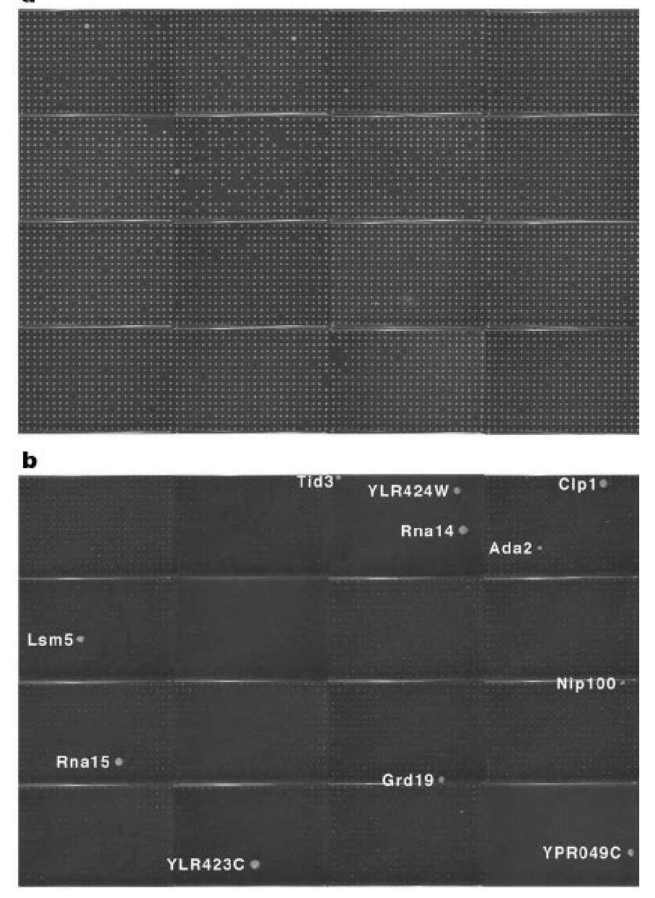
High-throughput yeast two-hybrid assays
Haploid yeast
cells expressing
activation domain-
prey fusion proteins
Diploid yeast
probed with
DNA-binding domain-
Pcf11 bait
fusion protein
Uetz, Giot, et al. Nature (2000)

Slide 8

Protein complexes
High-throughput complex mapping by mass spectrometry
Tag
Bait
Affinity
column
protein 1
protein 2
SDS-
page
protein 3
Trypsin digest,
identify peptides by
mass spectrometry
protein 4
protein 5
protein 6

Slide 9
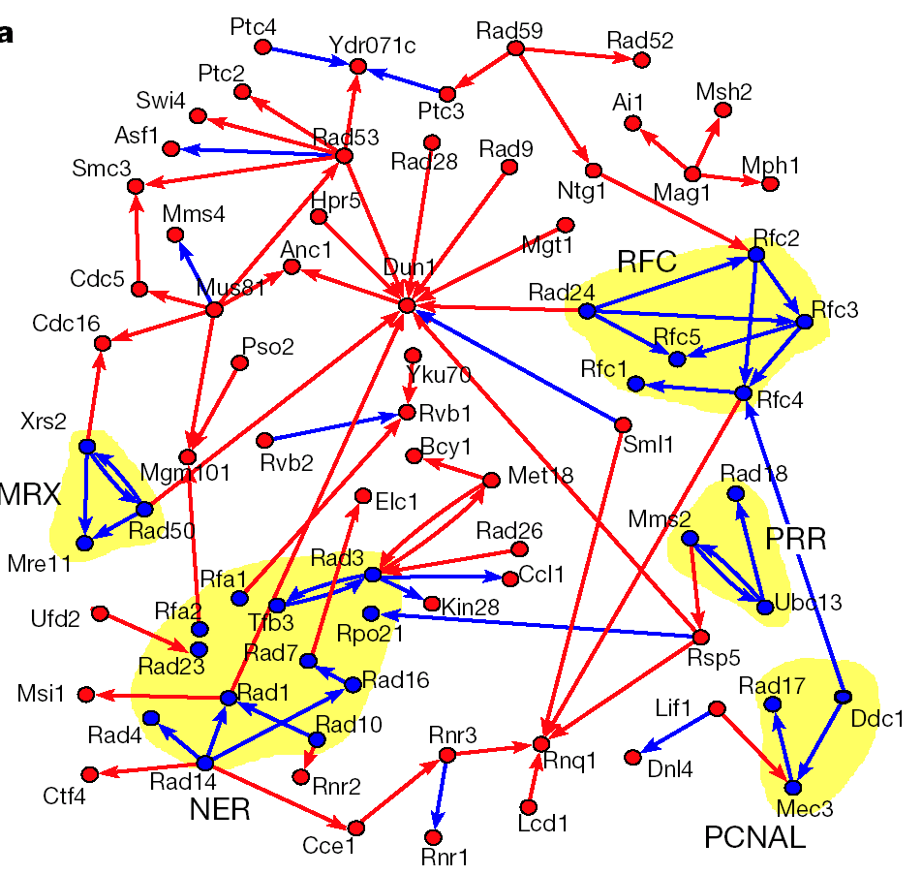
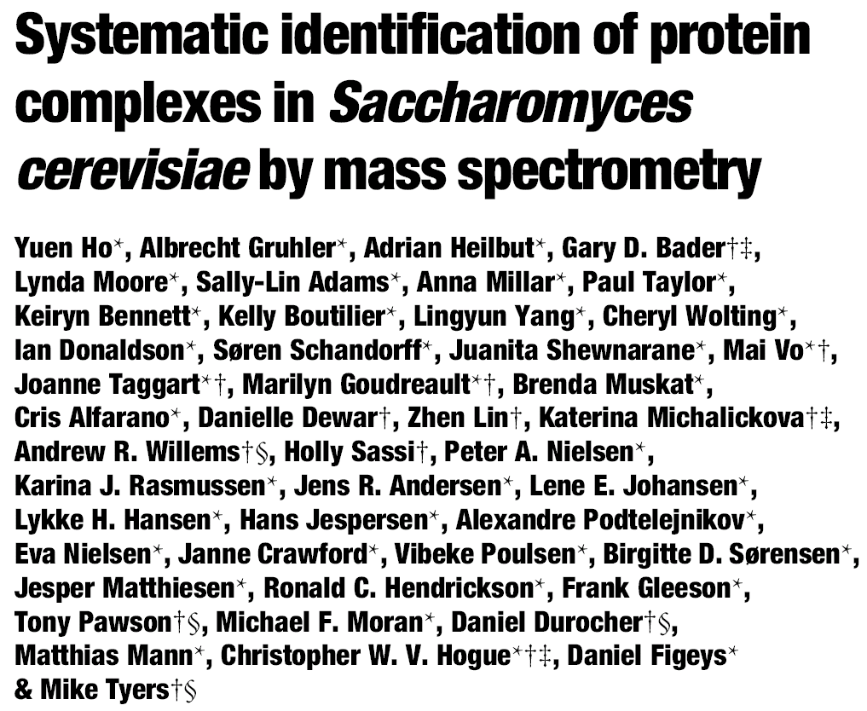
493 bait proteins
3617 interactions

Slide 10
A variant: tandem affinity purification (TAP)
Tag1
Tag2
Bait
Affinity
column2
protein 1
Affinity
column1
protein 2
SDS-
page
protein 3
protein 4
+ protease
protein 5
protein 6
Trypsin digest,
identify peptides by
mass spectrometry
Affinity
column1

Slide 11
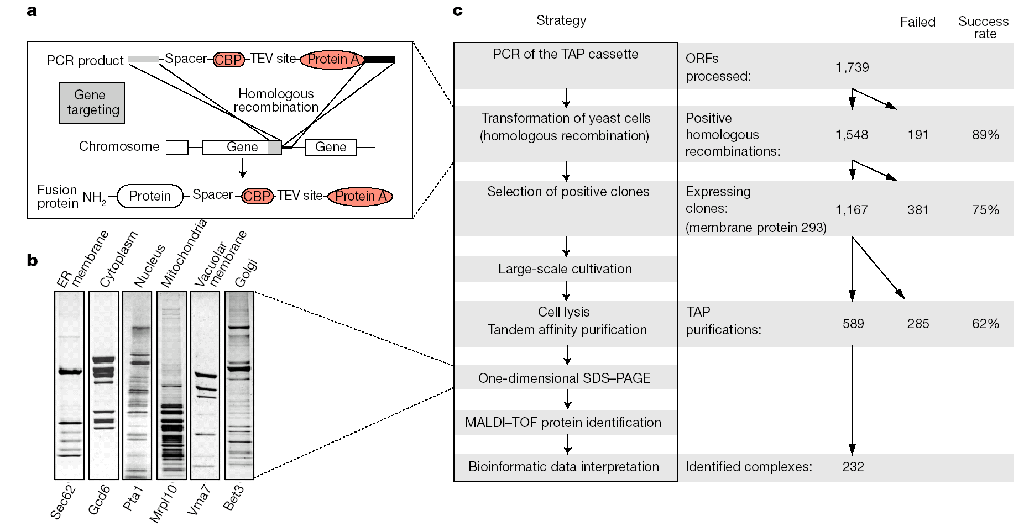
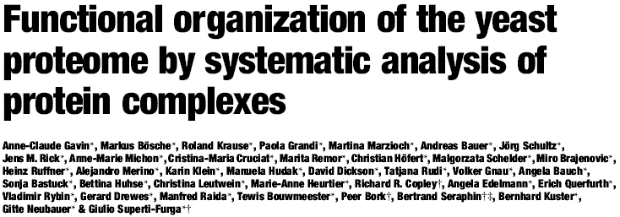


Slide 12
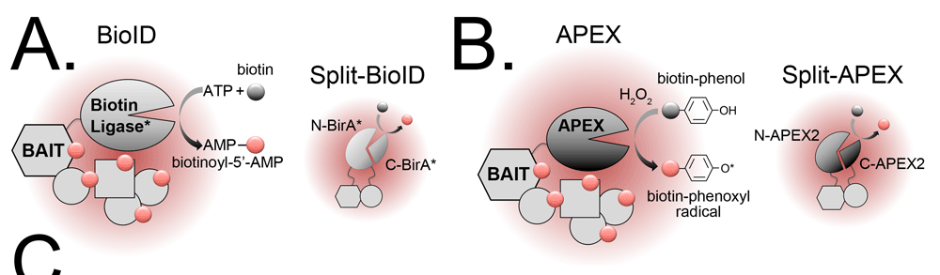
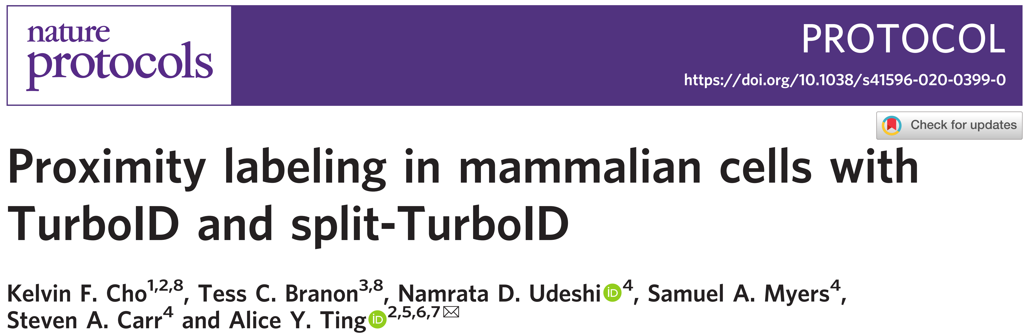
High-throughput protein interaction mapping by proximity labeling
4 variations on a theme:
Affinity purify interaction partners with streptavidin beads
For a good recent protocol see:
ID proteins by mass spectrometry
Figure/review at https://f1000research.com/articles/8-135/v1

Slide 13
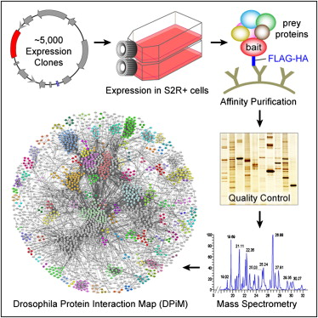
The current state-of-the-art in animal PPI maps – AP/MS
~3,500 affinity purification
experiments
~11K interactions /
~2.3K proteins
→ spans 556 complexes
Still daunting for the
human proteome, but…
Guruharsha et al. (2011) Cell 147, 690–703

Slide 14
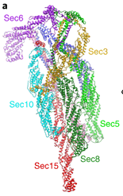
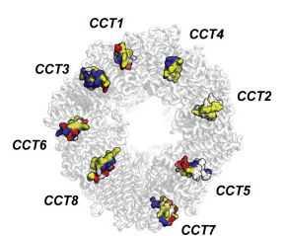
The current state-of-the-art in human PPI maps – Y2H
Human ORFeome (v9.1) → now ~90% of the protein-coding genes!
Screened all x all (150M pairs!) in 9 Y2H assays
52,569 PPIs involving 8,275 proteins
https://www.nature.com/articles/s41594-017-0016-2
https://www.cell.com/cell/fulltext/S0092-8674(14)01369-5
Y2H captures pairwise PPIs that can form when the proteins are expressed out of biological context (e.g., as fusion proteins in a yeast cell nucleus). It can reveal directly contacting proteins but often misses those that require additional molecular context or higher order assemblies,
← the exocyst e.g. the CCT complex→
+15 additional PPIs
+111 additional PPIs
Luck et al., A reference map of the human protein interactome, bioRxiv, posted April 10, 2019
https://www.biorxiv.org/content/10.1101/605451v1, published Nature, April 8, 2020

Slide 15
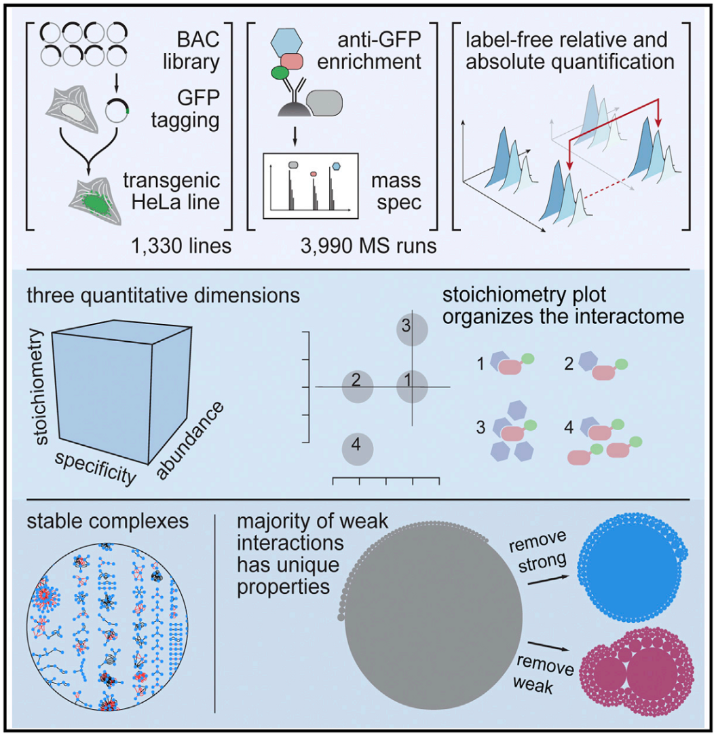
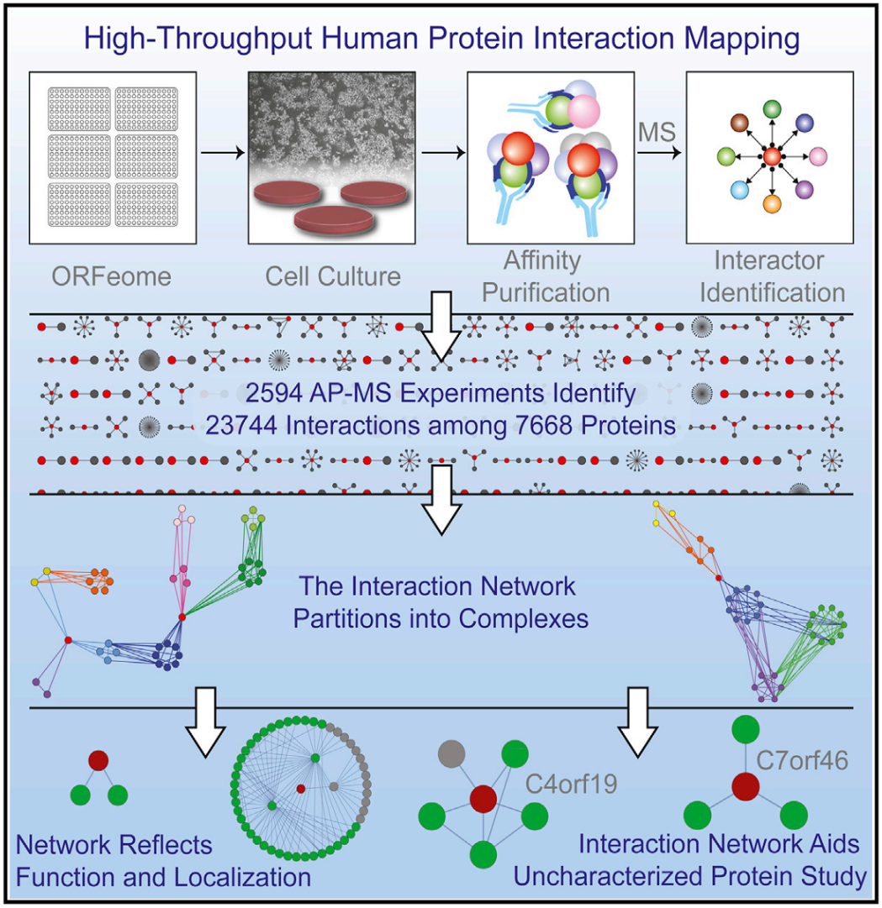
The current state-of-the-art in human PPI maps – large scale AP/MS
Hein et al., Cell (2015) 163:712-23.
Huttlin et al., Cell (2015) 162:425–440
Huttlin et al., Nature (2017) 545:505-509
Huttlin et al., Cell (2021) 184: 3022-3040.e28
Just in the past 5 years, >16K affinity purification/mass spec experiments on tagged human proteins expressed in cell lines

Slide 16
The current state-of-the-art in animal PPI maps – co-fractionation/MS
>2,000 biochemical fractions,
including replicates
>9,000 hours
mass spec machine time
Havugimana,
Hart, et al.,
Cell (2012)

Slide 17
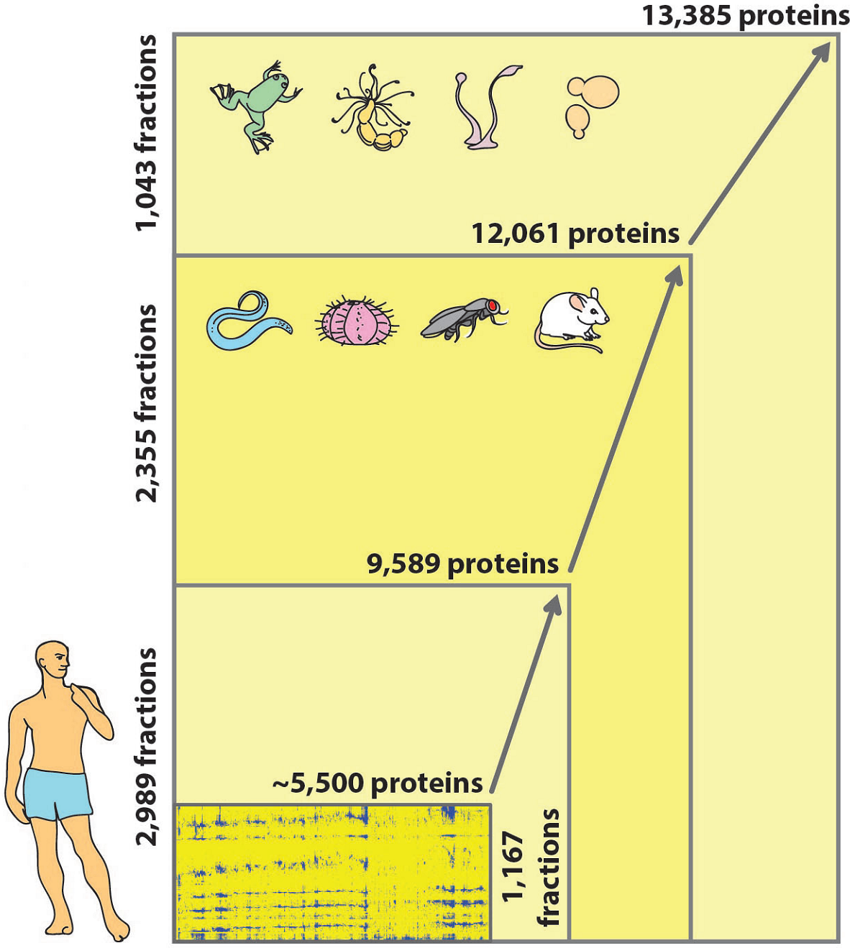
Extending the map across animals…
>6,400 CF/MS
experiments
These data capture >80 million protein abundance measurements
Pilot
project
Wan, Borgeson et al. Nature (2015)

Slide 18
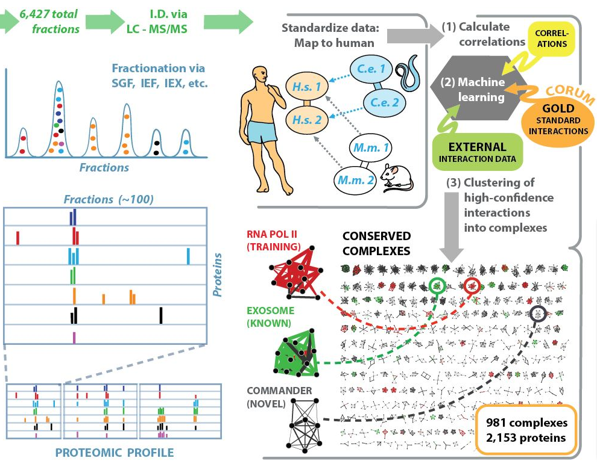
Extending the map across animals…
Wan, Borgeson et al. Nature (2015)

Slide 19
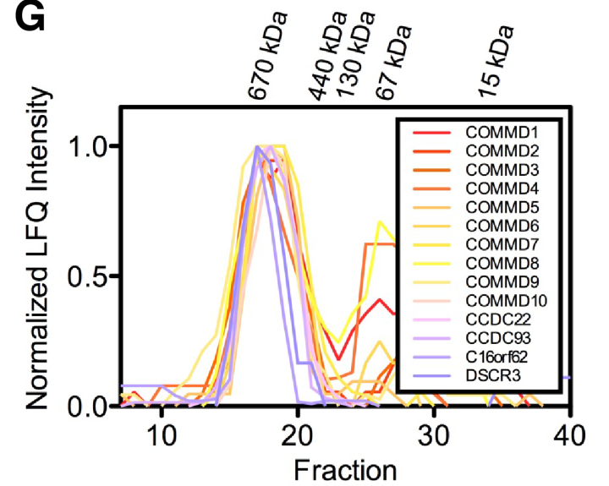
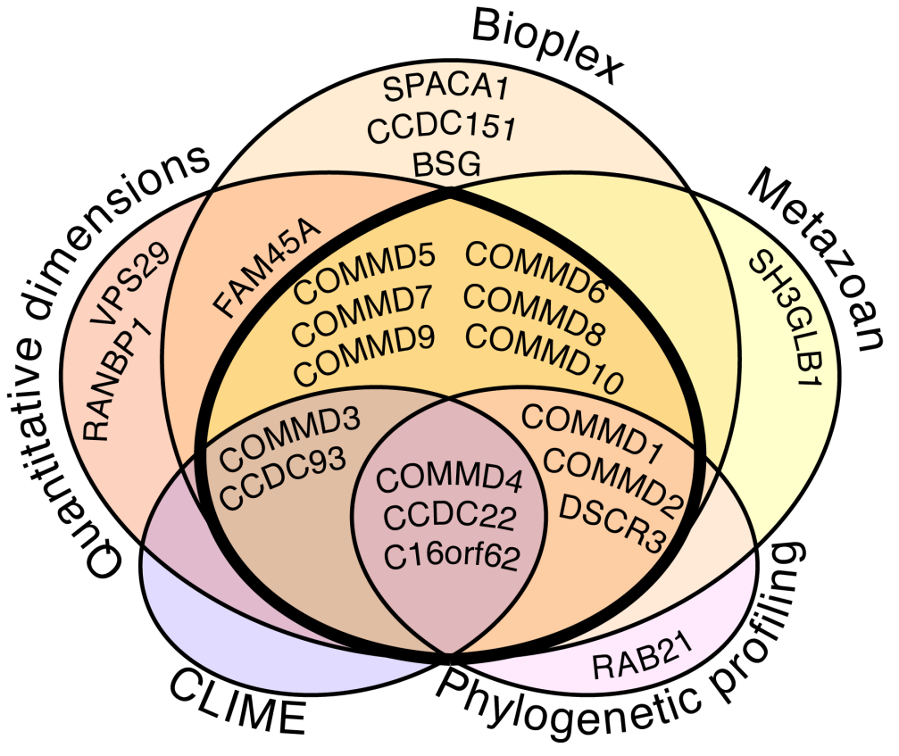
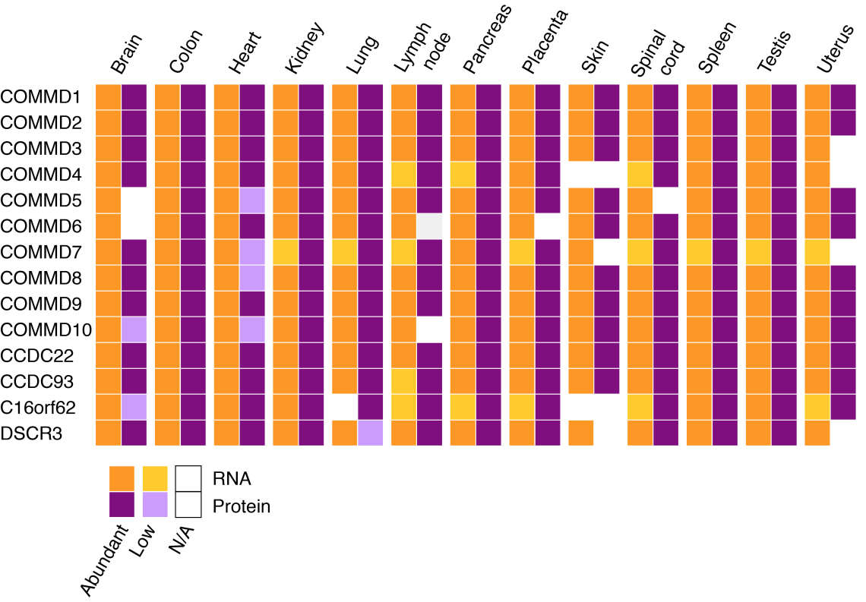
There are still lots of cellular machines left to find
e.g. the “Commander” complex, found in all 3 large human PPI maps, a 600 kDa protein complex expressed in nearly every human cell type and tissue
Reviewed in Mallam & Marcotte, Cell Systems (2017)

Slide 20
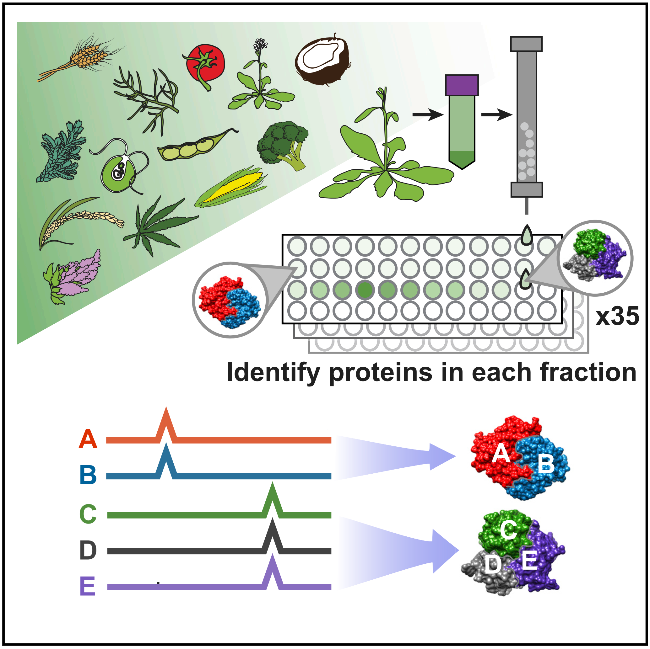
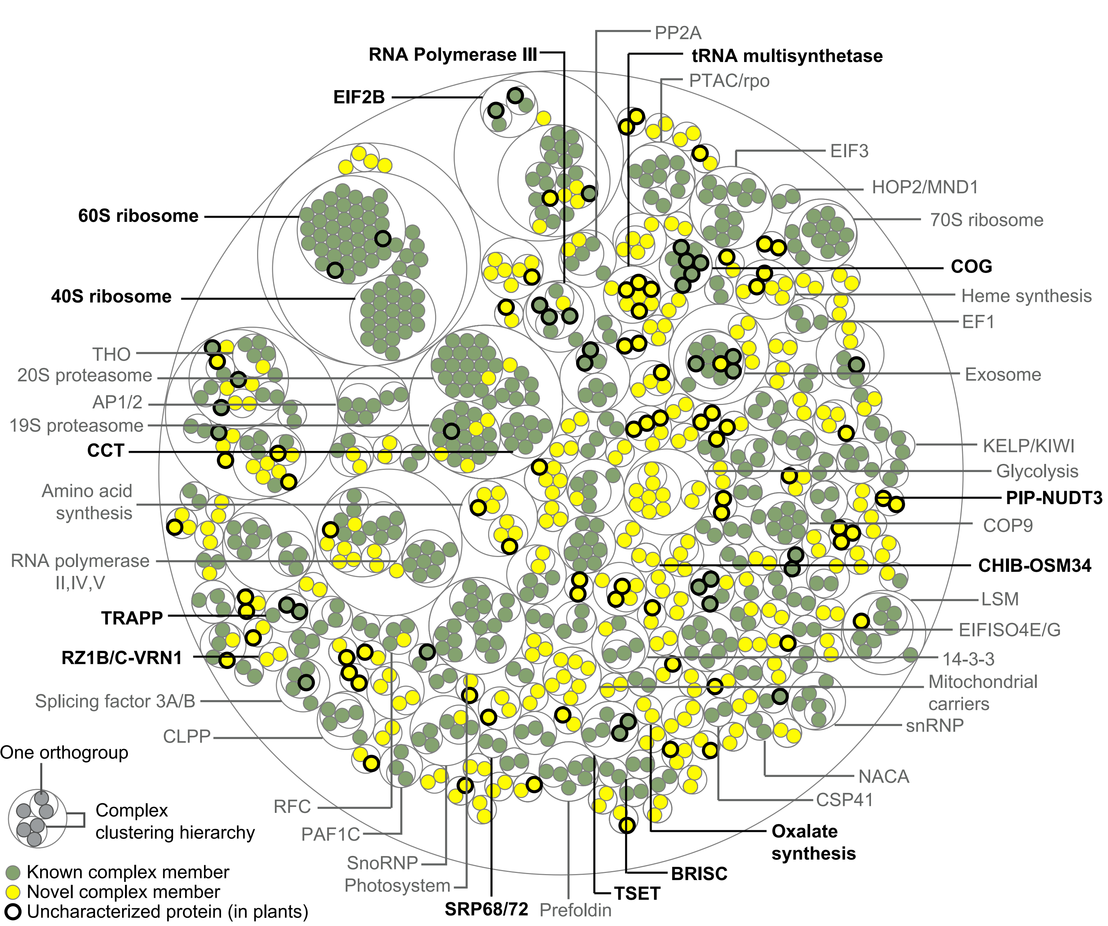
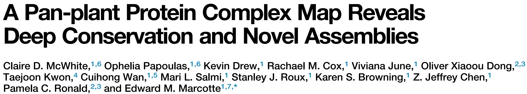
The 1st global plant PPI map
>2,100 CF/MS
experiments
~14M mass spectra
Cell 181(2) P460-474.e14, April 16, 2020

Slide 21
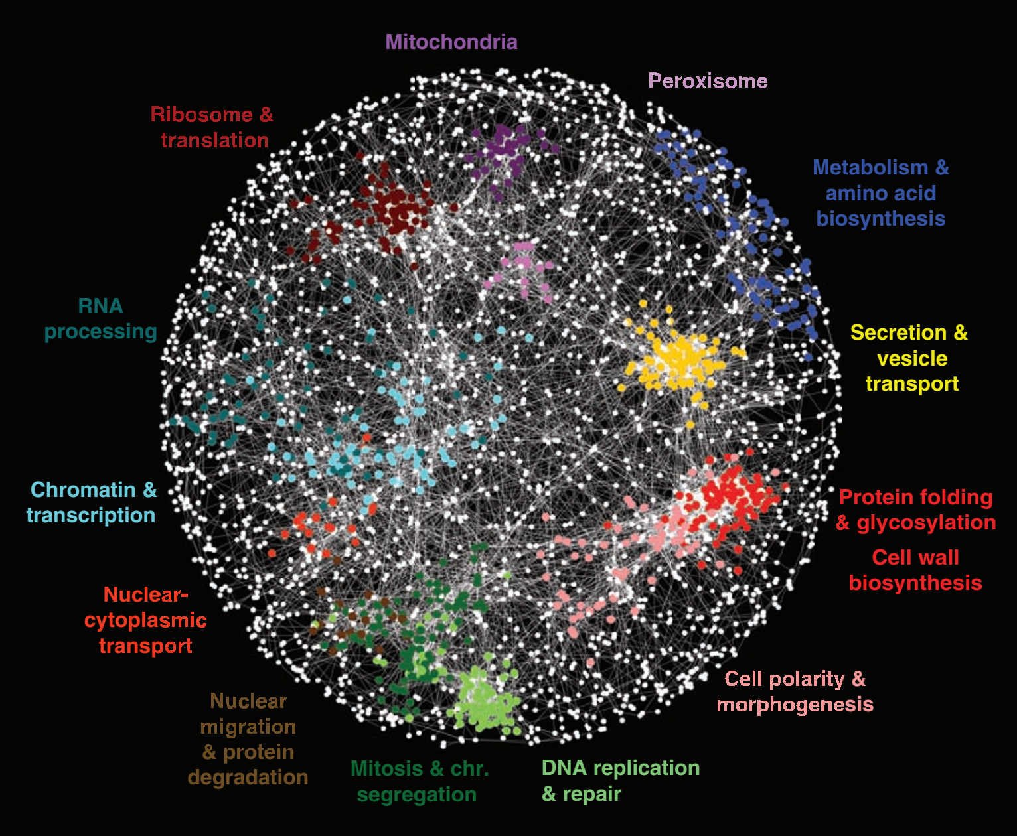
Genetic interactions
5.4 million gene-gene pairs assayed for synthetic genetic interactions in yeast
Costanzo et al., Science 327: 425 (2010)

Slide 22
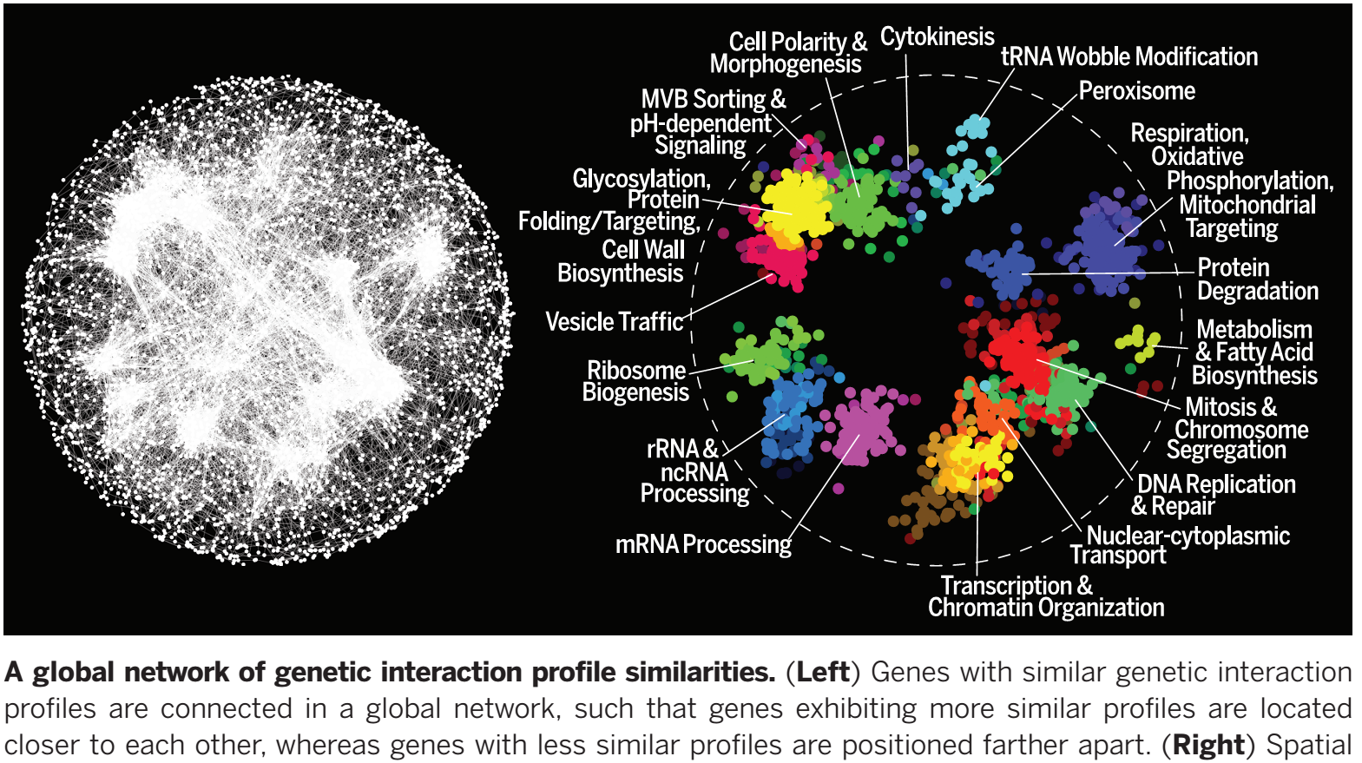
Genetic interactions, the 2016 version
23 million gene-gene pairs assayed for synthetic genetic interactions in yeast, identifying ~550,000 negative and ~350,000 positive genetic interactions
Costanzo et al., Science 353: 1381 (2016)

Slide 23
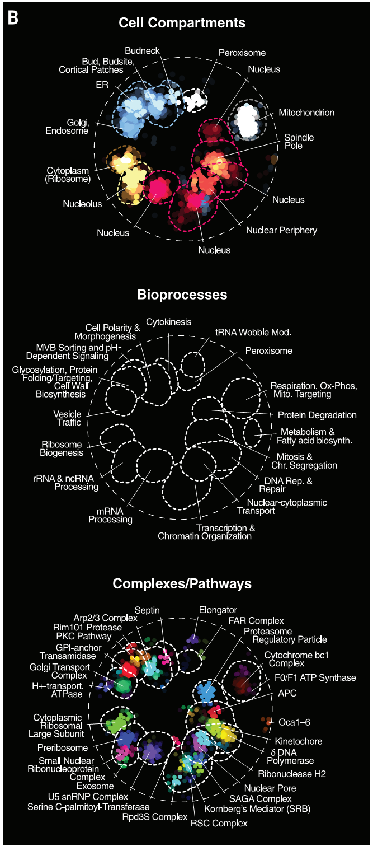
The global genetic interaction profile similarity network reveals a hierarchy of cellular function.

Slide 24
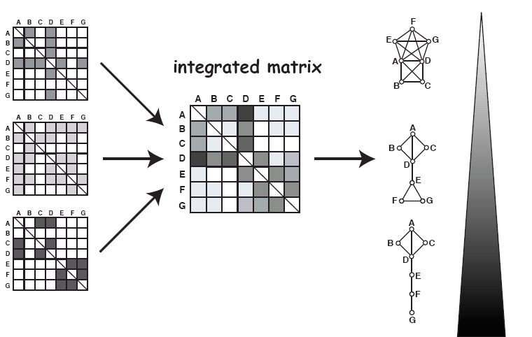
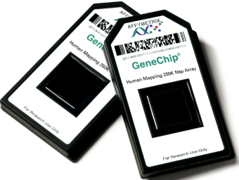
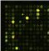
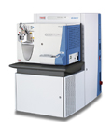
These sorts of data can be combined into
functional gene networks
Networks
Genes
Genes
Bayesian statistics
Genes
Genes
Integrated matrix
AAACTGCATCGA
ATCGCGCATCGC
AGCTCTAGCTCCC...
=
Likelihood of 2 genes
working in the same
biological process
Primary or derived interaction data
Confidence
Adapted from Fraser & Marcotte, Nature Genetics (2004)

Slide 25
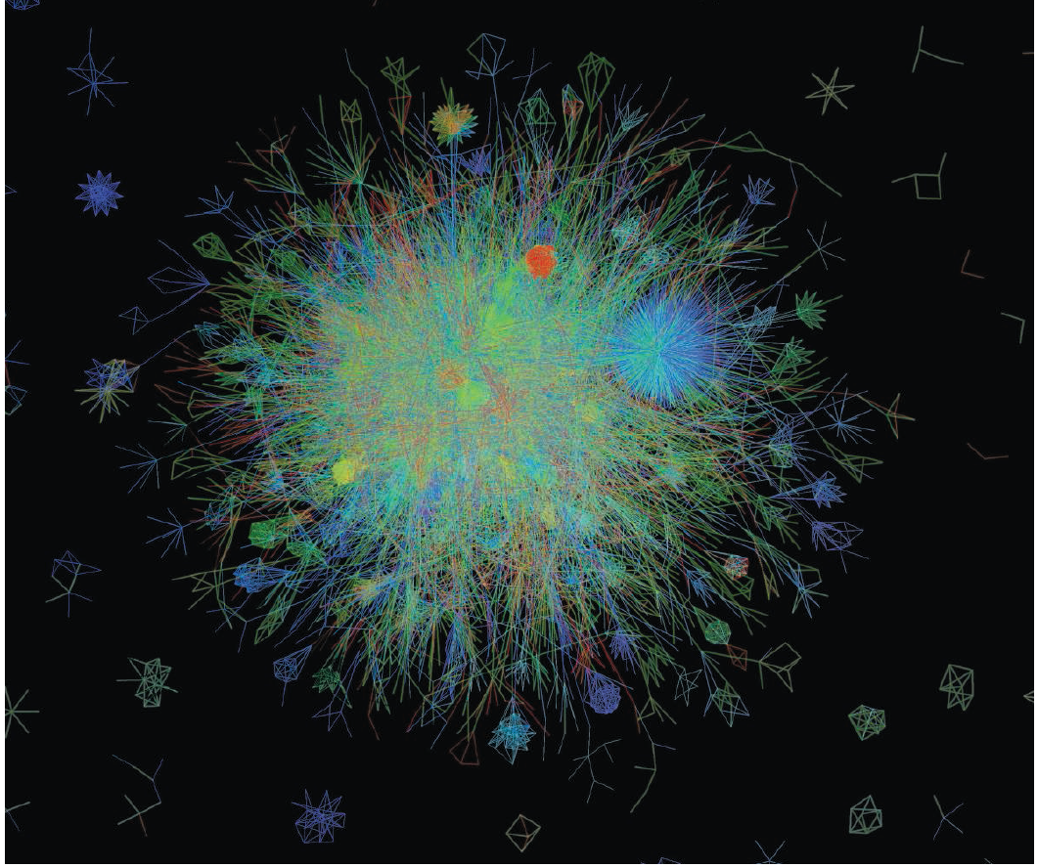


Slide 26
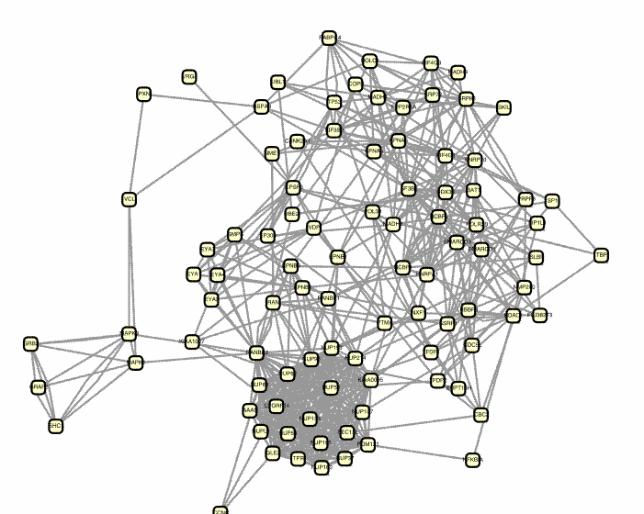
These networks are hypothesis generators.
Given a gene, what other genes does it function with?
What do they do?
Guilt-by-association
in the gene network
Genes already linked
to a disease or function
New candidate genes
for that process

Slide 27
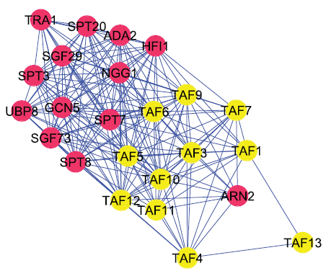
Gene networks frequently reflect functions, pathways, & phenotypes, e.g., lethality in yeast is linked to the molecular machine, not the gene
small
nucleolar
ribonucleoprotein
complex
SAGA
transcription factor/
chromatin remodeling
complex
TAFIID
complex
protein
phosphatase
2A complex
Essential gene
Nonessential gene
Hart, Lee, & Marcotte, BMC Bioinformatics 8:236 (2007)

Slide 28
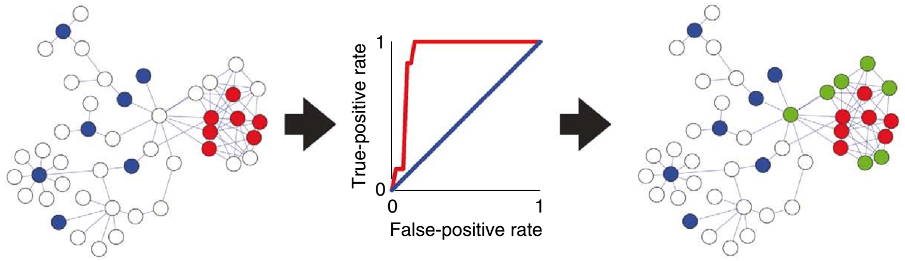
We can propagate annotations across the graph to infer new annotations for genes (network “guilt-by-association”, or GBA).
Testing how well this works on hidden, but known, cases let’s us measure how predictive it will be for new cases.
Query with genes already linked to a disease or function, e.g. the red or blue function
Assess the network’s predictive ability for that function using cross-validated ROC or recall/precision analysis
Infer new candidate genes for that process (e.g. predicting the green genes for the red function)
Lee, Ambaru et al. Nature Biotechnology 28:149-156 (2010)

Slide 29
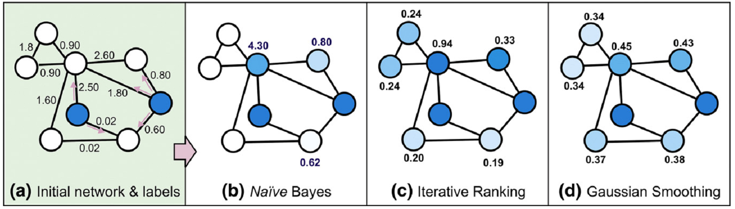
Numerous algorithms exist for network GBA
Similar to Google’s
personalized PageRank
Naïve Bayes assigns scores to neighboring nodes based on edges
Network diffusion algorithms start with initial annotations and the graph topology,
then propagate initial scores across the network,
e.g. Gaussian smoothing tries to find scores:
minimizing the difference between
final and initial scores of a protein
& between a protein's score and that of each of its neighbors
Reviewed in Wang & Marcotte, J Proteomics (2010)

Slide 30
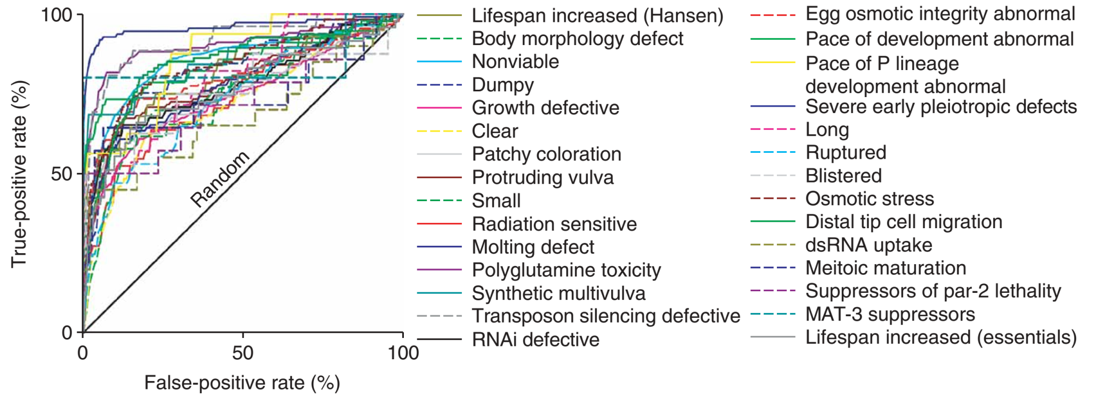
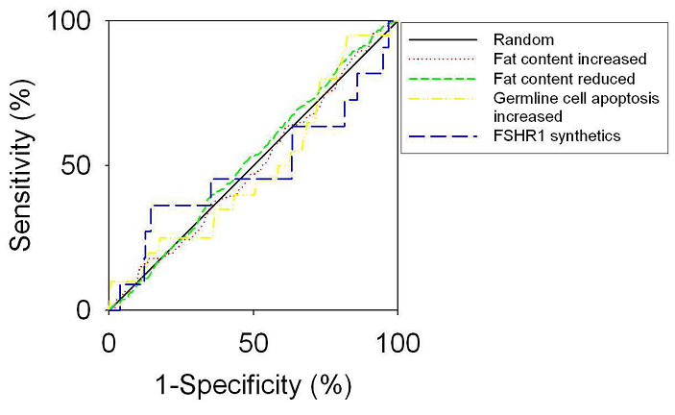
For example, predicting genes linked with worm phenotypes in genome-wide RNAi screens
ROC curves! Here, indicating the likely predictive power of the network for a system of interest, independent of how big the system is.
A poor ROC → no better
than random guessing.
Some very poorly predicted pathways:
Lee, Lehner et al., Nat Genet, 40(2):181-8 (2008)

Slide 31
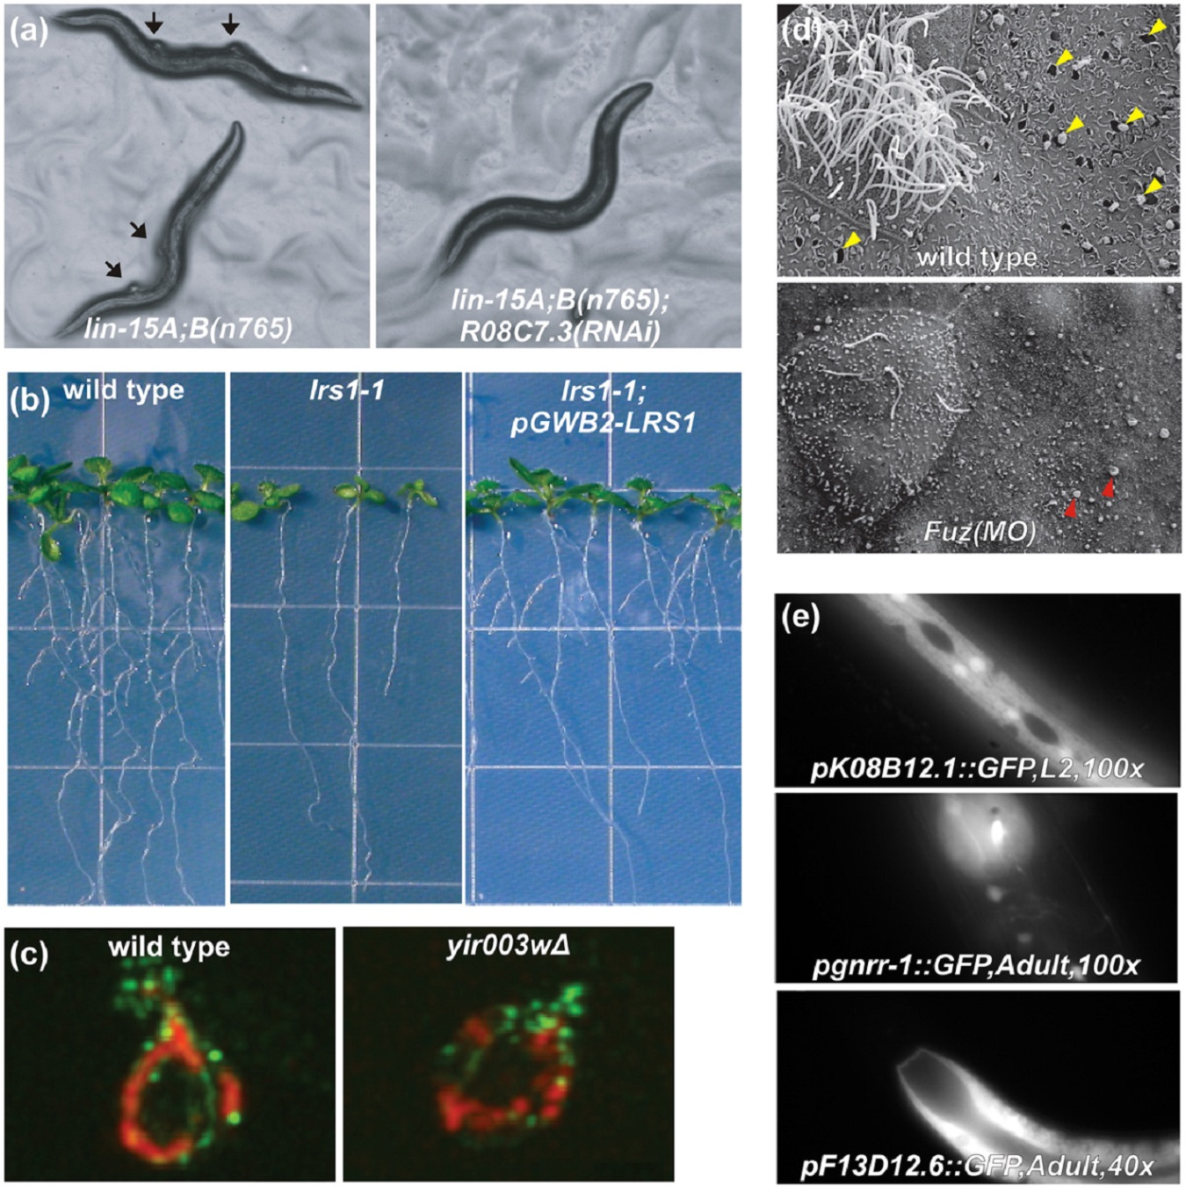
Remarkably, this strategy works quite well
Some examples of network-guided predictions:
In worms:
Genes that can reverse ‘tumors’ in a nematode model of tumorigenesis
In mice/frogs:
Functions for a
birth defect gene
Lee, Lehner et al.
Nature Genetics (2008)
Gray et al., Nature Cell Biology (2009)
In Arabidopsis:
New genes regulating root formation
Lee, Ambaru et al.
Nature Biotech (2010)
In worms:
Predicting tissue
specific gene
expression
In yeast: New mitochondrial
biogenesis genes
Chikina et al., PLoS Comp Biology (2009)
Hess et al., PLoS Genetics (2009)
Reviewed in Wang & Marcotte, J Proteomics (2010)

Slide 32
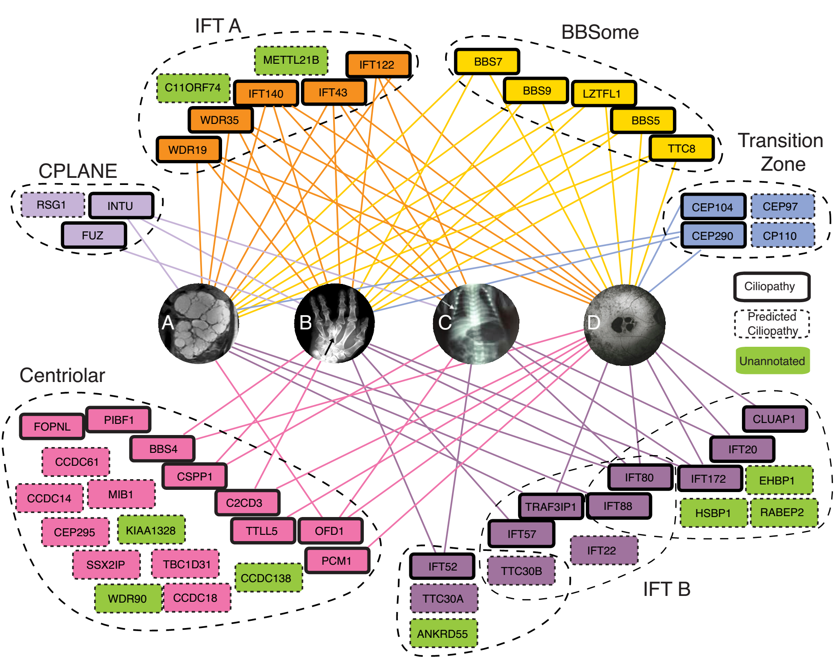

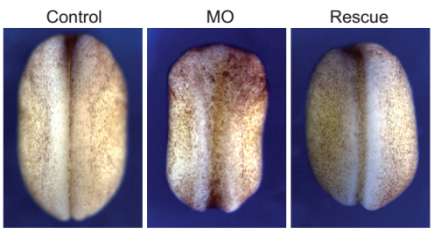


We use this approach routinely in the lab, e.g. an example of
predicting new ciliopathy genes from protein complexes
Complex
Neural tube defects in X. laevis
upon knockdown
Drew et al., Molecular Systems Biology (2017)

Slide 33
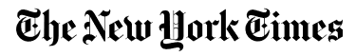
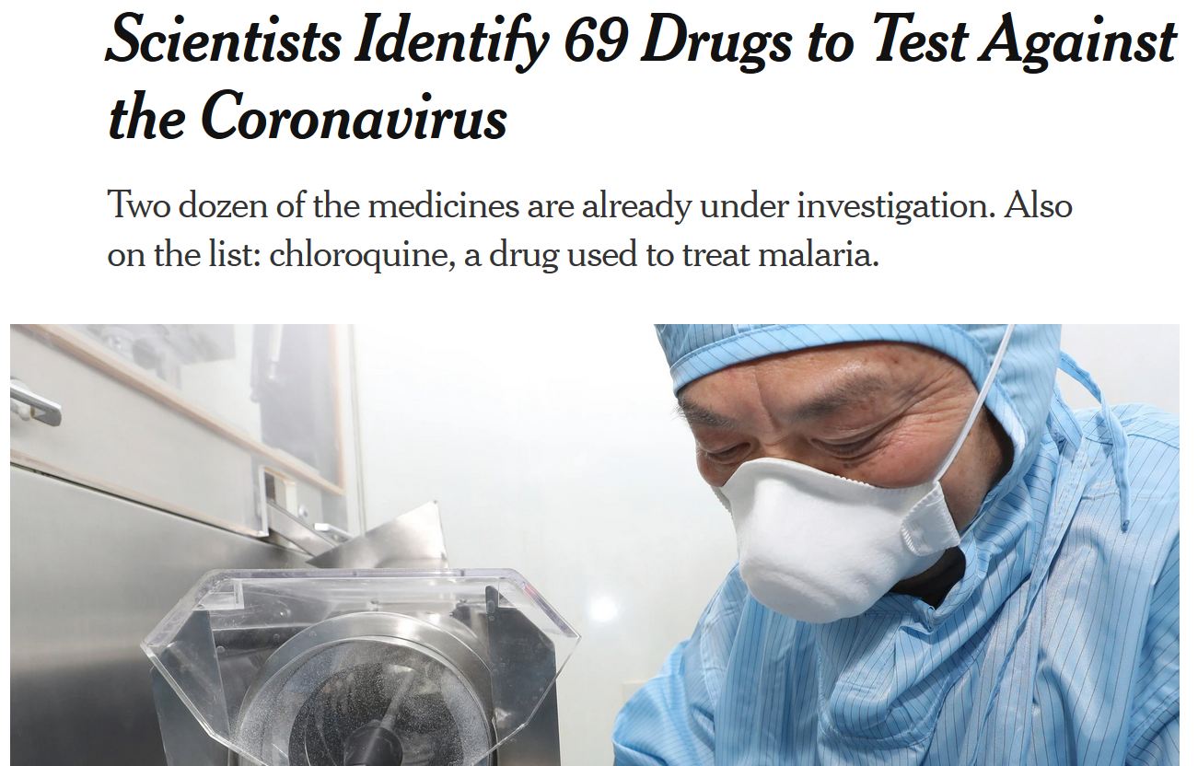
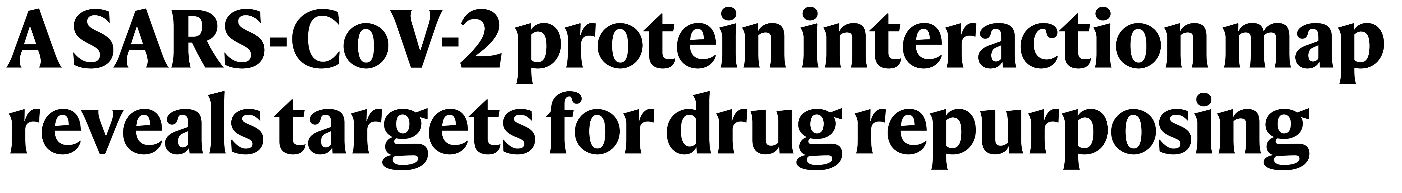
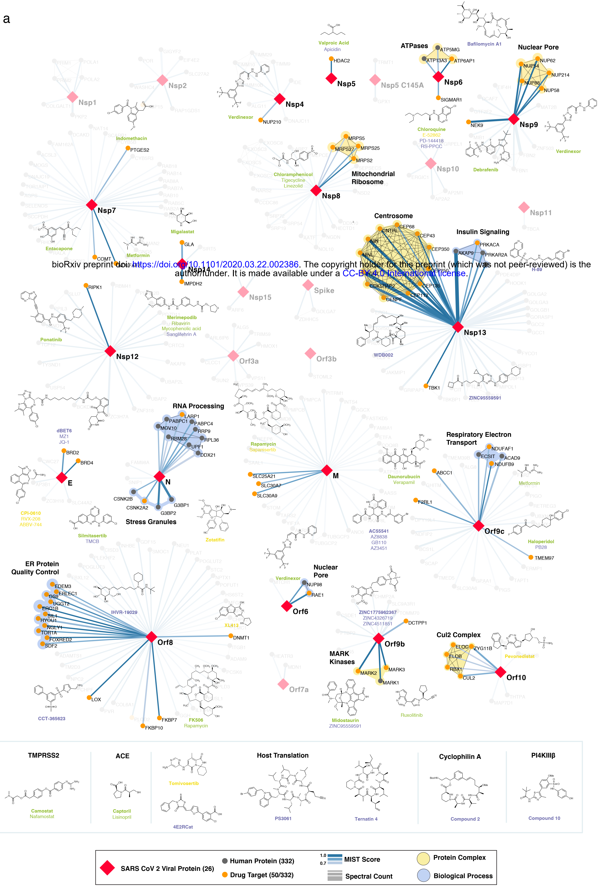
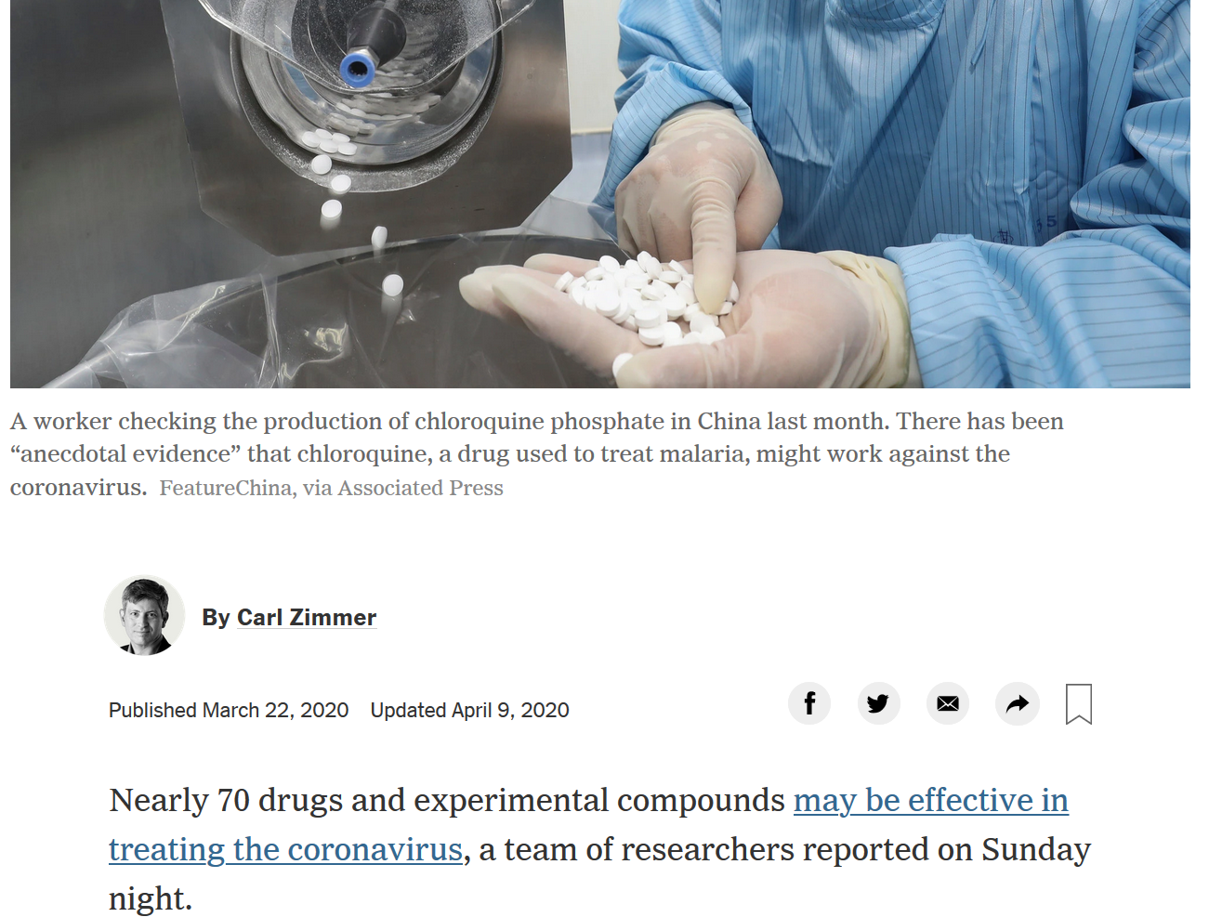
…
…
SARS2 Nsp9 interacts with translation initiation factors; drugs vs eIFs show activity
So, they tested a few more….

Slide 34
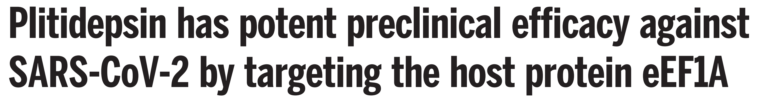
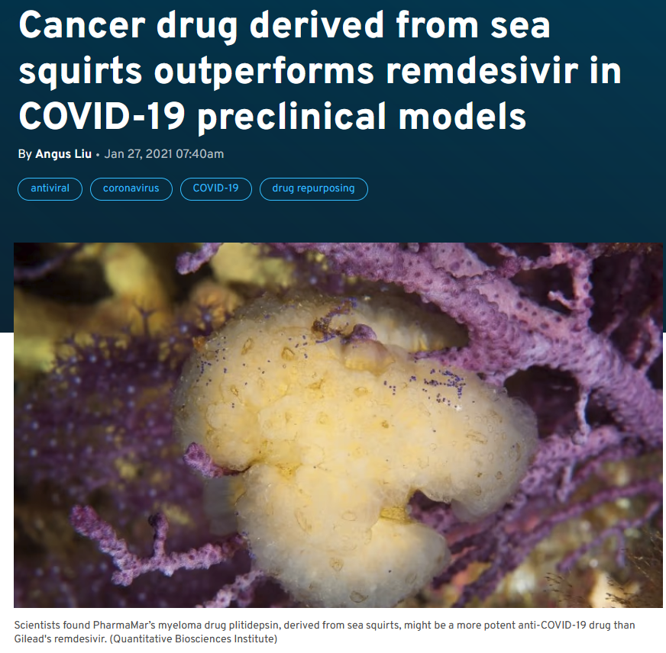
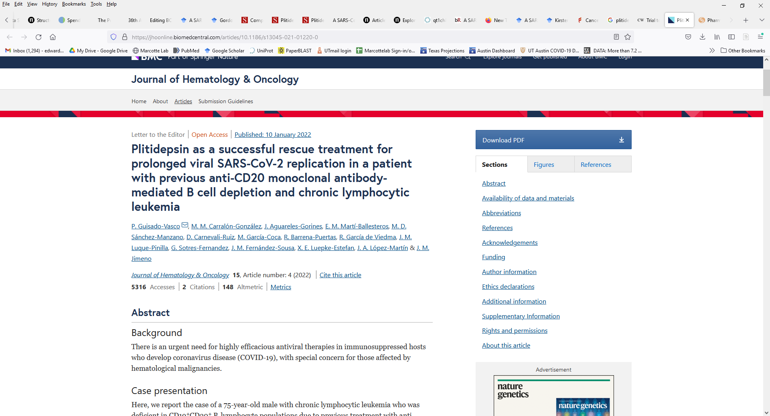
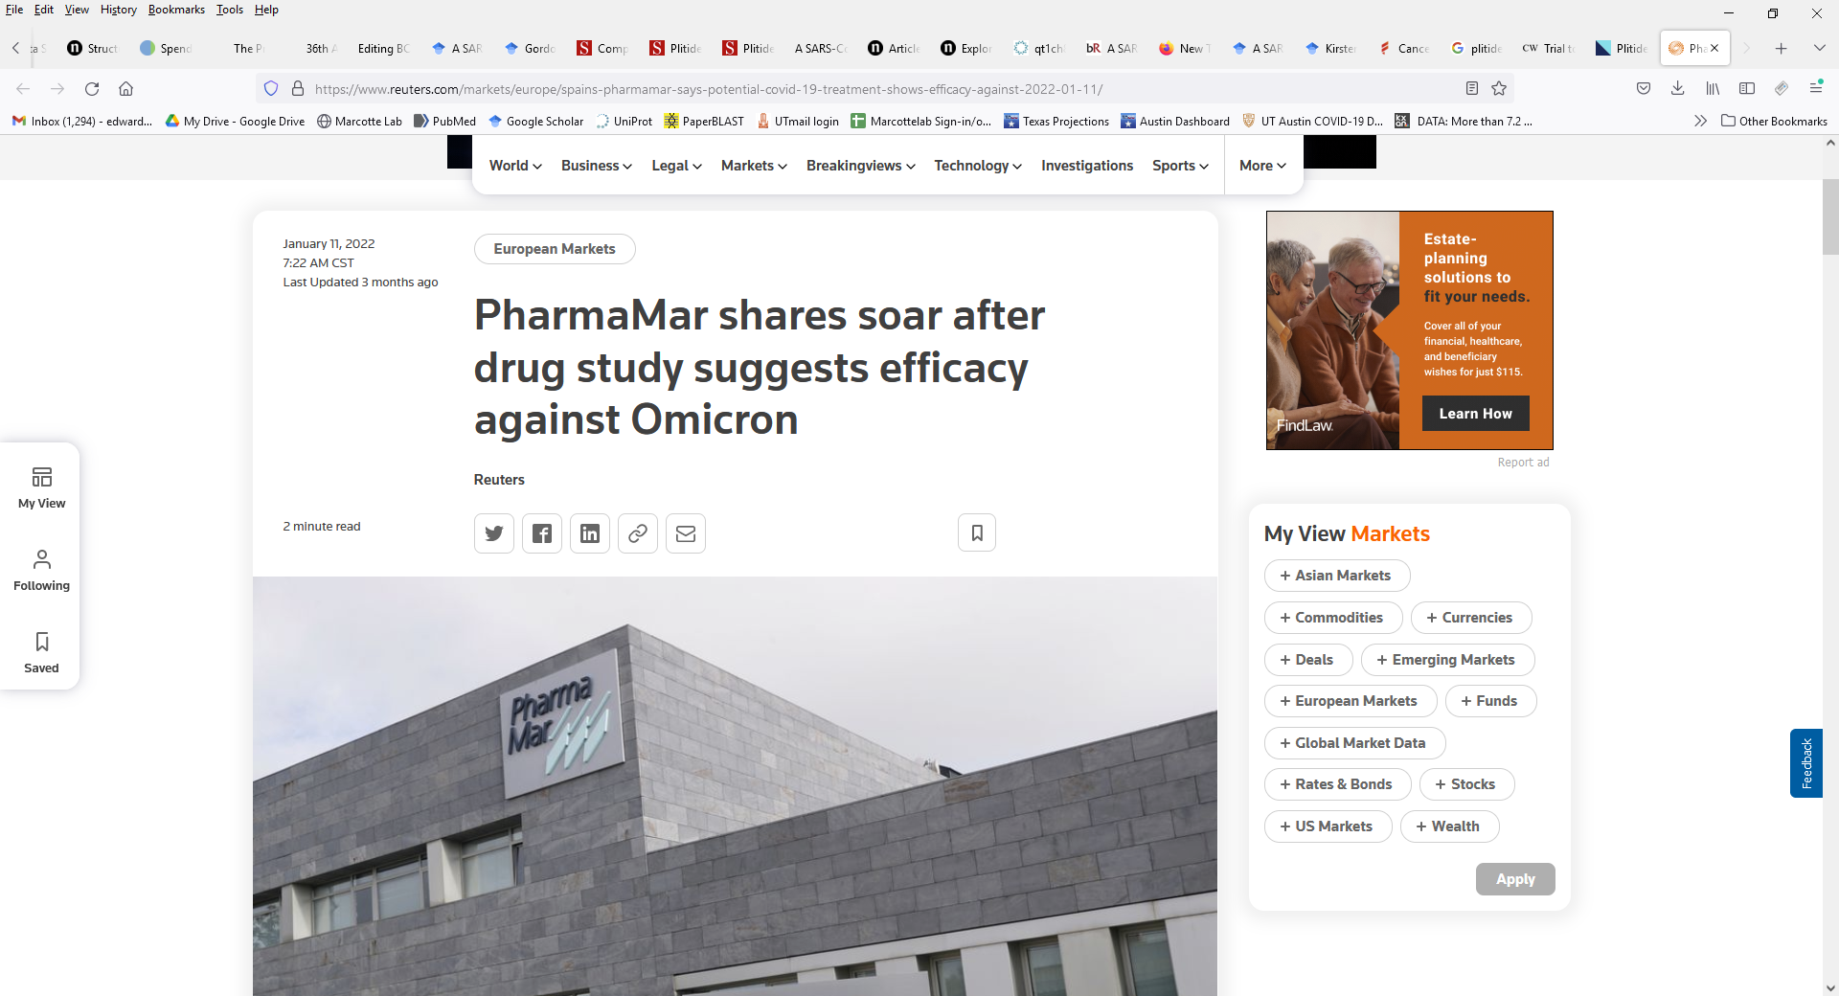
Phase III clinical trials
+ data from compassionate use
et al.

Slide 35
Live demo of
STRING, BioGRID, GeneMania,
functional networks and Cytoscape

