Slide 1
Synthetic biology:
Engineering new functions, cells, and even life?
BCH394P/364C Systems Biology / Bioinformatics
Edward Marcotte, Univ of Texas at Austin

Slide 2
Synthetic Biology = design and engineering of biological systems that aren’t found in nature
Why would we want to do this?
- Want to understand natural systems. One of the best ways to
understand a system is to change it or make new, related ones
- To fully “understand” a system, we should be able to predict
the outcome when we change the system
- For molecular biology, this means:
- designing new gene circuits and networks
- modeling the designed systems & predicting their properties
- making & testing the designs
- updating our understanding from the model/test agreement

Slide 3
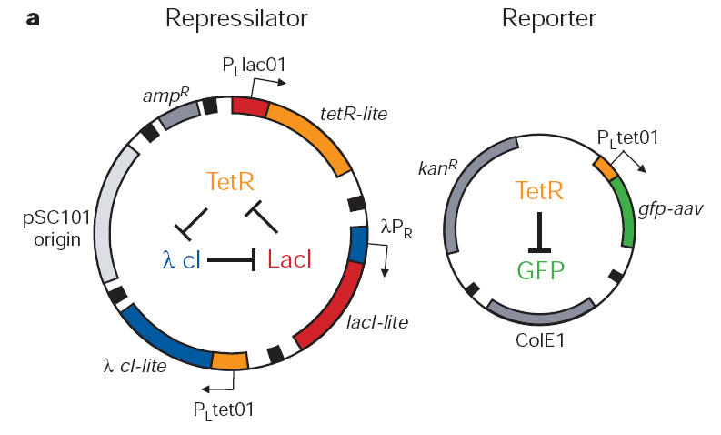
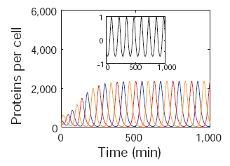
The Repressilator = engineered genetic circuit designed
to make bacteria glow in a oscillatory fashion
= “repressor” + “oscillator”
Transcriptional repressors
Green fluorescent
protein
Elowitz & Leibler, Nature (2000) 403:335-8

Slide 4
The Repressilator = engineered genetic circuit designed
to make bacteria glow in a oscillatory fashion
Elowitz & Leibler, Nature (2000) 403:335-8

Slide 5
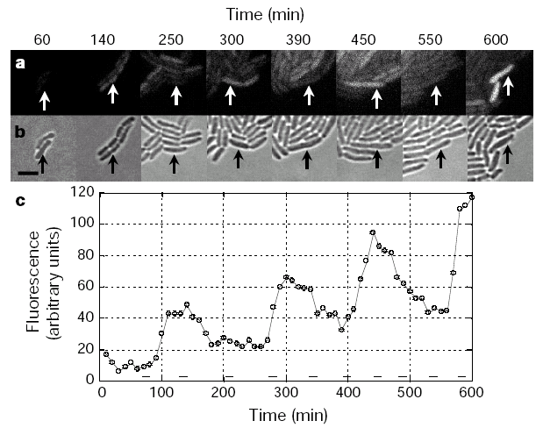
The repressilator in action...
Elowitz & Leibler, Nature (2000) 403:335-8

Slide 6
iGEM: A synthetic biology contest
Can simple biological systems be built from standard, interchangeable parts and operated in living cells?
Or is biology too complicated to be engineered in this way?
Broader goals include:
- Enable systematic engineering of biology
- Promote open & transparent development of tools for engineering biology
- Help construct a society that can productively apply biological technology
(from iGEM’s web site)

Slide 7
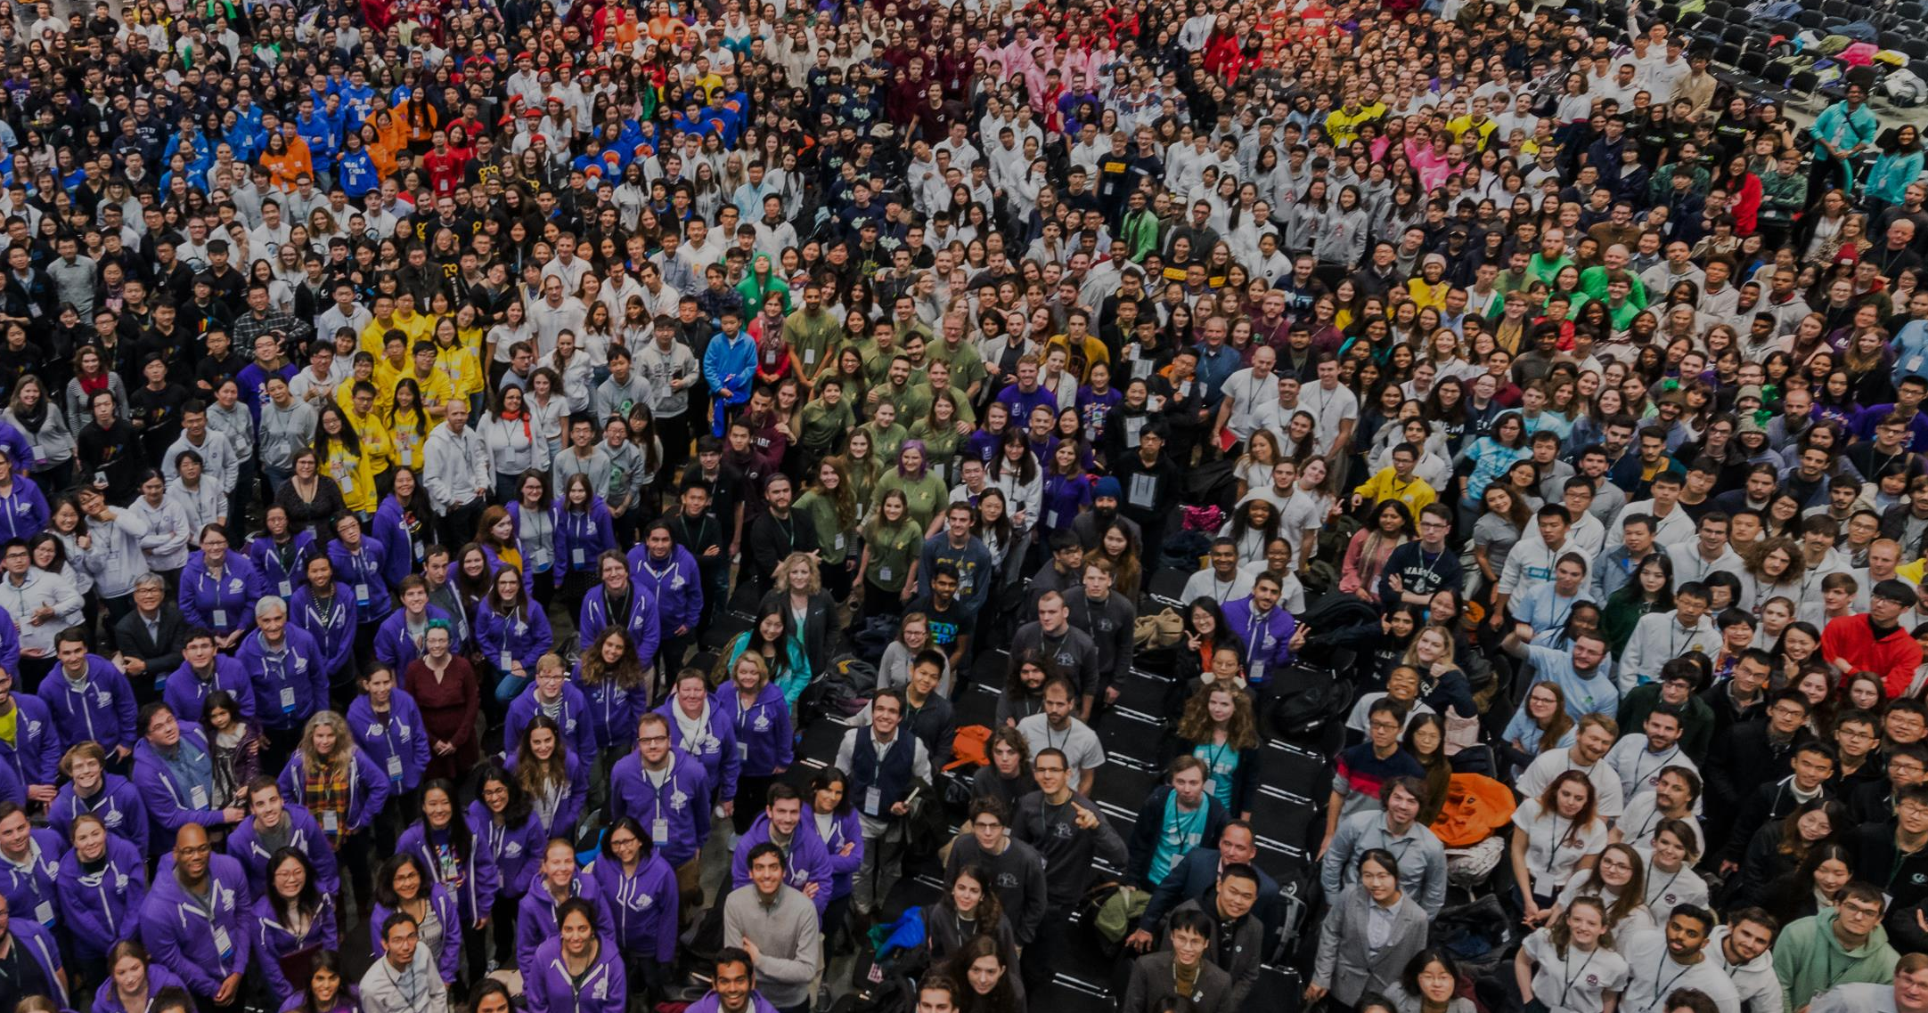
iGEM: A synthetic biology contest
2004: MIT, UT, Princeton, Boston University, Cornell
2005: 13 teams (the above + UK, Germany, more...)
2006: 32 teams, incl. Japan, Latin America, Korea, India, more Europe
54 teams in 2007, 112 in 2009, 165 in 2011, and 245 in 2013…
…now roughly 6,000 entrants / year

Slide 8



A little local history to illustrate the field:
UT’s 2004/2005 iGEM project – build bacterial edge detector
Projector
Original image
shine image
onto cells
petri dish coated with bacteria
Cells
luminesce
along the
light/dark
boundaries
Adapted from Zack Simpson

Slide 9
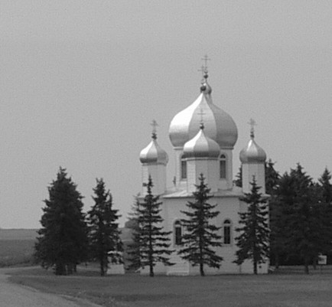
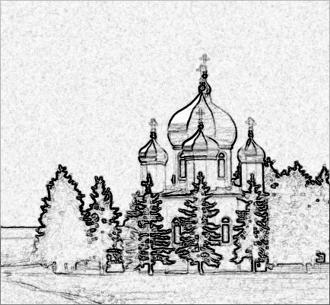
How does edge detection work in principle?
A computer might visit each pixel in turn, and check to see if it is
bordered by both black & white pixels. If yes, highlight the pixel.
Is this
pixel part
of an edge?
No
No
Yes

Slide 10
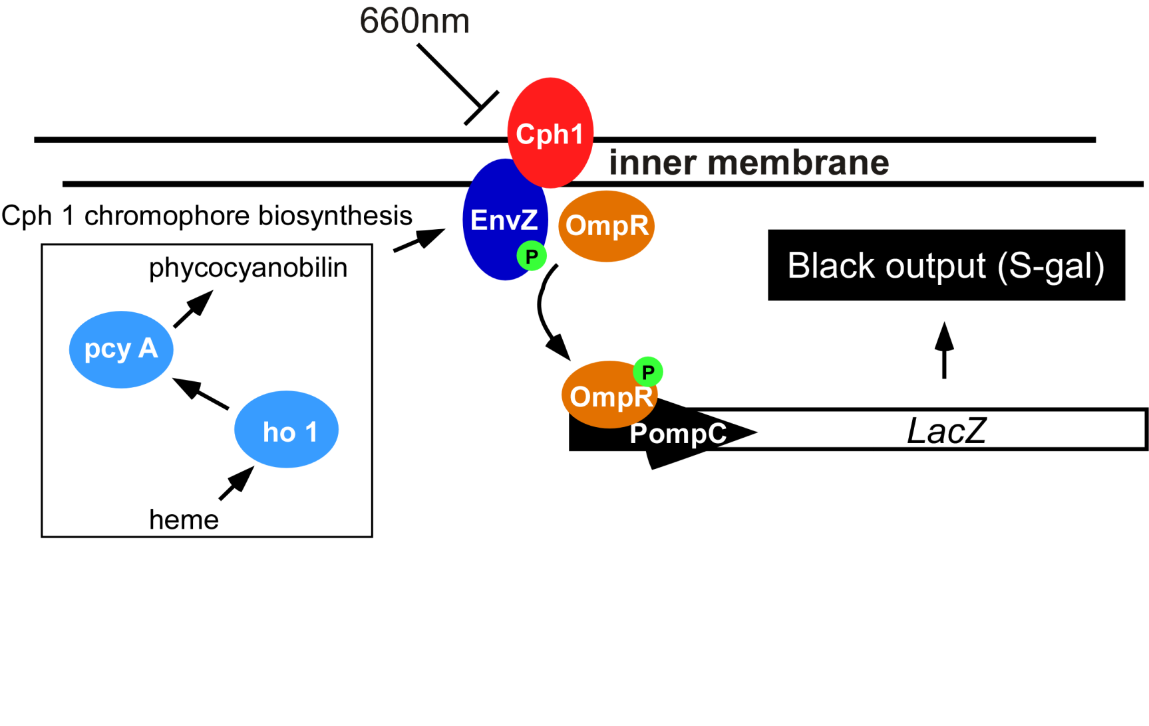
Bacterial photography
Levskaya et al. Nature, 438(7067):441-2 (2005)

Slide 11
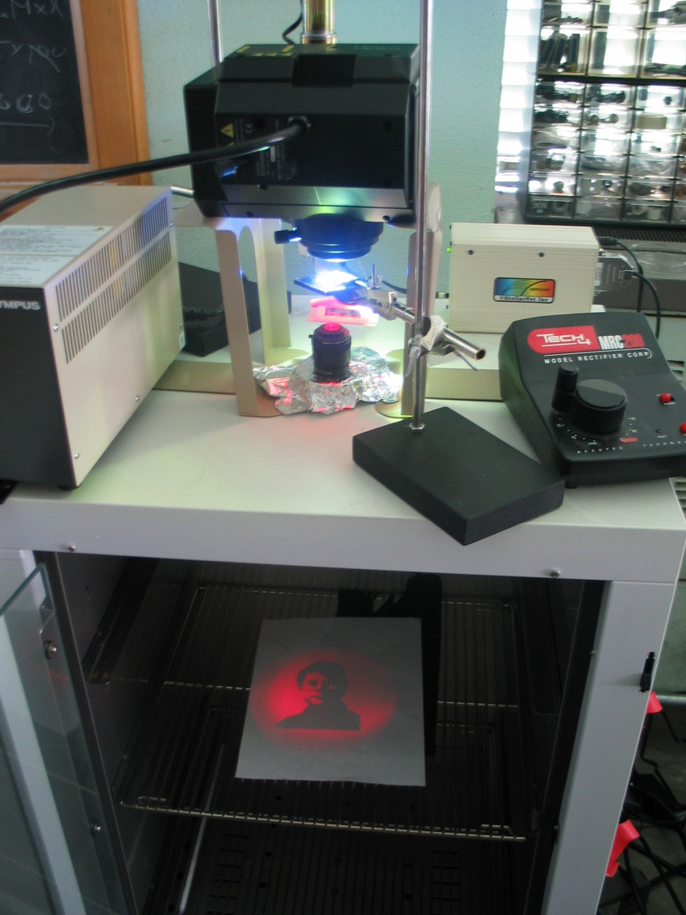

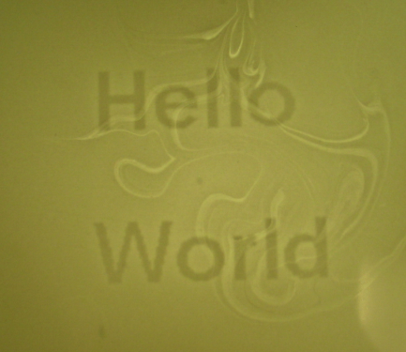

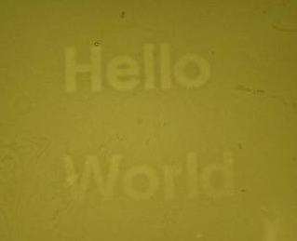
Mask
Cph1/EnvZ
“Light cannon” developed by Aaron Chevalier, UT undergraduate
Levskaya et al. Nature, 438(7067):441-2 (2005)

Slide 12
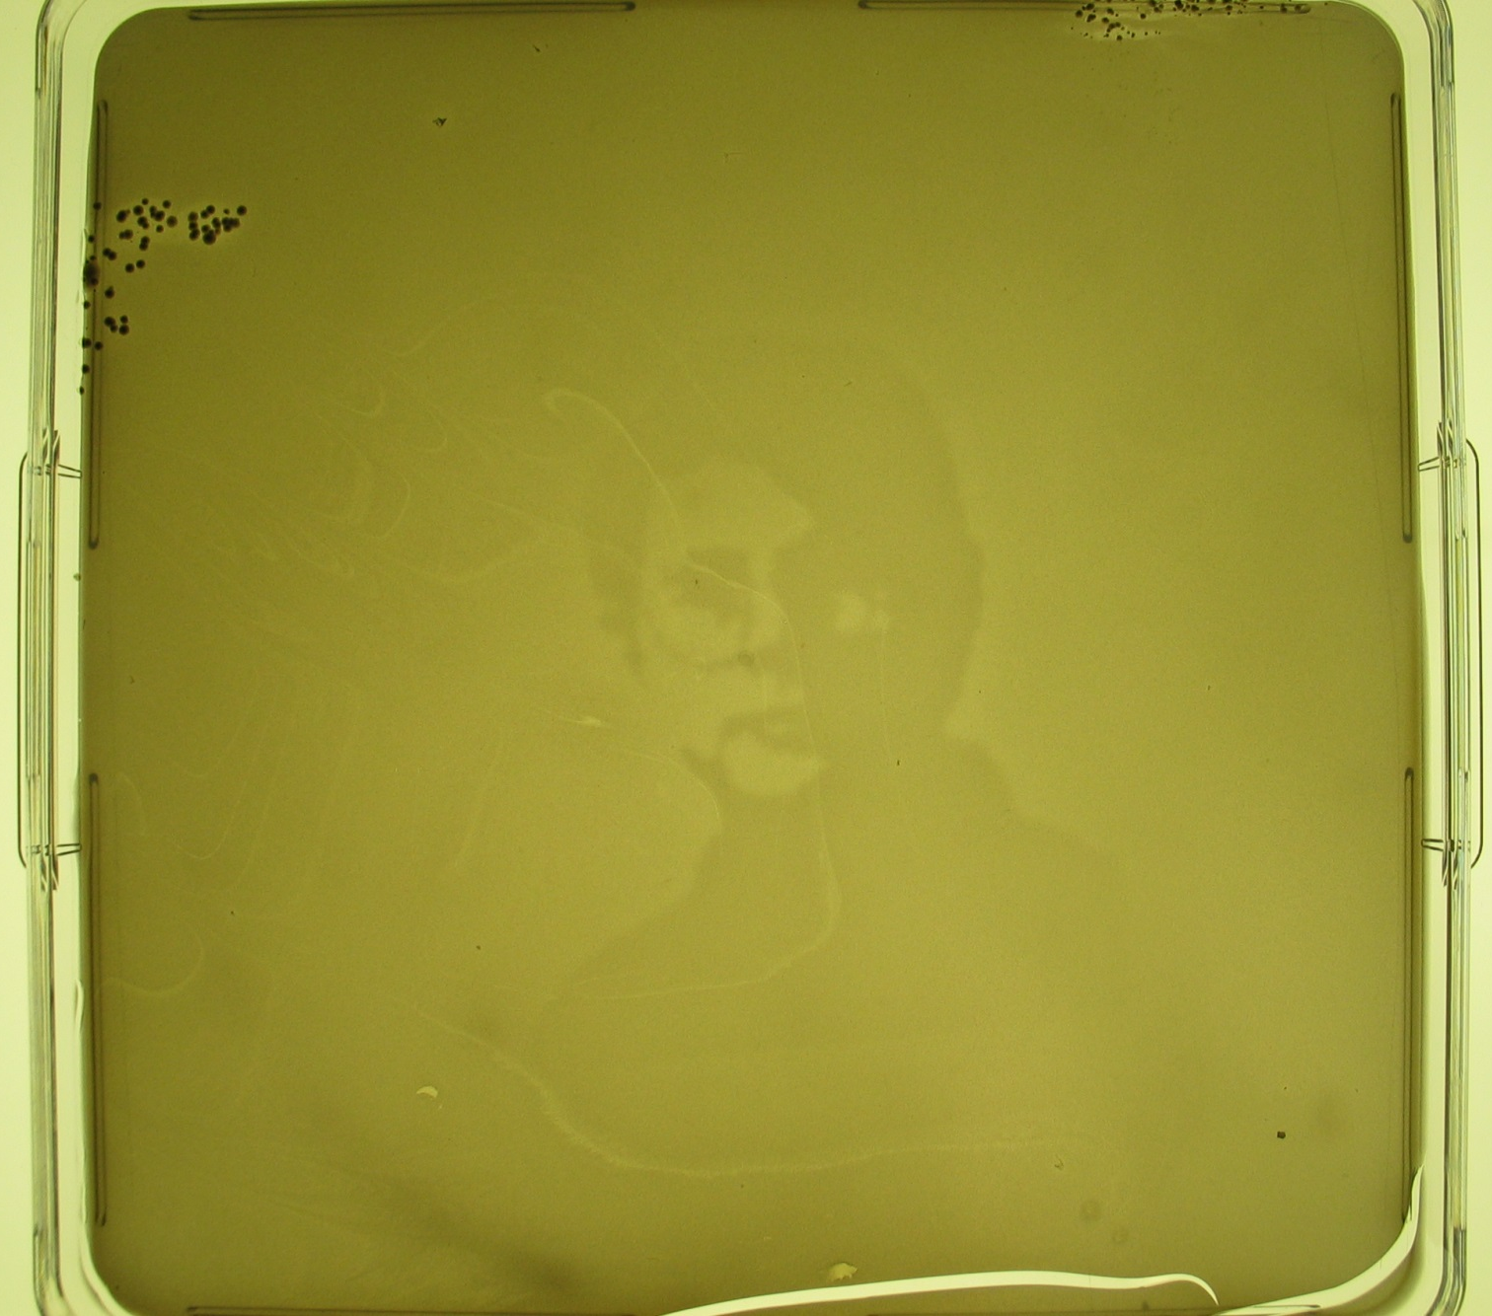
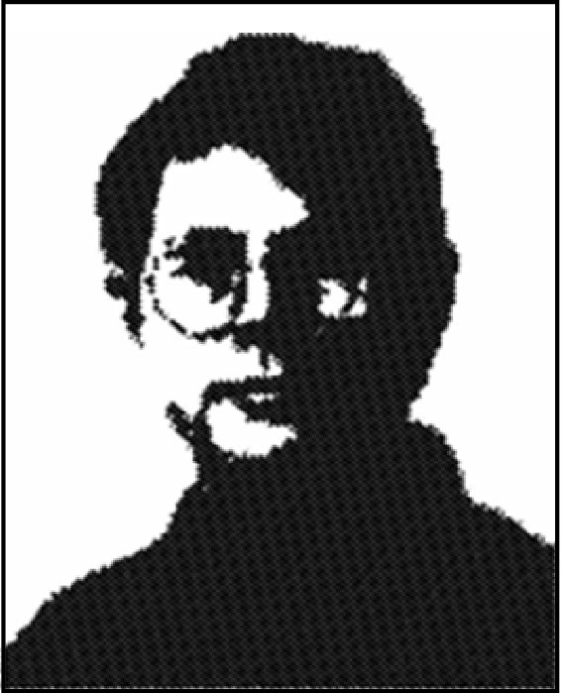
The first bacterial photograph (coliroid?)...
Great moments in contemporary images:
The virgin Maria on a tortilla...
Andy Ellington in a petri dish....
Levskaya et al. Nature, 438(7067):441-2 (2005)

Slide 13
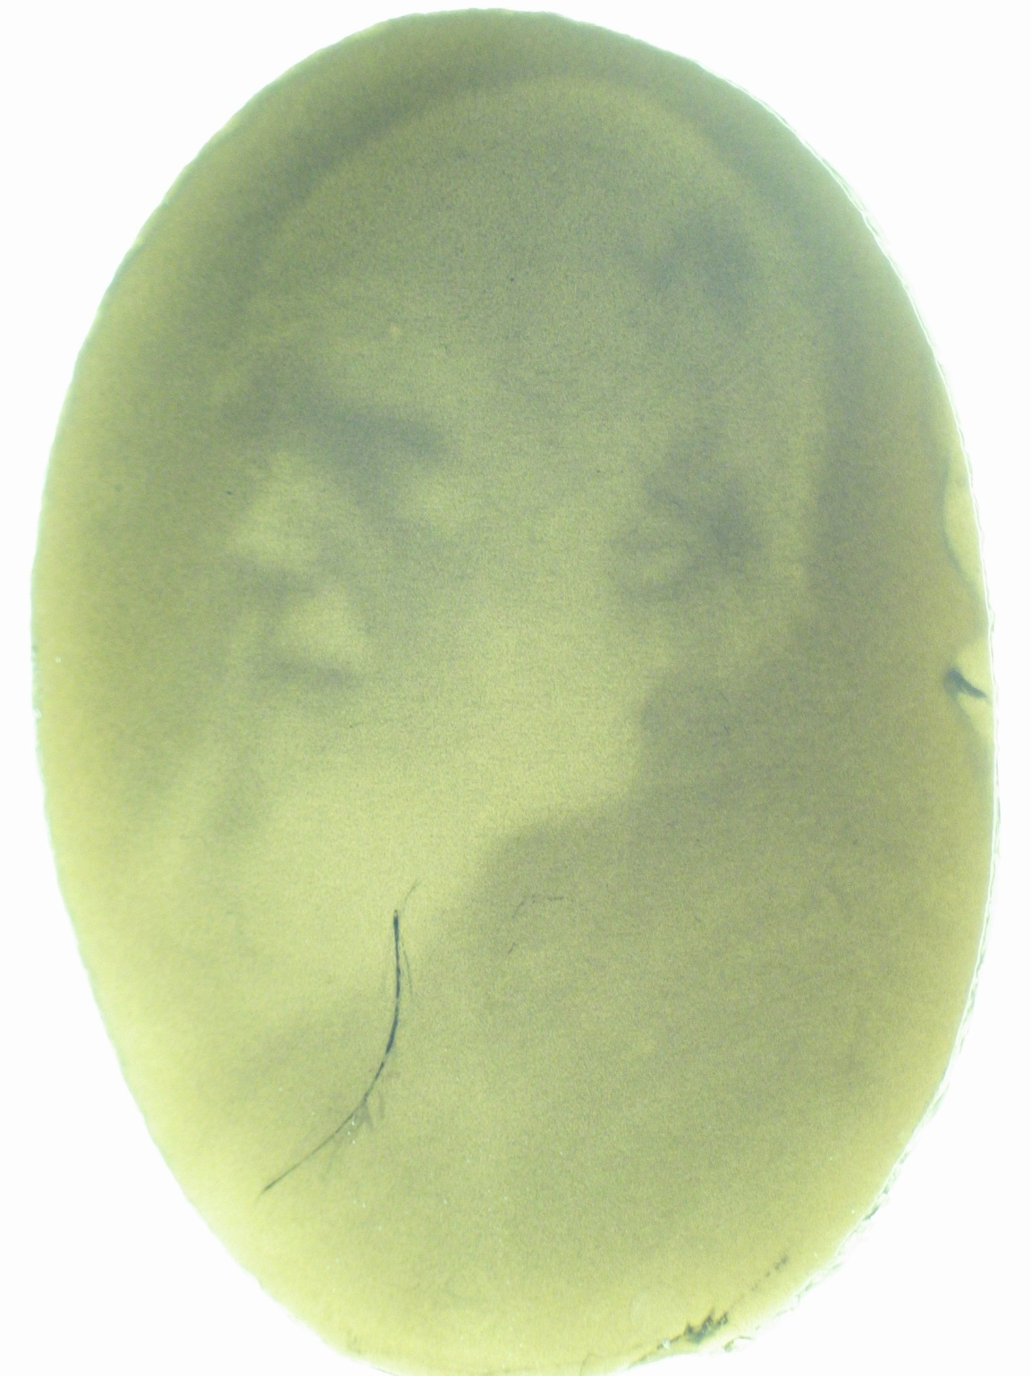
Escherichia darwinia
Image: Aaron Chevalier

Slide 14

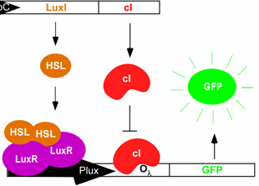
On to the edge
detector...
Dark
Light
HSL
HSL
HSL
HSL
HSL
HSL
HSL
HSL
HSL
HSL
HSL
HSL
HSL
HSL
HSL
HSL
HSL
Tabor et al., Cell 137(7):1272-1281 (2009)

Slide 15
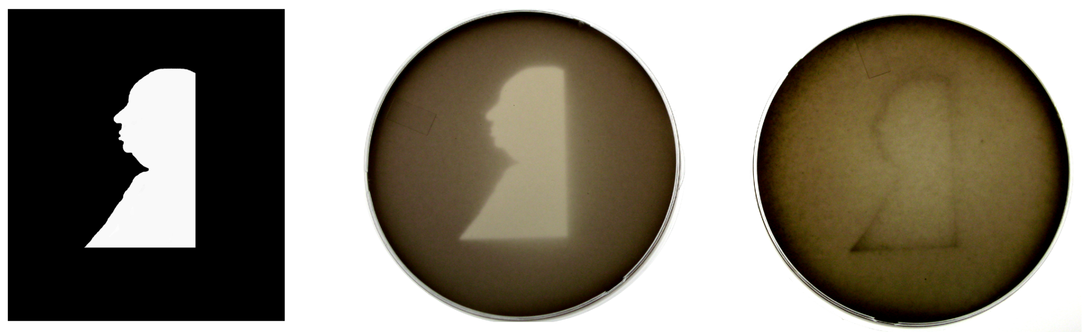
It works!
Projected Mask Photo strain Edge detector strain
Tabor et al., Cell 137(7):1272-1281 (2009)

Slide 16
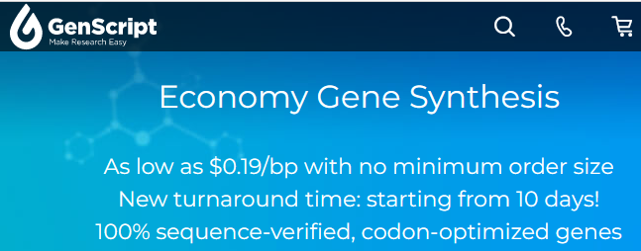
Who needs nature?
Made-to-order, designer organisms
www.genscript.com
We can now manufacture a complete genome
from commodity chemicals
Therefore, we can program whatever changes we want,
assuming we can get it into cells…

Slide 17
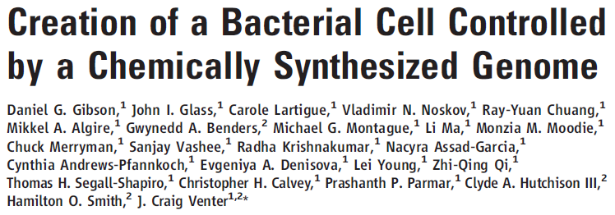
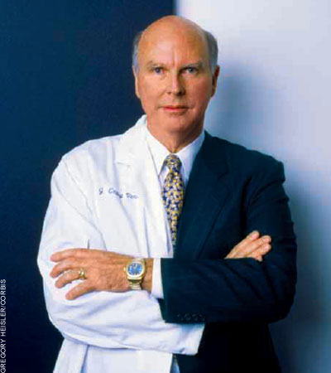
“We report the design, synthesis, and assembly of the 1.08–mega–base pair Mycoplasma mycoides JCVI-syn1.0 genome starting from digitized genome sequence information and its transplantation into a M. capricolum recipient cell to create new M. mycoides cells that are controlled only by the synthetic chromosome.”
http://science.docuwat.ch/
2 JULY 2010 VOL 329 SCIENCE

Slide 18
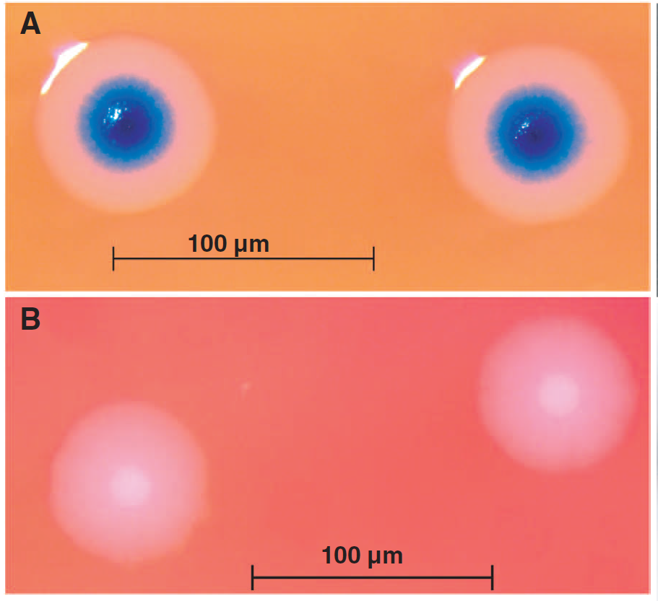
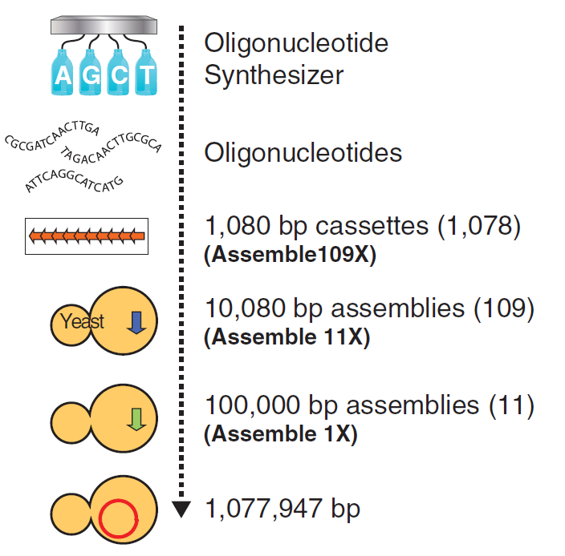
“Rebooting” bacteria with synthetic genomes
Genome transplant
2 JULY 2010 VOL 329 SCIENCE

Slide 19
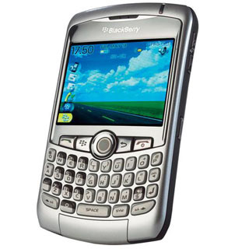
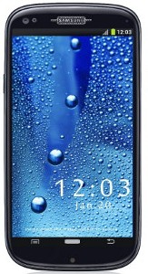
But, wait! They only changed DNA, not the rest of the cell!
However…
In biology, software encodes the hardware.
Most (all?) of the cell is specified by the DNA.
It’s as though you bought a old Blackberry…
installed the Android operating system…
& your phone physically morphed
into a Galaxy S10…
www.cellphones.ca
www.pinterest.com

Slide 20
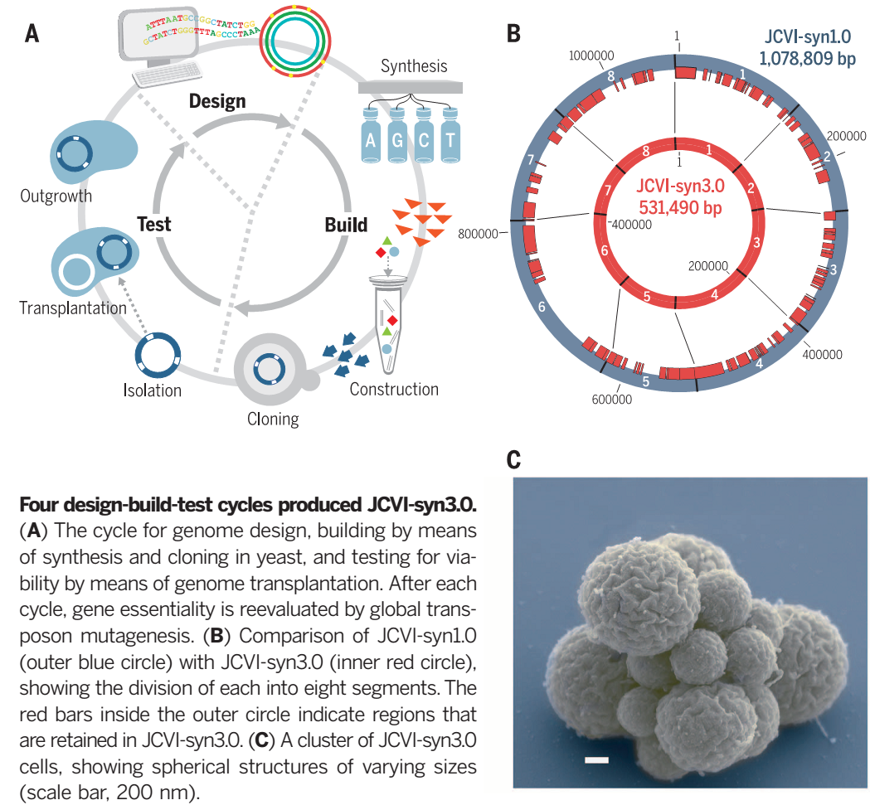
In 2016, Hutchison, Chuang, et al. reported making living mycoplasma after cutting the genome by ½ the genes
Science

Slide 21
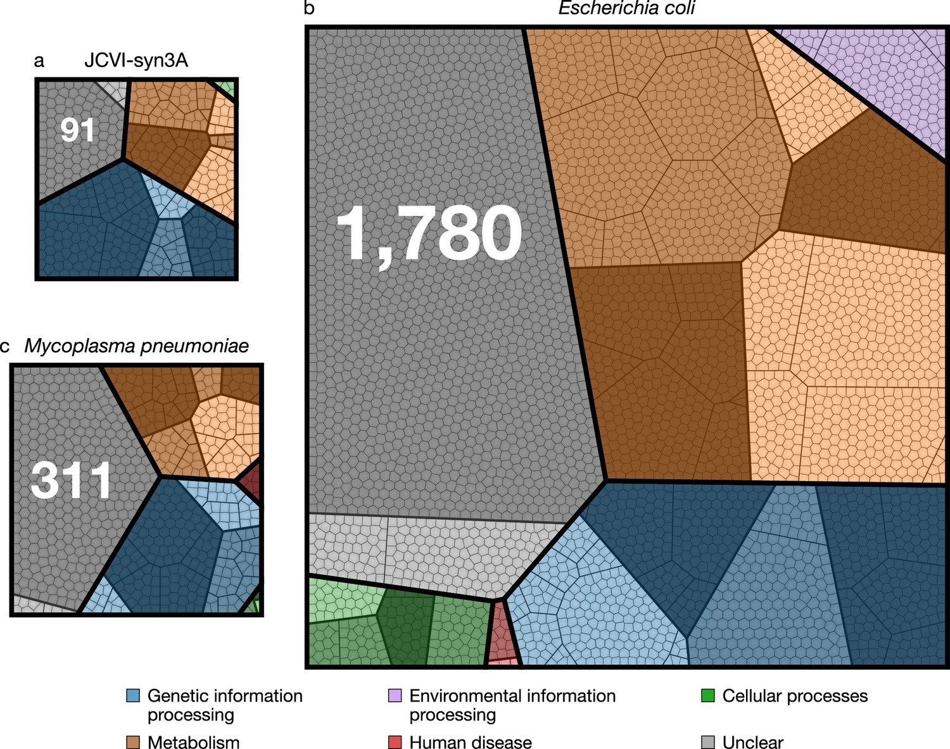
JCVI-syn3.0 now makes for a remarkably compact, engineerable, free living cell “chassis” to study
Breuer et al., eLife 2019;8:e36842 DOI: 10.7554/eLife.36842

Slide 22
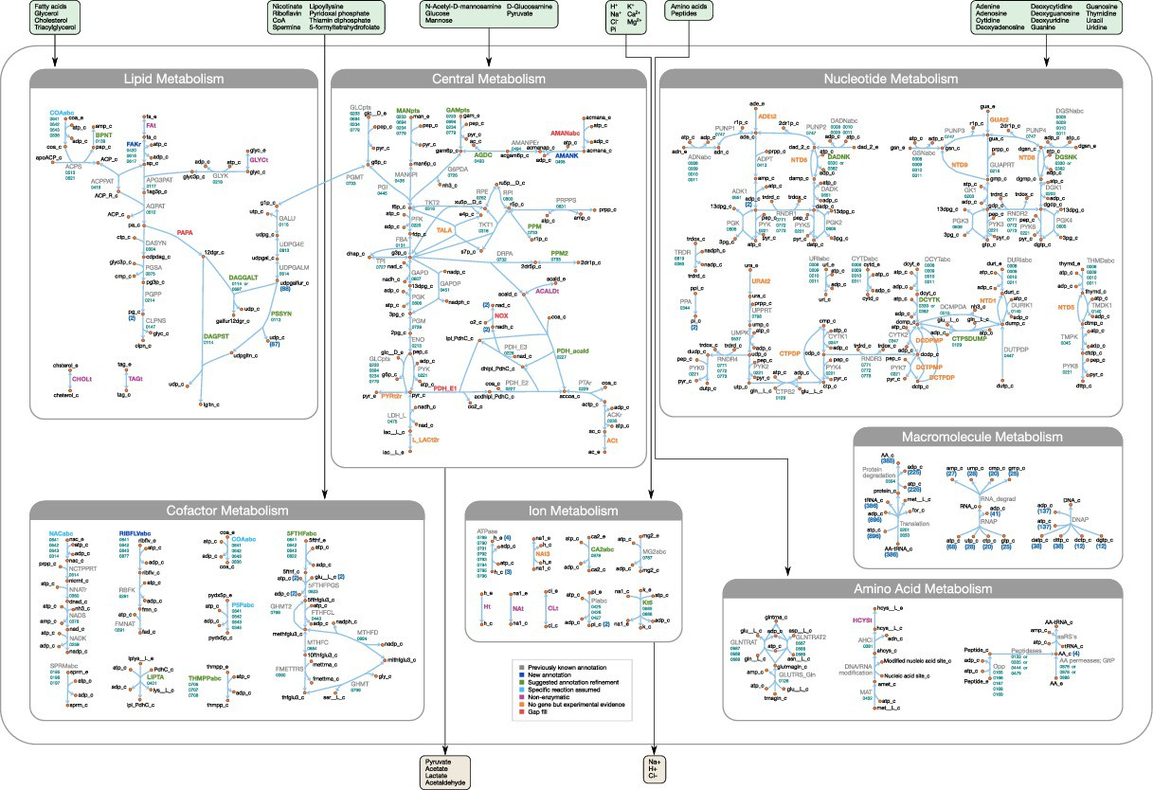
…which now has a rich metabolic reconstruction…
Breuer et al., eLife 2019;8:e36842 DOI: 10.7554/eLife.36842

Slide 23
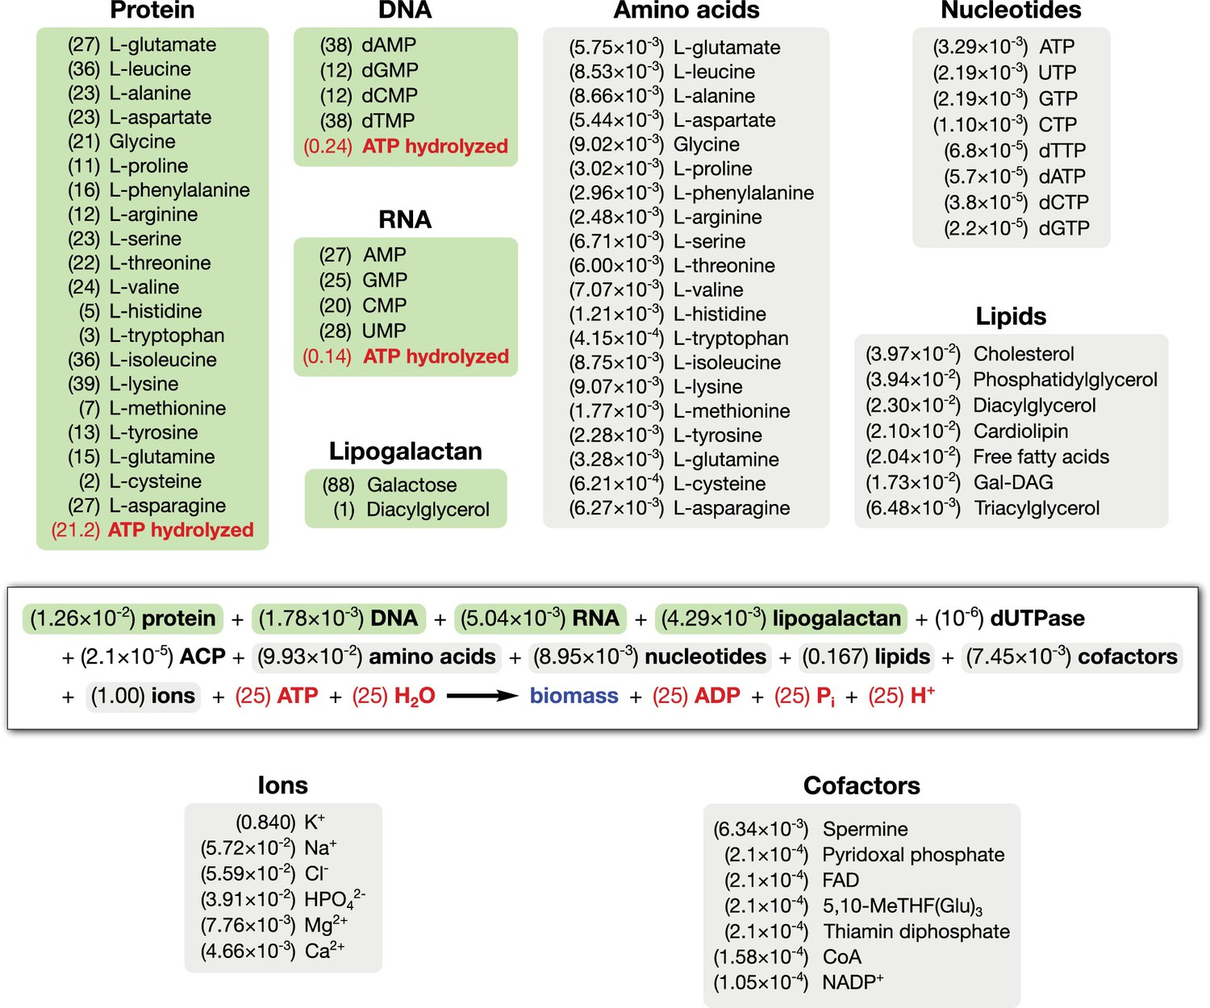
…and highly defined composition, to the extent one can write its biomass reaction equation:
Breuer et al., eLife 2019;8:e36842 DOI: 10.7554/eLife.36842

Slide 24
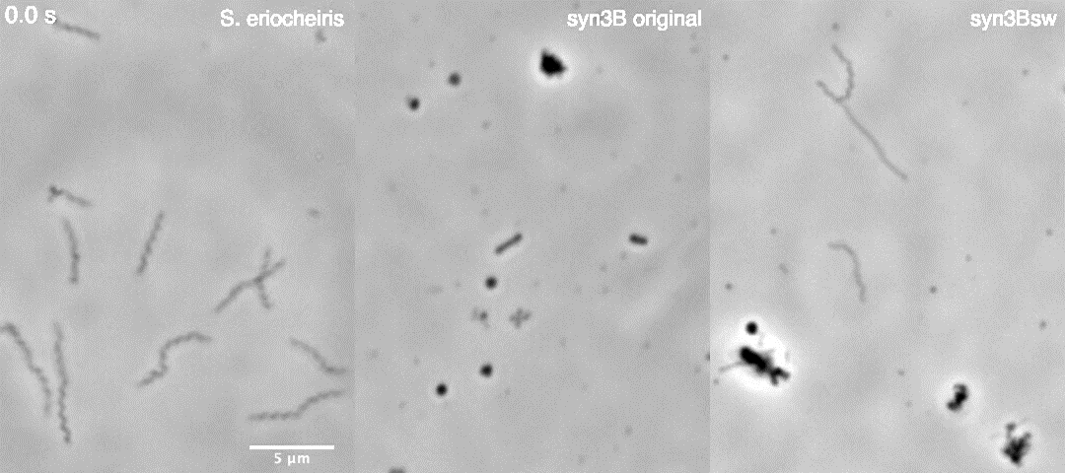
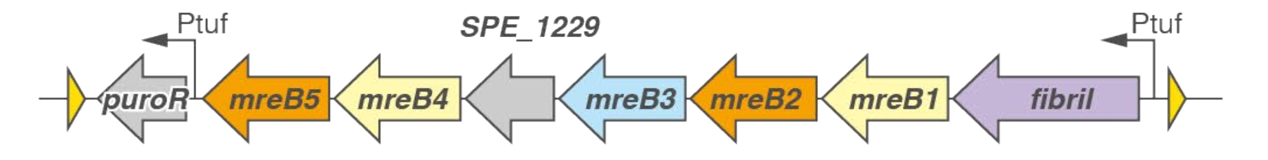
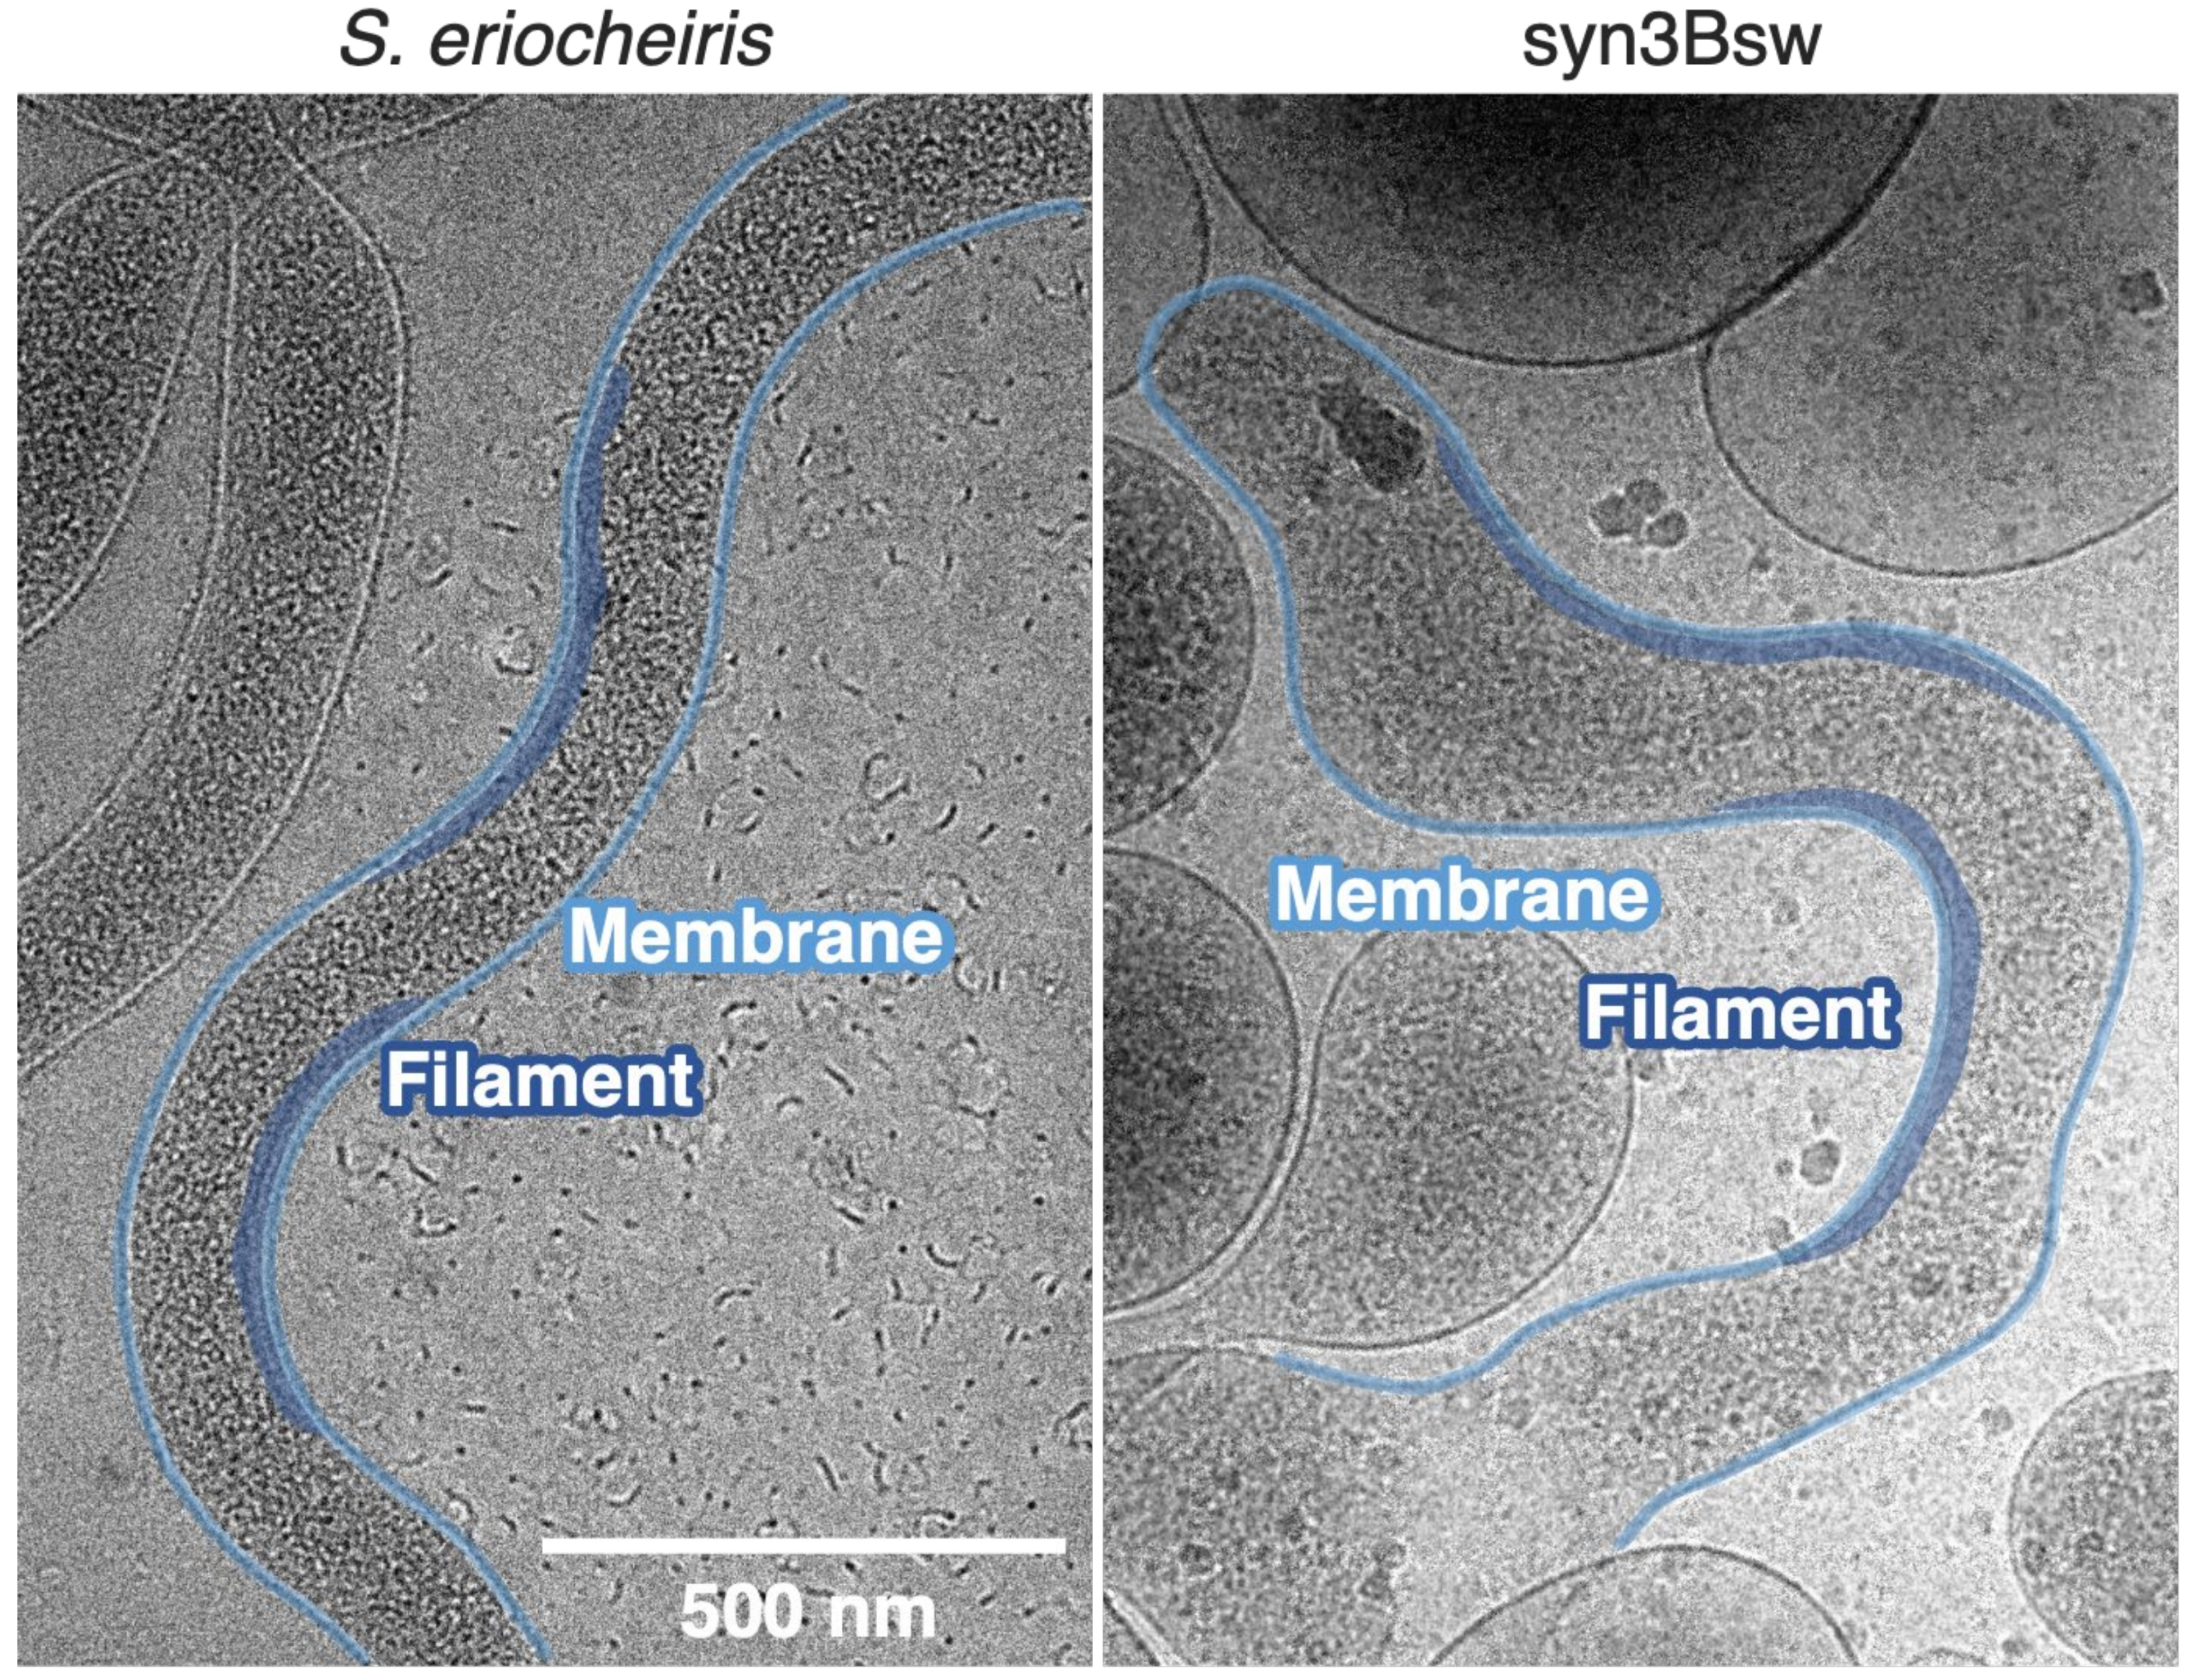
…and most recently, engineered motility
Spiroplasma actin operon
+
JCVI-syn3.0B
Kiyama et al., bioRxiv, doi:10.1101/2021.11.16.468548

Slide 25
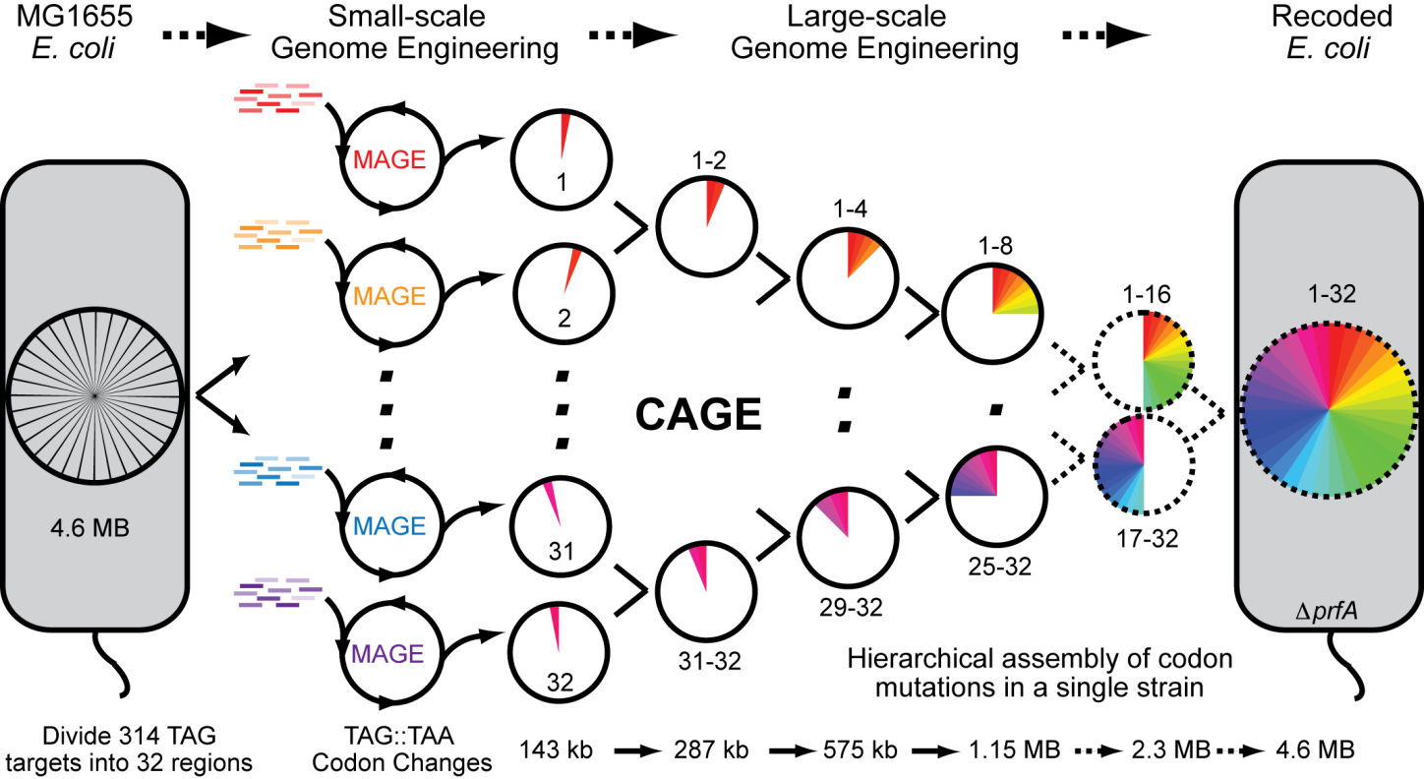
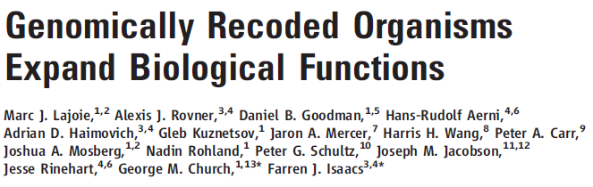
In parallel, methods were developed to edit genomes at many locations in parallel, e.g. reassigning all amber (TAG) stop codons in E. coli to ochre (TAA)
http://isaacs.commons.yale.edu/files/2012/07/rE.coli_.Fig1_.png

Slide 26
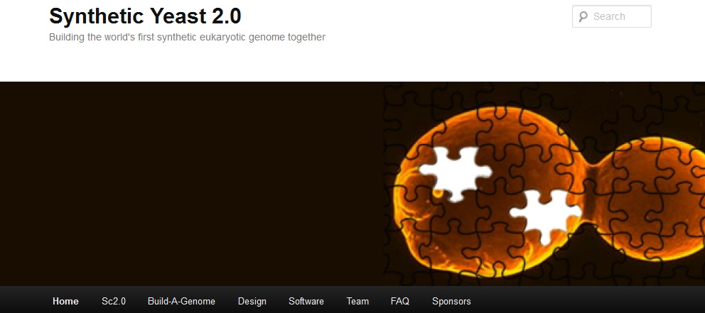
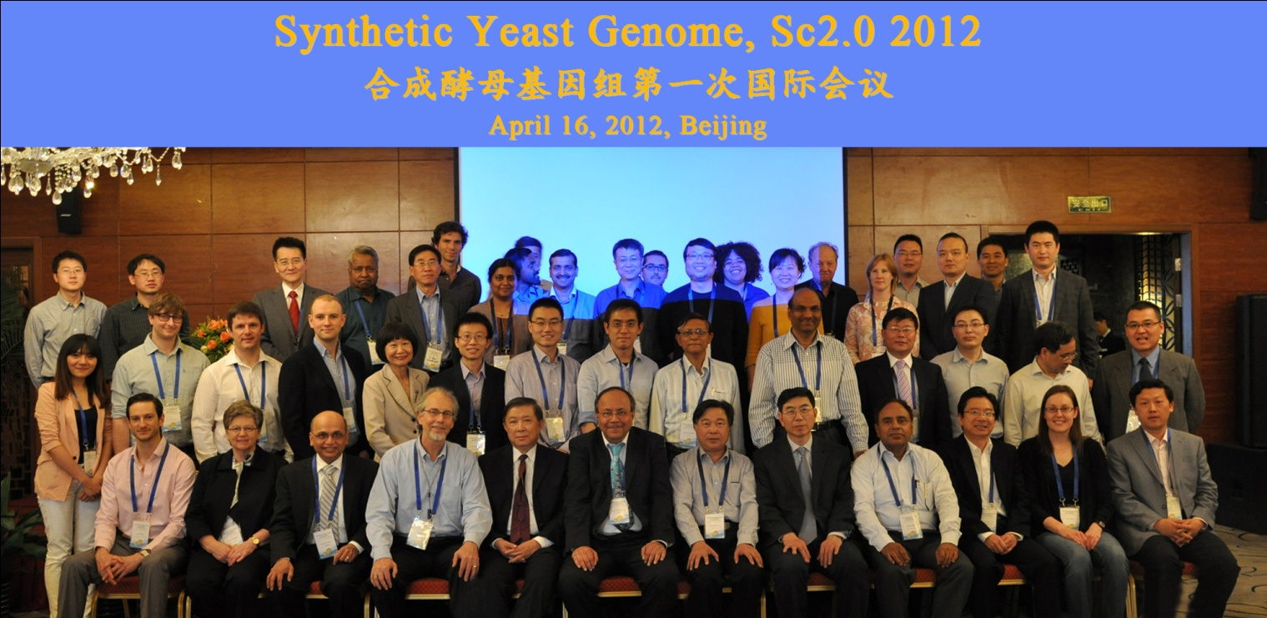
& now, “rebooting” yeast with synthetic chromosomes
Turns out chromosomes can be synthesized and replaced for yeast too…
& China is pushing for a completely synthetic yeast genome…

Slide 27
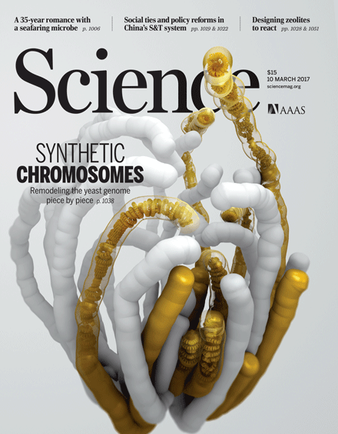
In 2017, the Synthetic Yeast Genome Project (Sc2.0) reported on five newly constructed synthetic yeast chromosomes:
How the cover was made: http://science.sciencemag.org/content/355/6329/eaan1126

Slide 28
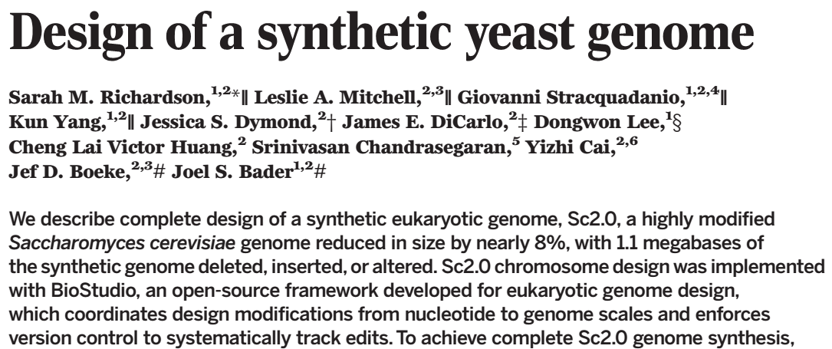
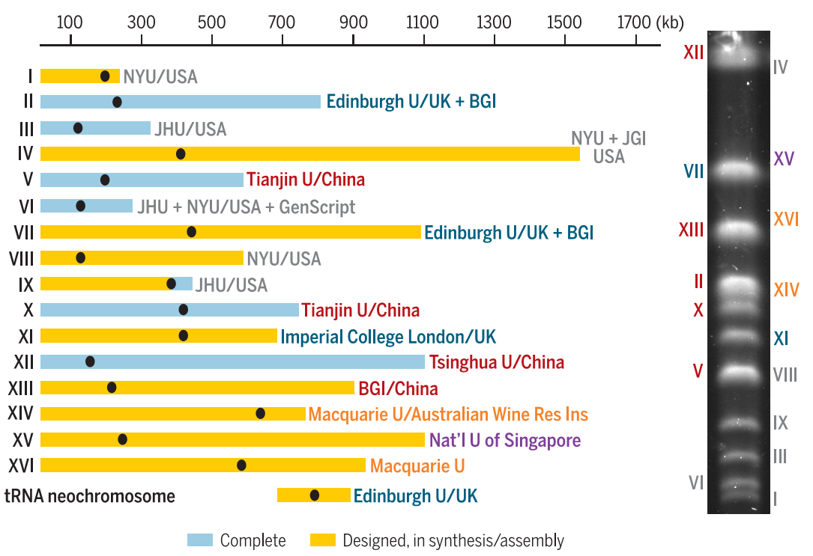

Slide 29
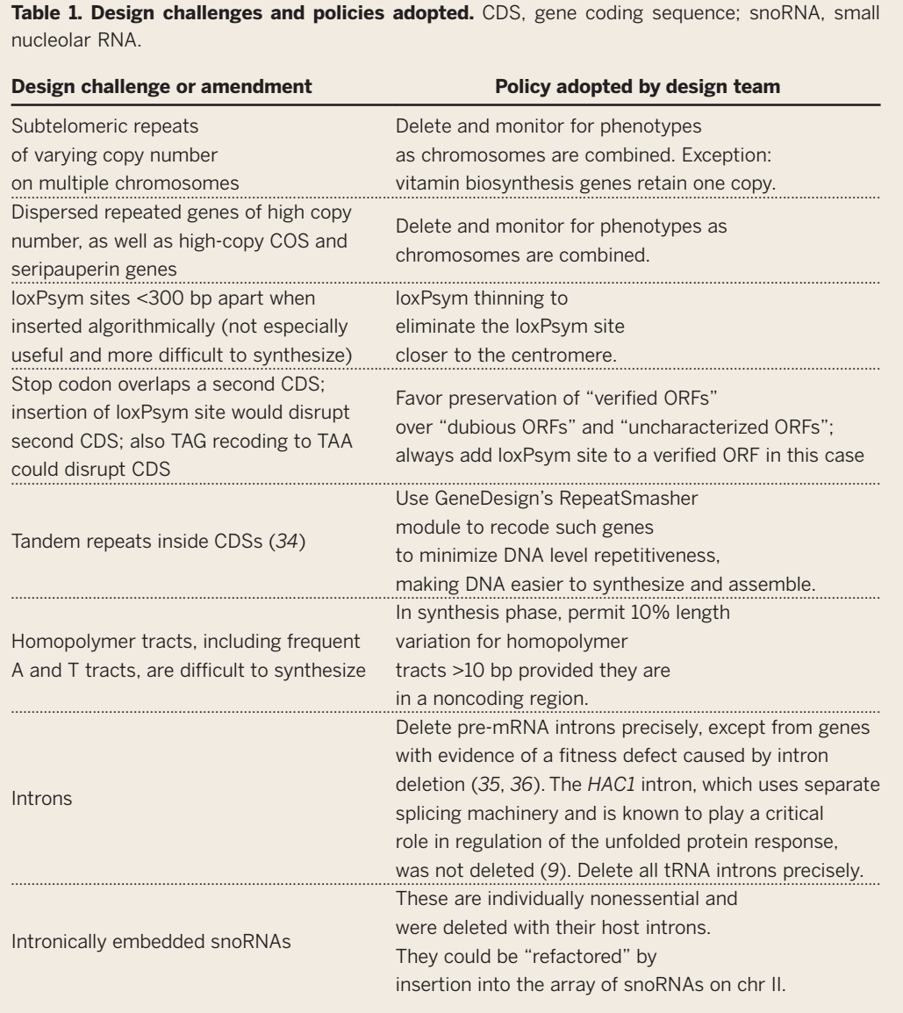

Slide 30
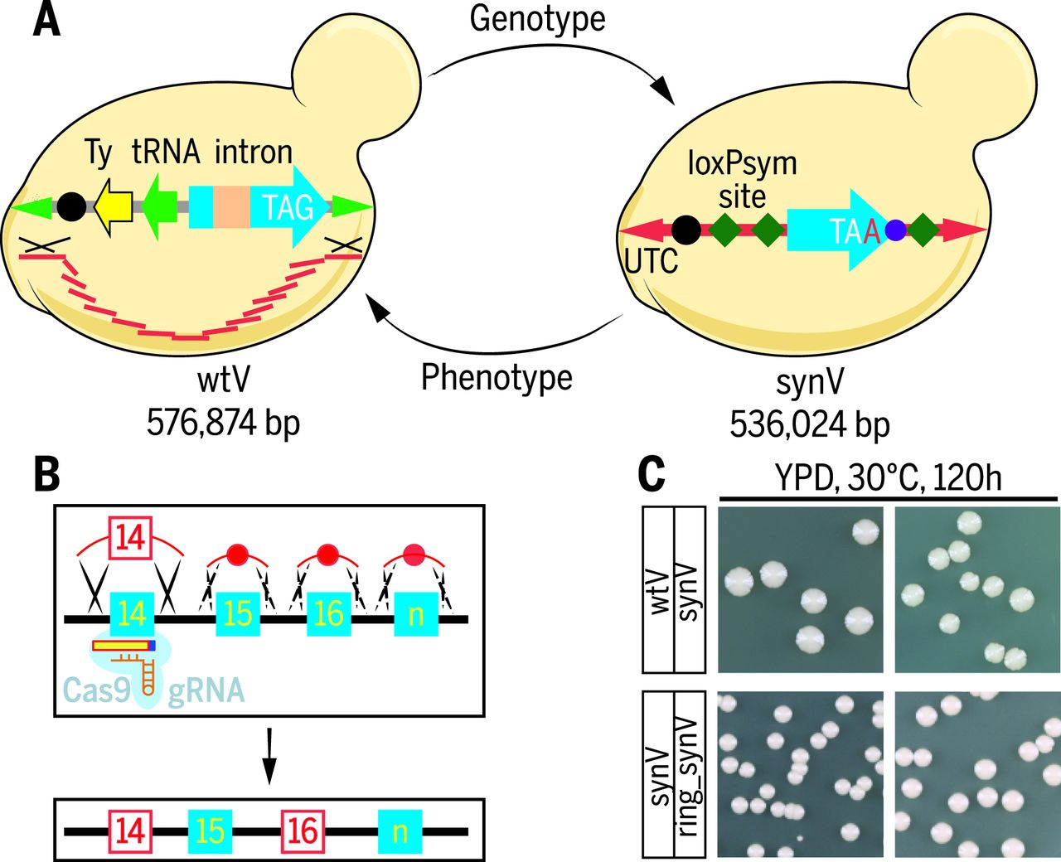
Synthesis, cyclization, and characterization of synV
Ze-Xiong Xie et al. Science 2017;355:eaaf4704
Notes:
Synthesis, cyclization, and characterization of synV. (A) Synthetic chromosome V (synV, 536,024 base pairs) was designed in silico from native chromosome V (wtV, 576,874 base pairs), with extensive genotype modification designed to be phenotypically neutral. (B) CRISPR/Cas9 strategy for multiplex repair. (C) Colonies of wtV, synV, and ring_synV strains.

Slide 31
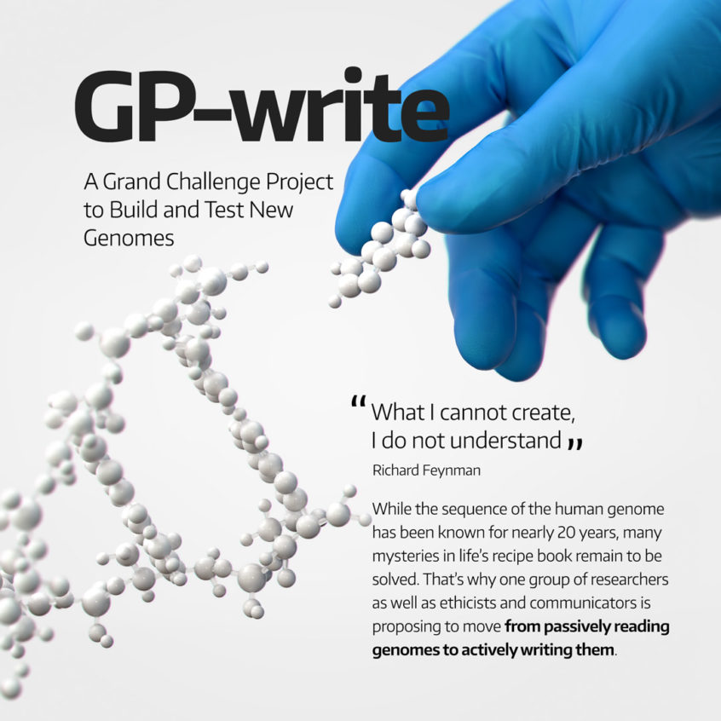
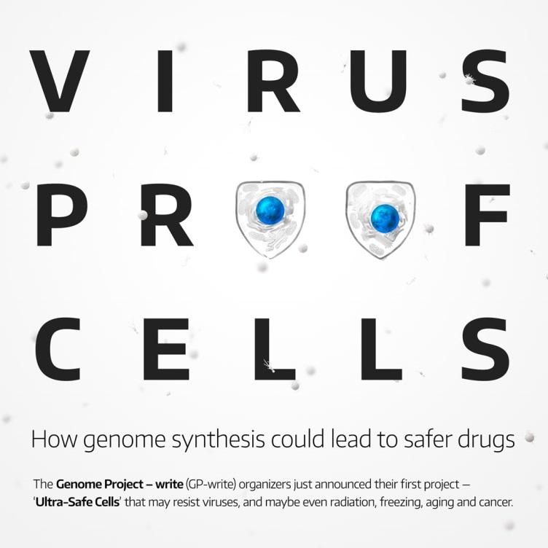
Inevitably (!), the human synthetic genome project:
First major project:
Recoding human codons (~200K edits?) to create virus-resistant cells
https://en.wikipedia.org/wiki/Genome_Project-Write
https://engineeringbiologycenter.org/

Slide 32

Let’s end the lectures on a fun note, with some speculative near-future synthetic biology experiments
Science fiction? or not?
You be the judge!
wikipedia

Slide 33
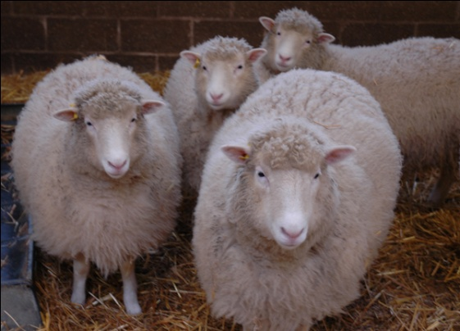
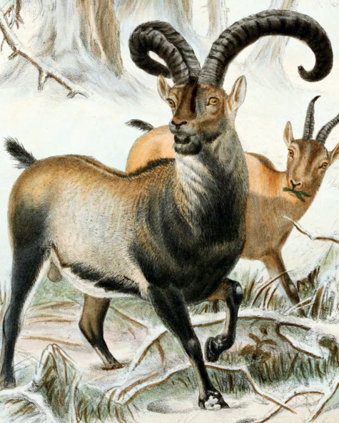
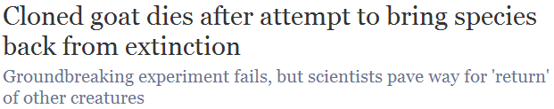
“De-extincting” extinct species
What if the cells being cloned came
from an extinct animal and were put into a surrogate mother?
Would that resurrect the species?
Cian O'Luanaigh
Remember Dolly,
the cloned sheep?
This was tried in 2009 for the Pyrenean ibex, and almost worked…
wikipedia

Slide 34
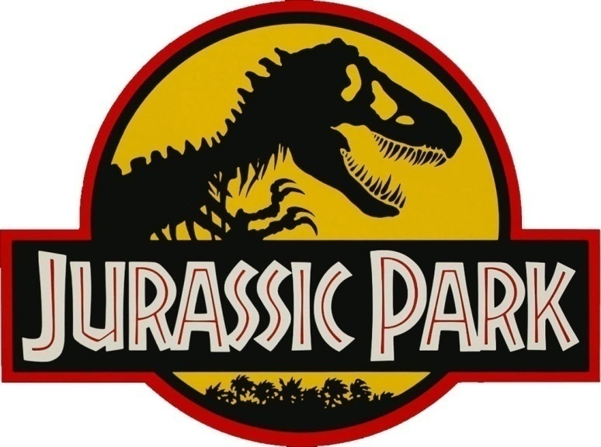
But now there’s another way!
We can sequence a genome in a few days for a few $K
We can synthesize or alter big pieces of the DNA
We can (almost) “reboot” cells with this DNA
We can convert cells to stem cells to embryos
We can in vitro fertilize animals
So why not just “edit” the genomes of the closest living animals to be like their extinct relatives?
Sound familiar?
http://jurassicpark.wikia.com

Slide 35
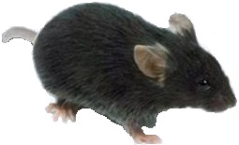
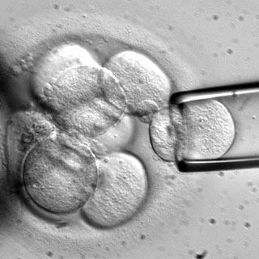
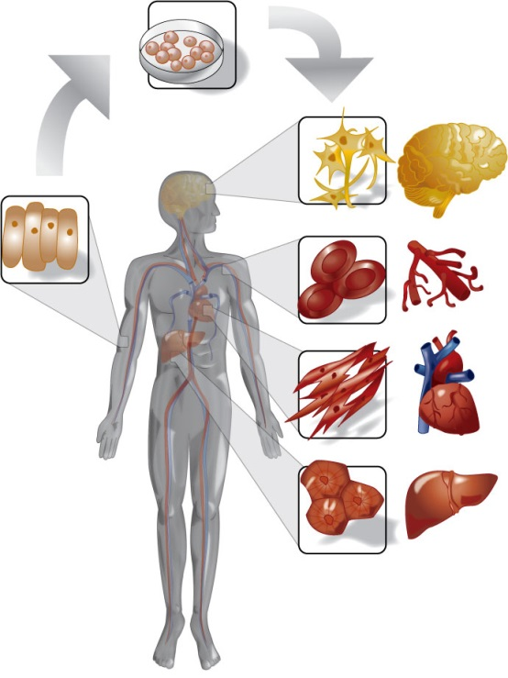
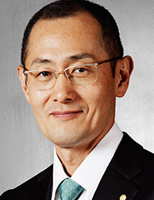
Besides the genome engineering, this hinges on iPS:
From embryonic stem cells, we can grow an entire organism
or any cells/tissues in it
Robert Lanza, ACT
& thanks to Yamanaka, we can convert skin cells back into stem cells
Shinya Yamanaka
Nobel Prize, 2012
www.regenexx.com

Slide 36
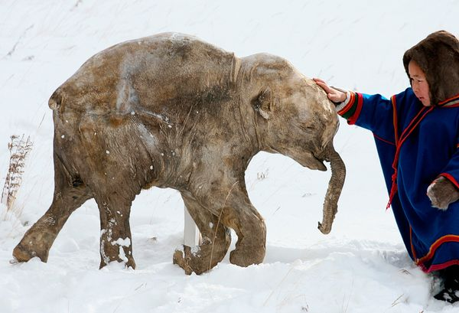
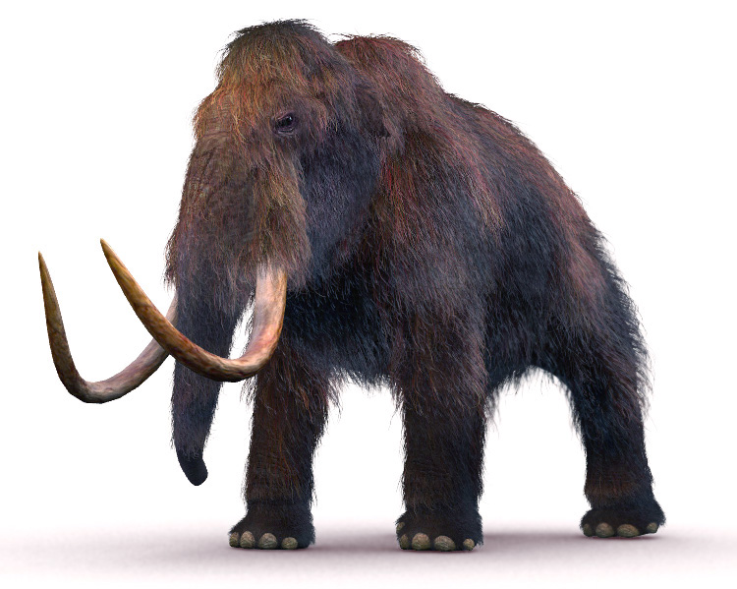

There’s a serious proposal to resurrect the woolly mammoth. Here’s the process:
Mammoth genome sequence
Make ~100K DNA changes in elephant skin cells to convert elephant skin cells→ mammoth skin cells
Convert skin cells to stem cells
Convert stem cells to embryos
In vitro fertilize elephants
This might be a
hard step.
Actual frozen mammoth!
nationalgeographic.com
www.interestingtopics.net

Slide 37


As of April 2015…
http://www.popsci.com/woolly-mammoth-dna-brought-life-elephant-cells

Slide 38

A team of scientists and entrepreneurs announced on Monday that they have started a new company to genetically resurrect the woolly mammoth.
The company, named Colossal, aims to place thousands of these magnificent beasts back on the Siberian tundra, thousands of years after they went extinct.
Sept. 13, 2021
https://www.nytimes.com/2021/09/13/science/colossal-woolly-mammoth-DNA.html

Slide 39

https://colossal.com/mammoth/

Slide 40





Slide 41




Which animal would you resurrect?
The dodo?
The quagga?
wikipedia
Saber-toothed tiger?
techandle.com
In principle, only need the DNA sequence (so, no dinosaurs)
Aurochs?
wiki

Slide 42






I vote for some crazy Australasian animals:
The 12’
tall
moa
& of, course, the marsupial Tasmanian tiger
>90° !!!
http://www.sandianet.com/kiwi/moabarb.jpg
The moa-eating
Haast’s eagle
wikipedia
Actual
scale!
wikipedia
wikipedia

Slide 43


And sure enough!

Slide 44


What about neanderthal?
It’s achievable. But should we do it?
Human and neanderthal genome sequence
Edit DNA in human skin cells to convert convert human skin cells→ neanderthal skin cells
→ I give this step 10 years max before we can do this
Convert skin cells to stem cells
Convert stem cells to embryos
In vitro fertilize
a surrogate mother
So many ethical questions!
Where to start?
Svante
Pääbo
Action Press/Rex Features

Slide 46

Tabor et al., Cell 137(7):1272-1281 (2009)

Slide 47



One major success of synthetic biology is engineering artemisinic acid production from wormwood into yeast:
25 g/L !
Normal source =
sweet wormwood
wikipedia
CJ Paddon et al. Nature 000, 1-5 (2013) doi:10.1038/nature12051

Slide 48



Some other recent successes in this field:
Service (2015) Science 349:677
Galanie et al. (2015) Science 349:1095-100

Slide 49


Luo et al. (2019) Nature 567:123-126

Slide 50

“The only DNA in the cells is the designed synthetic DNA sequence, including “watermark” sequences and other designed gene deletions and polymorphisms, and mutations acquired during the building process. The new cells have expected phenotypic properties and are capable of continuous self-replication.”
PCR of 4 engineered “watermarks”
2 JULY 2010 VOL 329 SCIENCE

Slide 51
Some good quotes from the paper:
“If the methods described here can be generalized, design, synthesis, assembly, and transplantation of synthetic chromosomes will no longer be a barrier to the progress of synthetic biology.”
“We expect that the cost of DNA synthesis will follow what has happened with DNA sequencing and continue to exponentially decrease. Lower synthesis costs combined with automation will enable broad applications for synthetic genomics.”
“As synthetic genomic applications expand, we anticipate that this work will continue to raise philosophical issues that have broad societal and ethical implications.”

Slide 52

Although the race is on as other groups try to resurrect frozen mammoth cells:

