Slide 1
Functional genomics
+
Data mining
BCH394P/364C Systems Biology / Bioinformatics
Edward Marcotte, Univ of Texas at Austin

Slide 2
Functional genomics
+
Data mining
= field that attempts to use the vast data produced by genomic projects (e.g. genome sequencing projects) to describe gene (and protein) functions and interactions.
Focuses on dynamic aspects, e.g. transcription, translation, and protein–protein interactions, as opposed to static aspects of the genome such as DNA sequence or structures.
Adapted from Wikipedia

Slide 3
Functional genomics
+
Data mining
= field that attempts to computationally discover patterns in large data sets
Adapted from Wikipedia

Slide 4
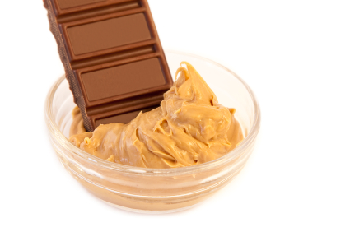
Functional genomics
+
Data mining
Adapted from Wikipedia
www.sparkpeople.com

Slide 5
We’re going to first learn about clustering algorithms & classifiers

Slide 6
We’re going to first learn about clustering algorithms & classifiers
Clustering = task of grouping a set of objects in such a way that objects in the same group (a cluster) are more similar (in some sense) to each other than to those in other groups (clusters).
Adapted from Wikipedia

Slide 7
We’re going to first learn about clustering algorithms & classifiers
Classification = task of categorizing a new observation, on the basis of a training set of data with observations (or instances) whose categories are known
Adapted from Wikipedia

Slide 8
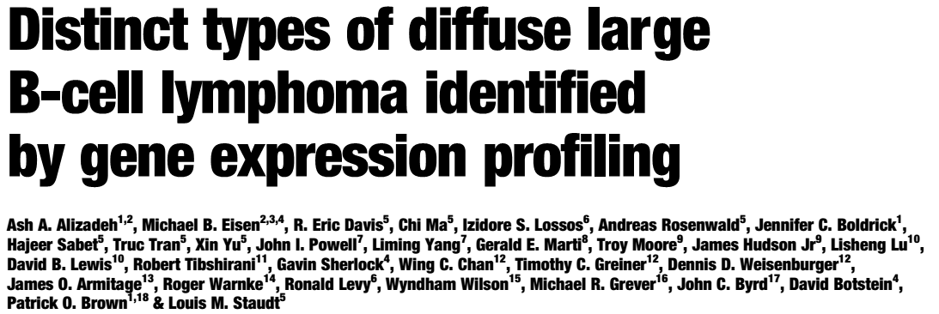
Let’s motivate this with an important historical example:
Nature 2000

Slide 9
“Diffuse large B-cell lymphoma (DLBCL), the most common subtype of non-Hodgkin's lymphoma … is one disease in which attempts to define subgroups on the basis of morphology have largely failed…”
“DLBCL … is clinically heterogeneous:
40% of patients respond well to current therapy and have prolonged survival, whereas the remainder succumb to the disease.
We proposed that this variability in natural history reflects unrecognized molecular heterogeneity in the tumours.”
Nature 2000

Slide 10
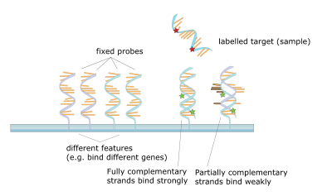
Blast from the past: Profiling mRNA expression with DNA microarrays
DNA molecules are attached to a solid substrate, then…
…probed with a labeled (usually fluorescent) DNA sequence
Wikipedia

Slide 11
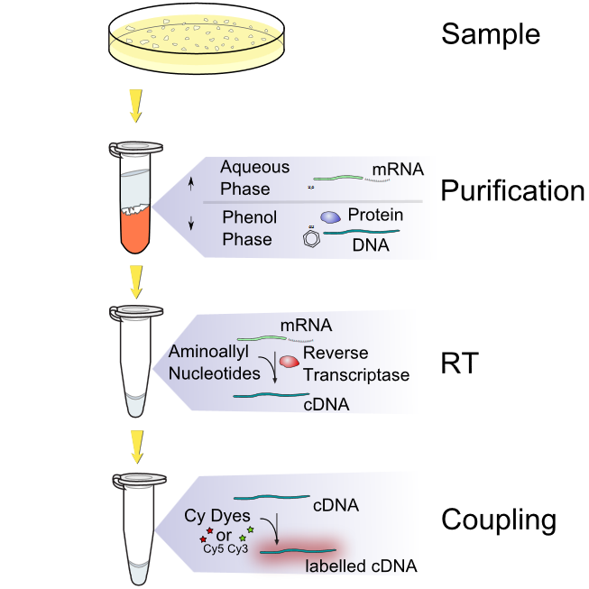
Blast from the past: Profiling mRNA expression with DNA microarrays
(FYI, we would generally now just sequence the cDNA)
Wikipedia

Slide 12
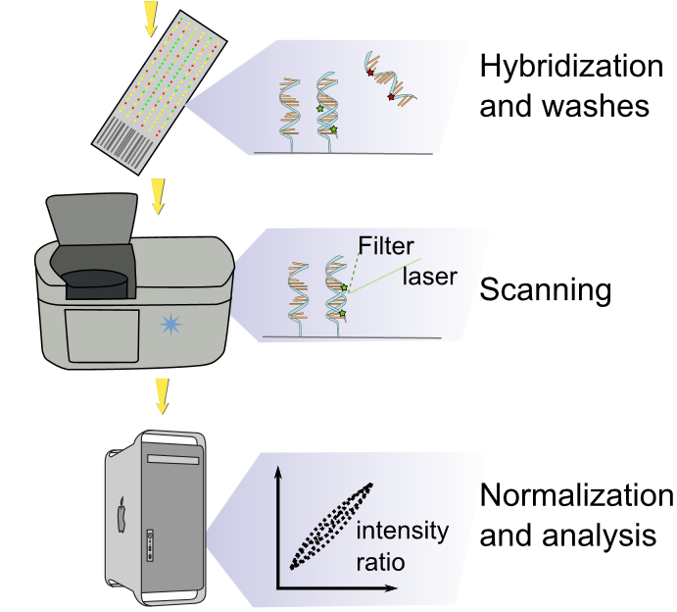
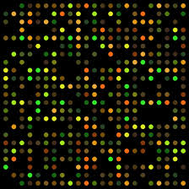
Blast from the past: Profiling mRNA expression with DNA microarrays
Note that some arrays are 1-color, some are 2. Why?
Wikipedia
Wikipedia

Slide 13
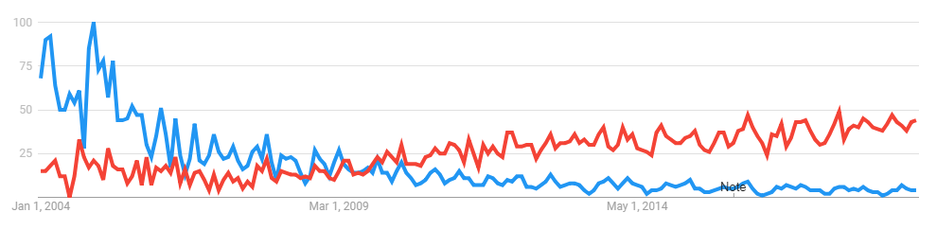
DNA microarrays are a great example of
the “arc” of a technology over time
DNA microarrays
RNA sequencing
Worldwide Google trends, 2004-present

Slide 14
Back to diffuse large B-cell lymphoma…
96 patient biopsies
(normal and malignant lymphocyte samples)
Extract mRNA from each sample
Perform DNA microarray experiment on each to measure mRNA abundances (~1.8 million total gene expression measurements)
Cluster samples by their expression patterns
Nature 2000

Slide 15
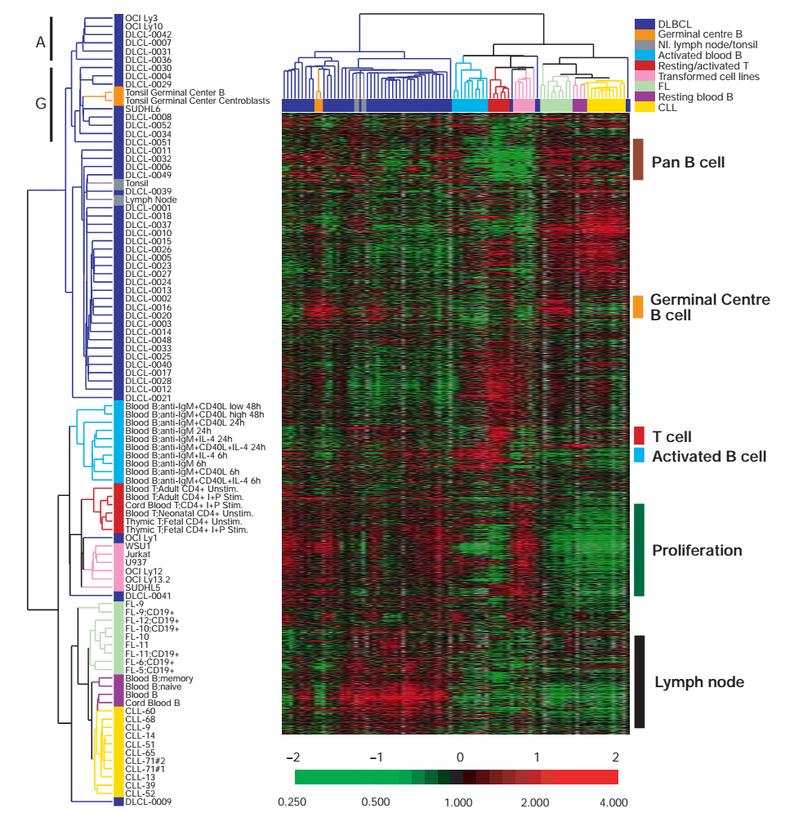
Red = high expression
Green = low
(yes, I know it’s exactly
backwards from what you might expect.)
Samples
Hierarchical clustering of the gene expression data
Genes
Nature 2000

Slide 16
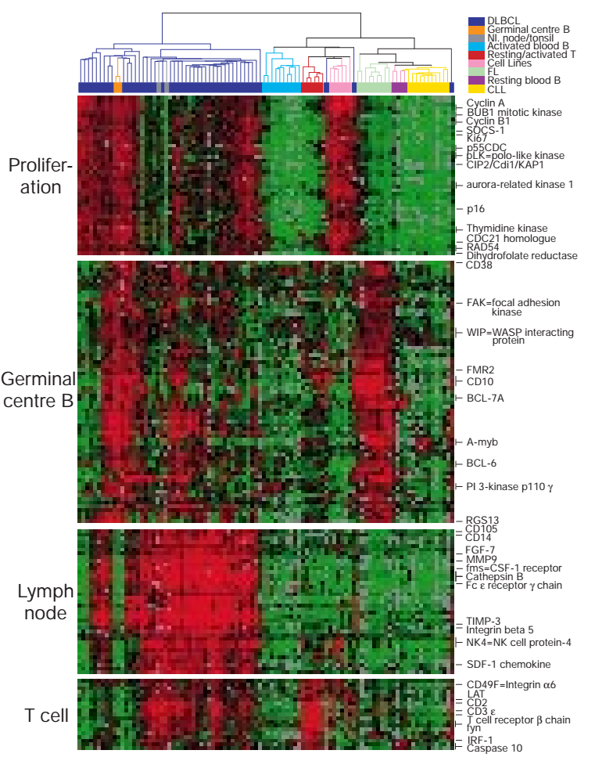
Genes can be found whose expression is specific to germinal centre B cells, and different across DLBCL’s
Nature 2000

Slide 17
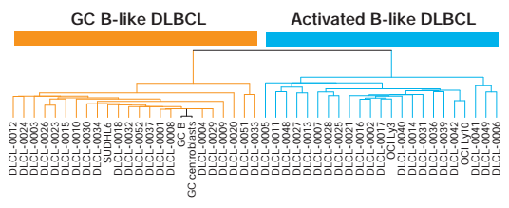
We can break up the DLBCL’s according the germinal B-cell specific gene expression:
Nature 2000

Slide 18
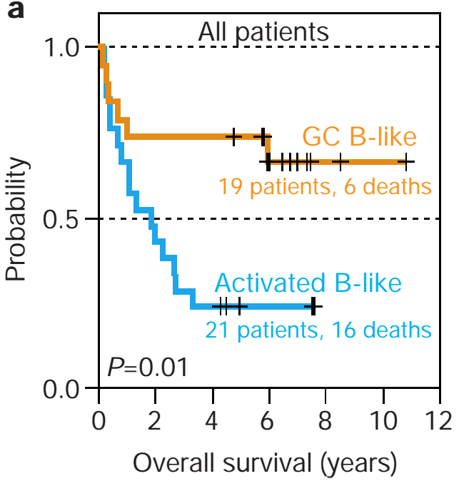
What good is this? These molecular phenotypes predict clinical survival.
Kaplan-Meier plot of patient survival
Nature 2000

Slide 19
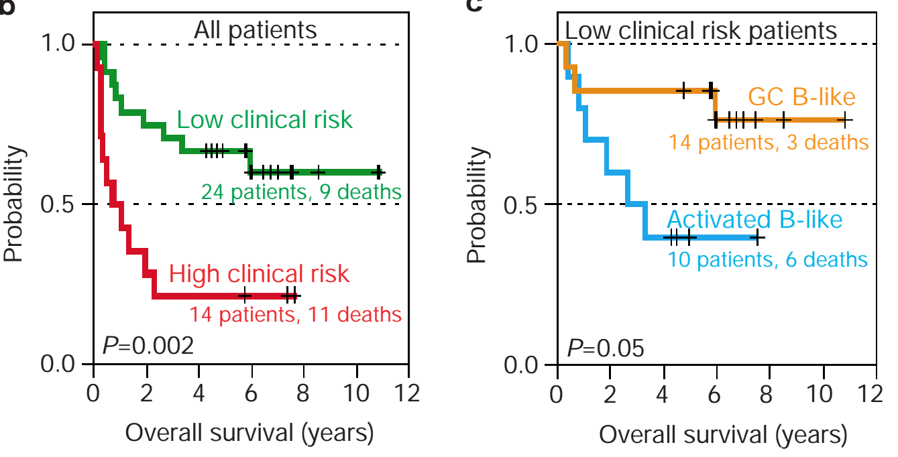
What good is this? These molecular phenotypes predict clinical survival.
Grouping patients by clinical prognostic index
Regrouping low risk patients by gene expression
Nature 2000

Slide 20
Gene expression, and other molecular measurements, provide far deeper phenotypes for cells, tissues, and organisms than traditional measurements
These sorts of observations have now motivated tons of work using these approaches to diagnose specific forms of disease, as well as to discover functions of genes and many other applications

Slide 21
So, how does clustering work?
First, let’s think about the data, e.g. as for gene expression.
From one sample, using DNA microarrays or RNA-seq, we get:
Expression level of gene 1
Expression level of gene 2
Expression level of gene 3
.
.
.
Expression level of gene i
.
.
.
Expression level of gene N
i.e., a vector of N numbers
N genes
For yeast, N ~ 6,000
For human, N ~ 22,000

Slide 22
So, how does clustering work?
Every additional sample adds another column, giving us a matrix of data:
M samples
Gene 1, sample 1 …
Gene 2, sample 1 …
Gene 3, sample 1 …
.
.
.
Gene i, sample 1 …
.
.
.
Gene N, sample 1 …
Gene 1, sample j …
Gene 2, sample j …
Gene 3, sample j …
.
.
.
Gene i, sample j …
.
.
.
Gene N, sample j …
Gene 1, sample M
Gene 2, sample M
Gene 3, sample M
.
.
.
Gene i, sample M
.
.
.
Gene N, sample M
N genes
For yeast, N ~ 6,000
For human, N ~ 22,000
i.e., a matrix of N x M numbers

Slide 23
So, how does clustering work?
M samples
Gene 1, sample 1 …
Gene 2, sample 1 …
Gene 3, sample 1 …
.
.
.
Gene i, sample 1 …
.
.
.
Gene N, sample 1 …
Gene 1, sample j …
Gene 2, sample j …
Gene 3, sample j …
.
.
.
Gene i, sample j …
.
.
.
Gene N, sample j …
Gene 1, sample M
Gene 2, sample M
Gene 3, sample M
.
.
.
Gene i, sample M
.
.
.
Gene N, sample M
Every gene has a feature vector of M numbers associated with it
N genes

Slide 24
So, how does clustering work?
M samples
Gene 1, sample 1 …
Gene 2, sample 1 …
Gene 3, sample 1 …
.
.
.
Gene i, sample 1 …
.
.
.
Gene N, sample 1 …
Gene 1, sample j …
Gene 2, sample j …
Gene 3, sample j …
.
.
.
Gene i, sample j …
.
.
.
Gene N, sample j …
Gene 1, sample M
Gene 2, sample M
Gene 3, sample M
.
.
.
Gene i, sample M
.
.
.
Gene N, sample M
Similarly, every sample has a feature vector of N numbers associated with it
N genes

Slide 25
So, how does clustering work?
M samples
The first clustering method we’ll learn about simply groups the objects
(samples or genes) in a hierarchy by the similarity of their feature vectors.
Gene 1, sample 1 …
Gene 2, sample 1 …
Gene 3, sample 1 …
.
.
.
Gene i, sample 1 …
.
.
.
Gene N, sample 1 …
Gene 1, sample j …
Gene 2, sample j …
Gene 3, sample j …
.
.
.
Gene i, sample j …
.
.
.
Gene N, sample j …
Gene 1, sample M
Gene 2, sample M
Gene 3, sample M
.
.
.
Gene i, sample M
.
.
.
Gene N, sample M
N genes

Slide 26
A hierarchical clustering algorithm
Start with each object in its own cluster
Until there is only one cluster left, repeat:
Among the current clusters, find the two most similar clusters
Merge those two clusters into one
We can choose our measure of similarity and how we merge the clusters

Slide 27
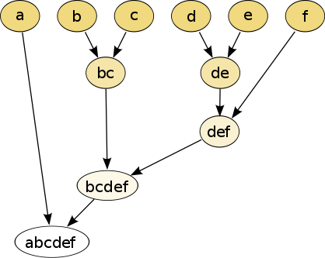
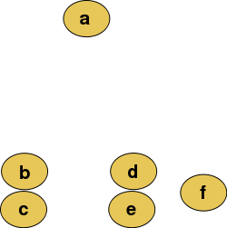
Hierarchical clustering
Conceptually
Data points on an X-Y plane
Dendrogram
(grouped by closeness)
Wikipedia

Slide 28
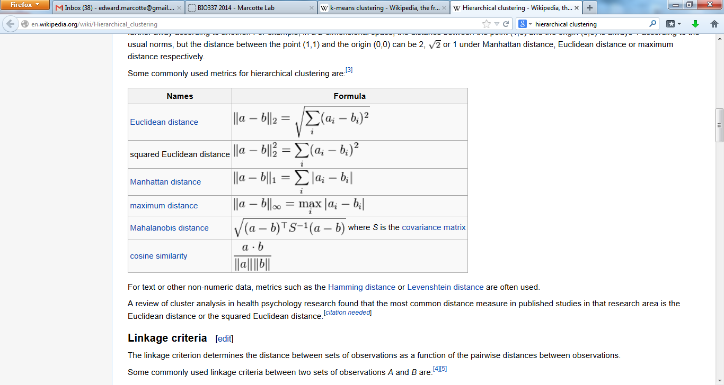
We’ll need to measure the similarity between feature vectors. Here are a few (of many) common distance measures used in clustering.
Wikipedia

Slide 29
Back to the
B cell lymphoma example
Samples
Hierarchical clustering
Similarity measure = Pearson correlation coefficient between gene expression vectors
Similarity between clusters = average similarity between individual elements of each cluster
(also called average linkage clustering)
Genes
Nature 2000

Slide 30
K-means clustering is a common alternative clustering approach
*mainly because it’s easy and can be quite fast!*
The basic algorithm:
Pick a number (k) of cluster centers
Assign each gene to its nearest cluster center
Move each cluster center to the mean of its
assigned genes
Repeat steps 2 & 3 until convergence
See the K-means example posted on the web site

Slide 31
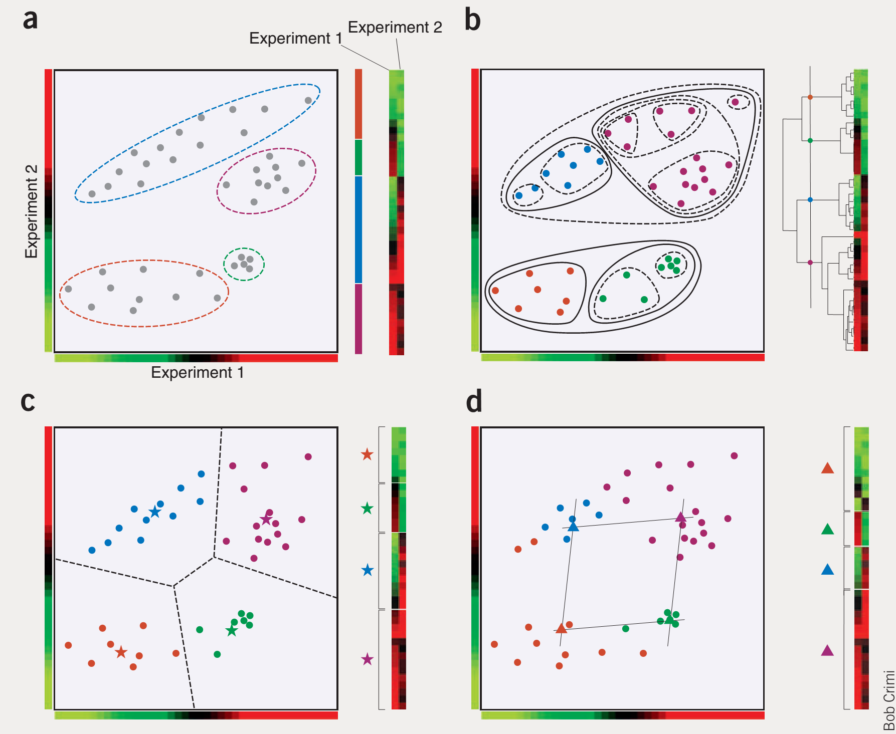
A 2-dimensional example
Nature Biotech 23(12):1499-1501 (2005)

Slide 32
A 2-dimensional example: hierarchical
Nature Biotech 23(12):1499-1501 (2005)

Slide 33
A 2-dimensional example: k-means
Nature Biotech 23(12):1499-1501 (2005)

Slide 34
A 2-dimensional example: k-means
Decision boundaries
Nature Biotech 23(12):1499-1501 (2005)

Slide 35
Some features of K-means clustering
Depending on how you seed the clusters, it may be stochastic. You may not get the same answer every time you run it.
Every data point ends up in exactly 1 cluster
(so-called hard clustering)
Not necessarily obvious how to choose k
Great example of something we’ve seen already:
Expectation-Maximization (E-M) algorithms
EM algorithms alternate between assigning data to models (here, assigning points to clusters) and updating the models (calculating new centroids)

Slide 36
Some features of K-means clustering
Depending on how you seed the clusters, it may be stochastic. You may not get the same answer every time you run it.
Every data point ends up in exactly 1 cluster
(so-called hard clustering)
Not necessarily obvious how to choose k
Great example of something we’ll meet again:
Expectation-Maximization (E-M) algorithms
EM algorithms alternate between assigning data to models (here, assigning points to clusters) and updating the models (calculating new centroids)
Let’s think about this aspect for a minute.
Why is this good or bad?
How could we change it?

Slide 37
k-means
The basic algorithm:
Pick a number (k) of cluster centers
Assign each gene to its nearest cluster center
Move each cluster center to the mean of its
assigned genes
Repeat steps 2 & 3 until convergence

Slide 38
Fuzzy k-means
The basic algorithm:
Choose k. Randomly assign cluster centers.
Fractionally assign each gene to each cluster:
e.g. occupancy (g_{i},m_{j}) = e
For each cluster, calculate weighted mean of genes to update cluster centroid
Repeat steps 2 & 3 until convergence
-||g_{i}-m_{j}||²
Note: ||x|| is just shorthand for the length of the vector x.
g_{i} = gene i
m_{j} = centroid of cluster j
Σ e
-||g_{i}-m_{j}||²
j

Slide 39
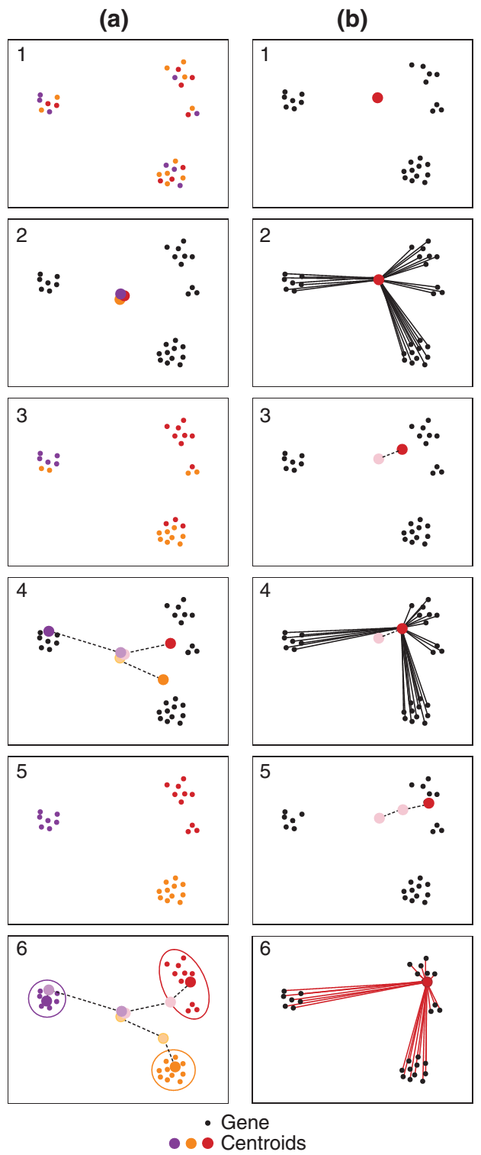
k-means
Fuzzy k-means
Genome Biology 3(11):research0059.1–0059.22 (2002)

Slide 40
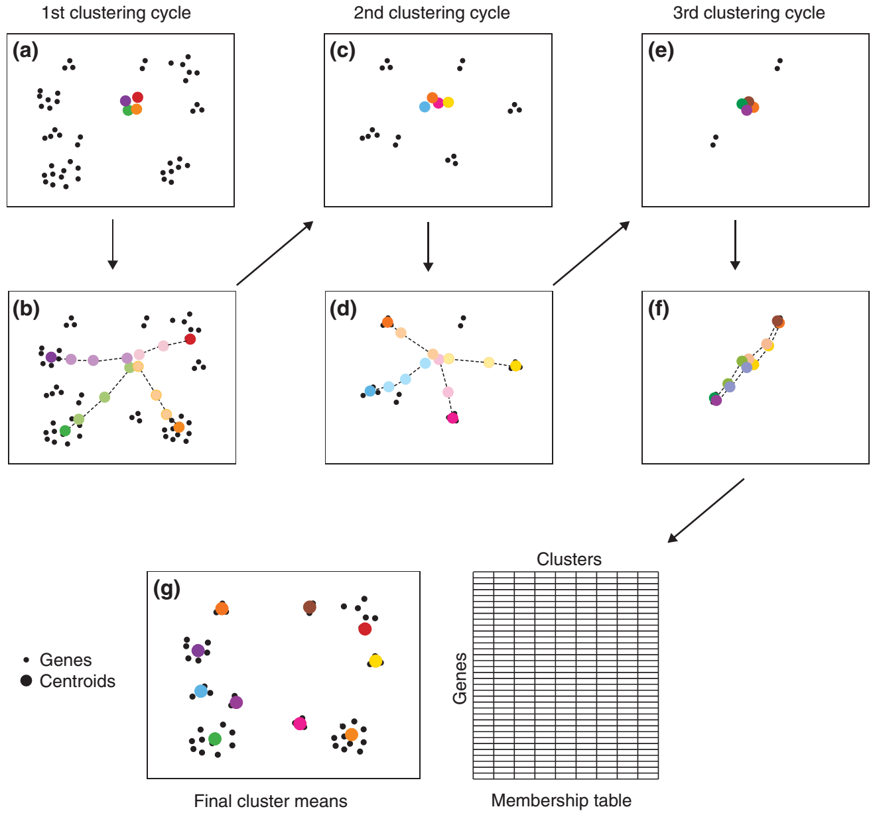
Remove genes correlated >0.7 to the identified centroids
Remove genes correlated >0.7 to the identified centroids
Iterating fuzzy k-means
Genome Biology 3(11):research0059.1–0059.22 (2002)

Slide 41
Iterating fuzzy k-means
Genome Biology 3(11):research0059.1–0059.22 (2002)

Slide 42
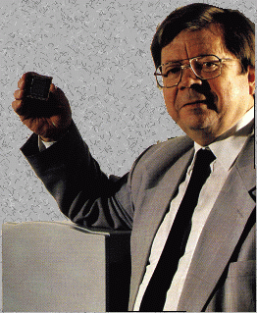
A fun clustering strategy that builds on these ideas: Self-organizing maps (SOMs)
Combination of clustering & visualization
A type of artificial neural network
Invented by Teuvo Kohonen, also called Kohonen maps
Dr. Eng., Emeritus Professor of the Academy of Finland; Academician

Slide 43
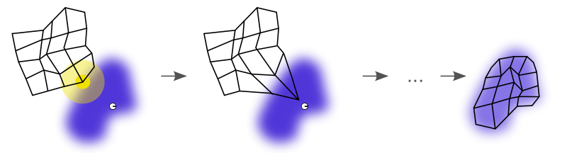
A fun clustering strategy that builds on these ideas: Self-organizing maps (SOMs)
SOMs have:
your data (points in some high-dimensional space)
a grid of nodes, each node also linked to a point someplace in data space
1. First, SOM nodes are arbitrarily positioned in data space. Then:
2. Choose a training data point. Find the node closest to that point.
3. Move its position closer to the training data point.
4. Move its grid neighbors closer too, to a lesser extent.
Repeat 2-4. After many iterations, the grid approximates the data distribution.
SOM grid
Data points
single observation
Wikipedia

Slide 44
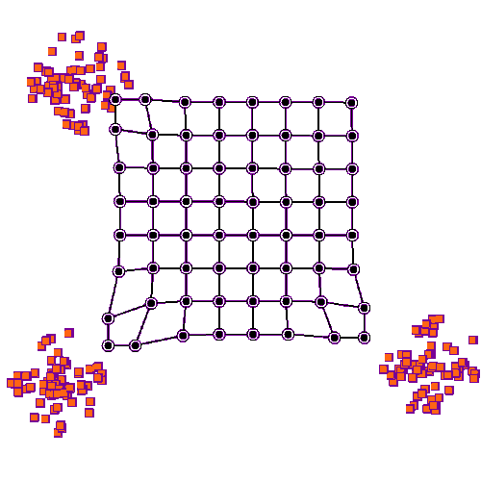
An animated representation of training a 2D SOM
https://en.wikipedia.org/wiki/File:TrainSOM.gif

Slide 45
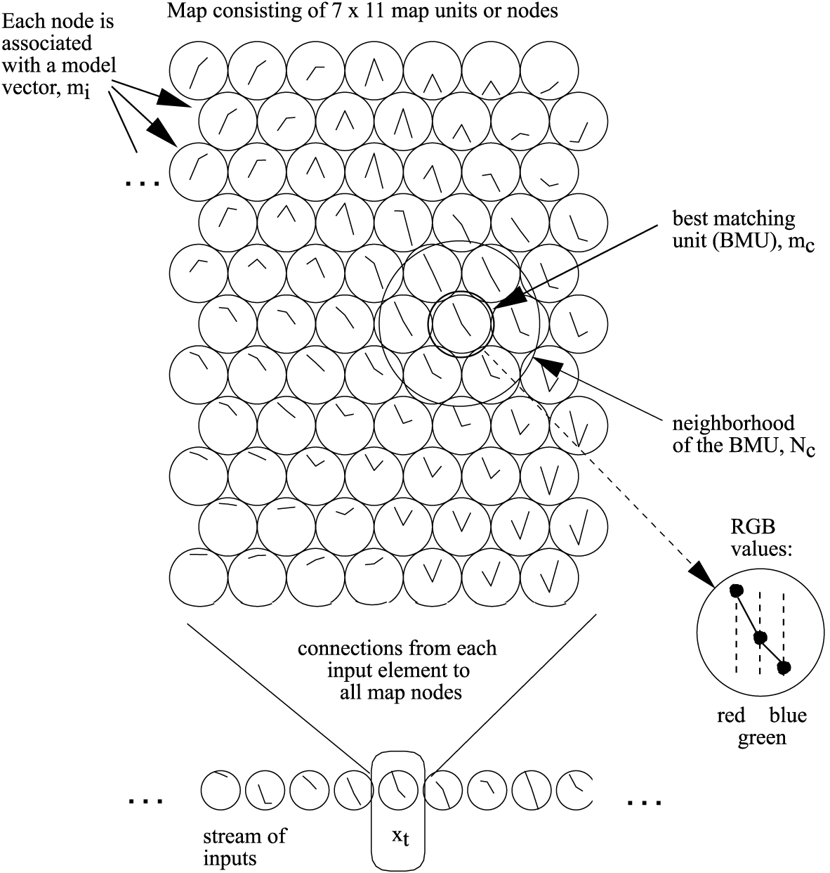
Here’s an example using colors. Each color has an RGB vector. Take a bunch of random colors and organize them into a map of similar colors:
Here’s the SOM →
Each SOM node lives in RGB space →
Here’s the input color data →
Kybernetes 34(1/2): 40-53 (2005)

Slide 46
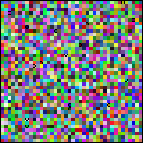
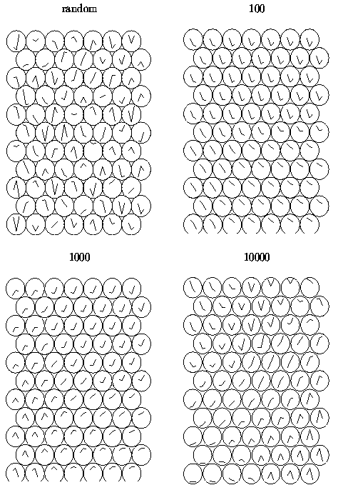
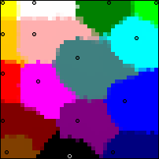
Iteratively test new colors, update the map using some rule
weight
Node neighborhood
Updated node vector
Starting
node vector
Difference from
data vector
The weight and node neighborhoods shrink with time (iterations)
Kybernetes 34(1/2): 40-53 (2005)
Over time, the map self-organizes to show clusters of like colors.
http://www.generation5.org/content/2004/
kohonenApplications.asp
http://users.ics.aalto.fi/tho/thesis/

Slide 47
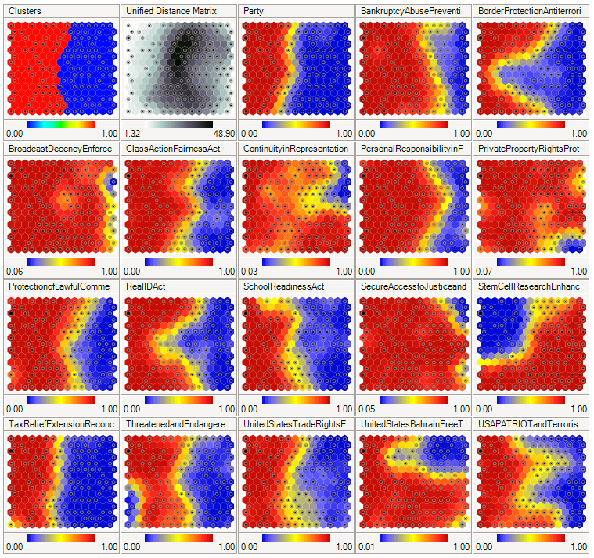
A SOM of U.S. Congress voting patterns
Red = yes votes
Blue = no votes
Republicans
Democrats
Wikipedia

Slide 48
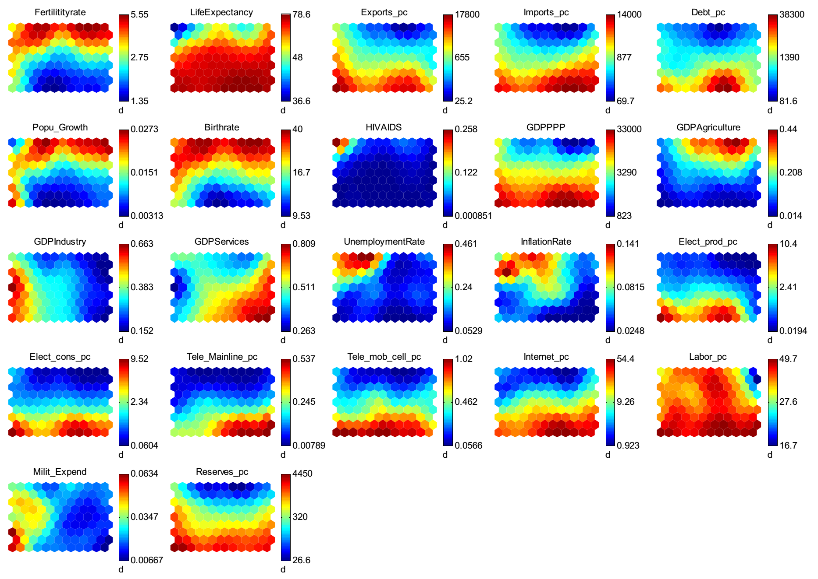
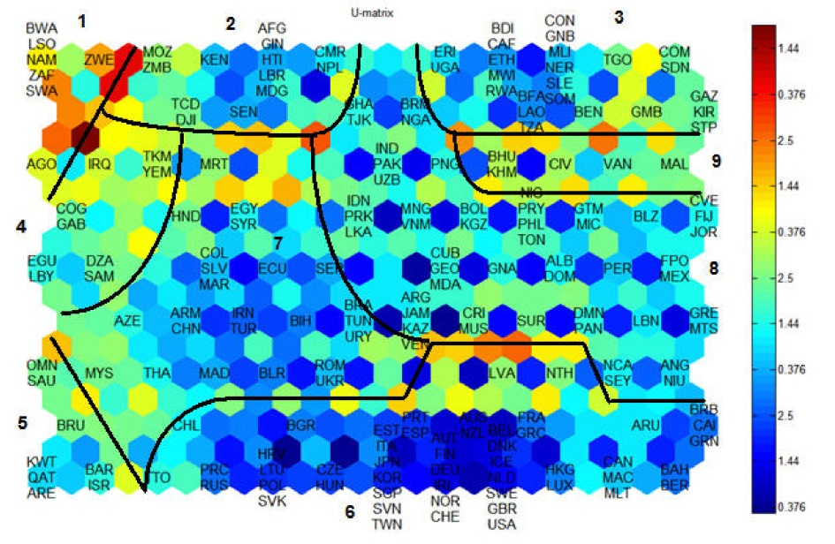
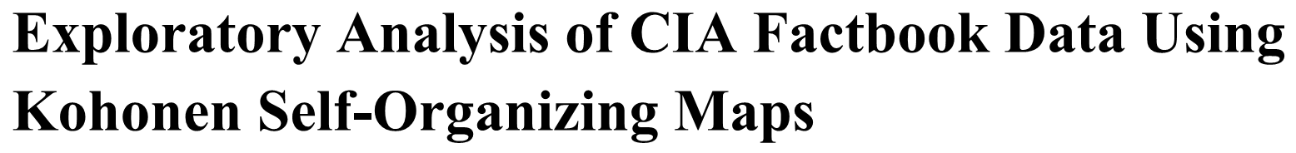


Slide 49

Botswana
USA

Slide 50
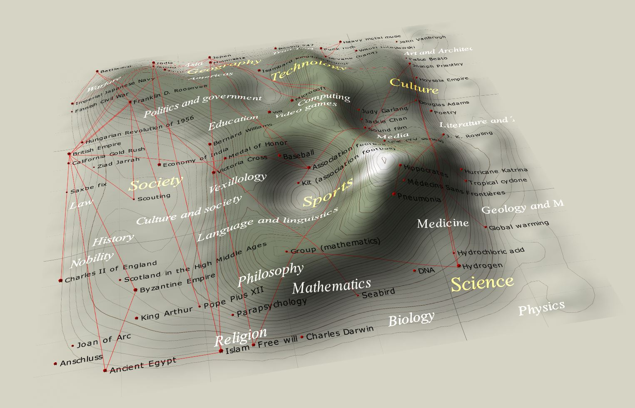
SOM of Wikipedia (from Wikipedia, naturally)
(data = wiki article word frequency vectors)
Wikipedia

Slide 51
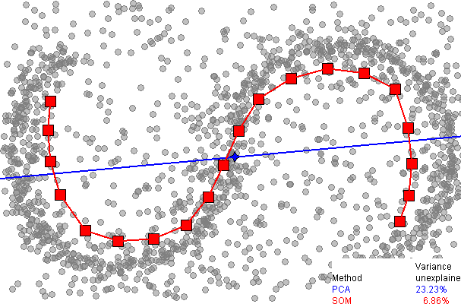
SOMs can accommodate unusual data distributions
One-dimensional SOM
Data points
Wikipedia

Slide 52

Finally, t-SNE is a nice way to visualize data in 2 or 3D
= t-distributed stochastic neighbor embedding
t-SNE tries to reproduce high-D data neighborhoods in a 2D or 3D picture by:
1. Defining a probability distribution over pairs of high-D objects such that
“similar” objects have a high probability of being picked, whilst “dissimilar“
objects have an extremely small probability of being picked
2. Defining a similar probability distribution over the points in the low- D map
3. Minimizing the Kullback–Leibler divergence between the two distributions
by varying the locations of the points in the low-D map, i.e.
minimize this:
probability i and j are close in high-D space
probability i and j are close in low-D space
Sum over all pairs of points
van der Maaten & Hinton, Visualizing High-Dimensional Data Using t-SNE.
Journal of Machine Learning Research 9: 2579–2605 (Nov 2008)

Slide 53
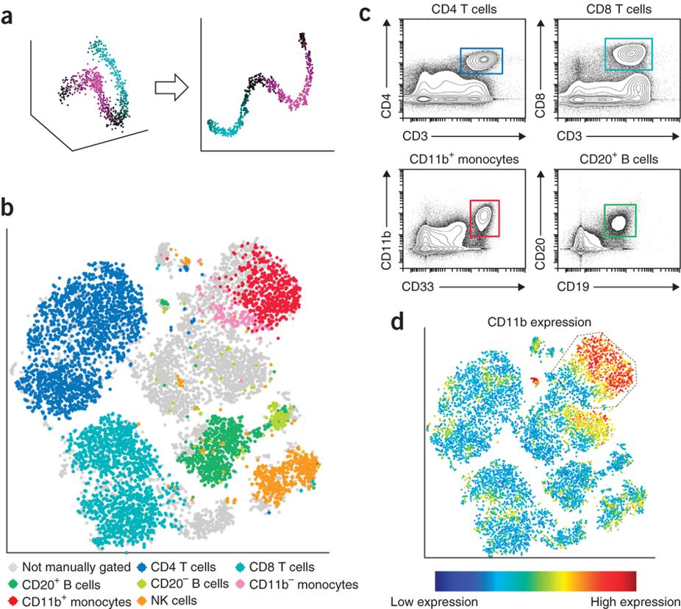
Separating cells into cell types by t-SNE
- healthy human bone marrow, stained with 13 markers and measured by mass cytometry, visualized with viSNE
The colors correspond to how an expert
would “gate” the cytometer
Amir et al., Nature Biotechnology 31:545–552 (2013)

Slide 54
You can compute your own t-SNE embeddings using the online tools at: http://projector.tensorflow.org/
There are also some great examples at:
http://distill.pub/2016/misread-tsne/
BUT tSNE lends itself to misinterpretation, so
use caution in interpreting it!: https://towardsdatascience.com/why-you-are-using-t-sne-wrong-502412aab0c0
There are only a couple of parameters you can (and should) tweak, mainly perplexity, which effectively captures the number of neighbors (often 5 to 50)

Slide 55
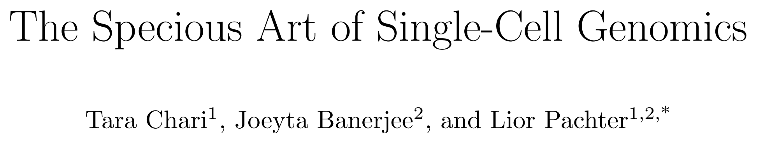
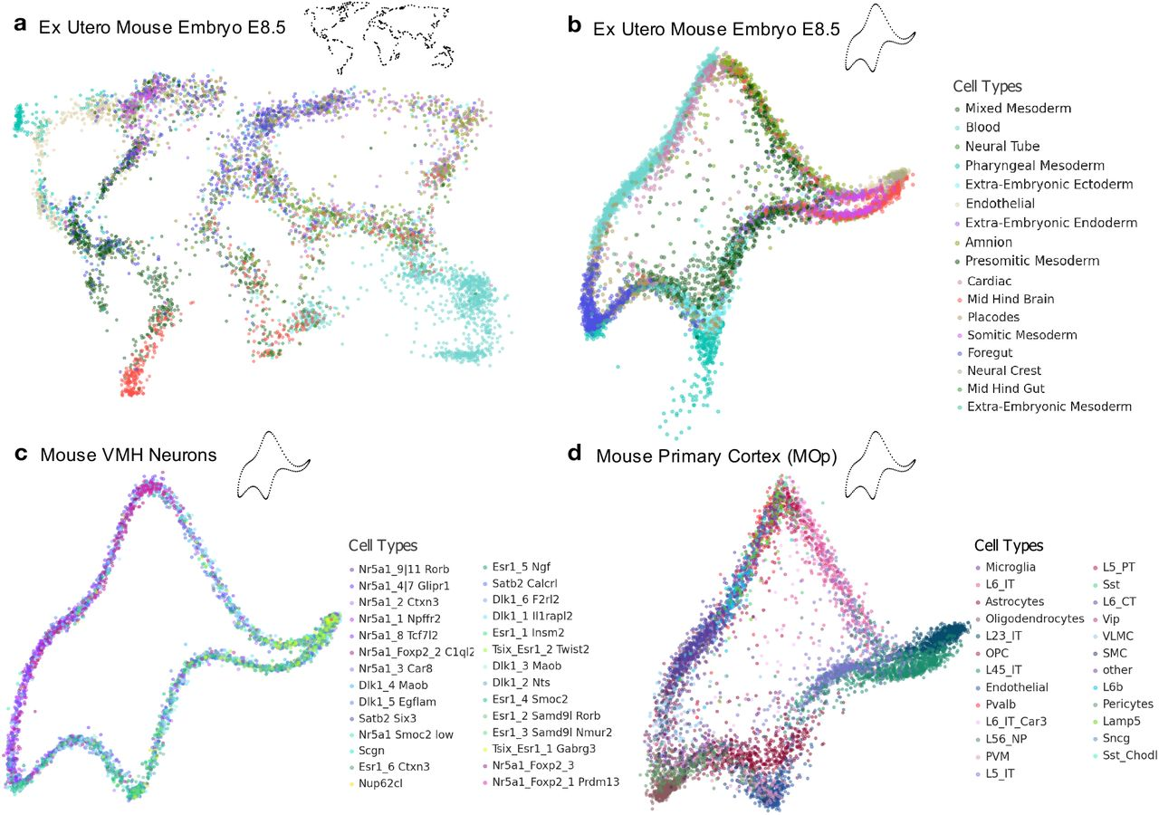
“In biology, single-cell expression studies almost always begin with reduction to two or three dimensions to produce ‘all-in-one’ visuals of the data that are amenable to the human eye, and these are subsequently used for qualitative and quantitative analysis of cell relationships. However, there is little theoretical support for this practice.”
https://www.biorxiv.org/content/10.1101/2021.08.25.457696v1.full

