Slide 1
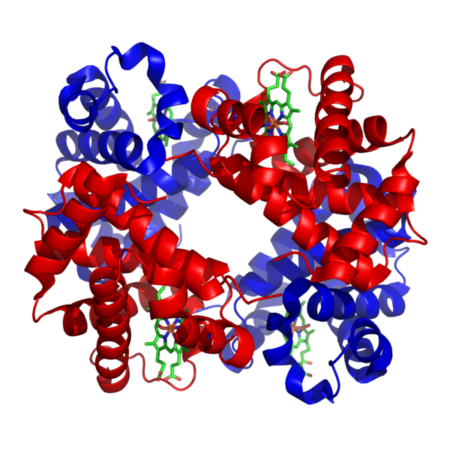
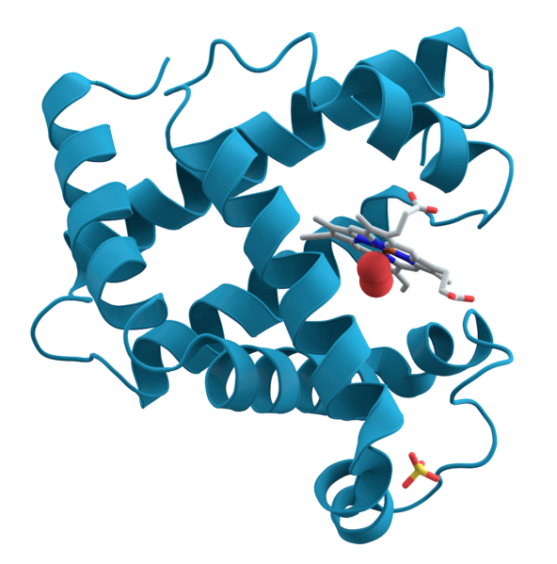
Typically, to be “biologically related” means to share a common ancestor. In biology, we call this homologous.
Two proteins sharing a common ancestor are said to be homologs.
Homology often implies structural similarity & sometimes (not always) sequence similarity. A statistically significant sequence or structural similarity can be used to infer homology (common ancestry).
e.g., Myoglobin & Hemoglobin
http://en.wikipedia.org/wiki/File:Myoglobin.png & File:1GZX_Haemoglobin.png

Slide 2
In practice, searching for sequence or structural similarity is one of the most powerful computational approaches to discover a gene’s function. We can often gain insight about a protein from its homologs.
For example, my lab discovered that myelinating the neurons in your brain reuses the same biochemical mechanism that phage use to make capsids. The key breakthrough was recognizing that the human and phage proteins contained homologous domains.
Homologs
Li, Park, Marcotte
PLoS Biology (2013)

Slide 3
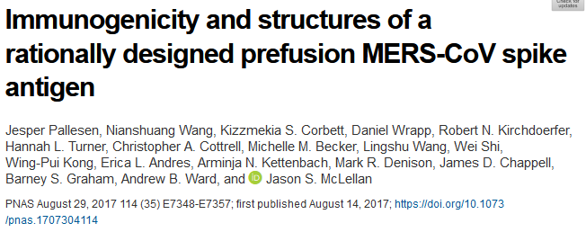
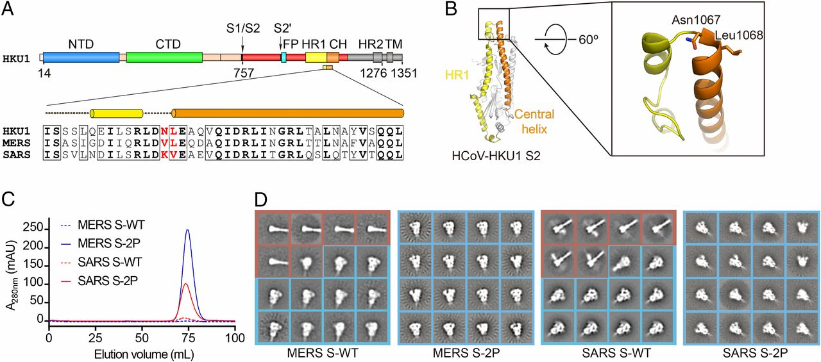
& for a very timely example, here’s the “trillion dollar” paper from the McLellan lab that the SARS-CoV-2 vaccines are designed from based on homology to MERS and SARS spike antigens

Slide 4
Sequence alignment algorithms such as
BLAST, PSI-BLAST, FASTA, and the Needleman–Wunsch &
Smith-Waterman algorithms arguably comprise some of the most important driver technologies of modern biology and underlie the sequencing revolution.
So, let’s start learning bioinformatics algorithms by learning how to align two protein sequences.

Slide 5
Live demo:
http://blast.ncbi.nlm.nih.gov/Blast.cgi?PROGRAM=blastp&BLAST_PROGRAMS=blastp&PAGE_TYPE=BlastSearch&SHOW_DEFAULTS=on&LINK_LOC=blasthome
MVLSPADKTNVKAAWGKVGAHAGEYGAEALERMFLSFPTTKTYFPHFDLSHGSAQVKGHG KKVADALTNAVAHVDDMPNALSALSDLHAHKLRVDPVNFKLLSHCLLVTLAAHLPAEFTP AVHASLDKFLASVSTVLTSKYR
The next few slides show the data from searching this dbase (#’s may be a bit different from the live version):
Title:All non-redundant GenBank CDS translations+PDB+SwissProt+PIR+PRF excluding environmental samples from WGS projects
Molecule Type:Protein
Update date:2024/01/11
Number of sequences:648450839

Slide 6
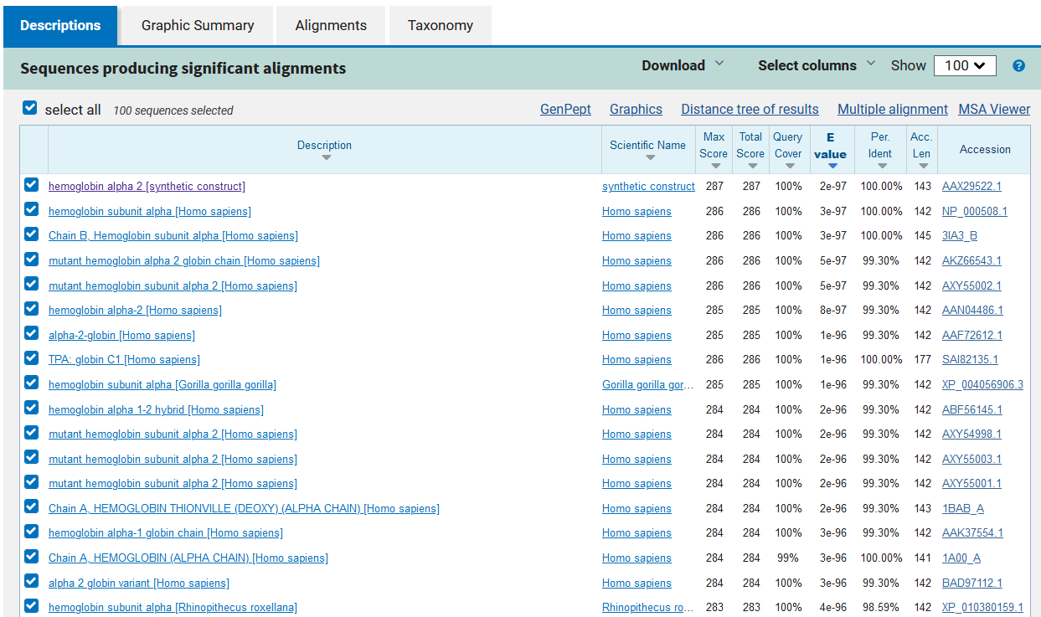

Slide 7
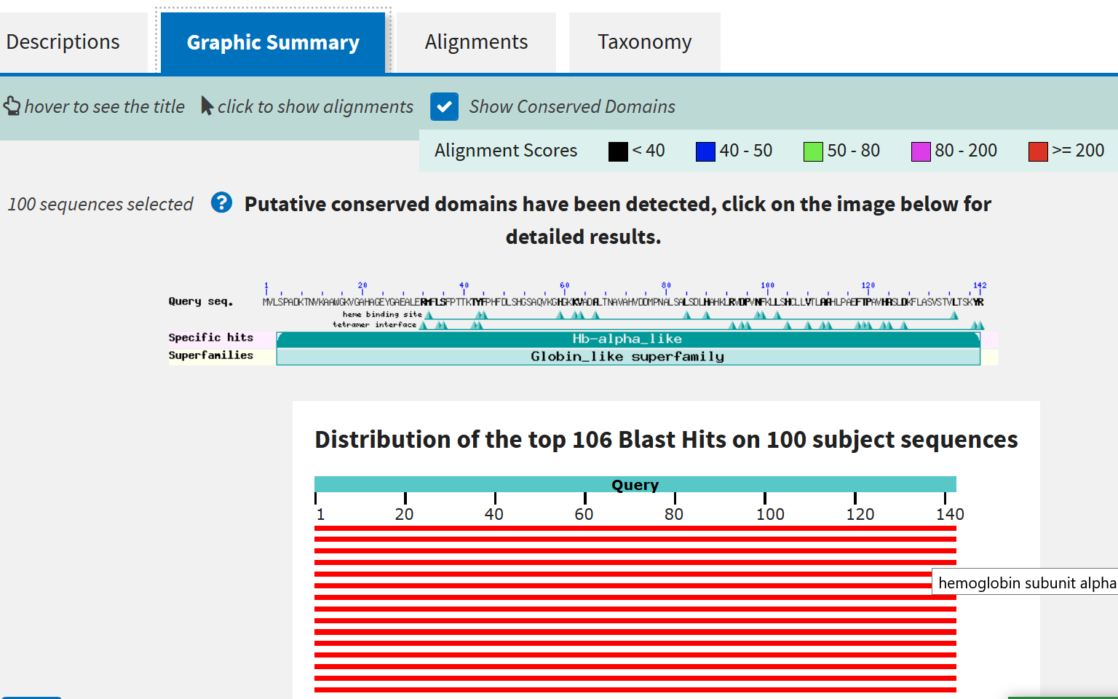

Slide 8
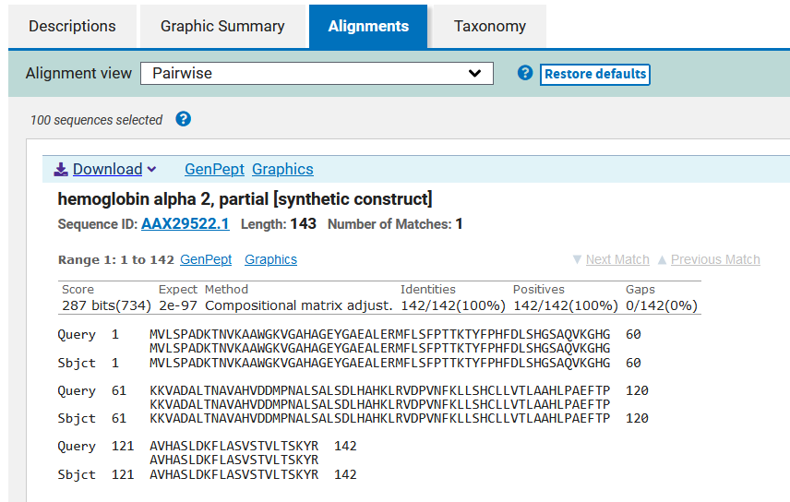

Slide 9
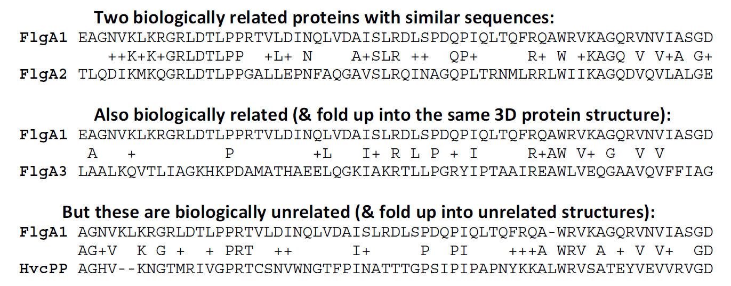
Protein sequence alignment
(FYI, we’ll draw examples from Durbin et al., Biological Sequence Analysis, Ch. 1 & 2).

Slide 10
To align two sequences, we need to perform 3 steps:
We need some way to decide which alignments are better than others.
For this, we’ll invent a way to give the alignments a “score” indicating their quality.
Align the two proteins so that they get the best possible score.
Decide if the score is “good enough” for us to believe the alignment is biologically significant.

Slide 11
To align two sequences, we need to perform 3 steps:
We need some way to decide which alignments are better than others.
For this, we’ll invent a way to give the alignments a “score” indicating their quality.
Align the two proteins so that they get the best possible score.
Decide if the score is “good enough” for us to believe the alignment is biologically significant.

Slide 12
We’ll treat mutations as independent events.
This allows us to create an additive scoring scheme.
The score for a sequence alignment will be the sum of the scores for aligning each of the individual positions in two sequences.
What kind of mutations should we expect?

Slide 13
Substitutions, insertions and deletions.
Insertions and deletions can be treated as equivalent events by considering one or the other sequence as the reference, and are usually called gaps.
substitution
gap

Slide 14

Let’s consider two models:
First, a random model, where amino acids in the sequences occur independently at some given frequencies.
The probability of observing an alignment between x and y is just the product of the frequencies (q) with which we find each amino acid.
We can write this as:
What does the capital pi mean?
What’s this mean?
What’s this mean?
i is just a counter indicating the sequence position

Slide 15
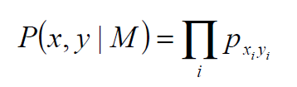
Second, a match model, where amino acids at a given position in the alignment arise from some common ancestor with a probability given by the joint probability p_{ab}.
So, under this model, the probability of the alignment is the product of the probabilities of seeing the individual amino acids aligned.
We can write that as:
What does the capital pi mean again?
What’s this mean?
What’s this mean?

Slide 16
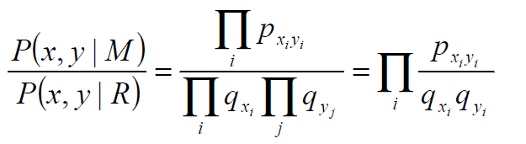
To decide which model better describes an alignment, we’ll take the ratio:
What did these mean again?
Such a ratio of probabilities under 2 different models is called an odds ratio.
Where else have you heard
odds ratios used?
Basically: if the ratio > 1, model M is more probable
if < 1, model R is more probable.
Notes:
Horse-racing (3:1 odds)
Medicine, disease risks

Slide 17

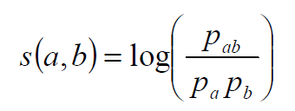
Now, to convert this to an additive score S, we can simply take the logarithm of the odds ratio (called the log odds ratio):
This is just the score for aligning one amino acid with another amino acid:
Here written a and b rather than x_{i} and y_{i} to emphasize that this score reflects the inherent preference of the two amino acids (a and b) to be aligned.
Almost done with step 1…

Slide 18
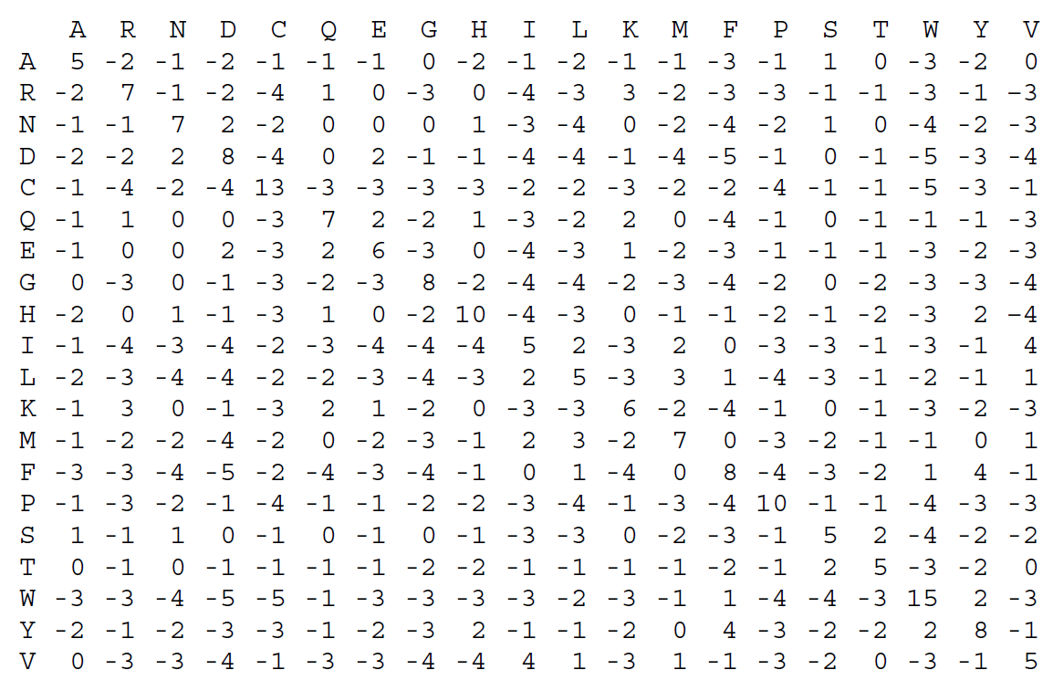
The last trick:
Take a big set of pre-aligned protein sequence alignments (that are correct!) and measure all of the pairwise amino acid substitution scores (the s(a,b)’s). Put them in a 20x20 amino acid substitution matrix :

Slide 19
This is the BLOSUM50 matrix.
(The numbers are scaled & rounded off to the nearest integer):
What’s the score for aspartate (D) aligning with itself?
How about aspartate with phenylalanine (F)? Why?

Slide 20
Using this matrix, we can score any alignment as the sum of scores of individual pairs of amino acids.
For example, the top alignment in our earlier example:
gets the score:
S(FlgA1,FlgA2) = – 1 – 2 – 2 + 2 + 4 + 6 + ... = 186
We also need to penalize gaps. For now, let’s just use a constant penalty d for each amino acid gap in an alignment, i. e.:
the penalty for a gap of length g = -g*d

Slide 21
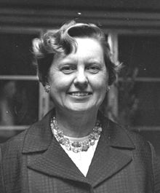
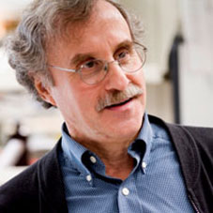

PAM vs. BLOSUM
Margaret Dayhoff (1925-1983)
Developed point accepted mutation matrices
(PAM matrices)
Steve and Jorja Henikoff
Developed BLOSUM matrices
Calibrated for different evolutionary times
PAM-n = n substitutions per 100 residues
e.g. matrices from PAM1 to PAM250
measure PAM1,
calculate higher PAMs from that
Explicit model of evolution
(calculated using a phylogenetic tree)
Calibrated for different % identity sequences
BLOSUM-n = for sequences of about n % identity
averages substitution probabilities over
sequence clusters, gives better estimates
for highly divergent cases
Implicit model of evolution
(calculated from blocks of aligned sequences)

Slide 22
To align two sequences, we need to perform 3 steps:
We need some way to decide which alignments are better than others.
For this, we’ll invent a way to give the alignments a “score” indicating their quality.
Align the two proteins so that they get the best possible score.
Decide if the score is “good enough” for us to believe the alignment is biologically significant.

Slide 23
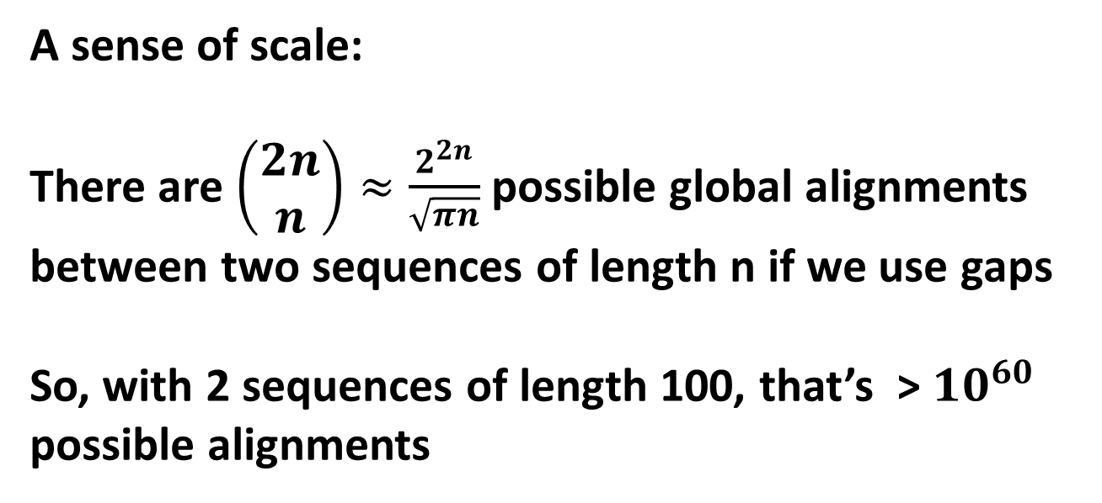
A sense of scale:
There are $\left(\begin{matrix}2n \\ n\end{matrix}\right)≈\frac{2^{2n}}{\sqrt{πn}}$ possible global alignments between two sequences of length n if we use gaps
So, with 2 sequences of length 100, that’s > ${10}^{60}$ possible alignments

Slide 24
We’ll use something called dynamic programming.
This is mathematically guaranteed to find the best scoring alignment, and uses recursion. This means problems are broken into sub-problems, which are in turn broken into sub-problems, etc, until the simplest sub-problems can be solved.
We’re going to find the best local alignment—the best matching
internal alignment—without forcing all of the amino acids to align (i.e. to match globally).
ATGCAT
ATGCAT
ACGTTATGCATGACGTA
-C---ATGCAT----T-
i.e., this
Not this
Notes:
Can’t test all alignments! For two 100 amino acid proteins => 10⁵⁹ possible alignments

Slide 25
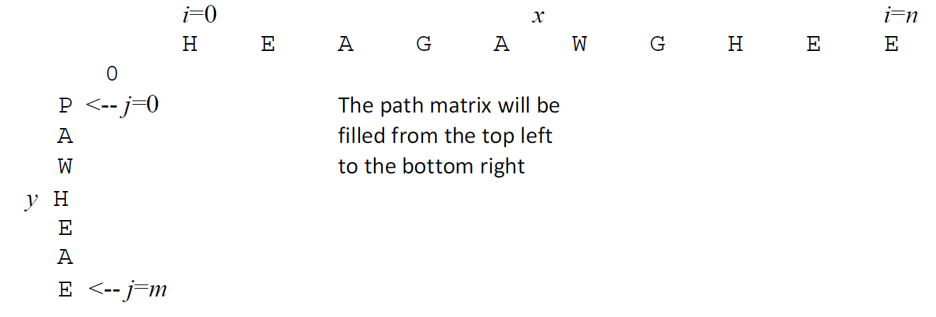
Here’s the main idea:
We’ll make a path matrix, showing the possible alignments and their scores. There are simple rules for how to fill in the matrix. This will test all possible alignments & give us the top-scoring alignment between the two sequences.

Slide 26
Here are the rules:
For a given square in the matrix F(i,j), we look at the squares to its left F(i-1,j) , top F(i,j-1) , and top-left F(i-1,j-1). Each should have a score.
We consider 3 possible events & choose the one scoring the highest:
(1) x_{i} is aligned to y_{j} F(i-1,j-1) + s(x_{i},y_{j})
(2) x_{i} is aligned to a gap F(i-1,j) – d
(3) y_{j} is aligned to a gap F(i,j-1) – d
For this example, we’ll use d = 8. We also set the left-most & top-most entries to zero.

Slide 27
Just two more rules:
If the score is negative, set it equal to zero.
At each step, we also keep track of which event was chosen by drawing an arrow from the cell we just filled back to the cell which contributed its score to this one.
That’s it! Just repeat this to fill the entire matrix.

Slide 28
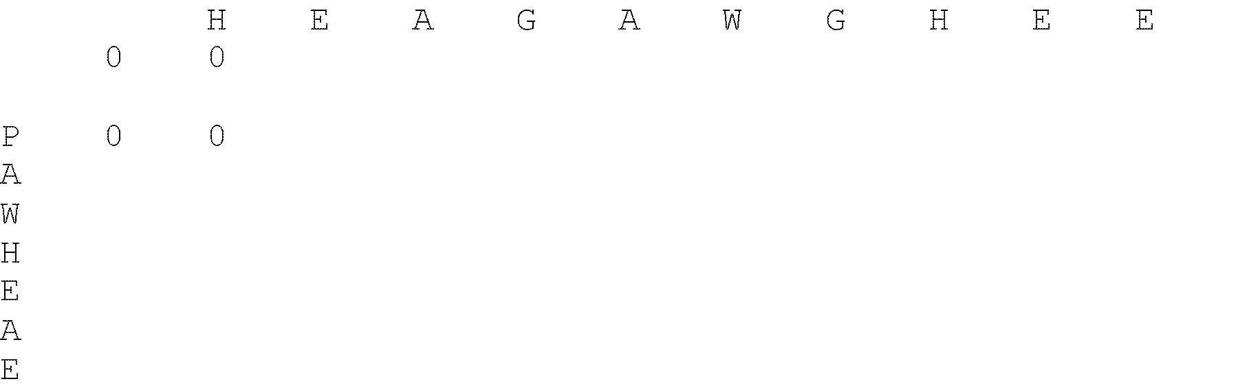
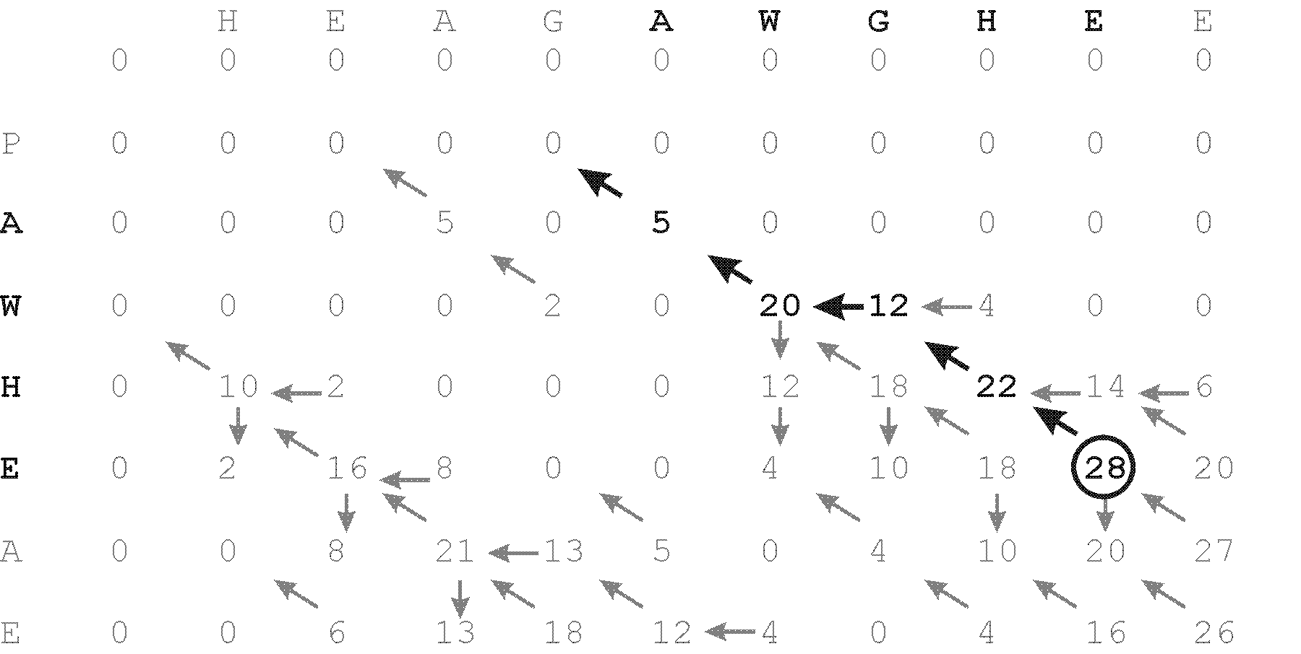
Here we go! Start with the borders & the first entry.
Why is this zero?
What’s the score from our BLOSSUM matrix for substituting H for P?

Slide 29
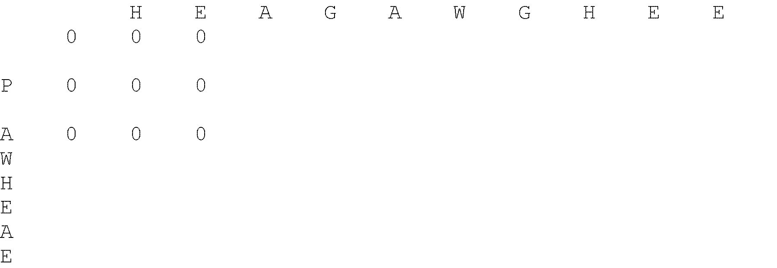
Next round!
Terrible! Again, none of the possible give positive scores.
We have to go a bit further in before we find a positive score…

Slide 30
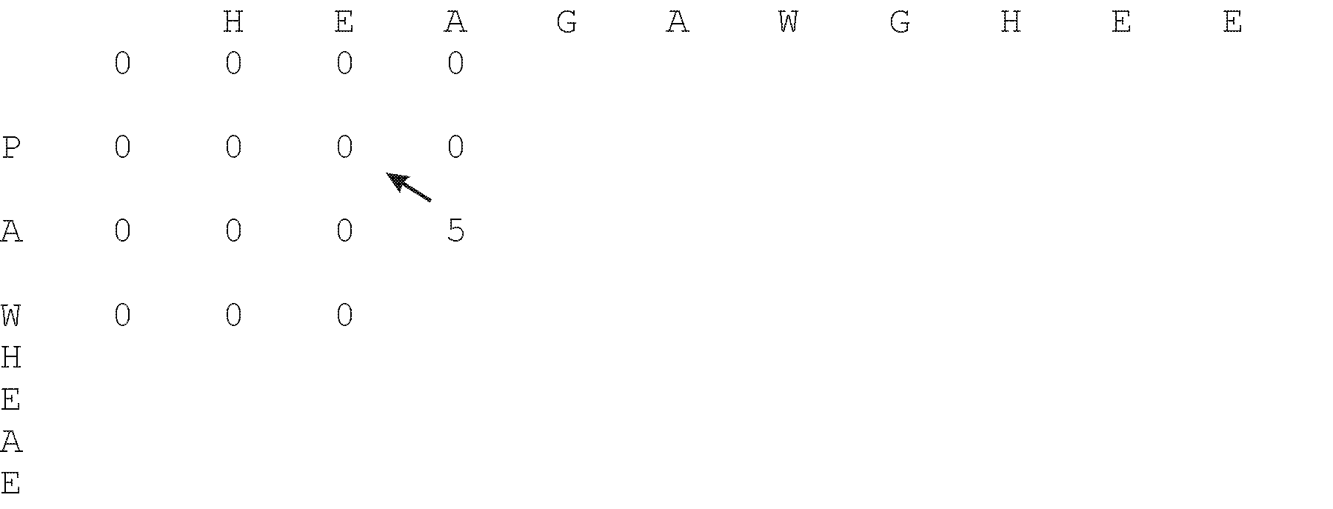
A few more rounds, and a positive score at last!
How did we get this one?
Notes:
A with A gives a score of 5 (remember, the score equals F(i-1,j-1) + s(x_{i},y_{j}), which is 0+5=5 in this case).
So, we write 5 in the A,A cell, and draw an arrow from the cell it came from, which is the P,E cell.

Slide 31
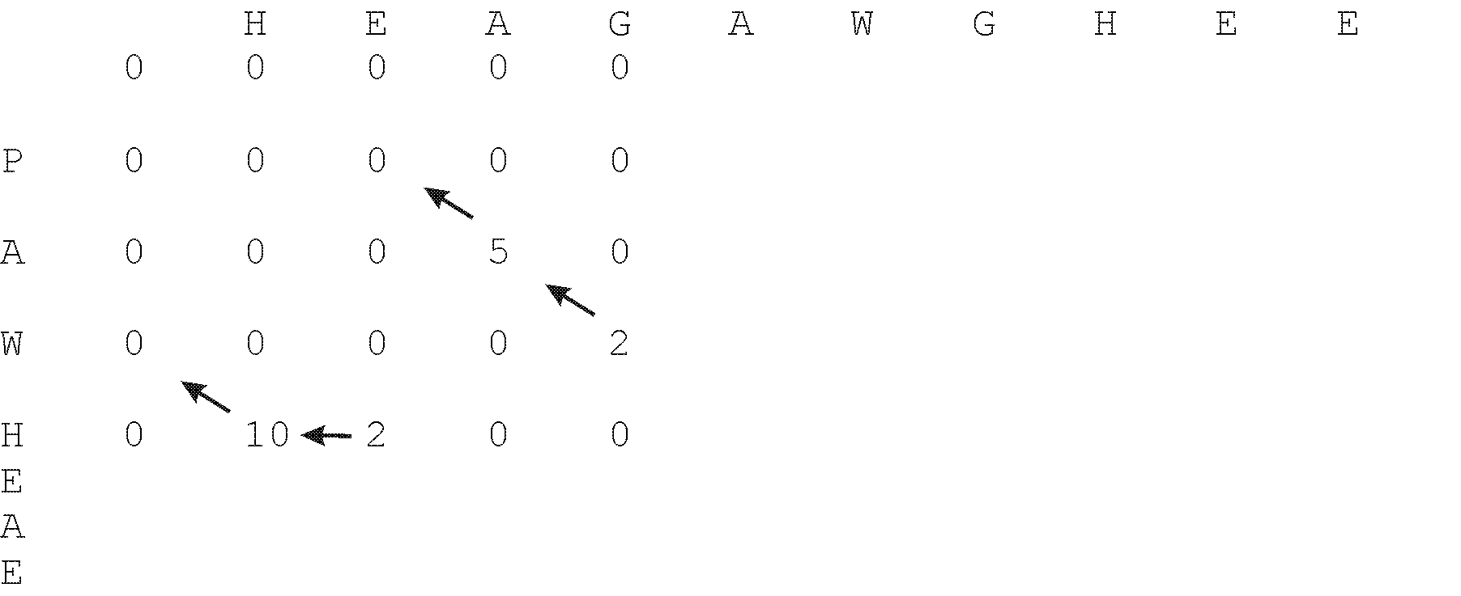
& a few more rounds…
What does this mean?

Slide 32
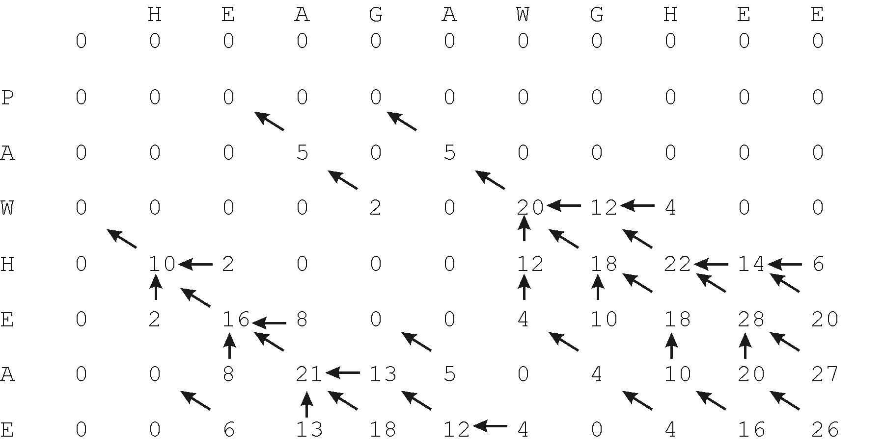
The whole thing filled in!

Slide 33
Now, find the optimal alignment using a traceback process:
Look for the highest score, then follow the arrows back.
The alignment “grows” from right to left

Slide 34

This gives the following alignment:
(Note: for gaps, the arrow points to the sequence that gets the gap)
Notes:
A vertical arrow means to add a gap in x (the sequence on the top) and a symbol in y (the sequence on the left side), a horizontal move is a gap in y and a symbol in x, and a diagonal move is a symbol from x aligned to one of y.

Slide 35
To align two sequences, we need to perform 3 steps:
We need some way to decide which alignments are better than others.
For this, we’ll invent a way to give the alignments a “score” indicating their quality.
Align the two proteins so that they get the best possible score.
Decide if the score is “good enough” for us to believe the alignment is biologically significant.

Slide 36
This algorithm always gives the best alignment.
Every pair of sequences can be aligned in some fashion.
So, when is a score “good enough”?
How can we figure this out?

Slide 37
Here’s one approach:
Shuffle one sequence. Calculate the best alignment & its score.
Repeat 1000 times.
If we never see a score as high as the real one, we say the real score has <1 in a 1000 chance of happening just by luck.
But if we want something that only occurs < 1 in a million, we’d have to shuffle 1,000,000 times…

Slide 38
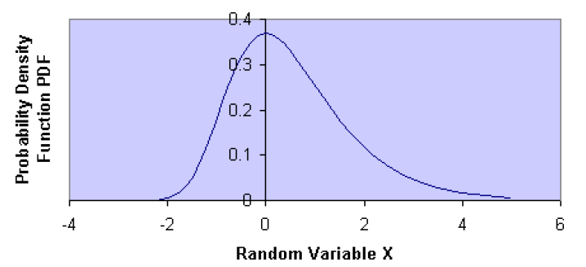

Luckily, alignment scores follow a well-behaved distribution,
the extreme value distribution, so we can do a few trials & fit to this.
# random trials & their average score
This p-value gives the significance of your alignment.
But, if we search a database and perform many alignments, we still need something more (next time).
Describe the shape & can
be fit from a few trials

Slide 39
Some extensions: Local vs. global alignments
How might you force the full sequences to align?
Notes:
A vertical arrow means to add a gap in x (the sequence on the top) and a symbol in y (the sequence on the left side), a horizontal move is a gap in y and a symbol in x, and a diagonal move is a symbol from x aligned to one of y.

Slide 40
Some extensions: Local vs. global alignments
How might you force the full sequences to align?
A few tiny changes:
Initialize only the top left cell of the path matrix to zero
(not all top and left cells).
Leave the negative values (don’t set them to zero).
The optimal alignment should start at the top left cell and finish at the bottom right cell of the path matrix.
Start the trace-back at the bottom right cell
Notes:
A vertical arrow means to add a gap in x (the sequence on the top) and a symbol in y (the sequence on the left side), a horizontal move is a gap in y and a symbol in x, and a diagonal move is a symbol from x aligned to one of y.

Slide 41
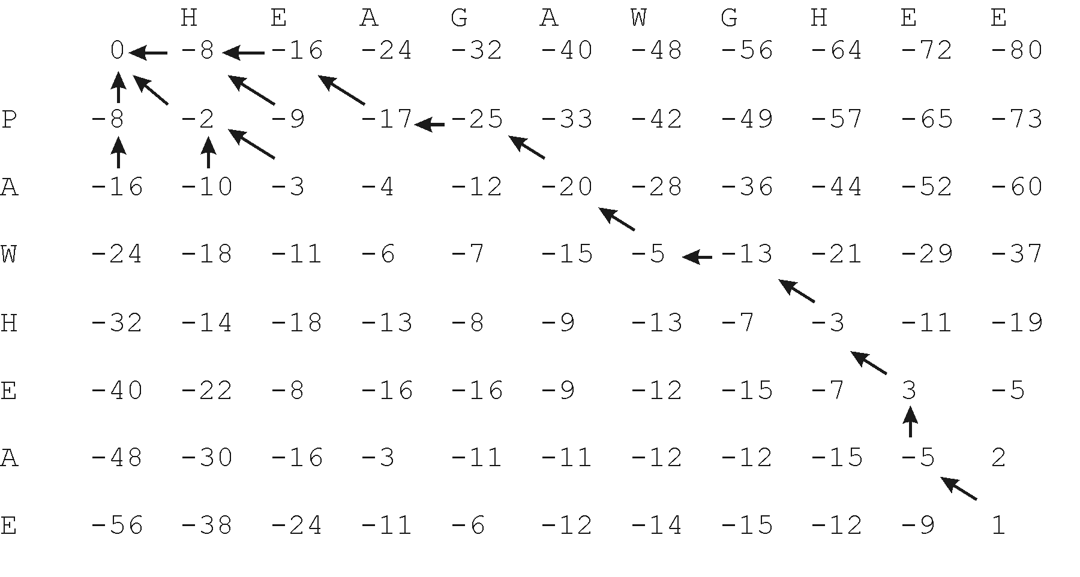
Some extensions: Local vs. global alignments
How might you force the full sequences to align?
HEAGAWGHE-E
--P-AW-HEAE
Notes:
A vertical arrow means to add a gap in x (the sequence on the top) and a symbol in y (the sequence on the left side), a horizontal move is a gap in y and a symbol in x, and a diagonal move is a symbol from x aligned to one of y.

Slide 42
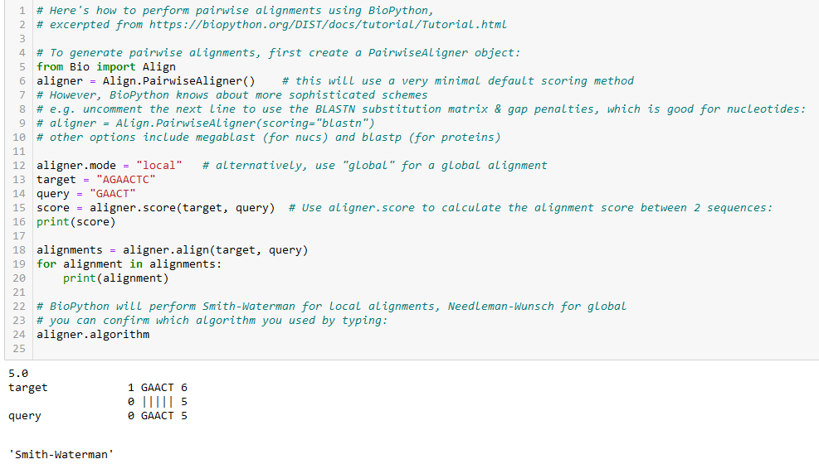
How can you try this yourself using BioPython?
BioPython can perform a wide variety of sequence alignments, DNA/protein, local/global, dynamic programming, BLAST, different scoring schemes, etc, & is a great environment to learn and play with these approaches. Here’s a minimal use case to start you off:

Slide 43
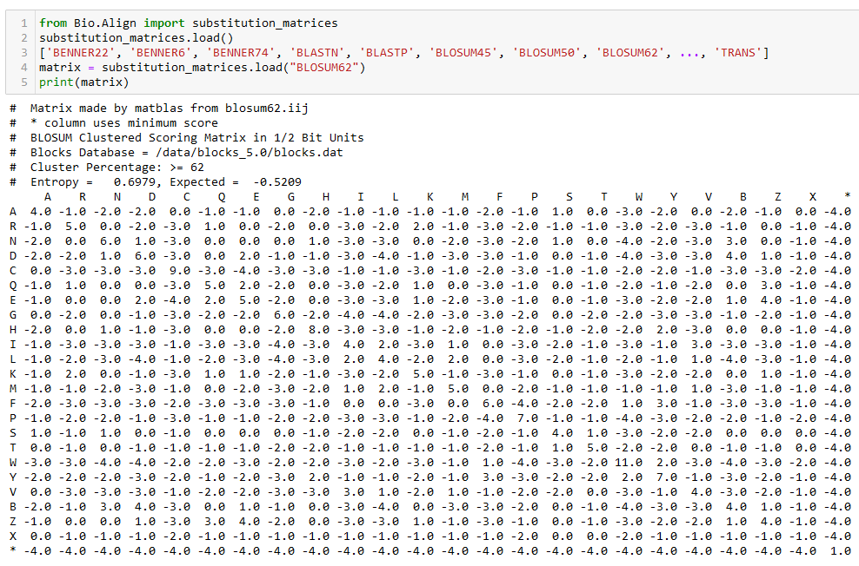
Using BioPython, you can change every aspect of the scoring & substitution matrices, as well as run BLAST locally or in the cloud.
e.g. here’s the BLOSUM62 matrix, along w/ many others that BioPython knows about:

Slide 44
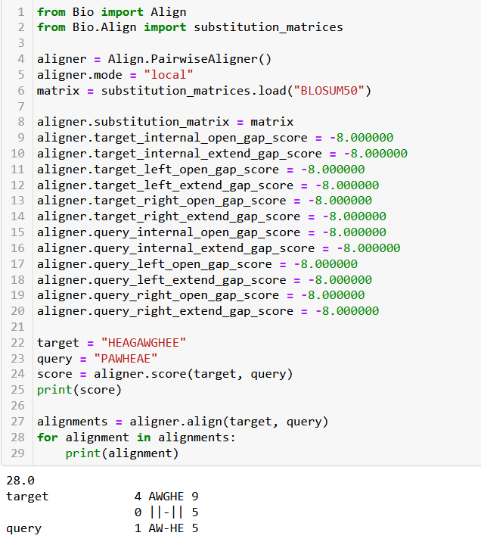
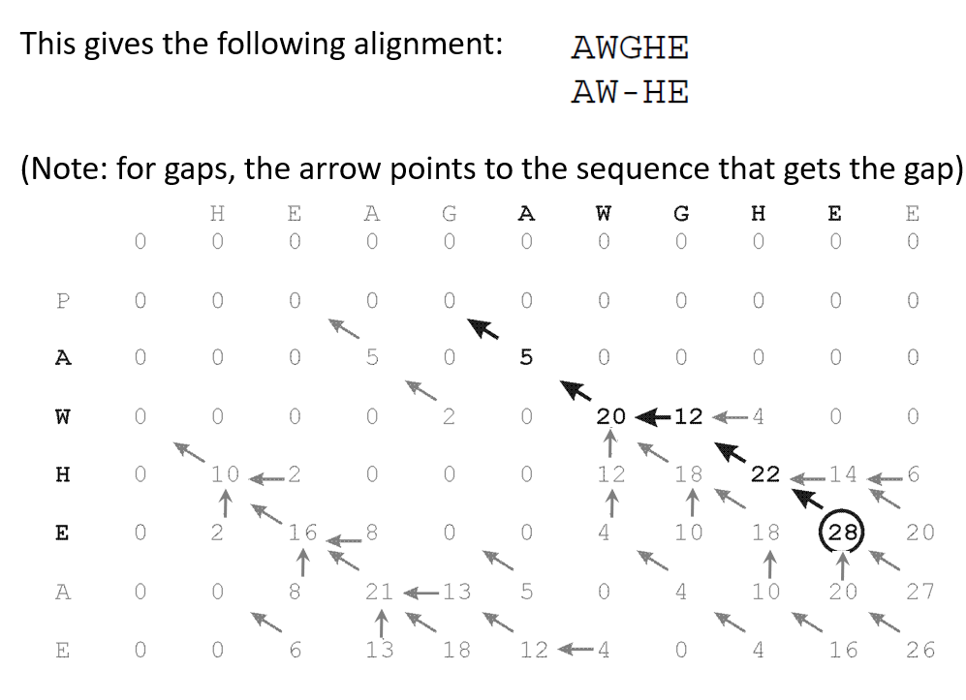
Putting it all together, here’s the example alignment we did manually
Here was our earlier version:

Slide 45
You can read more about using BioPython for sequence analyses & get example code at:
https://biopython.org/DIST/docs/tutorial/Tutorial.html
Chapter 7 is all about how to perform pairwise sequence alignments

Slide 46
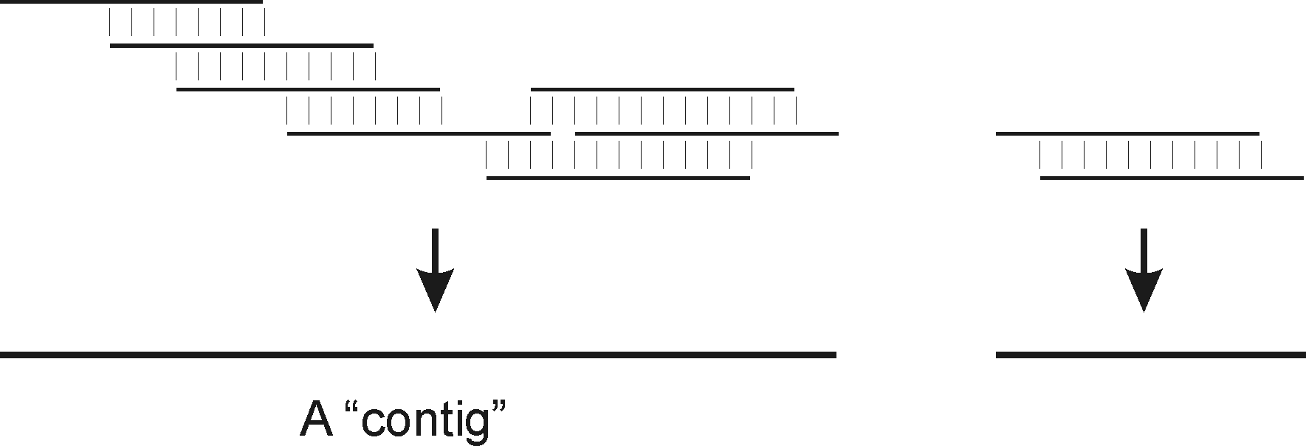
Some extensions:
What about overlapping sequences?
e.g. as in ‘shotgun sequencing’ genomes where
‘contigs’ are built up from overlapping sequences
Notes:
A vertical arrow means to add a gap in x (the sequence on the top) and a symbol in y (the sequence on the left side), a horizontal move is a gap in y and a symbol in x, and a diagonal move is a symbol from x aligned to one of y.

Slide 47
Some extensions:
What about overlapping sequences?
Modify global alignment to not penalize overhangs:
The optimal alignment should start at the top or left edge and finish at the bottom or right edge of the path matrix.
Set these boundary conditions :
F(i,0) = 0 for i=1 to n
F(0,j) = 0 for j=1 to m
Start the traceback at the cell with the highest score on the right or bottom border
Notes:
A vertical arrow means to add a gap in x (the sequence on the top) and a symbol in y (the sequence on the left side), a horizontal move is a gap in y and a symbol in x, and a diagonal move is a symbol from x aligned to one of y.

Slide 48
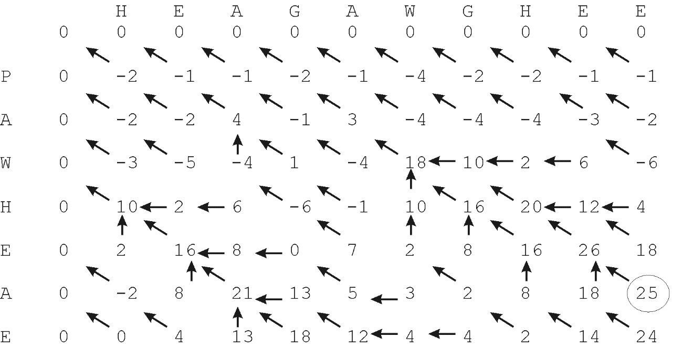
Some extensions:
What about overlapping sequences?
e.g. as in ‘shotgun sequencing’ genomes where
‘contigs’ are built up from overlapping sequences
(overhang = HEA) GAWGHEE
PAW-HEA (overhang = E)
Notes:
A vertical arrow means to add a gap in x (the sequence on the top) and a symbol in y (the sequence on the left side), a horizontal move is a gap in y and a symbol in x, and a diagonal move is a symbol from x aligned to one of y.

Slide 49
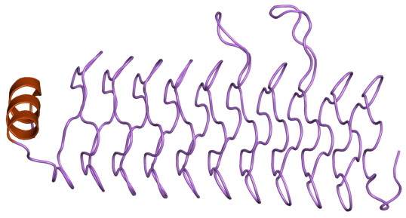
Some extensions:
How might you find repetitive sequences?
Structure of the pentapeptide repeat protein HetL
(from wiki, PMID18952182)

Slide 50
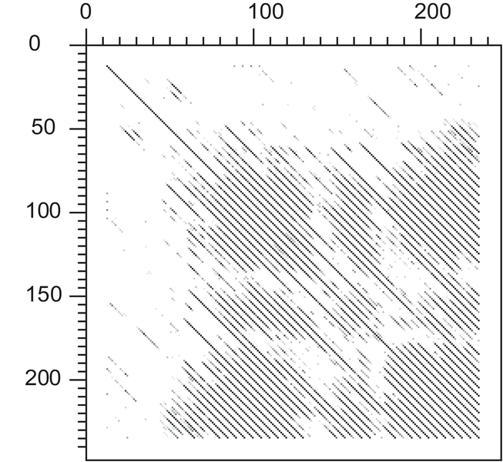
Align the sequence to itself and ignore the diagonal (optimal) alignment
→ High-scoring off-diagonal alignments will be repeats
Structure of the pentapeptide repeat protein HetL
(from wiki, PMID18952182)
Dot plot (quick visualization of sequence similarity)
of the pentapeptide repeat protein HglK protein vs. itself
(http://en.wikipedia.org/wiki/Pentapeptide_repeat)

