Slide 1
Orthologs, Paralogs,
and Phenologs
Using bioinformatics to find new genes for genetic traits
BCH394P/364C Systems Biology / Bioinformatics
Edward Marcotte, Univ of Texas at Austin

Slide 2
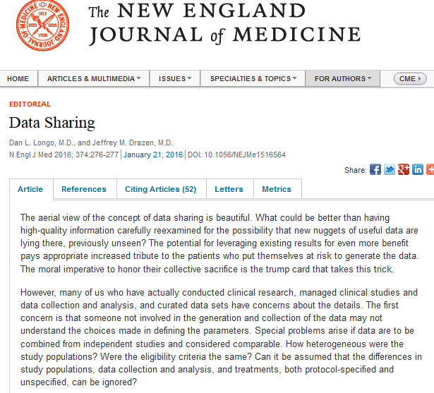
Are you a research parasite?
“The aerial view of the concept of data sharing is beautiful.”
[but!]
A … concern … is that a new class of research person will emerge…the system will be taken over by …
“research parasites.”
“[they might] use another group’s data for their own ends… or even use the data to try to disprove what the original investigators had posited”
http://www.nejm.org/doi/full/10.1056/NEJMe1516564

Slide 3
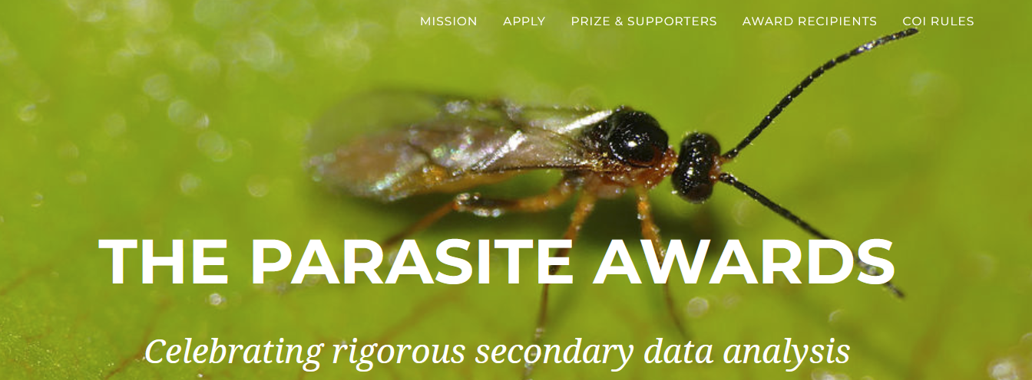
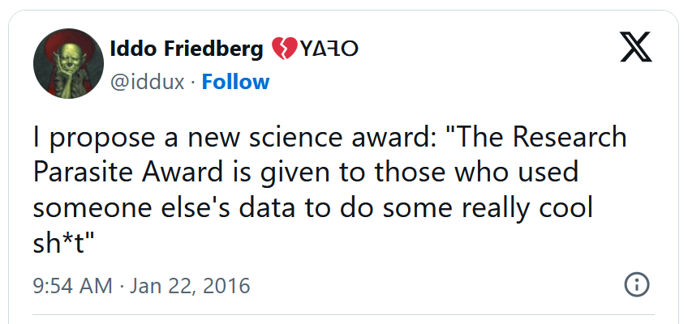
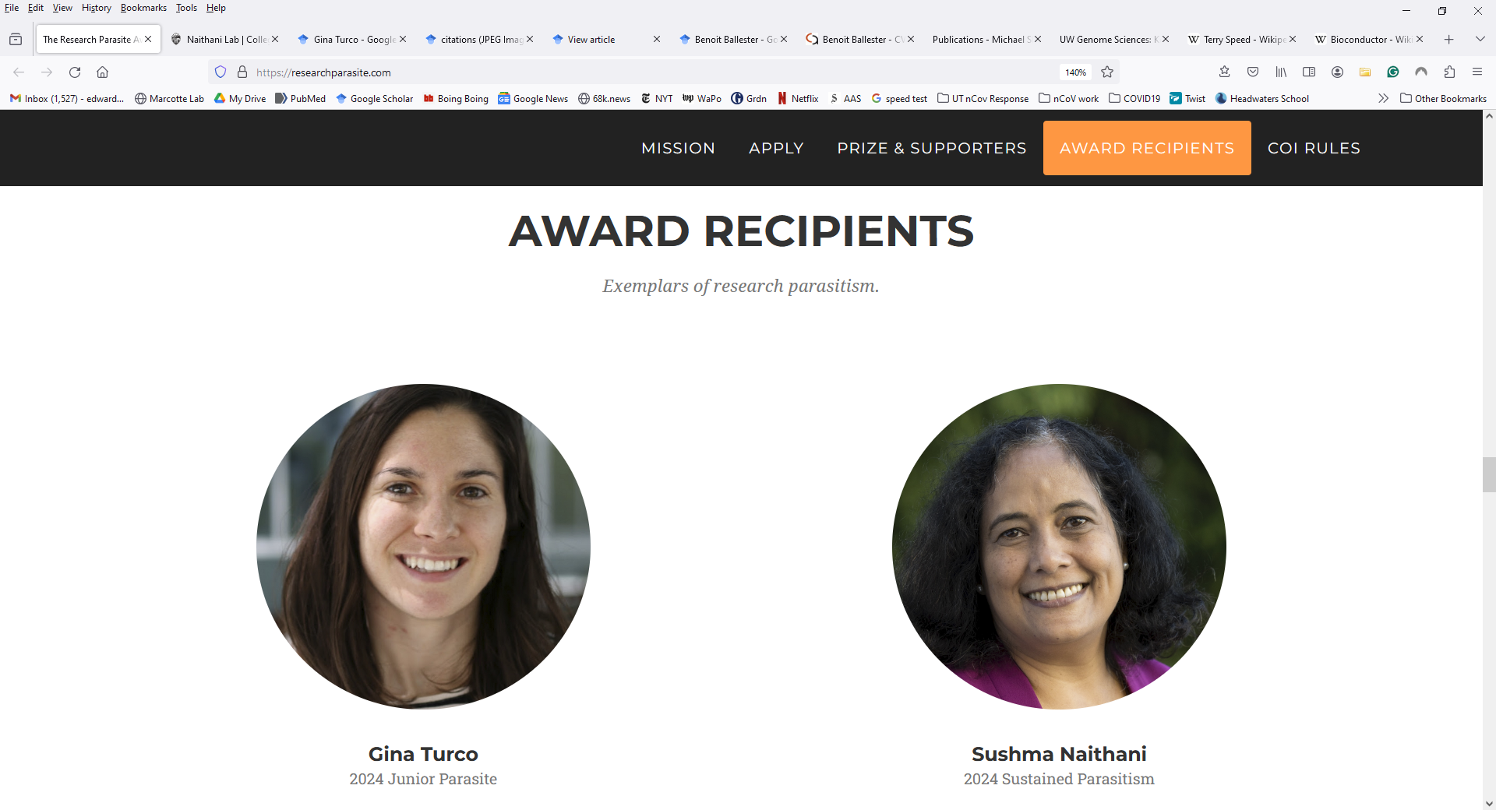

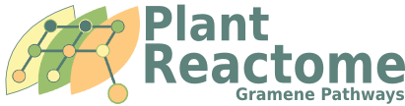
https://researchparasite.com/
Global analysis of the yeast knockout phenome
Turco et al., Sci. Adv. 9:eadg5702 (2023)
Here, we describe the aggregation, harmonization, and analysis of ~14,500 yeast knockout screens, which we call Yeast Phenome…

Slide 4
Are you a research parasite?
If not, you should be!
Today’s lecture gives a case study of using bioinformatics and public data to make new discoveries, specifically to discover new genes for genetic traits

Slide 5
Let’s think in the abstract for a moment:
How are mouse models useful for studying human disease? Are some models better than others?
What’s the worm equivalent of breast cancer?
Are there plant versions of human diseases?
Why would they possibly be useful?

Slide 6
Conserved systems intermediate between organism-specific genotype and phenotype
Genetic variation
x
Organism-specific
genotype
DNA
x
RNA/protein
x
The systems are conserved;
their mutant phenotypes often differ
Deeply conserved systems
Protein assemblies
x
Processes
Pathways
Failure of systems
Organism-specific
context
Organism-specific
Phenotype
x
+
Notes:
Conserved systems link genotype (DNA variation) with phenotype (variation in appearance).

Slide 7
A quick aside on terminology:
Comparative evolution studies rely on finding orthologs
Orthologs = genes from different species that derive from a single gene in the last common ancestor of the species
Paralogs = genes that derive from a single gene that was duplicated within a genome

Slide 8
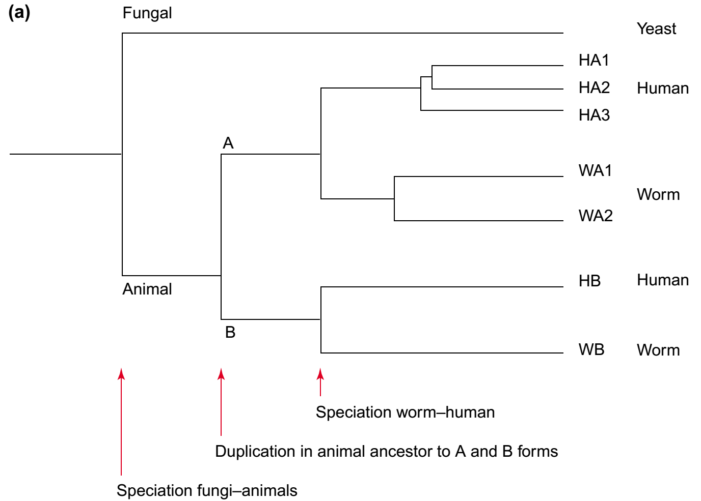
Comparative evolution studies rely on finding orthologs
Ortholog to all the rest
Paralogs
Co-
orthologs
Paralogs
Orthologs
In/out-paralogs: paralogs that evolved by gene duplication after/before the speciation event separating the lineages under consideration
Trends in Genetics 18:619–620 (2002)

Slide 9
Phenologs = significantly overlapping sets of
orthologous genes, such that each gene in a given set
gives rise to the same phenotype in that organism
(e.g., human)
(e.g., worm)
(e.g., breast cancer)
(e.g., specific worm phenotype)
McGary, Park et al. PNAS 107:6544-9 (2010)

Slide 10
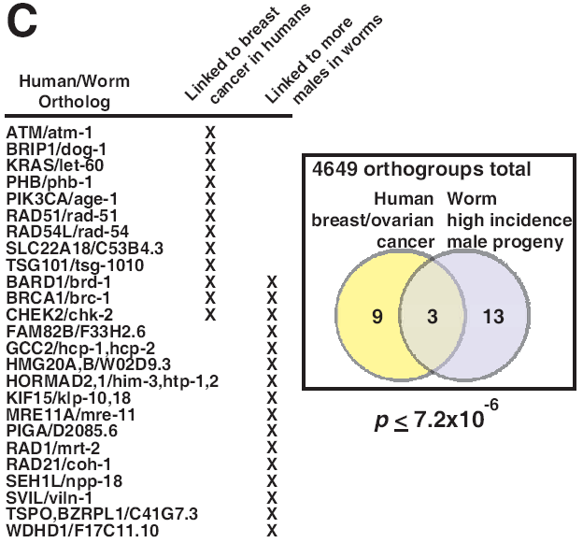
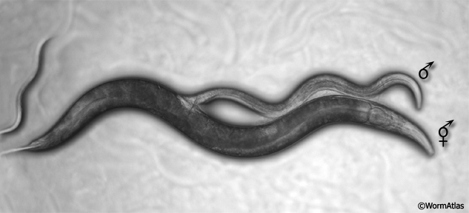
E.g., ‘high incidence of male’ C. elegans genes predict human breast/ovarian cancer genes
includes
BRCA1
McGary, Park et al. PNAS 107:6544-9 (2010)

Slide 11
Building & searching a collection of phenotypes
Mining available databases +
manual collection from the primary literature
Organism | # gene-phenotype associations
human | 1,923
mouse | 74,250
worm | 27,065
yeast | 86,383
Arabidopsis | 22,921
Spanning ~300 human diseases,
>7,000 model organism mutational phenotypes
Computational scan phenotypes for novel models of a disease of interest,
identify significant phenologs using permutation tests
McGary, Park et al. PNAS 107:6544-9 (2010)

Slide 12
Discovering phenologs
McGary, Park et al. PNAS 107:6544-9 (2010)

Slide 13
Computationally, we find many genes shared between human diseases and
mouse, yeast, worm, and even plant traits
A defect in... suggests genes for ...
yeast lovastatin sensitivity angiogenesis defects
worm abnormal body wall gastrointestinal
muscle cell polarization hemorrhage
yeast hydroxyurea sensitivity hemolytic anemia
plant cotyledon intellectual
development defects disability
McGary, Park et al. PNAS 107:6544-9 (2010)
Woods, Blom et al. BMC Bioinformatics, 14:203 (2013)

Slide 14
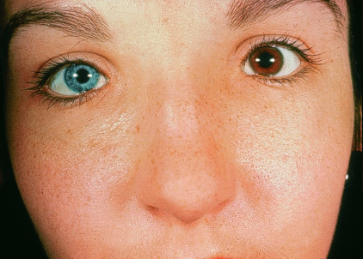
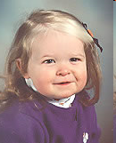
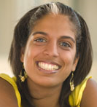
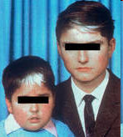
Waardenburg syndrome accounts for ~2-5% of cases of deafness
Michael Murphy, M.D.
Assorted websites, incl. www.verywell.com/waardenburg-syndrome-1048692, http://stephaniemariesanchez.blogspot.com/

Slide 15
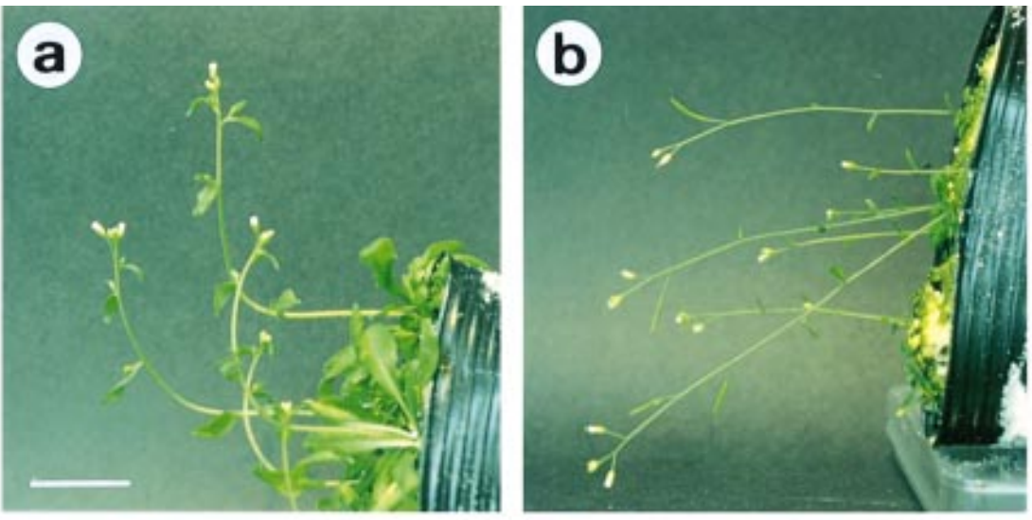
Plants sense and respond to gravity → gravitropism
Fukaki et al., The Plant Journal
14, 425–430 (1998)

Slide 16
Plant gravitropism genes predict Waardenburg syndrome, a human congenital deafness syndrome
Waardenburg syndrome genes
(with plant orthologs)
Defective
gravitropism genes
(with human orthologs)
1
2
3
Human versions of these plant genes are candidate Waardenburg genes
Michael Murphy, M.D.
~
~
Fukaki et al., The Plant Journal
14, 425–430 (1998)
https://www.pinterest.com/
pin/555561304003942032
Waardenburg syndrome
Gravitropism defects
McGary et al. PNAS 107:6544-9 (2010)

Slide 17
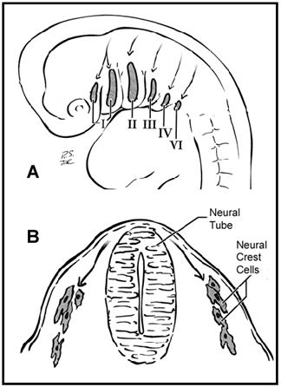
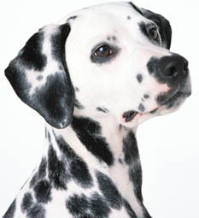
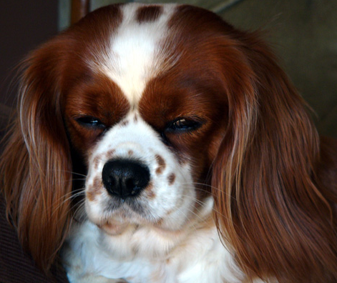
Waardenburg syndrome is a defect of neural crest cells
Neural crest cells migrate
during embryonic development
Some WS correlates in other animals:
Deafness in Dalmatian dogs (22% unilaterally deaf)
Variations in the Blenheim spot of
Cavalier King Charles Spaniels
Association between white blue-eyed cats and deafness (noted by Darwin in 1859)
White forelock and deafness/bowel blockage in foals & many more...
www.petplanet.co.uk
www.silvarcea.co.uk
Heike & Hing, Gene Reviews (2009)

Slide 18
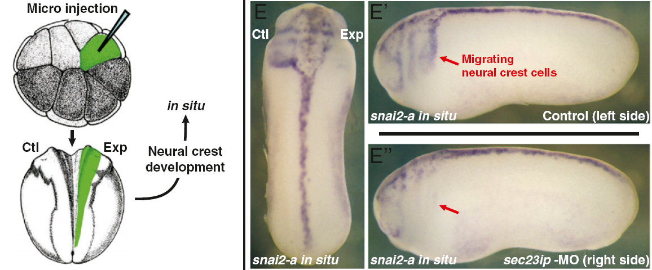
Sure enough, inactivating one of the genes—predicted from plants—in a tadpole disrupts neural crest cells, consistent with Waardenburg syndrome
Frog embryo
McGary, Park et al. PNAS 107:6544-9 (2010)

Slide 19
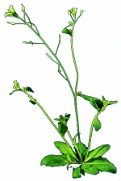
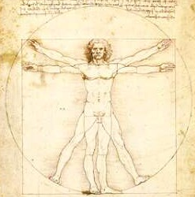
Conservation and “repurposing” of core cell machinery across deep evolutionary time
Last common
ancestor
Set of genes in LCA
Plant
Human
arabidopsis.info
Genes now
used to direct
polarized growth
in gravitropism
Orthologous
genes
Genes now
used to direct
neural crest
cell migration
McGary et al. PNAS 107:6544-9 (2010)

Slide 20
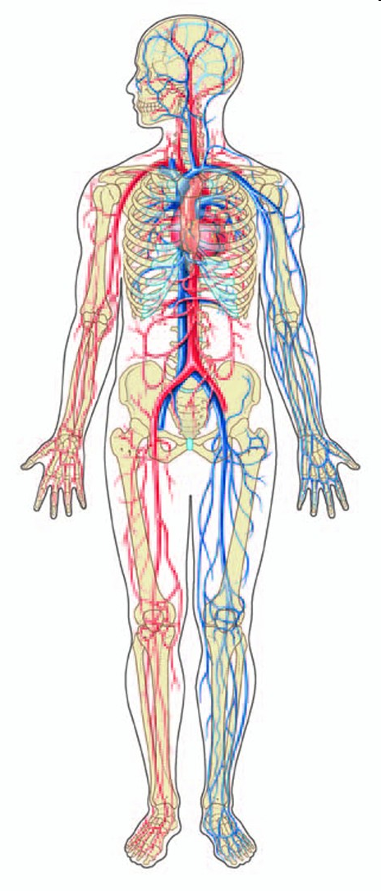
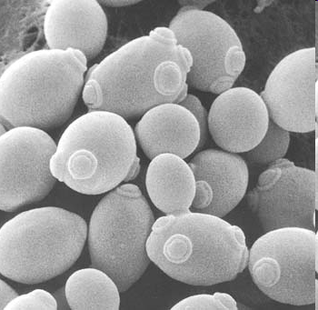
Another example: Yeast genes linked to statin sensitivity
predict blood vessel defects
The human versions of these yeast genes are candidate angiogenesis genes
Can these really tell us about these?
McGary, Park et al.
PNAS 107:6544-9 (2010)
www.chemistryland.com
Dorling Kindersley

Slide 21
Disrupting the SOX13 gene causes strong blood vessel defects
hemorrhaging in later stage embryos
& angiogenesis defects in cultured
human umbilical vein cells
McGary, Park et al.
PNAS 107:6544-9 (2010)

Slide 22
A yeast model of angiogenesis = example of a deeply conserved, but “repurposed” gene module
Last common
ancestor
Gene module
in LCA
Human
Yeast
Genes
form blood
vessels
Orthologs
Genes
maintain cell
walls
McGary, Park et al. PNAS (2010)

Slide 23
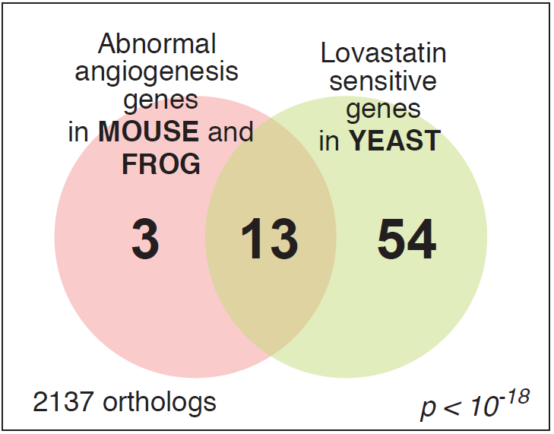
The yeast/angiogenesis gene module

Slide 24
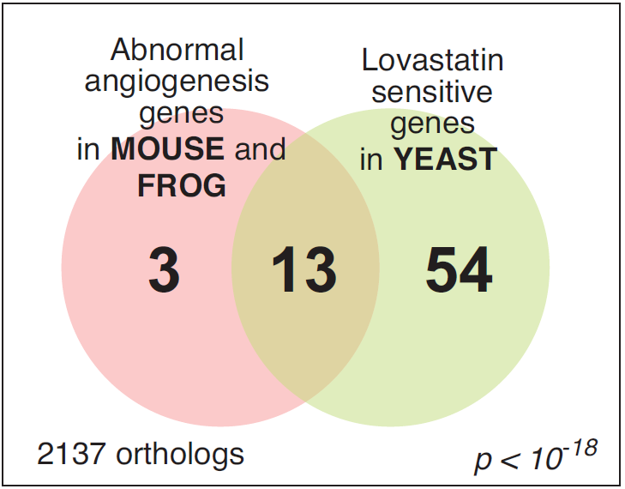
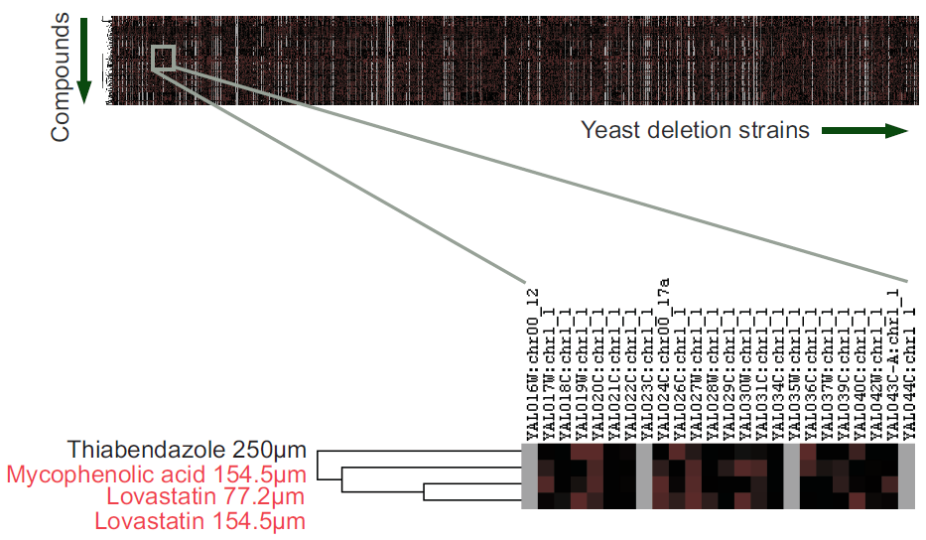
Chemicals that interact genetically with this module are candidate angiogenesis inhibitors
1144 assays from
Hillenmeyer et al.,
Science (2008)
www.chemistryland.com

Slide 25
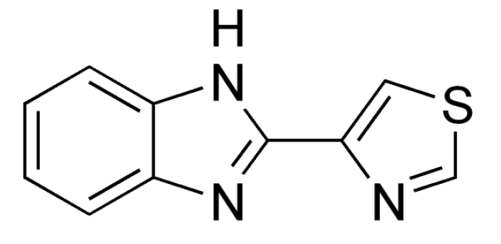
Screening for drugs that interact genetically with this yeast module led us to identify a new angiogenesis inhibitor
TBZ = thiabendazole
FDA-approved antifungal drug with 40 years of safety data
Approved by U.S. Food and Drug Administration in 1967
Fungicide and parasiticide
Not mutagenic or carcinogenic; 2 year dog safety trials
- Off-patent, marketed as a generic

Slide 26
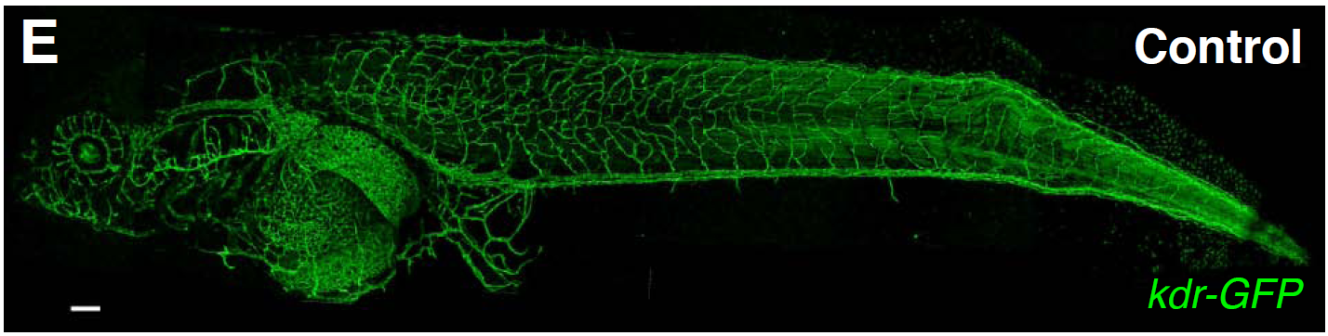
Imaging the blood vessels of a living, transgenic tadpole in a dish of water
200 μm
kdr:GFP transgenic Xenopus laevis

Slide 27

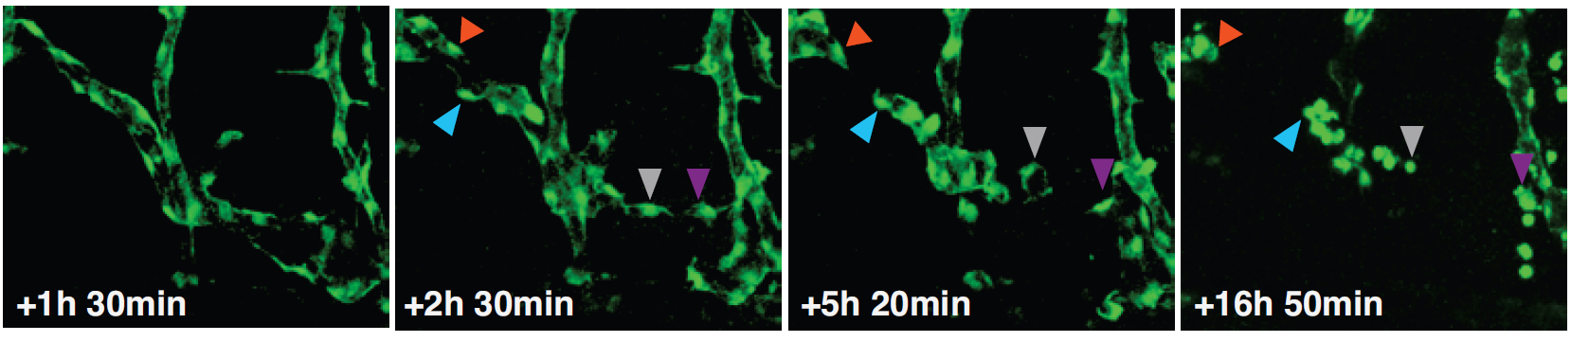
TBZ disrupts vascular integrity, making
vascular endothelial cells retract & round up
Control (DMSO carrier)
+ TBZ
Cha et al., PLoS Biology (2012)

Slide 28
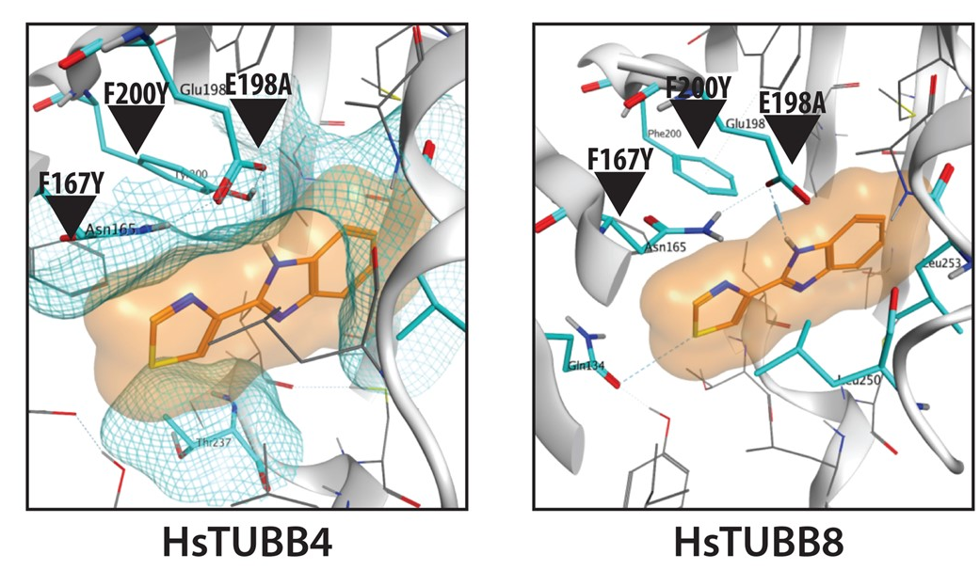
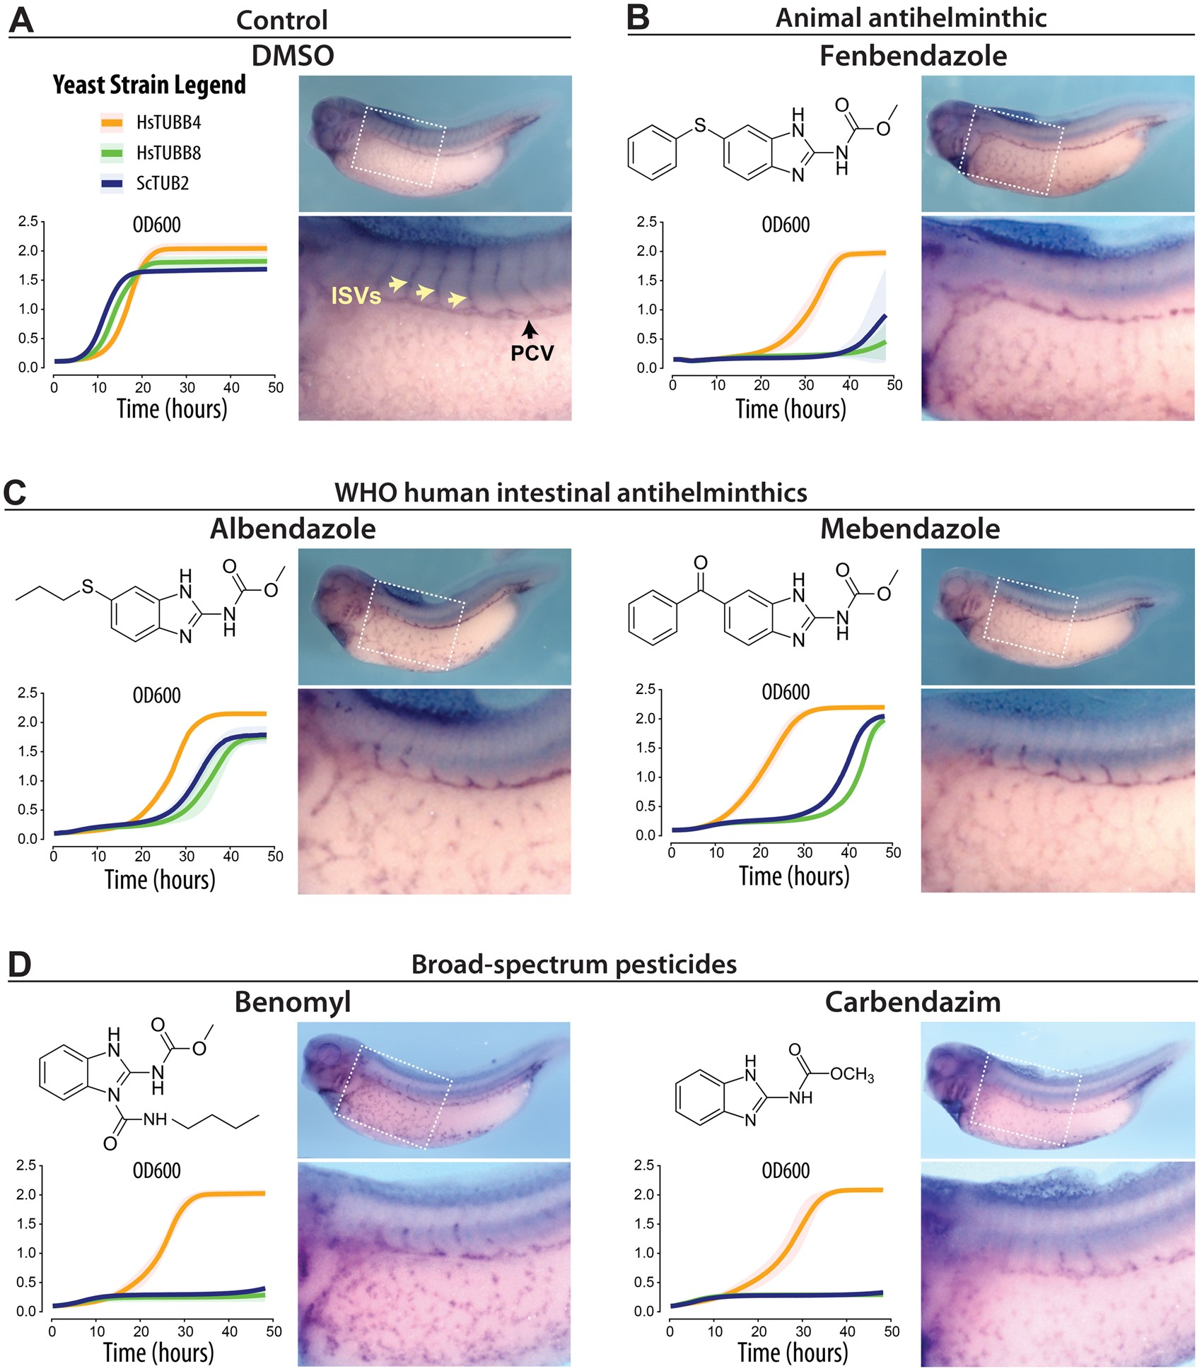
TBZ specifically inhibits just 1 of the 9 human beta tubulins, TUBB8, needed for angiogenesis
Found 5 more, including benomyl &
3 more FDA approved antifungal drugs
Steric clashes
Garge et al., Genetics 219:iyab101 (2021)

Slide 29
Let’s talk about how such projects play out in practice.
How are discoveries made?
How do you computationally explore ideas?

Slide 30
Let’s step through this particular discovery process:
We had an idea, based on a puzzling observation:
  Why do mutations in worm retinoblastoma genes induce ectopic vulva while a mutation in the human ortholog causes eye cancer?
  We weren’t interested in specific mechanism here, but rather the impact of organismal context on conserved systems. In particular, how do ever-more distant evolutionary models inform us about human disease?

Slide 31
Let’s step through this particular discovery process:
We thought about how this might be part of a large trend—does it illustrate a general principle? Could we could look for new cases systematically?
We thought about other examples, mentally assembling what could serve as positive and negative control cases. i.e. how to we decide if a systematic approach is working?
A grad student (Kris McGary) started assembling relevant datasets. We took heavy advantage of existing resources: model organism databases that had already pain-stakingly curated relevant data, large-scale screens reporting easy-to-process data.
We started inventing/evaluating statistical models/algorithms, exploring the data and thinking about how to search for the relevant trends. We iterated steps 4/5 until we thought we understood the problem better.
At some point, the lab bet a 6 pack of beer on the outcome: Can we discover plant models of human disease?
The algorithms predicted some remarkable and crazy results. We had no option but to test or reject the new predictions, so began testing, thanks to collaborators in the Wallingford lab willing to sink a few weeks into high-risk experiments.
Some tests worked, some didn’t. We went back & thought about the ones that didn’t and refined how we prioritized the results.
Iterate, iterate. Jackpot! A plant model of deafness! Shouting in the halls…
This might be the single most important lesson in the entire class:
Computational analyses need controls,
just like wet lab experiments.

Slide 32
Let’s step through this particular discovery process:
A grad student (Kris McGary) started assembling relevant datasets. We took heavy advantage of existing resources: model organism databases that had already pain-stakingly curated relevant data, large-scale screens reporting easy-to-process data.

Slide 33
Let’s step through this particular discovery process:
We started inventing/evaluating statistical models/algorithms, exploring the data and thinking about how to search for the relevant trends. We iterated these steps until we thought we understood the problem better.
At some point, the lab bet a 6 pack of beer on the outcome:
Can we discover plant models of human disease?

Slide 34
Let’s step through this particular discovery process:
The algorithms predicted some remarkable and crazy results. We had no option but to test or reject the new predictions, so began testing, thanks to collaborators in the Wallingford lab willing to sink a few weeks into high-risk experiments.
Some tests worked, some didn’t. We went back & thought about the ones that didn’t and refined how we prioritized the results.
Iterate, iterate. Jackpot! A plant model of deafness! Shouting in the halls…

Slide 35
Try it out yourself!
http://www.phenologs.org
You can start by rediscovering the plant model of Waardenburg syndrome:
Search known diseases for "Waardenburg", or enter the human genes linked to Waardenburg (Entrez gene IDs 4286, 5077, 6591, 7299) to start.
Tools for finding orthologs are linked on the class website

