Slide 1
Synthetic biology:
Engineering new functions, cells, and even life?
BCH394P/364C Systems Biology / Bioinformatics
Edward Marcotte, Univ of Texas at Austin

Slide 2
Synthetic Biology = design and engineering of biological systems that aren’t found in nature
Why would we want to do this?
- Want to understand natural systems. One of the best ways to
understand a system is to change it or make new, related ones
- To fully “understand” a system, we should be able to predict
the outcome when we change the system
- For molecular biology, this means:
- designing new gene circuits and networks
- modeling the designed systems & predicting their properties
- making & testing the designs
- updating our understanding from the model/test agreement

Slide 3
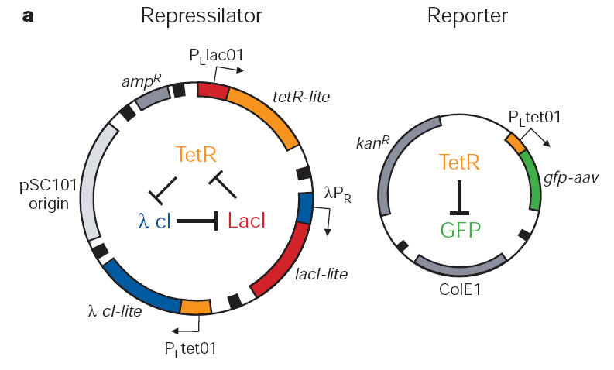
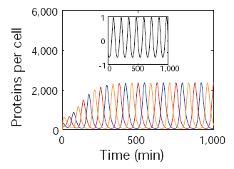
The Repressilator = engineered genetic circuit designed
to make bacteria glow in a oscillatory fashion
= “repressor” + “oscillator”
Transcriptional repressors
Green fluorescent
protein
Elowitz & Leibler, Nature (2000) 403:335-8

Slide 4
The Repressilator = engineered genetic circuit designed
to make bacteria glow in a oscillatory fashion
Elowitz & Leibler, Nature (2000) 403:335-8

Slide 5
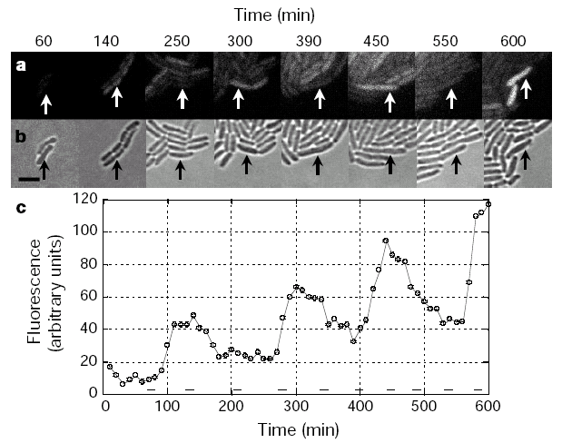
The repressilator in action...
Elowitz & Leibler, Nature (2000) 403:335-8

Slide 6
iGEM: A synthetic biology contest
Can simple biological systems be built from standard, interchangeable parts and operated in living cells?
Or is biology too complicated to be engineered in this way?
Broader goals include:
- Enable systematic engineering of biology
- Promote open & transparent development of tools for engineering biology
- Help construct a society that can productively apply biological technology
(from iGEM’s web site)

Slide 7
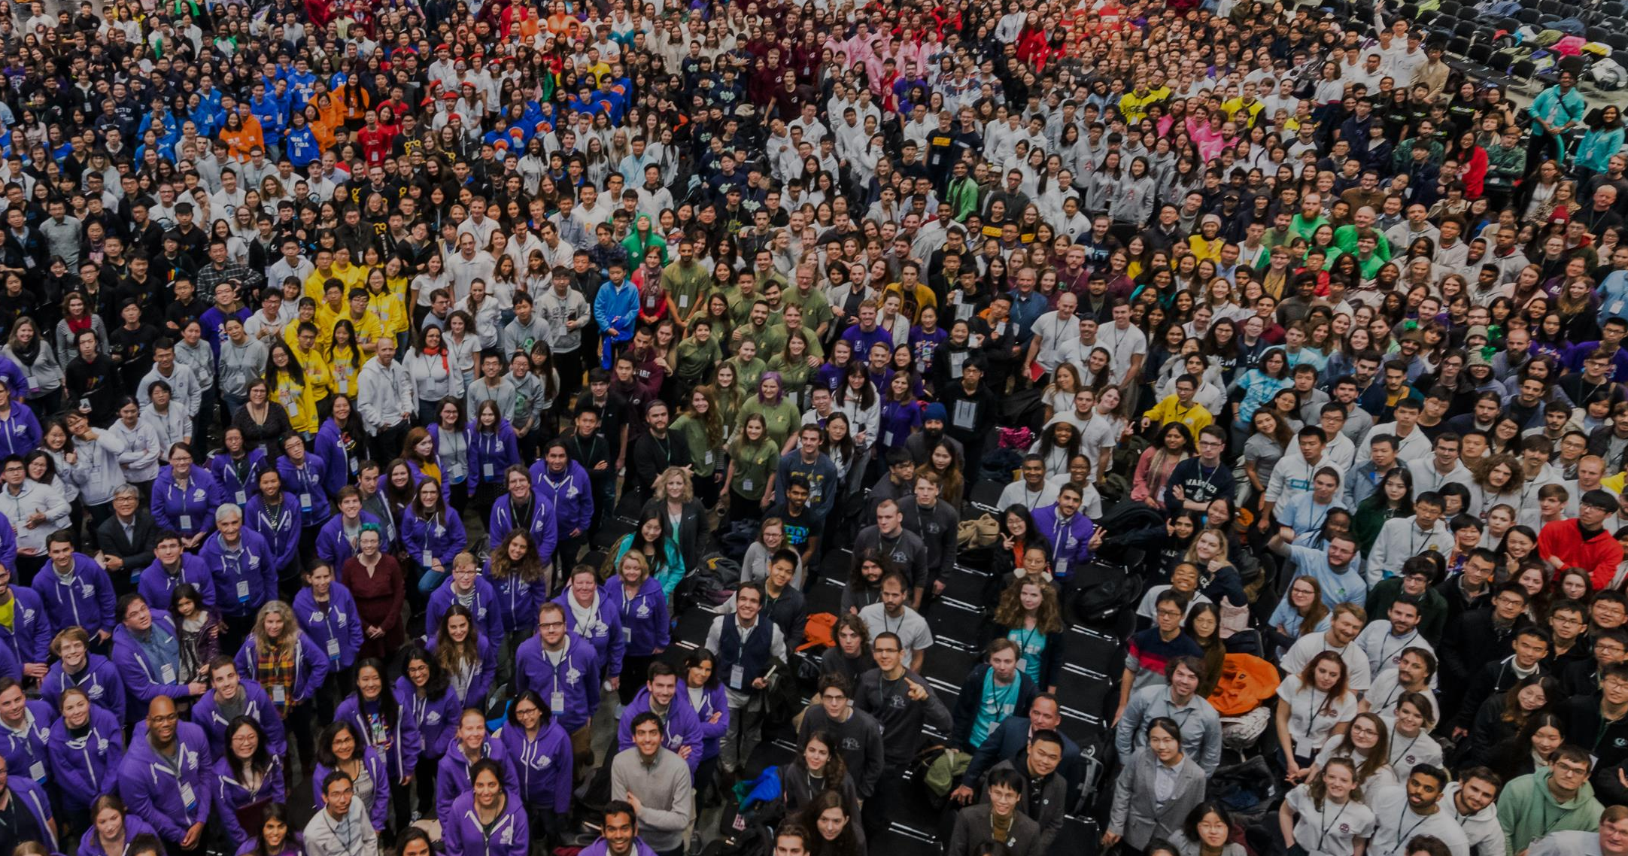
iGEM: A synthetic biology contest
2004: MIT, UT, Princeton, Boston University, Cornell
2005: 13 teams (the above + UK, Germany, more...)
2006: 32 teams, incl. Japan, Latin America, Korea, India, more Europe
54 teams in 2007, 112 in 2009, 165 in 2011, and 245 in 2013…
…now roughly 6,000 entrants / year

Slide 8



A little local history to illustrate the field:
UT’s 2004/2005 iGEM project – build bacterial edge detector
Projector
Original image
shine image
onto cells
petri dish coated with bacteria
Cells
luminesce
along the
light/dark
boundaries
Adapted from Zack Simpson

Slide 9
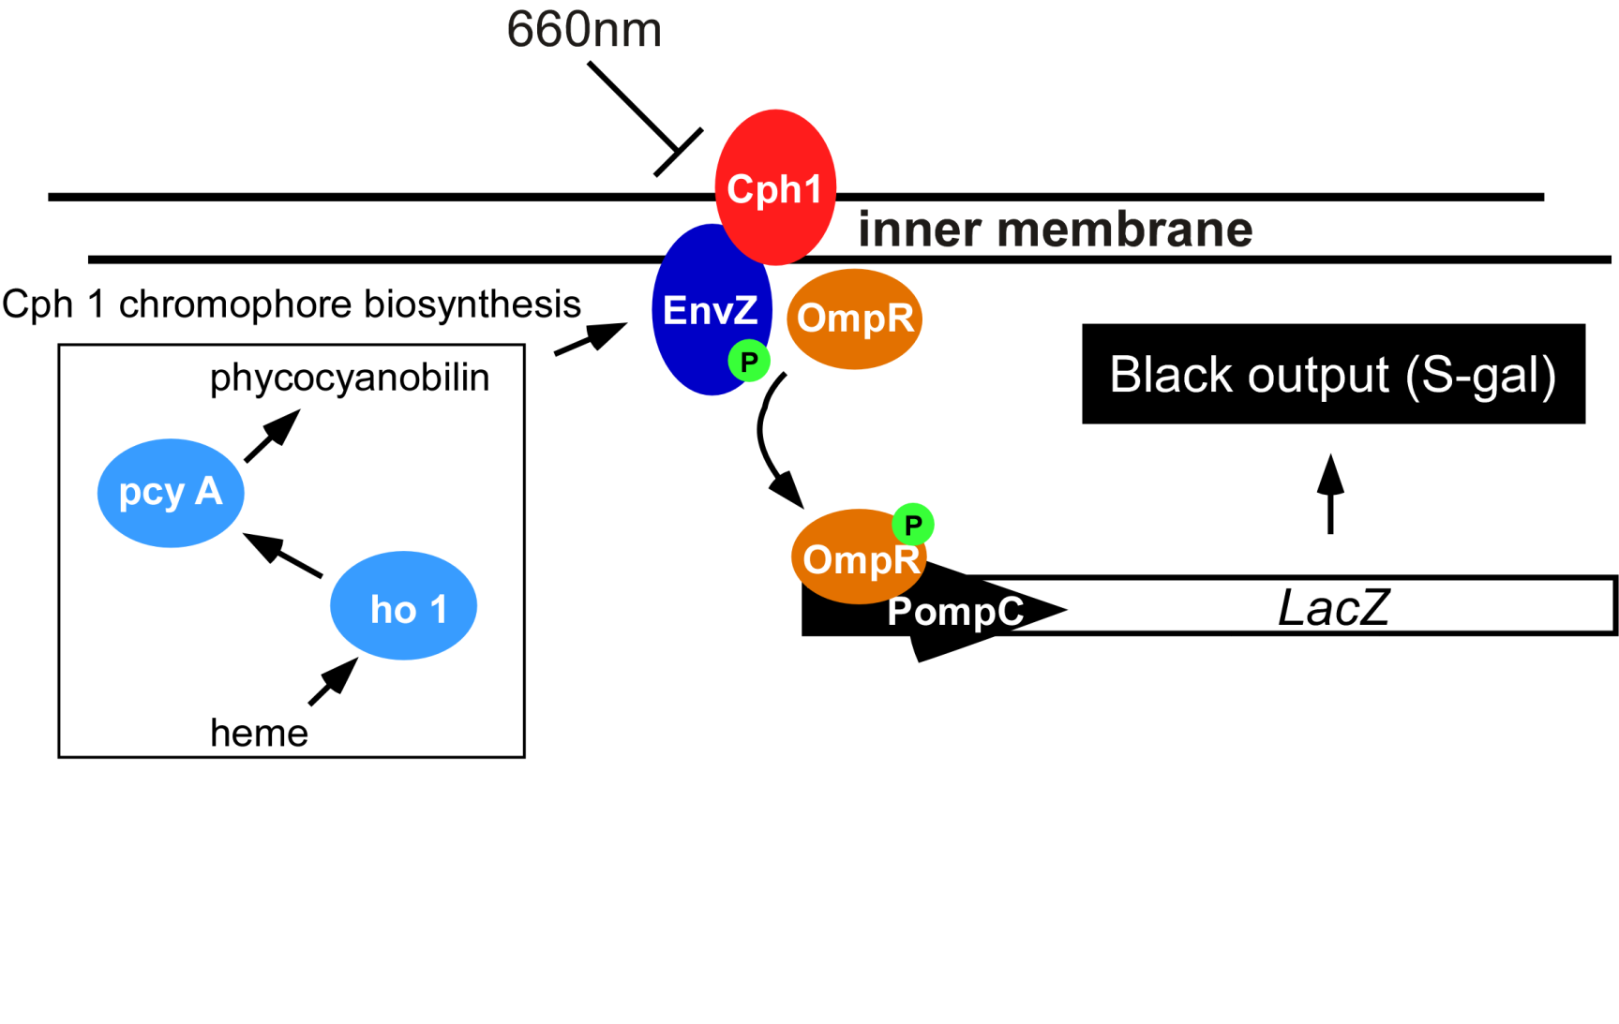
Bacterial photography
Levskaya et al. Nature, 438(7067):441-2 (2005)

Slide 10
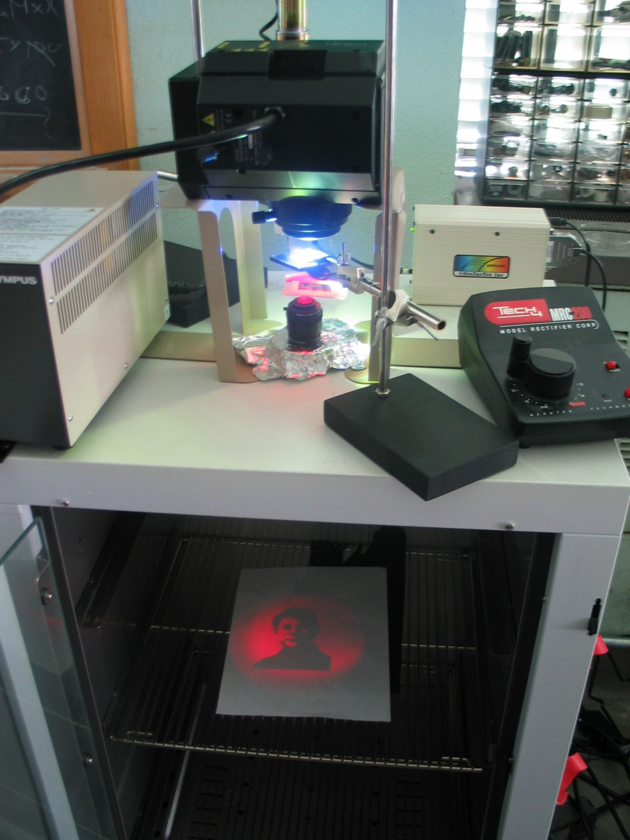

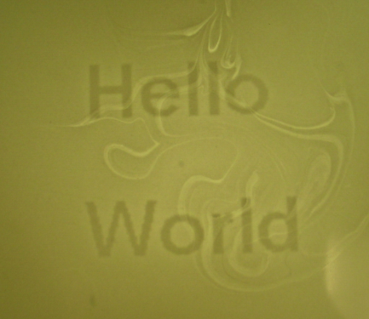

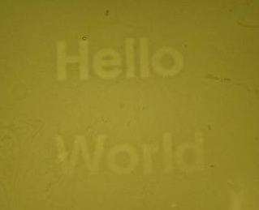
Mask
Cph1/EnvZ
“Light cannon” developed by Aaron Chevalier, UT undergraduate
Levskaya et al. Nature, 438(7067):441-2 (2005)

Slide 11
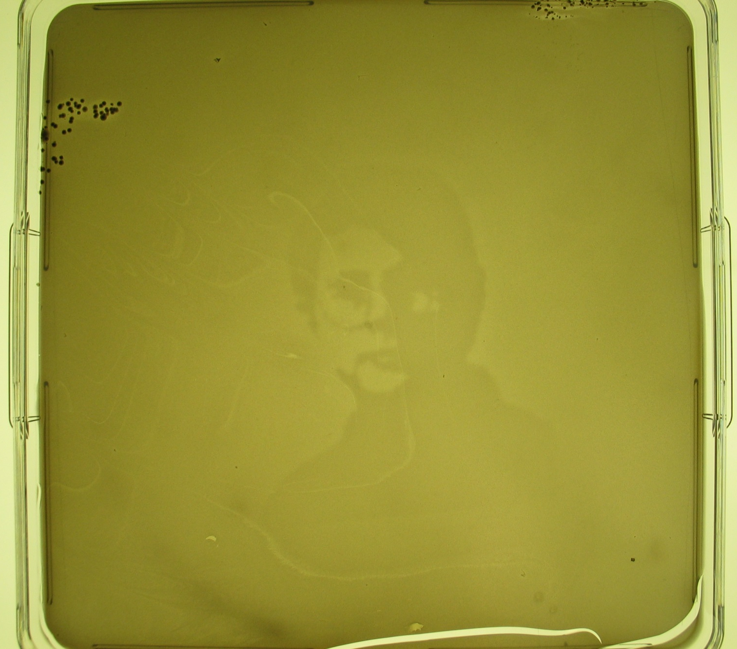
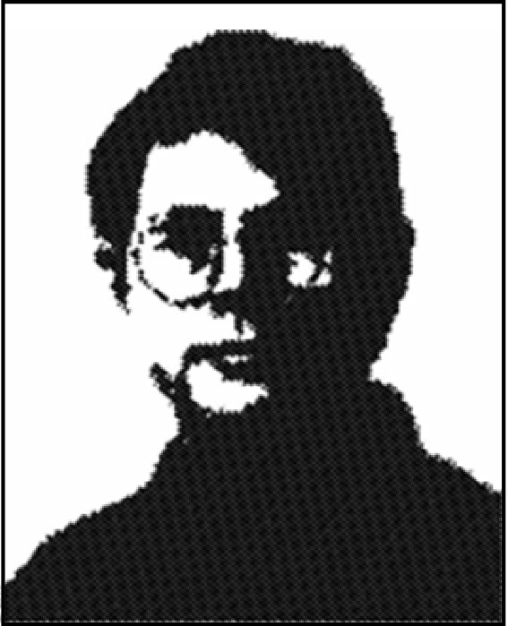
The first bacterial photograph (coliroid?)...
Great moments in contemporary images:
The virgin Maria on a tortilla...
Andy Ellington in a petri dish....
Levskaya et al. Nature, 438(7067):441-2 (2005)

Slide 12
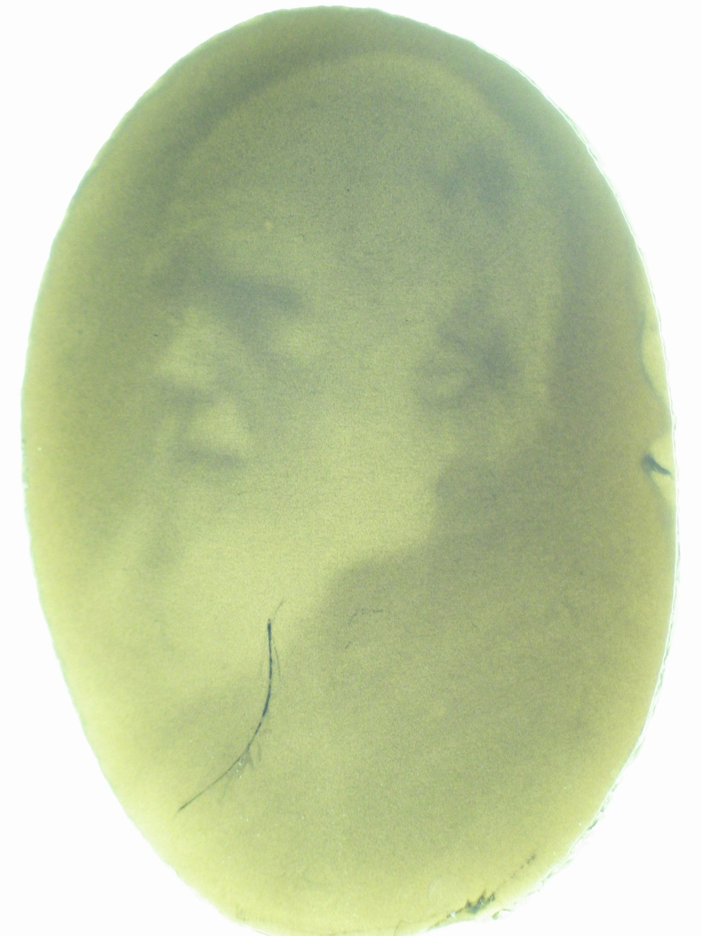
Escherichia darwinia
Image: Aaron Chevalier

Slide 13

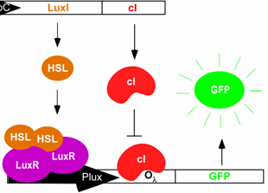
On to the edge
detector...
Dark
Light
HSL
HSL
HSL
HSL
HSL
HSL
HSL
HSL
HSL
HSL
HSL
HSL
HSL
HSL
HSL
HSL
HSL
Tabor et al., Cell 137(7):1272-1281 (2009)

Slide 14
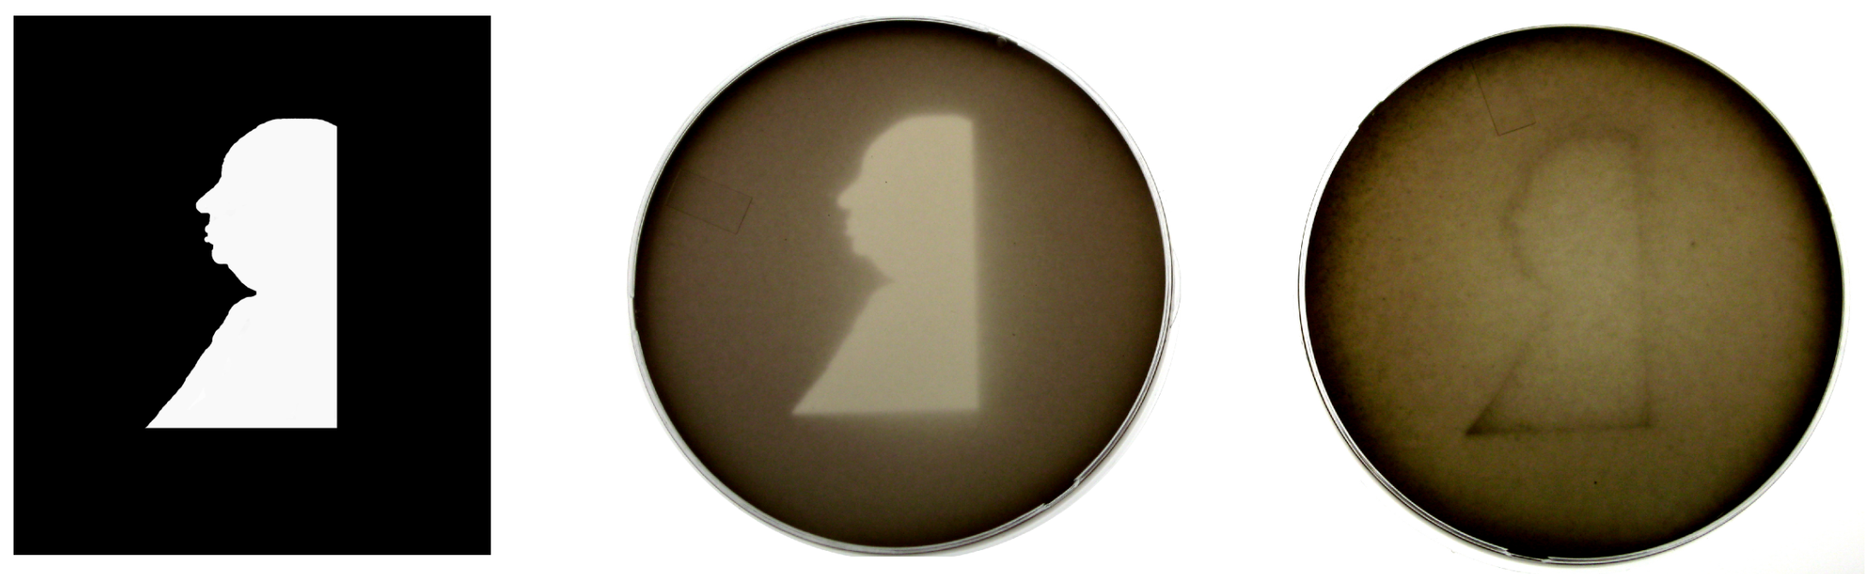
It works!
Projected Mask Photo strain Edge detector strain
Tabor et al., Cell 137(7):1272-1281 (2009)

Slide 15
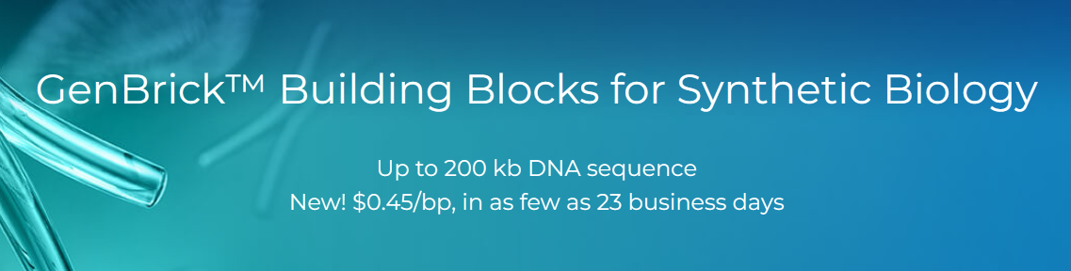
Who needs nature?
Made-to-order, designer organisms
www.genscript.com
We can now manufacture a complete genome
from commodity chemicals
Therefore, we can program whatever changes we want,
assuming we can get it into cells…

Slide 16
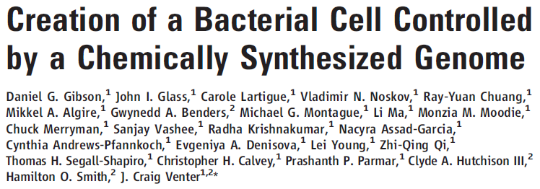
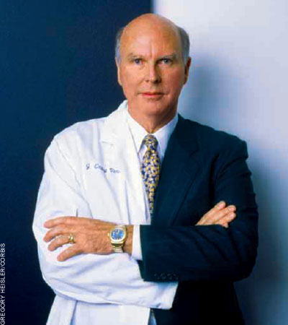
“We report the design, synthesis, and assembly of the 1.08–mega–base pair Mycoplasma mycoides JCVI-syn1.0 genome starting from digitized genome sequence information and its transplantation into a M. capricolum recipient cell to create new M. mycoides cells that are controlled only by the synthetic chromosome.”
http://science.docuwat.ch/
2 JULY 2010 VOL 329 SCIENCE

Slide 17
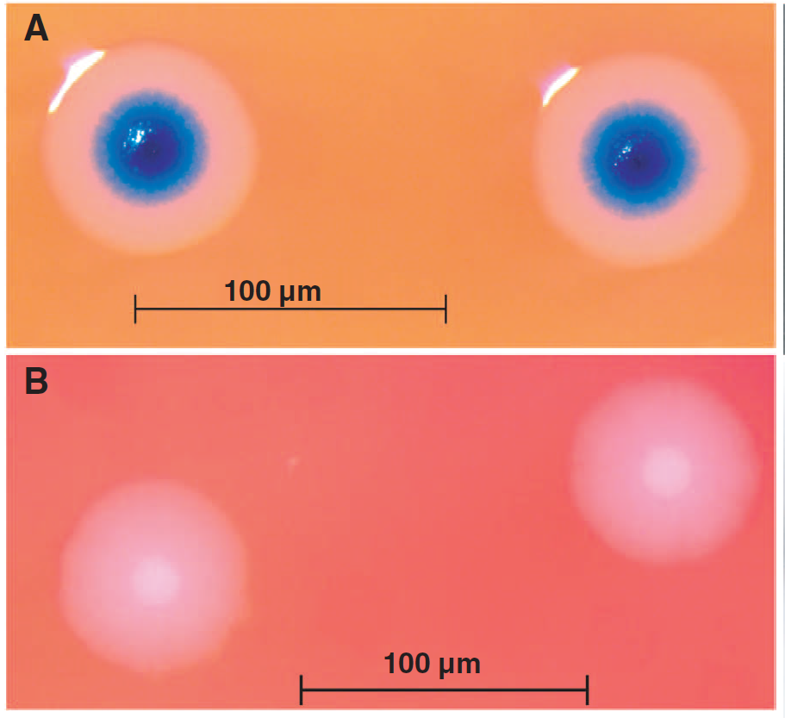
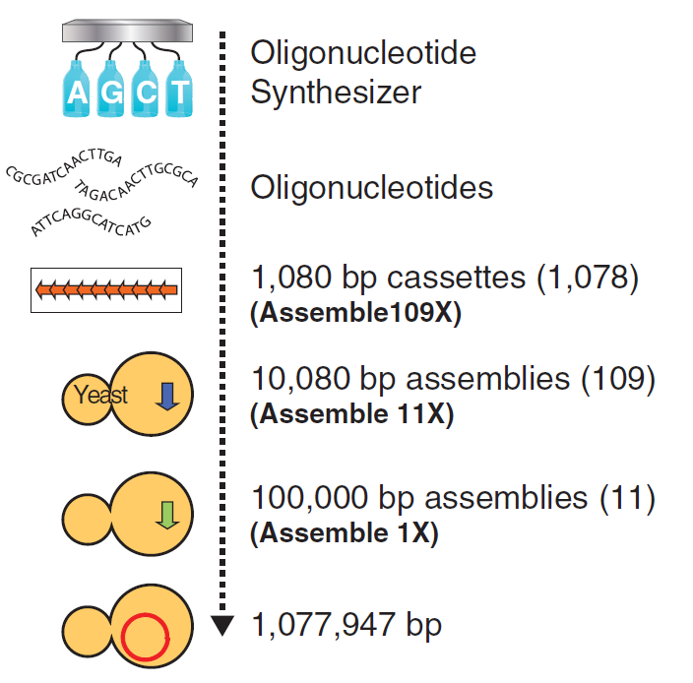
“Rebooting” bacteria with synthetic genomes
Genome transplant
2 JULY 2010 VOL 329 SCIENCE

Slide 18
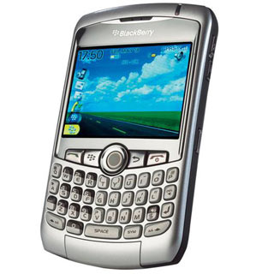
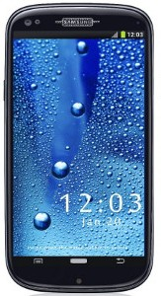
But, wait! They only changed DNA, not the rest of the cell!
However…
In biology, software encodes the hardware.
Most (all?) of the cell is specified by the DNA.
It’s as though you bought a old Blackberry…
installed the Android operating system…
& your phone physically morphed
into a Galaxy S10…
www.cellphones.ca
www.pinterest.com

Slide 19
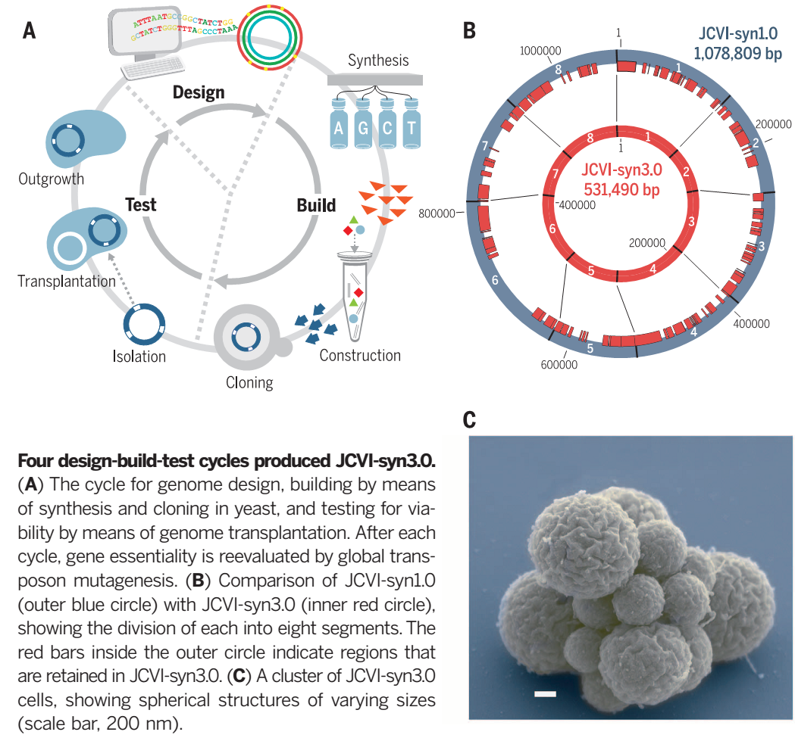
In 2016, Hutchison, Chuang, et al. reported making living mycoplasma after cutting the genome by ½ the genes
Science

Slide 20
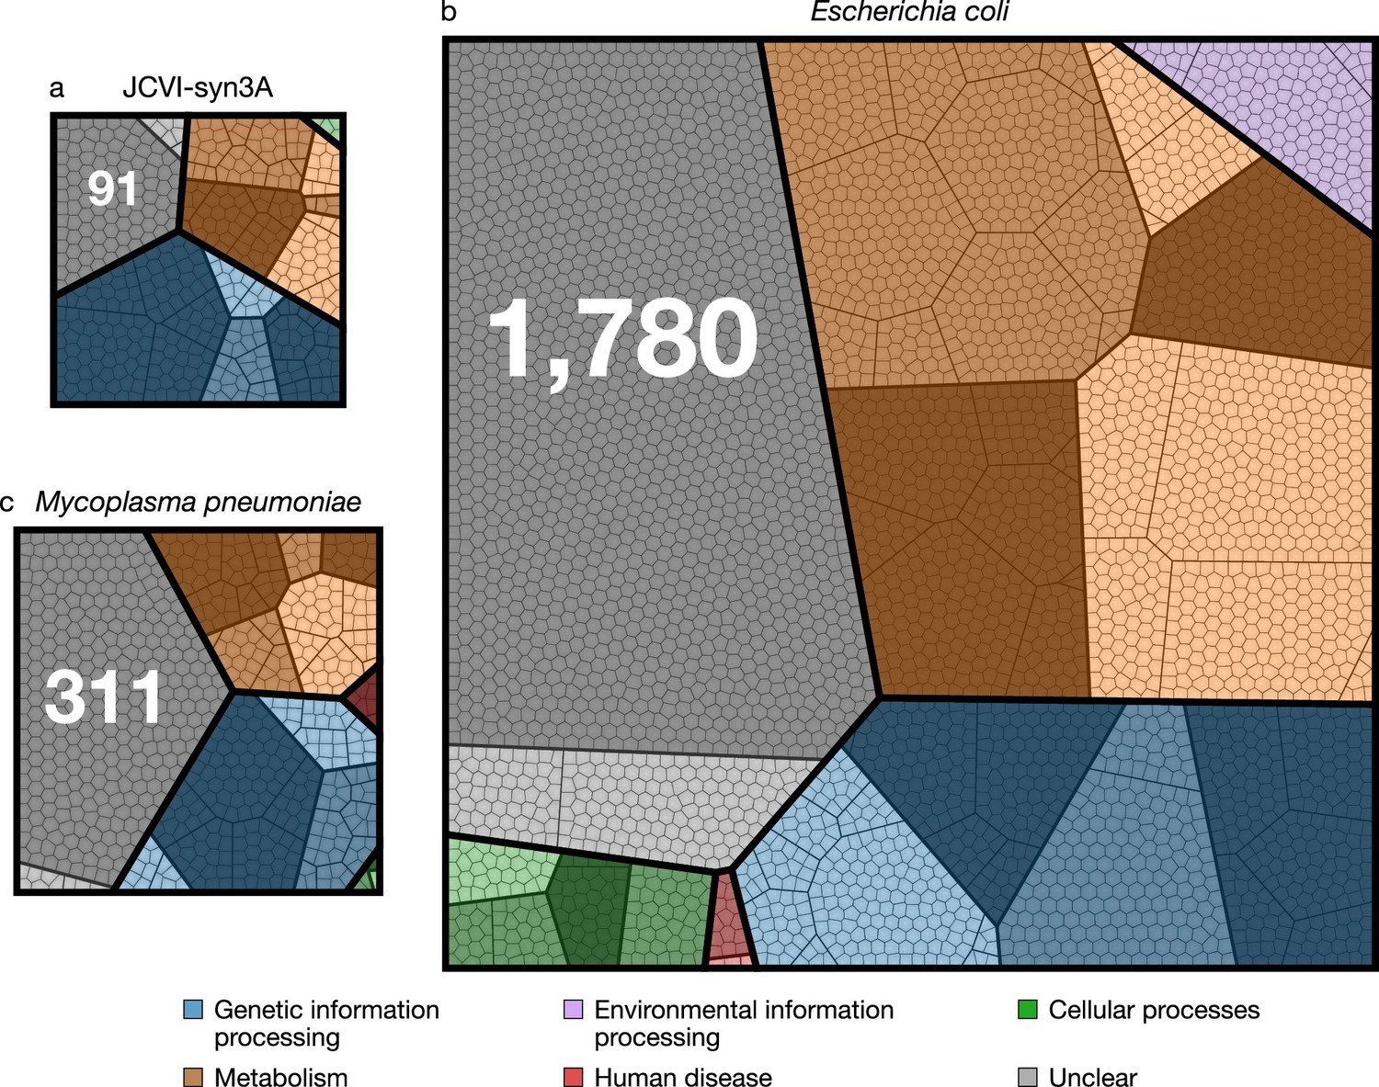
JCVI-syn3.0 now makes for a remarkably compact, engineerable, free living cell “chassis” to study
Breuer et al., eLife 2019;8:e36842 DOI: 10.7554/eLife.36842

Slide 21
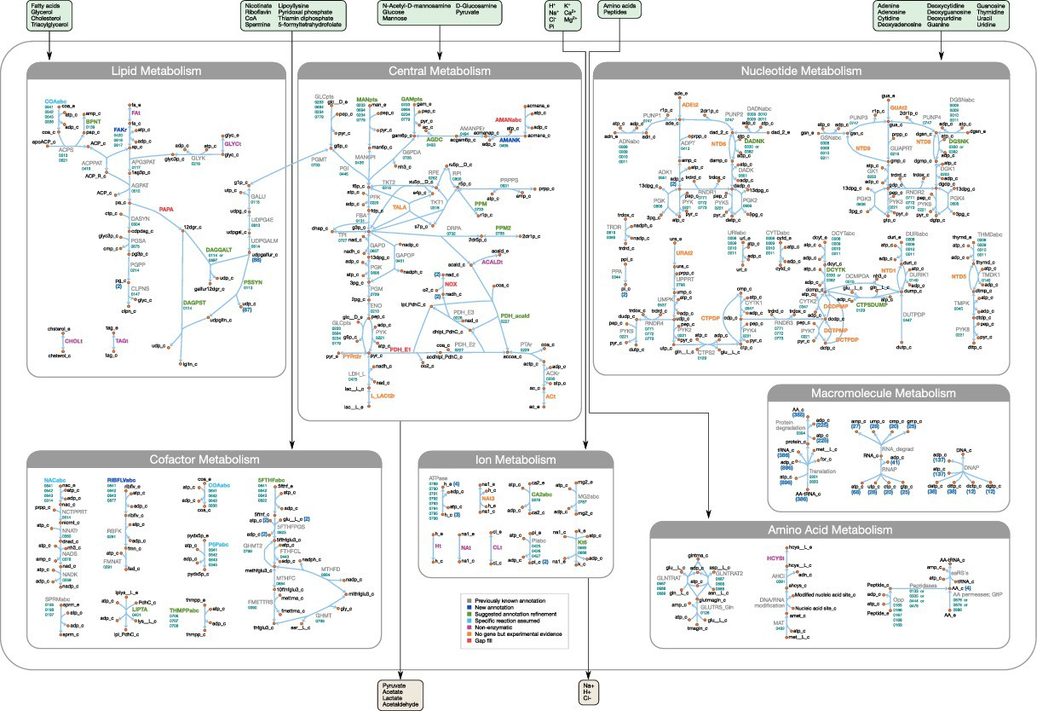
…which now has a rich metabolic reconstruction…
Breuer et al., eLife 2019;8:e36842 DOI: 10.7554/eLife.36842

Slide 22
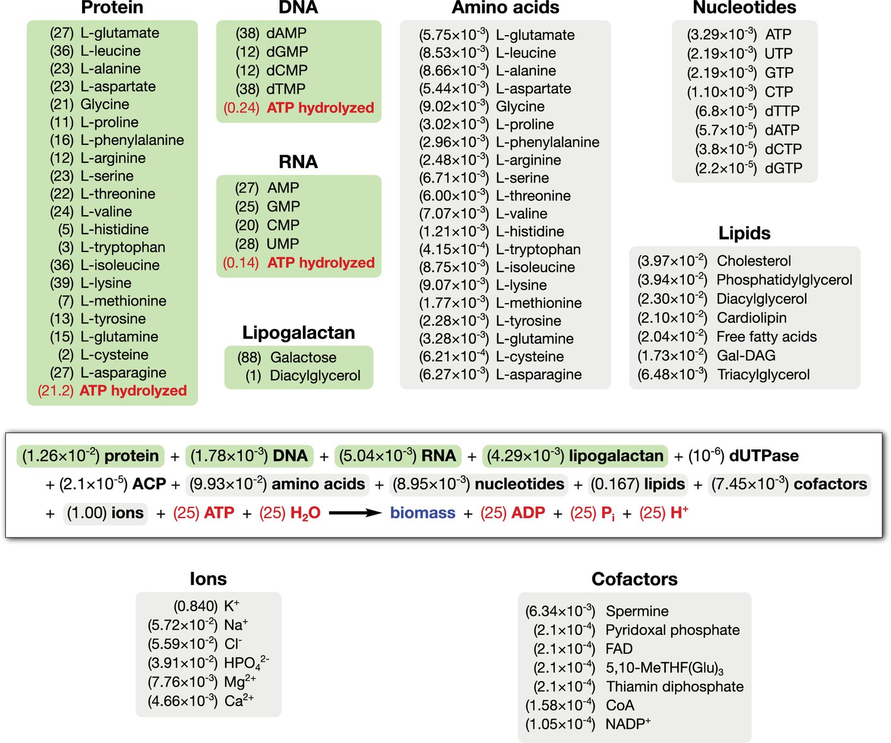
…and highly defined composition, to the extent one can write its biomass reaction equation:
Breuer et al., eLife 2019;8:e36842 DOI: 10.7554/eLife.36842

Slide 23
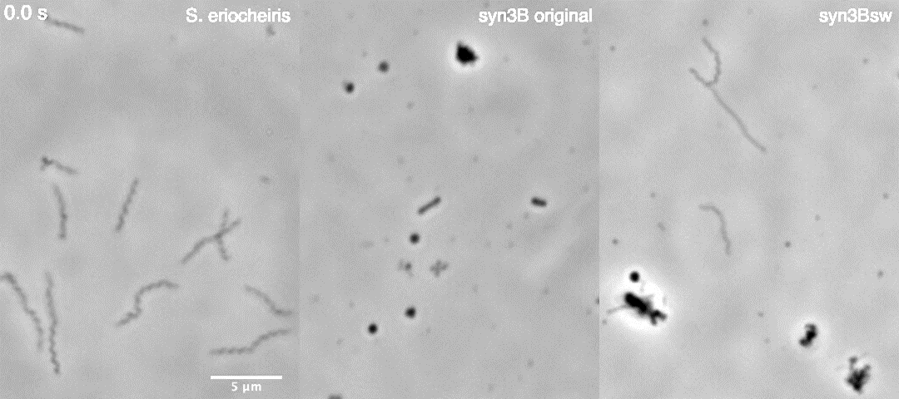
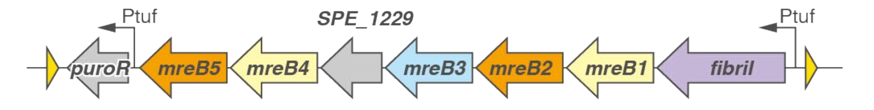
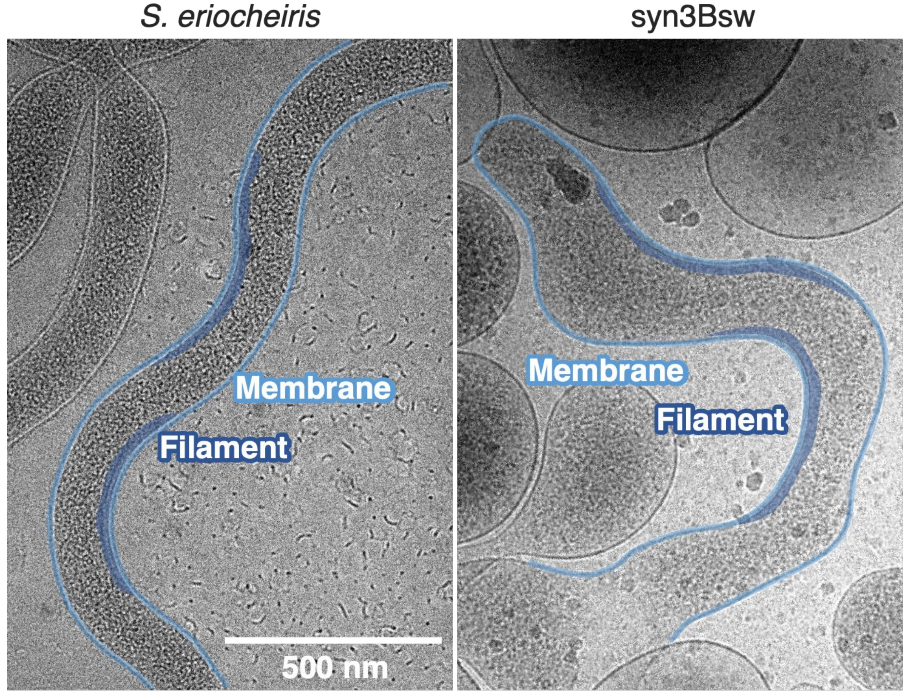
…and even engineered motility
Spiroplasma actin operon
+
JCVI-syn3.0B
Kiyama et al., bioRxiv, doi:10.1101/2021.11.16.468548

Slide 24
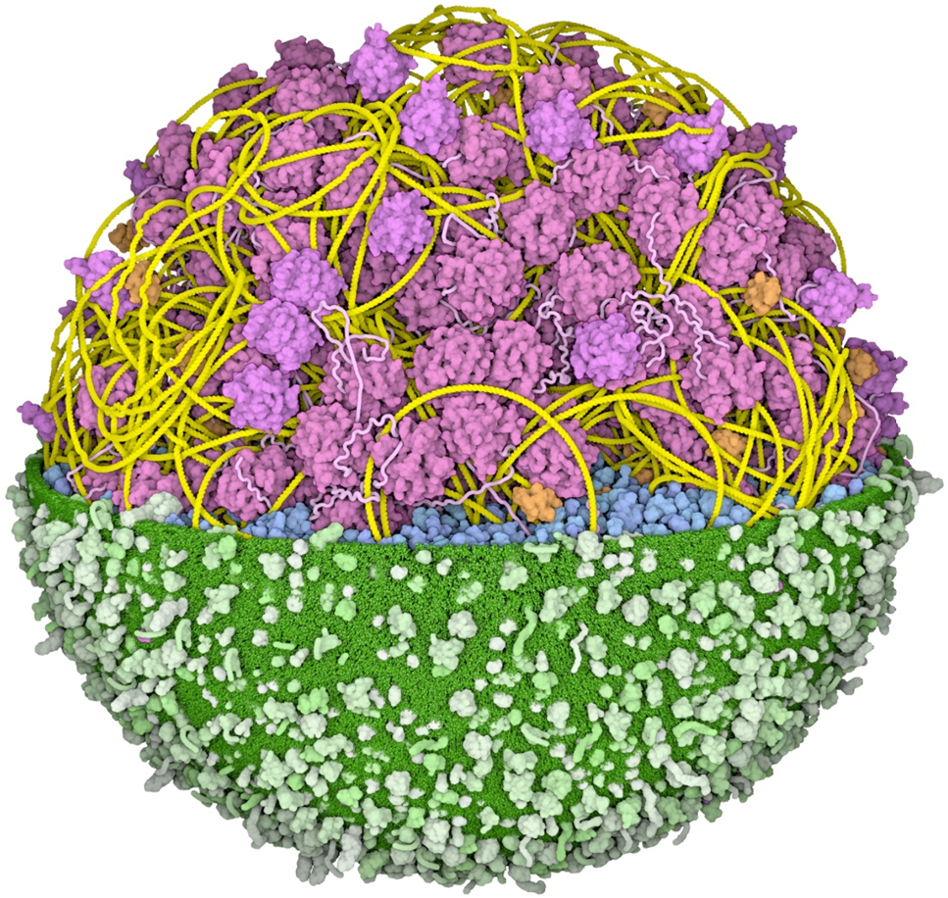
…and now a 3D whole cell model
https://doi.org/10.1515/jib-2022-0013
David S. Goodsell, Integrative illustration of a JCVI-syn3A minimal cell

Slide 25
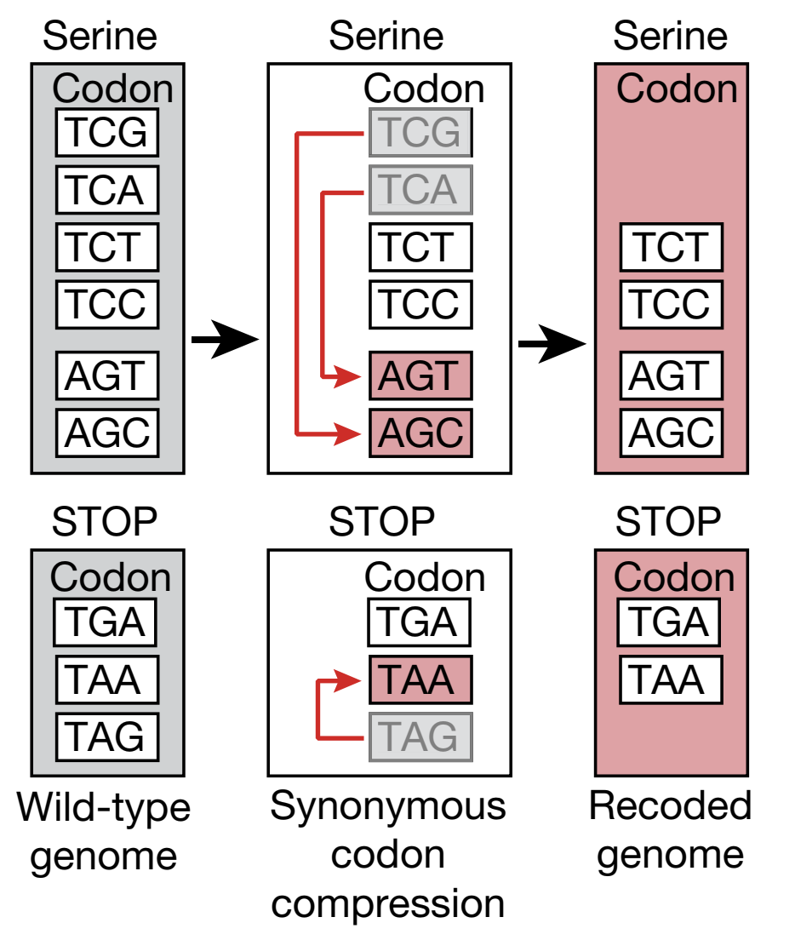
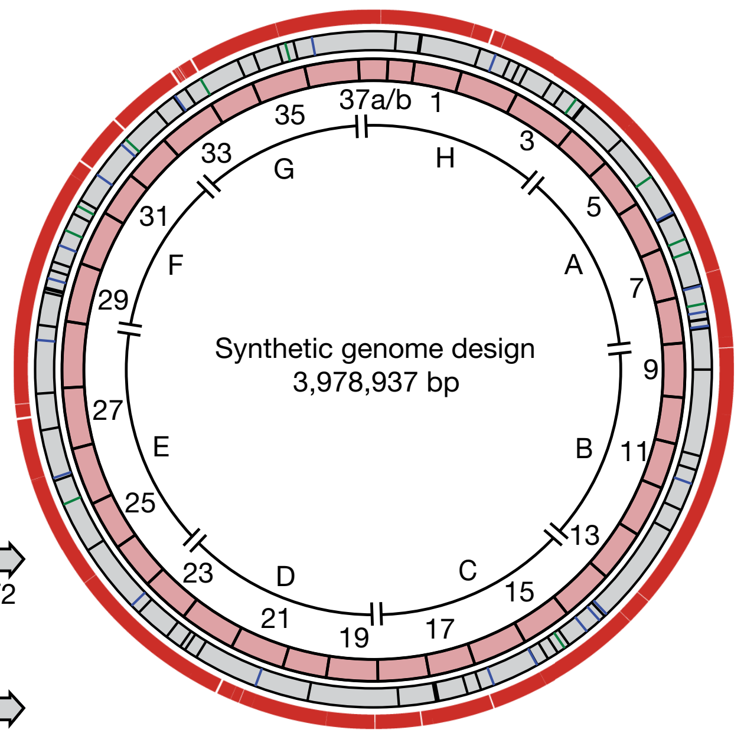
E. coli has also been completely synthesized & “rebooted”
→ Recoded 18,214 codons to make a 61 codon genome:
59 for the 20 amino acids + 2 stops
“…demonstrates that life can operate with a reduced number of synonymous sense codons”
Nature 569:514 (2019)

Slide 26
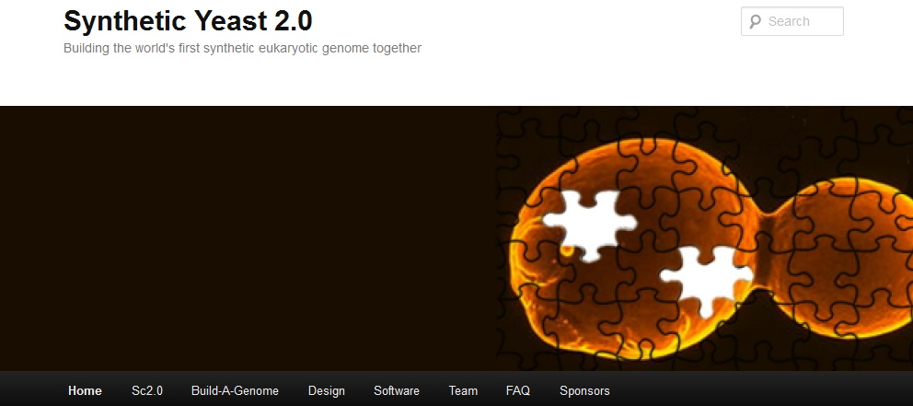
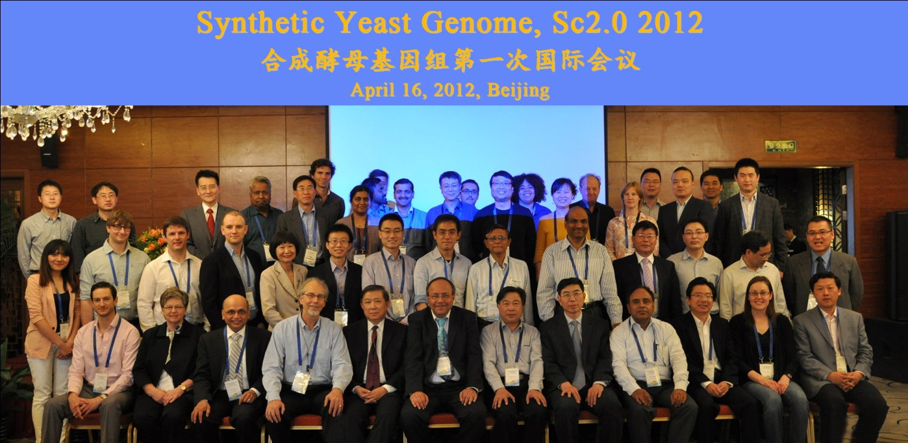
How about eukaryotes?
“rebooting” yeast with synthetic chromosomes
Turns out chromosomes can be synthesized and replaced for yeast too…
The Sc2.0 consortium’s goal is a complete synthetic yeast genome

Slide 27
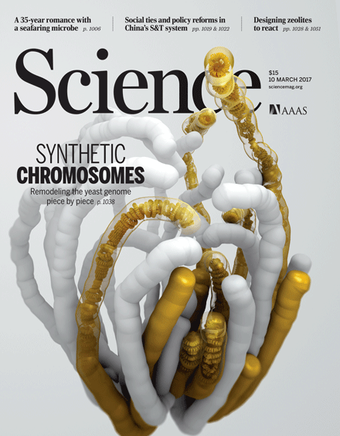
In 2017, the Synthetic Yeast Genome Project (Sc2.0) reported on five newly constructed synthetic yeast chromosomes:
How the cover was made: http://science.sciencemag.org/content/355/6329/eaan1126

Slide 28
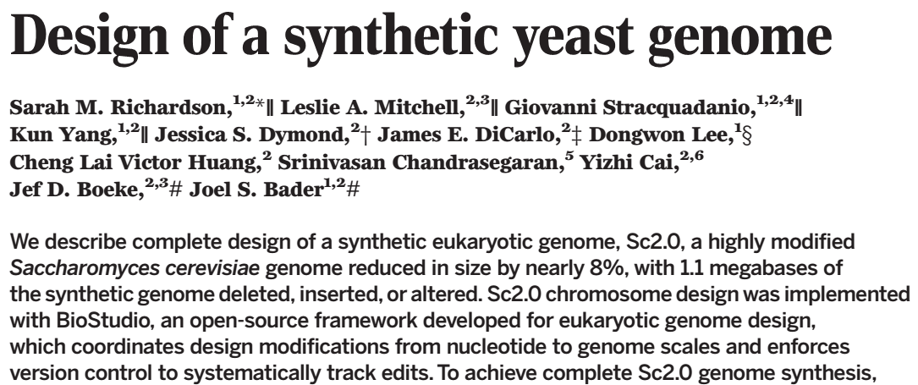
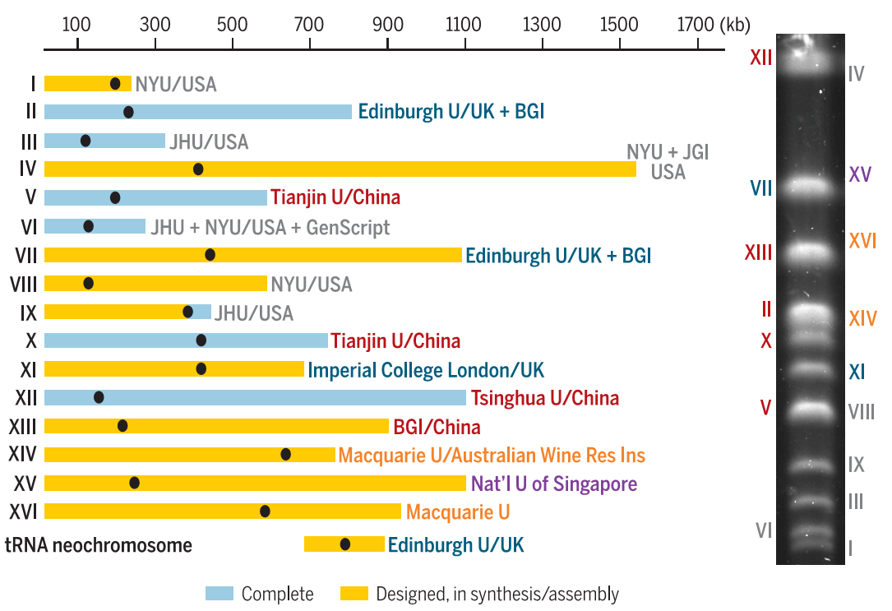

Slide 29
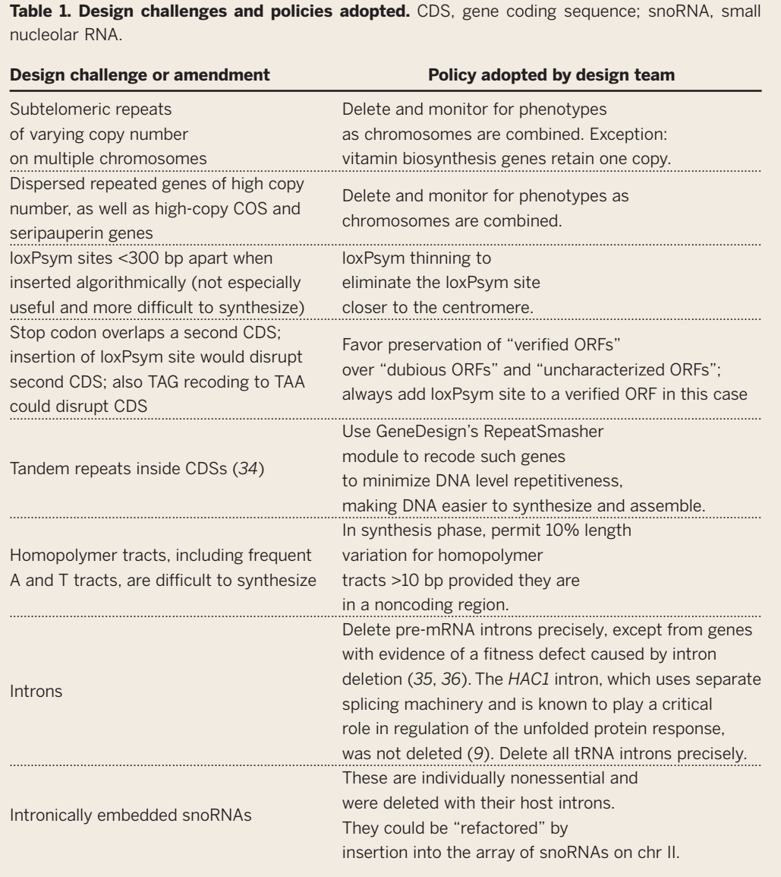

Slide 30
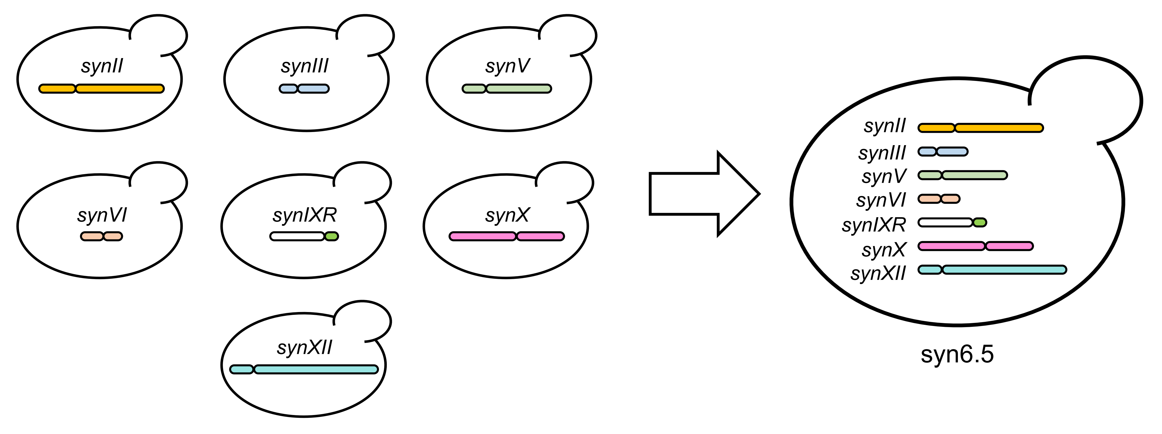
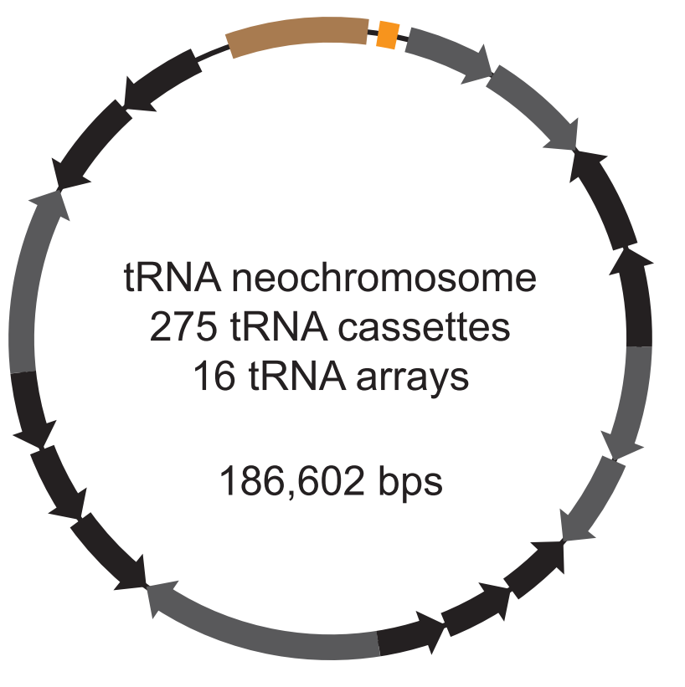
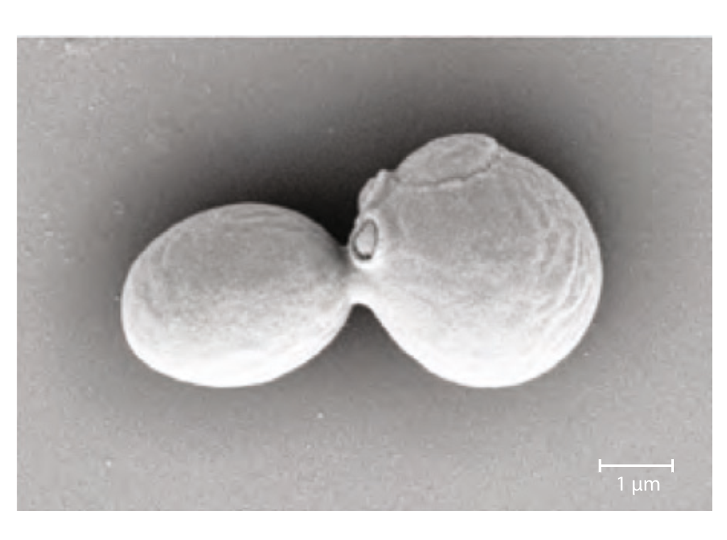
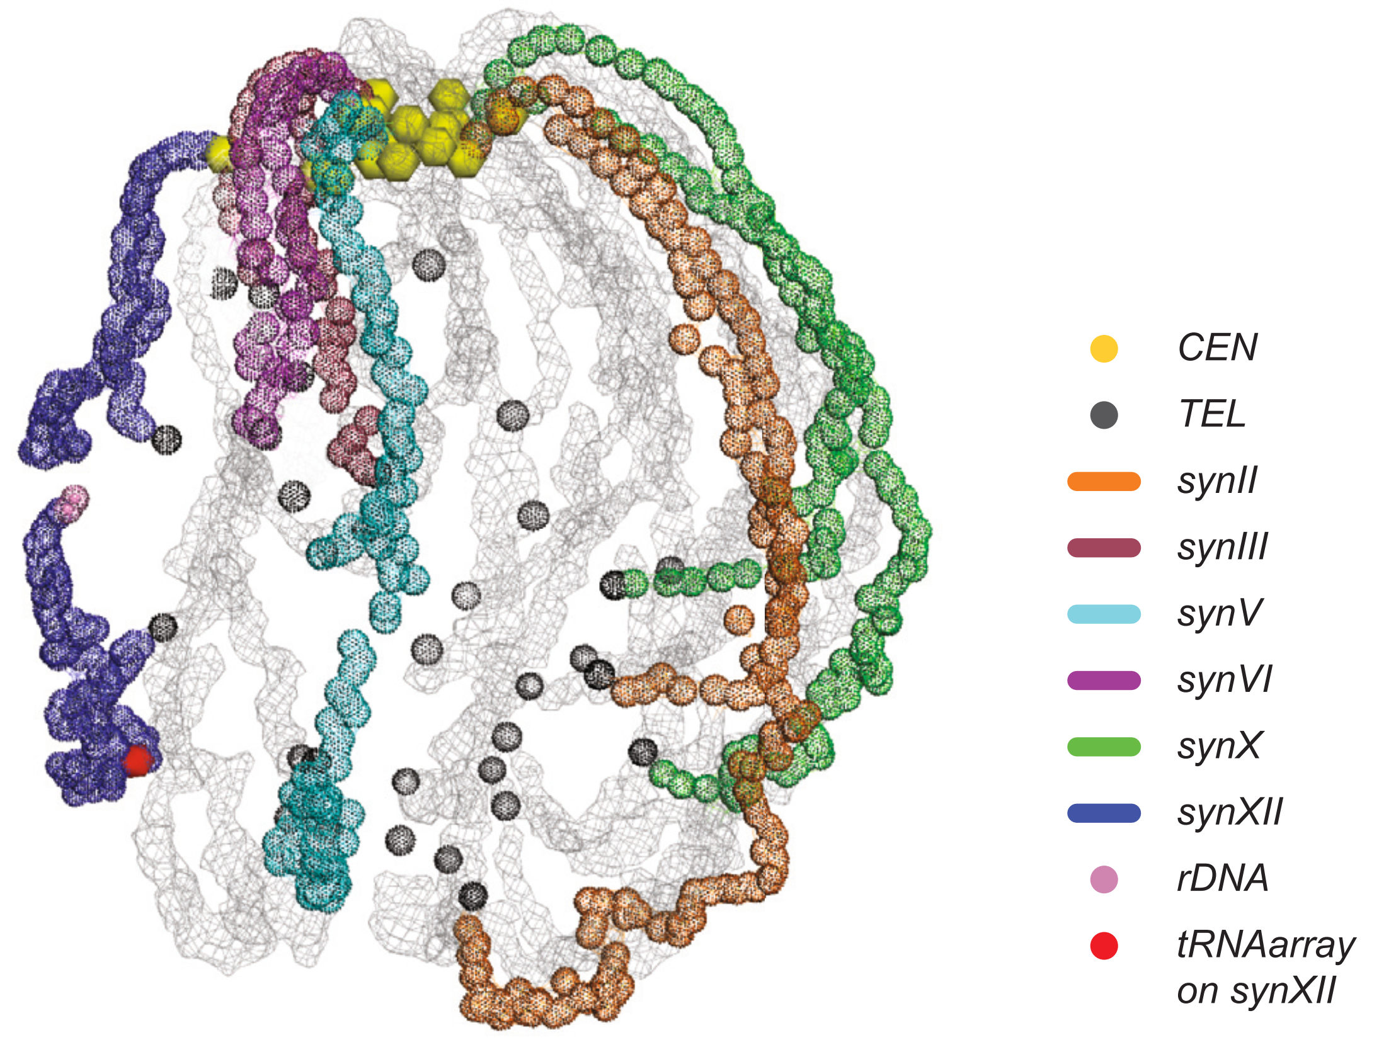
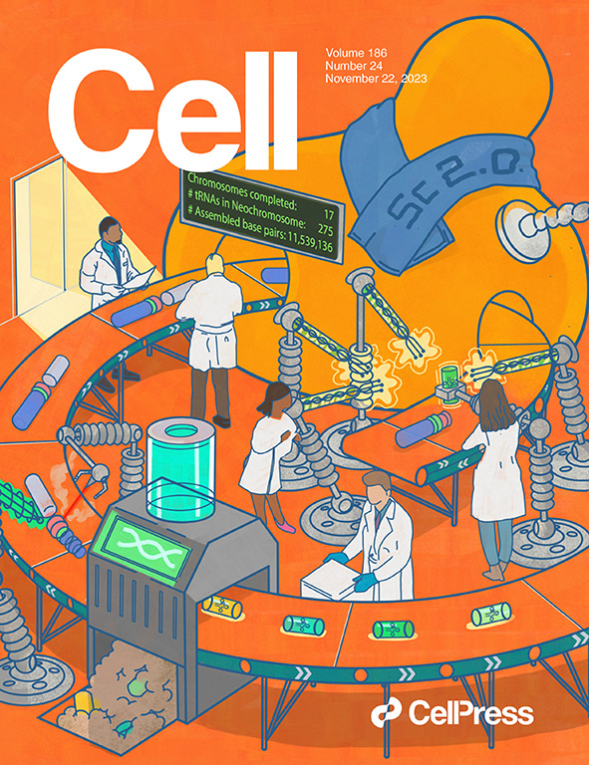
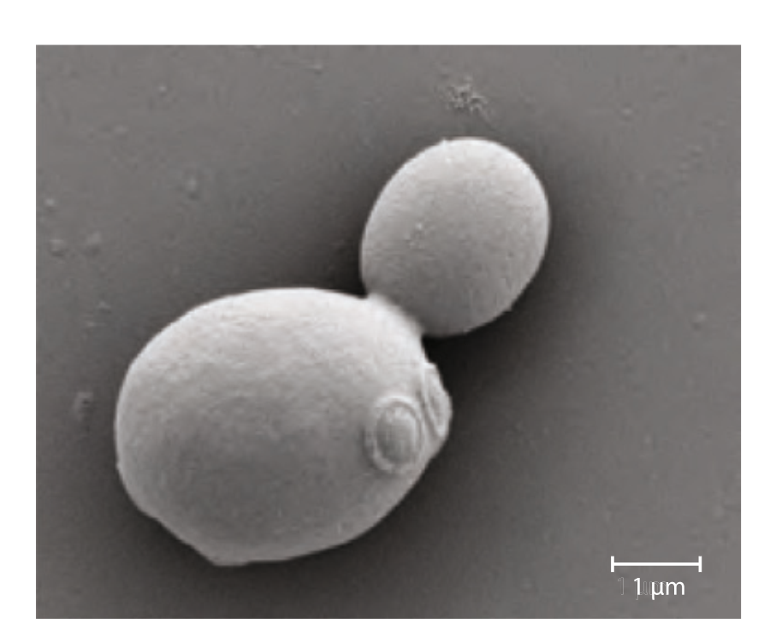
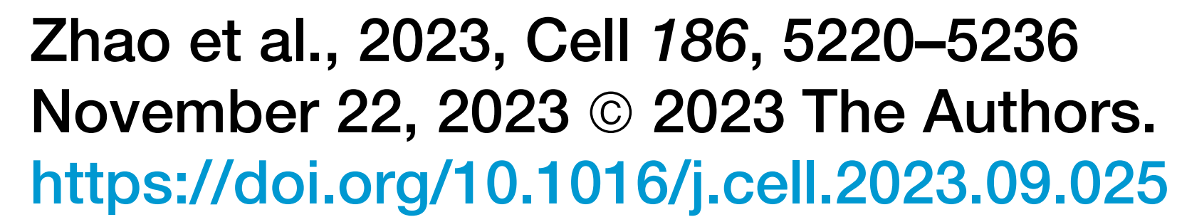
The consortium constructed all pairwise combinations of 7 synthetic chromosomes→the vast majority show no growth defects at 30C, modest at 37C
& moved all 275 tRNAs to a separate chromosome
syn6.5
wild-type

Slide 31
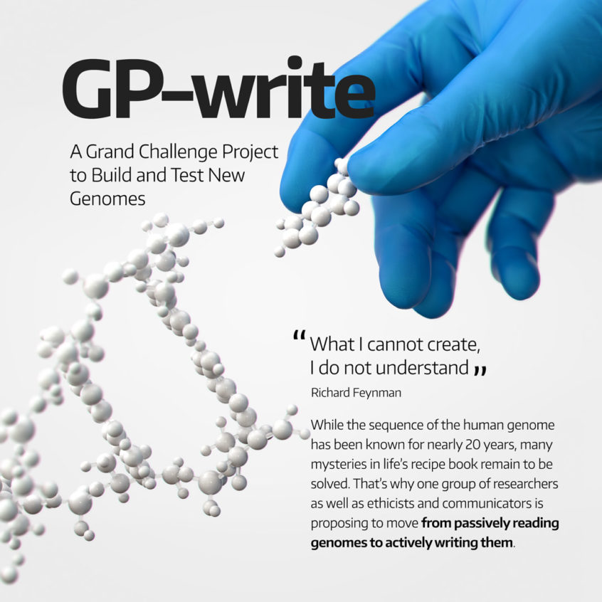
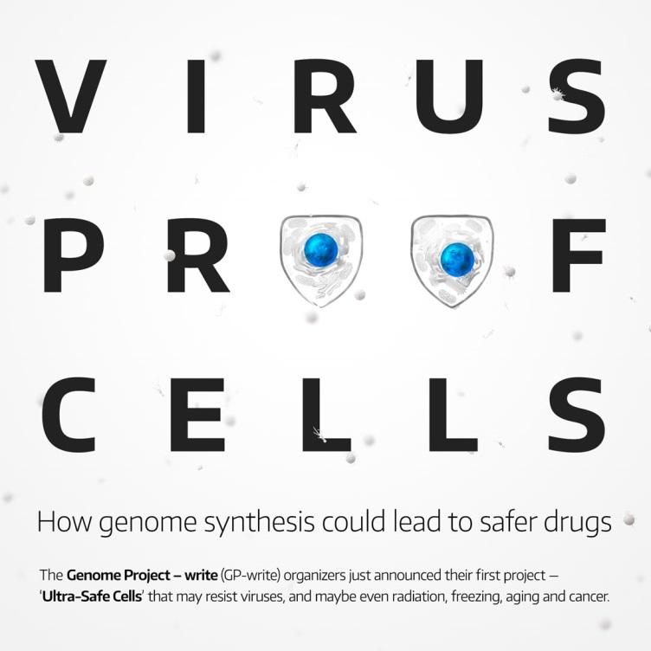
Inevitably (!), the human synthetic genome project:
First major project:
Recoding human codons (~200K edits?) to create virus-resistant cells
https://en.wikipedia.org/wiki/Genome_Project-Write
https://engineeringbiologycenter.org/

Slide 32

Let’s end the lectures on a fun note, with some speculative near-future synthetic biology experiments
Science fiction? or not?
You be the judge!
wikipedia

Slide 33
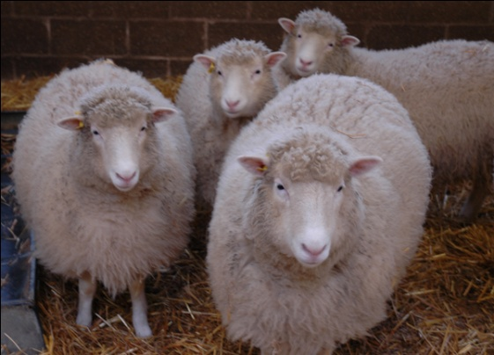
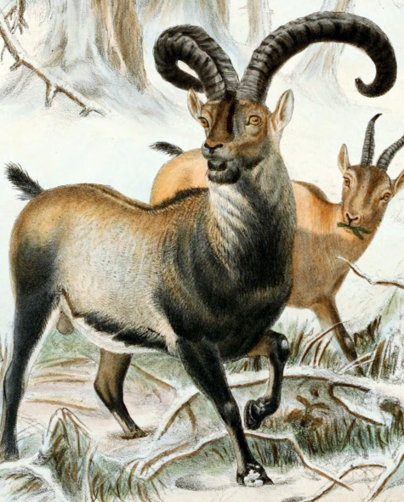
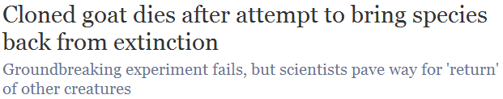
“De-extincting” extinct species
What if the cells being cloned came
from an extinct animal and were put into a surrogate mother?
Would that resurrect the species?
Cian O'Luanaigh
Remember Dolly,
the cloned sheep?
This was tried in 2009 for the Pyrenean ibex, and almost worked…
wikipedia

Slide 34
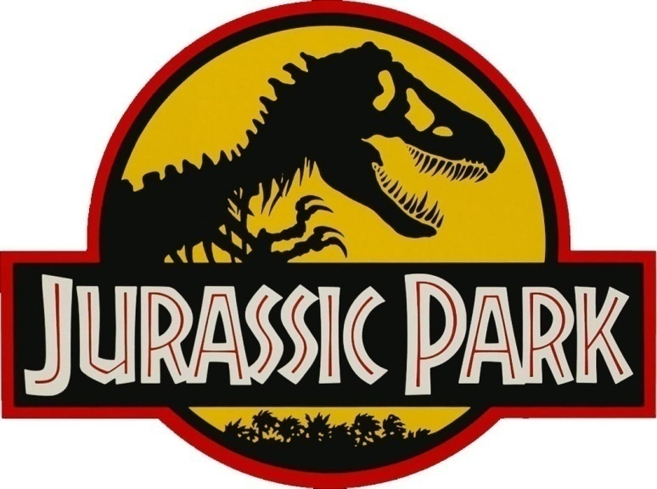
But now there’s another way!
  We can sequence a genome in a few days for a few $K
  We can synthesize or alter big pieces of the DNA
  We can (almost) “reboot” cells with this DNA
  We can convert cells to stem cells to embryos
  We can in vitro fertilize animals
So why not just “edit” the genomes of the closest living animals to be like their extinct relatives?
Sound familiar?
http://jurassicpark.wikia.com

Slide 35
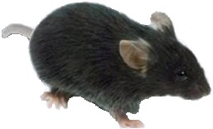



Besides the genome engineering, this hinges on iPS:
From embryonic stem cells, we can grow an entire organism
or any cells/tissues in it
Robert Lanza, ACT
& thanks to Yamanaka, we can convert skin cells back into stem cells
Shinya Yamanaka
Nobel Prize, 2012
www.regenexx.com

Slide 36



There’s a serious proposal to resurrect the woolly mammoth. Here’s the process:
  Mammoth genome sequence
  Make ~100K DNA changes in elephant skin cells to convert elephant skin cells→ mammoth skin cells
  Convert skin cells to stem cells
  Convert stem cells to embryos
  In vitro fertilize elephants
This might be a
hard step.
Actual frozen mammoth!
nationalgeographic.com
www.interestingtopics.net

Slide 37


As of April 2015…
http://www.popsci.com/woolly-mammoth-dna-brought-life-elephant-cells

Slide 38

A team of scientists and entrepreneurs announced on Monday that they have started a new company to genetically resurrect the woolly mammoth.
The company, named Colossal, aims to place thousands of these magnificent beasts back on the Siberian tundra, thousands of years after they went extinct.
Sept. 13, 2021
https://www.nytimes.com/2021/09/13/science/colossal-woolly-mammoth-DNA.html

Slide 39

https://colossal.com/mammoth/

Slide 40





Slide 41




Which animal would you resurrect?
The dodo?
The quagga?
wikipedia
Saber-toothed tiger?
techandle.com
In principle, only need the DNA sequence (so, no dinosaurs)
Aurochs?
wiki

Slide 42






I vote for some crazy Australasian animals:
The 12’
tall
moa
& of, course, the marsupial Tasmanian tiger
>90° !!!
http://www.sandianet.com/kiwi/moabarb.jpg
The moa-eating
Haast’s eagle
wikipedia
Actual
scale!
wikipedia
wikipedia

Slide 43


And sure enough!

Slide 44


What about neanderthal?
It’s achievable. But should we do it?
  Human and neanderthal genome sequence
  Edit DNA in human skin cells to convert convert human skin cells→ neanderthal skin cells
  → I give this step 10 years max before we can do this
  Convert skin cells to stem cells
  Convert stem cells to embryos
  In vitro fertilize
  a surrogate mother
  So many ethical questions!
  Where to start?
Svante
Pääbo
Action Press/Rex Features

