Slide 1
Computational Protein Design
Today’s slides were adapted & edited from sets by:
Clay Kosonocky (UT Austin, “Machine Learning for Biochemical Applications”, https://www.biomlsociety.org/seminar)
&
Joe Watson/David Juergens (Uwashington, “RFDiffusion: Accurate protein design using structure prediction and diffusion generative models”, https://www.youtube.com/watch?v=wIHwHDt2NoI)
BCH394P/364C Systems Biology / Bioinformatics
Edward Marcotte, Univ of Texas at Austin

Slide 2
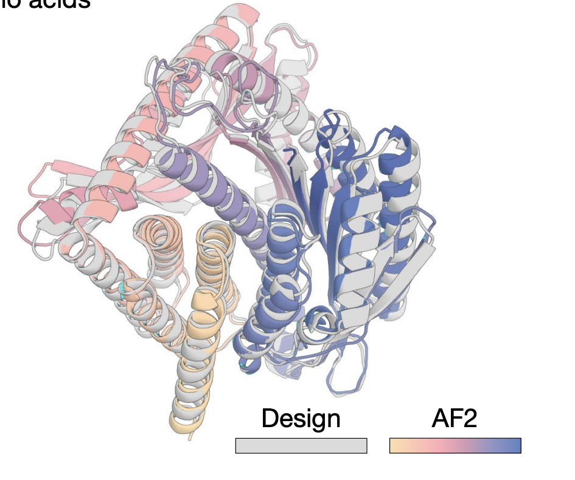
Why design new proteins?
Function
Create enzymes & binders not found in nature
Structure
Creating symmetric assemblies
Remove / modify antigenic structures
Property Optimization (stability, expression, etc.)
Redesign natural enzymes to work at higher temp, survive organic solvents, bind new substrates, etc
How do we design new proteins?
Modified from Clay Kosonocky
Watson, Juergens, Bennett, Trippe, Yim, Eisenach, Ahern et al., Nature 620:1089-1100 (2023)

Slide 3
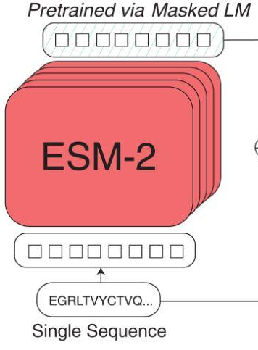
This is a rich field with decades of effort. We’re not going to review it. Instead, we’ll focus only on recent efforts using ML (=AI) for protein design by leveraging AlphaFold/RosettaFold/ESMFold. For example, language models like ESM2 can predict single amino substitutions:
M N K F K G N K V V …
Predict w/ model
M N K F K [?] N K V V …
Mask residue
M N K F K T N K V V …
Modified from Clay Kosonocky
Lin et al, Science 379:1123-1130 (2023)

Slide 4
This is a rich field with decades of effort. We’re not going to review it. Instead, we’ll focus only on recent efforts using ML (=AI) for protein design by leveraging AlphaFold/RosettaFold/ESMFold. For example, language models like ESM2 can predict single amino substitutions:
Why should this do anything?
Learned evolutionary information used to predict when nature “messed up”
Modified from Clay Kosonocky
Lin et al, Science 379:1123-1130 (2023)

Slide 5
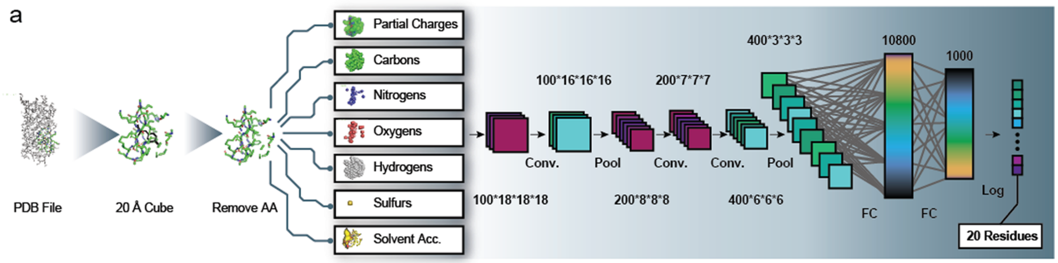
Similarly, substitutions can be predicted using a self-supervised structural approach
MutCompute Architecture
Predicts amino acid changes that would be expected to be preferred at a given position based on the structural environment
Modified from Clay Kosonocky
Shroff et al. ACS Synth. Biol. 9:2927–2935 (2020)

Slide 6
Amino acid segments can also be redesigned using LLMs
M N K H I G M K V V …
Predict w/ model
M N [ ? ] V V …
Mask span
M N K F K T N K V V …
Figures from Lin et al. 2022 & Dauparas et al. 2022
Slide from Clay Kosonocky

Slide 7
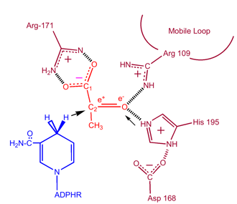
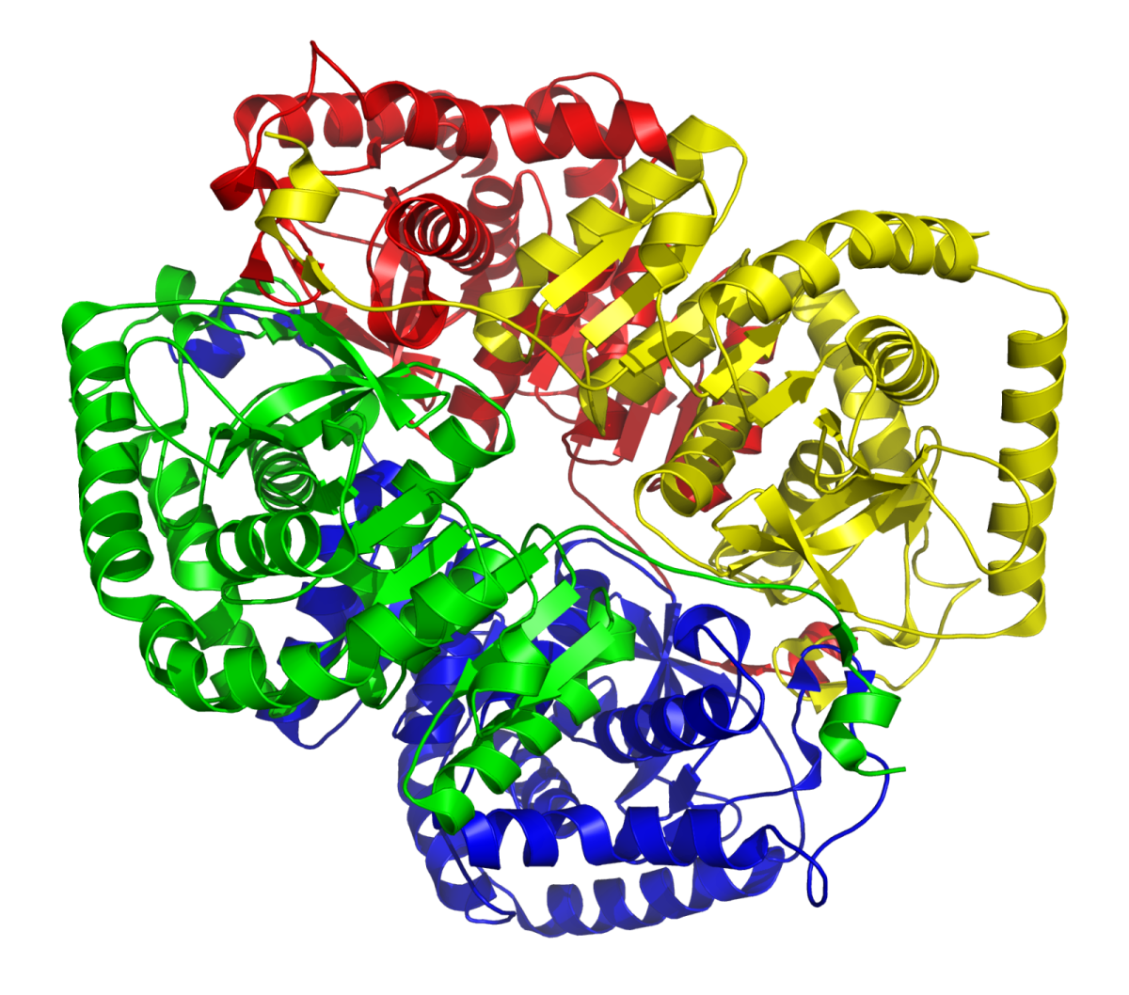
For complete redesigns, we can instead consider the following structure-based workflow for ML protein design:
Backbone Design
Inverse Folding
MNKFKGNKVVLIGNGAVGSSYAFSLVNQSIVD…
Lactate dehydrogenase
Protein function
Protein backbone
Amino acid sequence
Modified from Clay Kosonocky

Slide 8
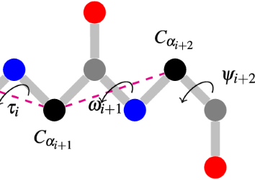
Backbone design
Which backbone will give us the desired function?
Backbone Design
Lactate dehydrogenase
Protein function
Protein backbone
Slide from Clay Kosonocky

Slide 9
Inverse folding
Which amino acid sequence will give us the desired backbone?
Inverse Folding
MNKFKGNKVVLIGNGAVGSSYAFSLVNQSIVD…
Protein backbone
Amino acid sequence
Slide from Clay Kosonocky

Slide 10
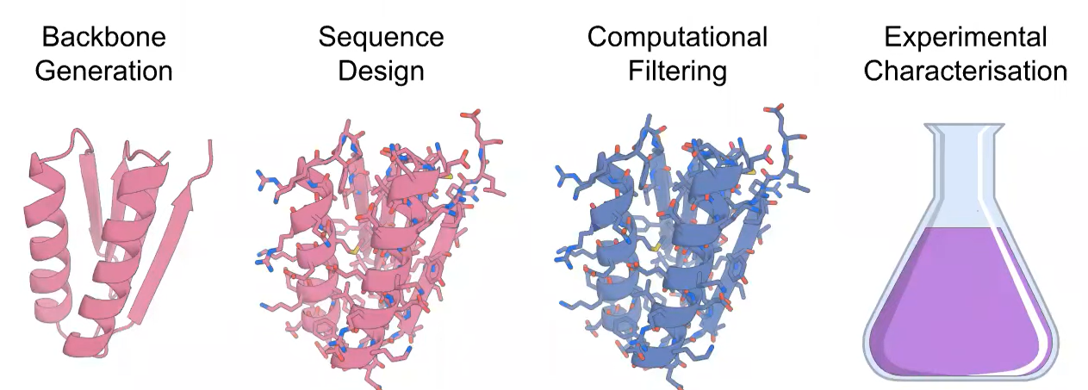
In practice, these steps can be carried out in the following way:
AlphaFold2
RoseTTAFold
ESMFold
OmegaFold
Clone, express, purify ~100 clones
RFDiffusion
ProteinMPNN
Joe Watson & David Juergens
https://www.youtube.com/watch?v=wIHwHDt2NoI

Slide 11
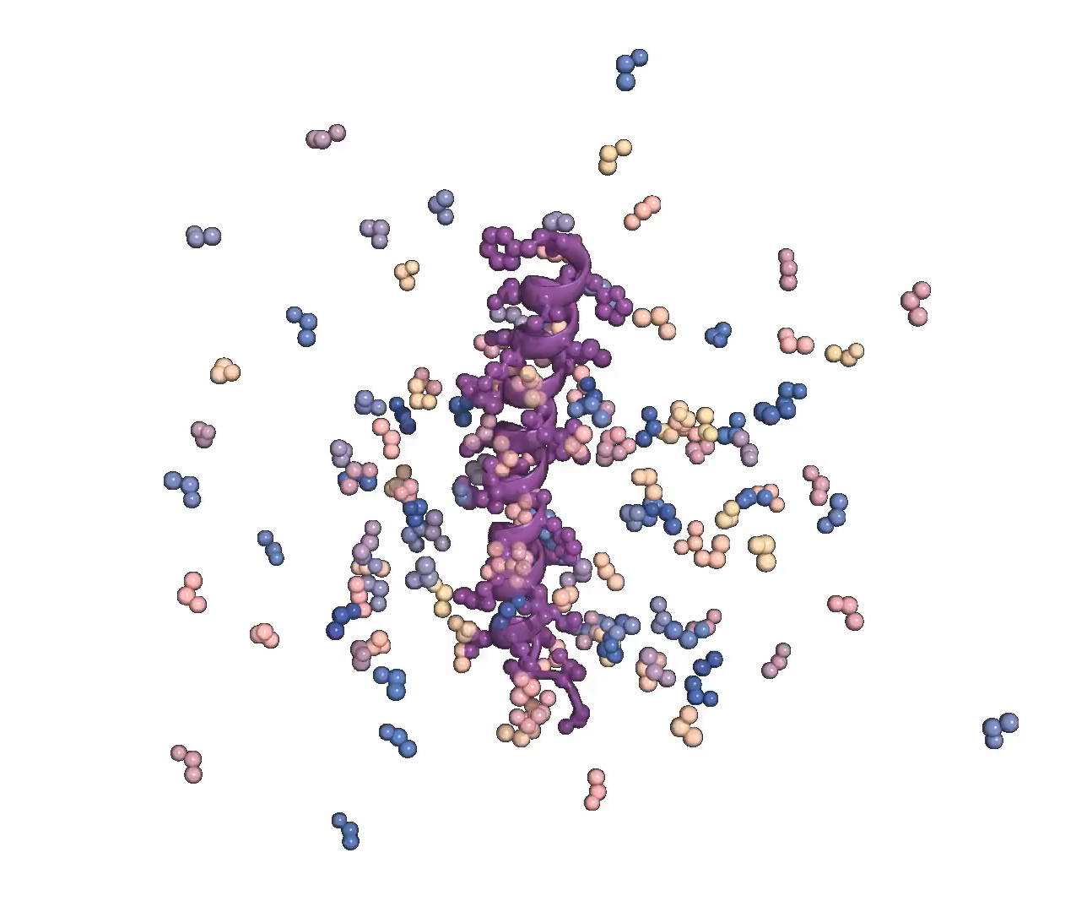

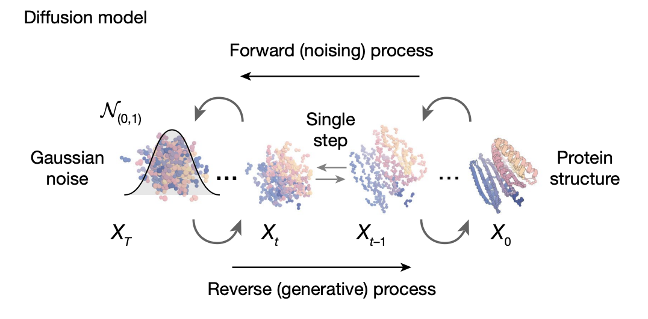
Protein backbone design: RFdiffusion
+
Slide from Clay Kosonocky
Watson, Juergens, Bennett, Trippe, Yim, Eisenach, Ahern et al., Nature 620:1089-1100 (2023)

Slide 12
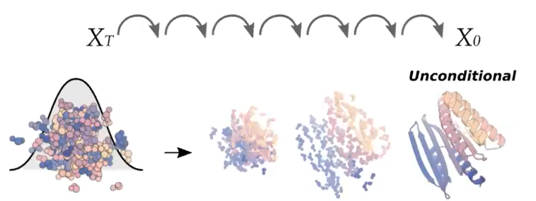
RFdiffusion can generate entirely new folds starting from noise
Slide from Clay Kosonocky
Watson, Juergens, Bennett, Trippe, Yim, Eisenach, Ahern et al., Nature 620:1089-1100 (2023)

Slide 13
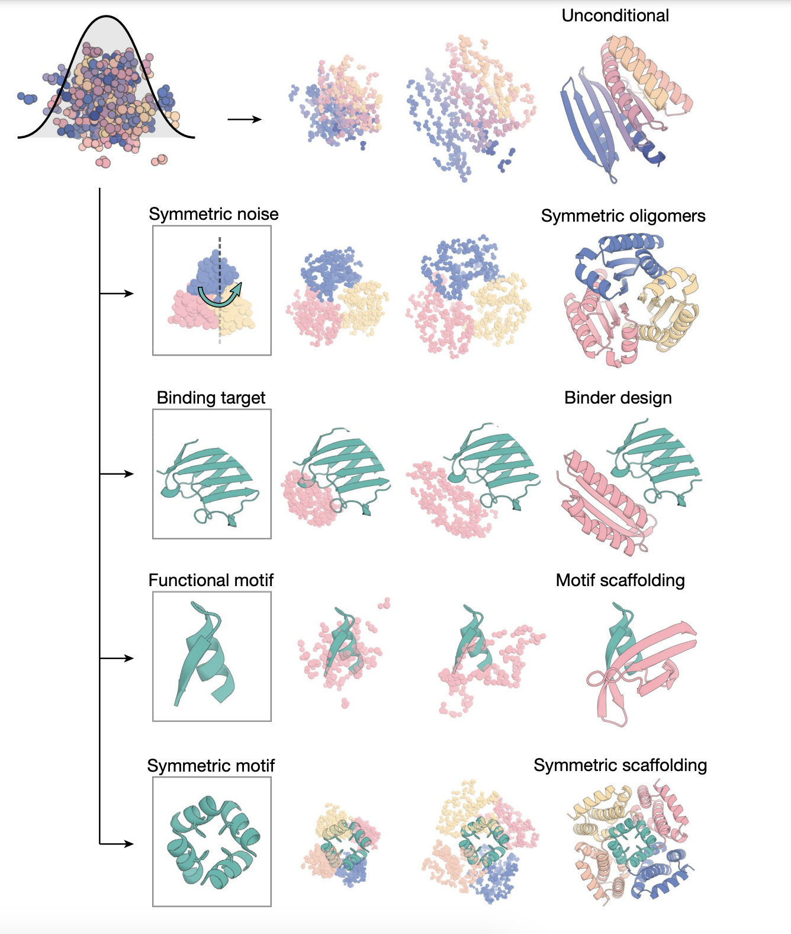
RFdiffusion can also conditionally generate new backbones, e.g. :
Slide from Clay Kosonocky
Watson, Juergens, Bennett, Trippe, Yim, Eisenach, Ahern et al., Nature 620:1089-1100 (2023)

Slide 14
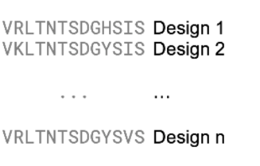
Combining RFdiffusion for backbone design + ProteinMPNN for amino acid sequence selection
RFdiffusion
ProteinMPNN
Noise
Backbone
Sequences
Slide from Clay Kosonocky
Figures from Watson et al. 2023 & Dauparas et al. 2022

Slide 15
Before we look at how these models work,
let’s try a live demo of RFDiffusion + MPNN to design 2 proteins designed to bind each other
https://colab.research.google.com/github/sokrypton/ColabDesign/blob/main/rf/examples/diffusion.ipynb

Slide 16
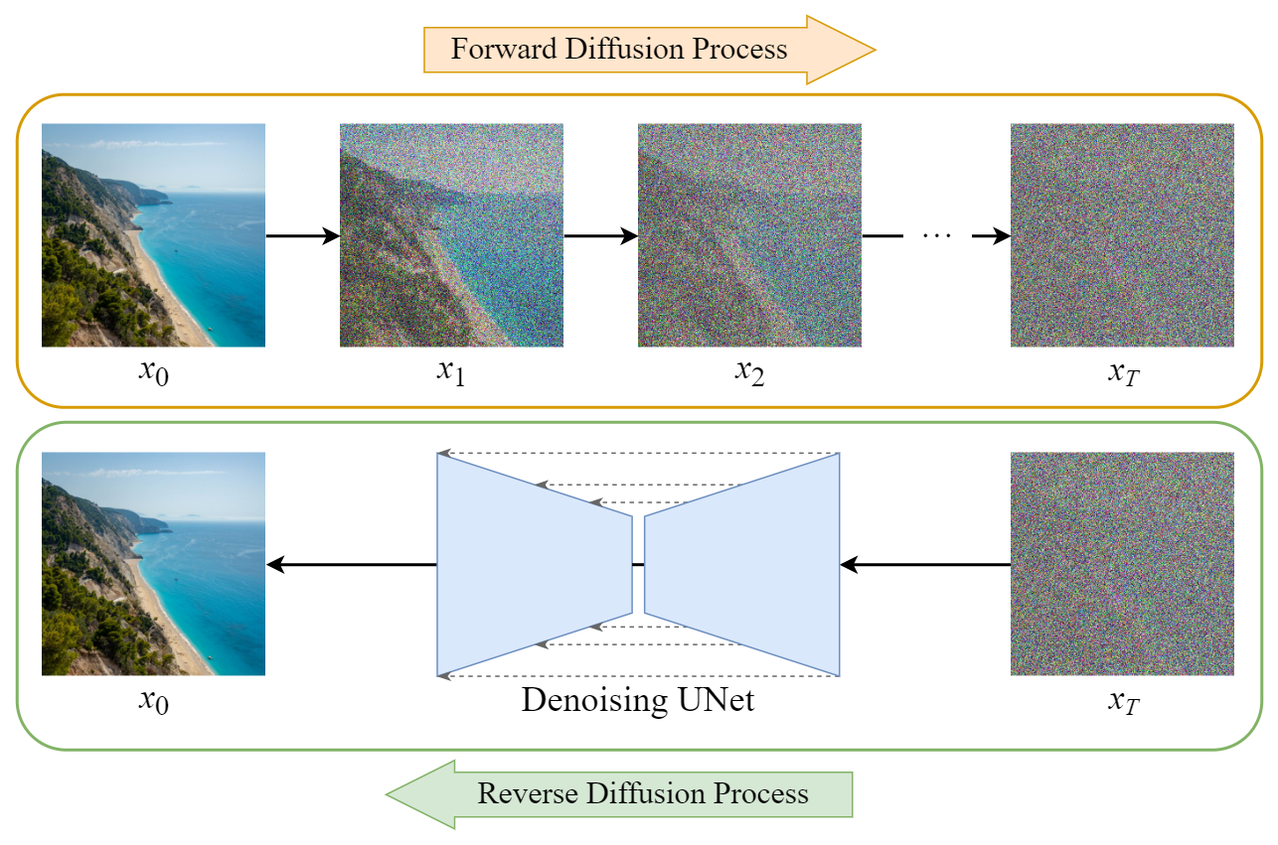
RFDiffusion is an example of a diffusion model, e.g.:
https://medium.com/@steinsfu/diffusion-model-clearly-explained-cd331bd41166#b614
The key idea is to add “structured” noise to data (like images) in a series of consecutive time steps = Gaussian noise of known variance. Then, train a NN to undo this noise. If starting from a full noise starting point, this process will then converge the image to something that resembles starting training data
Modified from Clay Kosonocky

Slide 17
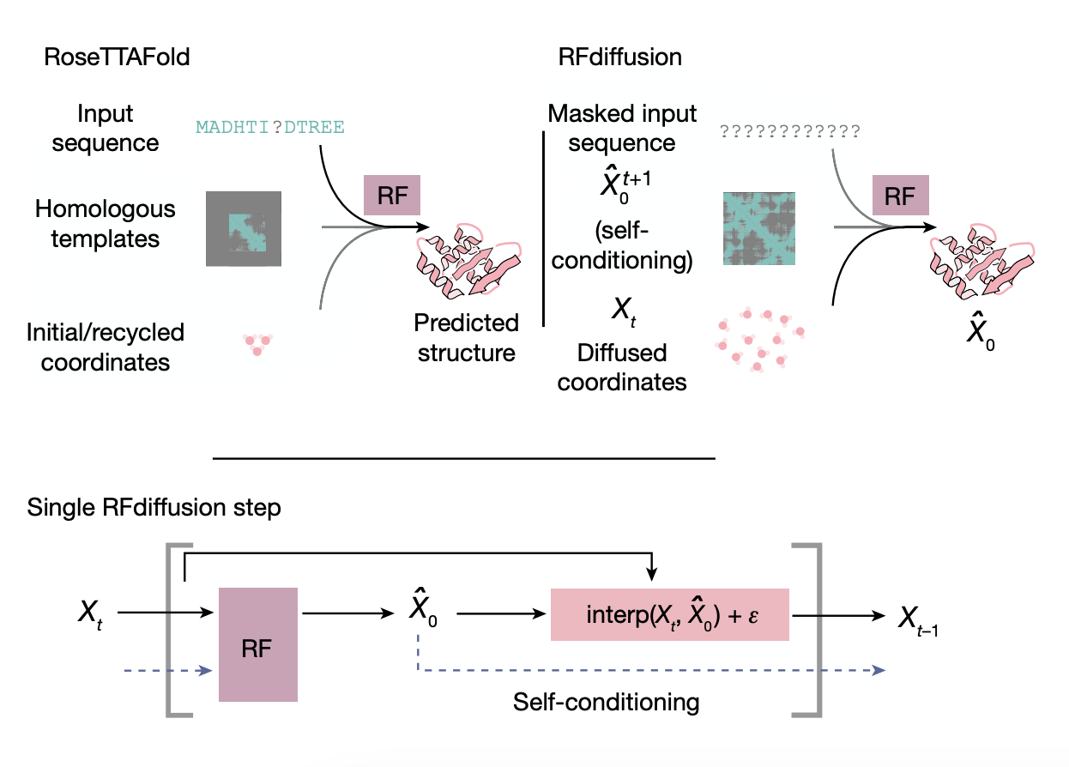
RFdiffusion architecture
Essentially, Watson et al. took the RoseTTAFold architecture and model parameters and fine tuned on the denoising task:
Slide from Clay Kosonocky
Watson, Juergens, Bennett, Trippe, Yim, Eisenach, Ahern et al., Nature 620:1089-1100 (2023)

Slide 18
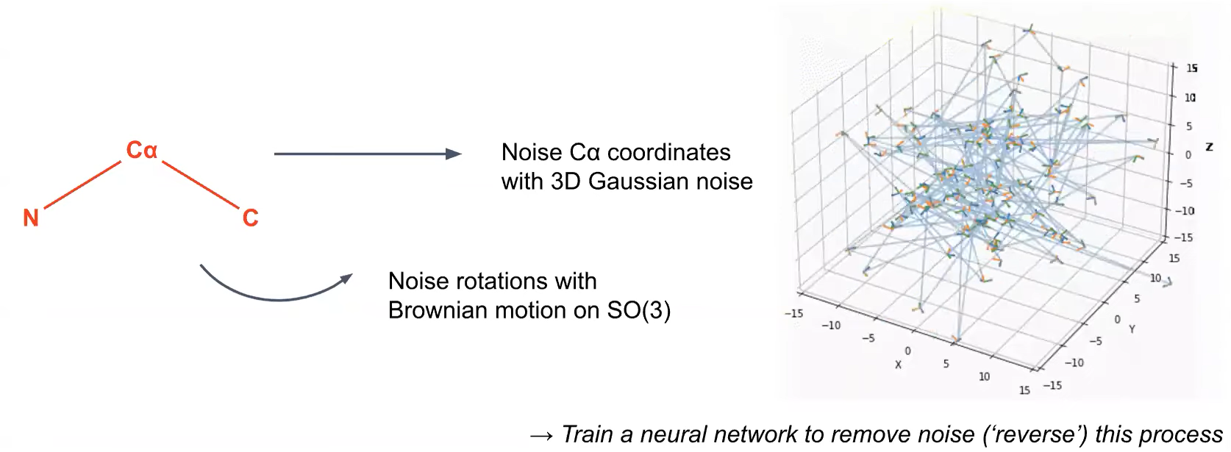
RFDiffusion treats each peptide bond N-Cα-C as a triangle, a simple representation that retains full information about the backbone, then “diffuses” (translates and rotates) these triangles
Slide from Jason Lim via the Watson/Juergens lecture

Slide 19
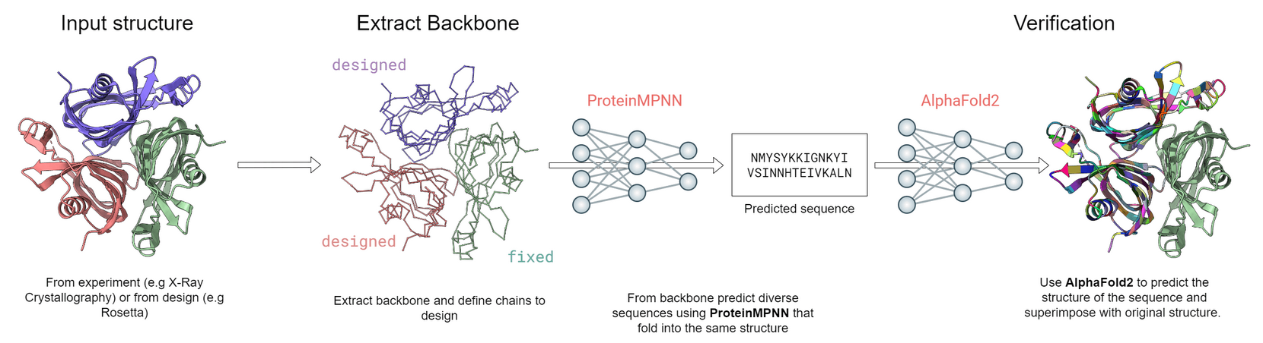
ProteinMPNN generates amino acid sequences for backbones
Input = a protein structure (just needs the backbone)
Output = predicts new sequences that should fold into that backbone
Live Demo: https://huggingface.co/spaces/simonduerr/ProteinMPNN
https://doi.org/10.5281/zenodo.7630417
ProteinMPNN paper: Dauparas et al. Science 378, 49–56 (2022)

Slide 20
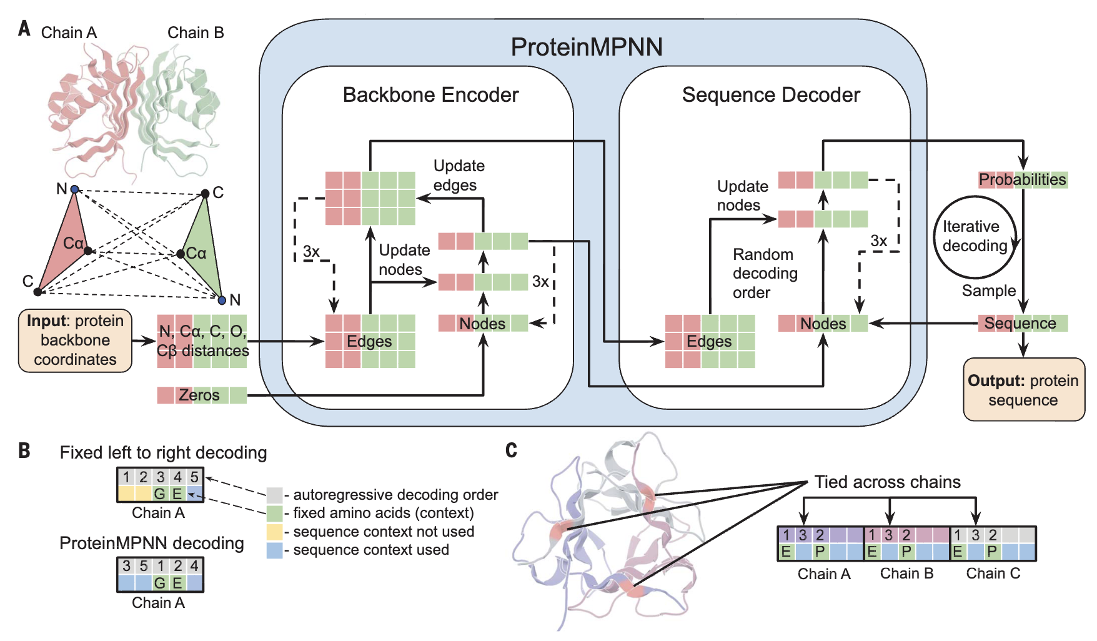
ProteinMPNN architecture
Encoder encodes the backbone features,
the decoder runs iteratively to predict each aa
~1.7M parameters (vs ~100M for alphafold), trained on 1 A100 for 2 days
Figure from Dauparas et al. 2022

Slide 21
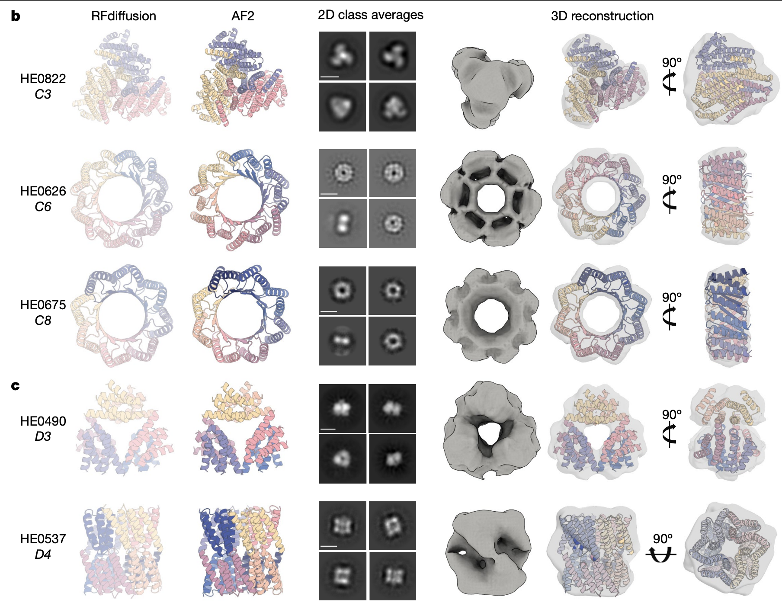
Designs: Symmetric assemblies
Slide from Clay Kosonocky
Watson, Juergens, Bennett, Trippe, Yim, Eisenach, Ahern et al., Nature 620:1089-1100 (2023)

Slide 22
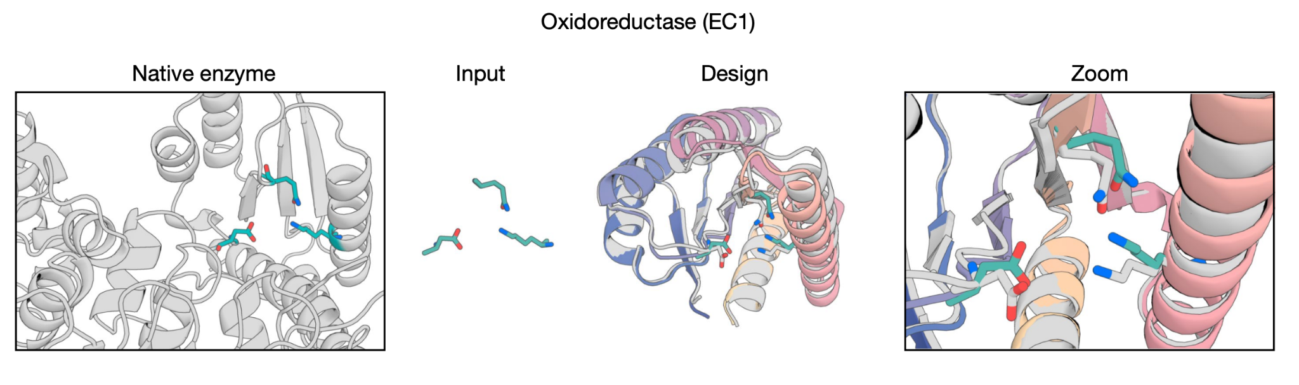
Designs: Constrained active site
Slide from Clay Kosonocky
Watson, Juergens, Bennett, Trippe, Yim, Eisenach, Ahern et al., Nature 620:1089-1100 (2023)

Slide 23
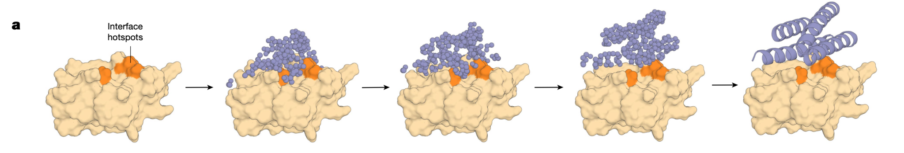
Designs: Protein binders
Slide from Clay Kosonocky
Watson, Juergens, Bennett, Trippe, Yim, Eisenach, Ahern et al., Nature 620:1089-1100 (2023)

Slide 24
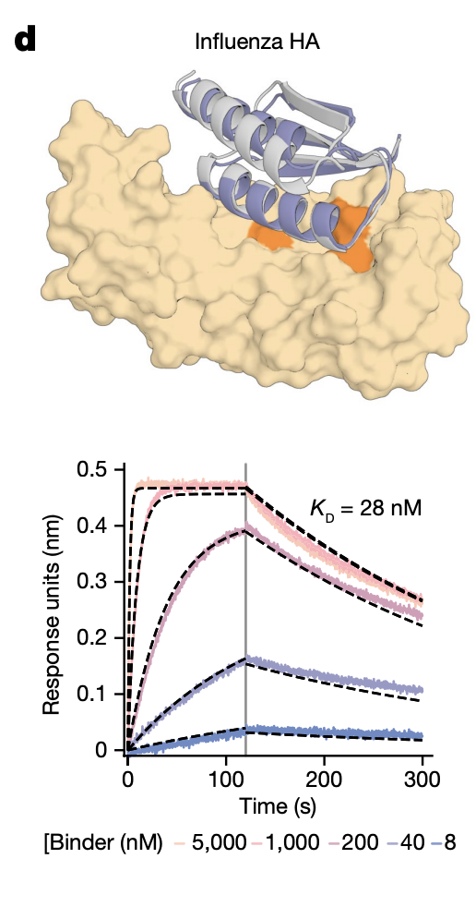
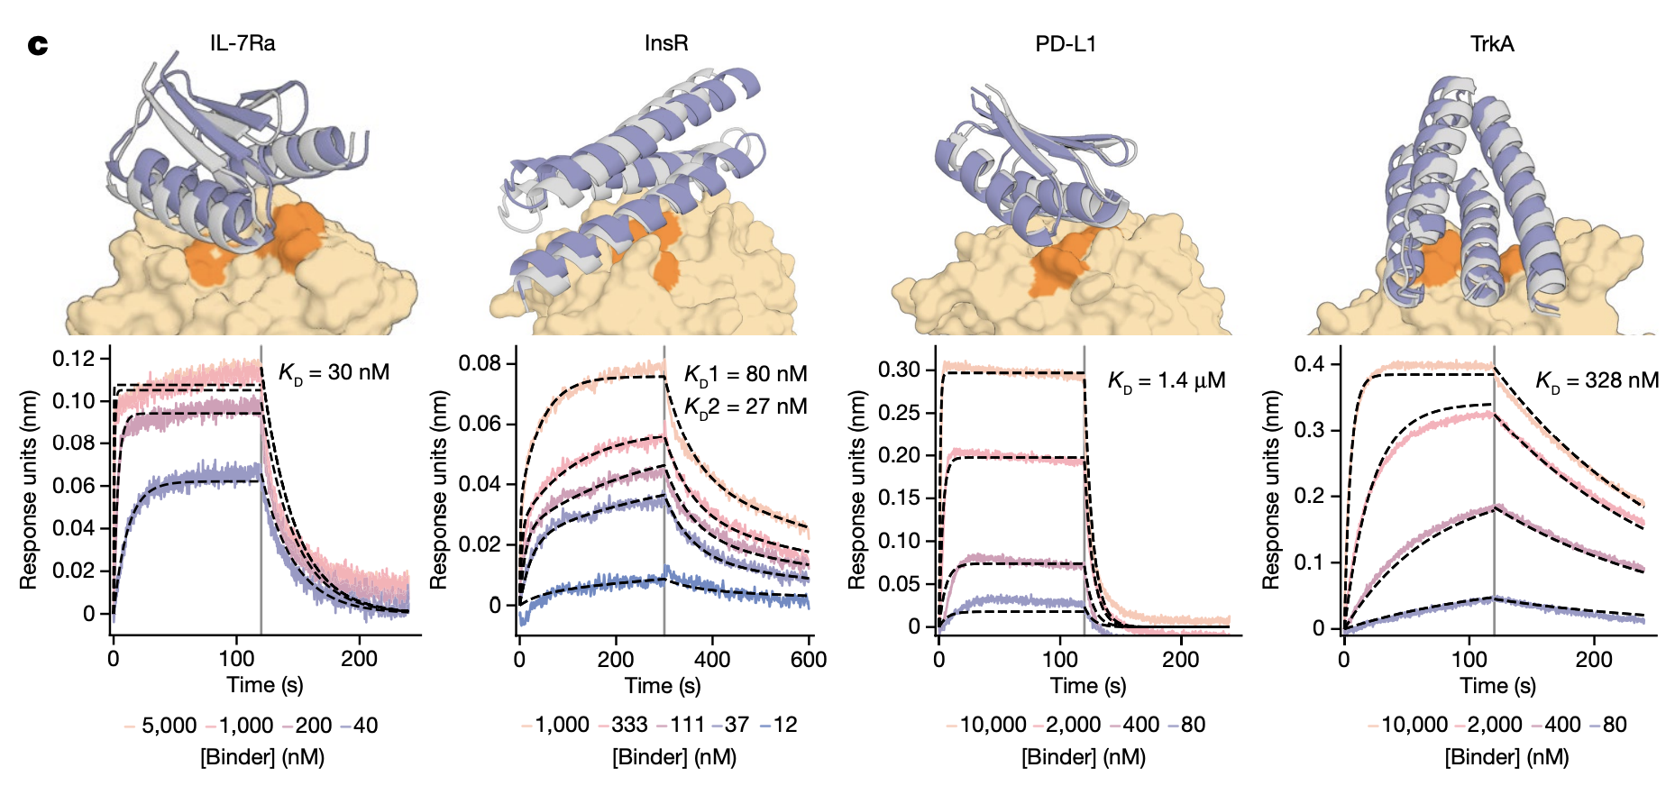
Protein binder experimental validation
Slide from Clay Kosonocky
Watson, Juergens, Bennett, Trippe, Yim, Eisenach, Ahern et al., Nature 620:1089-1100 (2023)

Slide 25
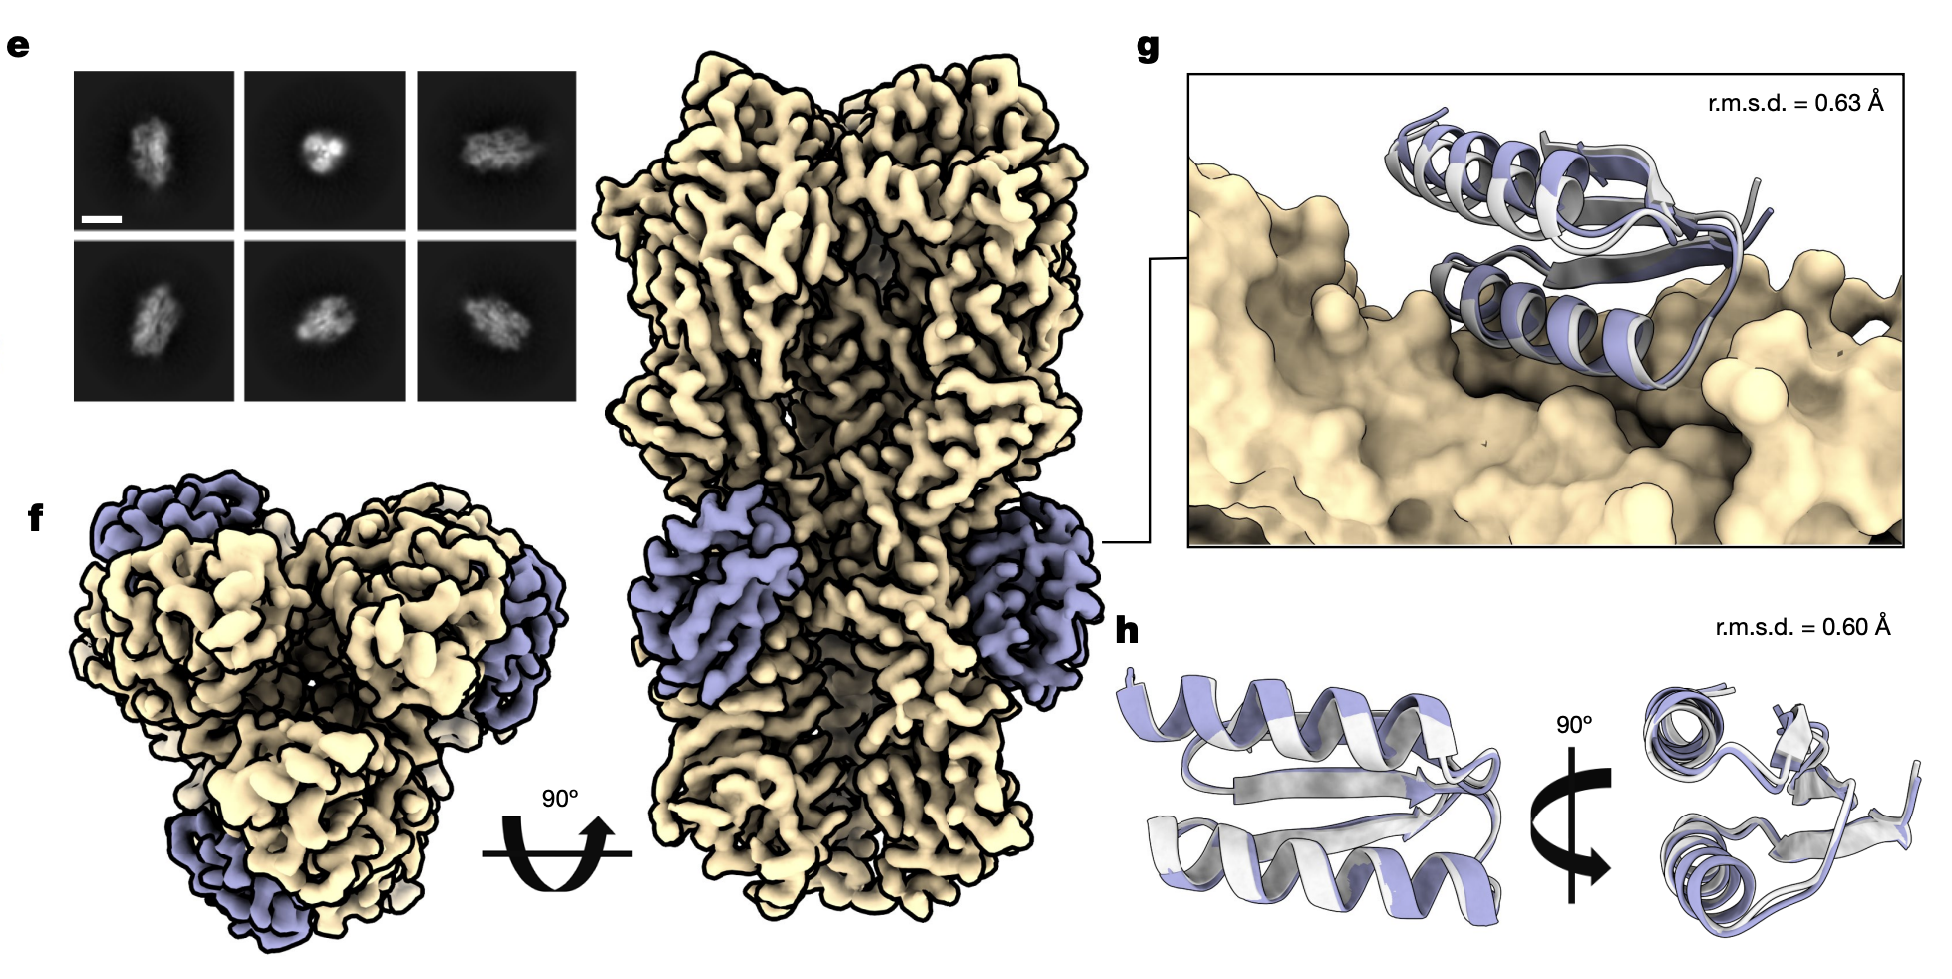
Influenza Haemagglutinin (HA) binder structure
Slide from Clay Kosonocky
Watson, Juergens, Bennett, Trippe, Yim, Eisenach, Ahern et al., Nature 620:1089-1100 (2023)

Slide 26
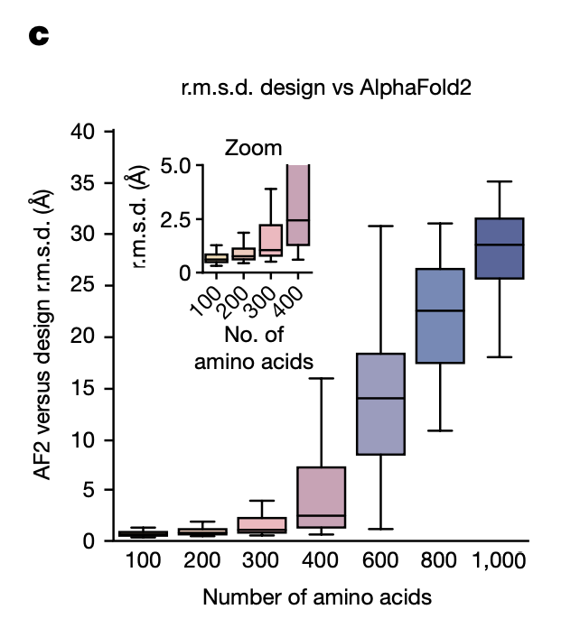
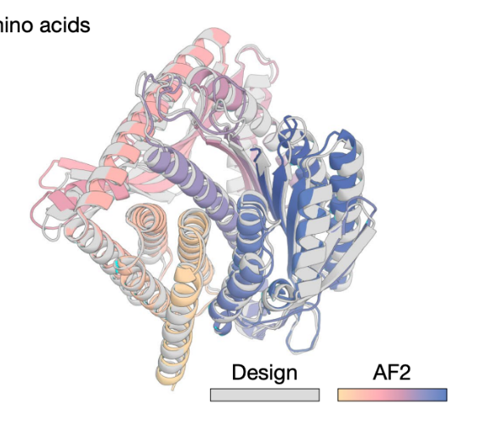
Rfdiffusion+MPNN designs can be independently computationally verified with AlphaFold
Slide from Clay Kosonocky
Watson, Juergens, Bennett, Trippe, Yim, Eisenach, Ahern et al., Nature 620:1089-1100 (2023)

Slide 27
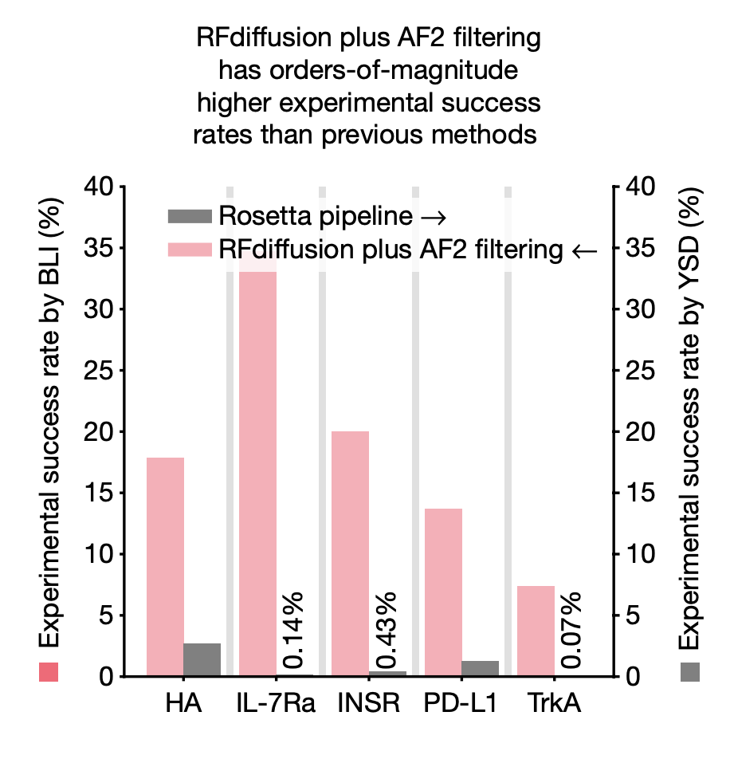
RFdiffusion + AF filtering outperforms previous methods
Slide from Clay Kosonocky
Watson, Juergens, Bennett, Trippe, Yim, Eisenach, Ahern et al., Nature 620:1089-1100 (2023)

Slide 28
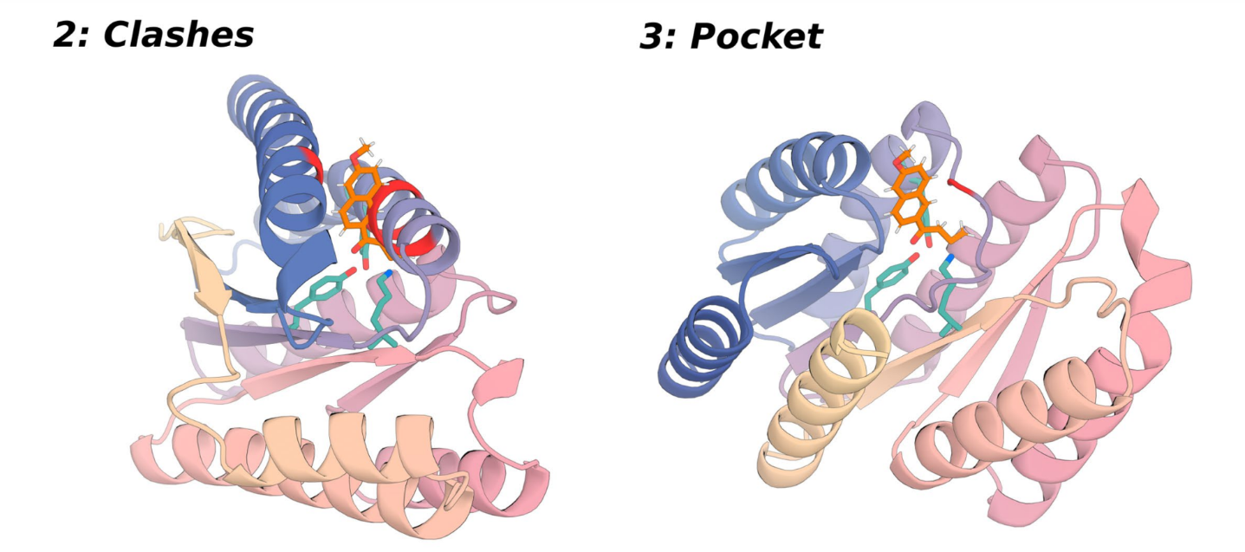
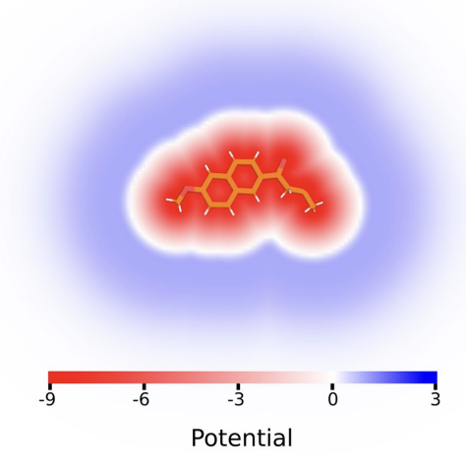
Ligands are not explicitly modeled in RFdiffusion, but…
Slide from Clay Kosonocky
Watson, Juergens, Bennett, Trippe, Yim, Eisenach, Ahern et al., Nature 620:1089-1100 (2023)

Slide 29
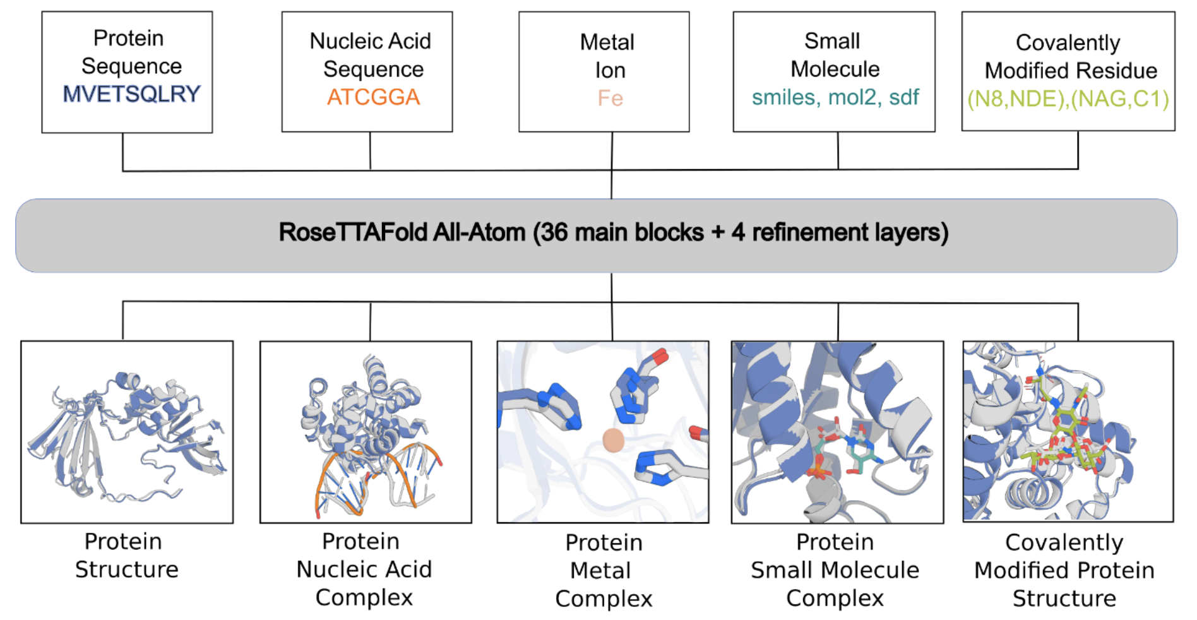
…they are in the new RoseTTAFold All-Atom release
Slide from Clay Kosonocky
Krishna et al, Science March 7, 2024 DOI: 10.1126/science.adl2528

Slide 30
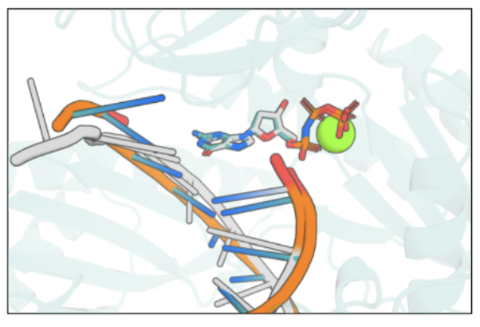
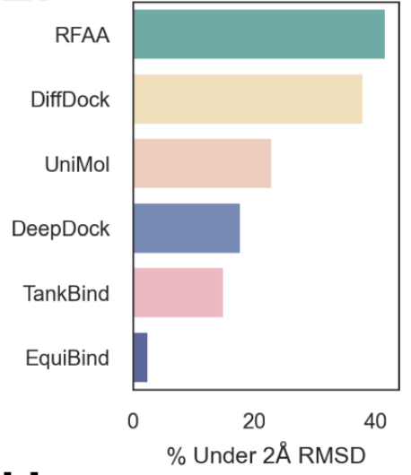
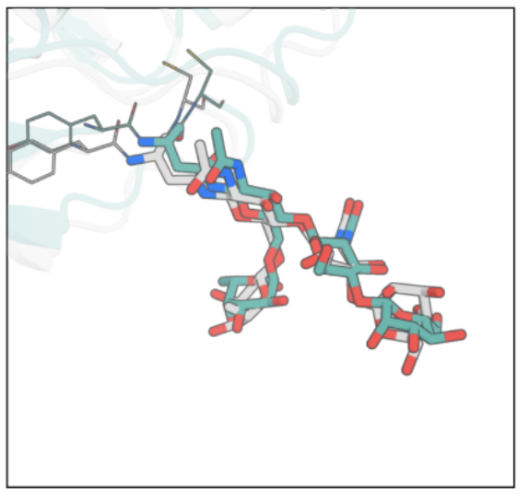
RoseTTAFold All-Atom does… everything?
Structure prediction for
Proteins
Nucleic acid sequence
Metal ions
Small molecules (docking)
Post-translational modifications
Protein design
Ligand-conditioned
Slide from Clay Kosonocky
Krishna et al, Science March 7, 2024 DOI: 10.1126/science.adl2528

Slide 31
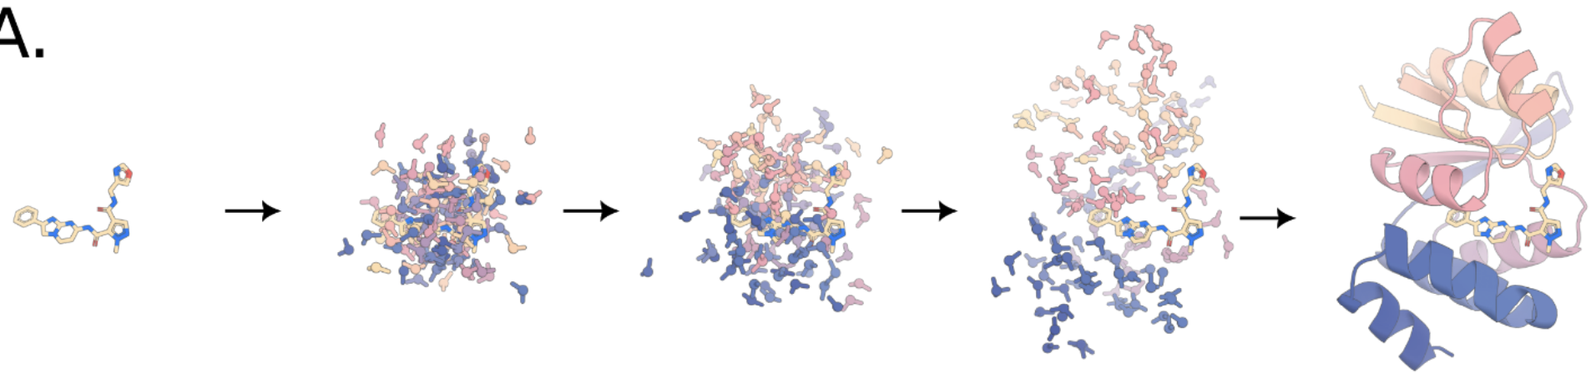
Similarly, now there’s Rfdiffusion All-Atom (RFdiffusionAA)
RFAA can be converted to a diffusion model just like RoseTTAFold
Slide from Clay Kosonocky
Krishna et al, Science March 7, 2024 DOI: 10.1126/science.adl2528

Slide 32
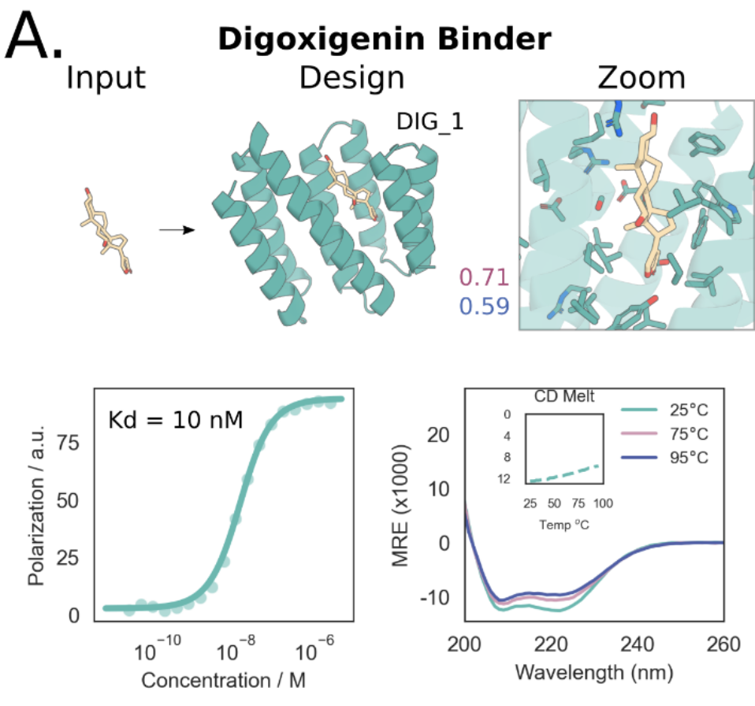
RFdiffusionAA ligand binder design: Digoxigenin
Slide from Clay Kosonocky
Krishna et al, Science March 7, 2024 DOI: 10.1126/science.adl2528

Slide 33
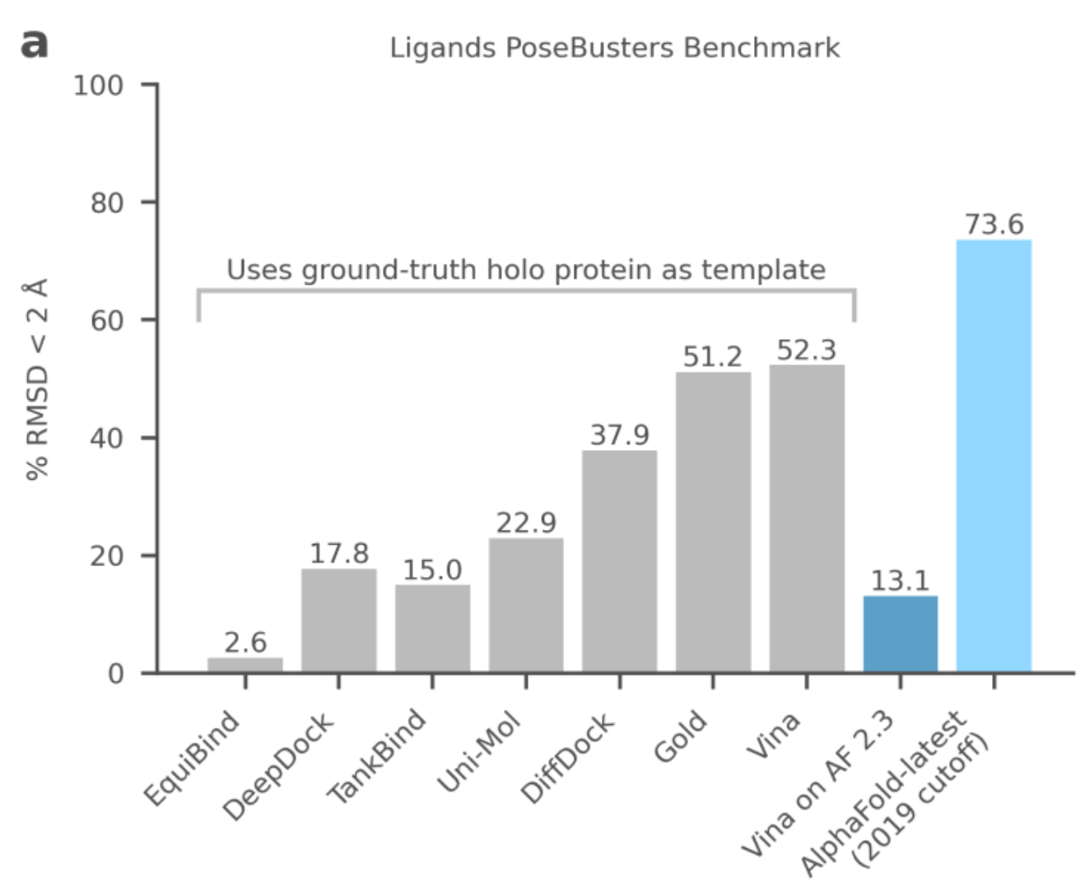
But wait… AlphaFold All Atom wins? (However, it isn’t available publically and hasn’t been independently tested)
Figure from Krishna et al. 2023 & Deepmind
Slide from Clay Kosonocky

Slide 34
Where does this bring us?
Protein design is getting better and better
Conditional generation options growing
Motifs, ligands, active sites, protein binding, etc.
Challenges
Needs broader experimental validation
Designing around conformation changes
Antibody-antigen designs have so far not been generally solved for high affinity binders
Non-immunogenic designs
Modified from Clay Kosonocky

