Slide 1
Protein Structure Prediction
BCH394P/364C Systems Biology/Bioinformatics
April 2, 2024
Daryl Barth

Slide 2
Today’s Goals
Motivation and bit of history on protein structure prediction
CASP
AlphaFold
Metrics you need to know
ColabFold
Demo!
Notes:
Databases of note!
AlphaFold Database, ESMAtlas, UniProt/SwissProt, 3D Beacons
Hands-on folding & visualization with ChimeraX
Play with your fav amino acid sequence!

Slide 3
Why?

Slide 4
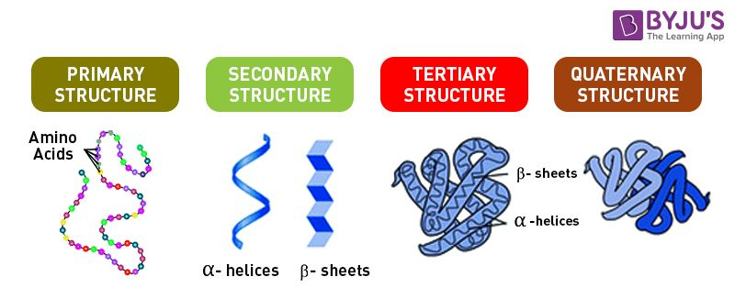
The four levels of protein structure
Notes:
Proteins are essential to life, and understanding their structure can facilitate a mechanistic understanding of their function.

Slide 5
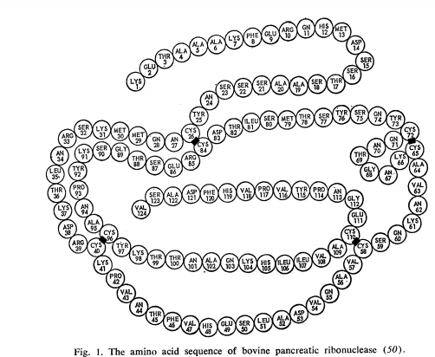
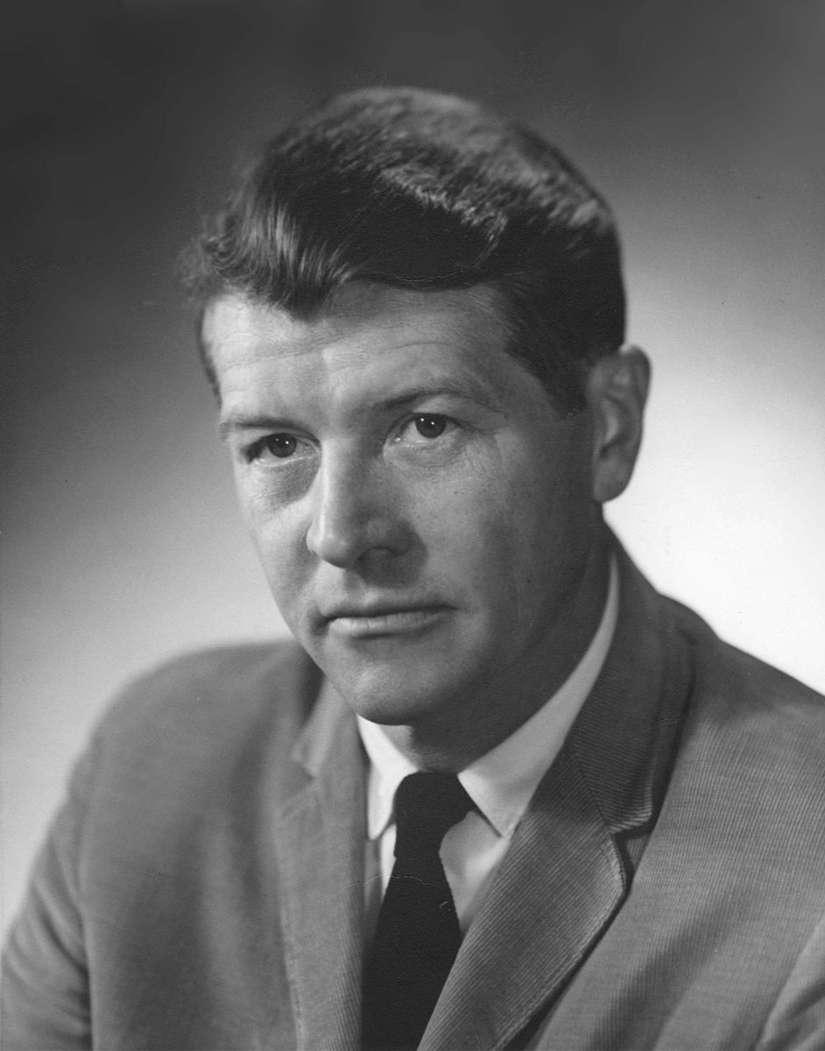
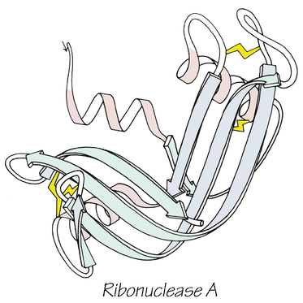
Is an amino acid sequence all you need?
A protein’s native structure stands for a free energy minimum determined by its amino acid sequence…
Anfinsen’s dogma:
The Protein Folding Problem
  What is the folding code?
  What is the folding mechanism?
  Can we predict a native protein structure from its primary, amino acid sequence?
Notes:
American Chemist, Christian B. Anfinsen won a Nobel prize in 1972 with Stanford Moore and William Howard Stein on ribonucleases for demonstrating a connection between a protein’s amino acid sequence and its three-dimensional structure. He was obsessed with determining whether you predict a native protein structure from its primary amino acid sequence.

Slide 6
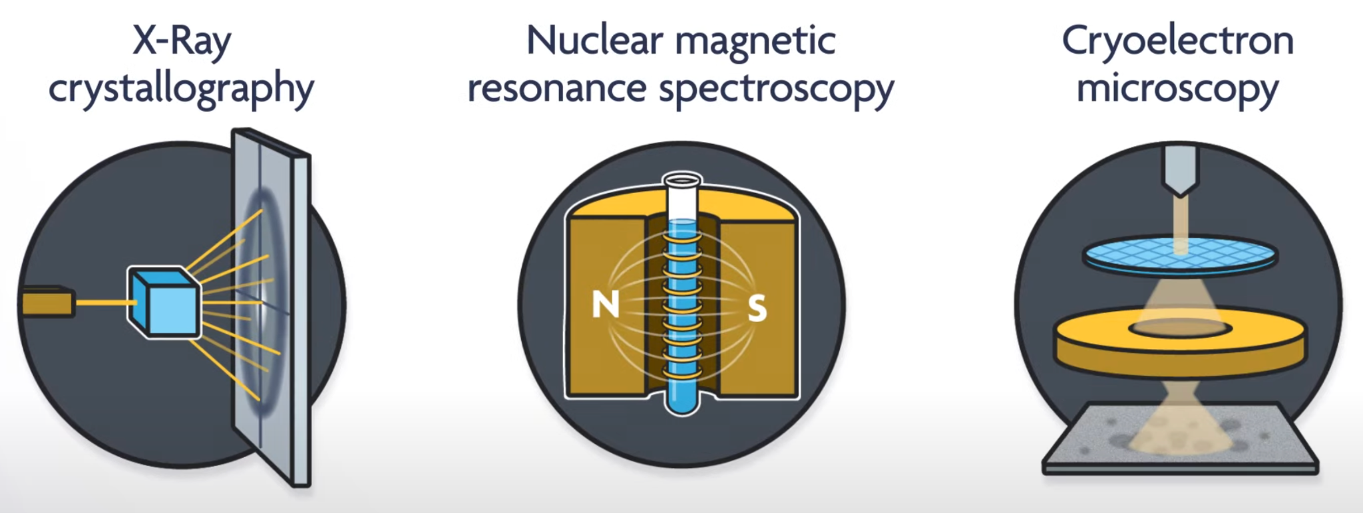
Experimental Methods for Determining Protein Structure
What is AlphaFold? New England Journal of Medicine:
https://www.youtube.com/watch?v=7q8Uw3rmXyE

Slide 7
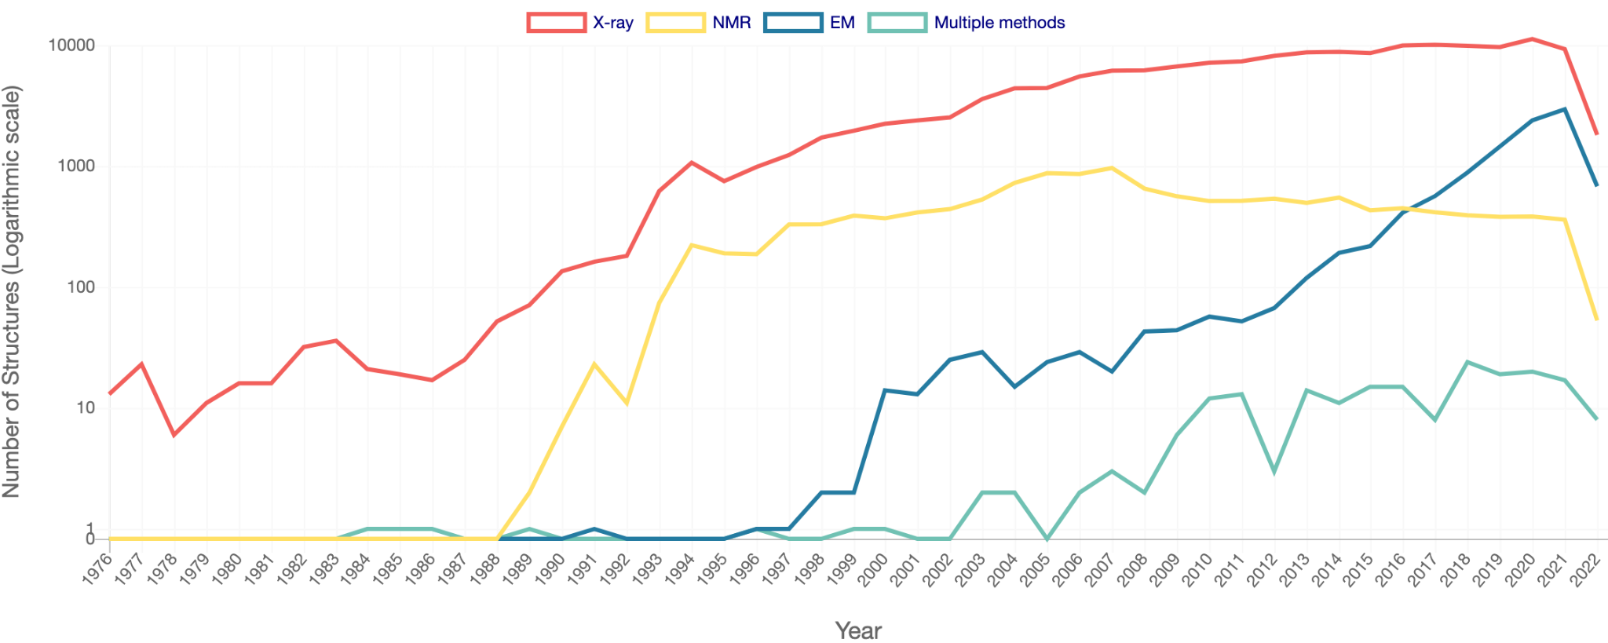
How many structures have been determined?

Slide 8
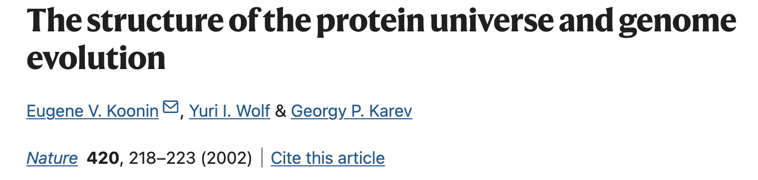
How many structures have been determined?
“The total number of possible protein sequences (that is, the size of the protein universe) is, for all practical purposes, infinite. Assuming an average protein length of 200 amino acids, there can be 20²⁰⁰ different protein sequences, a number that is much greater than, for example, the number of electrons in our (physical) Universe.”

Slide 9
Computational Methods
Homology Modeling (Comparative modeling)
De novo modeling from first principles (solving the free energy equation)
Machine learning approaches

Slide 10
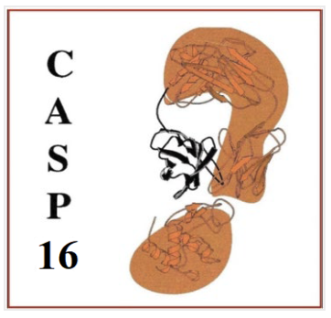
CASP Competition drives protein structure prediction
Critical Assessment of Structure Prediction (CASP)
Founded in 1994
‘Olympics’ of protein structure prediction
Supported by Lawrence Livermore National Labs, DOE, etc.
Check it out: https://www.predictioncenter.org

Slide 11
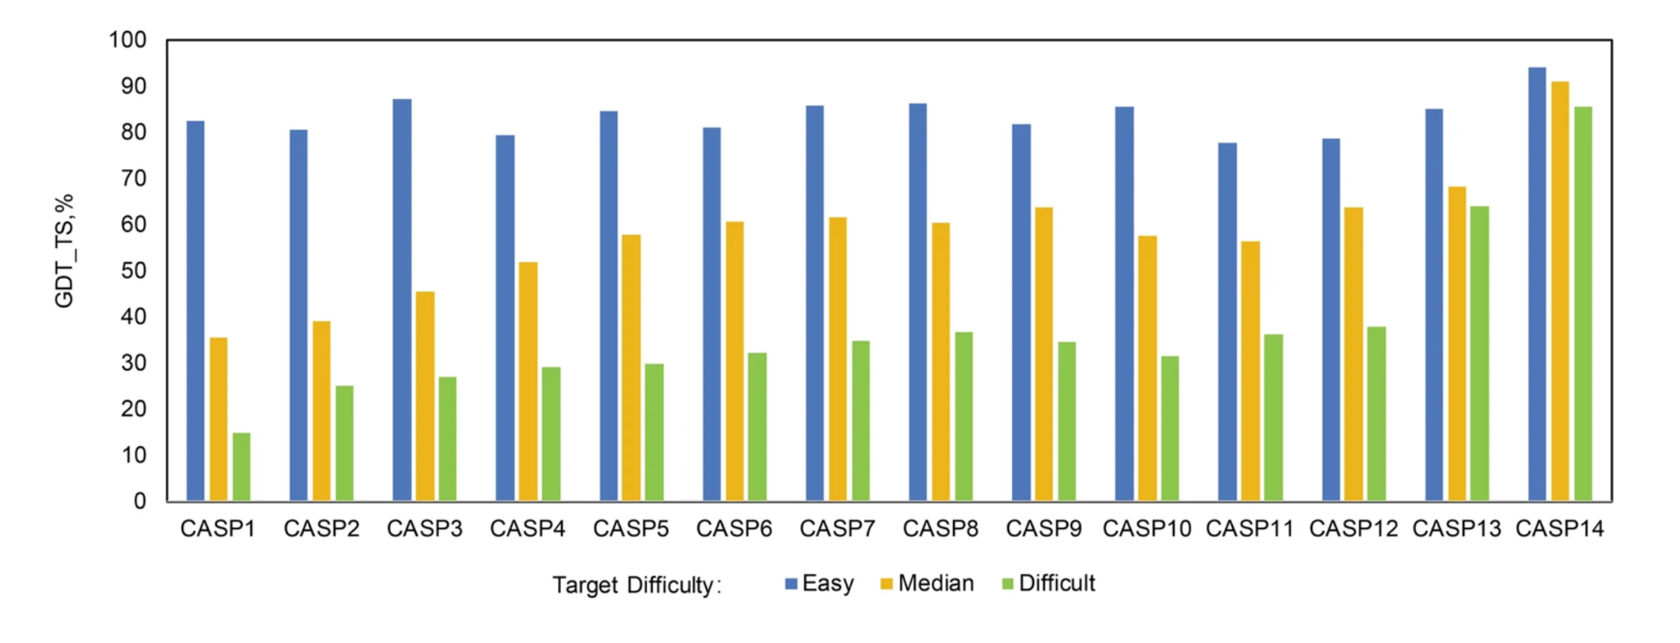
CASP Competition drives protein structure prediction
AlphaFold2 and its applications in the fields of biology and medicine. Sig Transduct Target Ther 8, 115 (2023). https://doi.org/10.1038/s41392-023-01381-z
Notes:
GDT: global distance test, fraction of protein that is directly predicted

Slide 12
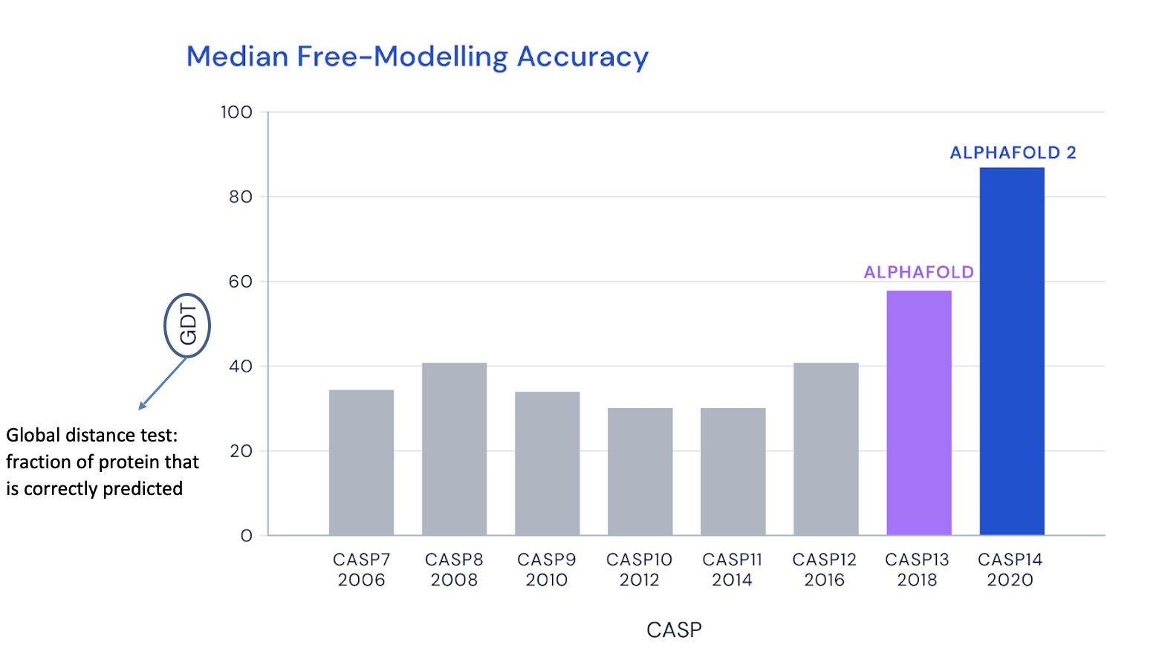
AF2 compared to CASP winners over the years
First AF as CNN
https://deepmind.com/blog/article/alphafold-a-solution-to-a-50-year-old-grand-challenge-in-biology

Slide 13
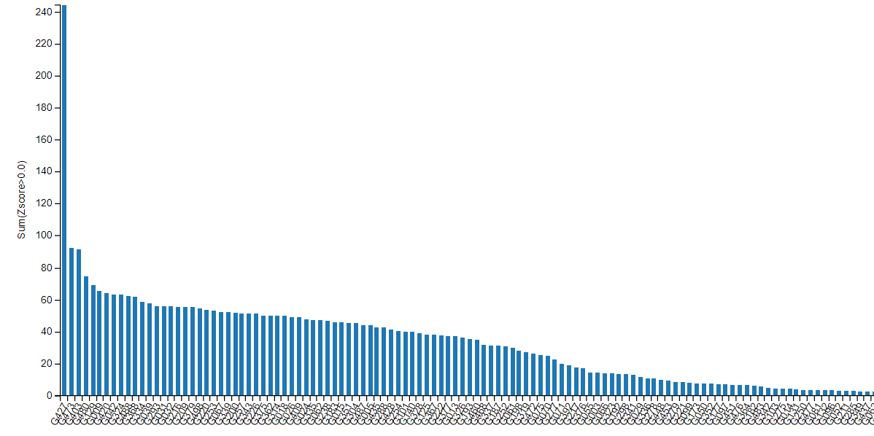
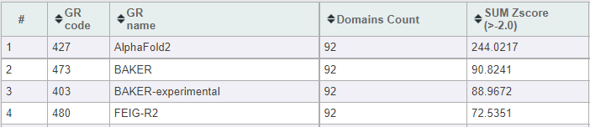
CASP14 (2020) Results: Entrance of AlphaFold2
Notes:
Z-score aggregate of all score categories in CASP competition.

Slide 14
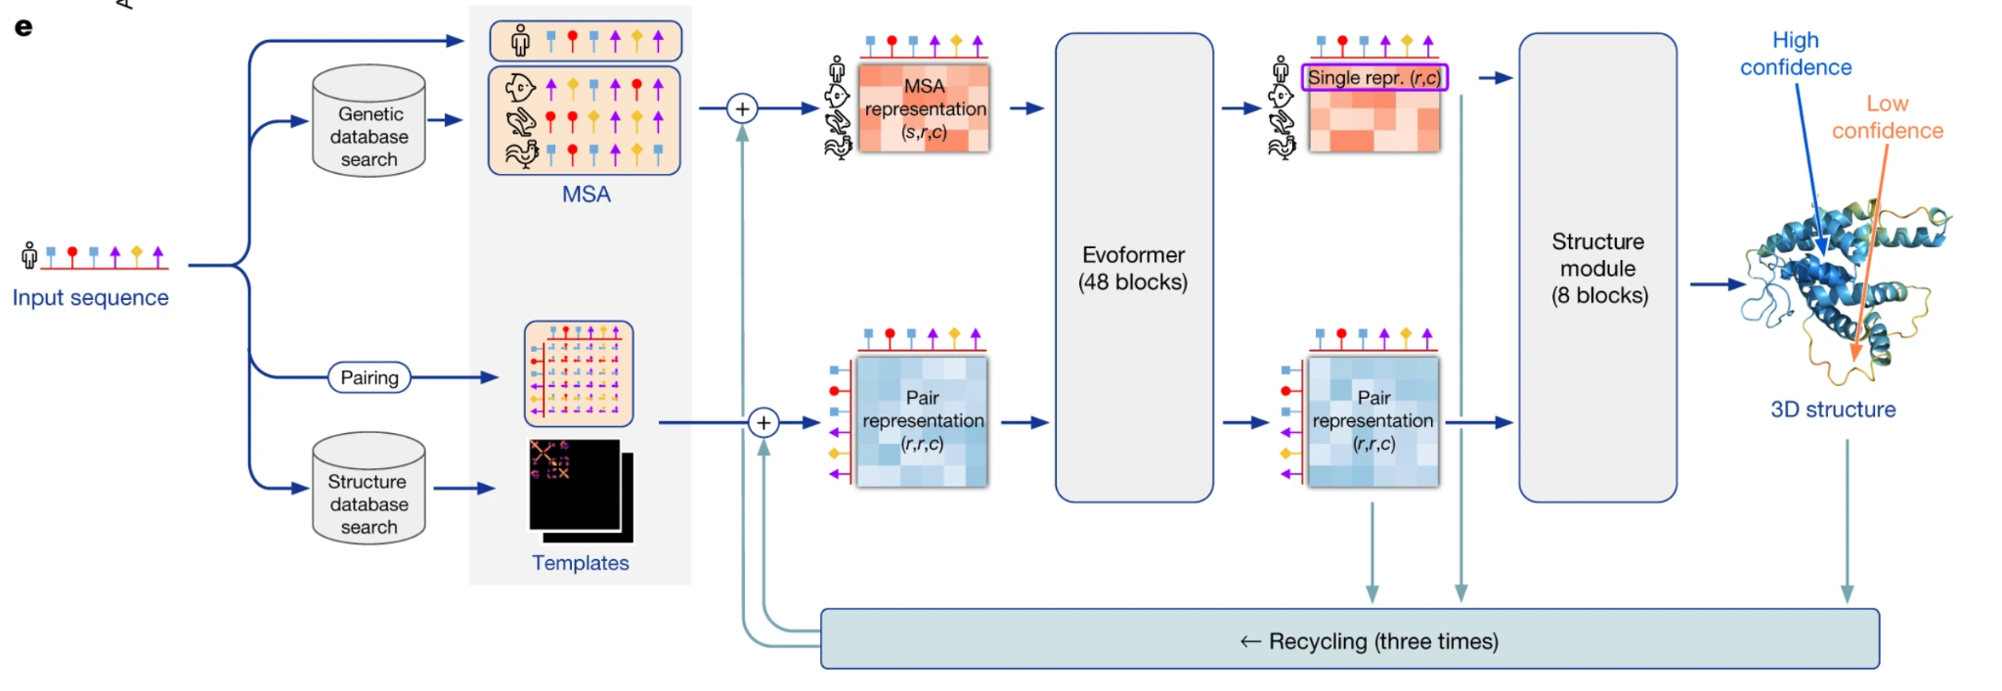

AlphaFold2: the dawn of a new age
Highly accurate protein structure prediction with AlphaFold. Nature 596, 583–589 (2021). https://doi.org/10.1038/s41586-021-03819-2

Slide 15
What is an MSA?
Highly accurate protein structure prediction with AlphaFold. Nature 596, 583–589 (2021). https://doi.org/10.1038/s41586-021-03819-2
Notes:
Need at least 30 sequences for a robust MSA. Queries multiple datasets – sometimes there aren’t enough sequences so need to incorporate metagenomic databases like MGNIFY.

Slide 16
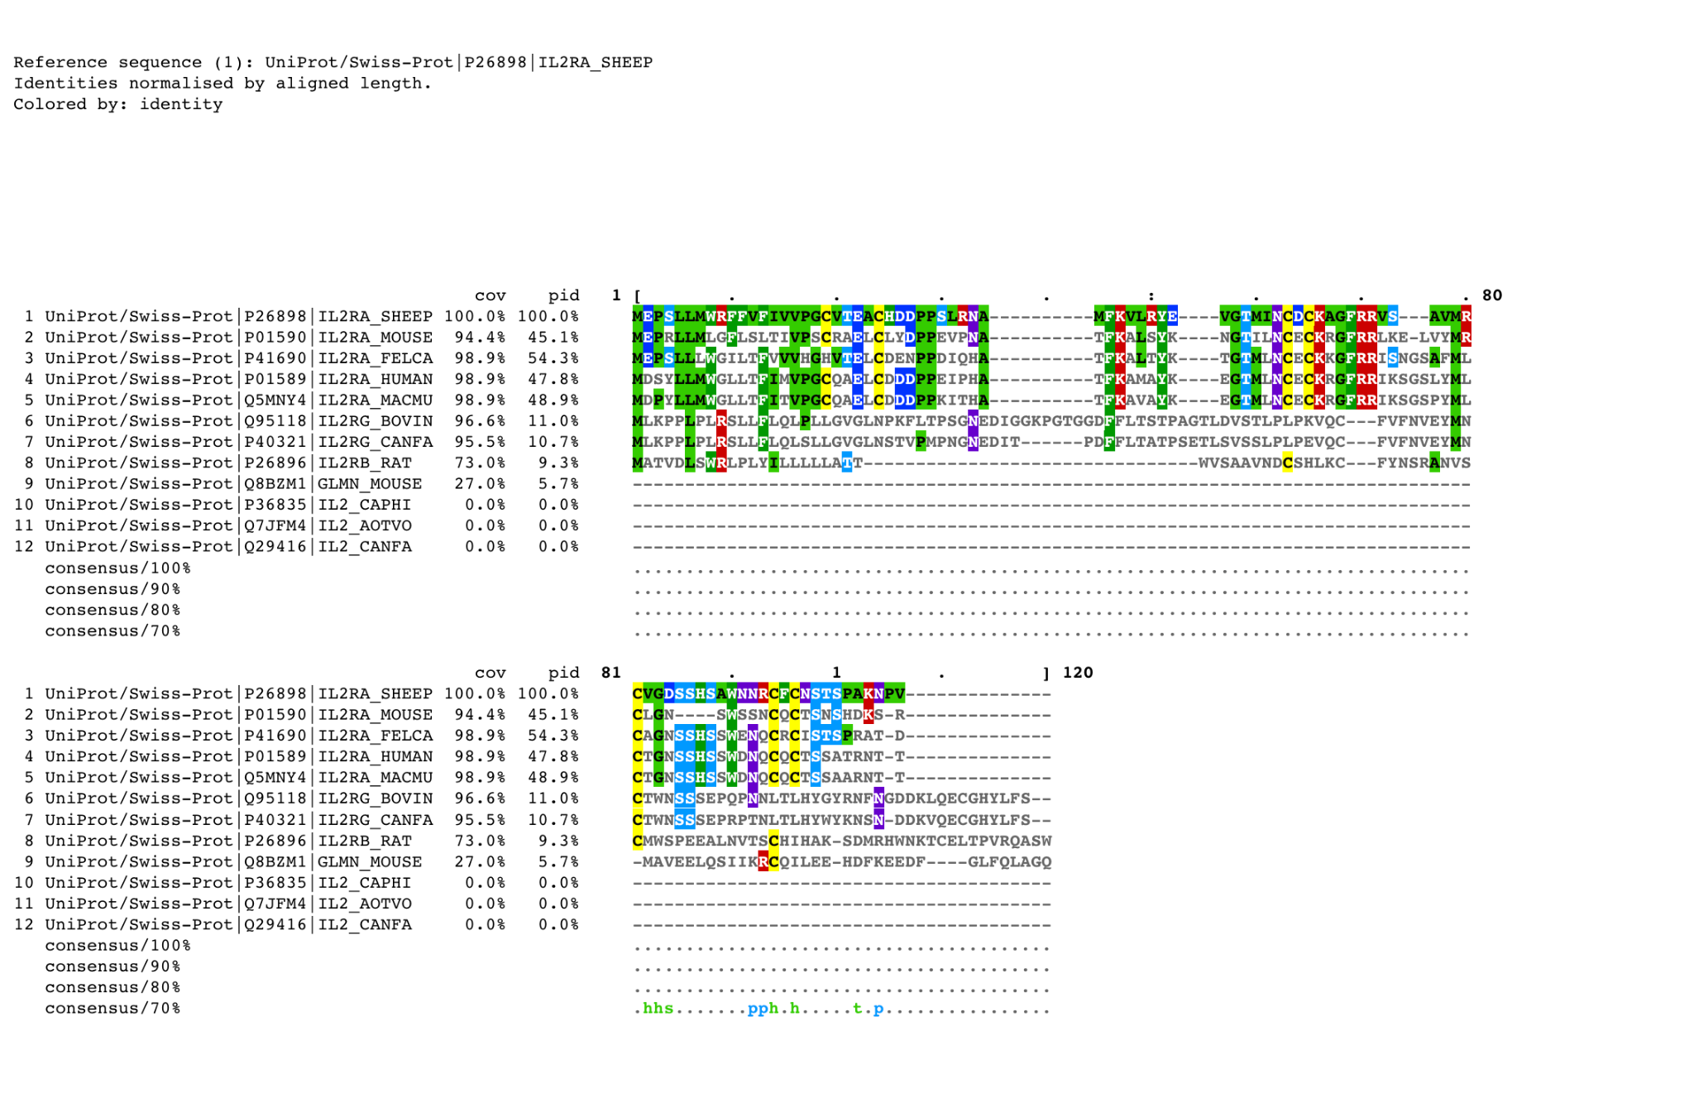
MSA: Multiple Sequence Alignment
Notes:
Similar sequence ~ similar structure, evolution

Slide 17
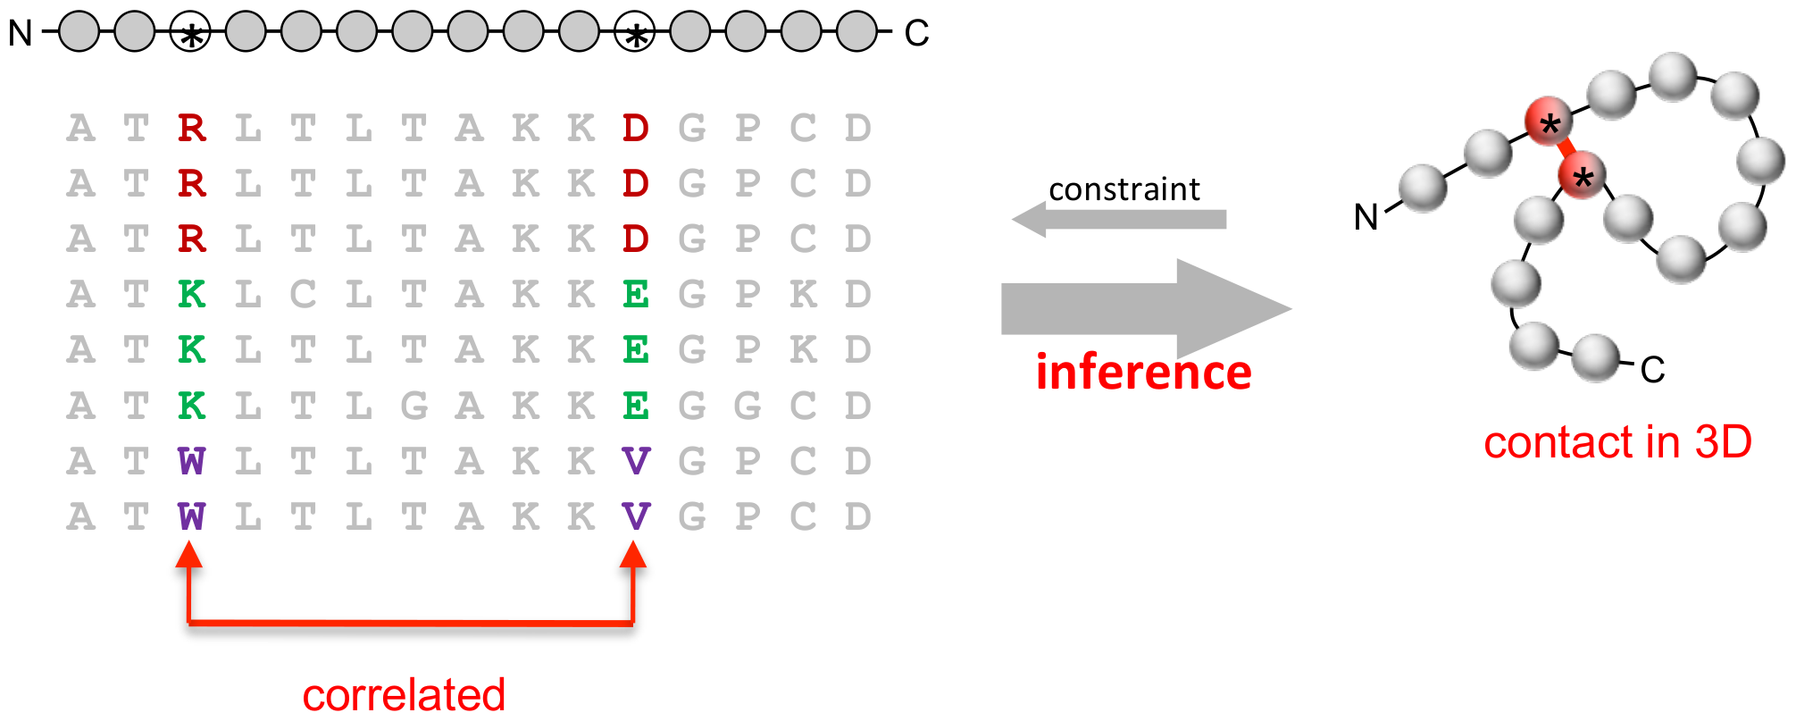
Direct-coupling analysis of residue coevolution captures native contacts across many protein families
Protein 3D Structure Computed from Evolutionary Sequence Variation. PLOS One, 2011.
Notes:
Around the 2010s, a new mathematical concept called Direct Coupling Analysis came out of 5 groups simultaneously. One group was working on bird flock behaviour, another on spin lattices, so from very disparate fields and essentially gave a mathematical framework for separating direct correlations from indirect ones.
It was then applied to the field of protein structure modelling and in 2011, Debora Marks’ group came out with Fast DCA which became the field’s tool of choice.
Essentially
Protein 3D structure computed from evolutionary sequence variation.
Can’t just use straight correlation, need to sparsify it! Big breakthrough.
Iterated on this for years, not enough

Slide 18
Initializing the Pair Representation
Highly accurate protein structure prediction with AlphaFold. Nature 596, 583–589 (2021). https://doi.org/10.1038/s41586-021-03819-2

Slide 19
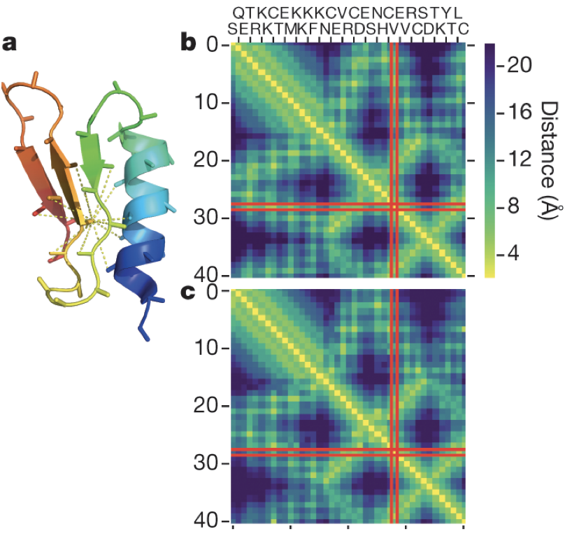
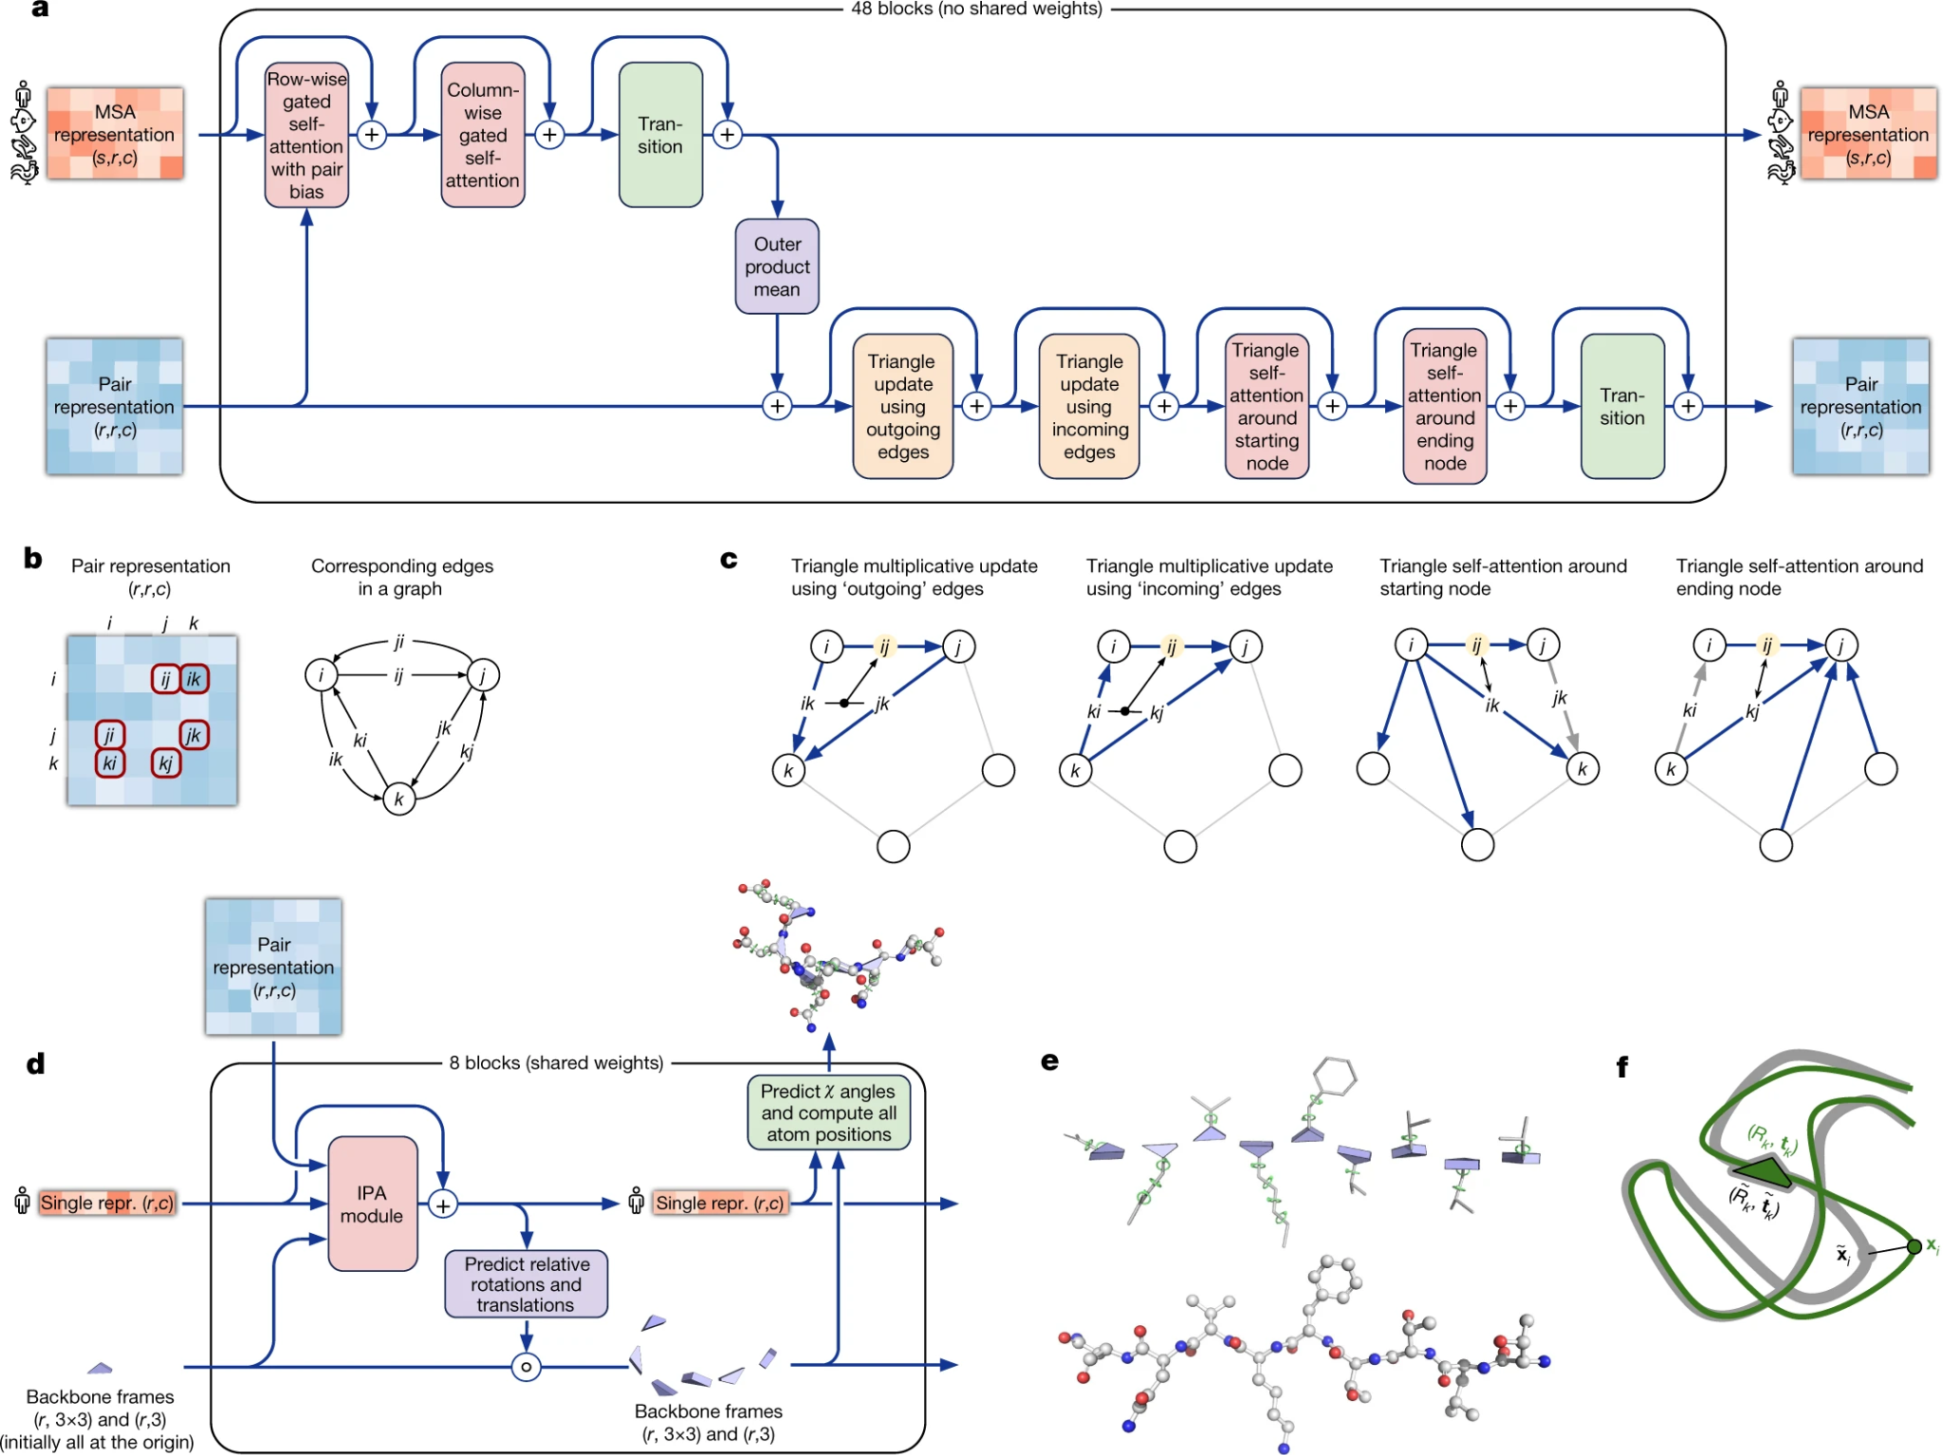
What is a pair representation?
Distogram is used to map 2D pairwise distances
Distogram are independent of translations and rotations, so no need to align structures (much faster)
Senior, A. W., Evans, R., Jumper, J., Kirkpatrick, J., Sifre, L., Green, T., ... & Hassabis, D. (2020). Nature.

Slide 20
Transformer-like module updates representations
Highly accurate protein structure prediction with AlphaFold. Nature 596, 583–589 (2021). https://doi.org/10.1038/s41586-021-03819-2

Slide 21
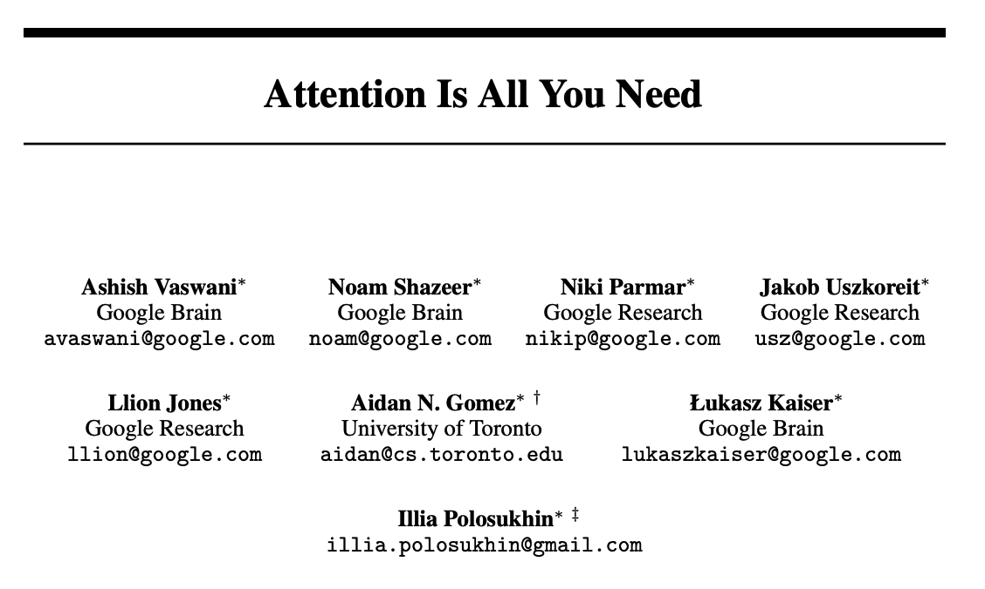
https://arxiv.org/abs/1706.03762

Slide 22
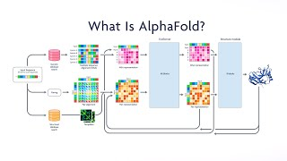

Slide 23
The Evoformer: 48 blocks of back and forth between evolutionary and spatial reasoning.

Slide 24
Structure module converts representation to structure
Highly accurate protein structure prediction with AlphaFold. Nature 596, 583–589 (2021). https://doi.org/10.1038/s41586-021-03819-2

Slide 25
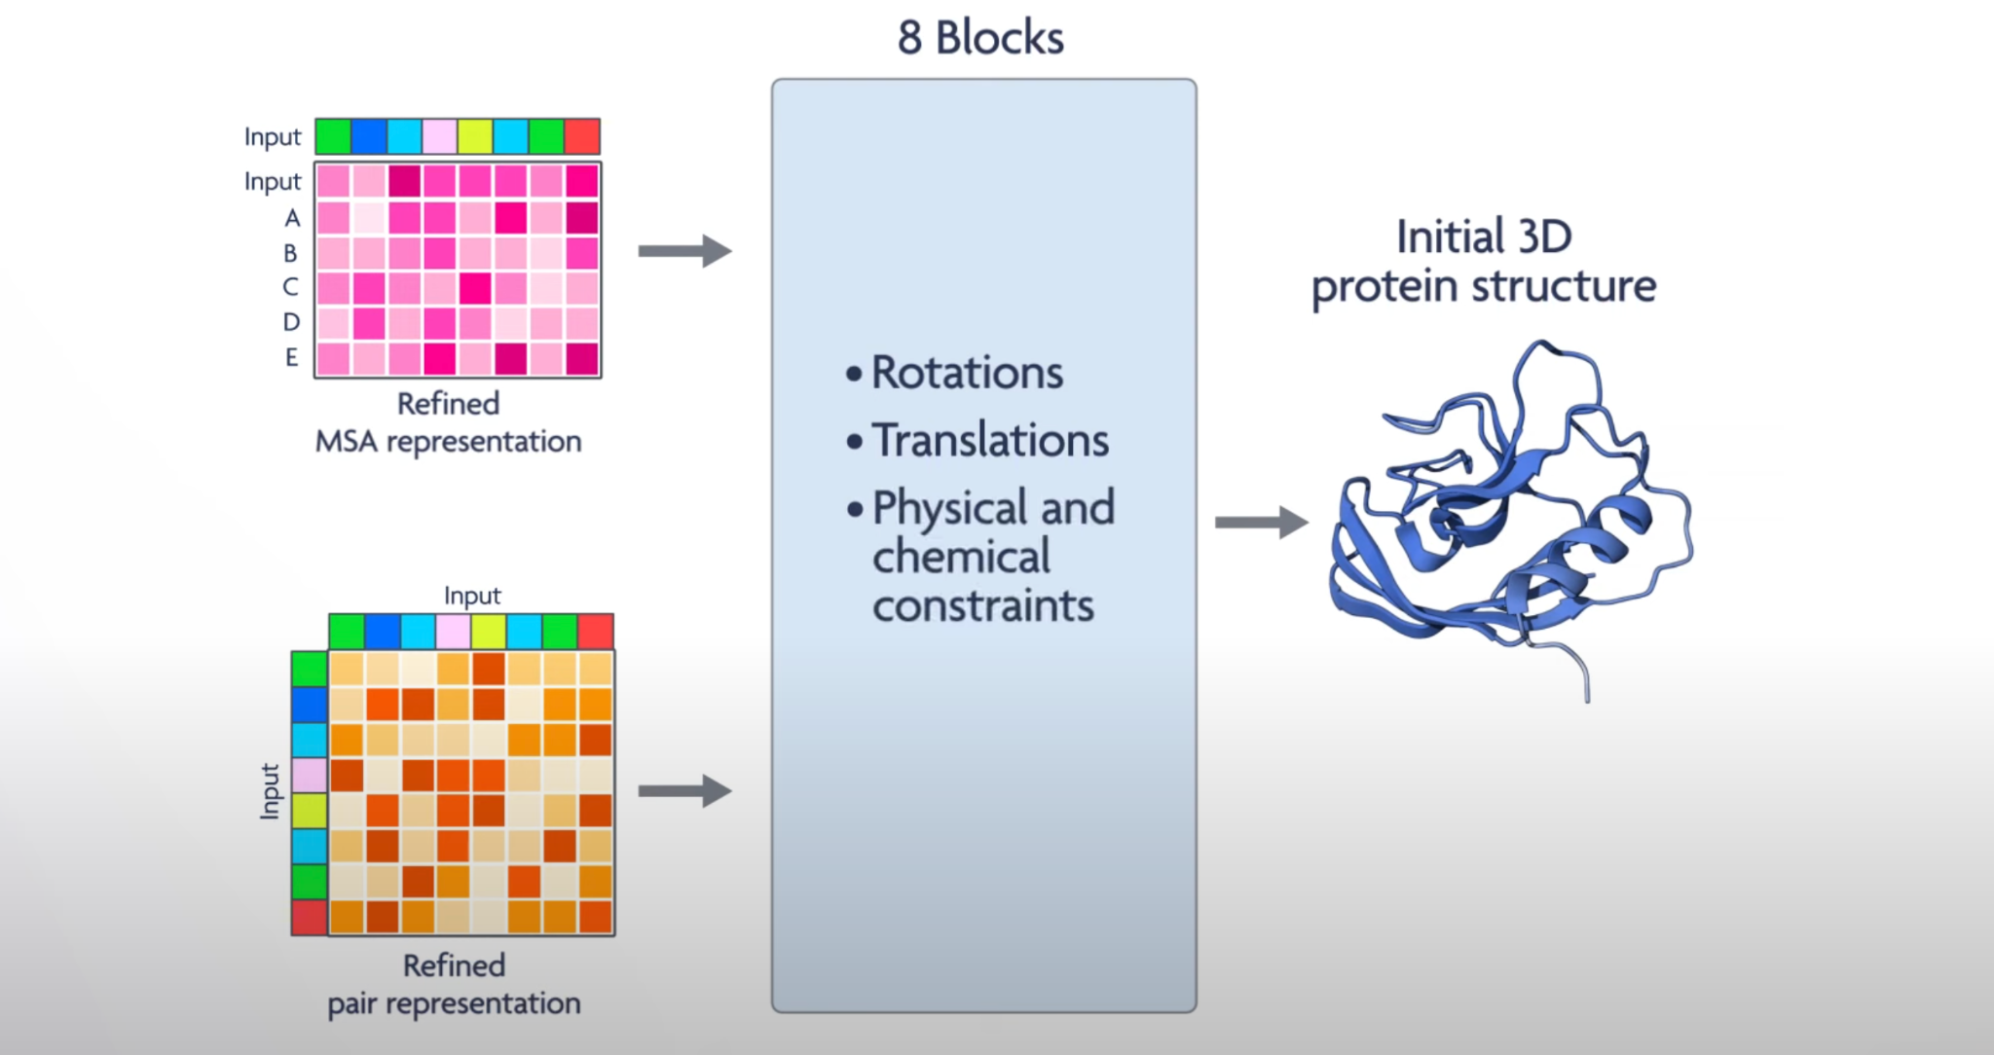
Structure module converts representation to structure

Slide 26
Structure Module

Slide 27
Structure Module

Slide 28
Recycling iteratively refines structure
Highly accurate protein structure prediction with AlphaFold. Nature 596, 583–589 (2021). https://doi.org/10.1038/s41586-021-03819-2

Slide 29
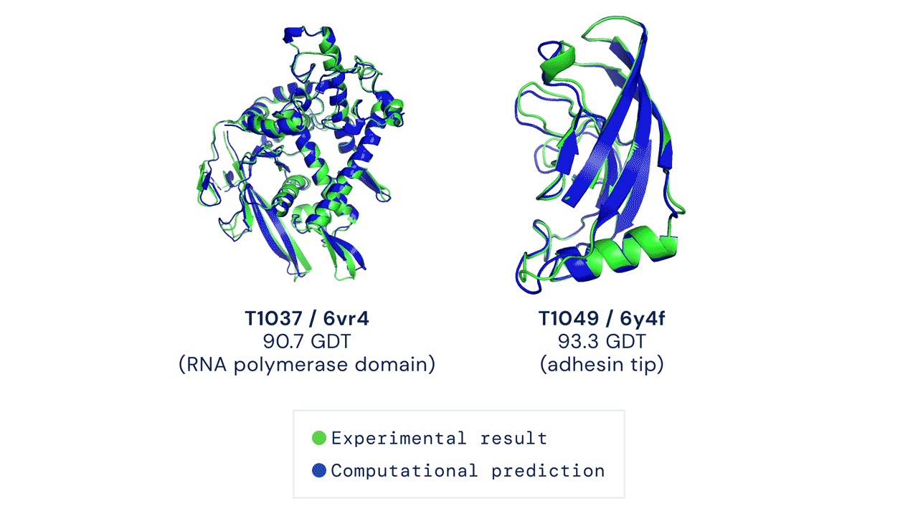
How do we know it works? – ask the model!

Slide 30
The 3Ps: pLDDT, PAE, and pTM
LDDT, AE, TM require ground truth. What can we do?
pLDDT: predicted Local Distance Difference Test
PAE: Predicted Aligned Error
pTM: predicted Template Modeling score
  Global comparison of similarity between two structures
  Measure of 0 to 1
Notes:
pLDDT: predicted Local Distance Difference Test (0-100) is a per residue confidence score, values greater than 90 indicate high confidence, values below 50 indicate low confidence. AF models coloring show high confidence residues in blue and lower confidence in yellow, orange, and red. The measure estimates whether the predicted residue has similar distances to neighboring C-alpha atoms (within 15Angstroms) in agreement with distances in the true structure. Measure came from the local distance difference test published in 2013. (https://www.ncbi.nlm.nih.gov/pmc/articles/PMC3799472/)
PAE: Predicted Aligned Error gives a distance error for every pair of residues, It gives AlphaFold’s estimate of positionerror at residue x when the predicted and true structures are aligned on residue y. Values range from 0-35 Angstroms, usually shown asa heatmap image with residue numbers running along vertical and horizontal axes and color at each pixel indicating PAE value for the corresponding pair of residues. If the relative position of two domains is confidently predicted then the PAE values will be low (less than 5A) for pairs of residues with one residue in each domain.
In bioinformatics, the template modeling score or TM-score is a measure of similarity between two protein structures. The TM-score is intended as a more accurate measure of the global similarity of full-length protein structures than the often used RMSD measure. The TM-score indicates the similarity between two structures by a score between
(0,1]
, where 1 indicates a perfect match between two structures (thus the higher the better).^{[1]} Generally scores below 0.20 corresponds to randomly chosen unrelated proteins whereas structures with a score higher than 0.5 assume roughly the same fold.^{[2]} A quantitative study ^{[3]} shows that proteins of TM-score = 0.5 have a posterior probability of 37% in the same CATH topology family and of 13% in the same SCOP fold family. The probabilities increase rapidly when TM-score > 0.5. The TM-score is designed to be independent of protein lengths.

Slide 31
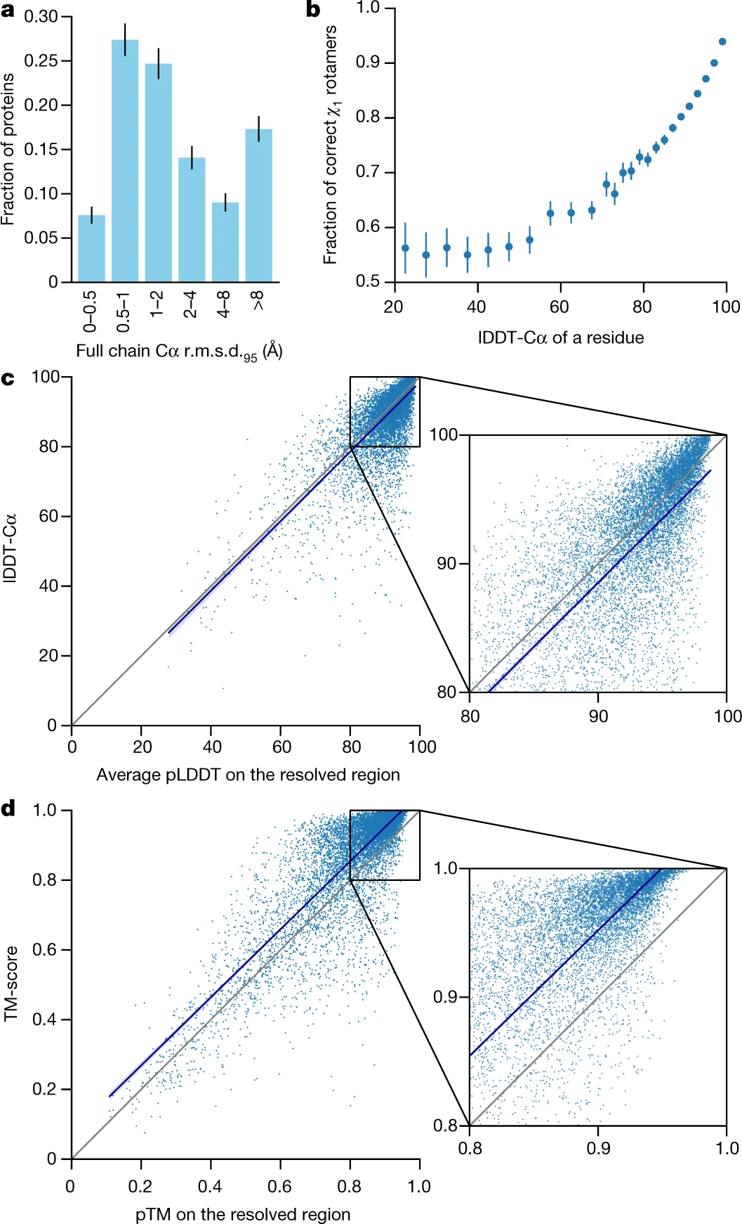
The 3Ps: pLDDT, PAE, and pTM
LDDT, AE, TM require ground truth. What can we do?
pLDDT: predicted Local Distance Difference Test
PAE: Predicted Aligned Error
pTM: predicted Template Modeling score
  Global comparison of similarity between two structures
  Measure of 0 to 1
Highly accurate protein structure prediction with AlphaFold. Nature 596, 583–589 (2021). https://doi.org/10.1038/s41586-021-03819-2
Notes:
pLDDT: predicted Local Distance Difference Test (0-100) is a per residue confidence score, values greater than 90 indicate high confidence, values below 50 indicate low confidence. AF models coloring show high confidence residues in blue and lower confidence in yellow, orange, and red. The measure estimates whether the predicted residue has similar distances to neighboring C-alpha atoms (within 15Angstroms) in agreement with distances in the true structure. Measure came from the local distance difference test published in 2013. (https://www.ncbi.nlm.nih.gov/pmc/articles/PMC3799472/)
PAE: Predicted Aligned Error gives a distance error for every pair of residues, It gives AlphaFold’s estimate of positionerror at residue x when the predicted and true structures are aligned on residue y. Values range from 0-35 Angstroms, usually shown asa heatmap image with residue numbers running along vertical and horizontal axes and color at each pixel indicating PAE value for the corresponding pair of residues. If the relative position of two domains is confidently predicted then the PAE values will be low (less than 5A) for pairs of residues with one residue in each domain.
In bioinformatics, the template modeling score or TM-score is a measure of similarity between two protein structures. The TM-score is intended as a more accurate measure of the global similarity of full-length protein structures than the often used RMSD measure. The TM-score indicates the similarity between two structures by a score between
(0,1]
, where 1 indicates a perfect match between two structures (thus the higher the better).^{[1]} Generally scores below 0.20 corresponds to randomly chosen unrelated proteins whereas structures with a score higher than 0.5 assume roughly the same fold.^{[2]} A quantitative study ^{[3]} shows that proteins of TM-score = 0.5 have a posterior probability of 37% in the same CATH topology family and of 13% in the same SCOP fold family. The probabilities increase rapidly when TM-score > 0.5. The TM-score is designed to be independent of protein lengths.

Slide 32
The 3Ps: pLDDT, PAE, and pTM
LDDT, AE, TM require ground truth. What can we do?
pLDDT: predicted Local Distance Difference Test
PAE: Predicted Aligned Error
pTM: predicted Template Modeling score
  Global comparison of similarity between two structures
  Measure of 0 to 1
Highly accurate protein structure prediction with AlphaFold. Nature 596, 583–589 (2021). https://doi.org/10.1038/s41586-021-03819-2
Notes:
pLDDT: predicted Local Distance Difference Test (0-100) is a per residue confidence score, values greater than 90 indicate high confidence, values below 50 indicate low confidence. AF models coloring show high confidence residues in blue and lower confidence in yellow, orange, and red. The measure estimates whether the predicted residue has similar distances to neighboring C-alpha atoms (within 15Angstroms) in agreement with distances in the true structure. Measure came from the local distance difference test published in 2013. (https://www.ncbi.nlm.nih.gov/pmc/articles/PMC3799472/)
PAE: Predicted Aligned Error gives a distance error for every pair of residues, It gives AlphaFold’s estimate of positionerror at residue x when the predicted and true structures are aligned on residue y. Values range from 0-35 Angstroms, usually shown asa heatmap image with residue numbers running along vertical and horizontal axes and color at each pixel indicating PAE value for the corresponding pair of residues. If the relative position of two domains is confidently predicted then the PAE values will be low (less than 5A) for pairs of residues with one residue in each domain.
In bioinformatics, the template modeling score or TM-score is a measure of similarity between two protein structures. The TM-score is intended as a more accurate measure of the global similarity of full-length protein structures than the often used RMSD measure. The TM-score indicates the similarity between two structures by a score between
(0,1]
, where 1 indicates a perfect match between two structures (thus the higher the better).^{[1]} Generally scores below 0.20 corresponds to randomly chosen unrelated proteins whereas structures with a score higher than 0.5 assume roughly the same fold.^{[2]} A quantitative study ^{[3]} shows that proteins of TM-score = 0.5 have a posterior probability of 37% in the same CATH topology family and of 13% in the same SCOP fold family. The probabilities increase rapidly when TM-score > 0.5. The TM-score is designed to be independent of protein lengths.

Slide 33
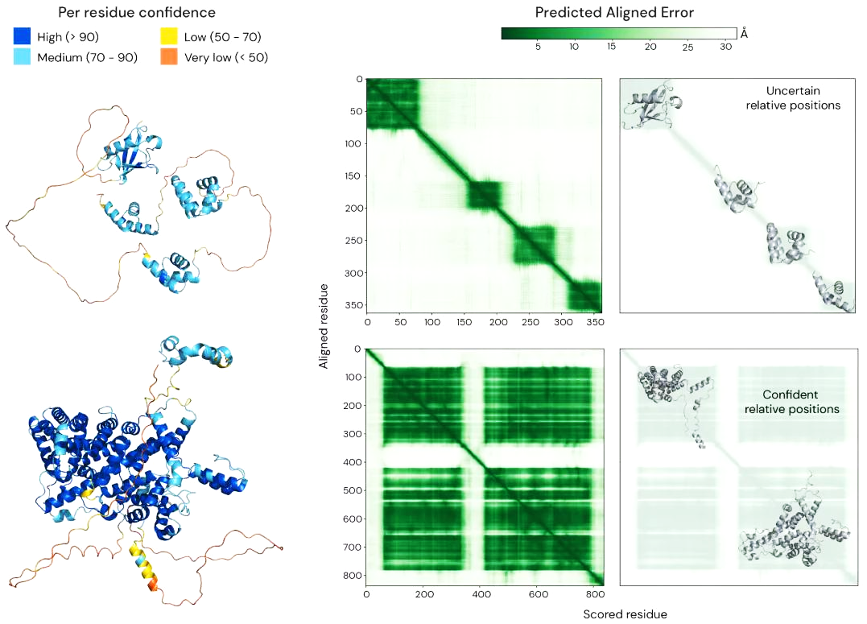
Predicted Local Distance Difference Test
AlphaFold’s per-residue prediction of its lDDT-Ca score
Low lDDT commonly associated with disorder
High pLDDT on each domain doesn’t imply confidence in relative positions!
Notes:
Roughly lDDT measures the percentage of correctly predicted interatomic distances, not how well the predicted and true structures can be imposed *like me asking you how well you did on your exam after you took it, typically you can be in the right ballpark. Maybe don’t know what all the answers are but have a rough idea of how well you did on each question.
PAE: Predicted Aligned Error gives a distance error for every pair of residues, It gives AlphaFold’s estimate of positionerror at residue x when the predicted and true structures are aligned on residue y. Values range from 0-35 Angstroms, usually shown asa heatmap image with residue numbers running along vertical and horizontal axes and color at each pixel indicating PAE value for the corresponding pair of residues. If the relative position of two domains is confidently predicted then the PAE values will be low (less than 5A) for pairs of residues with one residue in each domain.

Slide 34
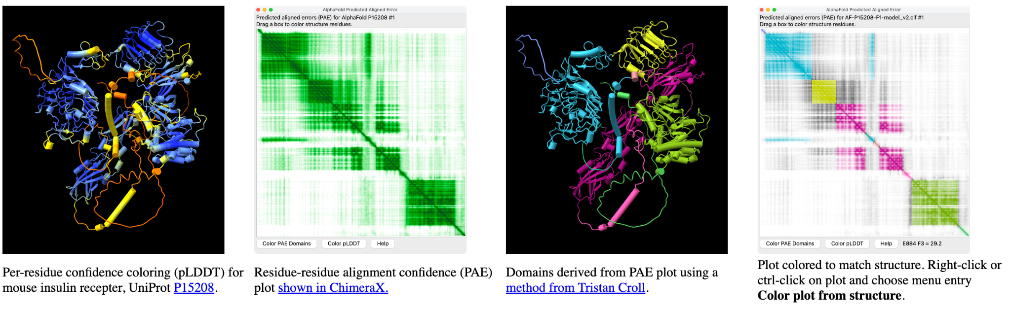
Predicted Aligned Error (PAE)
Prediction of position error at residue x if the predicted and the true structures were aligned on y
PAE aims to measure confidence in the relative positions of pairs of residues
Use where pairwise confidence is relevant – interpreting domain distances in a multi domain protein
Suppose residue y were aligned to the true structure and we measured the position error at residue x. The color at (x,y) is AF’s prediction of that error
Notes:
pLDDT: predicted Local Distance Difference Test (0-100) is a per residue confidence score, values greater than 90 indicate high confidence, values below 50 indicate low confidence. AF models coloring show high confidence residues in blue and lower confidence in yellow, orange, and red. The measure estimates whether the predicted residue has similar distances to neighboring C-alpha atoms (within 15Angstroms) in agreement with distances in the true structure. Measure came from the local distance difference test published in 2013. (https://www.ncbi.nlm.nih.gov/pmc/articles/PMC3799472/)
PAE: Predicted Aligned Error gives a distance error for every pair of residues, It gives AlphaFold’s estimate of positionerror at residue x when the predicted and true structures are aligned on residue y. Values range from 0-35 Angstroms, usually shown asa heatmap image with residue numbers running along vertical and horizontal axes and color at each pixel indicating PAE value for the corresponding pair of residues. If the relative position of two domains is confidently predicted then the PAE values will be low (less than 5A) for pairs of residues with one residue in each domain.

Slide 35
Predicted Aligned Error (PAE)
Prediction of position error at residue x if the predicted and the true structures were aligned on y
PAE aims to measure confidence in the relative positions of pairs of residues
Use where pairwise confidence is relevant – interpreting domain distances in a multi domain protein
Suppose residue y were aligned to the true structure and we measured the position error at residue x. The color at (x,y) is AF’s prediction of that error
Notes:
pLDDT: predicted Local Distance Difference Test (0-100) is a per residue confidence score, values greater than 90 indicate high confidence, values below 50 indicate low confidence. AF models coloring show high confidence residues in blue and lower confidence in yellow, orange, and red. The measure estimates whether the predicted residue has similar distances to neighboring C-alpha atoms (within 15Angstroms) in agreement with distances in the true structure. Measure came from the local distance difference test published in 2013. (https://www.ncbi.nlm.nih.gov/pmc/articles/PMC3799472/)
PAE: Predicted Aligned Error gives a distance error for every pair of residues, It gives AlphaFold’s estimate of positionerror at residue x when the predicted and true structures are aligned on residue y. Values range from 0-35 Angstroms, usually shown asa heatmap image with residue numbers running along vertical and horizontal axes and color at each pixel indicating PAE value for the corresponding pair of residues. If the relative position of two domains is confidently predicted then the PAE values will be low (less than 5A) for pairs of residues with one residue in each domain.

Slide 36


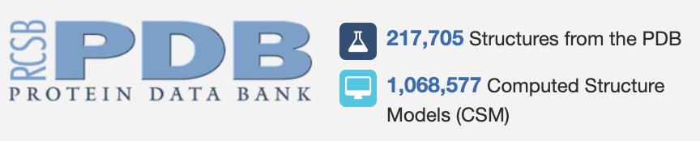
214,683,839 Predicted Protein Structures on AFDB!
+
Notes:
214,683,839

Slide 37
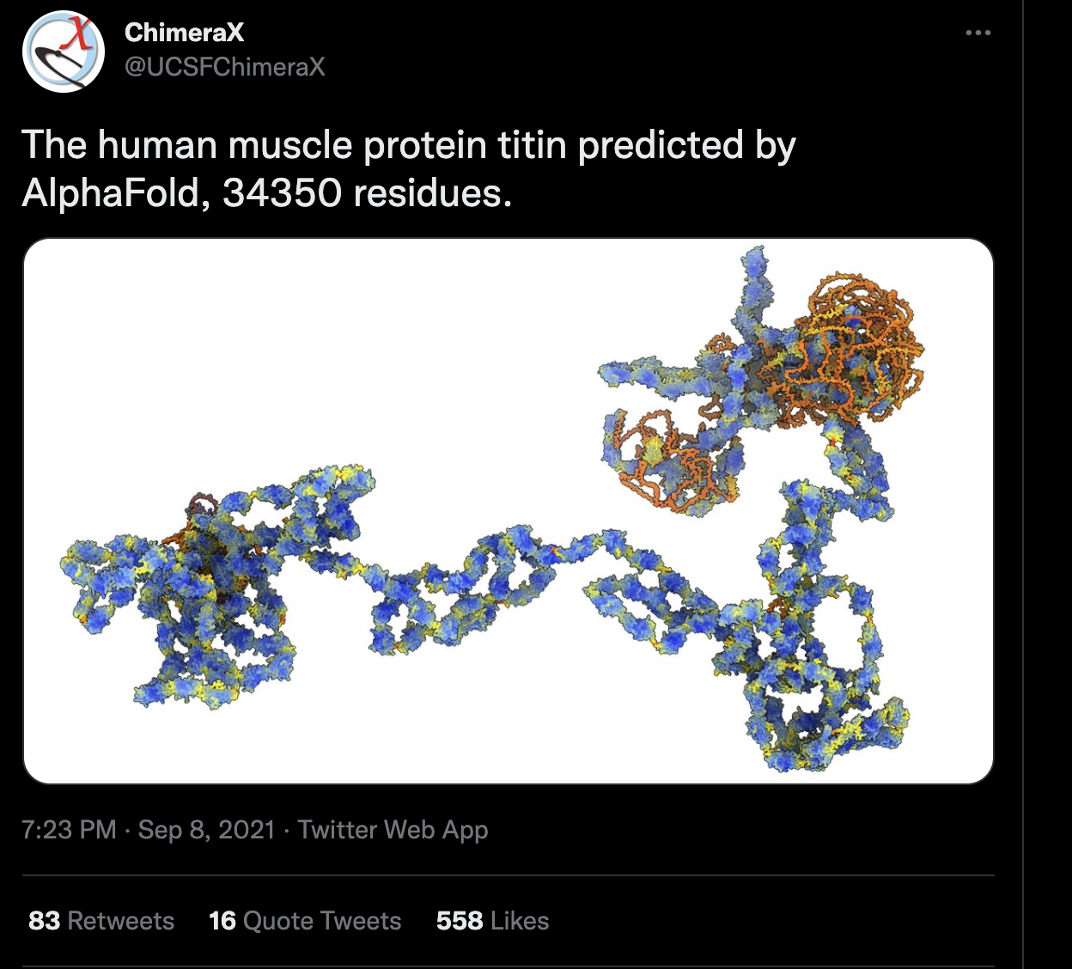
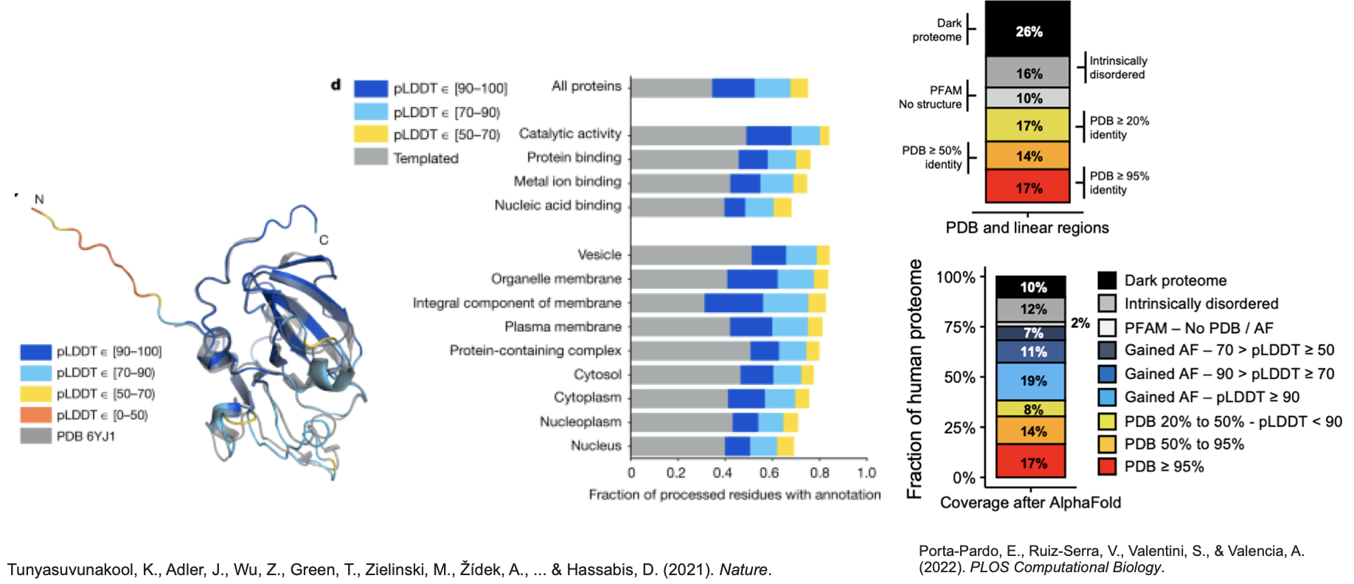
Proteome-wide structure prediction

Slide 38
AlphaFold Multimer!

Slide 39
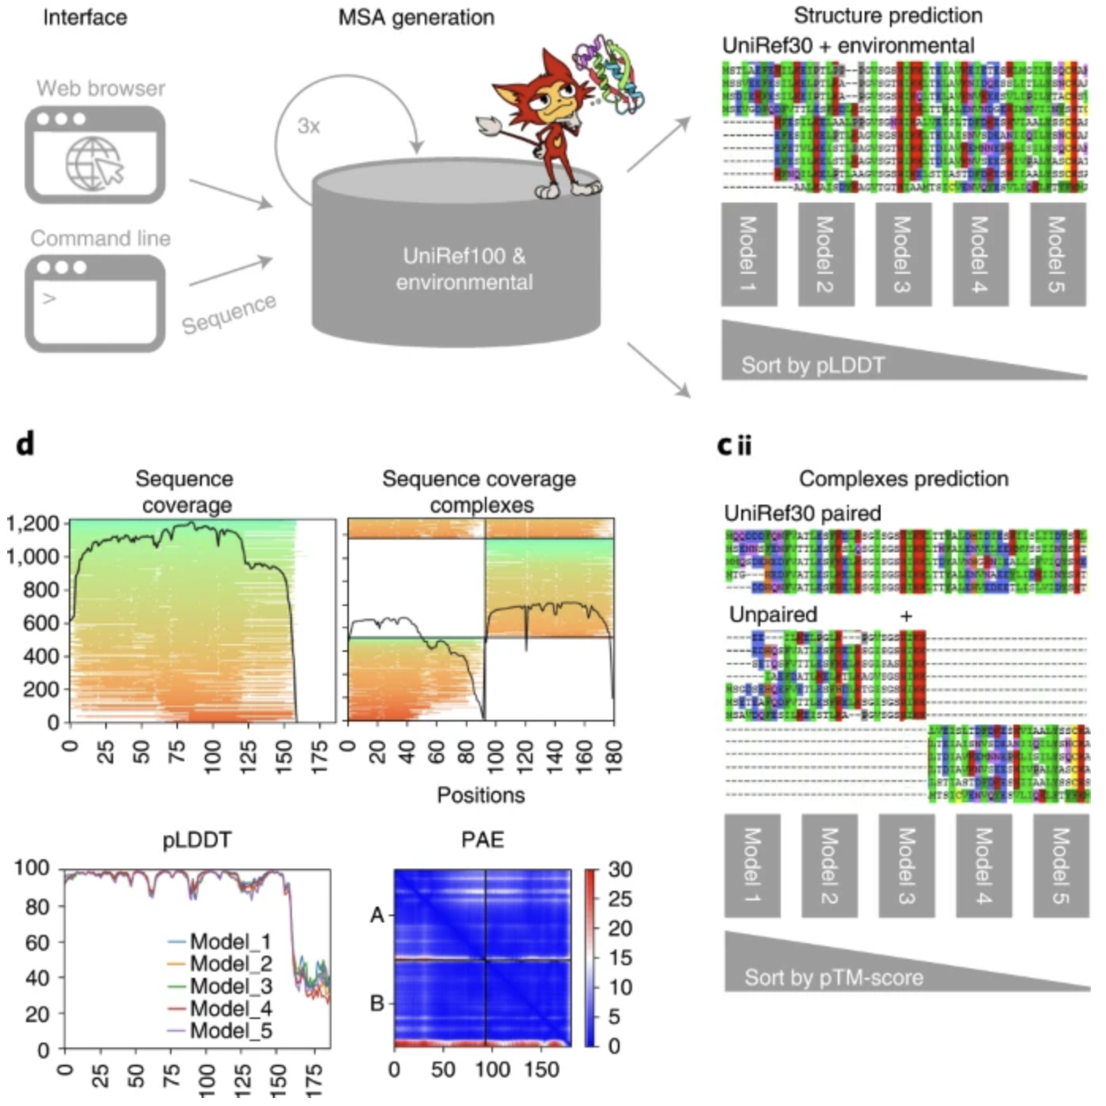
ColabFold speeds up AlphaFold by 40-60 fold!
AF2
ColabFold: making protein folding accessible to all. Nat Methods 19, 679–682 (2022). https://doi.org/10.1038/s41592-022-01488-1

Slide 40
ColabFold speeds up AlphaFold by 40-60 fold!
“ColabFold’s 40−60-fold faster search and optimized model utilization enables prediction of close to 1,000 structures per day on a server with one graphics processing unit.”
AF2
ColabFold: making protein folding accessible to all. Nat Methods 19, 679–682 (2022). https://doi.org/10.1038/s41592-022-01488-1
Notes:
AF2 uses hhsuite for its msa predictions!
Speeds up batch predictions by ~90-fold by avoiding recompilation and adding an early stop criterion. ColabFold outperforms AlphaFold-Colab and matches AlphaFold2 on CASP14 targets and also matches AlphaFold-multimer on the ClusPro dataset in prediction quality.

Slide 41
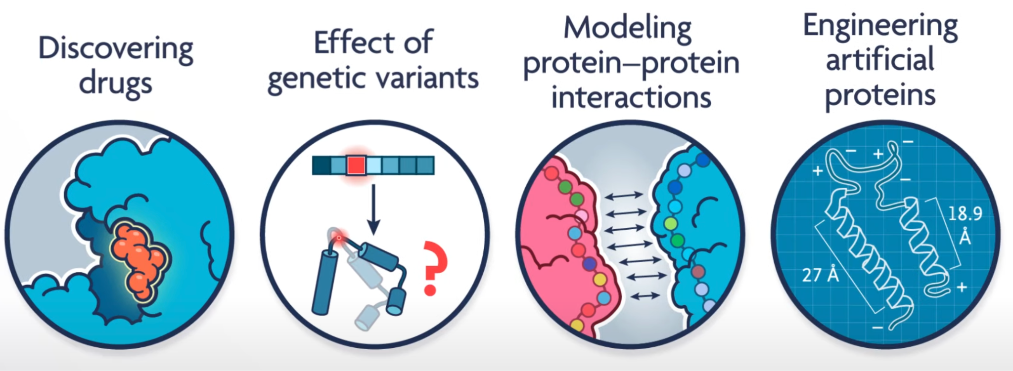
Applications and Frontiers!

Slide 42
Has protein structure prediction been solved?
Sort of.
The Protein Folding Problem (de novo)
  What is the folding code?
  What is the folding mechanism?
  Can we predict a native protein structure from its primary, amino acid sequence?
    No for a sequence in isolation…
    Yes when informed by like sequences and their structures

Slide 43
Let’s give it a try!
Google Colab Notebooks:
  AlphaFold
  ColabFold (AF2 w/MMSeqs2)
  Maintained list of Google Colabs: https://github.com/sokrypton/ColabFold
AlphaFold Resources:
  Github page: https://github.com/google-deepmind/alphafold
  AFDB Protein Structure Database and links: https://alphafold.com
  Lovely & more in depth lecture from John Jumper at Vanderbilt University
  Running AlphaFold on the BRCF Servers:
    AMD GPUs
    NVIDIA GPUs
  Running AlphaFold on TACC
Notes:
Interesting small protein to do as we go?

Slide 44
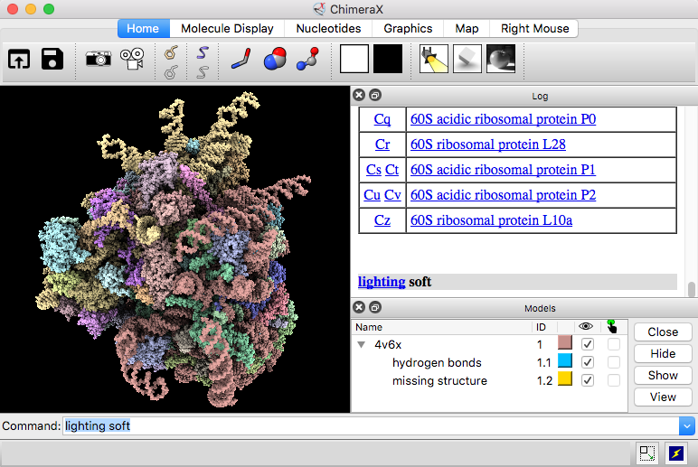
ChimeraX
Download ChimeraX: https://www.cgl.ucsf.edu/chimerax/download.html
Quick Start: https://www.cgl.ucsf.edu/chimerax/docs/quickstart/index.html
Very comprehensive user guide: https://www.cgl.ucsf.edu/chimerax/docs/user/index.html

Slide 45
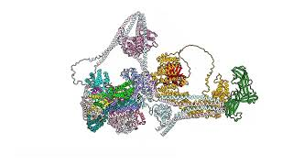

Thank you! Questions?
Watch the Commander Complex assemble!
Looking for people to work with/learn more about Machine Learning applied to Biology?
https://www.biomlsociety.org
We meet every other Thursday from 9:30am to 10:30am, in MBB 3.204
TACOS and COFFEE provided :)

