Slide 1
Introduction to NGS Analysis
Anna Battenhouse
abattenhouse@utexas.edu
March 8, 2022
Associate Research Scientist
Center for Biomedical Research Support (CBRS)
Bioinformatics Consulting Group (BCG)
Biomedical Research Computing Facility (BRCF)
Genome Sequencing & Analysis Facility (GSAF)
Center for Systems and Synthetic Biology (CSSB)
Ed Marcotte & Vishwanath Iyer labs

Slide 2
core processes
NGS Workflow
upstream processes
fastq
QC raw read sequences
no
experimental design
yes
has reference?
assembly
(genome or transcriptome)
map reads to reference
reference assembly
DNA/RNA isolation
fasta
metrics & QC
alignment metrics & QC
BAM
library preparation
basic analysis
(e.g. coverage, genes)
bed, gff, vcf, etc.
next-gen sequencing
further analysis & significance determination
(e.g. FPKM, peak or variant calls)
downstream processes
differential analysis
annotation
delivery of raw reads
confident calls
custom
analysis
motif analysis

Slide 3
Outline
Overview of sequencing technologies
NGS concepts and terminology
The FASTQ format and
raw data QC & preparation
Alignment to a reference

Slide 4
Part 1:
Overview of Sequencing Technologies
  High-throughput (“next gen”) sequencing
  Illumina short-read sequencing
  Long read sequencing

Slide 5
core processes
NGS Workflow
upstream processes
fastq
QC raw read sequences
no
experimental design
yes
has reference?
assembly
(genome or transcriptome)
map reads to reference
reference assembly
DNA/RNA isolation
fasta
metrics & QC
alignment metrics & QC
BAM
library preparation
basic analysis
(e.g. coverage, genes)
bed, gff, vcf, etc.
next-gen sequencing
further analysis & significance determination
(e.g. FPKM, peak or variant calls)
downstream processes
differential analysis
annotation
delivery of raw reads
confident calls
custom
analysis
motif analysis

Slide 6
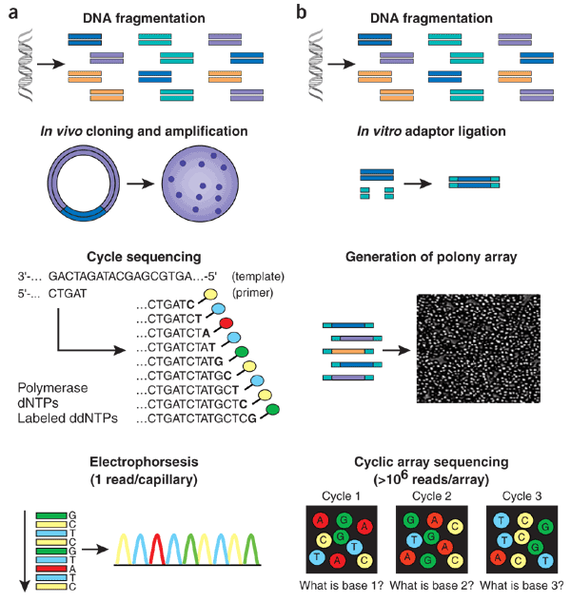
“Next Generation” sequencing
Sanger
NGS
Massively parallel
  simultaneously sequence “library” of millions of different DNA fragments
PCR colony clusters generated
  individual template DNA fragments titrated onto a flowcell to achieve
  inter-fragment separation
  PCR “bridge amplification” creates clusters of identical molecules
Sequencing by synthesis
  fluorescently-labeled dNTs added
  incorporation generates signal
  flowcell image captured after each cycle
  images computationally converted
  to base calls (including a quality score)
  results in 30 – 300 base “reads”
    much shorter than Sanger sequencing
(sequencing adapter)
→ Single type of molecule
→ Many different molecules
polony = PCR colony cluster
Shendure et al, Nature Biotechnology. 2008.
https://www.nature.com/articles/nbt1486

Slide 7
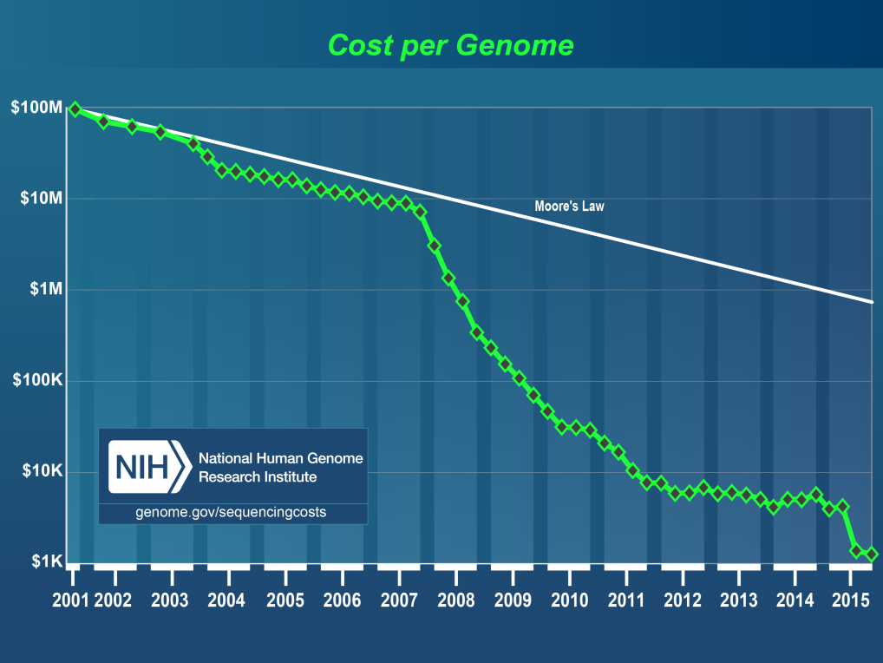
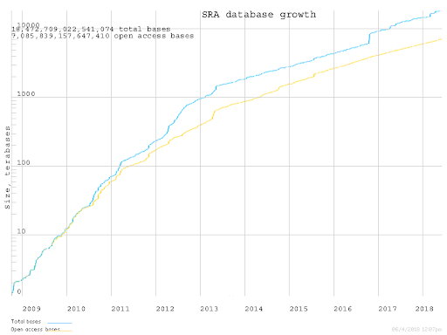
“Next Generation” sequencing
(2nd generation)
Pro’s:
  much faster!
  much lower cost!
  both deeper and wider coverage!
Con’s:
  data deluge!
  storage requirements!
  analysis lags!
10¹⁶ bases
(10 PetaBase)
& growing
SRA = Sequence Read Archive
(NCBI public sequence database)

Slide 8
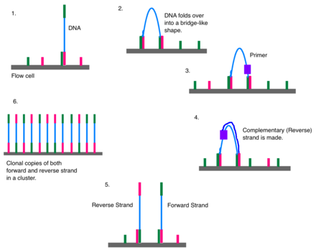
Illumina sequencing
Library preparation
Cluster generation via bridge amplification
Sequencing by synthesis
Image capture
Convert to base calls
  Short Illumina video
  (https://tinyurl.com/hvnmwjb)
Note
  2 PCR amplifications performed
    during library preparation
    during cluster generation
  amplification always introduces bias!
https://en.wikipedia.org/wiki/Illumina_dye_sequencing

Slide 9
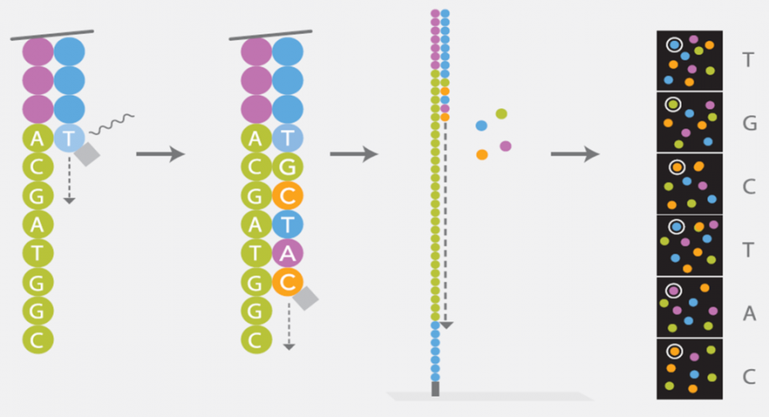
Illumina sequencing
Library preparation
Cluster generation via bridge amplification
Sequencing by synthesis
Image capture
Convert to base calls
http://www.cegat.de/

Slide 10
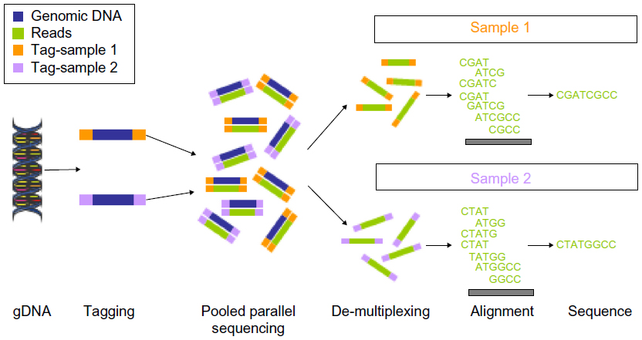
Multiplexing
Illumina sequencers have one or more flowcell “lanes”,
each of which can generate millions of reads
  ~20M reads/lane for MiSeq, ~10G reads/lane for NovaSeq
When less than a full flowcell lane is needed, multiple samples with different barcodes (a.k.a. indexes) can be run on the same lane
  6-8 bp library barcode attached to DNA library fragments
  data from sequencer must be demultiplexed
  to determine which reads belong to which library
https://doi.org/10.2147/BLCTT.S51503

Slide 11
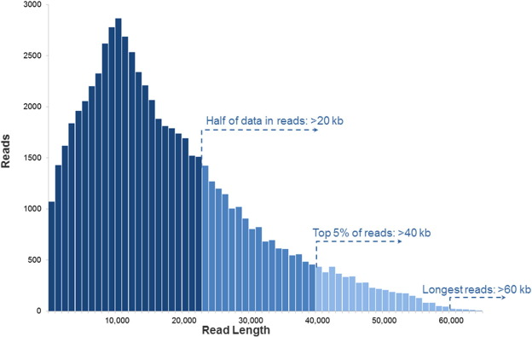

Long read sequencing
Short read technology limitations
  30 – 300 base reads (150 typical)
  PCR amplification bias
  short reads are difficult to assemble
    e.g., too short to span a long repeat region
  difficult to detect large structural variations
  like inversions
Newer “single molecule” sequencing
  sequences single molecules, not clusters
  allows for much longer reads (multi-Kb!)
    no signal wash-out due to lack of
    synchronization among cluster molecules
  but:
  weaker signal leads to high error rate
    10% vs <1% for Illumina
    and fewer reads are generated (~100 K)

Slide 12
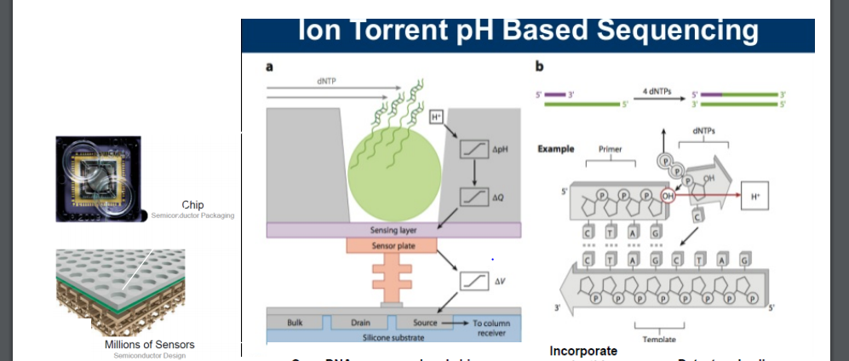
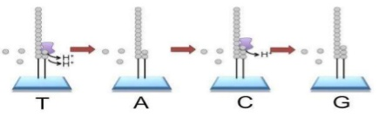
Long read sequencing
Oxford Nanopore ION technology systems (e.g. MinION)
  https://nanoporetech.com/
  DNA “spaghetti’s” through tiny protein pores
  Addition of different bases produces different pH changes
    measured as different changes in electrical conductivity
  MinION is hand-held, starter kit costs ~$1,000 – including reagents!
    inexpensive, but high error rates (~10%)

Slide 13
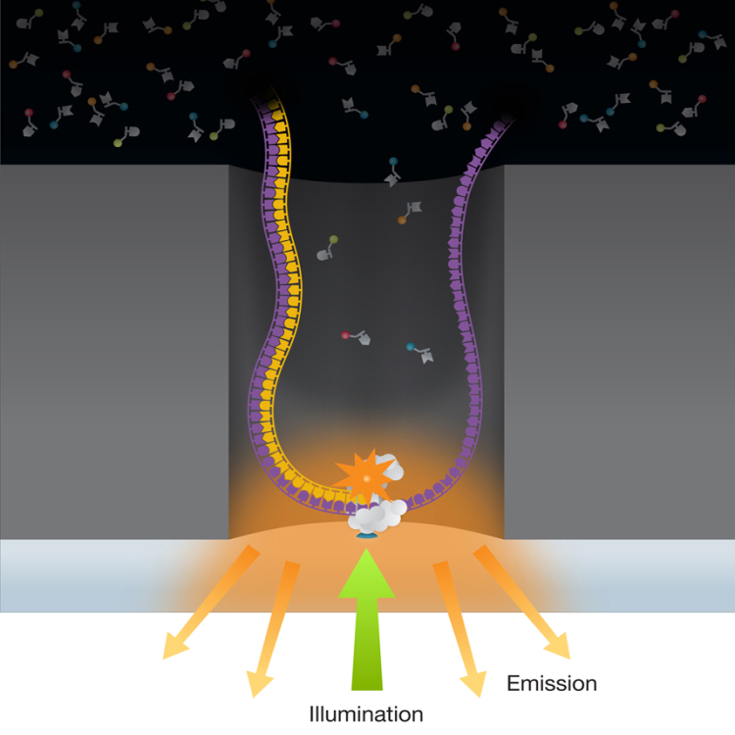
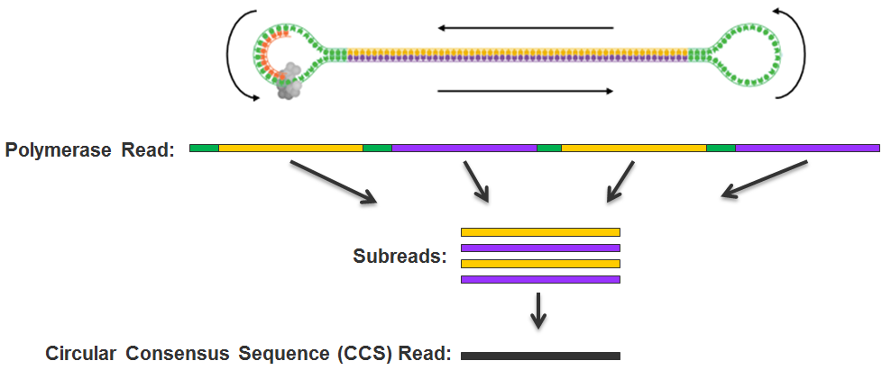
Long read sequencing
PacBio SMRT system
  http://www.pacb.com/smrt-science/smrt-sequencing/
  Sequencing by synthessis in Zero-Mode Waveguide (ZMW) wells
  DNA is circularized then repeatedly sequenced to achieve “consensus”
    reduces error rate (~1-2%), but equipment quite expensive

Slide 14
Part 2:
NGS Concepts
& Terminology
  Experiment types & library complexity
  Sequencing terminology
  Sequence duplication issues

Slide 15
core processes
NGS Workflow
upstream processes
fastq
QC raw read sequences
no
experimental design
yes
has reference?
assembly
(genome or transcriptome)
map reads to reference
reference assembly
DNA/RNA isolation
fasta
metrics & QC
alignment metrics & QC
BAM
library preparation
basic analysis
(e.g. coverage, genes)
bed, gff, vcf, etc.
next-gen sequencing
further analysis & significance determination
(e.g. FPKM, peak or variant calls)
downstream processes
differential analysis
annotation
delivery of raw reads
confident calls
custom
analysis
motif analysis

Slide 16
Library Complexity
Library complexity (diversity)
is a measure of the number of
distinct molecular species in the library.
Many different molecules → high complexity
Few different molecules → low complexity
The number of different molecules in a library depends on enrichment performed during
library construction.

Slide 17
Popular Experiment Types
Whole Genome sequencing (WGS)
  library: all genomic DNA
  complexity: high (fragments must cover the entire genome)
  applications: genome assembly, variant analysis
Exome sequencing (WXS)
  library: DNA from eukaryotic exonic regions (uses special kits)
  complexity: high/med (only ~5% of eukaryotic genome is in exons)
  applications: polymorphism/SNP detection; genotyping
RNA-seq
  library: extracted RNA converted to cDNA
  complexity: med/high (only a subset of genes are expressed in any given tissue)
  applications: differential gene expression
Amplicon panels (targeted sequencing)
  library: DNA from a set of PCR-amplified regions using custom primers
  complexity: very low (only 1 to a few thousand different library molecules)
  applications: genetic screening panels; metagenomics; mutagenesis

Slide 18
Type | Library construction | Applications | Complexity
Whole genome (WGS) | extract genomic DNA & fragment | Genome assembly Variant detection, genotyping | high
Bisulfite sequencing | bisulfite treatment converts C → U but not 5meC | Methylation profiling (CpG) | high
RAD-seq, ddRAD | restriction-enzyme digest DNA & fragment | Variant detection (SNPs) Population genetics, QTL mapping | high
Exome (WXS) | capture DNA from exons only (manufacturer kits) | Variant detection, genotyping | high-medium
ATAC-seq | high-activity transposase cuts DNA & ligates adapters | Profile nucleosome-free regions (“open chromatin”) | medium-high
RNA-seq, Tag-seq | extract RNA & fragment convert to cDNA | Differential gene or isoform expression Transcriptome assembly | medium, medium-low for Tag-seq
Transposon seq (Tn-seq) | create library of transposon-mutated genomic DNA amplify mutants via Tn-PCR | Charcterize genotype/phenotype relationships w/high sensitivity | medium
ChIP-seq | cross-link proteins to DNA pull-down proteins of interest w/ specific antibody, reverse cross-links | Genome-wide binding profiles of transcription factors, epigenetic marks & other proteins | medium (but variable)
GRO-seq | isolate actively-transcribed RNA | Characterize transcriptional dynamics | medium-low
RIP-seq | like ChIP-seq, but with RNA | Characterize protein-bound RNAs | low-medium
miRNA-seq | isolate 15-25bp RNA band | miRNA profiling | low
Amplicons | amplify 1-1000+ genes/regions | genotyping, metagenomics, mutagenesis | low

Slide 19
Library complexity is primarily a function of experiment type
higher complexity
Less enrichment for specific sequences
Higher diversity of library molecules
Lower sequence duplication expected
More sequencing depth required
genomic
bisulfite-seq
exon capture
… as well as…
genome size & sequencing depth
library construction skill & luck!
RNA-seq
ChIP-seq
amplicons
Lower diversity of library molecules
Higher sequence duplication expected
Less sequencing depth required
More enrichment for specific sequences
lower complexity
Notes:
Even Amelia Hall’s CTCF ChIP-seq experiments occasionally failed.

Slide 20
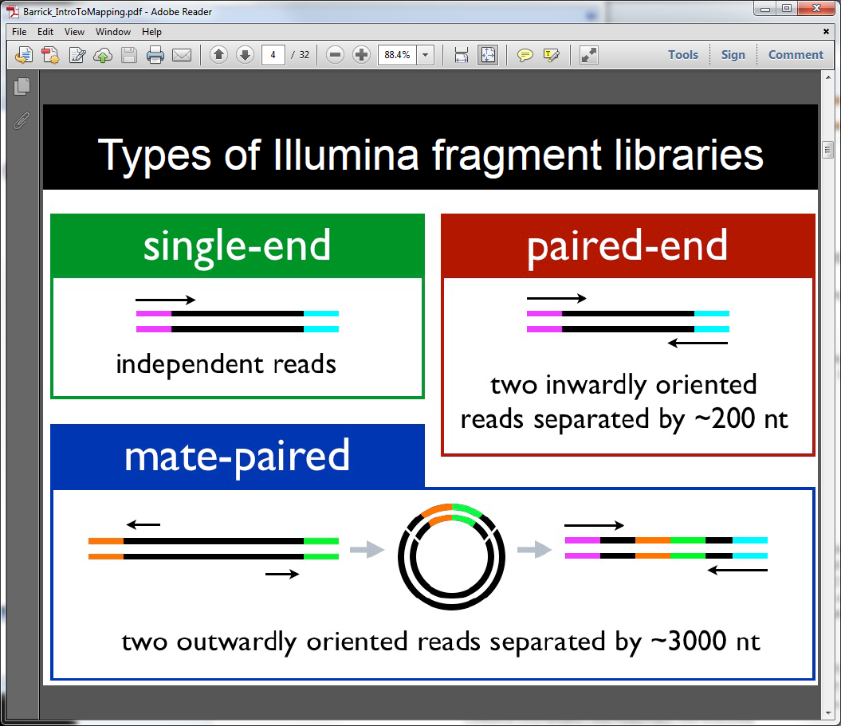
Read types
R1
R1
R2
alternative to long reads
rarely used now (expensive)

Slide 21
Reads and Fragments
With paired-end sequencing, keep in mind the
distinction between
  the library fragment from your library that was sequenced
    also called inserts
  the sequence reads (R1s & R2s) you receive
    also called tags
An R1 and its associated R2 form a read pair
  a readout of part (or all) of the fragment molecule
adapter
library fragment (insert)
adapter
R1 reads
R2 reads

Slide 22
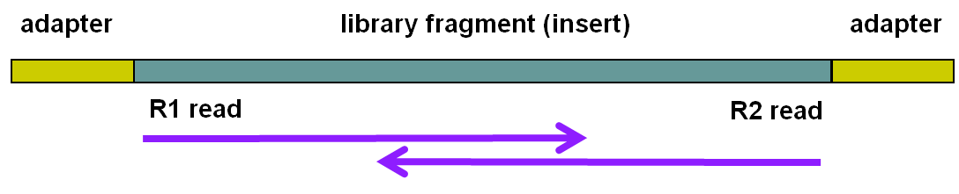
Single end vs Paired end
single end (SE) reads are less expensive
paired end (PE) reads can be mapped more reliably
  especially against lower complexity genomic regions
    an unmapped read can be “rescued” if its mate maps well
  they provide more bases around a locus
    e.g. for analysis of polymorphisms
  actual fragment sizes can be easily determined
    from the alignment records for each dual-mapping “proper pair”
  also help distinguish the true complexity of a library
    by clarifying which fragments are duplicates (vs read duplicates)
  but PE reads are more expensive – and larger
    more storage space and processing time required
General guidelines
  use PE for high location accuracy and/or base-level sensitivity
  use SE for lower-complexity experiment types

Slide 23
Sequence Duplication
The set of sequences you receive can contain exact duplicates
Duplication can arise from:
  sequencing of species enriched in your library (biological – good!)
    each read comes from a different DNA molecule
  sequencing of artifacts (technical – bad!)
    differentially amplified PCR species (PCR duplicates)
      recall that 2 PCR amplifications are performed w/Illumina sequencing
  cannot tell which using standard sequencing methods!
Standard best practice is to “mark duplicates” during initial processing
  then decide what to do with them later…
    e.g. retain (use all), remove (use only non-duplicates), dose (use some)
Different experiment types have different expected duplication

Slide 24
Expected sequence duplication is primarily a function of experiment type
higher complexity
Less enrichment for specific sequences
Higher diversity of library molecules
Lower sequence duplication expected
More sequencing depth required
genomic
bisulfite-seq
exon capture
… as well as…
genome size & sequencing depth
library construction skill & luck!
RNA-seq
ChIP-seq
amplicons
Lower diversity of library molecules
Higher sequence duplication expected
Less sequencing depth required
More enrichment for specific sequences
lower complexity
Notes:
Iyer lab bad Exon capture kit

Slide 25
Read vs Fragment duplication
Consider the 4 “aligned” fragments below
  4 R1 reads (pink), 4 R2 reads (blue)
Duplication when only 1 end considered
  A1, B1, C1 have identical sequences, D1 different
    2 unique + 2 duplicates = 50% duplication rate
  B2, C2, D2 have identical sequences, A2 different
    2 unique + 2 duplicates = 50% duplication rate
Duplication when both ends considered
  fragments B and C are duplicates (same external sequences)
    3 unique + 1 duplicate = 25% duplication rate
A1
A2
B1
B2
C1
C2
D1
D2

Slide 26
Molecular Barcoding
Resolves ambiguity between biological and technical
(PCR amplification) duplicates
  adds secondary, internal barcodes to pre-PCR molecules
    a.k.a UMIs (Unique Molecular Indexes)
  combination of barcodes + insert sequence provides accurate quantification
  but requires specialized pre- and post-processing
    e.g. UMI de-duplication for 3’ Tag-seq, scRNA-seq
Original library
naive count
Amplified library
barcode-aware
count
actual
count
molecule A-1
molecule A-1
molecule A-1
A : 2
A : 3
A : 2
molecule A-2
molecule A-2
B : 1
molecule B
B : 3
molecule B
B : 1
molecule B
molecule B
A/B
2/1
A/B
1/1
A/B
2/1

Slide 27
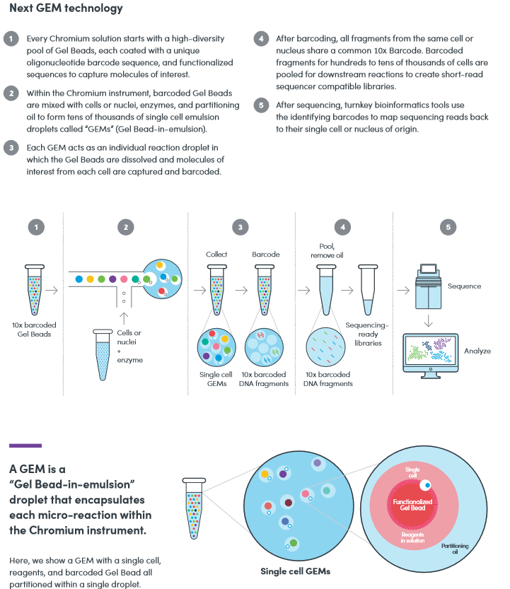
Single Cell sequencing
Standard sequencing library starts with millions of cells
  will be in different states unless synchronized
  a heterogeneous “ensemble” with (possibly) high cell-to-cell variability
Single cell sequencing technologies aim to capture this variability
  examples:
    cells in different layers/regions of somatic tissue
    cells in different areas of a tumor
  essentially a very sophisticated library preparation technique
Typical protocol (RNA-seq)
  isolate a few thousand cells (varying methods)
  the single-cell platform partitions each cell into an emulsion droplet
    e.g. 10x Genomics (https://www.10xgenomics.com/solutions/single-cell/)
  a different barcode is added to the RNA in each cell
  resulting library submitted for standard Illumina short-read sequencing
  custom downstream analysis links results to their cell (barcode) of origin

Slide 28
Part 3:
The FASTQ format,
Data QC & preparation
  The FASTQ format
  QC of raw sequences with FastQC tool
  Dealing with adapters

Slide 29
core processes
NGS Workflow
upstream processes
fastq
QC raw read sequences
no
experimental design
yes
has reference?
assembly
(genome or transcriptome)
map reads to reference
reference assembly
DNA/RNA isolation
fasta
metrics & QC
alignment metrics & QC
BAM
library preparation
basic analysis
(e.g. coverage, genes)
bed, gff, vcf, etc.
next-gen sequencing
further analysis & significance determination
(e.g. FPKM, peak or variant calls)
downstream processes
differential analysis
annotation
delivery of raw reads
confident calls
custom
analysis
motif analysis

Slide 30
FASTQ format
Text format for storing sequence and quality data
  http://en.wikipedia.org/wiki/FASTQ_format
4 lines per sequence:
  @read name (plus extra information after a space)
    R1 and R2 reads have the same read name
  called base sequence (ACGTN)
    always 5’ to 3’; usually excludes 5’ adapter
  +optional read information
  base quality scores encoded as text characters
FASTQ representation of a single, 50 base R2 sequence
@HWI-ST1097:97:D0WW0ACXX:4:1101:2007:2085 2:N:0:ACTTGA
ATTCTCCAAGATTTGGCAAATGATGAGTACAATTATATGCCCCAATTTACA
+
?@@?DD;?;FF?HHBB+:ABECGHDHDCF4?FGIGACFDFH;FHEIIIB9?

Slide 31
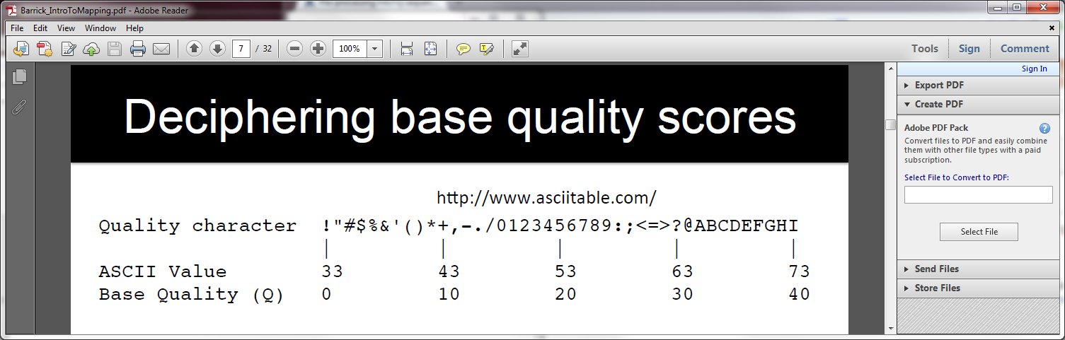
FASTQ quality scores
Base qualities expressed as Phred scores
  log scaled, higher = better
  20 = 1/10² = 1/100 errors, 30 = 1/10³ = 1/1000 errors
Integer Phred score converted to Ascii character (add 33)
Probability of Error = 10^{-Q/10}
J
?@@?DD;?;FF?HHBB+:ABECGHDHDCF4?FGIGACFDFH;FHEIIIB9?

Slide 32
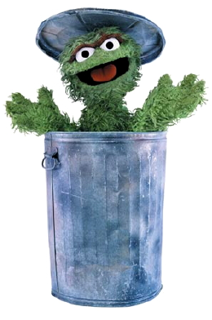
Raw sequence quality control
Critical step! Garbage in = Garbage out
  general sequence quality
    base quality distributions
    sequence duplication rate
  trim 3’ bases with poor quality?
    important for de novo assembly
  trim 3’ adapter sequences?
    important for RNAseq
  other contaminents?
    biological – rRNA in RNAseq
    technical – samples sequenced w/other barcodes

Slide 33
3’ Adapter contamination
A. reads short compared to fragment size (no contamination)
adapter
~200 base library fragment
adapter
5’
3’
50 base R1 read
3’
5’
50 base R2 read
B. Reads long compared to library fragment (3’ adapter contamination)
~100 base library fragment
5’
3’
150 base R1 read
3’
5’
150 base R2 read
The presence of the 3’ adapter sequence in the read can cause problems during alignment, because it does not match the genome.

Slide 34
FastQC
Quality Assurance tool for FASTQ sequences
http://www.bioinformatics.babraham.ac.uk
Most useful reports:
  Per-base sequence quality Report
    Should I trim low quality bases?
  Sequence duplication levels Report
    How complex is my sequence library?
  Overrepresented sequences Report
    Do I need to remove adapter sequences?

Slide 35
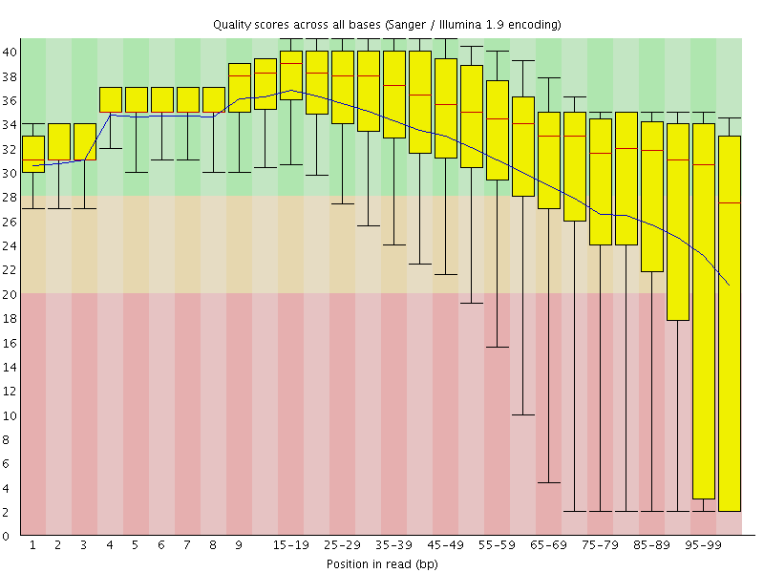
1. FastQC Per-base sequence quality report

Slide 36
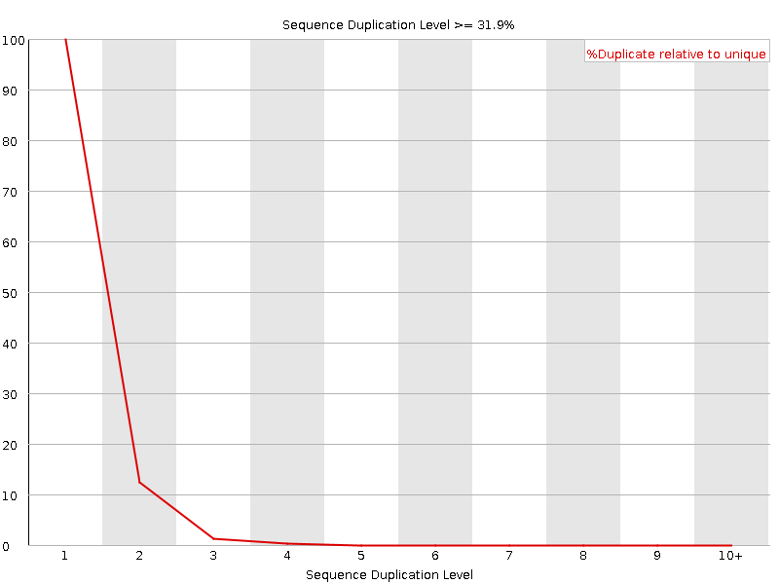
2. FastQC Sequence duplication report
Yeast ChIP-seq
For every 100 unique sequences there are:
~12 sequences w/2 copies
~1-2 with 3 copies
Ok – Some duplication expected due to IP enrichment

Slide 37
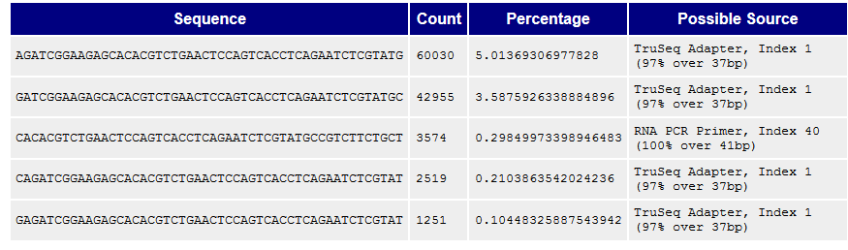
3. FastQC Overrepresented sequences report
FastQC knows Illumina adapter sequences
Here ~9-10% of sequences contain adapters
  calls for adapter removal or trimming

Slide 38
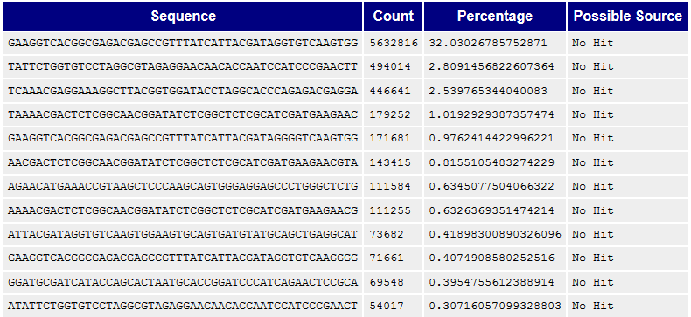
3. Overrepresented sequences
Here nearly 1/3 of sequences some type
of non-adapter contamination
  BLAST the sequence to identify it

Slide 39
Dealing with 3’ adapters
Three main options:
  Hard trim all sequences by specific amount
      e.g. trim 100 base reads to 50 bases
    Pro: fast & easy to perform; trims low-quality 3’ bases
    Con: removes information (bases) you might want
  Remove adapters specifically
      e.g. using specific tools (always needed for RNA-seq alignment)
    Pro: removes adapter contamination without losing sequenced bases
    Con: requires knowledge of insert fragment structure & adapters
  Perform a local alignment (vs global)
      e.g. bowtie2 --local or bwa mem
    Pro: mitigates adapter contamination while retaining full query sequence
    Con: limited aligner support

Slide 40
FASTQ trimming and adapter removal
Tools:
  cutadapt – https://code.google.com/p/cutadapt/
  trimmomatic – http://www.usadellab.org/cms/?page=trimmomatic
  FASTX-Toolkit – http://hannonlab.cshl.edu/fastx_toolkit/
Features:
  hard-trim specific number of bases
  trimming of low quality bases
  specific trimming of adapters
  support for trimming paired end read sets (except FASTX)
  cutadapt has protocol for separating reads based on internal barcode

Slide 41
Local vs. Global alignment
Global alignment
  requires query sequence to map fully (end-to-end) to reference
Local alignment
  allows a subset of the query sequence to map to reference
    “untemplated” adapter sequences will be “soft clipped” (ignored)
global (end-to-end) alignment of query
local (subsequence) alignment of query
CACAAGTACAATTATACAC
CTAGCTTATCGCCCTGAAGGACT
TACATACACAAGTACAATTATACACAGACA
TTAGTTCTTATCGCCCTGAAAATTCTCC
reference sequence

Slide 42
Part 4:
Alignment to a reference assembly
  Alignment overview & concepts
  Preparing a reference genome
  Alignment workflow steps

Slide 43
core processes
NGS Workflow
upstream processes
fastq
QC raw read sequences
no
experimental design
yes
has reference?
assembly
(genome or transcriptome)
map reads to reference
reference assembly
DNA/RNA isolation
fasta
metrics & QC
alignment metrics & QC
BAM
library preparation
basic analysis
(e.g. coverage, genes)
bed, gff, vcf, etc.
next-gen sequencing
further analysis & significance determination
(e.g. FPKM, peak or variant calls)
downstream processes
differential analysis
annotation
delivery of raw reads
confident calls
custom
analysis
motif analysis

Slide 44
Short Read Aligners
Short read mappers determine placement of query sequences
(your reads) against a known reference
  BLAST:
    one query sequence (or a few)
    many matches for each
  short read aligners
    many millions of query sequences
    want only one “best” mapping (or a few)
Many aligners available! Two of the most popular
  bwa (Burrows Wheeler Aligner) by Heng Li
    http://bio-bwa.sourceforge.net/
  bowtie2 – part of the Johns Hopkins Tuxedo suite of tools
    http://bowtie-bio.sourceforge.net/bowtie2/manual.shtml
  Given similar input parameters, they produce similar alignments
    and both run relatively quickly

Slide 45
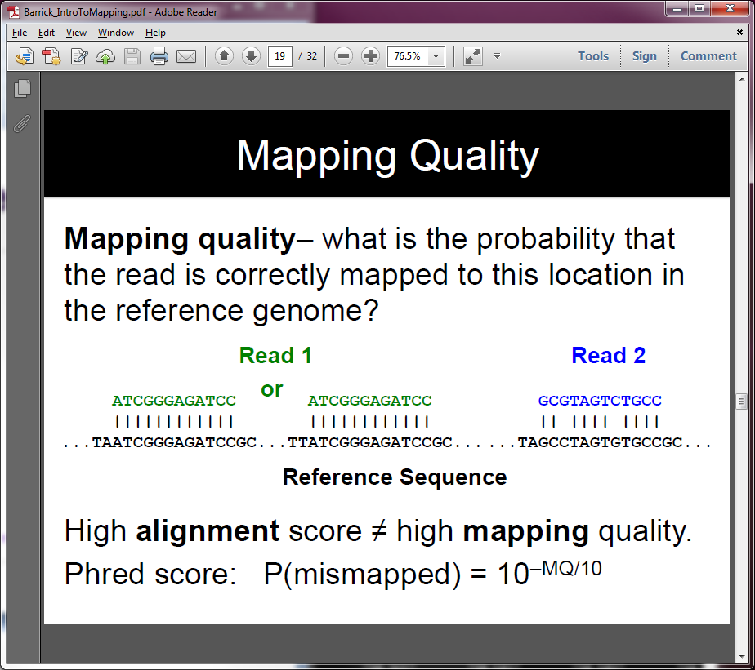
Mapping vs Alignment
Mapping determines one or more positions (a.k.a. seeds or hits)
where a read shares a short sequence with the reference
Alignment starts with the seed and determines how read bases
are best matched, base-by-base, around the seed
Mapping quality and alignment scores are both reported
  High mapping quality ≠ High alignment score
  mapping quality describes positioning
    reflects the probability that the read is incorrectly mapped to the reported location
    is a Phred score:
  alignment score describes fit
    reflects the correspondence between the read and the reference sequence
P(incorrectly mapped) = 10^{-mappingQuality/10}
Read 1
Read 2
Maps to one location
high mapping quality
Has 2 mismatches
low alignment score
Maps to 2 locations
low mapping quality
Matches perfectly
high alignment score
reference sequence

Slide 46
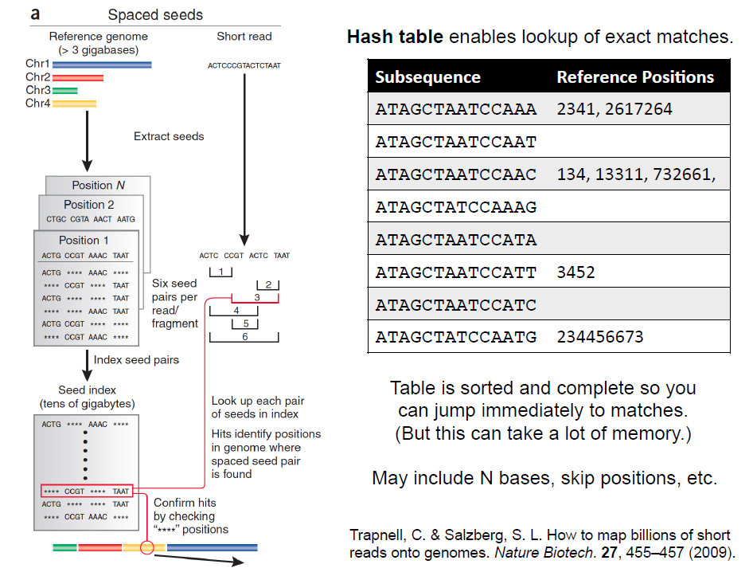
Mapping via hash table of seed sequences & positions

Slide 47
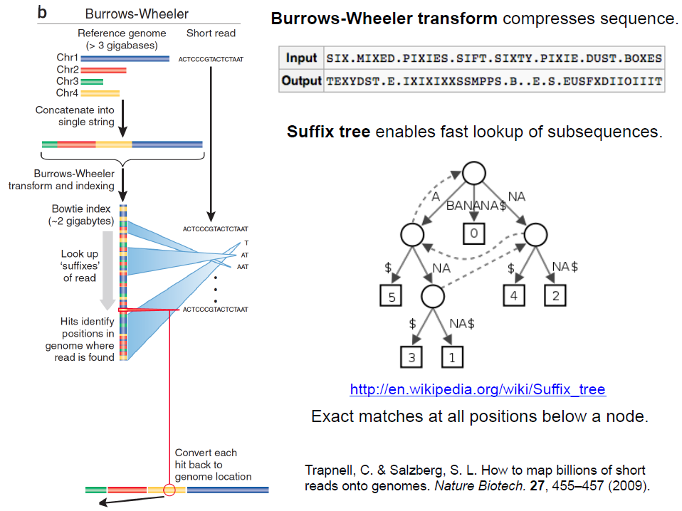
Mapping via
suffix array tree

Slide 48
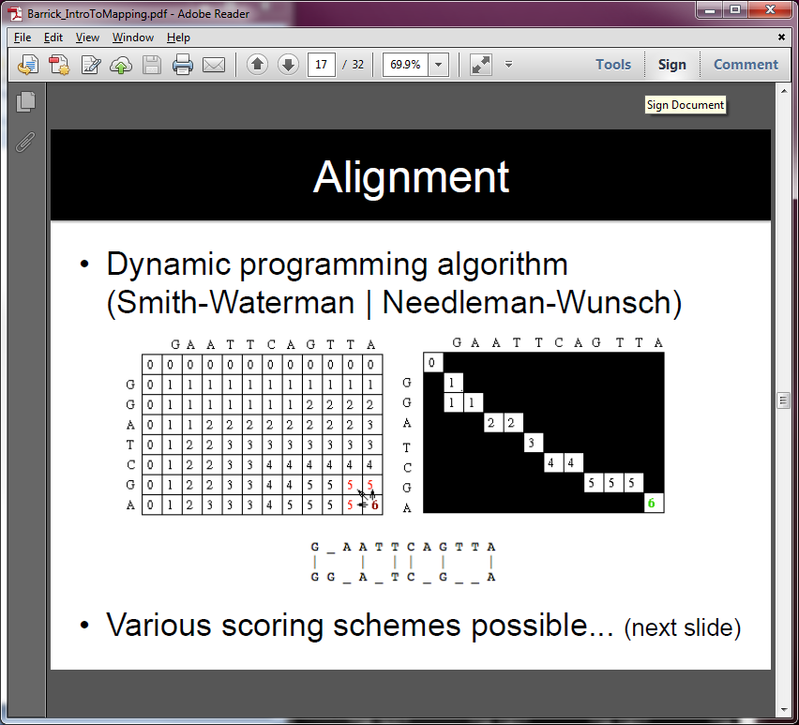
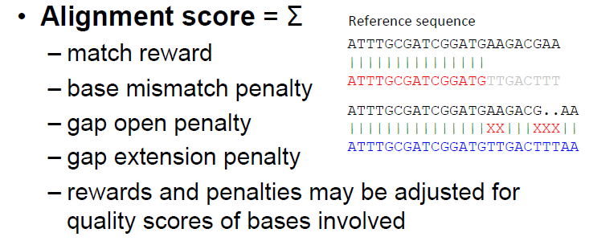
Alignment via dynamic programming
ii

Slide 49
Paired End mapping
Having paired-end reads improves mapping
  mapping one read with high confidence anchors the pair
    even when its mate read by itself maps several places equally
Three possible outcomes of mapping an R1/R2 pair
  only one of a pair might map (singleton/orphan)
  both reads can map within the most likely distance range and with correct orientation (proper pair)
  both reads can map but with an unexpected insert size or orientation, or to different contigs (discordant pair)
Insert fragment size is reported in the alignment record
  for both proper and discordant pairs

Slide 50
fastq
QC & trim raw reads
obtain reference genome
fastq
FastQC, cutadapt
bwa index
bowtie2-build
fasta
align reads to reference
build aligner-specific reference index
SAM
bwa aln + bwa samse or sampe,
bwa mem, or bowtie2
convert SAM to BAM
custom binary index
BAM
samtools view
sort BAM by position
Alignment Workflow
BAM
samtools sort
handle duplicates (optional)
Picard MarkDuplicates
samtools rmdup
BAM
index BAM
BAM + .bai
samtools index
alignment metrics & QC
http://bio-bwa.sourceforge.net/bwa.shtml
samtools flagstat
samtools idxstat
http://bowtie-bio.sourceforge.net/bowtie2/manual.shtml

Slide 51
Obtaining/building a reference
What is a reference?
  assembled genomes or transcriptomes
    Ensembl, UCSC, for eukaryotes
    NCBI RefSeq or GenBank for prokaryotes/microbes (prefer RefSeq)
  any set of named DNA sequences
    names can be chromosomes, genes, etc. (technically referred to as contigs)
Building a reference index (aligner-specific)
  may take several hours to build
    but you build each index once, use for multiple alignments
  requires FASTA files (.fa, .fasta) containing DNA sequences
    annotations (genome feature files, .gff) may also be used to build the index, but will definitely be needed for downstream analysis
>chrM Mitochondiral Chromosome
GATCACAGGTCTATCACCCTATTAACCACTCACGGGAGCTCTCCATGCAT
TTGGTATTTTCGTCTGGGGGGTGTGCACGCGATAGCATTGCGAGACGCTG
GAGCCGGAGCACCCTATGTCGCAGTATCTGTCTTTGATTCCTGCCTCATT
...
sequence name line
always starts with >
followed by a name and other (optional)
descriptive information
one or more line(s) of sequence characters
never starts with >

Slide 52
fastq
QC & trim raw reads
obtain reference genome
fastq
FastQC, cutadapt
bwa index
bowtie2-build
fasta
align reads to reference
build aligner-specific reference index
SAM
bwa aln + bwa samse or sampe,
bwa mem, or bowtie2
convert SAM to BAM
custom binary index
BAM
samtools view
sort BAM by position
Alignment Workflow
BAM
samtools sort
handle duplicates (optional)
Picard MarkDuplicates
samtools rmdup
BAM
index BAM
BAM + .bai
samtools index
alignment metrics & QC
http://bio-bwa.sourceforge.net/bwa.shtml
samtools flagstat
samtools idxstat
http://bowtie-bio.sourceforge.net/bowtie2/manual.shtml

Slide 53
SAM / BAM file format
Aligners take FASTQ as input, output alignments
in Sequence Alignment Map (SAM) format
  plain-text file format that describes how reads align to a reference
    http://samtools.github.io/hts-specs/SAMv1.pdf (the Bible)
    and now https://github.com/samtools/hts-specs/blob/master/SAMtags.pdf
SAM and BAM are two forms of the same data
  BAM – Binary Alignment Map
    same data in a custom compressed (gzip’d) format
    much smaller than SAM files
    when sorted + indexed, support fast random access (SAM files do not)
SAM file consists of
  a header (includes reference sequence names and lengths)
  alignment records, one for each sequence read
    alignments for R1 and R2 reads have separate records
    records have 11 fixed fields + extensible-format key:type:value tuples

Slide 54
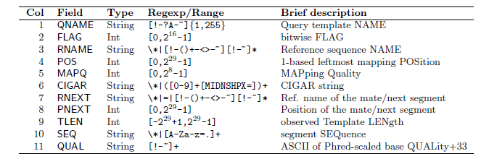
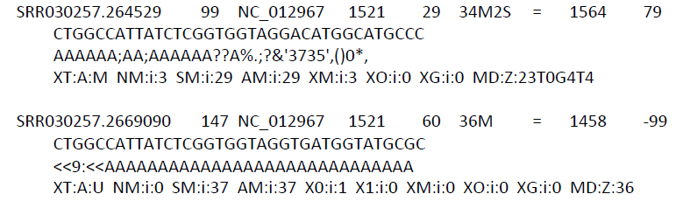
SAM file format
Fixed fields (tab-separated)
read name from fastq
s
contig + start = locus
use this to find end coordinate
insert size, if paired
positive
for plus strand reads
negative
for minus strand reads

Slide 55
fastq
QC & trim raw reads
obtain reference genome
fastq
FastQC, cutadapt
bwa index
bowtie2-build
fasta
align reads to reference
build aligner-specific reference index
SAM
bwa aln + bwa samse or sampe
bwa mem, or bowtie2
convert SAM to BAM
custom binary index
BAM
samtools view
sort BAM by position
Alignment Workflow
BAM
samtools sort
handle duplicates (optional)
BAM
Picard MarkDuplicates
samtools rmdup
index BAM
BAM + .bai
samtools index
alignment metrics & QC
http://broadinstitute.github.io/picard/
samtools flagstat
samtools idxstat
http://samtools.sourceforge.net/samtools.shtml

Slide 56
Sorting / indexing BAM files
SAM created by aligner contains read records in name order
  same order as read names in the input FASTQ file
    R1, R2 have adjacent SAM records
  SAM → BAM conversion does not change the name-sorted order
Sorting BAM puts records in position (locus) order
  by contig name then start position (leftmost)
  sorting is very compute, I/O and memory intensive!
    can take hours for large BAM
Indexing a locus-sorted BAM allows fast random access
  creates a small, binary alignment index file (.bai)
  quite fast

Slide 57
Handling Duplicates
Optional step, but very important for many protocols
Definition of alignment duplicates:
  single-end reads or singleton/discordant PE alignment reads
    alignments have the same start positions
  properly paired reads
    pairs have same external coordinates (5’ + 3’ coordinates of the insert)
Two choices for handling:
  samtools rmdup – removes duplicates entirely
    faster, but data is lost
  Picard MarkDuplicates – flags duplicates only (0x400 bam flag)
    slower, but all alignments are retained
  both tools are quirky in their own ways

Slide 58
fastq
QC & trim raw reads
obtain reference genome
fastq
FastQC, cutadapt
bwa index
bowtie2-build
fasta
align reads to reference
build aligner-specific reference index
SAM
bwa aln + bwa samse or sampe
bwa mem, or bowtie2
convert SAM to BAM
custom binary index
BAM
samtools view
sort BAM by position
Alignment Workflow
BAM
samtools sort
handle duplicates (optional)
BAM
Picard MarkDuplicates
samtools rmdup
index BAM
BAM + .bai
samtools index
alignment metrics & QC
samtools flagstat
samtools idxstat

Slide 59
Alignment metrics
  samtools flagstat
  simple statistics based on alignment record flag values
    total sequences (R1+R2), total mapped
    number properly paired
    number of duplicates (0 if duplicates were not marked)
161490318 + 0 in total (QC-passed reads + QC-failed reads)
0 + 0 secondary
0 + 0 supplementary
31602827 + 0 duplicates
158093331 + 0 mapped (97.90% : N/A)
161490318 + 0 paired in sequencing
80745159 + 0 read1
80745159 + 0 read2
153721151 + 0 properly paired (95.19% : N/A)
156184878 + 0 with itself and mate mapped
1908453 + 0 singletons (1.18% : N/A)
1061095 + 0 with mate mapped to a different chr
606632 + 0 with mate mapped to a different chr (mapQ>=5)

Slide 60
Alignment wrap up
Many tools involved
  choose one or two and learn their options well
Many steps are involved in the full alignment workflow
  important to go through manually a few times for learning
    but gets tedious quickly!
  best practice
    automate series of complex steps by wrapping into a pipeline script
    e.g. bash or python script
  the Bioinformatics team has a set of pipeline scripts
  available at TACC and BRCF “pods”
    align_bowtie2_illumina.sh, align_bwa_illumina.sh, trim_adapters.sh, etc.
    TACC: shared project directory /work/projects/BioITeam/common/script/
    BRCF pods: read-only mount /mnt/bioi/

Slide 61
Other NGS Resources at UT
CBRS training courses
  Intro to NGS, RNAseq, many others
    https://research.utexas.edu/cbrs/cores/cbb/educational-resources/
  “Summer School” (4 or 5 half-day sessions in June)
    lots of hands-on, including w/TACC
  Short courses (3-4 hour workshops)
Genome Sequencing & Analysis Facility (GSAF)
  Jessica Podnar, Director, gsaf@utgsaf.org
Bioinformatics consultants
  Dennis Wylie, Dhivya Arasappan, Benni Goetz, Anna
  BioITeam wiki – https://wikis.utexas.edu/display/bioiteam/
Biomedical Research Support Facility (BRCF)
  provides local compute and managed storage resources
    https://wikis.utexas.edu/display/RCTFUsers

