Slide 1
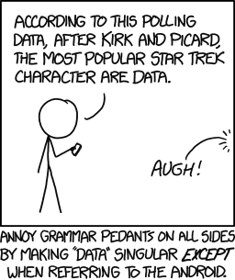
More data! Biological databases for
feeding your programs
Systems Biology / Bioinformatics
Edward Marcotte, Univ of Texas at Austin
https://xkcd.com/1429/

Slide 2
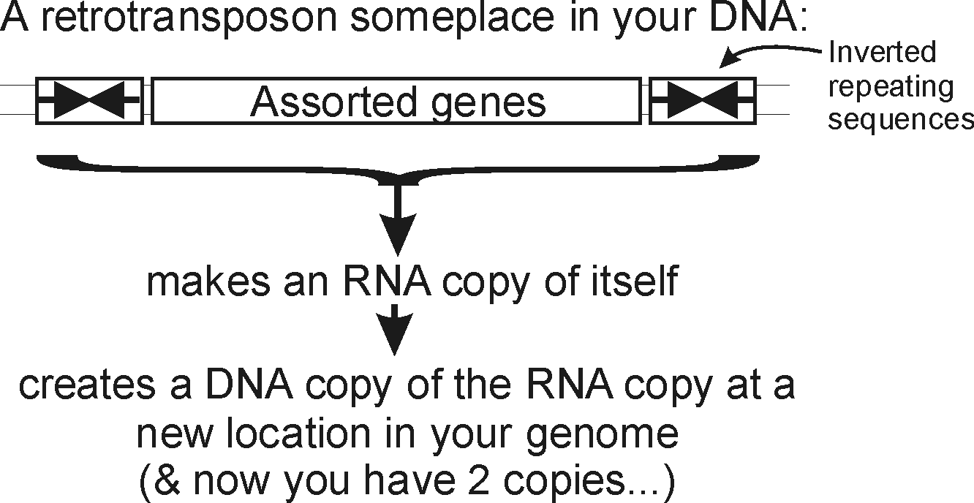
A quick aside to wrap up sequence alignments before we get started on databases:
You and your (DNA) parasites
Events like these, happening over and over again, have led to…

Slide 3
You and your (DNA) parasites
Major types of repeats in the human genome
Fraction of
genome
Length
Copies
LINEs
Autonomous
ORF1 ORF2 (pol)
AAA
6-8 kb
850,000
21%
Non-autonomous
A B
100-300 bp
1,500,000
13%
SINEs
AAA
Retrovirus-like
elements
Autonomous
gag pol (env)
6-11 kb
450,000
8%
Non-autonomous
(gag)
1.5-3 kb
DNA
transposon
fossils
Autonomous
transposase
2-3 kb
300,000
3%
Non-autonomous
80-3,000 bp
~45%
Bottom line: Roughly half of your (and my) genome is the fossil wreckage of genomic parasites.
We know this (in part) from sequence alignments.

Slide 4
So far, we’ve talked about
DNA, RNA (or rather, not RNA), and protein sequences
How to compare sequences to decide if they are related
Having databases full of sequences and comparing them rapidly (BLAST)
In fact, many such databases exist, so today we’ll start with a brief tour of some of the biological data on the web.

Slide 5
Database | Records | Address
BioGRID | >2 M protein interactions | https://thebiogrid.org
EcoCyc/MetaCyc | >3,200 pathways from >3,400 organisms | http://www.ecocyc.org, http://www.metacyc.org
Ensembl (+ BioMart for easy sequence queries) | Major repository of DNA sequences, genomes, genes, proteins, and transcripts | http://useast.ensembl.org/index.html
Entrez Genome | Millions of genome sequences | http://www.ncbi.nlm.nih.gov/genome?db=genome
Expression Atlas | 159K mRNA expression expts in 66 species | https://www.ebi.ac.uk/gxa/home/
Genbank | >5 triillion bases sequenced; > 33 trillion bases as whole genome shotgun data | https://www.ncbi.nlm.nih.gov/genbank/
Gene Expression Omnibus (GEO) | >7 M mRNA or protein expression expts | http://www.ncbi.nlm.nih.gov/geo/
Genomes Online Database (GOLD) | >500K genome sequences, many in progress | https://gold.jgi.doe.gov/index
Human Protein Atlas | millions of high-res images of ~17K human proteins across tissues, cancers, & cell lines | http://www.proteinatlas.org/
KEGG | Most known pathways, in >500 graphical diagrams and >10K organisms (via homology) | http://www.genome.ad.jp/kegg/
Medline / PubMed | >37 million references | https://www.ncbi.nlm.nih.gov/PubMed/
Mouse Genome Informatics | ~20,000 mouse genes, diverse associated data & annotations | http://www.informatics.jax.org/
Online Mendelian Inheritance in Man (OMIM) | Compendium of human genes and genetic phenotypes, data for >16,000 human genes | https://www.ncbi.nlm.nih.gov/omim/
Pride | Hundreds of millions of peptide mass spectra from 10’s of thousands of experiments | https://www.ebi.ac.uk/pride/archive/
Reactome | >2K pathways involving >11K human proteins, also other organisms | https://www.reactome.org/
SGD | ~6,000 yeast genes, diverse associated data & annotations | https://www.yeastgenome.org/
UniProtKB/SWISS-PROT | >570K hand-curated sequence entries from >14K organisms | https://www.uniprot.org/
Just some of the resources available for bioinformatics
Think of these as the raw data for new discoveries

Slide 6
Database | Records | Address
BioGRID | >2 M protein interactions | https://thebiogrid.org
EcoCyc/MetaCyc | >3,200 pathways from >3,400 organisms | http://www.ecocyc.org, http://www.metacyc.org
Ensembl (+ BioMart for easy sequence queries) | Major repository of DNA sequences, genomes, genes, proteins, and transcripts | http://useast.ensembl.org/index.html
Entrez Genome | Millions of genome sequences | http://www.ncbi.nlm.nih.gov/genome?db=genome
Expression Atlas | 159K mRNA expression expts in 66 species | https://www.ebi.ac.uk/gxa/home/
Genbank | >5 triillion bases sequenced; > 33 trillion bases as whole genome shotgun data | https://www.ncbi.nlm.nih.gov/genbank/
Gene Expression Omnibus (GEO) | >7 M mRNA or protein expression expts | http://www.ncbi.nlm.nih.gov/geo/
Genomes Online Database (GOLD) | >500K genome sequences, many in progress | https://gold.jgi.doe.gov/index
Human Protein Atlas | millions of high-res images of ~17K human proteins across tissues, cancers, & cell lines | http://www.proteinatlas.org/
KEGG | Most known pathways, in >500 graphical diagrams and >10K organisms (via homology) | http://www.genome.ad.jp/kegg/
Medline / PubMed | >37 million references | https://www.ncbi.nlm.nih.gov/PubMed/
Mouse Genome Informatics | ~20,000 mouse genes, diverse associated data & annotations | http://www.informatics.jax.org/
Online Mendelian Inheritance in Man (OMIM) | Compendium of human genes and genetic phenotypes, data for >16,000 human genes | https://www.ncbi.nlm.nih.gov/omim/
Pride | Hundreds of millions of peptide mass spectra from 10’s of thousands of experiments | https://www.ebi.ac.uk/pride/archive/
Reactome | >2K pathways involving >11K human proteins, also other organisms | https://www.reactome.org/
SGD | ~6,000 yeast genes, diverse associated data & annotations | https://www.yeastgenome.org/
UniProtKB/SWISS-PROT | >570K hand-curated sequence entries from >14K organisms | https://www.uniprot.org/
Biogrid has >2 M protein-protein interactions (https://thebiogrid.org/)
Just some of the resources available for bioinformatics
Think of these as the raw data for new discoveries
GEO has millions of experiments, each measuring 1000’s of mRNA or protein abundances
Medline has >37 million research articles, many with complete text online
OMIM = the most important resource for human genetic disease
Uniprot = a frequent
first step to learn about genes, proteins, and 3D structures. Also amazingly useful for interconverting IDs and linking to other resources

Slide 7
Live demo Ensembl->BioMart->filter for
[JOUBERT SYNDROME 5]-> CEP290, OMIM,
Reactome, Human Protein Atlas & OpenCell,
AlphaFold database (CEP290 is awful!)

Slide 8
It’s nice to know that all of this exists, but ideally, you’d like to be able to so something constructive with the data.
That means getting the data inside your own programs.
All of these databases let you download data in big batches, but this isn’t always the case, so….

Slide 9

Let’s empower your Python scripts to grab data from the web.
For a number of specific biological databases, you can use BioPython
BioPython lets you access sequence & structure databases, read fasta/genome files,
  do simple sequence analyses, BLAST, etc, right from your Python code
If you need to install it, just open an Anaconda prompt (on a PC) or launch a console window from Anaconda Navigator & type “pip install biopython”
e.g.
from Bio import Entrez
Entrez.email = "your_email@gmail.com" # Always tell NCBI who you are
handle = Entrez.efetch(db="nucleotide", id="EU490707", rettype="gb", retmode="text")
print(handle.read())
LOCUS EU490707 1302 bp DNA linear PLN 26-JUL-2016
DEFINITION Selenipedium aequinoctiale maturase K (matK) gene, partial cds;
chloroplast.
ACCESSION EU490707
VERSION EU490707.1
KEYWORDS .
SOURCE chloroplast Selenipedium aequinoctiale
ORGANISM Selenipedium aequinoctiale
…..
ORIGIN
1 attttttacg aacctgtgga aatttttggt tatgacaata aatctagttt agtacttgtg
61 aaacgtttaa ttactcgaat gtatcaacag aattttttga tttcttcggt taatgattct ….
There’s a complete pdf tutorial @ http://biopython.org/DIST/docs/tutorial/Tutorial.pdf

Slide 10
But for other kinds of web data there’s a more generic approach:
We’ll use Python library/module = an optional, specialized set of Python methods
This particular Python module is called urllib (Py3) or urllib2 (Py2)
urllib/urllib2 is:
A collection of programs/tools to let you to surf the web from inside your programs.
Much more powerful than the simple tasks we’ll do with it.
More details: https://docs.python.org/3.8/library/urllib.request.html
or http://docs.python.org/2/library/urllib2.html

Slide 11
The basic idea:
We first set up a “request” by opening a connection to the URL.
We then save the response in a variable and print it.
If it can’t connect to the site, it’ll print out a helpful error message instead of the page.
You can more or less use the commands in a cookbook fashion….

Slide 12
For example:
import urllib.request # include the urllib.request module
url = "https://www.utexas.edu/"
x = urllib.request.urlopen(url) # setup a request
print(x.read()) # read page and show the result to the user
Python 3 version

Slide 13
We can be slightly fancier in order to handle different formats and the inevitable internet connection errors
import urllib.request # include the urllib.request module
url = "https://www.utexas.edu/"
try: # this 'try' statement tells Python that we might expect an error.
request = urllib.request.urlopen(url) # setup a request
page = request.read().decode('utf-8') # save the response
print(page) # show the result to the user
except urllib.error.URLError: # handle a page not found error
print("Could not find page.")
→ Run this…
Python 3 version

Slide 14
→ We just captured the UT web page and printed it out…
>>>
<!doctype html>
<html lang="en" dir="ltr">
<head>
….
<h3 class="feature-headline">Change the World</h3>
<div class="feature-text">
<p>Longhorns are passionate about making the world a better place, united by the belief that creating and sharing knowledge can save lives and transform society. Come explore our vast research enterprise — or better yet, create, innovate and discover with us.</p>
</div>
</div>
…and so on, and on, and on…

Slide 15
That was (more or less) a static web page.
Let’s try one that requires some sort of action,
for example by entering a document id or an id code for a sequence.
Many web pages pass this information along in the web URL itself…

Slide 16
Here’s a complete Python program to retrieve a single entry from Medline:
import urllib.request
pmid = 11237011
# Insert the pmid where the {} are in the following URL:
url = "https://pubmed.ncbi.nlm.nih.gov/?term={0}[uid]&format=pubmed".format(pmid)
try: # there might be an error!
request = urllib.request.urlopen(url)
page = request.read().decode('utf-8')
print(page)
except urllib.error.URLError: # handle page not found error
print("Could not connect to Medline!")
Python 3 version

Slide 17
If you run that program, you should get back…
>>>
<!DOCTYPE html>
…..lots of metadata…..
OWN - NLM
STAT- MEDLINE
DCOM- 20010322
LR - 20210108
IS - 0028-0836 (Print)
IS - 0028-0836 (Linking)
VI - 409
IP - 6822
DP - 2001 Feb 15
TI - Initial sequencing and analysis of the human genome.
PG - 860-921
AB - The human genome holds an extraordinary trove of information about human
development, physiology, medicine and evolution. Here we report the results of an
international collaboration to produce and make freely available a draft sequence of
the human genome. We also present an initial analysis of the data, describing some
of the insights that can be gleaned from the sequence.
FAU - Lander, E S
AU - Lander ES
AD - Whitehead Institute for Biomedical Research, Center for Genome Research, Cambridge,
MA 02142, USA. lander@genome.wi.mit.edu
[and so on]
the Medline entry for the human genome sequence paper

Slide 18
If you run that program, you should get back…
>>>
<!DOCTYPE html>
…..lots of metadata…..
OWN - NLM
STAT- MEDLINE
DCOM- 20010322
LR - 20210108
IS - 0028-0836 (Print)
IS - 0028-0836 (Linking)
VI - 409
IP - 6822
DP - 2001 Feb 15
TI - Initial sequencing and analysis of the human genome.
PG - 860-921
AB - The human genome holds an extraordinary trove of information about human
development, physiology, medicine and evolution. Here we report the results of an
international collaboration to produce and make freely available a draft sequence of
the human genome. We also present an initial analysis of the data, describing some
of the insights that can be gleaned from the sequence.
FAU - Lander, E S
AU - Lander ES
AD - Whitehead Institute for Biomedical Research, Center for Genome Research, Cambridge,
MA 02142, USA. lander@genome.wi.mit.edu
[and so on]
We just printed it. We could have saved it or extracted data from it.
For example…

Slide 19
Here’s our Python program again to retrieve a single entry from Medline. How would we modify this to count the authors?
import urllib.request
pmid = 11237011
# Insert the pmid where the {} are in the following URL:
url = "https://pubmed.ncbi.nlm.nih.gov/?term={0}[uid]&format=pubmed".format(pmid)
try: # there might be an error!
request = urllib.request.urlopen(url)
page = request.read().decode('utf-8')
print(page)
except urllib.error.URLError: # handle page not found error
print("Could not connect to Medline!")
Python 3 version

Slide 20
Here’s our Python program again to retrieve a single entry from Medline. How would we modify this to count the authors?
import urllib.request
pmid = 11237011
# Insert the pmid where the {} are in the following URL:
url = "https://pubmed.ncbi.nlm.nih.gov/?term={0}[uid]&format=pubmed".format(pmid)
try: # there might be an error!
request = urllib.request.urlopen(url)
page = request.read().decode('utf-8')
print(page.count("AU - "))
except urllib.error.URLError: # handle page not found error
print("Could not connect to Medline!")
Medline begins author lines with "AU - " , so…
So, there were 256 authors on one (of the two) human genome papers
→ Run this, & get …
>>>
256
Python 3 version

Slide 21
Since this was PubMed, we could have done it in BioPython as well:
from Bio import Entrez
pmid = "11237011"
Entrez.email = "your_email@gmail.com" # Always tell NCBI who you are
handle = Entrez.efetch(db="pubmed", id=pmid, rettype="medline", retmode="text")
print(handle.read())
PMID- 11237011
OWN - NLM
STAT- MEDLINE
DCOM- 20010322
LR - 20240729
IS - 0028-0836 (Print)
IS - 0028-0836 (Linking)
VI - 409
IP - 6822
DP - 2001 Feb 15
TI - Initial sequencing and analysis of the human genome.
PG - 860-921
AB - The human genome holds an extraordinary trove of information about human
development, physiology, medicine and evolution. Here we report the results of an
international collaboration to produce and make freely available a draft sequence
of the human genome. We also present an initial analysis of the data, describing
some of the insights that can be gleaned from the sequence.
print(handle.read().count("AU - "))

Slide 22
Queries to Medline or any other NCBI database, including GenBank, are described at: http://www.ncbi.nlm.nih.gov/books/NBK3862/
(& for that matter, all of medline is downloadable)
You can often figure out the form of the URL just by looking something up in a database, then noting the address of the web page with the data.
This very simple approach could easily be the basis for:
  a home-made web browser
  a program to consult biological databases in real time
  a program to map the internet, etc.
Of course, with this kind of power available to you, the imagination reels...

