Slide 1
Assembling Genomes
BCH394P/364C Systems Biology / Bioinformatics
Edward Marcotte, Univ of Texas at Austin

Slide 2
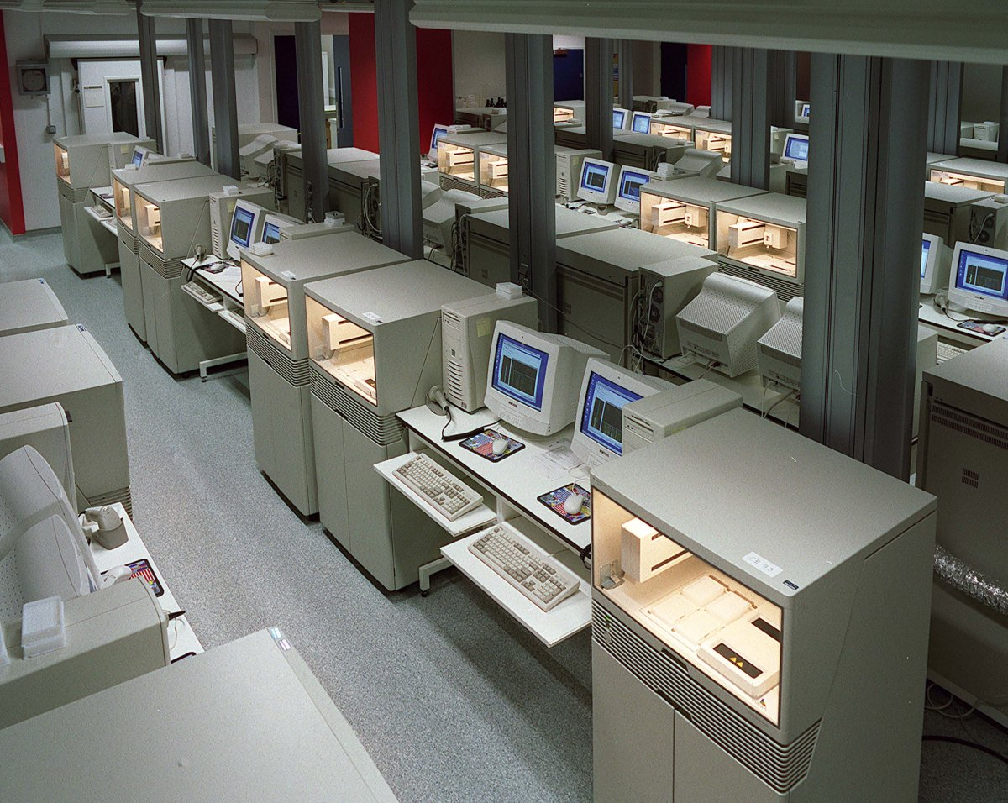
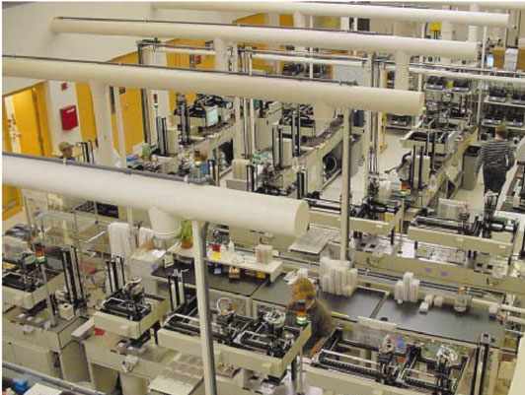
www.yourgenome.org/facts/timeline-the-human-genome-project
Nature 409, 860-921(2001)

Slide 3
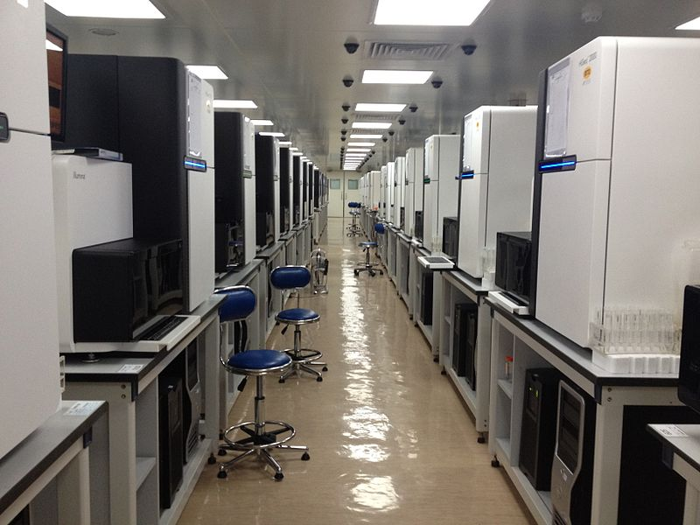
Beijing Genomics Institute
“If it tastes good you should sequence it...
you should know what's in the genes of that species”
Wang Jun, Chief executive, BGI
(Wikipedia)

Slide 4
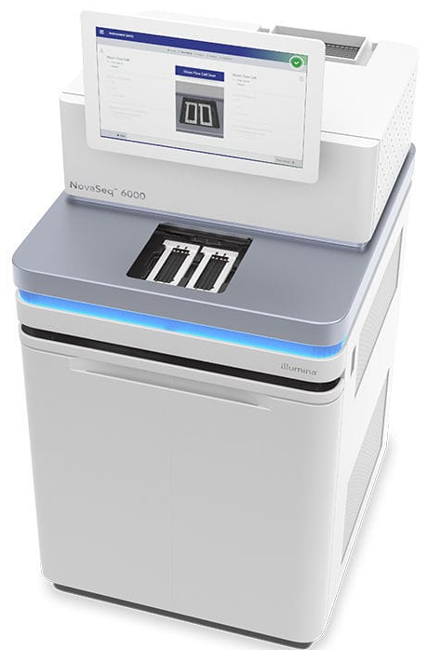
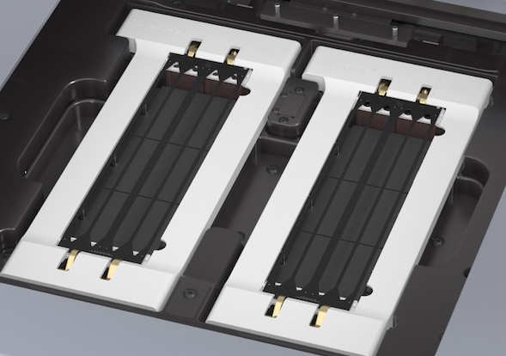
The NovaSeq in the UT GSAF core generates
>1.4 terabases of sequence in a 1-day run
Illumina
→ Many millions of 75-150 bp reads

Slide 5
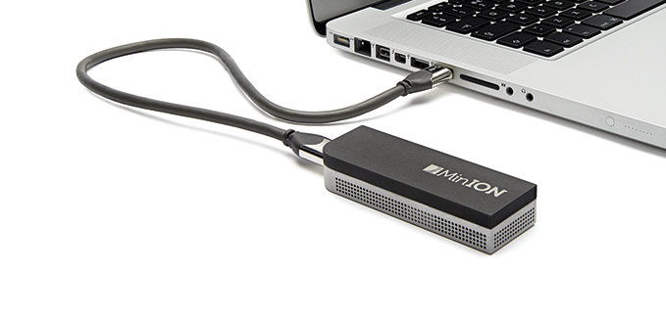
→ Thousands of 1,000 to 1,000,000 (ish) bp reads

Slide 6
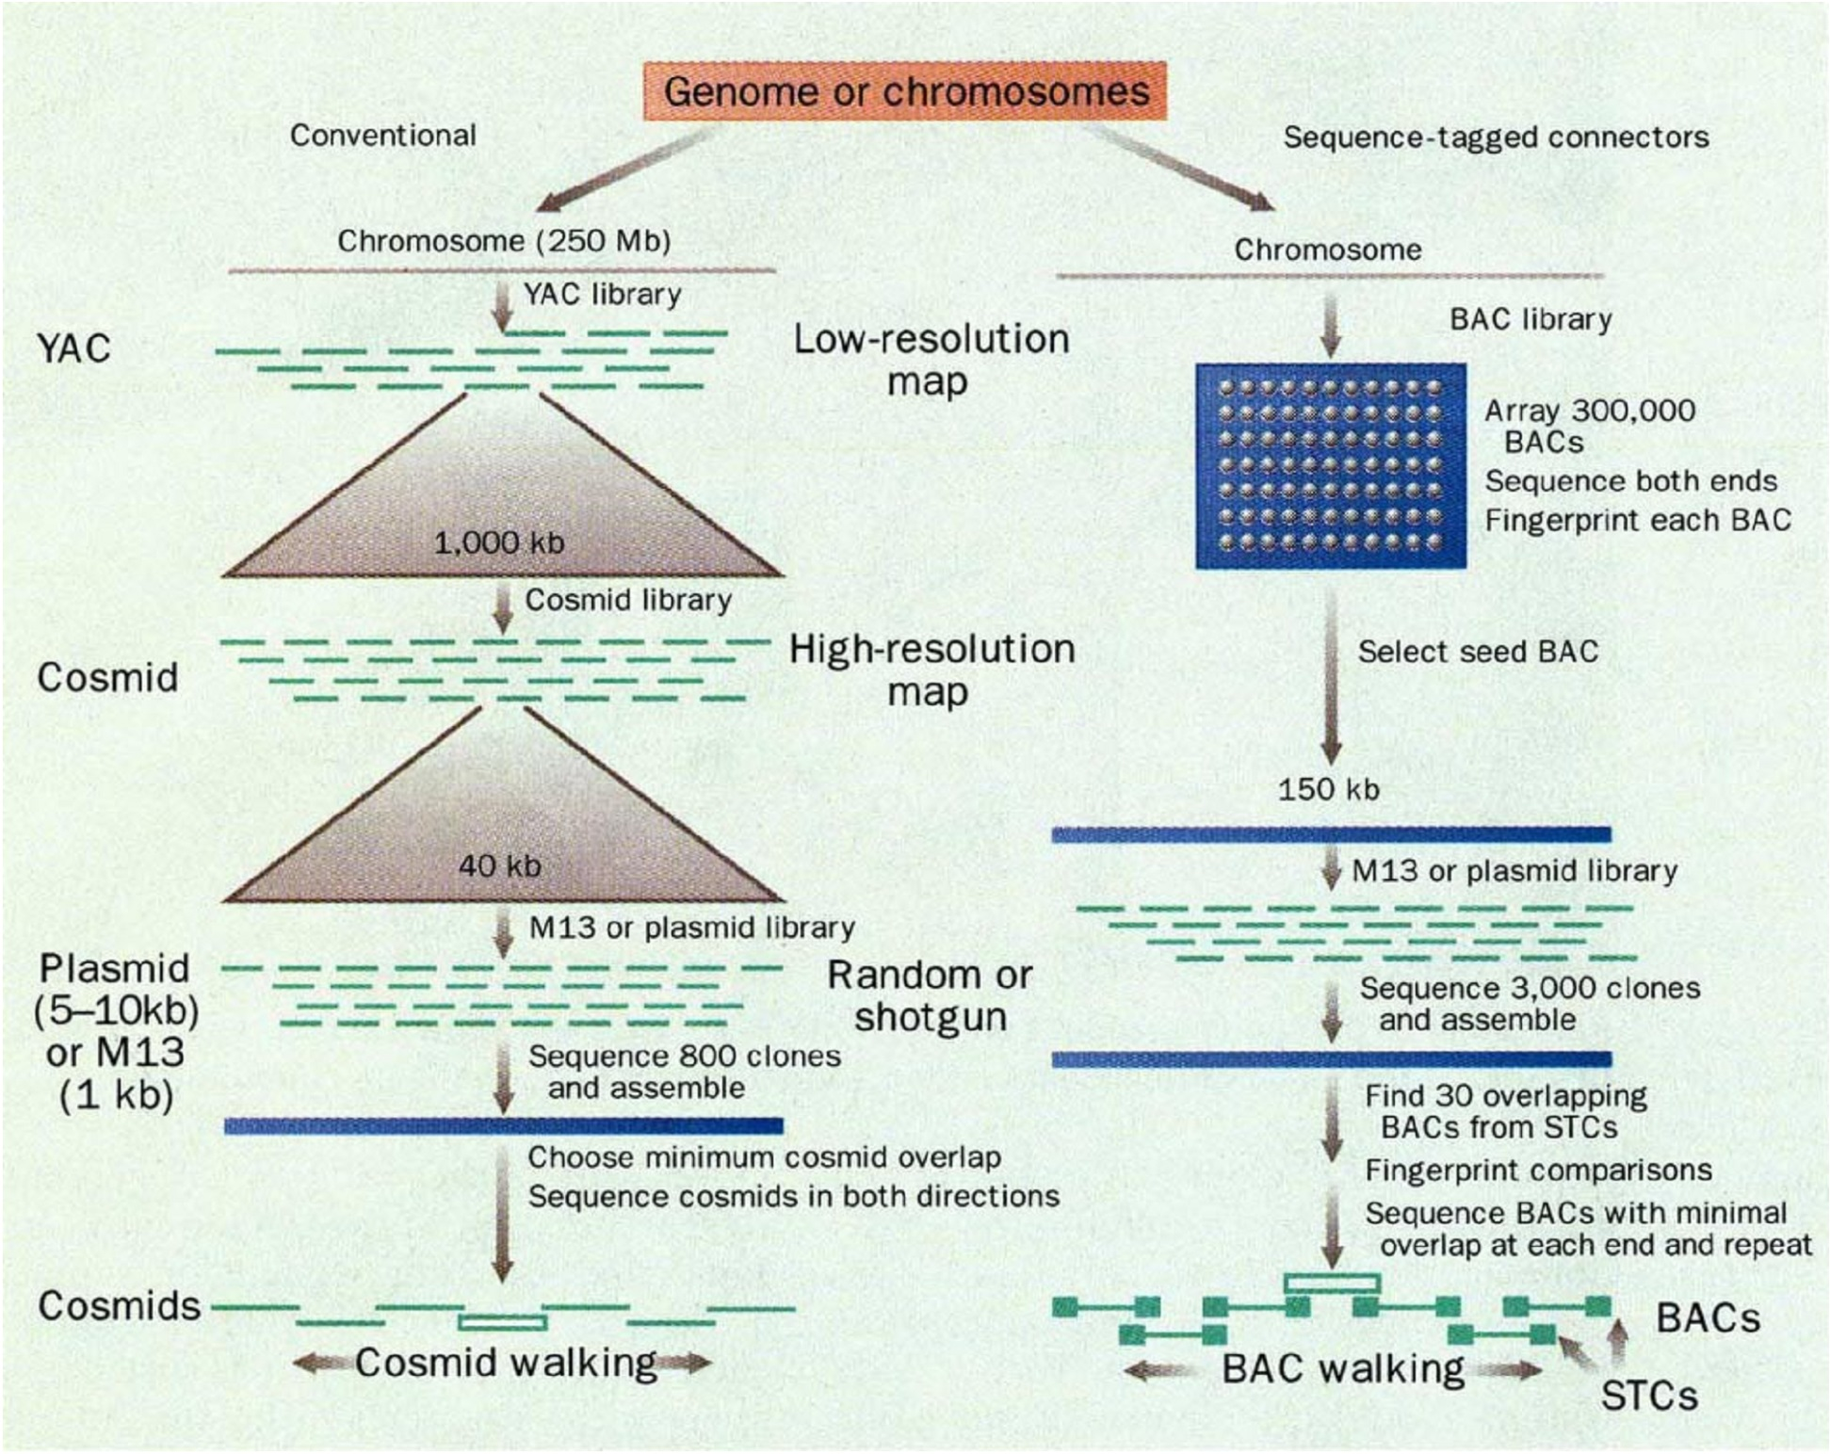
“mapping”
“shotgun” sequencing

Slide 7
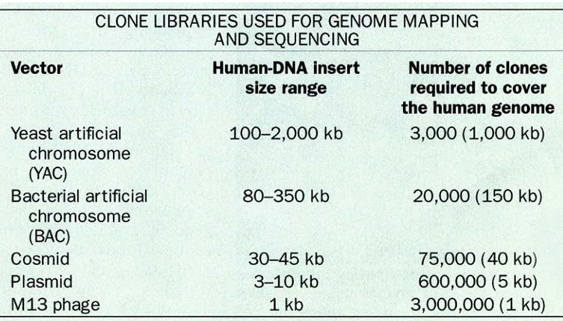
(Translating the cloning jargon)

Slide 8
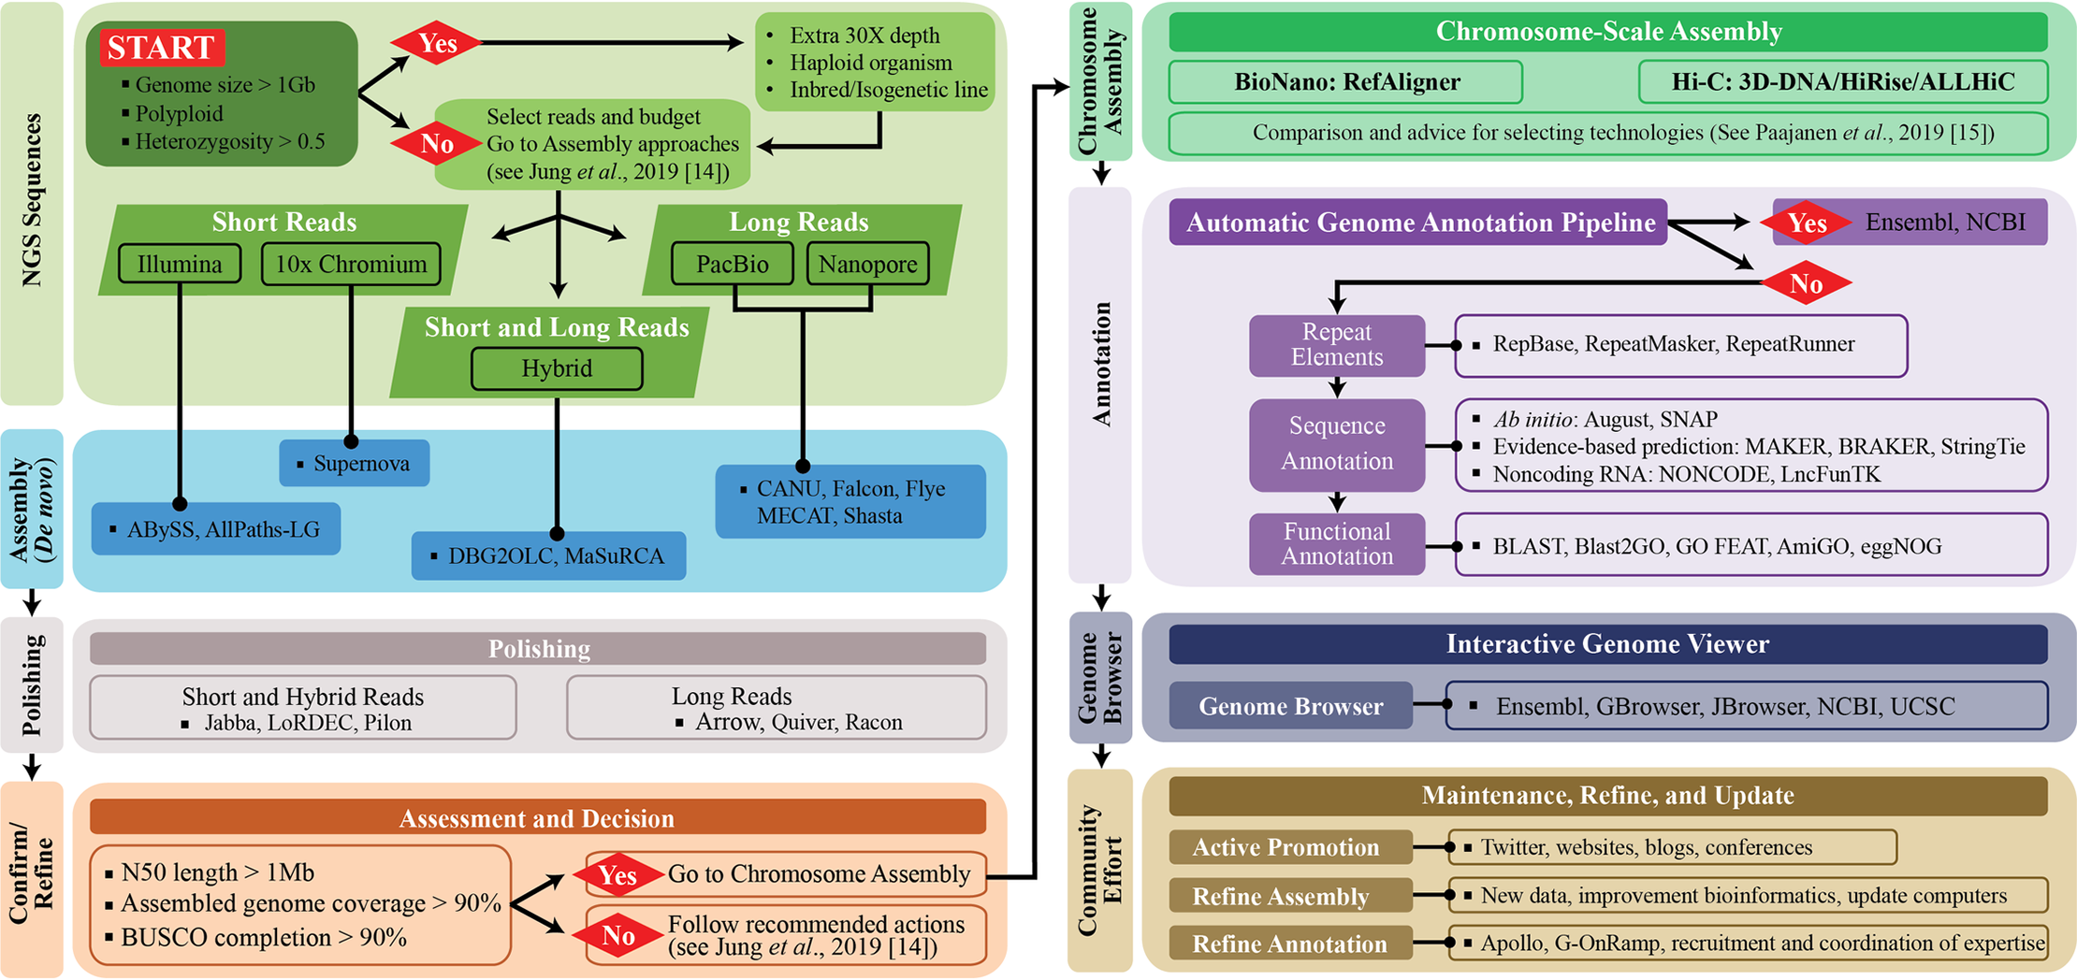
Contemporary genome assembly is fairly complex, but at its core are assembly algorithms that grew from the shotgun concept
Twelve quick steps for genome assembly and annotation in the classroom
PLoS Comp Biology (2020), doi:10.1371/journal.pcbi.1008325

Slide 9
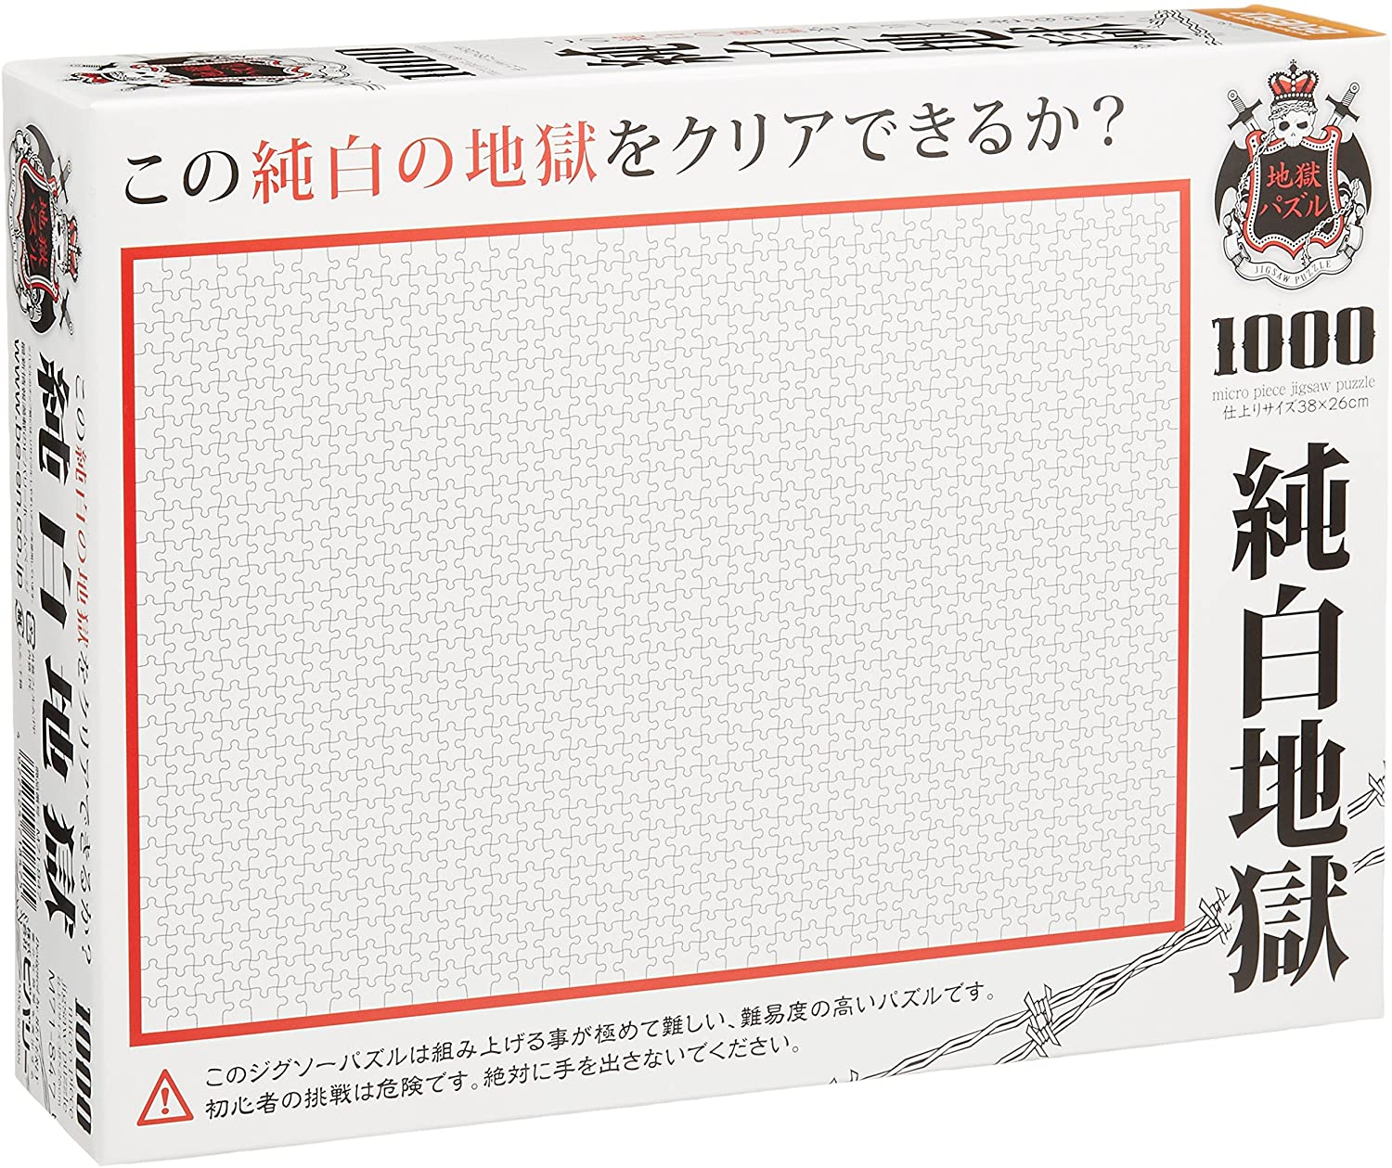
Beverly Micro “Pure White Hell” Jigsaw Puzzle (10,000,000,000 Piece)

Slide 10
Thinking about the basic shotgun concept
Start with a very large set of random sequencing reads
How might we match up the overlapping sequences?
How can we assemble the overlapping reads together in order to derive the genome?

Slide 11
Thinking about the basic shotgun concept
At a high level, the first genomes were sequenced by comparing pairs of reads to find overlapping reads
Then, building a graph (i.e., a network) to represent those relationships
The genome sequence is a “walk” across that graph

Slide 12
The “Overlap-Layout-Consensus” method
Overlap: Compare all pairs of reads
(allow some low level of mismatches)
Layout: Construct a graph describing the overlaps
Simplify the graph
Find the simplest path through the graph
Consensus: Reconcile errors among reads along that
path to find the consensus sequence
sequence overlap
read
read

Slide 13
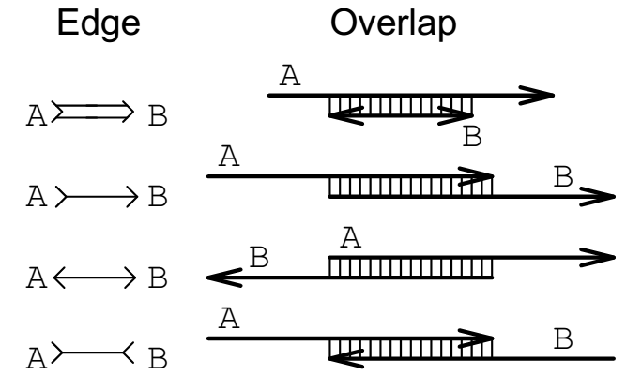
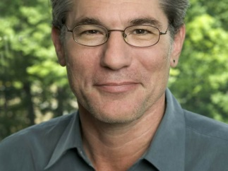
Building an overlap graph
5’
3’
EUGENE W. MYERS. Journal of Computational Biology. Summer 1995, 2(2): 275-290

Slide 14
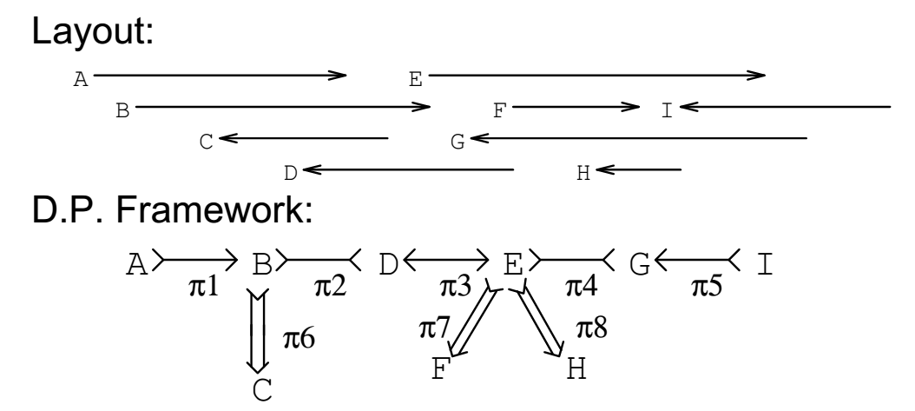


Building an overlap graph
Reads
5’
3’
Overlap graph
EUGENE W. MYERS. Journal of Computational Biology. Summer 1995, 2(2): 275-290 (more or less)

Slide 15
Simplifying an overlap graph
1. Remove all contained nodes & edges going to them
EUGENE W. MYERS. Journal of Computational Biology. Summer 1995, 2(2): 275-290 (more or less)

Slide 16
Simplifying an overlap graph
2. Transitive edge removal:
Given A – B – D and A – D , remove A – D
EUGENE W. MYERS. Journal of Computational Biology. Summer 1995, 2(2): 275-290 (more or less)

Slide 17
Simplifying an overlap graph
3. If un-branched, calculate consensus sequence
If branched, assemble un-branched bits and then decide
how they fit together
EUGENE W. MYERS. Journal of Computational Biology. Summer 1995, 2(2): 275-290 (more or less)

Slide 18
Simplifying an overlap graph
“contig” (assembled contiguous sequence)
EUGENE W. MYERS. Journal of Computational Biology. Summer 1995, 2(2): 275-290 (more or less)

Slide 19
This basic strategy was used for most of the early genomes.
Also useful: “mate pairs”
2 reads separated by a known distance
Read #1
DNA fragment of known size
Read #2
Contigs can be ordered using these paired reads
to produce “scaffolds”
Contig #1
Contig #2

Slide 20
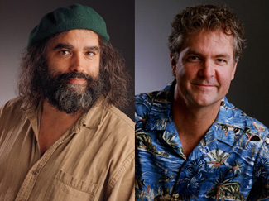
GigAssembler (used to assemble the public human genome project sequence)
Jim Kent
David Haussler
Let’s take a little walk through history to see what they did…

Slide 21
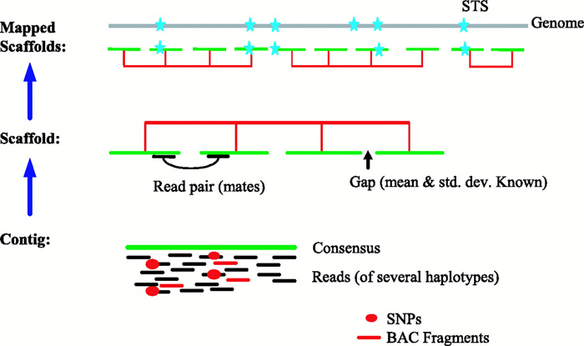
Whole genome Assembly: big picture
http://www.nature.com/scitable/content/anatomy-of-whole-genome-assembly-20429

Slide 22
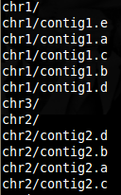
GigAssembler – Preprocessing
Decontaminating & Repeat Masking.
Aligning of mRNAs, ESTs, BAC ends & paired reads against initial sequence contigs.
  psLayout → BLAT
Creating an input directory (folder) structure.

Slide 23
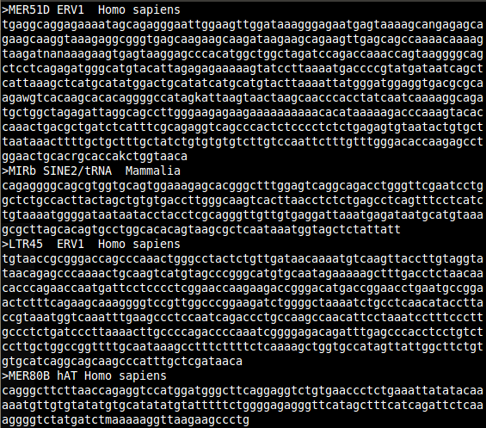
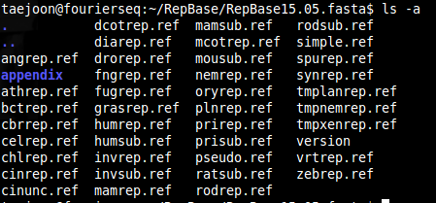
RepBase + RepeatMasker

Slide 24
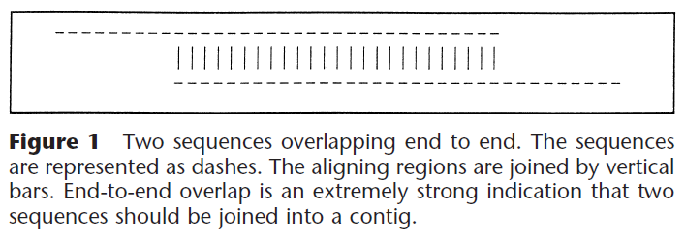
GigAssembler: Build merged sequence contigs (“rafts”)

Slide 25
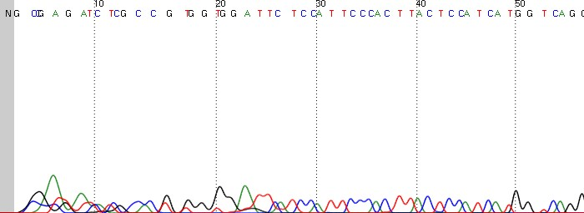
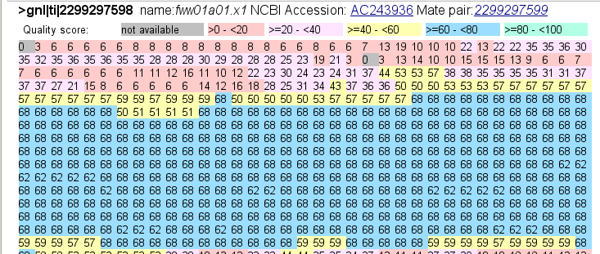
Sequencing quality (Phred Score)

Slide 26

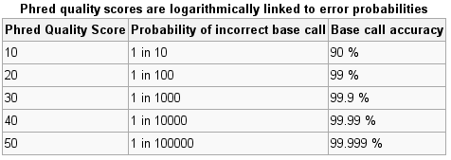
Sequencing quality (Phred Score)
Base-calling
Error
Probability
http://en.wikipedia.org/wiki/Phred_quality_score

Slide 27
We’re going to skip the remaining details of GigAssembler (mainly of historical interest now) to get to the key strategy for assembling all of the various contigs and paired end reads into a genome

Slide 28
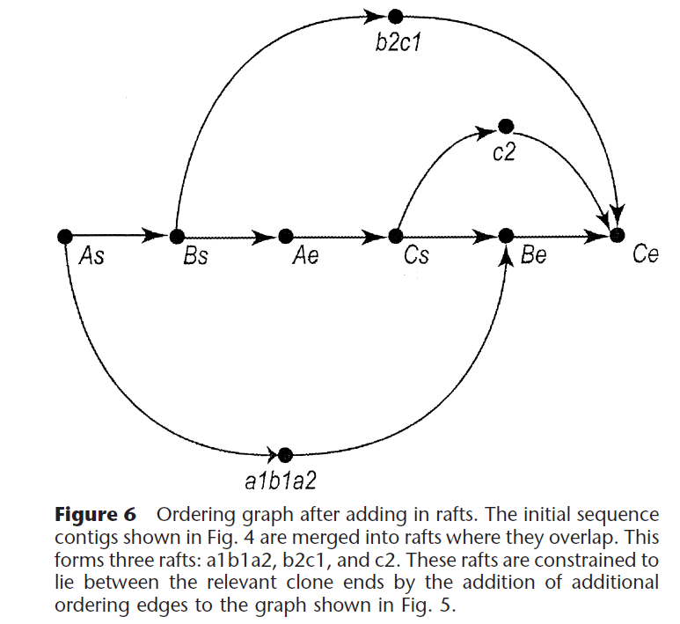
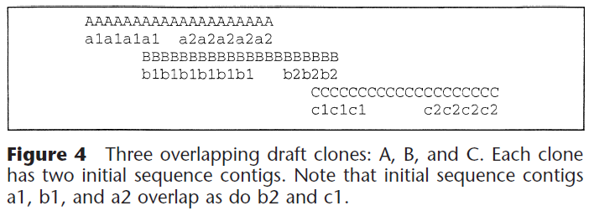
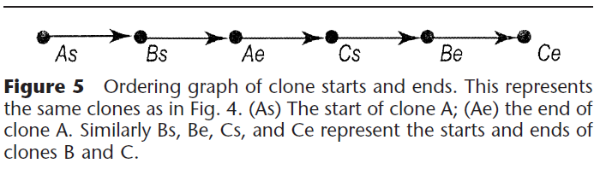
GigAssembler:
Build a “raft-ordering” graph

Slide 29
GigAssembler:
Build a “raft-ordering” graph
Add information from mRNAs, ESTs, paired plasmid reads, BAC end pairs: building a “bridge”
  Different weight to different data type: (mRNA ~ highest)
  Conflicts with the graph as constructed so far are rejected.
Build a sequence path through each raft.
Fill the gap with N’s.
  100: between rafts
  50,000: between bridged barges

Slide 30
Finding the shortest path across the ordering graph using the
Bellman-Ford algorithm
http://compprog.wordpress.com/2007/11/29/one-source-shortest-path-the-bellman-ford-algorithm/

Slide 31
Find the shortest path to all nodes.
Take every edge and try to relax it (N – 1 times where N is the count of nodes)
+5
B
C
-2
+6
A
+8
-3
+7
-4
+7
D
E
+2
+9

Slide 32
Find the shortest path to all nodes.
Take every edge and try to relax it (N – 1 times where N is the count of nodes)
+5
B
C
Inf.
Inf.
-2
+6
A
+8
-3
0
START
+7
-4
+7
D
E
+2
Inf.
+9
Inf.

Slide 33
Find the shortest path to all nodes.
Take every edge and try to relax it (N – 1 times where N is the count of nodes)
+5
B
C
+6
(→ A)
Inf.
-2
+6
A
+8
-3
0
START
+7
-4
+7
D
E
+2
+7
(→ A)
Inf.
+9

Slide 34
Find the shortest path to all nodes.
Take every edge and try to relax it (N – 1 times where N is the count of nodes)
+5
B
C
+6
(→ A)
+4
(→ D)
-2
+6
A
+8
-3
0
START
+7
-4
+7
D
E
+2
+7
(→ A)
+2
(→ B)
+9

Slide 35
Find the shortest path to all nodes.
Take every edge and try to relax it (N – 1 times where N is the count of nodes)
+5
B
C
+2
(→ C)
+4
(→ D)
-2
+6
A
+8
-3
0
START
+7
-4
+7
D
E
+2
+7
(→ A)
+2
(→ B)
+9

Slide 36
Find the shortest path to all nodes.
Take every edge and try to relax it (N – 1 times where N is the count of nodes)
+5
B
C
+2
(→ C)
+4
(→ D)
-2
+6
A
+8
-3
0
START
+7
-4
+7
D
E
+2
+7
(→ A)
-2
(→ B)
+9

Slide 37
Answer: A-D-C-B-E
+5
B
C
+2
(→ C)
+4
(→ D)
-2
+6
A
+8
-3
0
START
+7
-4
+7
D
E
+2
+7
(→ A)
-2
(→ B)
+9

Slide 38
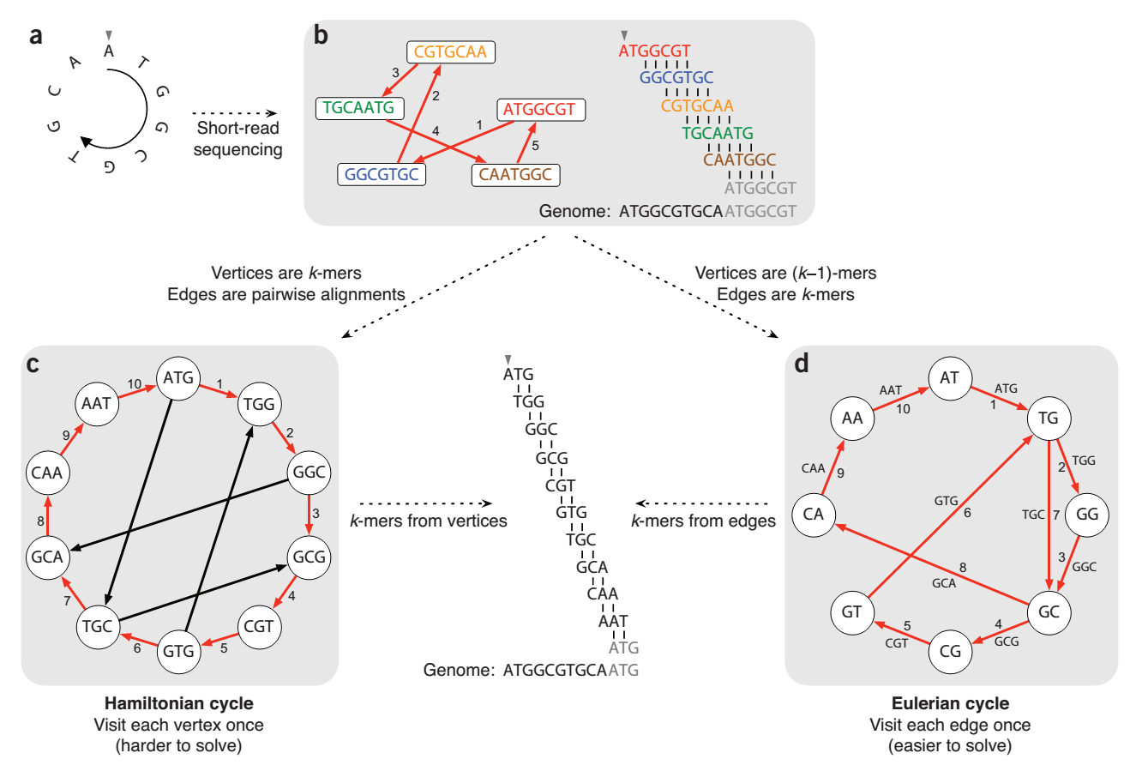
Modern assemblers now work a bit differently, using so-called DeBruijn graphs:
Here’s what we saw before:
In Overlap-Layout-Consensus:
Nodes are reads
Edges are overlaps
Nature Biotech 29(11):987-991 (2011)

Slide 39

Modern assemblers now work a bit differently, using so-called DeBruijn graphs:
In a DeBruijn graph:
Nature Biotech 29(11):987-991 (2011)

Slide 40
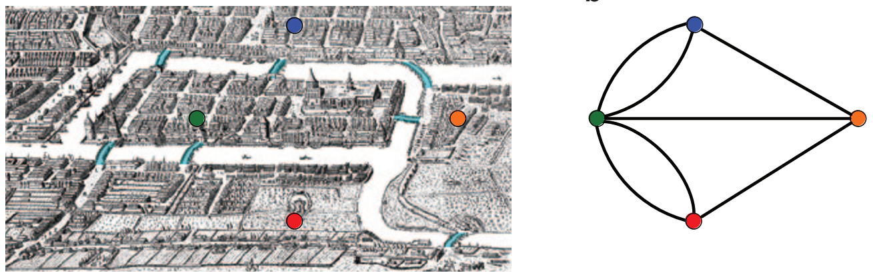
Why Eulerian?
From Leonhard Euler’s solution in 1735 to the
‘Bridges of Königsberg’ problem:
Königsberg (now Kaliningrad, Russia) had 7 bridges connecting 4 parts of the city. Could you visit each part of the city, walking across each bridge only once, & finish back where you started?
Euler conceptualized it as a graph:
Nodes = parts of city
Edges = bridges
(Visiting every edge once = an Eulerian path)
Nature Biotech 29(11):987-991 (2011)

Slide 41
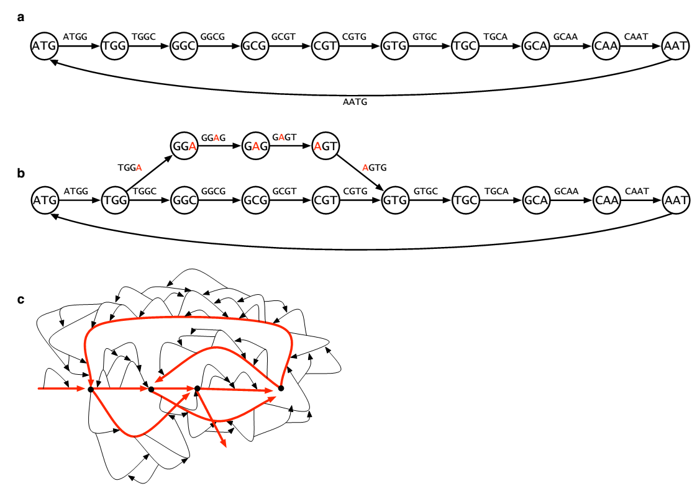
DeBruijn graph assemblers tend to have nice properties, e.g. correcting sequencing errors & handling repeats better
Sequencing errors appear as ‘bulges’
Removing the ‘bulges’ corrects the errors
(e.g. leaves the red path)
Nature Biotech 29(11):987-991 (2011)

Slide 42
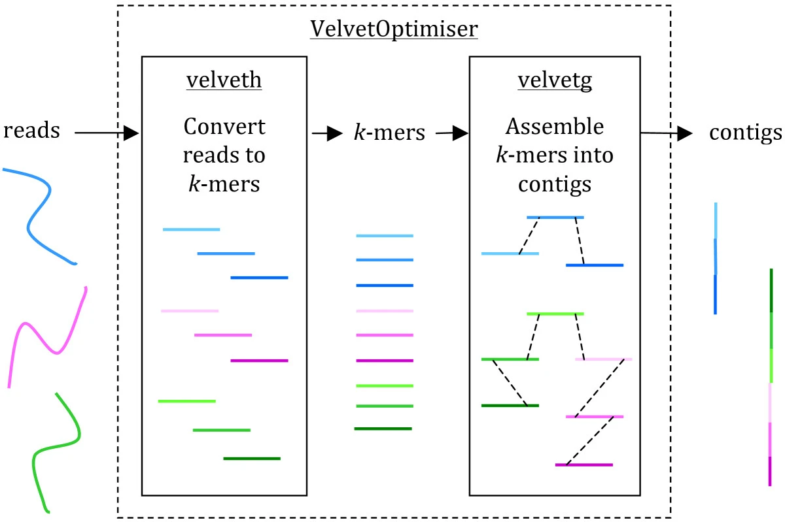
e.g. Velvet, an example algorithm using DeBruijn graphs
Beginner’s guide to comparative bacterial genome analysis using next-generation sequence data
Microb Informatics Exp (2013) doi:10.1186/2042-5783-3-2

Slide 43
Once a reference genome is assembled, new sequencing data can ‘simply’ be mapped to the reference.
reads
Reference genome

Slide 44
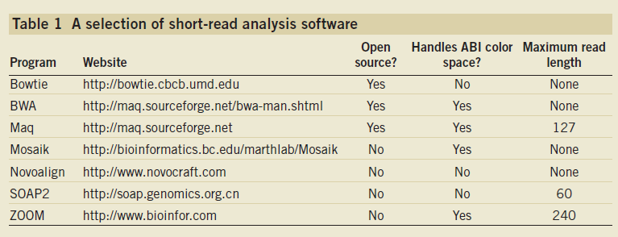
Mapping reads to assembled genomes
The list is a little longer now! e.g. see https://en.wikipedia.org/wiki/
List_of_sequence_alignment_software#Short-Read_Sequence_Alignment
Trapnell C, Salzberg SL, Nat. Biotech., 2009

Slide 45
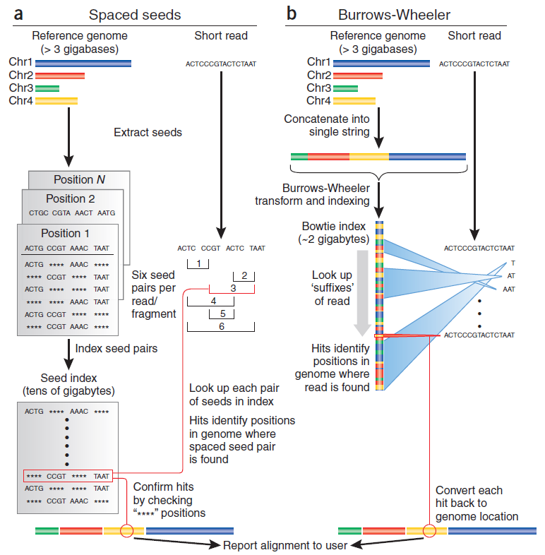
Mapping strategies
Trapnell C, Salzberg SL, Nat. Biotech., 2009

Slide 46
Burrows
Wheeler indexing
Trapnell C, Salzberg SL, Nat. Biotech., 2009

Slide 47
Burrows-Wheeler transform indexing
BWT is often used for file compression (like bzip2),
here used to make a fast ‘lookup’ index in a genome
BWT = ‘reversible block-sorting’
Input | SIX.MIXED.PIXIES.SIFT.SIXTY.PIXIE.DUST.BOXES
Output | TEXYDST.E.IXIXIXXSSMPPS.B..E.S.EUSFXDIIOIIIT
Recovered input | SIX.MIXED.PIXIES.SIFT.SIXTY.PIXIE.DUST.BOXES
This sequence is more compressible
Forward BWT
Reverse BWT
http://en.wikipedia.org/wiki/Burrows-Wheeler_transform

Slide 48
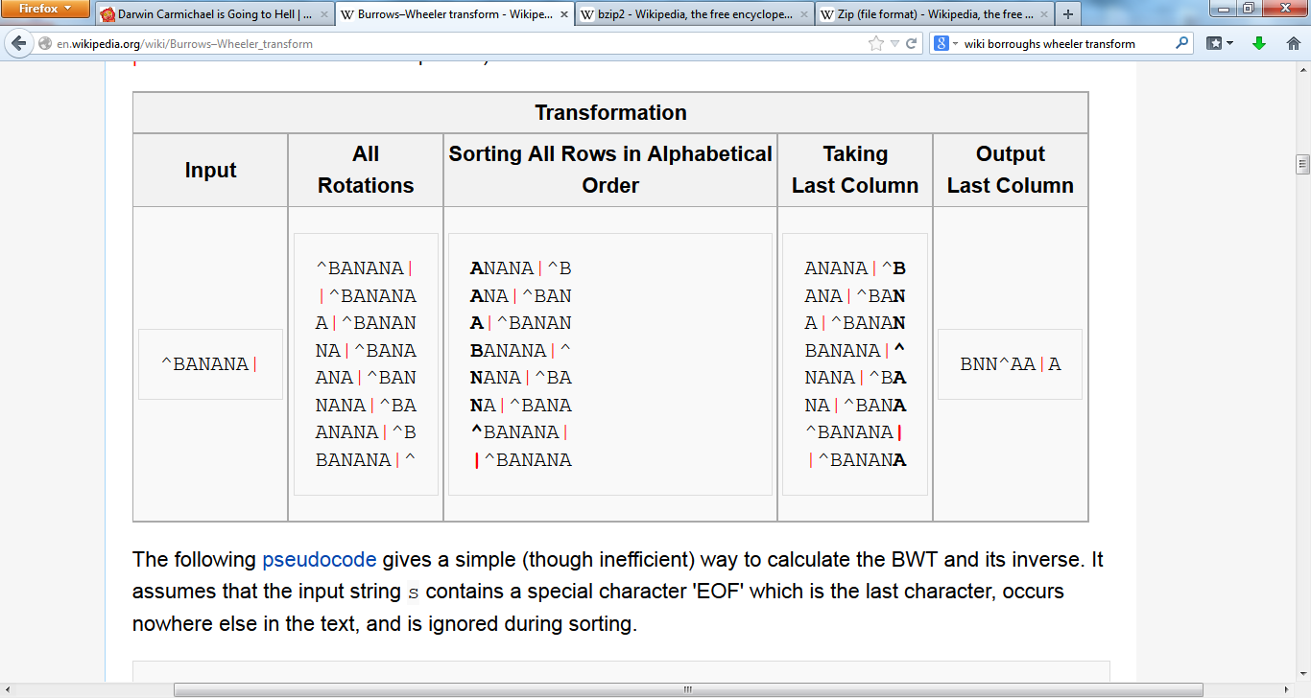
Burrows-Wheeler transform indexing
http://en.wikipedia.org/wiki/Burrows-Wheeler_transform

Slide 49
Burrows-Wheeler transform indexing
http://en.wikipedia.org/wiki/Burrows-Wheeler_transform

Slide 50
Burrows-Wheeler transform indexing
http://en.wikipedia.org/wiki/Burrows-Wheeler_transform

Slide 51
Burrows-Wheeler transform indexing
http://en.wikipedia.org/wiki/Burrows-Wheeler_transform

Slide 52
Burrows-Wheeler transform indexing
http://en.wikipedia.org/wiki/Burrows-Wheeler_transform

Slide 53
Burrows-Wheeler transform indexing
http://en.wikipedia.org/wiki/Burrows-Wheeler_transform

Slide 54
BWT is remarkable because it is reversible.
Any ideas as how you might reverse it?

Slide 55
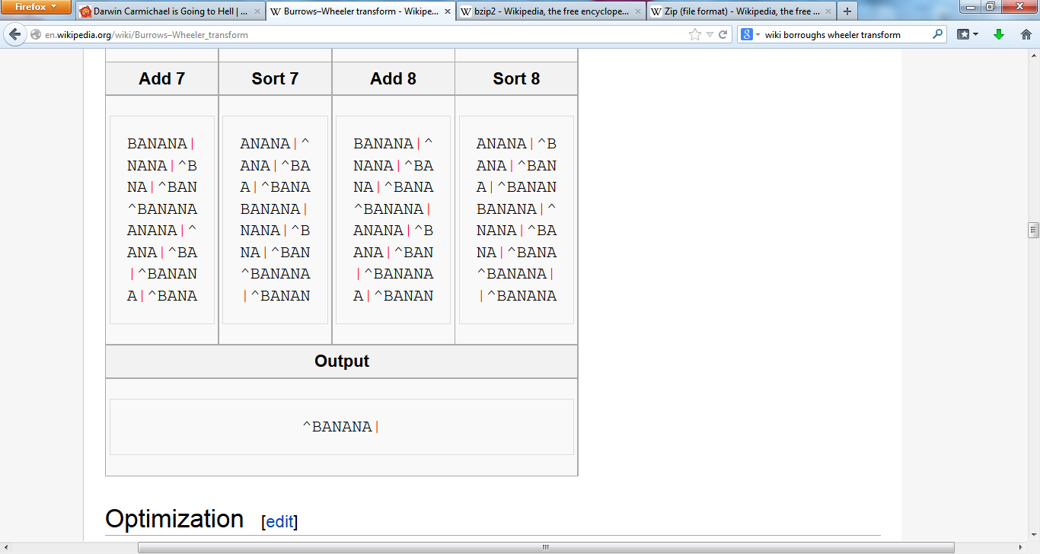
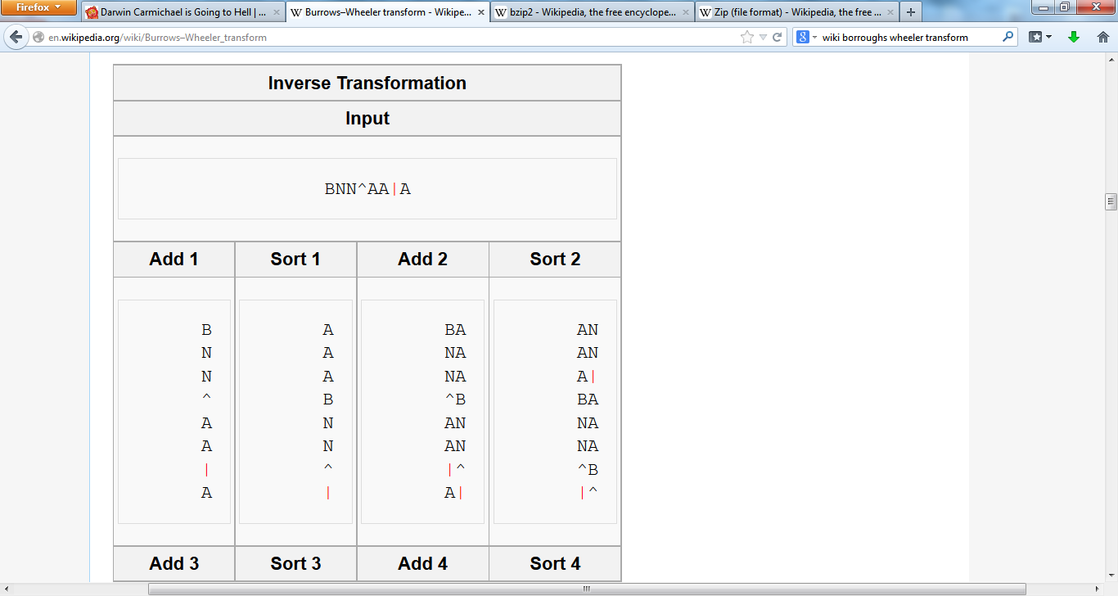
Burrows-Wheeler transform indexing
http://en.wikipedia.org/wiki/Burrows-Wheeler_transform

Slide 56
Burrows-Wheeler transform indexing
Write the sequence as the last column
Sort it…
Add the columns…
Sort those…
http://en.wikipedia.org/wiki/Burrows-Wheeler_transform

Slide 57
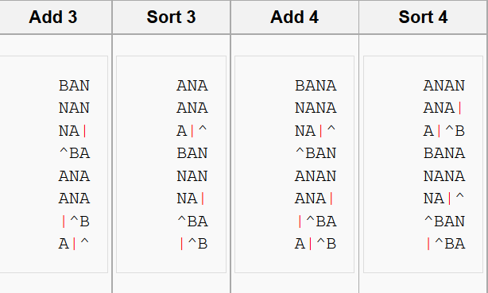
Burrows-Wheeler transform indexing
Add the columns…
Sort those…
Add the columns…
Sort those…
http://en.wikipedia.org/wiki/Burrows-Wheeler_transform

Slide 58
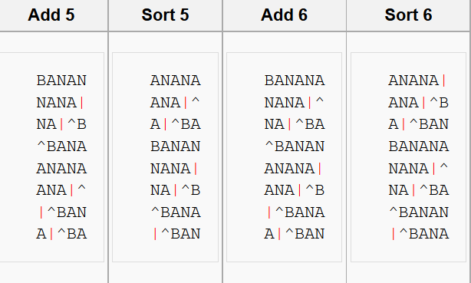
Burrows-Wheeler transform indexing
Add the columns…
Sort those…
Add the columns…
Sort those…
http://en.wikipedia.org/wiki/Burrows-Wheeler_transform

Slide 59
Burrows-Wheeler transform indexing
The row with the "end of file" character at the end is the original text
Add the columns…
Sort those…
Add the columns…
http://en.wikipedia.org/wiki/Burrows-Wheeler_transform

Slide 60
Burrows-Wheeler transform indexing
The row with the "end of file" character at the end is the original text
http://en.wikipedia.org/wiki/Burrows-Wheeler_transform

Slide 61
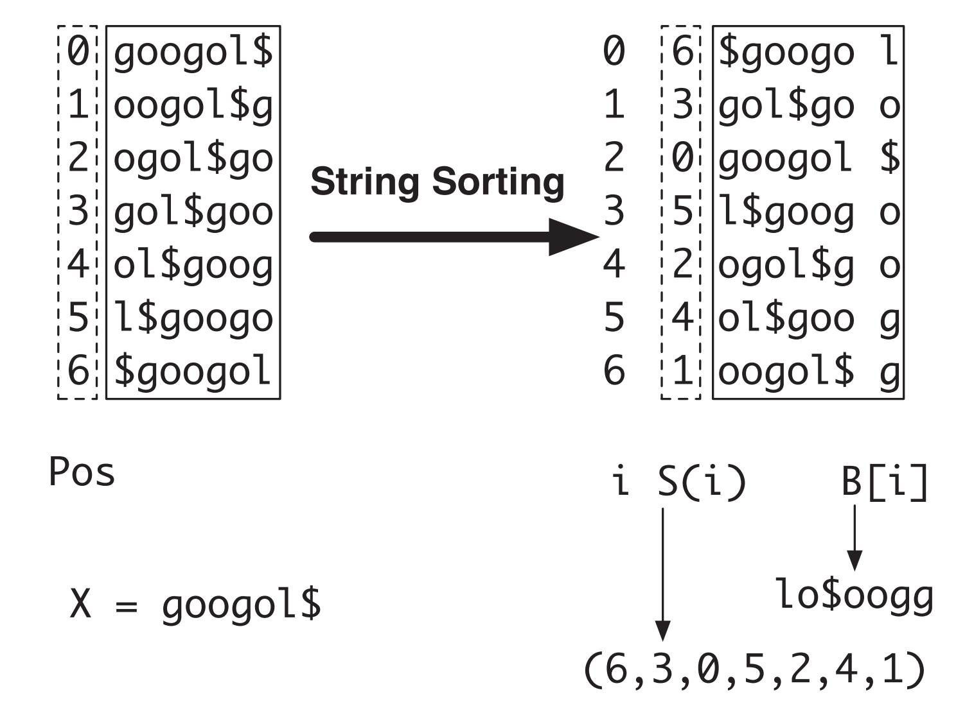
The Burrows-Wheeler transform leads naturally to a suffix array
Li & Durbin, doi:10.1093bioinformatics/btp324/

Slide 62
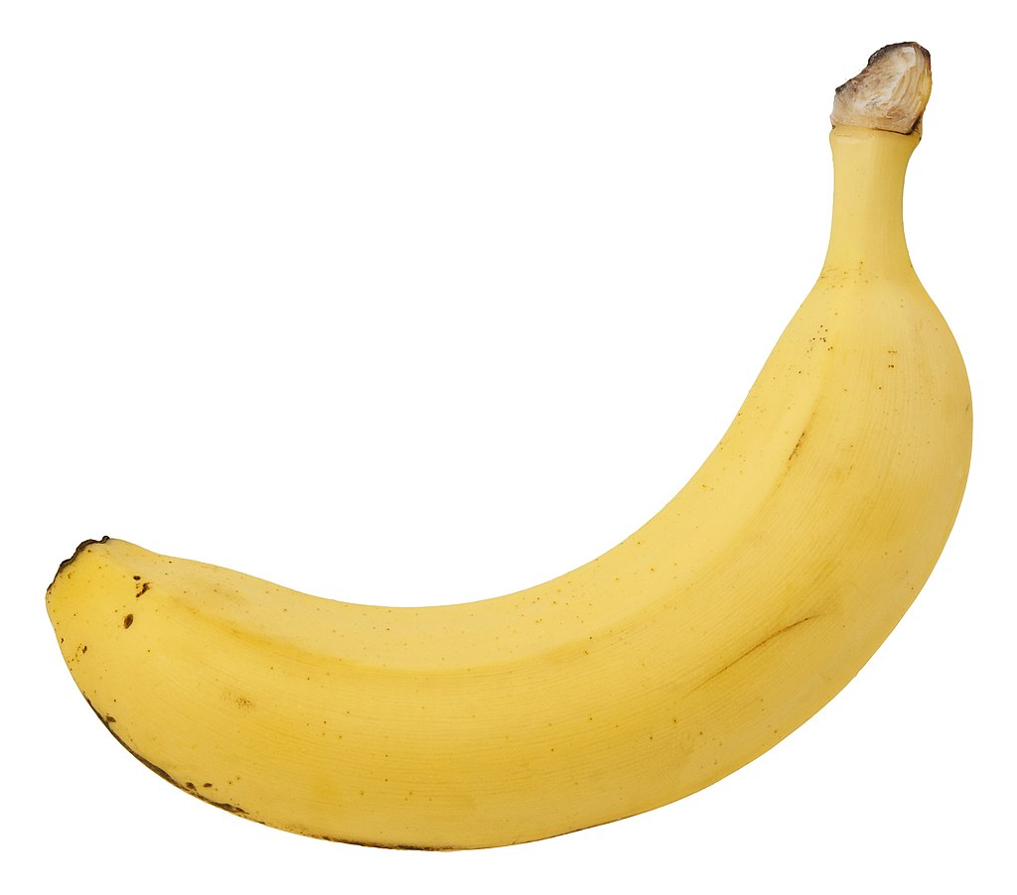
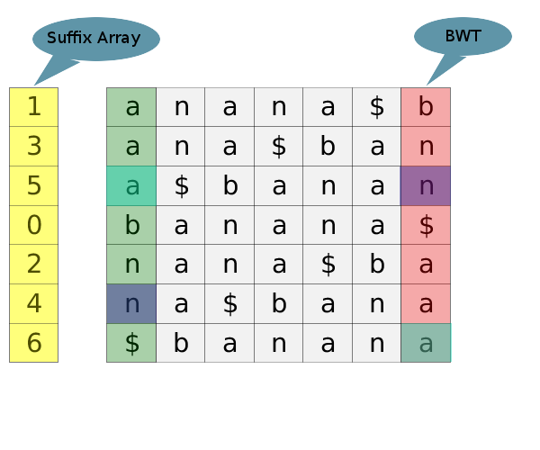
The Burrows-Wheeler transform leads naturally to a suffix array
http://blog.avadis-ngs.com/2012/04/elegant-exact-string-match-using-bwt-2/ (& wikipedia)

Slide 63
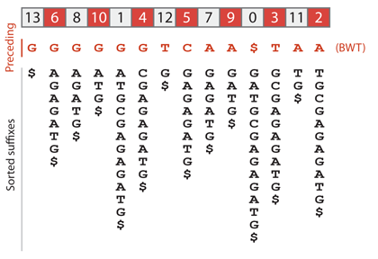
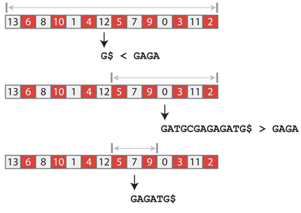
“If string W is a substring of X, the position of each occurrence of W in X will occur in an interval in the suffix array. This is because all the suffixes that have W as prefix are sorted together.”
Li & Durbin, doi:10.1093bioinformatics/btp324/
e.g. applying BWT to construct the suffix array of GATGCGAGAGATG
The search can be even more efficient by using compression & various other extensions
http://blog.thegrandlocus.com/2016/07/a-tutorial-on-burrows-wheeler-indexing-methods

Slide 64
Why is this efficient?
Searching a suffix array in this way cuts the search space in half at each step, so…
A suffix array of the human genome (3.2 billion bases) takes at most
log₂(3.2 billion) + 1 = 32 steps
to determine if a query sequence is present or not
There are few more steps to find all the occurrences, build an efficient real-world implementation, use compression to reduce memory and storage space, etc., but this still illustrates the massive savings in time and memory from constructing an index

Slide 65
Burrows
Wheeler indexing
Convert each hit back to genome location
Trapnell C, Salzberg SL, Nat. Biotech., 2009

