Slide 1
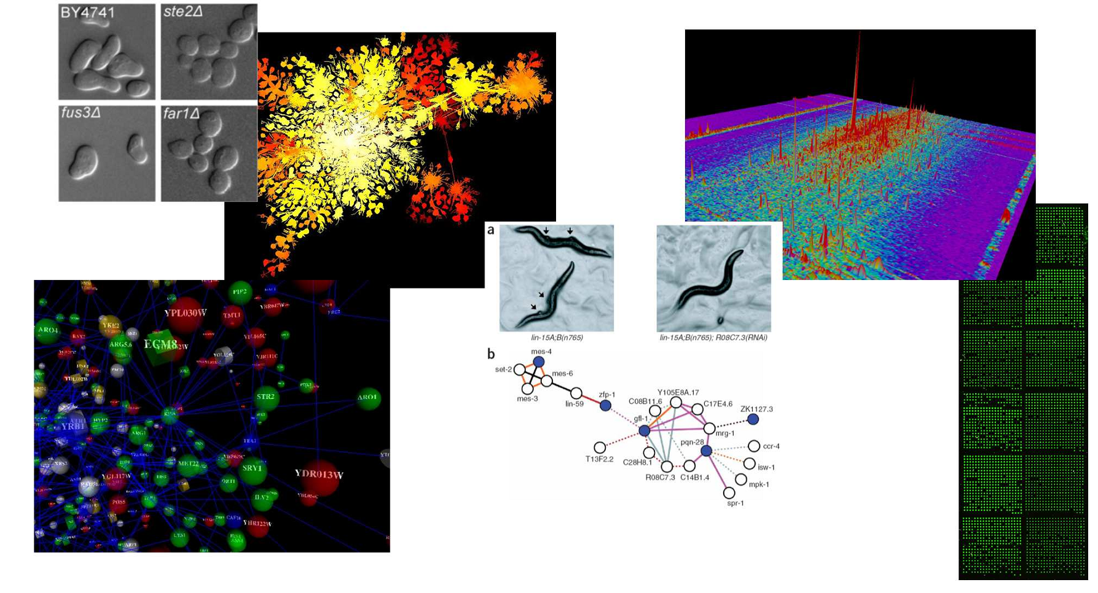
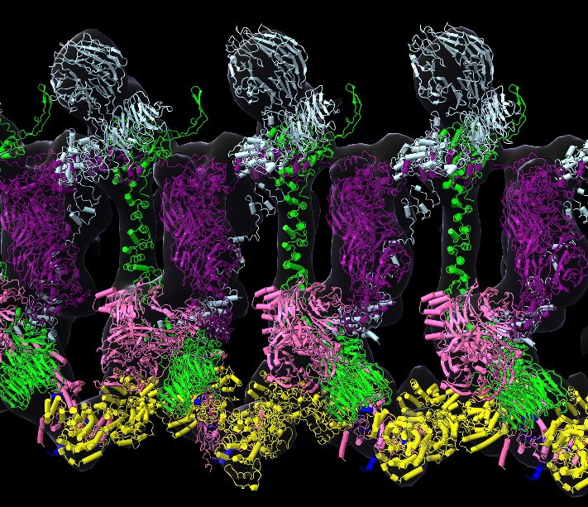
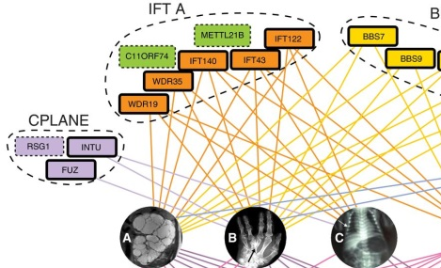
BCH394P/BCH364C Systems Biology & Bioinformatics
(course # 54960 / 54860)
Spring 2025 Tue/Thu 9:30 – 11:00 AM WEL 2.246

Slide 2
Instructor: Prof. Edward Marcotte marcotte@utexas.edu
Zoom office hours: Mon 4 – 5
TA: Zoya Ansari zansari@utexas.edu
Coding/problem set help hours:
Tues 1 – 2/Fri 1 – 2 in MBB 3.304
or by appointment on zoom
After hours Q/A, discussion: Canvas
The class zoom channel will be posted on Canvas.
It will be the same zoom for class and office hours.

Slide 3
Probably the most important slide today!
Course web page:
http://www.marcottelab.org/
index.php/BCH394P_BCH364C_2025
This is a graduate student class!
It is open to a small # of upper division undergrads in natural sciences and engineering.
UG prerequisites: Biochemistry 339F with a grade of at least B; Computer Science 303E and Statistics and Data Sciences 328M (or Statistics and Scientific Computation 318M, 328M) with a grade of at least C-; and consent of the instructor.

Slide 4
An introduction to systems biology and bioinformatics, emphasizing quantitative analysis of high-throughput biological data, and covering typical data, data analysis, and computer algorithms.
Topics will include introductory probability and statistics, basics of Python programming, protein and nucleic acid sequence analysis, genome sequencing and assembly, proteomics, analysis of large-scale gene expression data, data clustering & classification, biological pattern recognition, gene and protein networks, AI/machine learning, and protein 3D structure prediction/design.

Slide 5
Note: it’s NOT really a course on practical sequence analysis or using web-based tools. We’ll use these, but the focus will be on learning the underlying algorithms, exploratory data analyses, and their applications, esp. in high-throughput biology.
By the end of the course, you’ll know the fundamentals of important algorithms in bioinformatics and systems biology, be able to design and run computational studies in biology, and have performed an element of original computational biology research

Slide 6
Books
Most of the lectures will be from research articles and slides. For sequence analysis, there will be an Optional text:
Biological sequence analysis, Durbin, Eddy, Krogh, Mitchison, Cambridge Univ. Press (available from Amazon, used & ebook)
For biologists rusty on their stats, The Cartoon Guide to Statistics (Gonick/Smith) is very good (really!).
We will also be learning intro Python programming.
The course web site lists some recommendations to help you out, such as the free web course Practical Python Programming
https://dabeaz-course.github.io/practical-python/
Important: There are bi-weekly coding/problem set help sessions.
Plan to attend at least one per week!

Slide 7
Grading
No exams. Grades will be based on:
Online programming homework
  (10 points each and counting 30% of the final grade)
3 problem sets
  (15 points each and counting 45% of the final grade)
A course project that you will develop over the semester & present in the last 3 days of class (25% of final grade)
The course project will consist of a research project on a bioinformatics topic chosen by the student (with approval by the instructor) containing an element of independent computational biology research (e.g. calculation, programming, database analysis, etc.) turned in as a web URL (20%) and presented in class (5%).
The project will be emailed as a web URL to the TA & I, developed through the semester and finished by 10 PM, April 16, 2025.
The last 3 classes will be spent presenting your projects.

Slide 8
Late policy
All projects and homework will be turned in electronically and time-stamped.
No makeup work will be given.
Instead, all students have 5 days of free “late time”.
  This is for the entire semester, NOT per project, and counting weekends/holidays just like any other day.
  For projects turned in late, days will be deducted from the 5 day total (or what remains of it) by the # of days late.
  Deductions are in 1 day increments, rounding up
    e.g. 10 minutes late = 1 day deducted.
  Once the 5 days are used up, assignments will be penalized 10% / day late (rounding up), e.g., a 50 point assignment turned in 1 ½ days late would be penalized 20%, or 10 points.

Slide 9
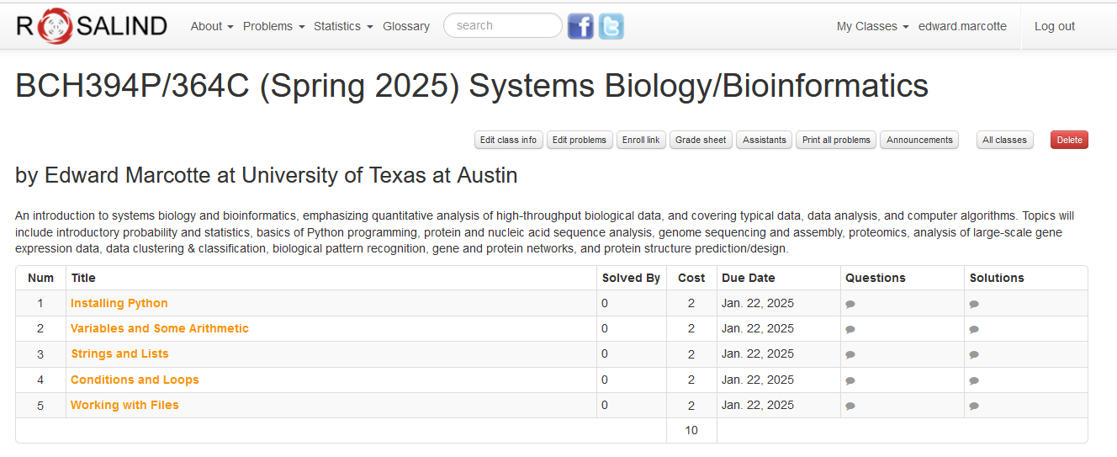
Online homework will be via Rosalind: http://rosalind.info/faq/
Enroll specifically for BCH394P/364C at:
https://rosalind.info/classes/enroll/8cf0c8d95f/
The first homework will be due (in Rosalind) by 10 PM, Jan 22

Slide 10
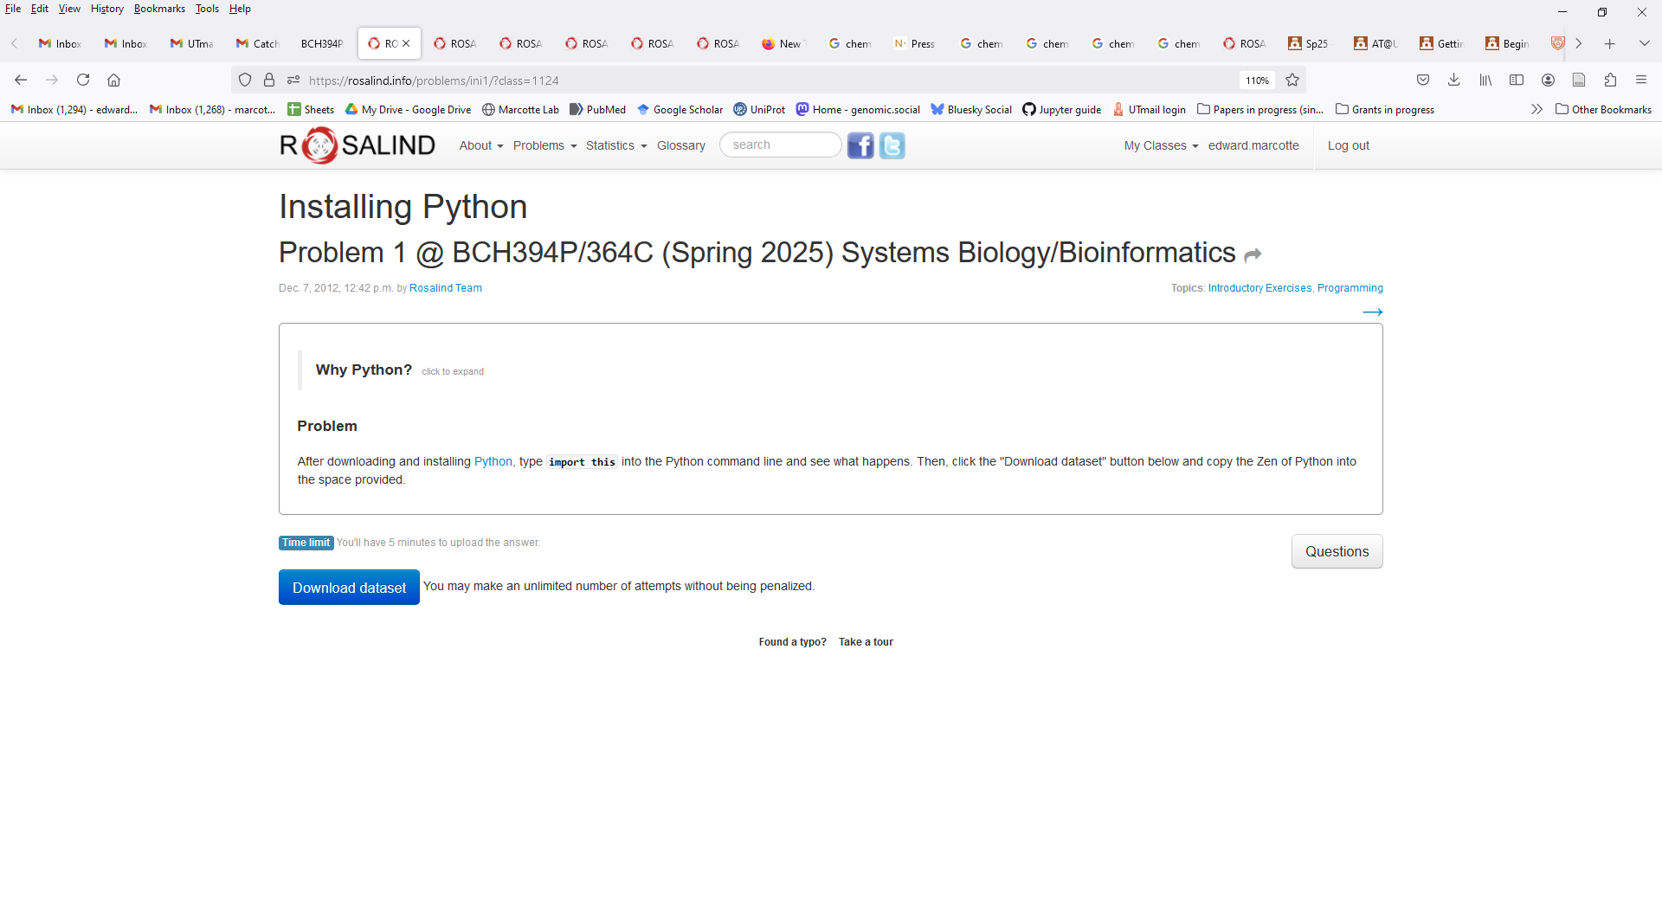

Slide 11
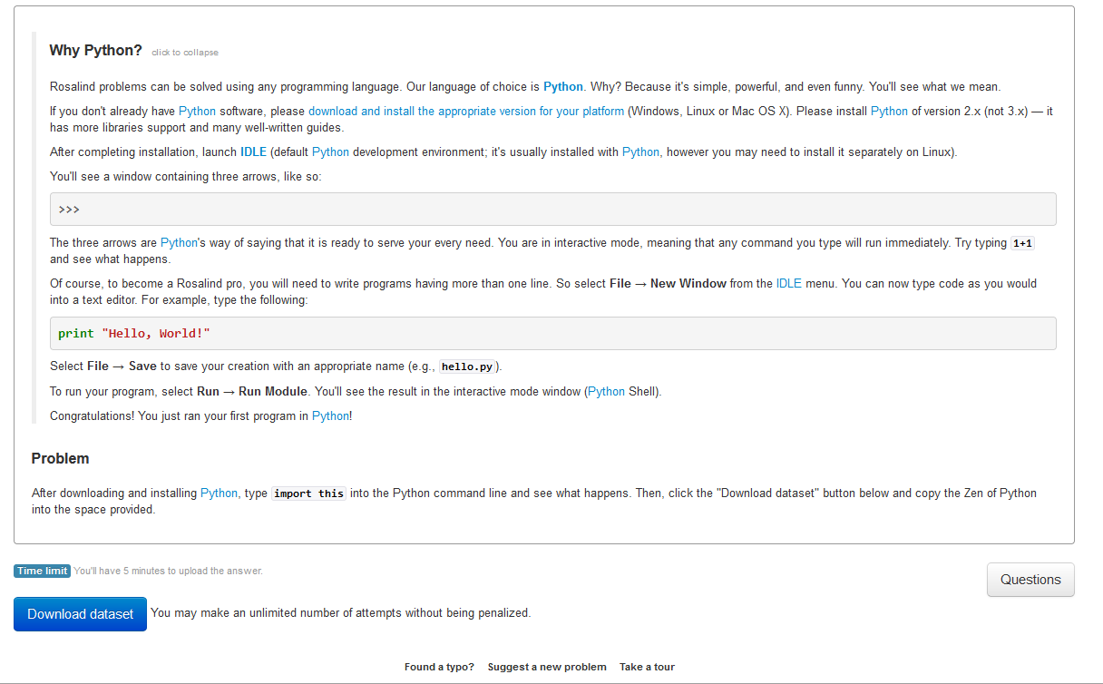
Rosalind uses Python version 2,
but we’ll use version 3
Rosalind uses the “vanilla” installation of Python.
You’re welcome to do it this way, but I
recommend Anaconda/Jupyter as a nicer option
Click here to turn in your answer

Slide 12
Installing Anaconda/Jupyter
My recommendation for a good, all-round Python installation is Anaconda, available free to individuals here:
https://www.anaconda.com/download
(note you can “skip registration” if you prefer that)
***Get the latest Python 3 version***
(but any version > 3.0 is probably fine)
Anaconda is a general management system for the various Python libraries and packages you might need, with >7,500 data science, visualization, and machine learning packages
Anaconda also provides multiple Python interfaces. For this course, I recommend using Jupyter Notebook, which can be launched directly from the main Anaconda navigation window.

Slide 13
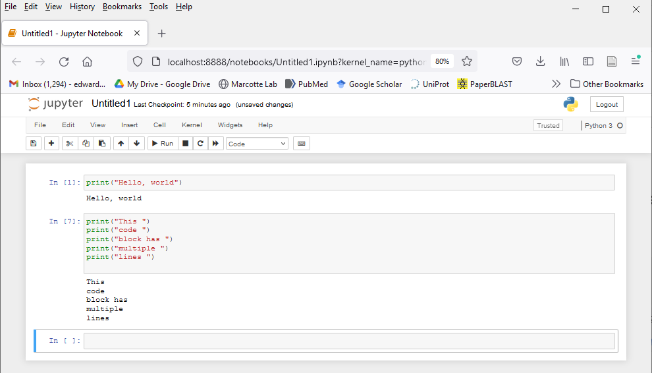
Jupyter is an interactive Python interface that shows your code & its output in successive entries in a shareable, archivable notebook viewable in any web browser, e.g.
Just type your command or code block
& press “Shift-Enter” (or any of the various
alternatives in the “cell” pulldown menu)
It’s widely used in bioinformatics and data visualization.

Slide 14
Back to Rosalind, for those of you that are a bit more advanced:
If you’re feeling restless/adventurous…

Slide 15
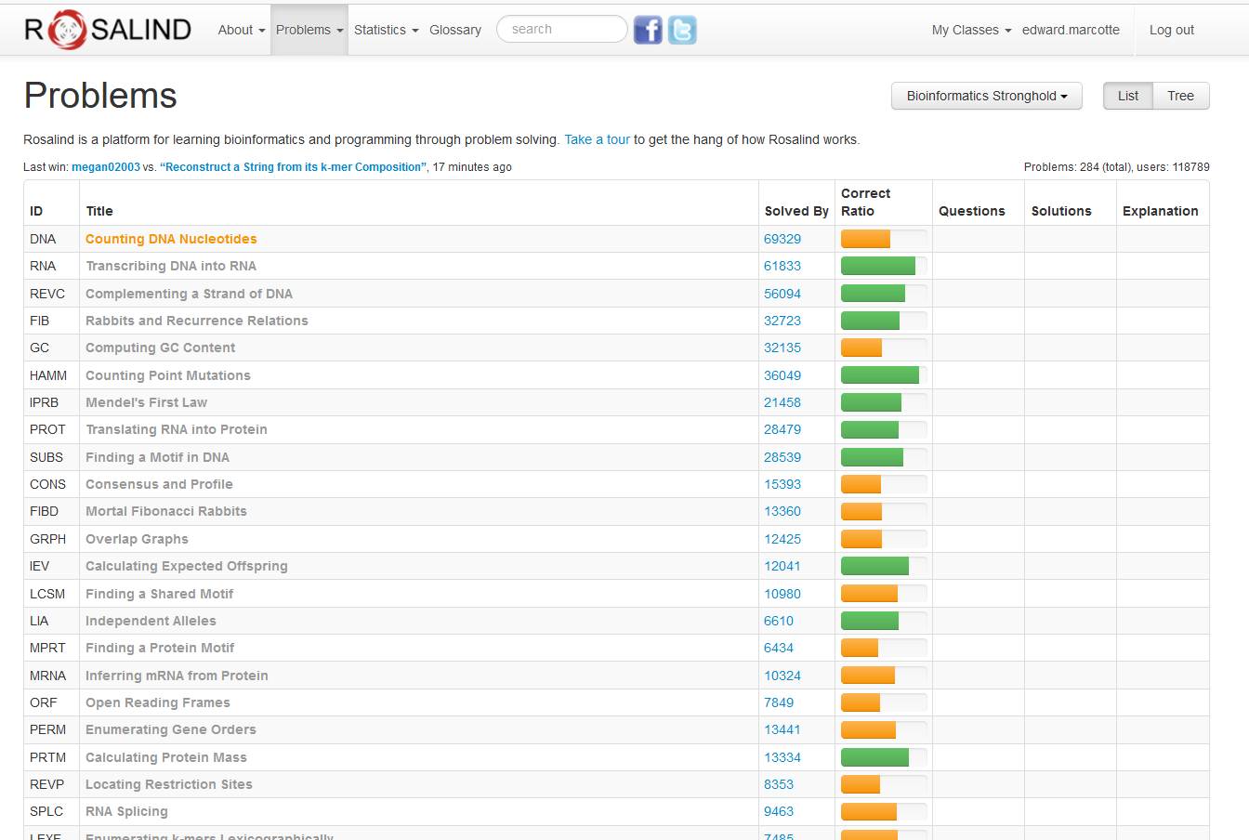
…there are quite a few good bioinformatics problems in the archives.
…
…
…

Slide 16
Expectations on working together
Students are welcome to discuss ideas and problems with each other, but all programs, Rosalind homework, problem sets, and written solutions
should be performed independently,
→ except the final presentation.
tl;dr: study/discuss together
do your own programming/writing/project
collaborate on the final presentation

Slide 17
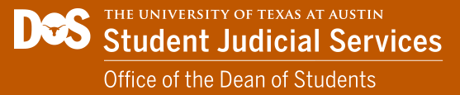
A reminder about academic integrity
By submitting as your own work any unattributed material that you obtained from other sources, you have committed plagiarism.
Copying homework solutions from other students or internet sources (e.g. CourseHero) is cheating, collusion, and/or plagiarism.
Software and computer code are legally considered in the same framework as other written works. Copying code directly without attribution is plagiarism.
https://deanofstudents.utexas.edu/conduct/academicintegrity.php

Slide 18
Any materials found online (e.g. CourseHero) that are associated with you, or any suspected unauthorized sharing of materials, will be reported to Student Conduct and Academic Integrity in the Office of the Dean of Students. These reports can result in sanctions, including failure in the course.
See the university’s official policy on plagiarism here: https://catalog.utexas.edu/general-information/appendices/appendix-c/student-discipline-and-conduct/

Slide 19
You can use the internet to get ideas, programming suggestions and syntax, but downloading completed answers to assigned questions and submitting these as your own work is cheating/plagiarism.
Copying entire programs verbatim from marked repositories offering Rosalind homework solutions is cheating and plagiarism.

Slide 20
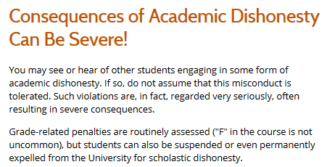
https://deanofstudents.utexas.edu/conduct/academicintegrity.php

Slide 21
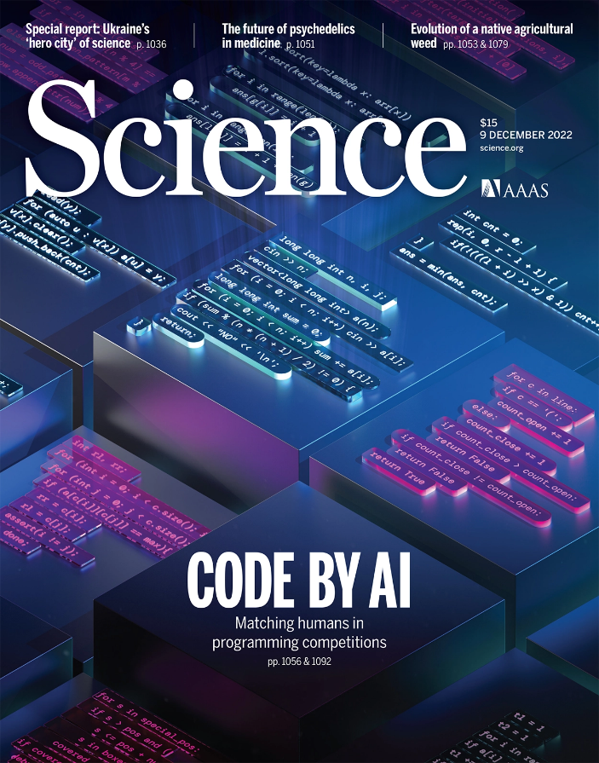
Yes, but …
Later in the semester, we’ll try co-programming with AI using chatGPT, where the goal is to make the computer write the code for you

Slide 22
Why are we here?
(practically, not existentially)

Slide 23
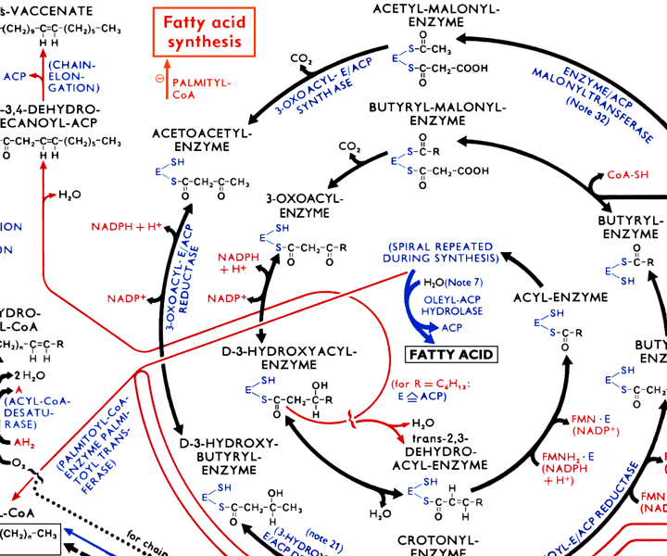
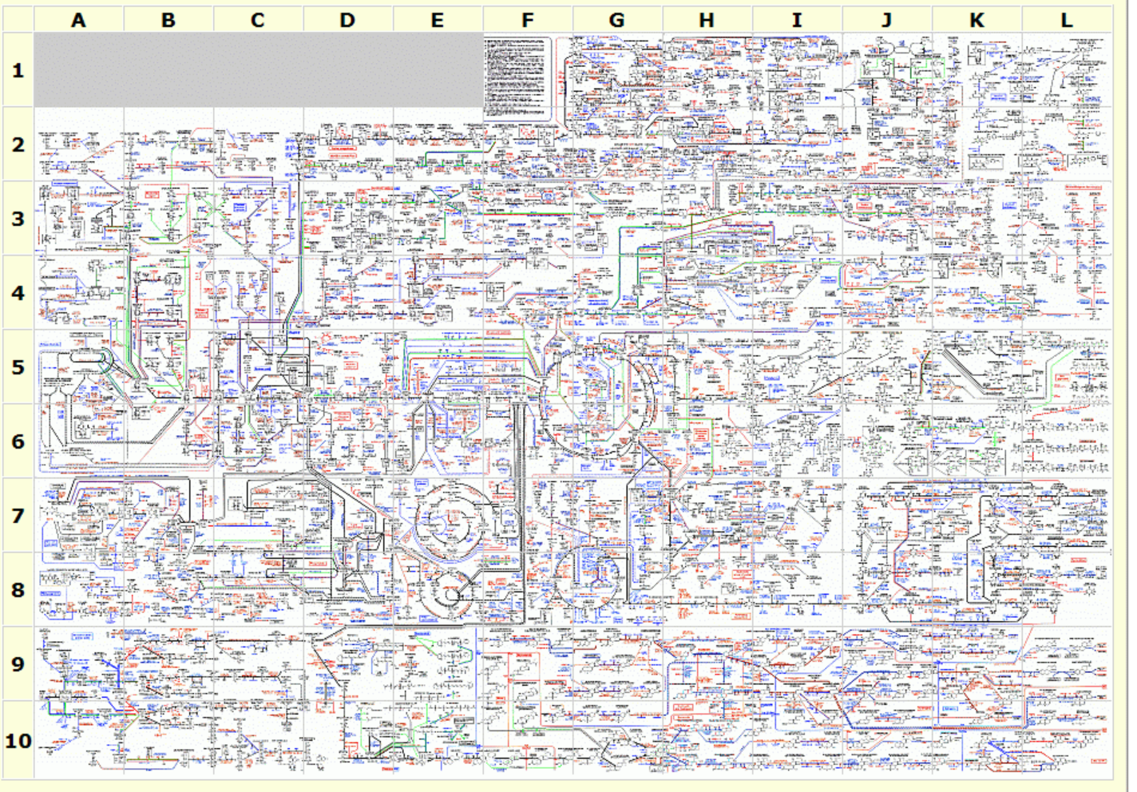
The metabolic wall chart…
http://web.expasy.org/cgi-bin/pathways/show_thumbnails.pl

Slide 24
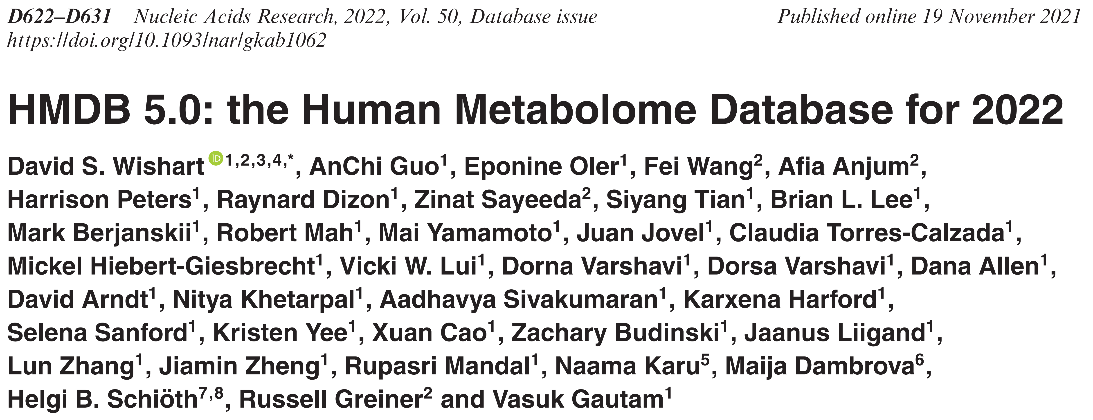
Our current-ish knowledge of human metabolism…
A few statistics from the Human Metabolome Database (https://hmdb.ca/):
Total Number of Metabolites 253,245
Total Number of Expected Metabolites 98,257
Total Number of Predicted Metabolites 130,679
Total Number of Endogenous Metabolites 222,860
Total Number of Metabolites Having Associated Proteins (Enzymes and Transporters) 71,168
Total Number of Metabolites with Synthesis Records 1,608
Total Number of Compounds Detected and Quantified for Normal Individuals 3,292
Total Number of Compounds Detected and Quantified for Abnormal Conditions 1,791
Total Number of Different Diseases 657
Total Number of Metabolites Associated with Diseases 22,600
Total Number of Metabolite Concentrations for Diseases 32,087
Total Number of NMR or GC-MS or MS/MS Spectra 2,732,152
Total Number of Compounds with NMR or GC-MS or MS/MS Spectra 211,527
Total Number of NMR Spectra 242,268
Total Number of Compounds with NMR Spectra 12,345

Slide 25
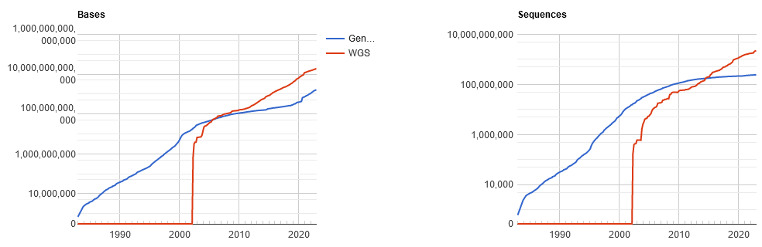
Pales beside the phenomenal explosion of DNA sequencing:
GenBank
December 2024:
5 trillion bp Genbank
+
33 trillion bp DNA
whole genome
shotgun sequencing
Here are the latest
statistics…
Which basically means GenBank is falling behind more every year!
http://www.ncbi.nlm.nih.gov/genbank/statistics

Slide 26
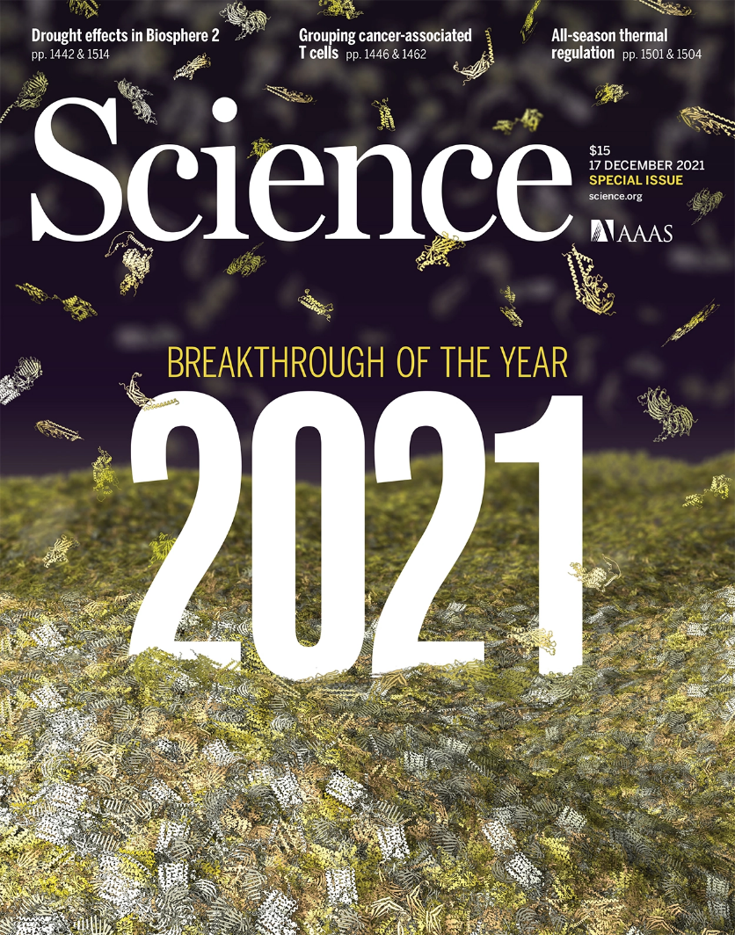
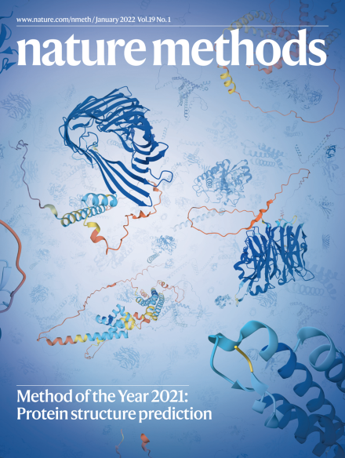
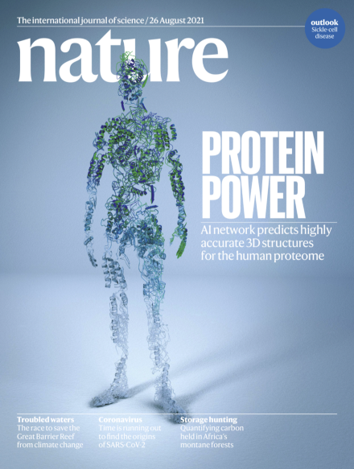
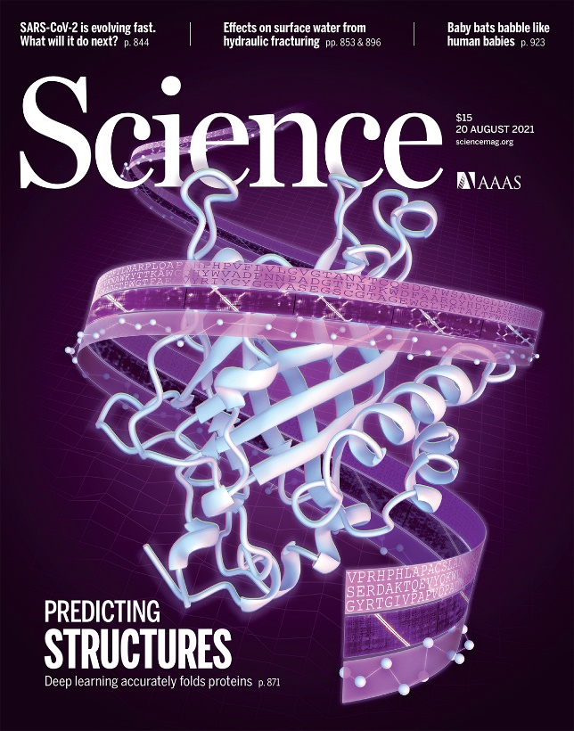
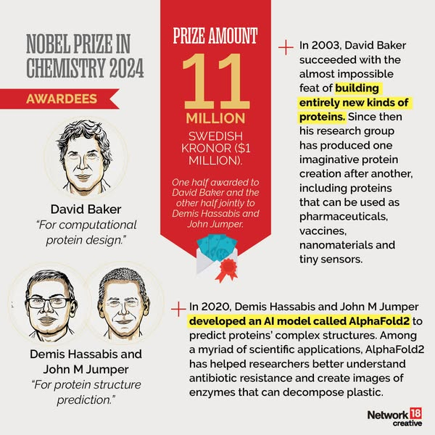

Slide 27
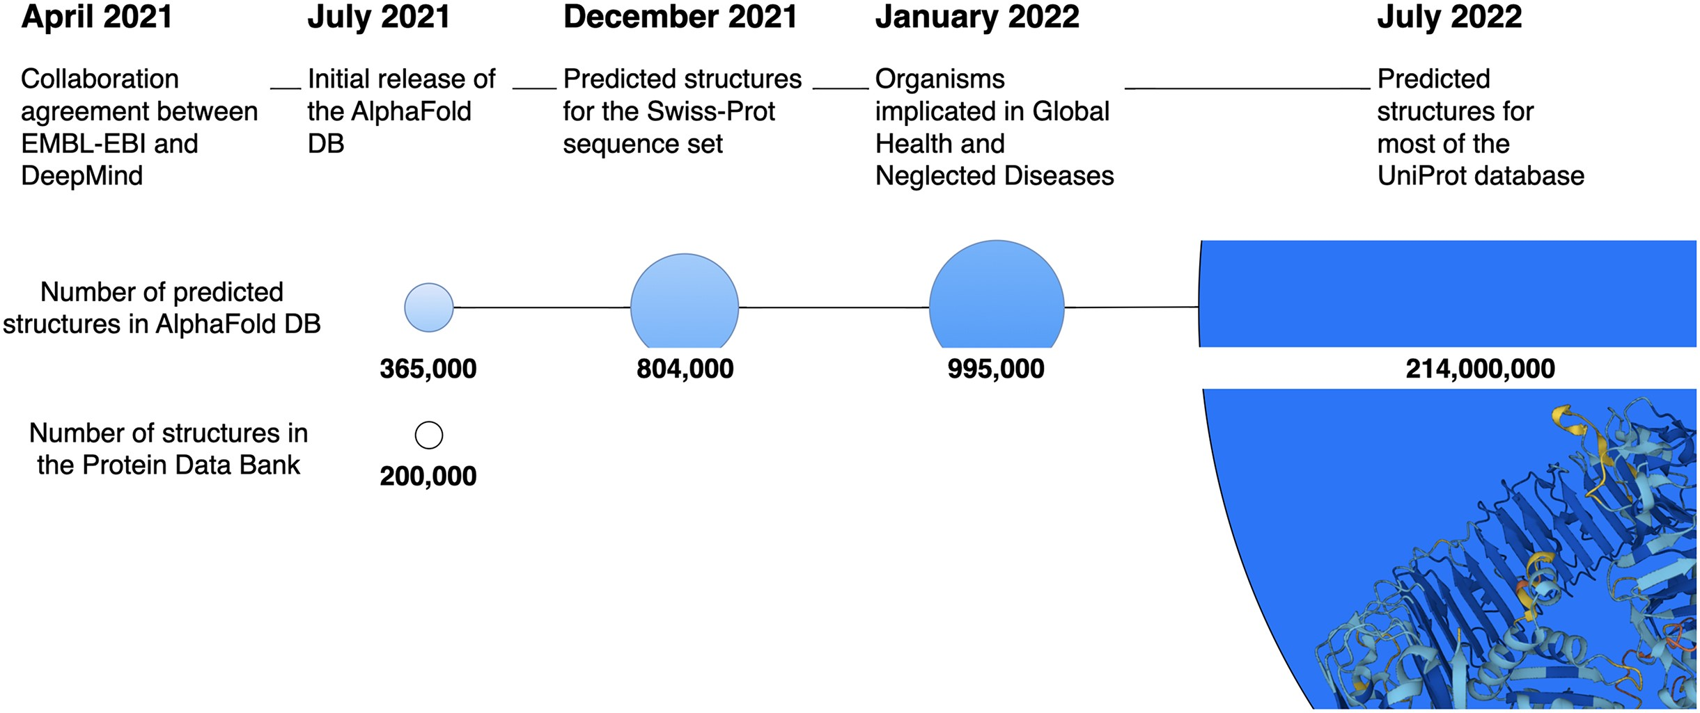
Resulting in huge growth in 3D structural data:
to >200M predicted structures in the latest release
From 200K experimental structures in 2021
Nucleic Acids Research 52(D1):D368–D375 (2024)

Slide 28
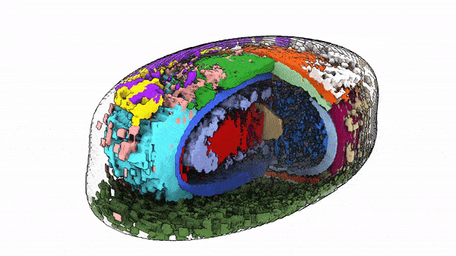
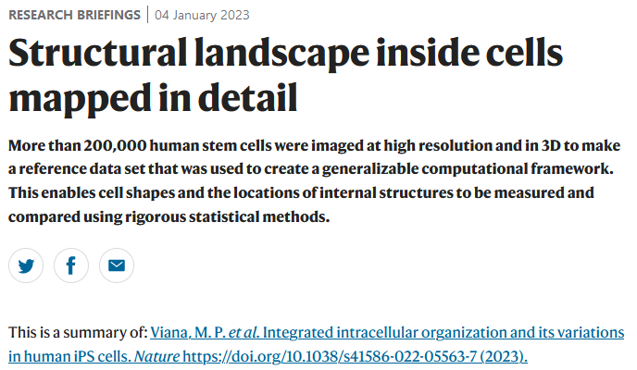
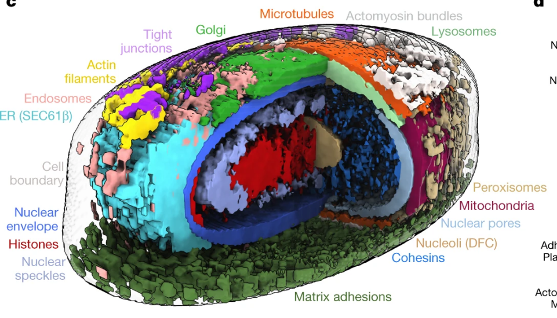

Slide 29
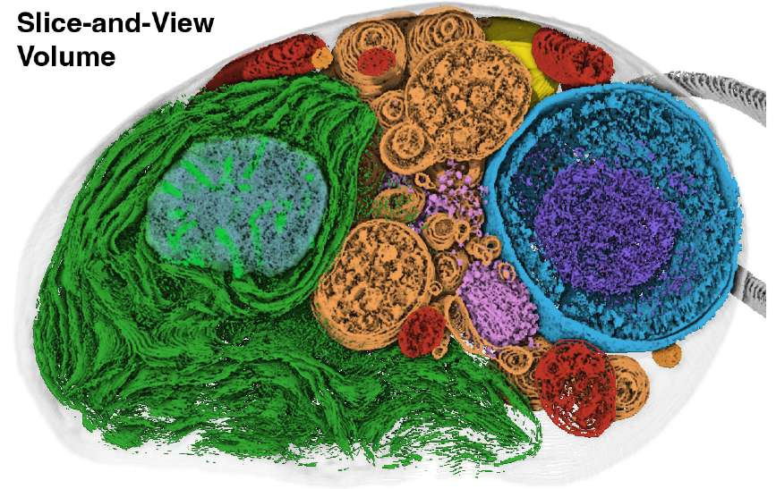
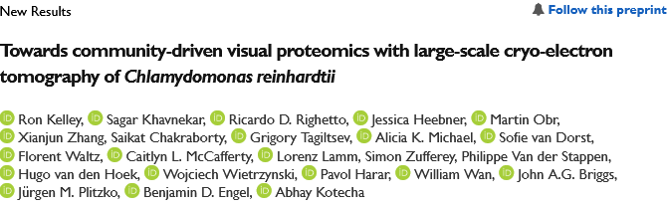

& 3 weeks ago, >1,800 3D tomograms of green algae were released
“as a community resource to … inspire biological discovery”
https://www.biorxiv.org/content/10.1101/2024.12.28.630444v1.full

Slide 30
Why are we here? We have no choice!
Biologists are faced with a staggering deluge of data, growing exponentially
Bioinformatics/comp bio tools and approaches help us understand these data and work productively, and to build increasingly powerful models of biological systems
We’ll learn important basic concepts in this field and get exposed to key technologies driving the field

Slide 31
Specifically…
We’ll cover the following topics, approximately in this order:
BASICS OF PYTHON PROGRAMMING
Introduction to Rosalind
A Python programming primer for non-programmers
Rosalind help & programming Q/A, new AI tools for learning programming
BIOLOGICAL SEQUENCE ANALYSIS
Substitution matrices (BLOSSUM, PAM) & sequence alignment
Protein and nucleic acid sequence alignments, dynamic programming
Sequence profiles
BLAST! (the algorithm), MMSeqs2, & FoldSeek
Biological databases
Markov processes and Hidden Markov Models

Slide 32
GENOMES, PROTEOMES, & "BIG BIOLOGY"
Gene finding algorithms
Genome sequencing & assembly
An introduction to large gene expression data sets
Promoter and motif finding, Gibbs sampling
Guest lecture: Intro to NGS analysis and the CBRF core
MACHINE LEARNING/AI
Clustering algorithms, hierarchical, k-means, self-organizing maps,
force-directed maps, UMAP/tSNE
Classification algorithms
Principal component analysis and data transformations
Guest lecture: Protein 3D structure prediction, incl. AlphaFold
Guest lecture: AI/deep neural networks and large language models

Slide 33
SYNTHETIC BIOLOGY & PROTEIN DESIGN
Protein 3D design/engineering, RFDiffusion/ProteinMPNN, ColabFold
Synthetic biology & genome design
THE FINAL COURSE PROJECT IS DUE by 10 PM, April 16, 2024
The last 3 class days will be for presenting your projects

