Slide 1


Slide 2
A Python programming primer for biologists
(Named after Monty Python’s Flying Circus & designed to be fun to use)
Systems Biology/Bioinformatics
Edward Marcotte, Univ of Texas at Austin

Slide 3
In bioinformatics, you often want to do completely new analyses. Having the ability to program a computer opens all sorts of research opportunities. Plus, it’s fun!
Most bioinformatics researchers use a scripting language, such as Python, Perl, or R, rather than a compiled language like C++
These languages are not the fastest, not the slowest, nor best, nor worst languages, but they’re easy to learn and write, and for many reasons, are well-suited to bioinformatics.
We’ll spend the next 2 lectures introducing Python to give you a sense for the language and help introduce the basics of algorithms.

Slide 4
Python documentation: http://www.python.org/doc/
& tips: http://www.tutorialspoint.com/python
Good introductory Python books:
Learning Python, Mark Lutz & David Ascher, O’Reilly Media
Bioinformatics Programming Using Python: Practical Programming for Biological Data, Mitchell Model, O'Reilly
Good intro video (from a 2 day intro class at Google):
https://www.youtube.com/playlist?list=PLC8825D0450647509
Practical Python, a self-paced online intro course:
https://dabeaz-course.github.io/practical-python/
An online Python tutor with a nice interactive code viewer:
http://www.pythontutor.com/

Slide 5
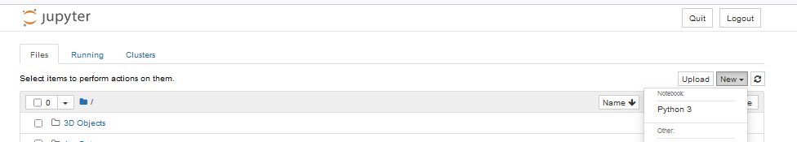
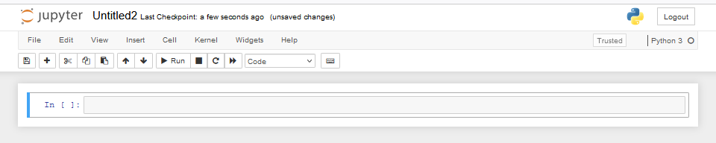
By now, you should have installed Python on your computer.
If you’re using Anaconda/Jupyter, it runs in a web browser:
Launch a new notebook
You can write your commands and programs here and they will be evaluated when you press Shift-Enter (or other options from the Cell pulldown menu)

Slide 6
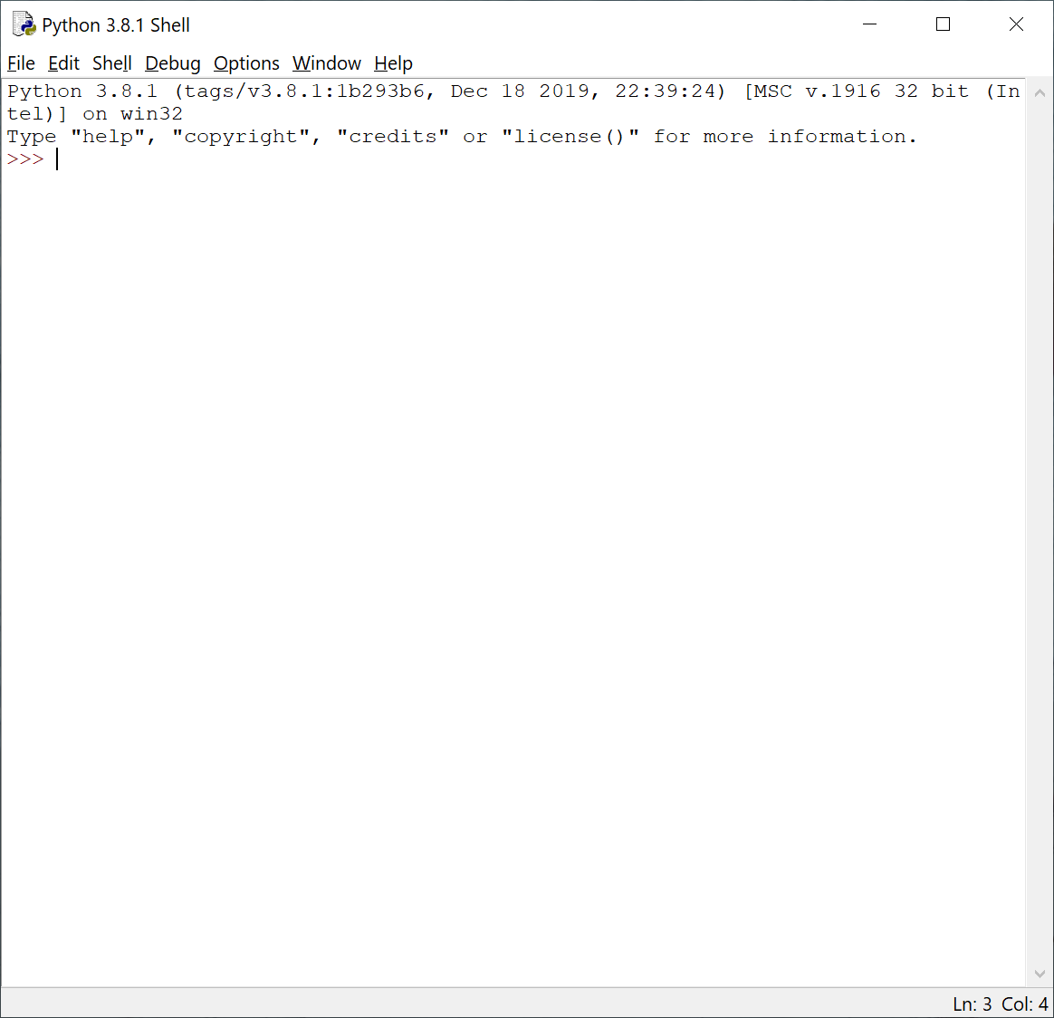
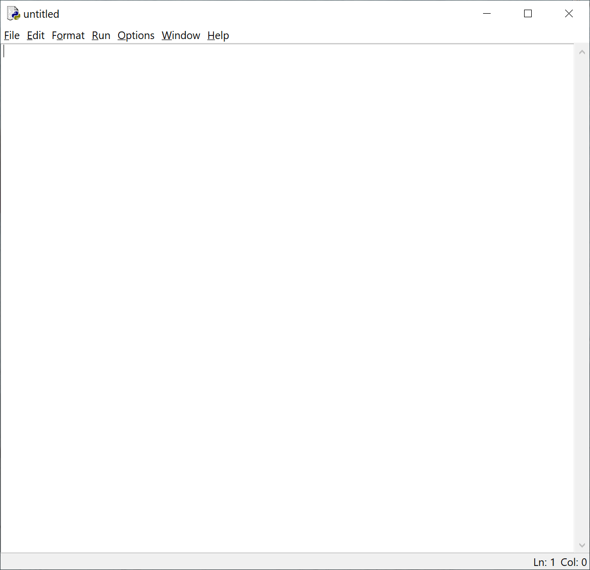
Or if you installed IDLE by following the instructions in Rosalind Homework problem #1:
Launch IDLE:
You can test out commands here
to make sure they work…
…but to actually write your programs,
open a new window.
This window will serve as a command line
interface & display your program output.
This window will serve as a text editor for programming.

Slide 7
Let’s start with some simple programs in Python:
A very simple example is:
print("Hello, future bioinformatician!") # print out the greeting
Run the program. In Jupyter, you can just type Shift-Enter & the output will appear below this cell of the notebook.
The output looks like this:
Hello, future bioinformatician!
FYI: This is version agnostic. Python 3 takes print(“X”). Python 2 also takes print “X” as in Rosalind

Slide 8
A slightly more sophisticated version:
name = input("What is your name? ") # asks a question and saves the answer
# in the variable "name"
print("Hello, future bioinformatician " + name + "!") # print out the greeting
When you run it this time, the output looks like:
What is your name?
If you type in your name, followed by the enter key, the program will print:
Hello, future bioinformatician Alice!
FYI: Python 2.x uses raw_input() instead of input()

Slide 9
GENERAL CONCEPTS
Names, numbers, words, etc. are stored as variables.
Variables in Python can be named essentially anything except words Python uses as command.
For example:
BobsSocialSecurityNumber = 456249685
mole = 6.022e-23
password = "7 infinite fields of blue"
Note that strings of letters and/or numbers are in quotes, unlike numerical values.

Slide 10
LISTS
Groups of variables can be stored as lists.
A list is a numbered series of values,
like a vector, an array, or a matrix.
Lists are variables, so you can name them just as you would name any other variable.
Individual elements of the list can be referred to using [] notation:
The list nucleotides might contain the elements nucleotides[0] = "A"
nucleotides[1] = "C"
nucleotides[2] = "G"
nucleotides[3] = "T"
(Notice the numbering starts from zero. This is standard in Python.)

Slide 11
DICTIONARIES
A VERY useful variation on lists is called a dictionary or dict (sometimes also called a hash).
Groups of values indexed not with numbers (although they could be) but with other values.
Individual hash elements are accessed like array elements:
For example, we could store the genetic code in a hash named codons, which might contain 64 entries, one for each codon, e.g.
codons["ATG"] = "Methionine"
codons["TAG"] = "Stop codon"
etc…

Slide 12
Now, for some control over what happens in programs.
There are two very important ways to control the logical flow of your programs:
if statements
and
for loops
There are some other ways too, but this will get you going for now.

Slide 13
if statements
if dnaTriplet == "ATG":
# Start translating here. We’re not going to write this part
# since we’re really just learning about IF statements
else:
# Read another codon
Python cares about the white space (tabs & spaces) you use!
This is how it knows where the conditional actions that follow begin and end. These conditional steps must always be indented by the same number of spaces (e.g., 4).
Pick one (e.g. a tab or 4 spaces) and always be consistent.

Slide 14
Note: in the sense of performing a comparison, not as in setting a value.
== equals
!= is not equal to
< is less than
> is greater than
<= is less than or equal to
>= is greater than or equal to
Can nest these using parentheses and Boolean operations, such as and, not, or or, e.g.:
if dnaTriplet == "TAA" or dnaTriplet == "TAG" or dnaTriplet == "TGA":
print("Reached stop codon")

Slide 15
for loops
Often, we’d like to perform the same command repeatedly or with slight variations.
For example, to calculate the mean value of the number in an array, we might try:
Take each value in the array in turn.
Add each value to a running sum.
Divide the total by the number of values.

Slide 16
In Python, you could write this as:
grades = [93, 95, 87, 63, 75] # create a list of grades
sum = 0.0 # variable to store the sum
for grade in grades: # iterate over the list called grades
sum = sum + grade # indented commands are executed on
# each cycle of the loop.
mean = sum / 5 # now calculate the average grade
print ("The average grade is ",mean) # print the results
In general, Python cares whether numbers are integers or floating point (also long integers and complex numbers).
You can tell Python you want floating point by defining your variables accordingly
(e.g., X = 1.0 versus X = 1)
Python 2 Python 3
>>> 2 / 3 >>> 2 / 3
0 0.666666
Python 2.x: print ("The average grade is "),mean

Slide 17
In general, Python will perform most mathematical operations, e.g.
multiplication (A * B)
division (A / B)
exponentiation (A ** B)
etc.
There are lots of advanced mathematical capabilities you can explore later on.

Slide 18
READING FILES
You can use a for loop to read text files line by line:
count = 0 # Declare a variable to count lines
file = open("mygenomefile", "r") # Open a file for reading (r)
for raw_line in file: # Loop through each line in the file
line = raw_line.rstrip("\r\n") # Remove newline
words = line.split(" ") # split the line into a list of words
# Print the appropriate word:
print ("The first word of line {0} of the file is {1}".format(count, words[0]))
count += 1 # shorthand for count = count + 1
file.close() # Last, close the file.
print ("Read in {0} lines\n".format(count))
Stands for “read”
\r = carriage return
\n = newline
Increment counter by 1
Placeholders (e.g., {0}) in the print statement indicate variables listed at the end of the line after the format command
Note: Python expects the file to be in your working directory or that you give it a full path.

Slide 19
WRITING FILES
Same as reading files, but use "w" for ‘write’:
file = open("test_file", "w")
file.write("Hello!\n")
file.write("Goodbye!\n")
file.close() # close the file as you did before
Unless you specify otherwise, you can find the new text file you created (test_file) in the default Python directory on your computer. In Jupyter, you should see now it appear in the Jupyter home page directory.

Slide 20
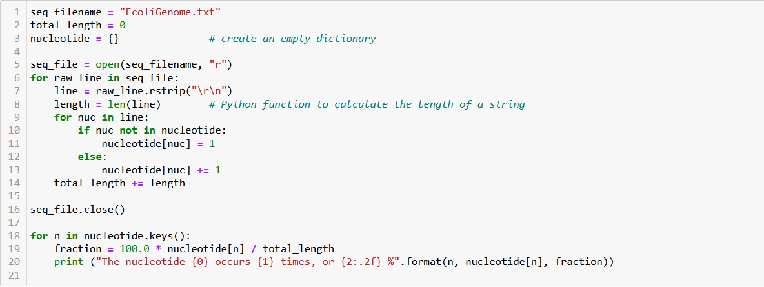
PUTTING IT ALL TOGETHER

Slide 21
Let’s choose the input DNA sequence in the file to be the genome of E. coli, available the class web site (& originally from the Entrez genomes web site)
The format of the file is ~77,000 lines of A’s, C’s, G’s and T’s:
AGCTTTTCATTCTGACTGCAACGGGCAATATGTCTCTGTGTGGATTAAAAAAAGAGTGTC
TGATAGCAGCTTCTGAACTGGTTACCTGCCGTGAGTAAATTAAAATTTTATTGACTTAGG
TCACTAAATACTTTAACCAATATAGGCATAGCGCACAGACAGATAAAAATTACAGAGTAC
ACAACATCCATGAAACGCATTAGCACCACCATTACCACCACCATCACCATTACCACAGGT
etc…
Running the program produces the output:
The nucleotide A occurs 1142742 times, or 24.62 %
The nucleotide G occurs 1177437 times, or 25.37 %
The nucleotide C occurs 1180091 times, or 25.42 %
The nucleotide T occurs 1141382 times, or 24.59 %
So, now we know that the four nucleotides are present in roughly equal numbers in the E. coli genome.

Slide 22
One really important aspect of Python is that there are literally thousands of existing libraries of pre-written functions that you can use to make life easier
Some examples you might use at some point are:
Numpy for numerical analyses (https://numpy.org/)
Scipy for scientific computation (https://scipy.org/)
BioPython for biological data analysis (https://biopython.org/)
Matplotlib for data visualization (https://matplotlib.org/)
Scikit-image for image processing (https://scikit-image.org/)
Many are preinstalled with Python (like numpy and scipy),
but if not, open the Anaconda Powershell Prompt & type:
pip install biopython
That’s it! Now you should have access to BioPython

Slide 23
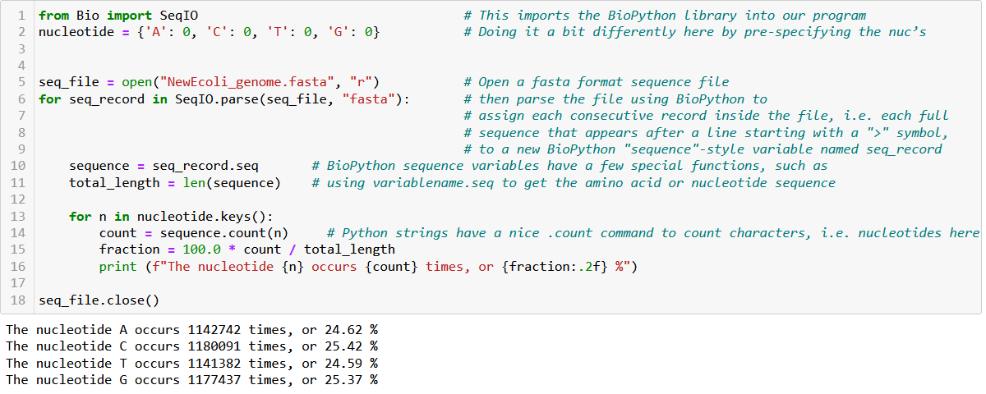
Let’s use BioPython to rewrite our last program:
We get the same answer, but without having to worry about parsing lines, newlines, etc.,
& this will make life a lot easier for dealing with files with 1000’s of protein or DNA sequences

Slide 24
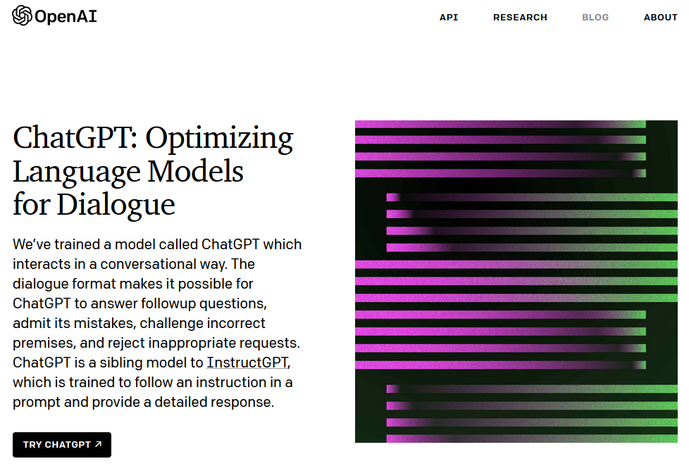
Finally, let’s give you a new programming super-power with ChatGPT
ChatGPT is (1) truly amazing and powerful, and (2) a pathological liar. Caveat emptor.
Try it out, but don’t trust it implicitly. It will give you an astonishing leg up with your programming, with the caveat that you have to check every single piece of code or fact supplied by it. It’s like getting programming help from a gifted psychopath.
https://chat.openai.com/

Slide 25
At this stage, I don’t want you to rely on it, especially if you’re just getting started and don’t know enough to recognize when it’s wrong.
Please don’t ask it write full programs for you or answer homework problems.
However, a few things you might find helpful at this stage:
Ask it to explain a line of code to you
    → “What does this command do?”
Ask it to explain programming syntax, suggest an alternative syntax, or a more compact way to perform the same task
Debugging, debugging, debugging. Give it your code (if there’s not too much to it) and ask it to debug.
Just as an example, here’s what chatGPT offers if we give it the example code for reading a file from 5 slides back.

Slide 26
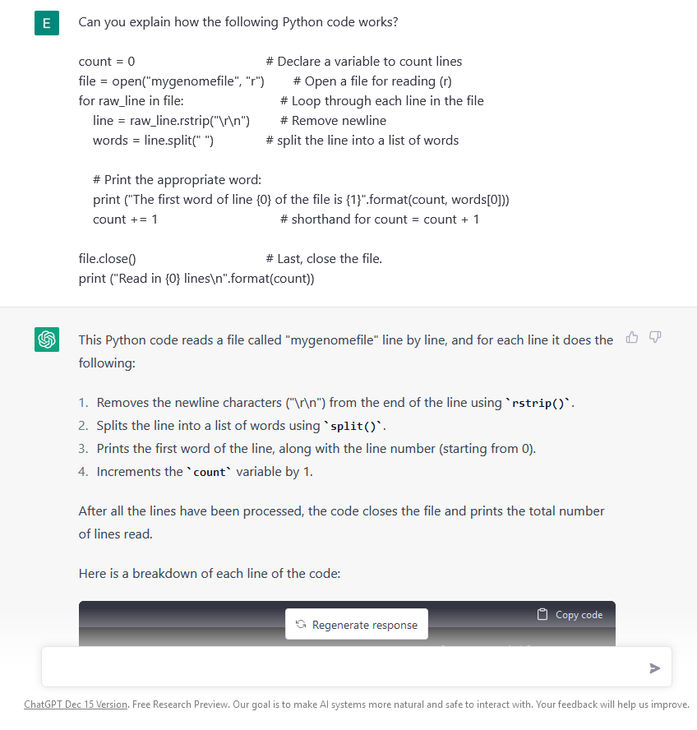
etc…
(for several pages)

Slide 27
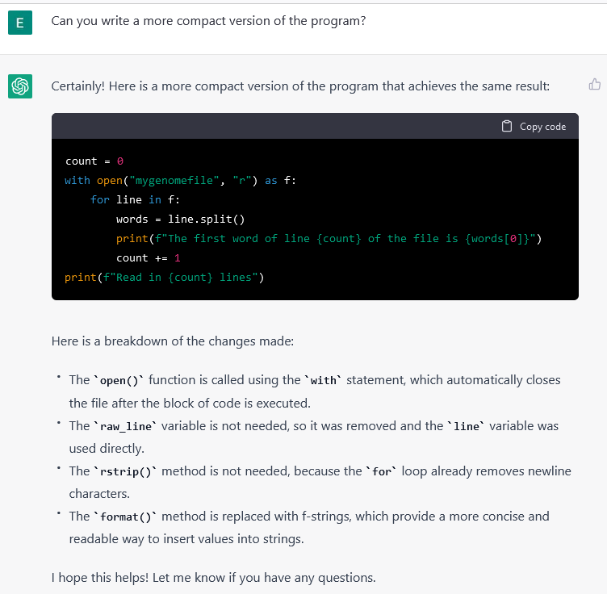

Slide 28
A last note about programming and proper attribution of other people’s code:
Most code is either commercial (which you usually can’t access or redistribute) or, if it’s in the public domain, available under a license, e.g. as for most of the code on github.
Common open source licenses include CC-BY-4.0, BSD, and the MIT license (my own lab often uses the MIT license). These are very permissive and allow you to use the code (with attribution) and license your own project in turn however you like. Others are for non-commercial use only, and still others are strong “copyleft” licenses (like GPL licenses) that require you to use the identical license for any code you distribute as was on the code you reused.
Be absolutely sure to acknowledge code that you use & check that you’re licensed to use it (especially if you go work in industry after grad school!)
You can read more about software licenses here:
https://opensource.guide/legal/#which-open-source-license-is-appropriate-for-my-project
& specifically for Github:
https://docs.github.com/en/repositories/managing-your-repositorys-settings-and-features/customizing-your-repository/licensing-a-repository

