Slide 1
Classifiers!!!
BCH394P/364C Systems Biology / Bioinformatics
Edward Marcotte, Univ of Texas at Austin

Slide 2
Clustering = task of grouping a set of objects in such a way that objects in the same group (a cluster) are more similar (in some sense) to each other than to those in other groups (clusters).
VS.
Classification = task of categorizing a new observation, on the basis of a training set of data with observations (or instances) whose categories are known
Adapted from Wikipedia

Slide 3
Remember, for clustering, we had a matrix of data…
M samples
Gene 1, sample 1 …
Gene 2, sample 1 …
Gene 3, sample 1 …
.
.
.
Gene i, sample 1 …
.
.
.
Gene N, sample 1 …
Gene 1, sample j …
Gene 2, sample j …
Gene 3, sample j …
.
.
.
Gene i, sample j …
.
.
.
Gene N, sample j …
Gene 1, sample M
Gene 2, sample M
Gene 3, sample M
.
.
.
Gene i, sample M
.
.
.
Gene N, sample M
N genes
For yeast, N ~ 6,000
For human, N ~ 22,000
i.e., a matrix of N x M numbers

Slide 4
We discussed gene expression profiles. Here’s another example of gene features.
genomes
M samples
Gene 1, sample 1 …
Gene 2, sample 1 …
Gene 3, sample 1 …
.
.
.
Gene i, sample 1 …
.
.
.
Gene N, sample 1 …
Gene 1, sample j …
Gene 2, sample j …
Gene 3, sample j …
.
.
.
Gene i, sample j …
.
.
.
Gene N, sample j …
Gene 1, sample M
Gene 2, sample M
Gene 3, sample M
.
.
.
Gene i, sample M
.
.
.
Gene N, sample M
Gene expression profiles:
each entry indicates an mRNA’s abundance in a different condition
Phylogenetic profiles:
each entry indicates whether the gene has homologs in a different organism
N genes
For yeast, N ~ 6,000
For human, N ~ 22,000

Slide 5
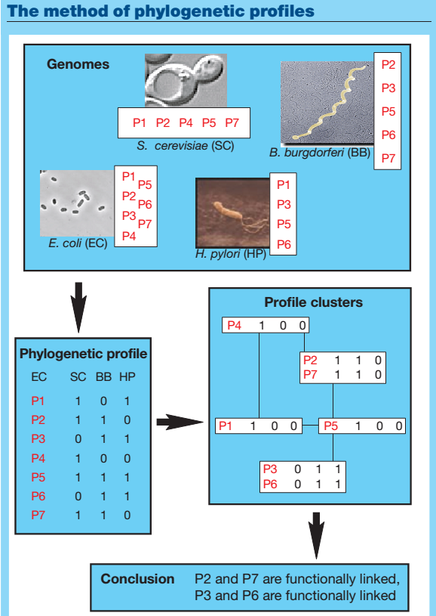
This is useful because biological systems tend to be modular and often inherited intact across evolution.
(e.g. you tend to have a flagellum or not)

Slide 6
Many such features are possible…
M samples
Gene 1, sample 1 …
Gene 2, sample 1 …
Gene 3, sample 1 …
.
.
.
Gene i, sample 1 …
.
.
.
Gene N, sample 1 …
Gene 1, sample j …
Gene 2, sample j …
Gene 3, sample j …
.
.
.
Gene i, sample j …
.
.
.
Gene N, sample j …
Gene 1, sample M
Gene 2, sample M
Gene 3, sample M
.
.
.
Gene i, sample M
.
.
.
Gene N, sample M
N genes
For yeast, N ~ 6,000
For human, N ~ 22,000
i.e., a matrix of N x M numbers

Slide 7
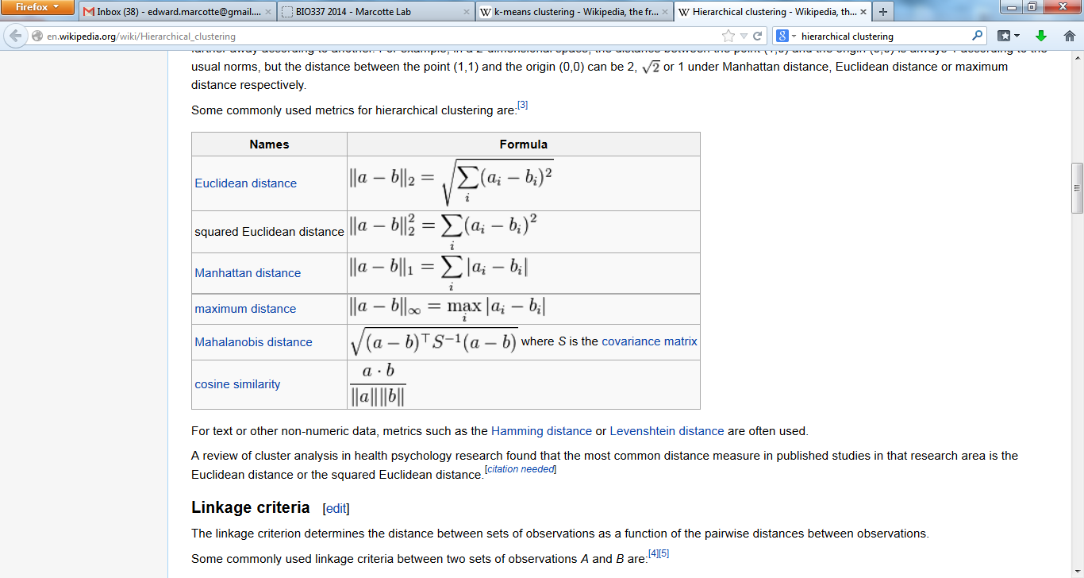
We also needed a measure of the similarity between feature vectors. Here are a few (of many) common distance measures used in clustering.
Wikipedia

Slide 8
We also needed a measure of the similarity between feature vectors. Here are a few (of many) common distance measures used in clustering.
classifying
Wikipedia

Slide 9
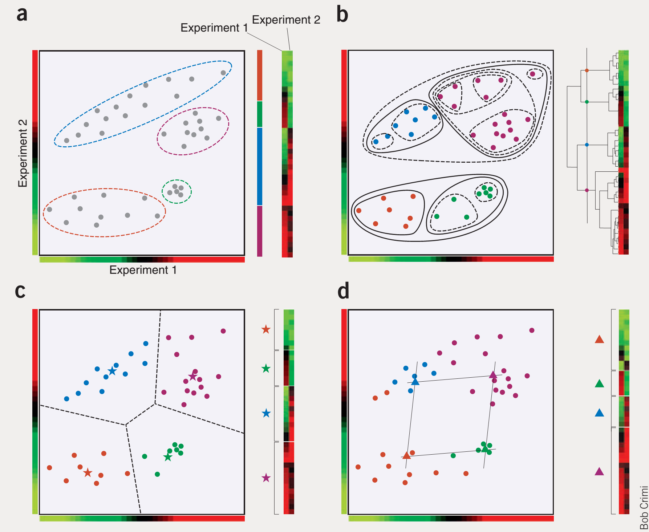
Clustering refresher: 2-D example
Nature Biotech 23(12):1499-1501 (2005)

Slide 10
Clustering refresher: hierarchical
Nature Biotech 23(12):1499-1501 (2005)

Slide 11
Clustering refresher: SOM
Nature Biotech 23(12):1499-1501 (2005)

Slide 12
Clustering refresher: k-means
Nature Biotech 23(12):1499-1501 (2005)

Slide 13
Clustering refresher: k-means
Decision boundaries
Nature Biotech 23(12):1499-1501 (2005)

Slide 14
One of the simplest classifiers uses the same notion of decision boundaries.
Decision boundaries
Nature Biotech 23(12):1499-1501 (2005)

Slide 15
One of the simplest classifiers uses this notion of decision boundaries.
Rather than first clustering, calculate the centroid (mean) of objects with each label.
New observations are classified as belonging to the group whose mean is nearest.
=“minimum distance classifier”
Nature Biotech 23(12):1499-1501 (2005)

Slide 16
One of the simplest classifiers uses this notion of decision boundaries.
B cell lymphoma
healthy B cells
For example….
something else
B cell precursor
Nature Biotech 23(12):1499-1501 (2005)

Slide 17
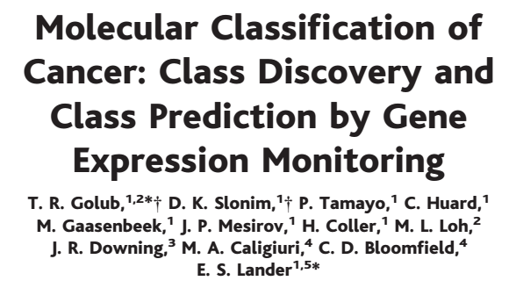
Let’s look at a specific historic example:
“Enzyme-based histochemical analyses were introduced in the 1960s to demonstrate that some leukemias were periodic acid-Schiff positive, whereas others were myeloperoxidase positive…
This provided the first basis for classification of acute leukemias into those arising
from lymphoid precursors (acute lymphoblastic leukemia, ALL), or from myeloid precursors (acute myeloid leukemia, AML).”

Slide 18
Let’s look at a specific historic example:
“Distinguishing ALL from AML is critical for successful treatment…
chemotherapy regimens for ALL generally contain corticosteroids, vincristine, methotrexate, and L-asparaginase, whereas
most AML regimens rely on a backbone of daunorubicin and cytarabine (8).
Although remissions can be achieved using ALL therapy for AML (and vice versa), cure rates are markedly diminished, and unwarranted toxicities are encountered.”

Slide 19
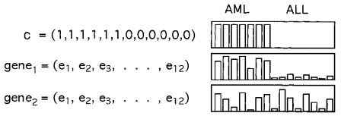
Let’s look at a specific historic example:
Take labeled samples, find genes whose abundances separate the samples…

Slide 20
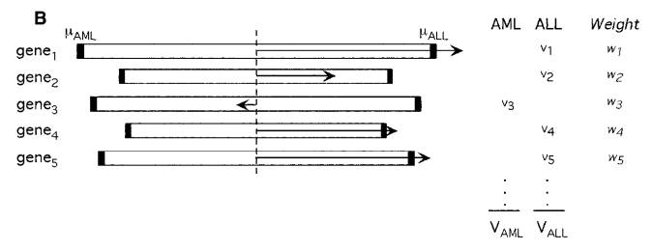
Let’s look at a specific historic example:
Calculate weighted average of indicator genes to assign class of an unknown

Slide 21
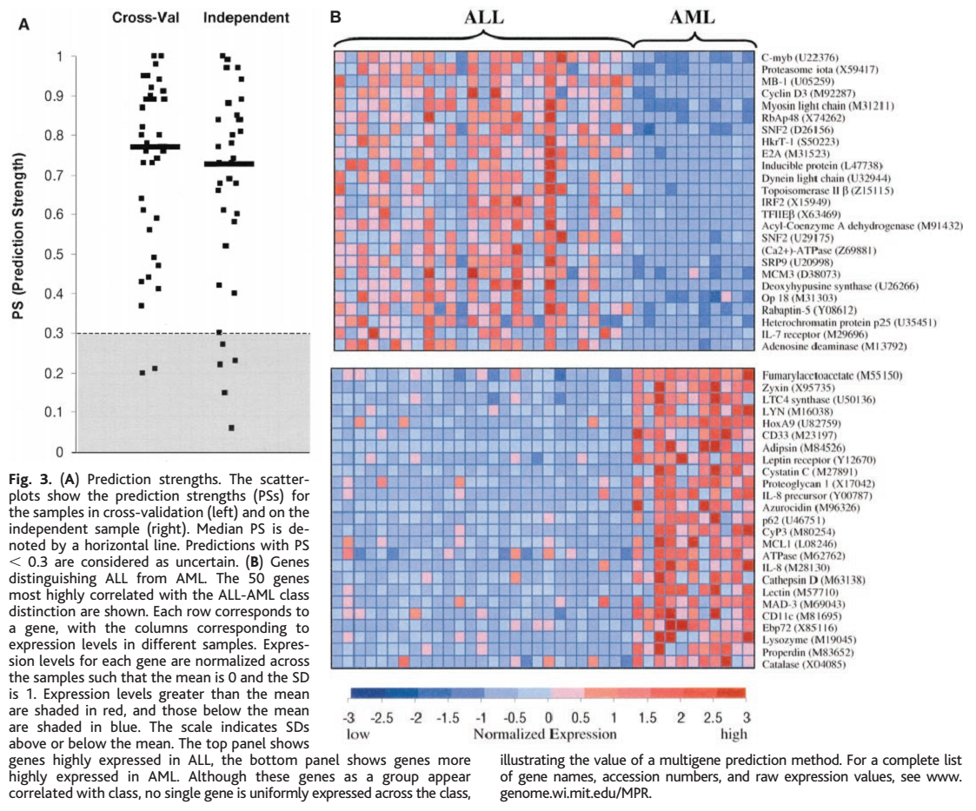
PS=(Vwin-Vlose)/(Vwin+Vlose), whereVwin and VLose are the vote totals for the winning and losing classes.

Slide 22
What are these?

Slide 23
Cross-validation
Withhold a sample, build a predictor based only on the remaining samples, and predict the class of the withheld sample.
Repeat this process for each sample, then calculate the cumulative or average error rate.

Slide 24
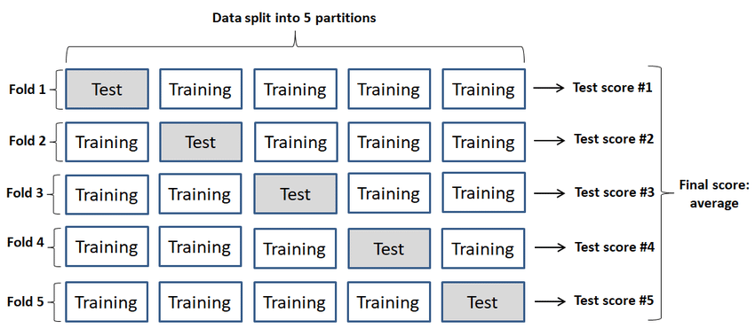
X-fold cross-validation
e.g. here, 5-fold:
Image CC-BY, from DOI:10.3390/app9214500

Slide 25
Independent data
Withhold an entire dataset, build a predictor based only on the remaining samples
(the training data).
Test the trained classifier on the independent test data to give a fully independent measure of performance.

Slide 26
You already know how to measure how well these algorithms work (way back in our discussion of gene finding!)…
True answer:
Positive
Negative
True positive
False positive
Positive
Algorithm
predicts:
False negative
True negative
Negative
Specificity = TP / (TP + FP)
Sensitivity = TP / (TP + FN)

Slide 27
You already know how to measure how well these algorithms work (way back in our discussion of gene finding!)…
Sort the data by their classifier score, then step from best to worst and plot the performance:
Precision =
TP / (TP + FP)
also called positive predictive value (PPV)
100%
Good classifier
Better
Precision- recall curve
Much worse
0 %
0 %
Recall =
TP / (TP + FN)
(= sensitivity)
100%

Slide 28
Another good option:
Sort the data by their classifier score, then step from best to worst and plot the performance:
First used in WWII to analyze radar signals (e.g., after attack on Pearl Harbor)
Sensitivity =
TP / (TP + FN)
also called
True Positive
Rate (TPR)
100%
Best
classifier
ROC curve
(receiver operator
characteristic)
random
0 %
0 %
100%
1- Specificity =
FP / (FP + TN)
also called False Positive Rate (FPR)

Slide 29
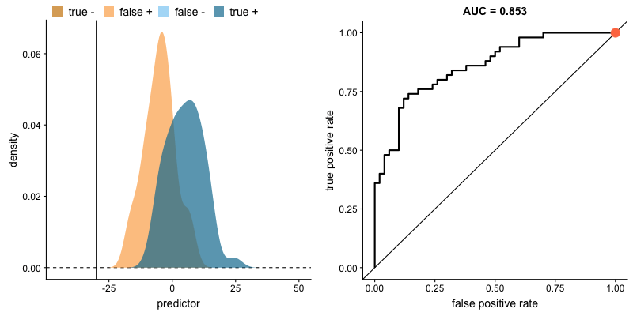
ROC curve, as you go from stronger to weaker predictions
Thanks to Dariya Sydykova (UT Austin), for her excellent visualizations, available here:
https://github.com/dariyasydykova/open_projects/tree/master/ROC_animation

Slide 30
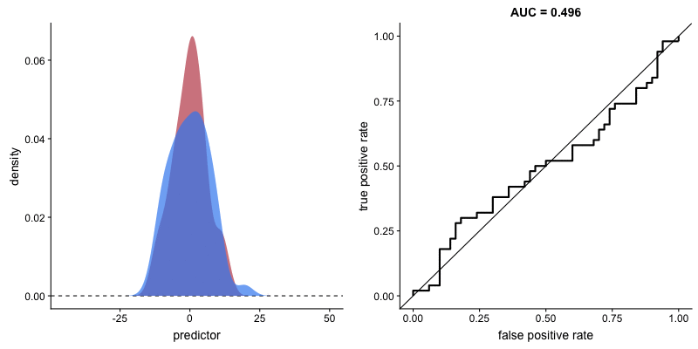
ROC curve, as you go from stronger to weaker classifiers
Thanks to Dariya Sydykova (UT Austin), for her excellent visualizations, available here:
https://github.com/dariyasydykova/open_projects/tree/master/ROC_animation

Slide 31
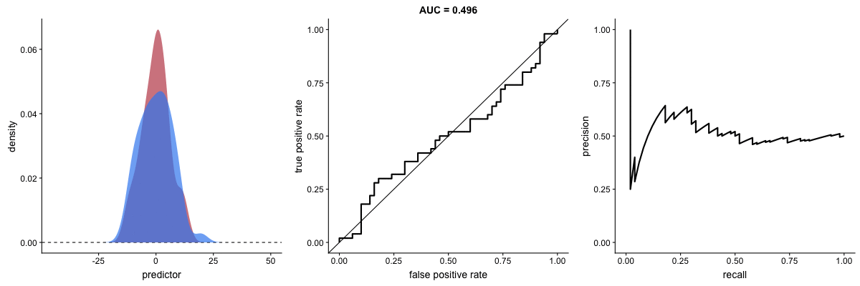
ROC versus Recall/Precision
The 2 measures are related and both useful. They differ strongly in performance as proportions of positive and negative classes change.
Top preds
Top preds
ROC
P/R
Thanks to Dariya Sydykova (UT Austin), for her excellent visualizations, available here:
https://github.com/dariyasydykova/open_projects/tree/master/ROC_animation

Slide 32
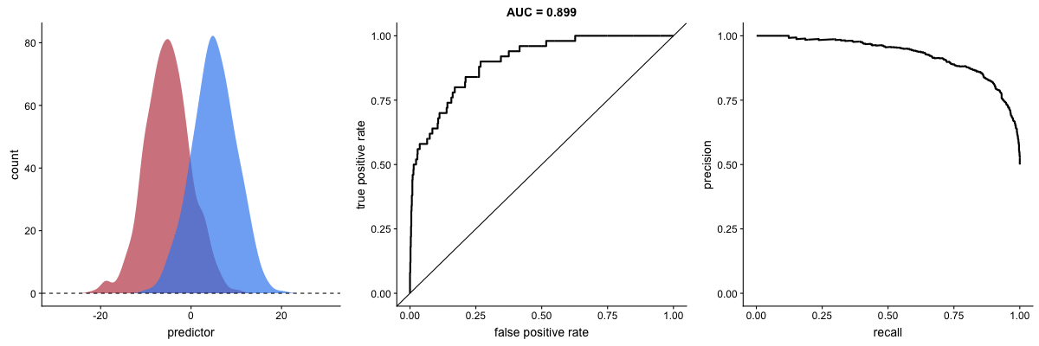
ROC versus Recall/Precision
R/P depends strongly on relative rates of the 2 classes
ROC performance is independent of their relative rates
  (It may be important or not for your particular problem…)
ROC
P/R
Thanks to Dariya Sydykova (UT Austin), for her excellent visualizations, available here:
https://github.com/dariyasydykova/open_projects/tree/master/ROC_animation

Slide 33
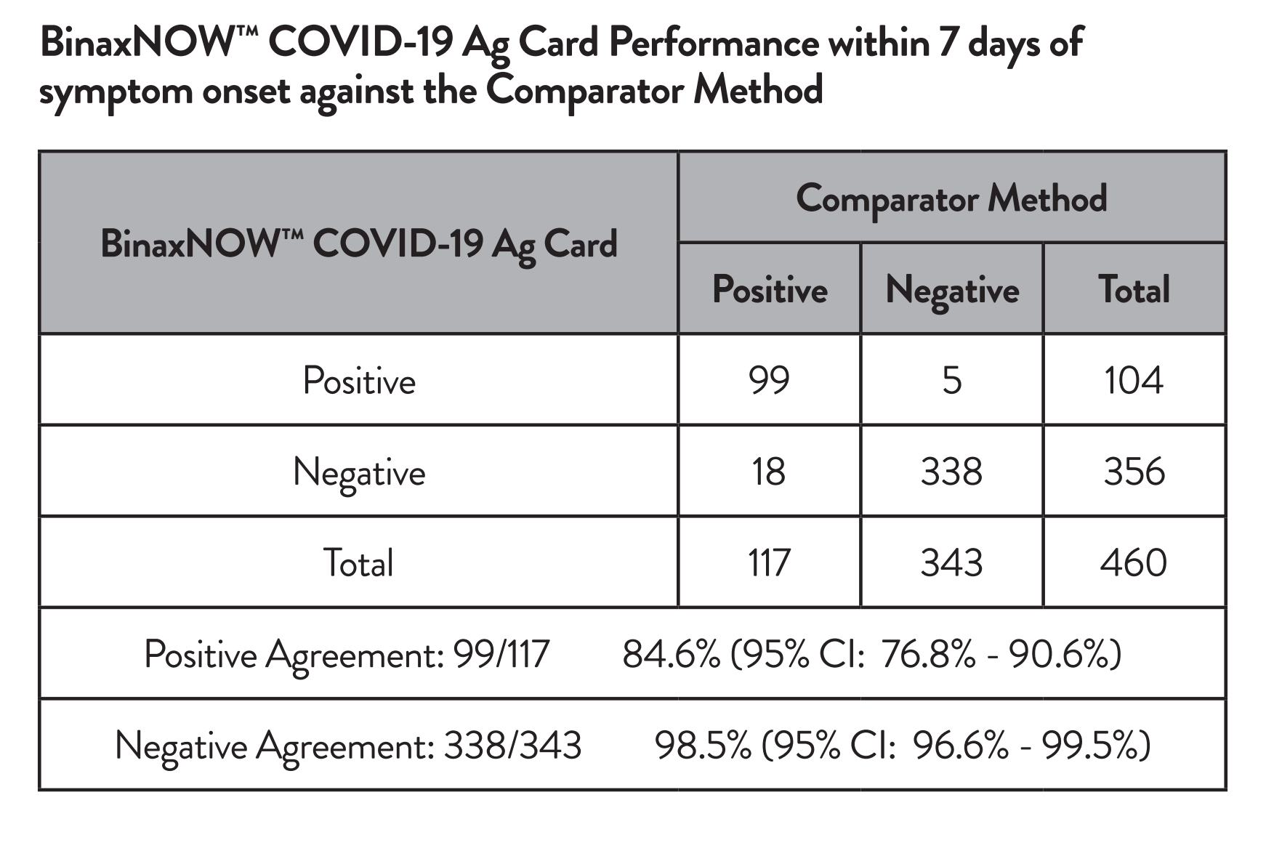
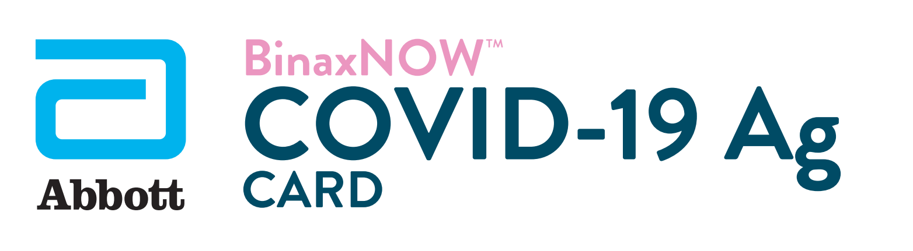
For example, the FDA evaluates diagnostic tests (≈classifiers) using ROC-like measures
Sensitivity (TPR)
1- Specificity (FPR)
Any guesses why?
Hint: How would COVID test performance change for ROC vs Precision/Recall as the infection rate in the population changes?
https://www.fda.gov/media/141570/download

Slide 34
Back to our minimum distance classifier…
Would it work well for this data?
X
X
X
O
O
X
O
X
X
X
X
X
O
O
O
X
X
X
X
X
O
O
X
X
X
O
X
X
O
O
O
X
X
O
X
X
X
X
X
X
X
O
O
O
O
O
O
O
X
X
X
X
X
O
X
X
X
X
O
O
O
X
O
O
O
O
O
X
X
X
X
X
X
X
X
O
O
O
X
X
X
O
X
X
X
X
X
O
X
X
X
O
O
O
O
O
O
O
X
X
X
X
X
X
O
X
X
X
O
O
O
O
O
O
O
O
X
X
X
X
X
X
X
O
O
O
O
O
X
X
X
X
X
O
O
O
X
X
O
O
O
O
O
O
O
O
O
O
O
O
O
O
O
O
O
O

Slide 35
Back to our minimum distance classifier…
How about this data? What might?
O
O
O
O
O
O
O
O
O
O
O
O
O
O
O
O
O
O
O
O
O
O
X
X
X
O
O
X
X
X
X
X
X
X
X
X
X
X
O
O
O
X
X
X
X
X
X
X
O
X
X
X
X
X
X
X
X
X
X
X
X
X
X
X
X
O
O
O
X
X
X
X
X
X
X
O
O
X
X
X
X
X
X
X
X
X
X
O
O
X
X
X
O
O
O
O
X
X
X
X
X
X
O
X
X
X
O
O
O
X
X
X
X
O
O
O
O
X
X
X
O
O
O
X
X
X
X
X
O
O
O
X
X
O
O
O
O
O
O
O
O
O
O
O
O
O
O
O
O
O
O
O
O
O
O
O

Slide 36
Back to our minimum distance classifier…
How about this data? What might?
X
X
X
X
O
O
O
O
X
X
X
X
O
O
O
O
X
X
X
X
O
O
O
O
X
X
X
X
O
O
O
O
X
X
X
X
O
O
O
O
X
X
X
X
O
O
O
O
X
X
X
X
O
O
O
O
X
X
X
X
O
O
O
O
O
O
O
O
X
X
X
X
O
O
O
O
X
X
X
X
O
O
O
O
X
X
X
X
O
O
O
O
X
X
X
X
O
O
O
O
X
X
X
X
O
O
O
O
X
X
X
X
O
O
O
O
X
X
X
X
O
O
O
O
X
X
X
X
X
X
X
X
O
O
O
O
X
X
X
X
O
O
O
O
X
X
X
X
O
O
O
O
X
X
X
X
O
O
O
O
X
X
X
X
O
O
O
O
X
X
X
X
O
O
O
O
X
X
X
X
O
O
O
O
X
X
X
X
O
O
O
O
O
O
O
O
X
X
X
X
O
O
O
O
X
X
X
X
O
O
O
O
X
X
X
X
O
O
O
O
X
X
X
X
O
O
O
O
X
X
X
X
O
O
O
O
X
X
X
X
O
O
O
O
X
X
X
X
O
O
O
O
X
X
X
X

Slide 37
This is a great case for something called
a k-nearest neighbors classifier:
For each new object, calculate the k closest data points.
Let them vote on the label of the new object.
X
X
X
X
O
O
O
O
X
X
X
X
O
O
O
O
X
X
X
X
O
O
O
O
X
X
X
X
O
O
O
O
X
X
X
X
O
O
O
O
X
X
X
X
O
O
O
O
X
X
X
X
O
O
O
O
X
X
X
X
O
O
O
O
O
O
O
O
X
X
X
X
O
O
O
O
X
X
X
X
This is surrounded by O’s and will probably be voted to be an O.
O
O
O
O
X
X
X
X
O
O
O
O
X
X
X
X
O
O
O
O
X
X
X
X
O
O
O
O
X
X
X
X
O
O
O
O
X
X
X
X
O
O
O
O
X
X
X
X
X
X
X
X
O
O
O
O
X
X
X
X
O
O
O
O
X
X
X
X
O
O
O
O
X
X
X
X
O
O
O
O
X
X
X
X
O
O
O
O
X
X
X
X
O
O
O
O
X
X
X
X
O
O
O
O
X
X
X
X
O
O
O
O
O
O
O
O
X
X
X
X
O
O
O
O
X
X
X
X
O
O
O
O
X
X
X
X
O
O
O
O
X
X
X
X
O
O
O
O
X
X
X
X
O
O
O
O
X
X
X
X
O
O
O
O
X
X
X
X
O
O
O
O
X
X
X
X
This one is surrounded by X’s and will probably be voted to be an X.

Slide 38
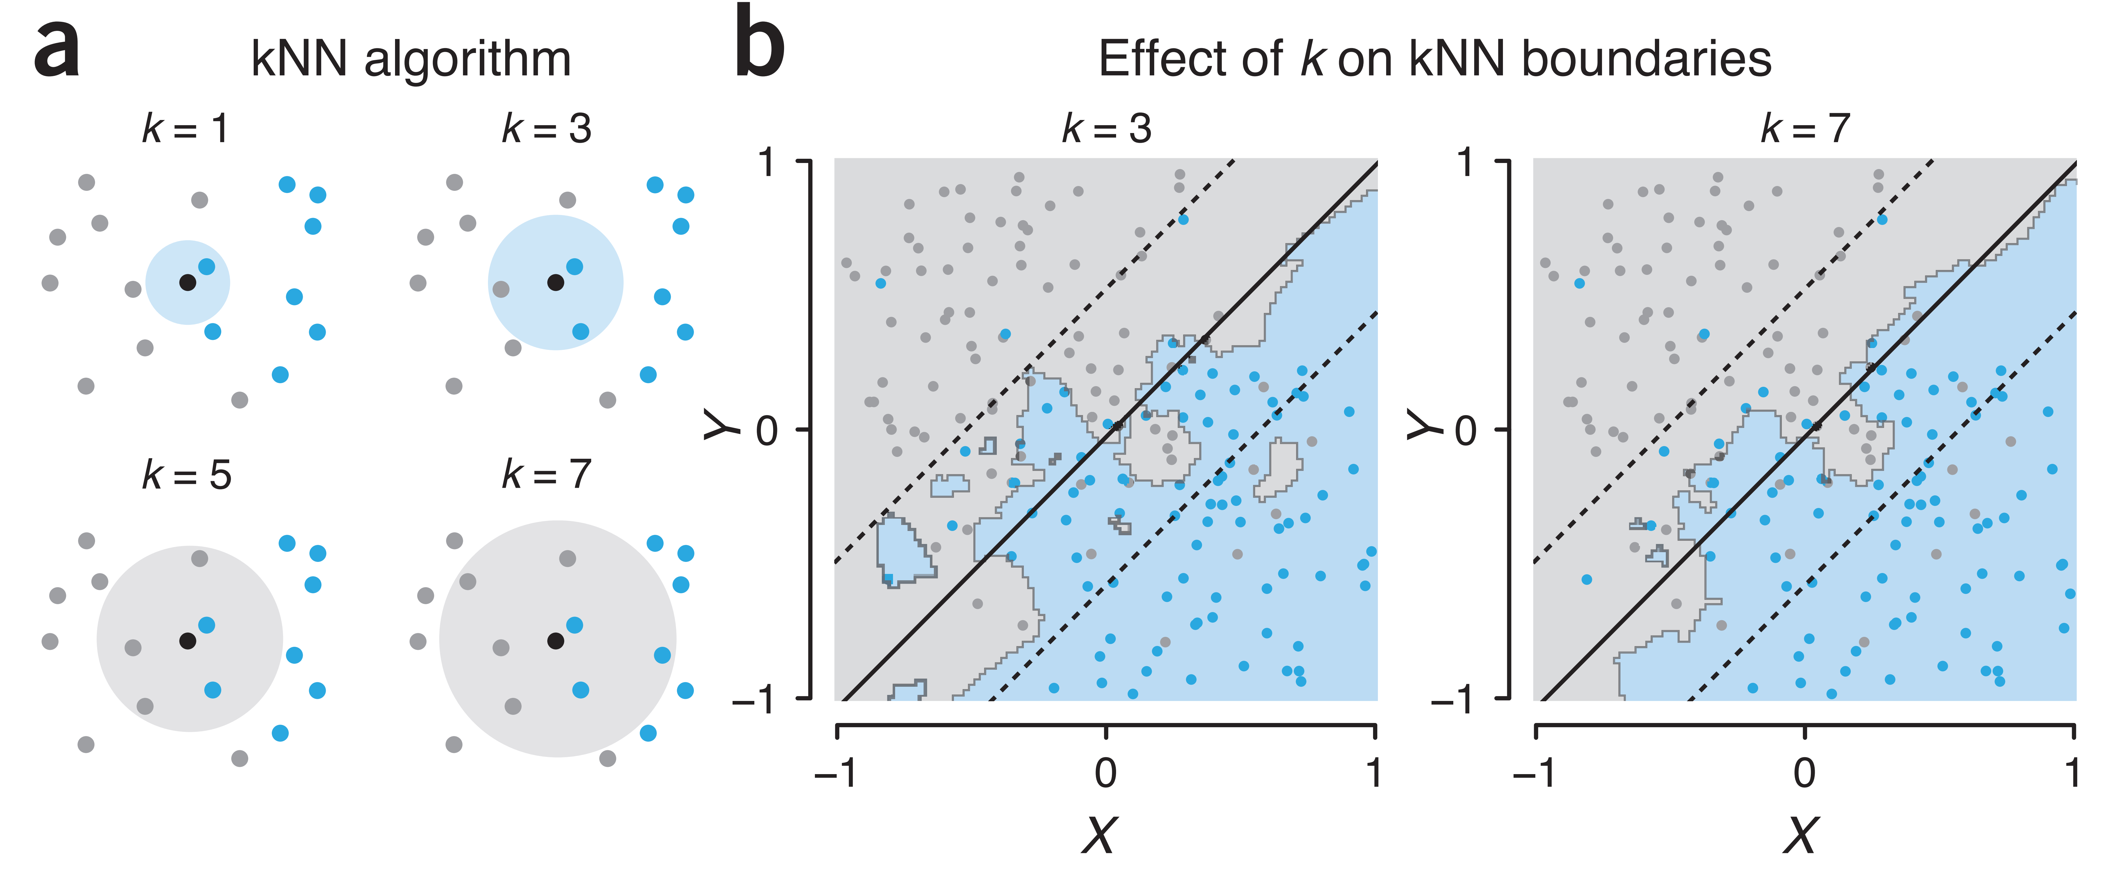
This is a great case for something called
a k-nearest neighbors classifier:
For each new object, calculate the k closest data points.
Let them vote on the label of the new object.
kNN can (and often will) have complex, non-linear decision boundaries

Slide 39
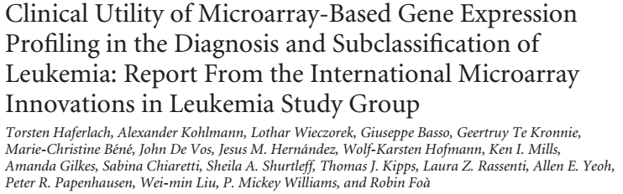
Back to leukemias. There was a follow-up study in 2010:
Tested clinical use of expression profiling to subtype leukemias
Meta-analysis of 11 labs, 3 continents, 3,334 patients
Stage 1 (2,096 patients):
  92.2% classification accuracy for 18 leukemia classes (99.7% median specificity)
Stage 2 (1,152 patients):
  95.6% median sensitivity and 99.8% median specificity for 14 subtypes of acute leukemia
Microarrays outperformed routine diagnostics in 29 (57%) of 51 discrepant cases
Conclusion: “Gene expression profiling is a robust technology for the diagnosis of hematologic malignancies with high accuracy”

Slide 40
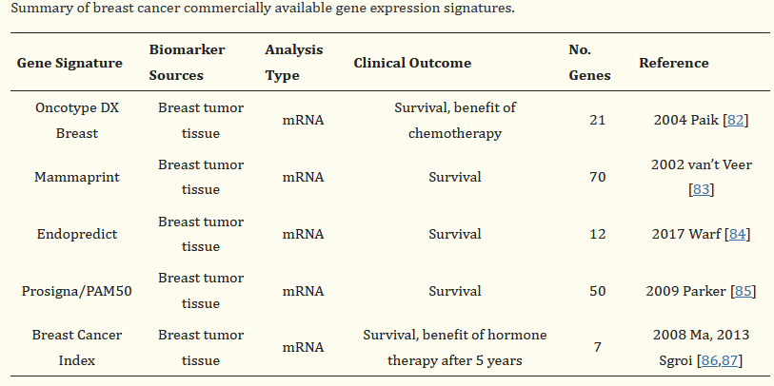
Current commercial breast cancer gene expression panels use this same strategy
Prognostic Cancer Gene Expression Signatures: Current Status and Challenges (2021) Cells 10(3): 648

Slide 41
In practice, if you want to explore classifiers, I also strongly recommend always testing these classifiers:
Random forests
Support vector machines (SVM)
These two are surprisingly often the best for many biological classification problems. Weka can do both of them.
Note that I didn’t say neural networks. Deep neural networks can be extremely powerful (e.g. AlphaFold) but usually require extensive training examples. In general, you’ll often be better off starting off with the above classifiers for many problems, only moving to deep neural networks if you really need to and when you have data to support it.
We’ll talk about NNs in the next 2 lectures, including large language models.

Slide 42
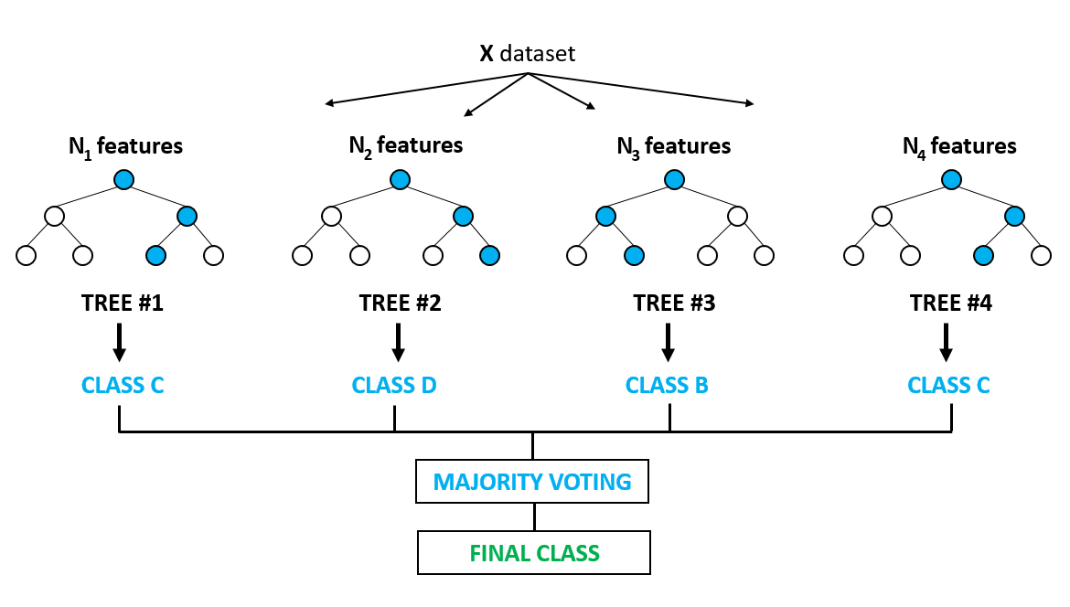
The two-slide overview of Random forest classifiers:
Construct many decision trees from random subsets of your features. Because the features vary across trees, trees tend to be weak but uncorrelated
All the trees “vote” on the answer, majority wins.
https://www.globalsoftwaresupport.com/random-forest-classifier-bagging-machine-learning/

Slide 43
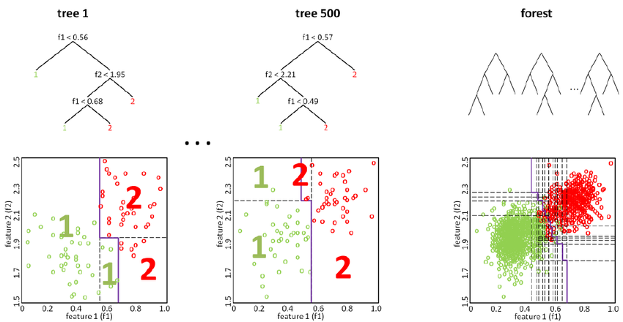
The two-slide overview of Random forest classifiers:
Construct many decision trees from random subsets of your features. Because the features vary across trees, trees tend to be weak but uncorrelated
All the trees “vote” on the answer, majority wins.
https://www.researchgate.net/figure/The-Random-Forest-classifier-is-an-ensemble-of-decision-trees-where-the-single-trees-are_fig1_228540194

Slide 44
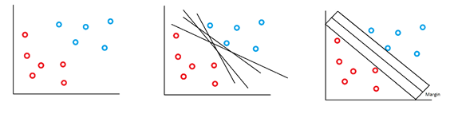
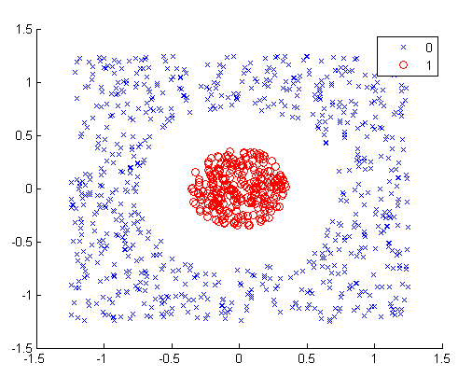
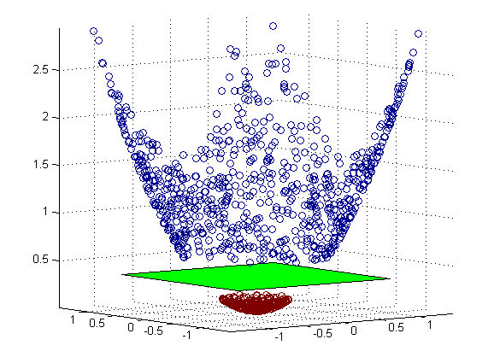
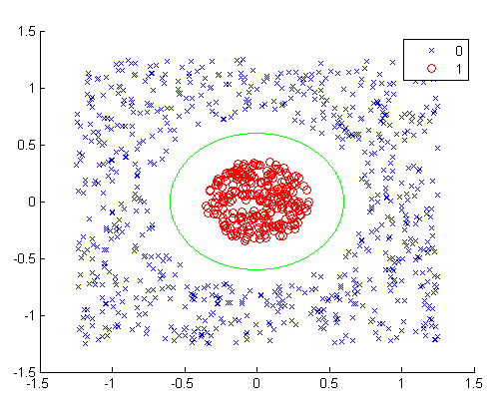
The one-slide overview of Support vector machines:
Goal: make a linear classifier, choosing a decision boundary that maximizes the distance margin between classes
But what if the boundary is non-linear? Use kernels to implicitly map the data to higher dimension where a linear decision can be made
https://quantdare.com/svm-versus-a-monkey/
Maximum margin hyperplane

Slide 45

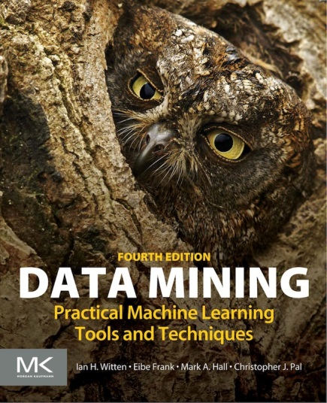
In practice, if you want to explore classifiers, I strongly recommend the Weka package:
http://www.cs.waikato.ac.nz/ml/weka/
It’s free, and easy to install, use, & troubleshoot. It lets you quickly test many alternative (well-vetted) classifiers,
all in a proper cross-validated/precision-recall framework.
Here’s a nice step-by-step intro for biologists :
Introducing Machine Learning Concepts with WEKA, in Statistical Genomics,
Methods in Molecular Biology, v. 1418, p. 353-378, 24 March 2016
http://link.springer.com/content/pdf/10.1007%2F978-1-4939-3578-9_17.pdf
There’s also a great book to walk you through the entire process.
Highly recommended!!!

Slide 46
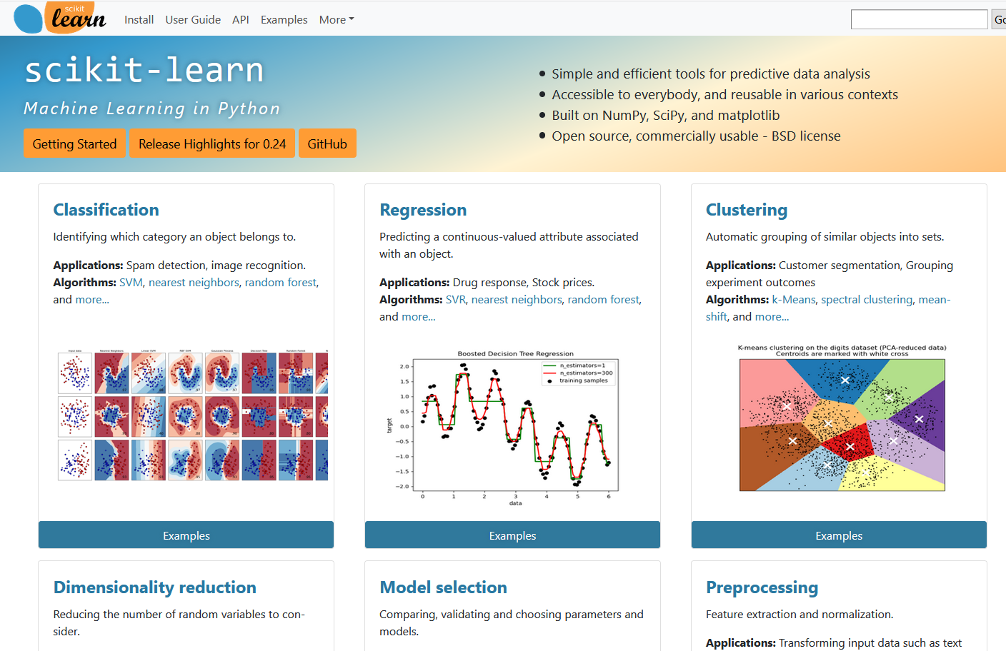

In Python, you can also use the scikit-learn library:
https://scikit-learn.org/stable/
Like Weka, it’s free, easy to install & use, and very powerful
I recommend combining it with the Pandas library for data analysis to make it easy to work with big, tabular datasets:
https://pandas.pydata.org/

Slide 47
Coming up:
The next two lectures will be guest lectures covering the basics of deep neural networks, with talks on
Protein 3D structural modeling and prediction w/ AlphaFold/ChimeraX
DeepNNs, Large Language Models, & ESM

