Slide 1
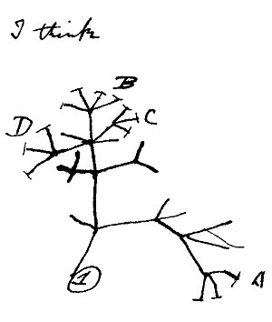
Homology, Orthology, and Trees
Benjamin J. Liebeskind
Post-doctoral Fellow, UT Austin
PIs: Edward Marcotte, Rick Aldrich

Slide 2
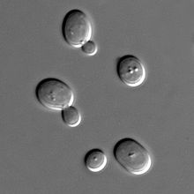
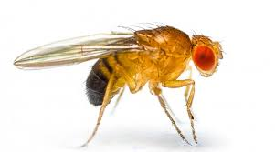
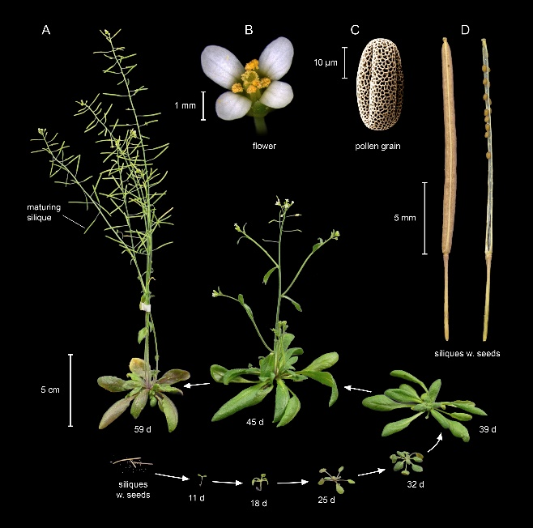
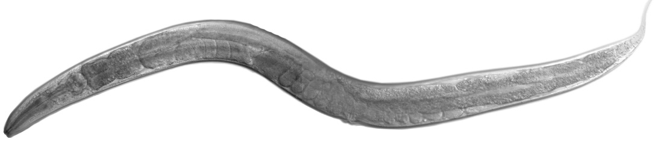
How do we compare proteins across species?

Slide 3
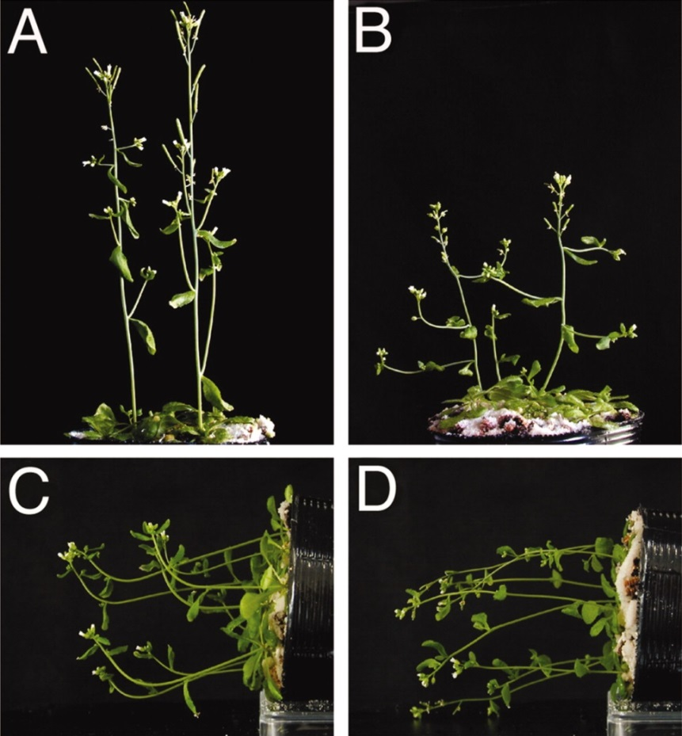

Gravitropism defects
Waardenburg syndrome
Significantly overlapping gene set
McGary et al. (2013)

Slide 4
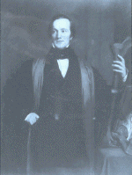
Homology
“Homologue…The same organ in different animals under every variety of form and function…Analogue…A part or organ in one animal which has the same function as another part or organ in a different animal”
- Richard Owen (1843)

Slide 5
Homology
Since Darwin:
  Organs (or genes, or…) in two or more species that are similar due to common descent
  I.e. they are descended from a similar organ in their most recent common ancestor

Slide 6
Homology
Since Darwin:
  Organs (or genes, or…) in two or more species that are similar due to common descent
  I.e. they are descended from a similar organ in their most recent common ancestor
Note
  This means homology is binary
  No such thing as % homology

Slide 7
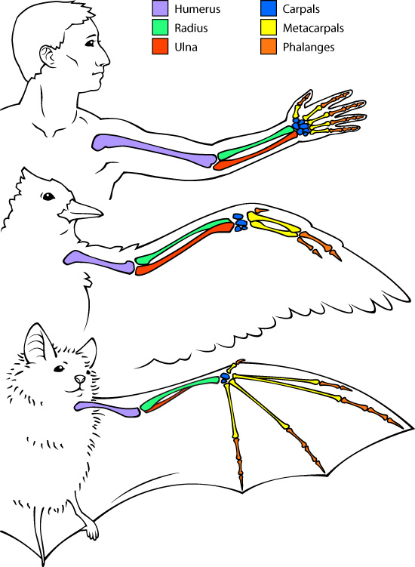
Homology
This is trickier than it sounds!!
Organs are not monolithic entities!!
askabiologist.asu.edu/human-bird-and-bat-bone-comparison

Slide 8
Homology
This is trickier than it sounds!!
Organs are not monolithic entities!!
Bat wings and bird wings are homologous as vertebrate forelimbs
But they are analogous as wings
askabiologist.asu.edu/human-bird-and-bat-bone-comparison

Slide 9
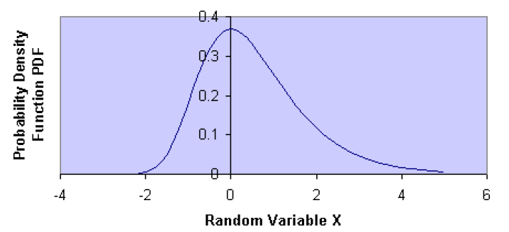

Homology of Genes
Alignment scores follow an extreme value distribution
# random trials & their average score
Describe the shape & can
be fit from a few trials

Slide 10
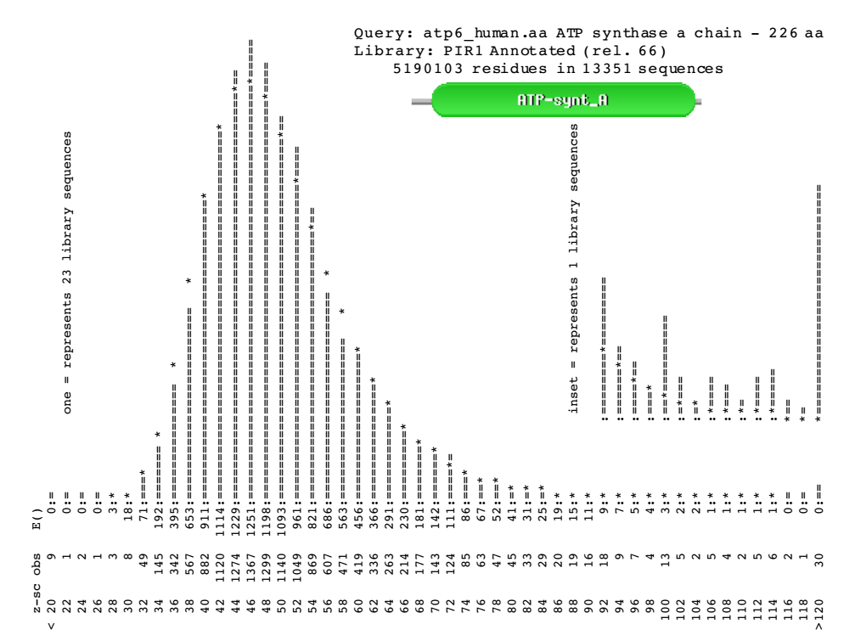
Alignment scores between real non-homologous sequences are indistinguishable from random
Real homologs have non-random scores
Slide courtesy of William Pearson

Slide 11
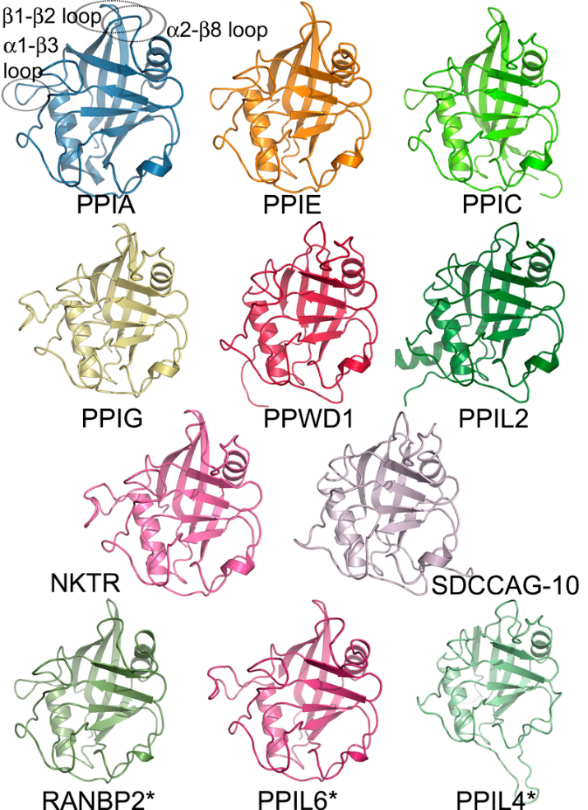
Homology
Homologous gene families are very large
How do we find one-to-one correspondence across species?
Human cycophilin family
Fig. 2 in Davis et al., PLoS Biol 8(7): e1000439, 2010

Slide 12
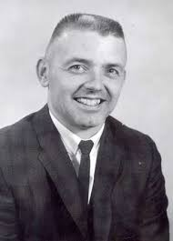
Orthology
Walter Fitch
1929 - 2011

Slide 13
What is an Ortholog?
Orthology is used nearly universally to compare single genes across species
“Same gene in a different species”

Slide 14
What is an Ortholog?
Orthology is used nearly universally to compare single genes across species
“Same gene in a different species”

Slide 15
Terminology Barf
Paralogs
Inparalogs
Outparalogs
Xenolog
Ohnologs
Gametologs

Slide 16
What is an Ortholog?
All these terms are meant to approximate the tree-like structure of gene evolution
First an aside on trees…

Slide 17
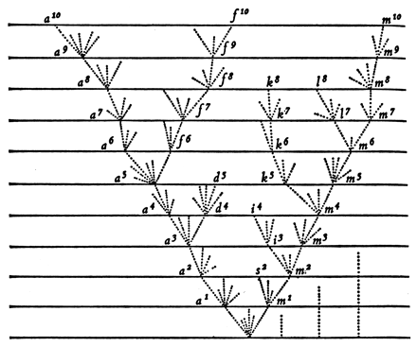
Basics of Phylogenetics
Only figure in Darwin’s “Origin of Species”

Slide 18
Basics of Phylogenetics
Trees show the relationship between pattern and process

Slide 19
Basics of Phylogenetics
Pattern
Process

Slide 20
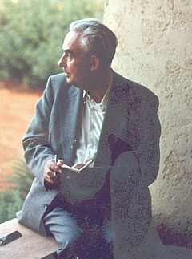
Basics of Phylogenetics
Phylogenetic systematics (cladistics)
  Organisms should be grouped by phylogenetic relationships
  Bifurcating trees
Key terms:
  Clade
  Monophyly
  Paraphyly
Willi Hennig (1913 – 1976)

Slide 21
Basics of Phylogenetics
Clade: an ancestor and all of its descendants

Slide 22
Basics of Phylogenetics
Clade: an ancestor and all of its descendants
Clade!!

Slide 23
Basics of Phylogenetics
Clade: an ancestor and all of its descendants
Clade!!

Slide 24
Basics of Phylogenetics
Clade: an ancestor and all of its descendants
Clade!!

Slide 25
Basics of Phylogenetics
Clade: an ancestor and all of its descendants
Not A Clade!!

Slide 26
Basics of Phylogenetics
Monophyletic group: organisms in a clade

Slide 27
Basics of Phylogenetics
Monophyletic group: organisms in a clade
Monophyletic group!!

Slide 28
Basics of Phylogenetics
Monophyletic group: organisms in a clade
Not a monophyletic group!!

Slide 29
Basics of Phylogenetics
Monophyletic group: organisms in a clade
A group is not monophyletic
if their most recent
common ancestor has
descendants that are not
in the group
Not a monophyletic group!!

Slide 30
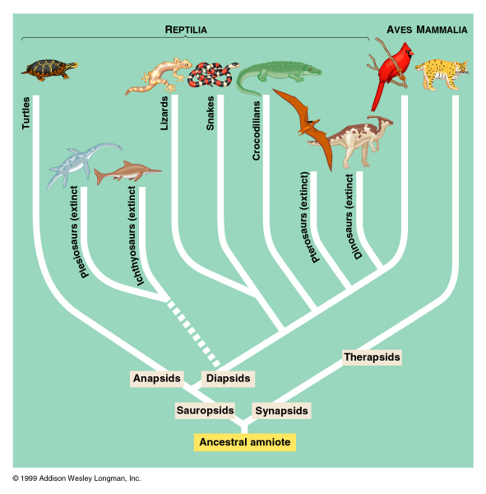
Basics of Phylogenetics

Slide 31
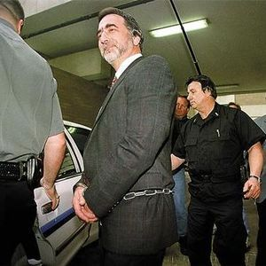
Basics of Phylogenetics
A doctor’s girlfriend accuses him of injecting her with HIV. He said it was vitamin B12.
  Who’s right?
Phylogenetics to the rescue!!

Slide 32
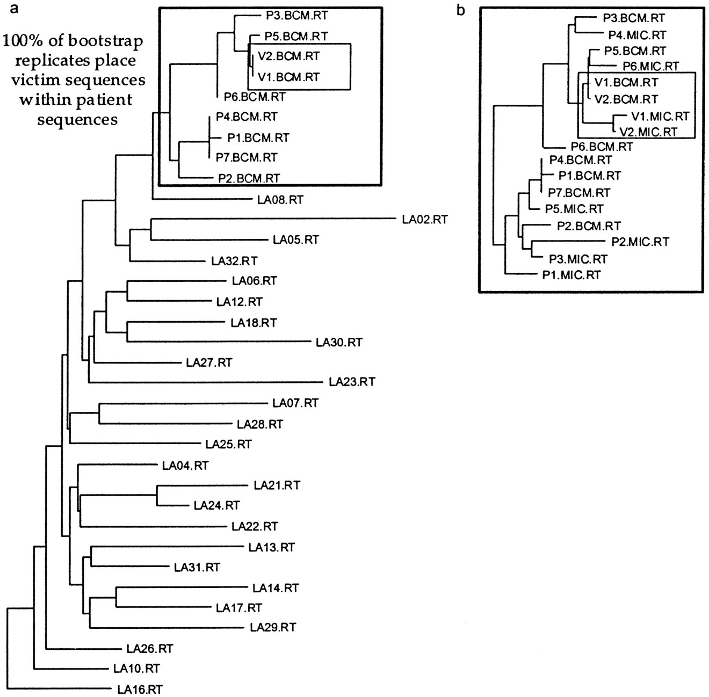
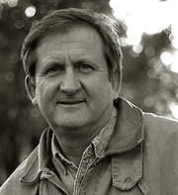
V: victim
P: patient
LA: Louisiana residents with HIV
Michael L. Metzker et al. PNAS 2002;99:14292-14297
David Hillis

Slide 33
Basics of Phylogenetics
Tree nomenclature: nodes
Node

Slide 34
Basics of Phylogenetics
Tree nomenclature: nodes
Leaf or Tip
Node

Slide 35
Basics of Phylogenetics
Tree nomenclature: nodes
Leaf or Tip
Node
Root

Slide 36
Basics of Phylogenetics
Tree nomenclature: branches
  Measures of evolutionary rate
Branch or Edge

Slide 37
Basics of Phylogenetics
Tree nomenclature: branches
  Measures of evolutionary rate
Nothing!!
Branch or Edge

Slide 38
Basics of Phylogenetics
Topology
A
B
C
D

Slide 39
Basics of Phylogenetics
Any node can be rotated without changing topology
A
C
B
D

Slide 40
Basics of Phylogenetics
The tree can be unrooted without changing topology
C
A
B
D

Slide 41
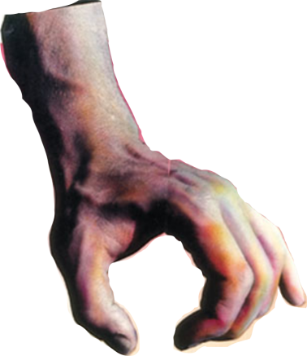
Basics of Phylogenetics
The tree can be unrooted without changing topology
C
A
B
D

Slide 42
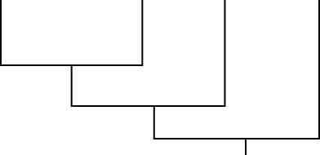
Basics of Phylogenetics
The tree can be unrooted without changing topology
C
B
A
D

Slide 43
Basics of Phylogenetics
The tree can be unrooted without changing topology
C
B
A
D

Slide 44
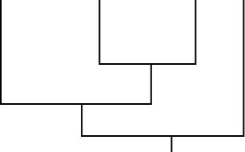
Basics of Phylogenetics
The tree can be unrooted without changing topology
A
C
B
D

Slide 45
Basics of Phylogenetics
Interpreting trees
  Trees tell us the relative relatedness of leaf nodes
C
B
A
D

Slide 46
Basics of Phylogenetics
Interpreting trees
  Trees tell us the relative relatedness of leaf nodes
Common misperceptions:
  D is not the “ancestor” of any other leaf and is not necessarily an older lineage
C
B
A
D

Slide 47
Basics of Phylogenetics
Interpreting trees
  Trees tell us the relative relatedness of leaf nodes
Common misperceptions:
  D is not the “ancestor” of any other leaf and is not necessarily an older lineage
  The tree does not tell us that these tips are “related” (all organisms are related)
C
B
A
D

Slide 48
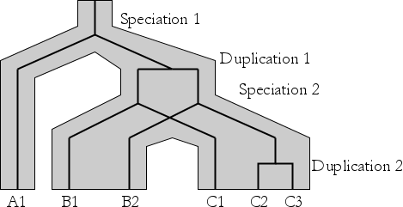
What is an Ortholog?

Slide 49
What is an Ortholog?
“Two genes whose common ancestor resides at a Y junction (speciation) are orthologous. Two genes whose common ancestor resides at a horizontal bar junction (gene duplications) are paralogous.” – Walter Fitch (2000) Trends in Genetics

Slide 50
What is an Ortholog?
“Two genes whose common ancestor resides at a Y junction (speciation) are orthologous. Two genes whose common ancestor resides at a horizontal bar junction (gene duplications) are paralogous.” – Walter Fitch (2000) Trends in Genetics

Slide 51
What is an Ortholog?
“Two genes whose common ancestor resides at a Y junction (speciation) are orthologous. Two genes whose common ancestor resides at a horizontal bar junction (gene duplications) are paralogous.” – Walter Fitch (2000) Trends in Genetics

Slide 52
What is an Ortholog?
Deceptive simplicity:
Orthology is a
pairwise relationship
It is not transitive
Co-orthology is often
abstracted from, with
confusing results
“Two genes whose common ancestor resides at a Y junction (speciation) are orthologous. Two genes whose common ancestor resides at a horizontal bar junction (gene duplications) are paralogous.” – Walter Fitch (2000) Trends in Genetics

Slide 53
What is an Orthologous Group?

Slide 54
What is an Orthologous Group?

Slide 55
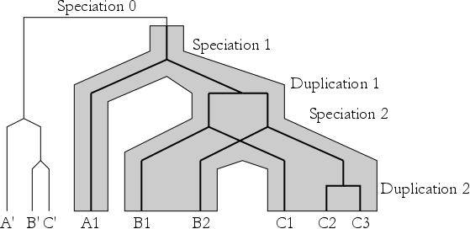
What is an Orthologous Group?

Slide 56
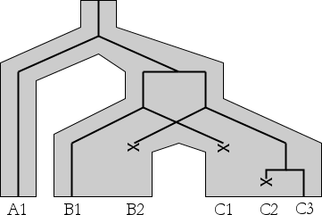
Uh Oh

Slide 57
-ologies
Homology and Orthology give us a way to compare genes in different species
  Homology contains whole families
  Orthology is a direct comparison, usually denoting more functional similarity
Both concepts are potentially slippery

Slide 58
-ologies
They are slippery because they try to “flatten” the true tree-like structure
Orthology inference algorithms are fast
Are they accurate?

Slide 59
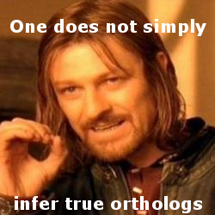
-ologies
They are slippery because they try to “flatten” the true tree-like structure
Orthology inference algorithms are fast
Are they accurate?

Slide 60
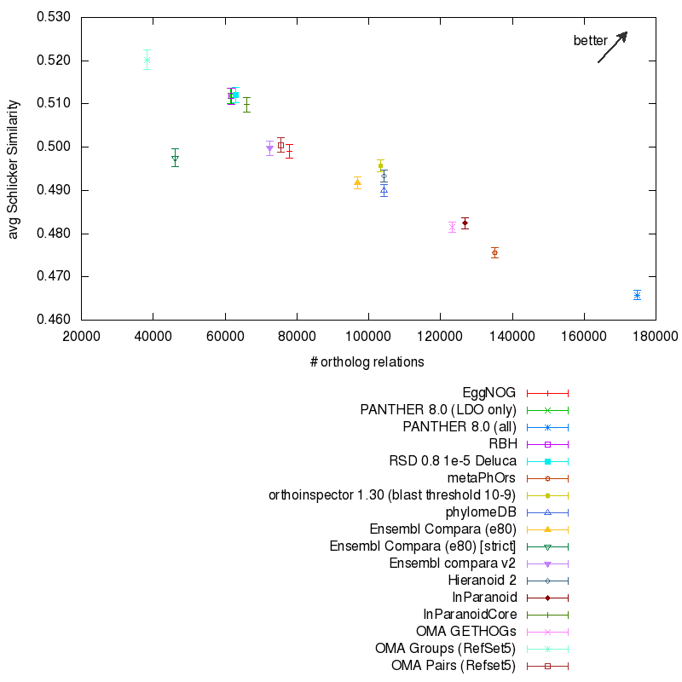
Precision
Recall
Benchmarking
Pairwise orthology calls
on reference proteomes
http://questfororthologs.org/home

Slide 61
Precision
Recall
Benchmarking
Pairwise orthology calls
on reference proteomes
http://questfororthologs.org/home

Slide 62
What’s the way forward?

Slide 63
What’s the way forward?
Error propagation, handling uncertainty

Slide 64
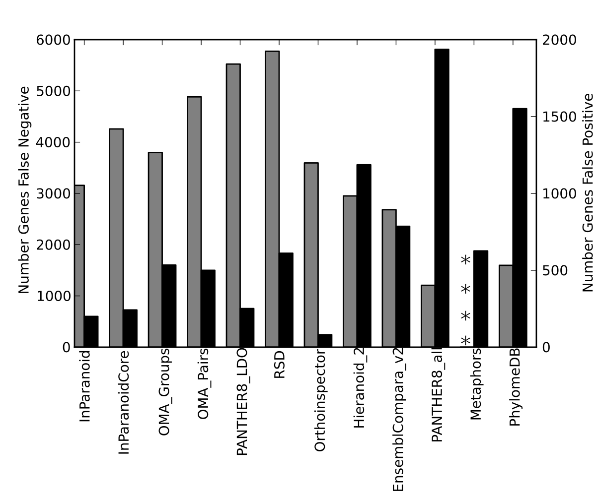
What’s the way forward?
Error propagation, handling uncertainty
False positive
False negative
Liebeskind, McWhite, Marcotte (2016)

Slide 65
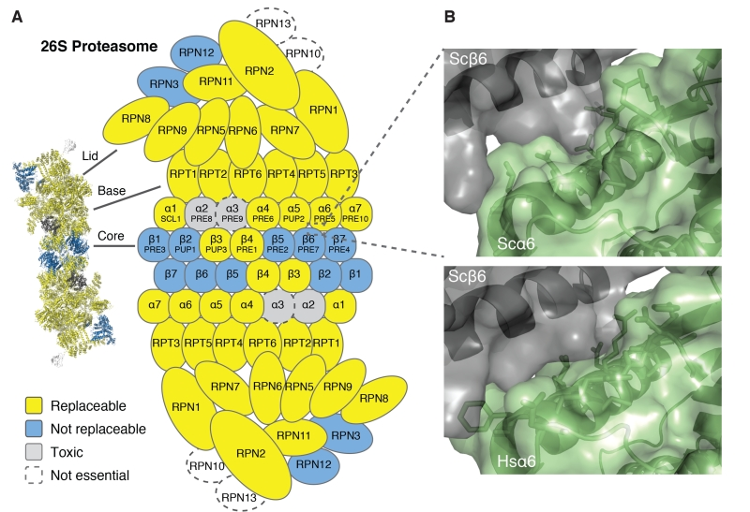
And yet…
We can do amazing things with orthology,
even with all the associated error
Kachroo, et al. (2015)

Slide 66
Thanks!

Slide 67
Inferring Phylogenies
How do we infer relatedness between genes?

Slide 68
Inferring Phylogenies
Algorithms:
Random starting tree
Measure fit of data to tree under optimality criterion
Iterate
(for how long?)
Choose another tree

Slide 69
Number of Possible Trees
Number of Taxa | Number of unrooted trees | Number of rooted trees
3 | 1 | 3
4 | 3 | 15
5 | 15 | 105
6 | 105 | 945
7 | 945 | 10395
8 | 10395 | 135135
9 | 135135 | 2027025
10 | 2027025 | 34459425
20 | 2.22E+020 | 8.20E+021
30 | 8.69E+036 | 4.95E+038
40 | 1.31E+055 | 1.01E+057
50 | 2.84E+074 | 2.75E+076
60 | 5.01E+094 | 5.86E+096
70 | 5.00E+115 | 6.85E+117
80 | 2.18E+137 | 3.43E+139
For comparison the universe contains only about 10⁸⁹ protons.
(http://www.pagines.ma1.upc.edu/~casanellas/eaca/tree_number.html)

Slide 70
Inferring Phylogenies
Algorithms:
Random starting tree
Measure fit of data to tree under optimality criterion
Heuristic Search:
Search a sub-space of trees with a well-defined stopping criterion
Choose another tree

Slide 71
Inferring Phylogenies
Optimality criteria for inferring trees
  Pairwise distance methods
  Maximum parsimony
  Likelihood/Bayesian methods

Slide 72
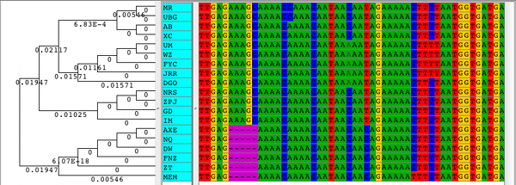
Inferring Phylogenies
Phylogenies are based on alignments
  Taxa are represented row-wise
  Columns are sites in the genome
    Can be nucleotides or amino acids

Slide 73
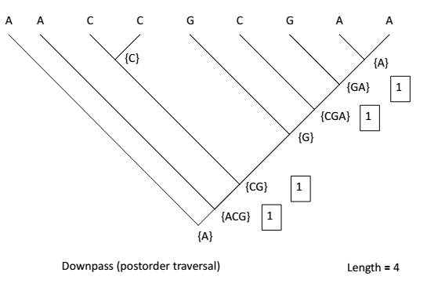
Parsimony Score
Figure curtesy of David Hillis

Slide 74
Parsimony Score
Figure curtesy of David Hillis

Slide 75
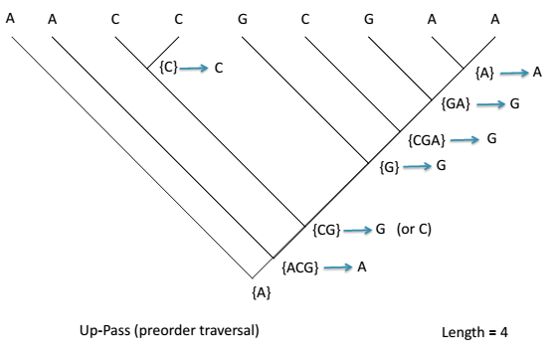
Parsimony Score
Figure curtesy of David Hillis

Slide 76
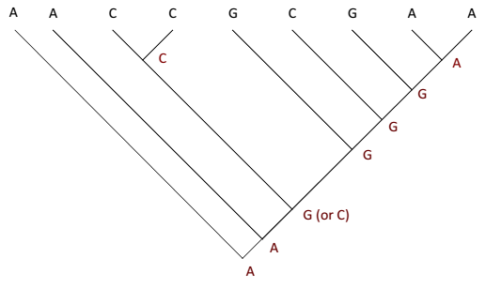
Parsimony Score
Figure curtesy of David Hillis

Slide 77
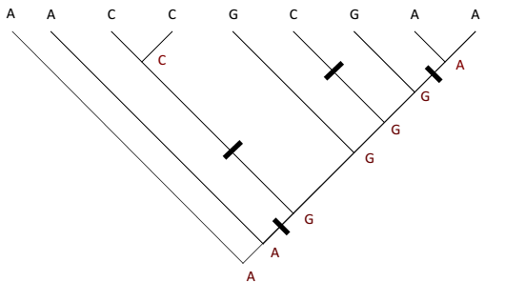
Parsimony Score
Figure curtesy of David Hillis

Slide 78
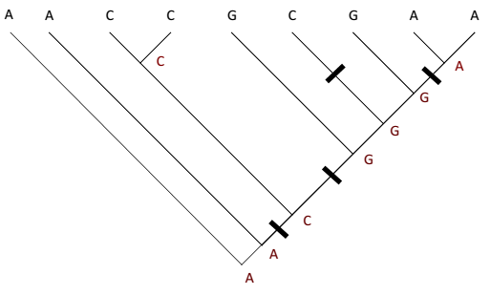
Parsimony Score
Figure curtesy of David Hillis

Slide 79
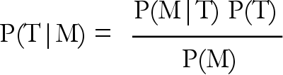
Parametric Methods
Maximum likelihood methods find the tree that maximizes the probability of a model
  arg max P(M|T)
Bayesian methods calculate the probability of a tree given a model
  P(T|M)
  Bayes’ theorem:

Slide 80
Models of Evolution
Parametric criteria are evaluated analogously to parsimony
  One tree is tried at a time!!

Slide 81
Performance
Parametric methods (likelihood, Bayesian) perform best except in cases of egregious model violation
  Con: they are much slower
Distance methods are the norm in prepackaged software. Parsimony still used widely
  Con: both are statistically inconsistent when internal branch lengths get longer

Slide 82
Parametric Methods
Maximum likelihood methods find the tree that maximizes the probability of a model
  arg max P(M|T)
Bayesian methods calculate the probability of a tree given a model
  P(T|M)
  Bayes’ theorem:
Likelihood
Prior prob. of tree
(usually flat)
Sum over parameter values of model
Evaluated numerically

Slide 83

Models of Evolution
Continuous time Markov models

Slide 84
Models of Evolution
Continuous time Markov models
Probability of changing from cytosine to thymine
In time t along a branch

Slide 85
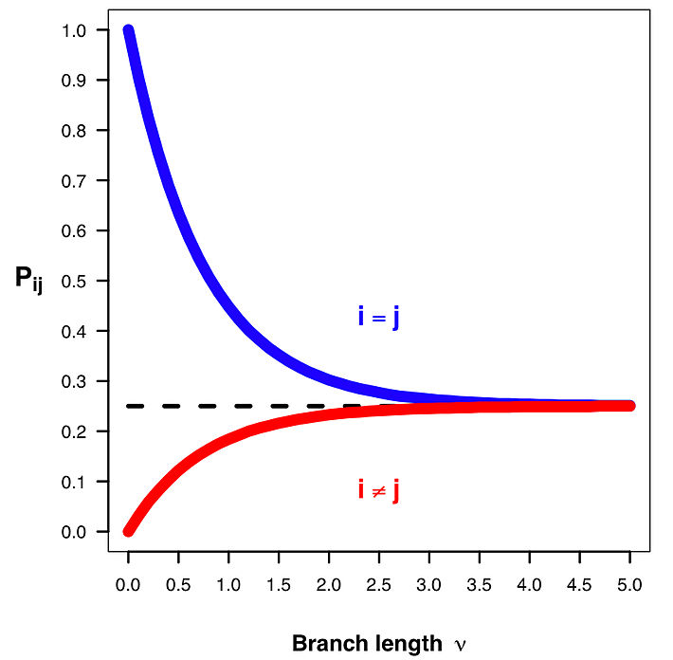
Models of Evolution
Continuous time Markov models
Wait times are exponentially functions
If transition probabilities are equal (=.25),
all probabilities approach .25

