Slide 1
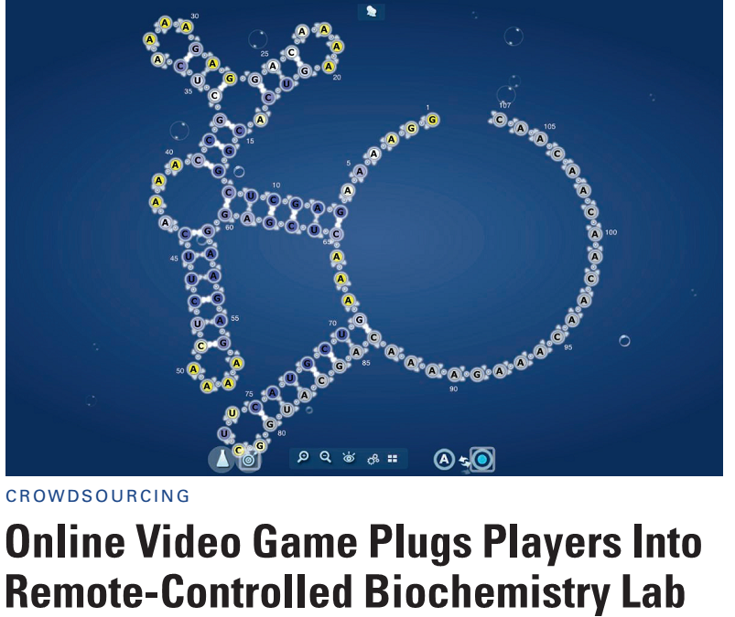
Science news of the day:
“The game, called EteRNA, allows players to remotely carry out real
experiments to verify their predictions of how RNA molecules fold.”
“hooking players up directly to a real-world, robot-controlled biochemistry lab.”
In tests, … “human players still came out on top, solving structures more accurately than the standard software 99% of the time.”
Science 343 (2014)
The paper reporting EteRNA (Lee et al., PNAS, 2014) has >37,000 authors.
Edward Marcotte/Univ. of Texas/BIO337/Spring 2014

Slide 2
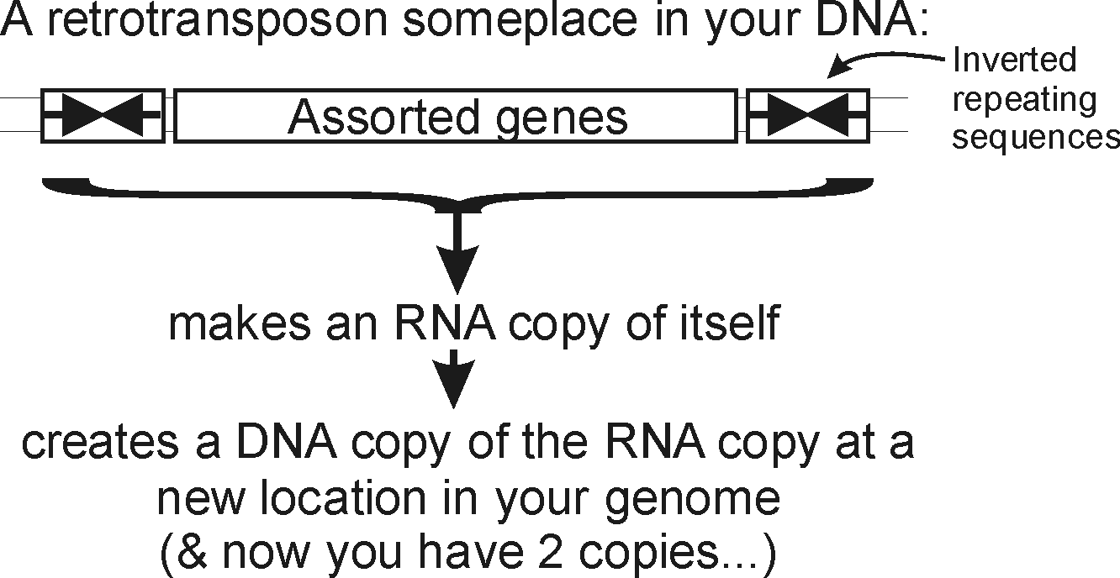
Wrapping up our last topic:
You and your (DNA) parasites
Events like these, happening over and over again, have led to…
Edward Marcotte/Univ. of Texas/BIO337/Spring 2014

Slide 3
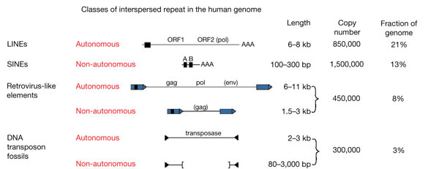
Wrapping up our last topic:
You and your (DNA) parasites
~45%
Bottom line: Roughly half of your (and my) genome is the fossil wreckage of genomic parasites.
We know this (in part) from sequence alignments.
Edward Marcotte/Univ. of Texas/BIO337/Spring 2014
(apologies—missing the citation, now lost)

Slide 4
So far, we’ve talked about
DNA, RNA and protein sequences
How to compare sequences to decide if they are related
Having databases full of sequences and comparing them rapidly (BLAST)
In fact, many such databases exist, so today we’ll start with a brief tour of some of the biological data on the web.
Edward Marcotte/Univ. of Texas/BIO337/Spring 2014

Slide 5
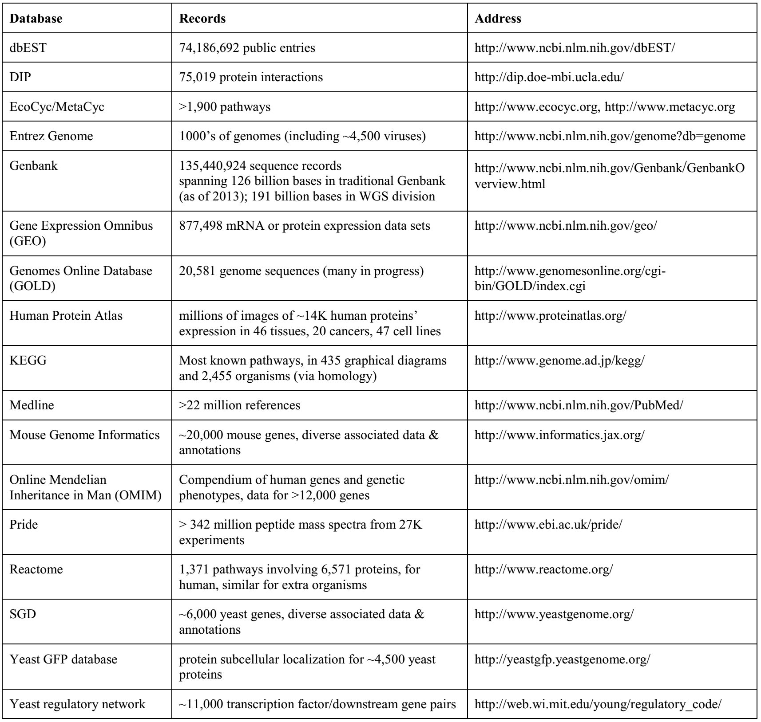
Just some of the resources available for bioinformatics
Think of these as the raw data for new discoveries
Edward Marcotte/Univ. of Texas/BIO337/Spring 2014

Slide 6
>75K protein-protein interactions
Just some of the resources available for bioinformatics
Think of these as the raw data for new discoveries
GEO has ~900K experiments, each measuring 1000’s of mRNA or protein abundances
Medline has >22 million research articles, many with complete text online
OMIM = the most important resource for human genetic disease
>1,300 biochemical processes and reactions, described in detail
Edward Marcotte/Univ. of Texas/BIO337/Spring 2014

Slide 7
Live demo OMIM,
Reactome,
Human Protein Atlas
Edward Marcotte/Univ. of Texas/BIO337/Spring 2014

Slide 8
It’s nice to know that all of this exists, but ideally, you’d like to be able to so something constructive with the data.
That means getting the data inside your own programs.
All of these databases let you download data in big batches, but this isn’t always the case, so….
We saw one way to do this in AppSoma. Here’s another.
Edward Marcotte/Univ. of Texas/BIO337/Spring 2014

Slide 9
Let’s empower your Python scripts to grab data from the web.
We’ll use Python library/module = an optional, specialized set of Python methods
This particular Python module is called urllib2.
urllib2 is:
A collection of programs/tools to let you to surf the web from inside your programs.
Much more powerful than the simple tasks we’ll do with it.
More details: http://docs.python.org/2/library/urllib2.html
Edward Marcotte/Univ. of Texas/BIO337/Spring 2014

Slide 10
The basic idea:
We first set up a “request” by opening a connection to the URL.
We then save the response in a variable and print it.
If it can’t connect to the site, it’ll print out a helpful error message instead of the page.
You can more or less use the commands in a cookbook fashion….
Edward Marcotte/Univ. of Texas/BIO337/Spring 2014

Slide 11
For example:
import urllib2 # include the urllib2 module
url = "http://www.utexas.edu/"
try: # this 'try' statement tells Python that we might expect an error.
request = urllib2.urlopen(url) # setup a request
page = request.read() # save the response
print page # show the result to the user
except urllib2.HTTPError: # handle a page not found error
print "Could not find page."
→ Run this…
Edward Marcotte/Univ. of Texas/BIO337/Spring 2014

Slide 12
→ We just captured the UT web page and printed it out (minus the images)…
>>>
<!DOCTYPE html PUBLIC "-//W3C//DTD XHTML 1.0 Strict//EN"
"http://www.w3.org/TR/xhtml1/DTD/xhtml1-strict.dtd">
<html xmlns="http://www.w3.org/1999/xhtml" xml:lang="en" lang="en" dir="ltr">
<head>
<meta http-equiv="Content-Type" content="text/html; charset=utf-8" />
<meta http-equiv="Content-Type" content="text/html; charset=utf-8" />
<link rel="shortcut icon" href="/sites/default/files/webcentral_favicon_0.ico" type="image/x-icon" />
<title>Home | The University of Texas at Austin</title>
<link type="text/css" rel="stylesheet" media="all" href="/sites/default/files/css/css_39da96d3505397e78e1b5ff4743df898.css" />
<script type="text/javascript" src="/sites/default/files/js/js_bb53cbf52ebfa96587a1c184036c356e.jsmin.js"></script>
<script type="text/javascript">
<!--//--><![CDATA[//><!—
…and so on…
Edward Marcotte/Univ. of Texas/BIO337/Spring 2014

Slide 13
That was a static web page.
Let’s try one that requires some sort of action,
for example by entering a document id or an id code for a sequence.
Many web pages pass this information along in the web URL itself…
Edward Marcotte/Univ. of Texas/BIO337/Spring 2014

Slide 14
Here’s a complete Python program to retrieve a single entry from Medline:
import urllib2
pmid = 11237011
# Insert the pmid where the {} are in the following URL:
url = "http://www.ncbi.nlm.nih.gov/pubmed/{0}?report=medline&format=text".format(pmid)
try: # there might be an error!
request = urllib2.urlopen(url)
page = request.read()
print page
except urllib2.HTTPError: # handle page not found error
print "Could not connect to Medline!"
Edward Marcotte/Univ. of Texas/BIO337/Spring 2014

Slide 15
If you run that program, you should get back…
>>>
<?xml version="1.0" encoding="utf-8"?>
<!DOCTYPE html PUBLIC "-//W3C//DTD XHTML 1.0 Transitional//EN" "http://www.w3.org/TR/xhtml1/DTD/xhtml1-transitional.dtd">
<pre>
PMID- 11237011
OWN - NLM
STAT- MEDLINE
DA - 20010309
DCOM- 20010322
LR - 20061115
IS - 0028-0836 (Print)
IS - 0028-0836 (Linking)
VI - 409
IP - 6822
DP - 2001 Feb 15
TI - Initial sequencing and analysis of the human genome.
PG - 860-921
AB - The human genome holds an extraordinary trove of information about human
development, physiology, medicine and evolution. Here we report the results of an
international collaboration to produce and make freely available a draft sequence
of the human genome. We also present an initial analysis of the data, describing
some of the insights that can be gleaned from the sequence.
FAU - Lander, E S
AU - Lander ES
AD - Whitehead Institute for Biomedical Research, Center for Genome Research,
Cambridge, Massachusetts 02142, USA. lander@genome.wi.mit.edu [and so on]
the Medline entry for the human genome sequence paper
Edward Marcotte/Univ. of Texas/BIO337/Spring 2014

Slide 16
If you run that program, you should get back…
>>>
<?xml version="1.0" encoding="utf-8"?>
<!DOCTYPE html PUBLIC "-//W3C//DTD XHTML 1.0 Transitional//EN" "http://www.w3.org/TR/xhtml1/DTD/xhtml1-transitional.dtd">
<pre>
PMID- 11237011
OWN - NLM
STAT- MEDLINE
DA - 20010309
DCOM- 20010322
LR - 20061115
IS - 0028-0836 (Print)
IS - 0028-0836 (Linking)
VI - 409
IP - 6822
DP - 2001 Feb 15
TI - Initial sequencing and analysis of the human genome.
PG - 860-921
AB - The human genome holds an extraordinary trove of information about human
development, physiology, medicine and evolution. Here we report the results of an
international collaboration to produce and make freely available a draft sequence
of the human genome. We also present an initial analysis of the data, describing
some of the insights that can be gleaned from the sequence.
FAU - Lander, E S
AU - Lander ES
AD - Whitehead Institute for Biomedical Research, Center for Genome Research,
Cambridge, Massachusetts 02142, USA. lander@genome.wi.mit.edu [and so on]
We just printed it. We could have saved it or extracted data from it.
For example…
Edward Marcotte/Univ. of Texas/BIO337/Spring 2014

Slide 17
Here’s our Python program again to retrieve a single entry from Medline. How would we modify this to count the authors?
import urllib2
pmid = 11237011
# Insert the pmid where the {} are in the following URL:
url = "http://www.ncbi.nlm.nih.gov/pubmed/{0}?report=medline&format=text".format(pmid)
try: # there might be an error!
request = urllib2.urlopen(url)
page = request.read()
print page
except urllib2.HTTPError: # handle page not found error
print "Could not connect to Medline!"
Edward Marcotte/Univ. of Texas/BIO337/Spring 2014

Slide 18
Here’s our Python program again to retrieve a single entry from Medline. How would we modify this to count the authors?
import urllib2
pmid = 11237011
# Insert the pmid where the {} are in the following URL:
url = "http://www.ncbi.nlm.nih.gov/pubmed/{0}?report=medline&format=text".format(pmid)
try: # there might be an error!
request = urllib2.urlopen(url)
page = request.read()
print page.count("AU - ")
except urllib2.HTTPError: # handle page not found error
print "Could not connect to Medline!"
Medline begins author lines with "AU - " , so…
So, there were 255 authors on one (of the two) human genome papers
→ Run this, & get …
>>>
255
Edward Marcotte/Univ. of Texas/BIO337/Spring 2014

Slide 19
Queries to Medline or any other NCBI database, including GenBank, are described at: http://www.ncbi.nlm.nih.gov/books/NBK3862/
You can often figure out the form of the URL just by looking something up in a database, then noting the address of the web page with the data.
This very simple approach could easily be the basis for:
a home-made web browser
a program to consult biological databases in real time
a program to map the internet, etc.
Of course, with this kind of power available to you, the imagination reels...
Edward Marcotte/Univ. of Texas/BIO337/Spring 2014

