Slide 1
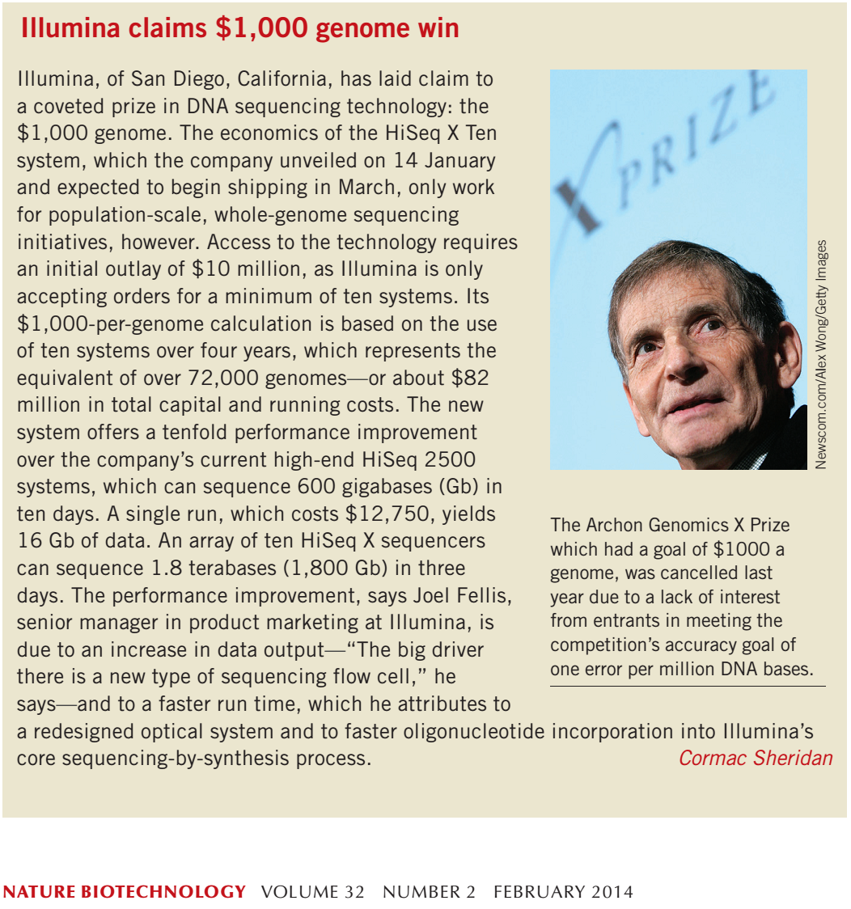
Edward Marcotte/Univ. of Texas/BIO337/Spring 2014

Slide 2
Markov Chains
and
Hidden Markov Models
= stochastic, generative models
(Drawing heavily from Durbin et al., Biological Sequence Analysis)
BIO337 Systems Biology / Bioinformatics – Spring 2014
Edward Marcotte, Univ of Texas at Austin
Edward Marcotte/Univ. of Texas/BIO337/Spring 2014

Slide 3
Markov Chains and Hidden Markov Models are important probabilistic models in computational biology
Some of their applications include:
  Finding genes in genomes
  Mapping introns, exons, and splice sites
  Identifying protein domain families
  Detecting distant sequence homology
  Identifying secondary structures in proteins
  Identifying transmembrane segments in proteins
  Aligning sequences
& outside biology, they have many uses, including:
  Speech, handwriting, and gesture recognition
  Tagging parts-of-speech
  Language translation
  Cryptanalysis and so on….
Edward Marcotte/Univ. of Texas/BIO337/Spring 2014

Slide 4
The key idea of both of these types of models is that:
Biological sequences can be modeled as series of stochastic (i.e., random) events.
It’s easy to see how a random process might model stretches of DNA between genes and other important regions.
BUT, the idea of modeling something as structured and meaningful as a gene or protein sequence by a similar process might seem odd.
Edward Marcotte/Univ. of Texas/BIO337/Spring 2014

Slide 5
It’s important to realize exactly what we’re modeling.
The idea behind hidden Markov models is not that the sequence is random, but that the sequence we observe is one of many possible instances of some underlying process or object.
E.g., actin differs slightly from organism to organism.
Imagine an “ideal”, but unobservable, actin, defined by certain underlying specific physico-chemical properties important for its function. What we see in nature is not this ideal gene, but numerous instances of observed sequences, all just a bit different.
In the hidden Markov model, the underlying process or structure is represented as hidden, unobservable states and the observed sequences represent possible sequences compatible with these states.
We would say that the observed sequence is emitted from the hidden state.
Edward Marcotte/Univ. of Texas/BIO337/Spring 2014

Slide 6

Let’s start with a easier case: Markov chains
We’ll explore a simple non-biological model: a coin-toss
Flip a coin a bunch of times and observe the results, e.g.
TTTHTTTHHTTHTTHTTHHTHTHHHHTTTTTTTTHTTHHTTTHTHHHTHH
We could model this process as two states:
H for heads,
T for tails,
and the probability of switching between them:
Edward Marcotte/Univ. of Texas/BIO337/Spring 2014

Slide 7
Let’s start with a easier case: Markov chains
We’ll explore a simple non-biological model: a coin-toss
Flip a coin a bunch of times and observe the results, e.g.
TTTHTTTHHTTHTTHTTHHTHTHHHHTTTTTTTTHTTHHTTTHTHHHTHH
We could model this process as two states:
H for heads,
T for tails,
and the probability of switching between them:
H
A sequence is a walk along this graph:
H
T
H
H
H
T
H …
Edward Marcotte/Univ. of Texas/BIO337/Spring 2014

Slide 8
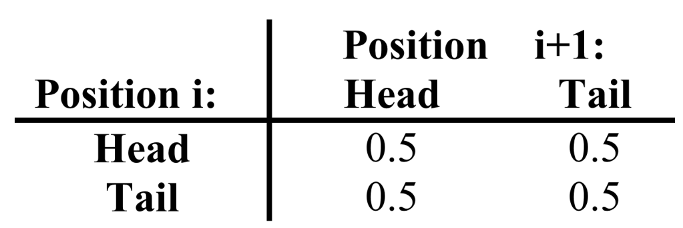
0.5
Important: All probabilities leading out of a state add up to 1!
0.5
0.5
0.5
With a fair coin:
The chance of seeing heads or tails is equal, and
the chance of seeing heads following tails and vice versa is equal.
Therefore, the transition probabilities
(corresponding to the arrows above) are:
Edward Marcotte/Univ. of Texas/BIO337/Spring 2014

Slide 9
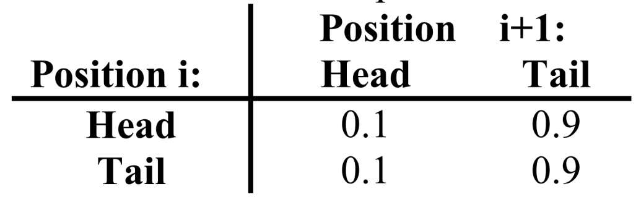
0.1
Important: All probabilities leading out of a state add up to 1!
0.1
0.9
0.9
With a biased coin (e.g. tails comes up 90% of the time):
The chance of seeing heads or tails is not equal, nor is
the chance of seeing heads following tails and vice versa.
We might have the same model,
but with skewed transition probabilities :
Edward Marcotte/Univ. of Texas/BIO337/Spring 2014

Slide 10
Now, imagine a scenario where the observed sequence of coin flips was actually generated by 2 coins, one fair and one biased.
To decide whether we are looking at a sequence of coin flips from the biased or fair coin, we could evaluate the ratio of the probabilities of observing the sequence by each model:
P( X | fair coin )
P( X | biased coin )
Does this remind you of something we’ve seen before?
How might we test where the fair & biased coins were swapped along a long stretch of coin flips?
Edward Marcotte/Univ. of Texas/BIO337/Spring 2014

Slide 11
How might we test where the fair & biased coins were swapped along a long stretch of coin flips?
One way using our current Markov chain model is to calculate the ratio of probabilities (e.g. log odds ratio) in a sliding window along the sequence:
HTHTHTHTTTTTTTTTTTTTTTTTTTHTHTHTHTHT
FFFFFFFFFFFFBBBBBBBBBBBBBBBBFFFFFFFFFF
Fair
+
Log odds ratio
0
-
Biased
Edward Marcotte/Univ. of Texas/BIO337/Spring 2014

Slide 12
How about a biological application? A classic example is CpG islands
In animal genomes, the dinucleotide CG is strongly underrepresented
(note: NOT the base pair C:G, but rather 5’-CG-3’)
Why? C’s are often methylated, and methylated C’s mutate at higher rates into T’s. So, over time, CG’s convert to TG’s
EXCEPT around promoters, which tend not to be methylated.
Thus, CpG ‘islands’ often indicate nearby genes. Finding them was a classic method for annotating genes.
How could we make a CpG island finding model analogous to the fair/biased coin model?
Edward Marcotte/Univ. of Texas/BIO337/Spring 2014

Slide 13
A CpG island model might look like:
( of course, need the parameters, but maybe these are the most important….)
A C
T G
A C
T G
p(C→G) is
higher
p(C→G) is
lower
CpG island
model
Not CpG island
model
P( X | CpG island)
P( X | not CpG island)
Could calculate (or log ratio) along a sliding window,
just like the fair/biased coin test
Edward Marcotte/Univ. of Texas/BIO337/Spring 2014

Slide 14
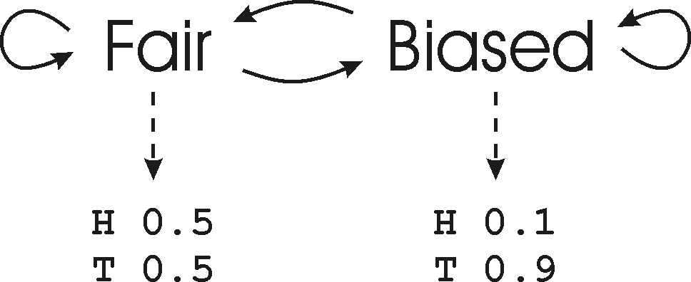
In these simple models, called Markov chains,
we don’t have hidden states.
BUT, we could have used a hidden Markov model:
Now, the underlying state (the choice of coin) is hidden.
Each state emits H or T with different probabilities.
Edward Marcotte/Univ. of Texas/BIO337/Spring 2014

Slide 15
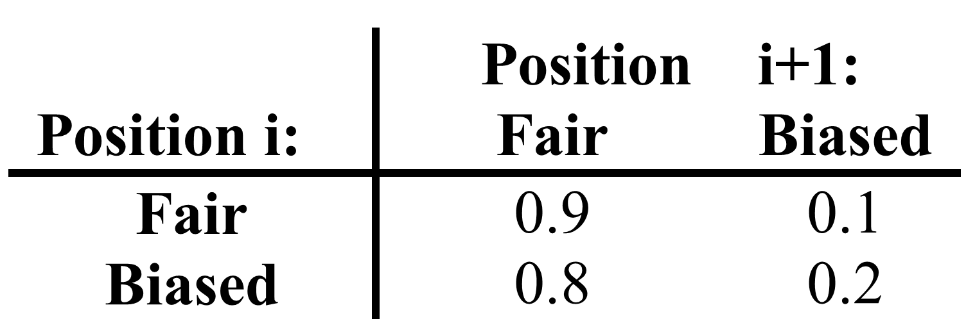
0.8
0.9
0.2
0.1
These are the
emission probabilities
for each state
The transition probabilities might be something like:
Edward Marcotte/Univ. of Texas/BIO337/Spring 2014

Slide 16
Important questions we might like to ask:
Given an observed sequence and a model, what is the most likely sequence of hidden states?
i.e., what is the path through the HMM that maximizes P(p,X|l), where p is the sequence of states)?
In our coin example, we might be given an observed sequence:
HTHTHTHTTTTTTTTTTTTTTTTTTTHTHTHTHTHT
and want to identify when the biased coin was used:
FFFFFFFFFFFFBBBBBBBBBBBBBBBBFFFFFFFFFF
Answer: Use the Viterbi algorithm.
We’ll see this shortly.
Edward Marcotte/Univ. of Texas/BIO337/Spring 2014

Slide 17
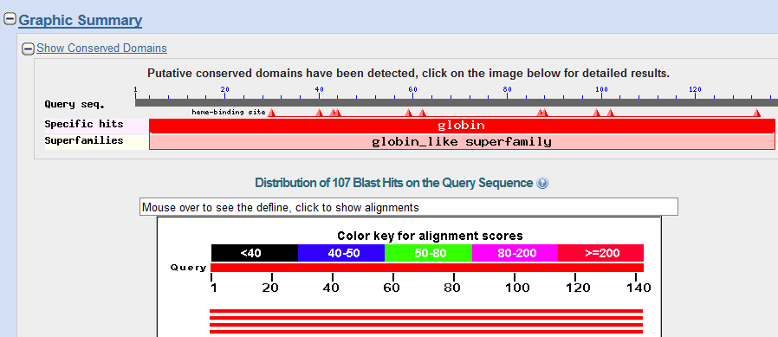
Important questions we might like to ask:
Given a sequence of observations, can we calculate the probability that the sequence was derived from our model ?
i.e., can we calculate P(X|l),
where X is our observed sequence, and l represents our HMM ?
For example, we might want to know if a given protein sequence is a member of a certain protein family.
e.g. as we saw before
(although calculated a bit
differently)
Edward Marcotte/Univ. of Texas/BIO337/Spring 2014

Slide 18
Important questions we might like to ask:
Given a sequence of observations, can we calculate the probability that the sequence was derived from our model ?
i.e., can we calculate P(X|l),
where X is our observed sequence, and l represents our HMM ?
For example, we might want to know if a given protein sequence is a member of a certain protein family.
Answer: Yes. Use the forward algorithm.
We’ll see this shortly.
Edward Marcotte/Univ. of Texas/BIO337/Spring 2014

Slide 19
Important questions we might like to ask:
Given a model, what is the most likely sequence of observations?
For example, after having trained an HMM to recognize a type of protein domain, what amino acid sequence best embodies that domain?
Answer: Follow the maximum transition and emission probability at each state in the model. This will give the most likely state sequence and observed sequence.
Edward Marcotte/Univ. of Texas/BIO337/Spring 2014

Slide 20
Important questions we might like to ask:
How do we train our HMM?
i.e., given some training observations, how do we set the
emission and transition probabilities to maximize P(X|l)?
Answer: If the state sequence is known for your training set, just directly calculate the transition and emission frequencies. With sufficient data, these can be used as the probabilities.
This is what you will do in Problem Set #2.
With insufficient data, probabilities can be estimated from these (e.g., by adding pseudo-counts).
If the state path is unknown, use the forward-backward algorithm (also known as the Baum-Welch algorithm).
Edward Marcotte/Univ. of Texas/BIO337/Spring 2014

Slide 21
Important questions we might like to ask:
How do we choose the best HMM topology from the many possible choices?
Answer: Good question. No great answer.
Often trial-and-error, and understanding the essential features of the system that you are modeling.
Edward Marcotte/Univ. of Texas/BIO337/Spring 2014

Slide 22
Each of these algorithms (the Viterbi, forward, and forward-backward) uses dynamic programming to find an optimal solution.
(just like aligning sequences)
Edward Marcotte/Univ. of Texas/BIO337/Spring 2014

Slide 23
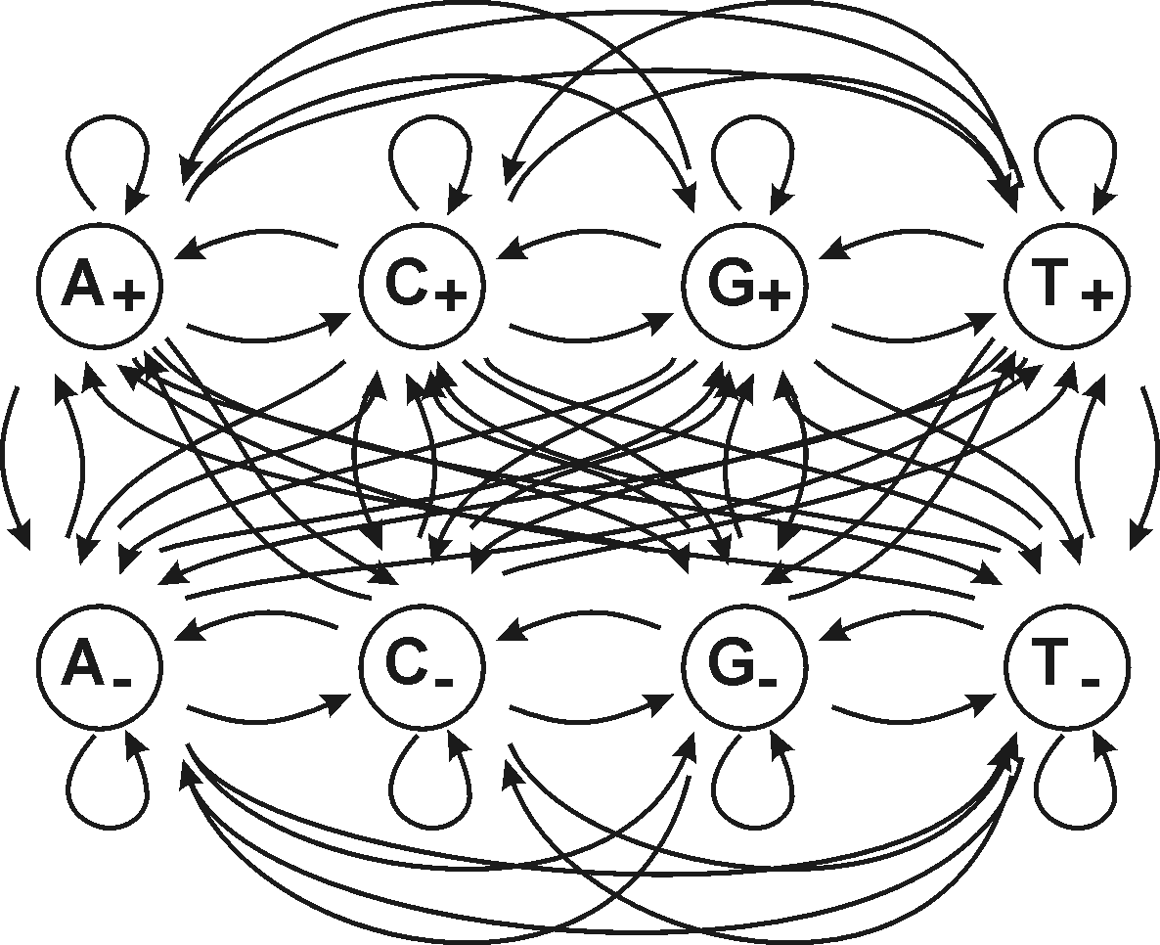
Let’s revisit the CpG islands using an HMM:
8 states: one per nucleotide inside CpG islands (+) and one per nucleotide outside CpG islands (-)
All possible transition probabilities are represented as arrows
This is a particularly simple model: each state emits the nucleotide indicated with probability of 1 and has zero probability of emitting a different nucleotide.
Edward Marcotte/Univ. of Texas/BIO337/Spring 2014

Slide 24
Given a DNA sequence X (e.g., CGATCGCG),
how do we find the most probable sequence of states (e.g., ----++++)?
→ The Viterbi algorithm
We want to find the state path that maximizes the probability of observing that sequence from that HMM model.
Viterbi does this recursively using dynamic programming.
As with sequence alignment, we’ll construct a path matrix that captures the best score (i.e., highest probability) along a single path through the HMM up to each position. We’ll “grow” this matrix using a few simple recursion rule.
Edward Marcotte/Univ. of Texas/BIO337/Spring 2014

Slide 25
The rules (stated formally):
v is an entry in the Viterbi path matrix
Initialization (i=0): v₀(0) = 1, v_{k}(0)=0 for k>0
Recursion (i=1 to L): v_{l}(i) = e_{l}(x_{i}) max_{k} (v_{k}(i-1)a_{kl})
pointer_{i}(l) = argmax_{k} (v_{k}(i-1)a_{kl})
Termination: P(X,p*) = max_{k} (v_{k}(L)a_{k0})
p_{L}* = argmax_{k} (v_{k}(L)a_{k0})
Find the best score among the alternatives at this position
x indicates an observed character
a gives the transition probability between previous state k and current state l
e indicates an emission probability
i indicates our position in the sequence
i.e., draw the pointer back to the entry that gave rise to the current best score
For each Viterbi matrix entry:
We try to maximize the product of prior score and transition from that state to this one.
We then multiply that score times the emission probability for the current character.
Edward Marcotte/Univ. of Texas/BIO337/Spring 2014

Slide 26
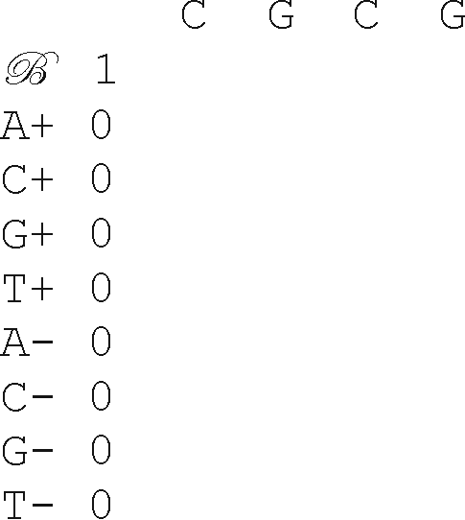
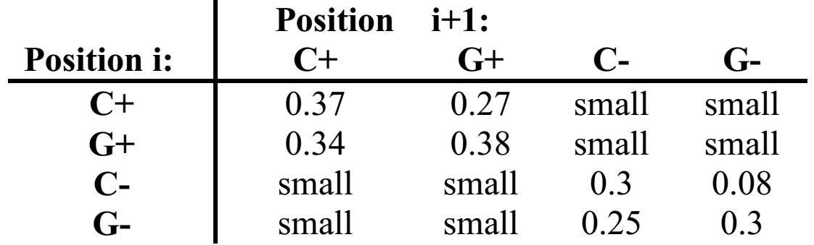
Step 1: Initialize the path matrix.
Observed DNA sequence
Possible
states
For simplicity, let’s assume the transition probability from B to each nucleotide is 1/8. We’ll also ignore all transition probabilities except these for now:
Edward Marcotte/Univ. of Texas/BIO337/Spring 2014

Slide 27
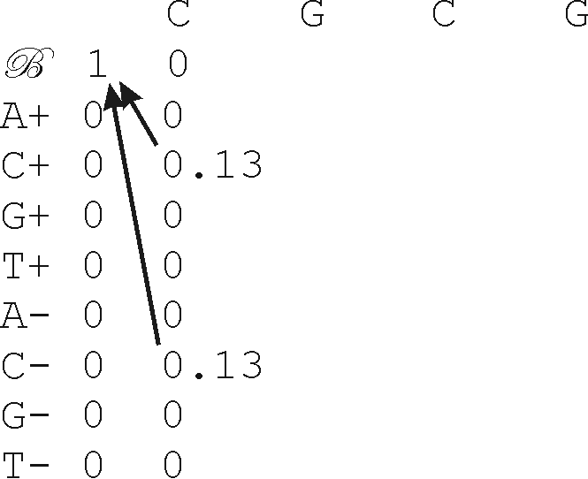
Step 2: Calculate the elements of the v_{k} matrix for i = 1.
Then keep going for i = 2, etc..
For simplicity, let’s assume the transition probability from B to each nucleotide is 1/8. We’ll also ignore all transition probabilities except these for now:
For example, the score v_{C+}(i=1) = 1 * max_{k}{1*1/8, 0*a_{A+,C+}, 0*a_{C+,C+}, ..., 0*a_{T-,C+}} = 1/8
Edward Marcotte/Univ. of Texas/BIO337/Spring 2014

Slide 28
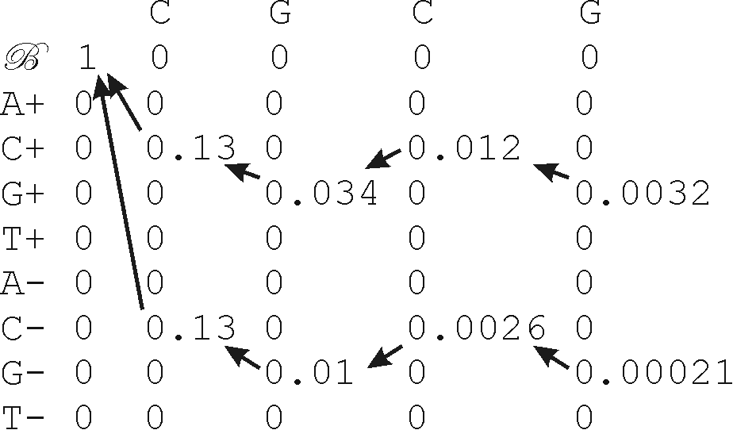
Step 3: Keep going for i = 2, etc..
Edward Marcotte/Univ. of Texas/BIO337/Spring 2014

Slide 29
The maximum scoring path scores 0.0032.
The most likely state path is found by traceback from the 0.0032 to give C+G+C+G+.
In a longer sequence, the model would switch back & forth between CpG and non-CpG states appropriately.
Edward Marcotte/Univ. of Texas/BIO337/Spring 2014

Slide 30
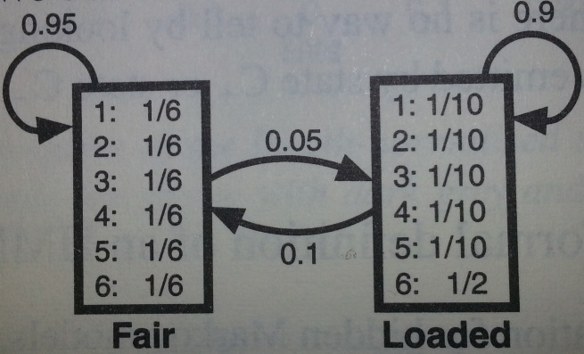
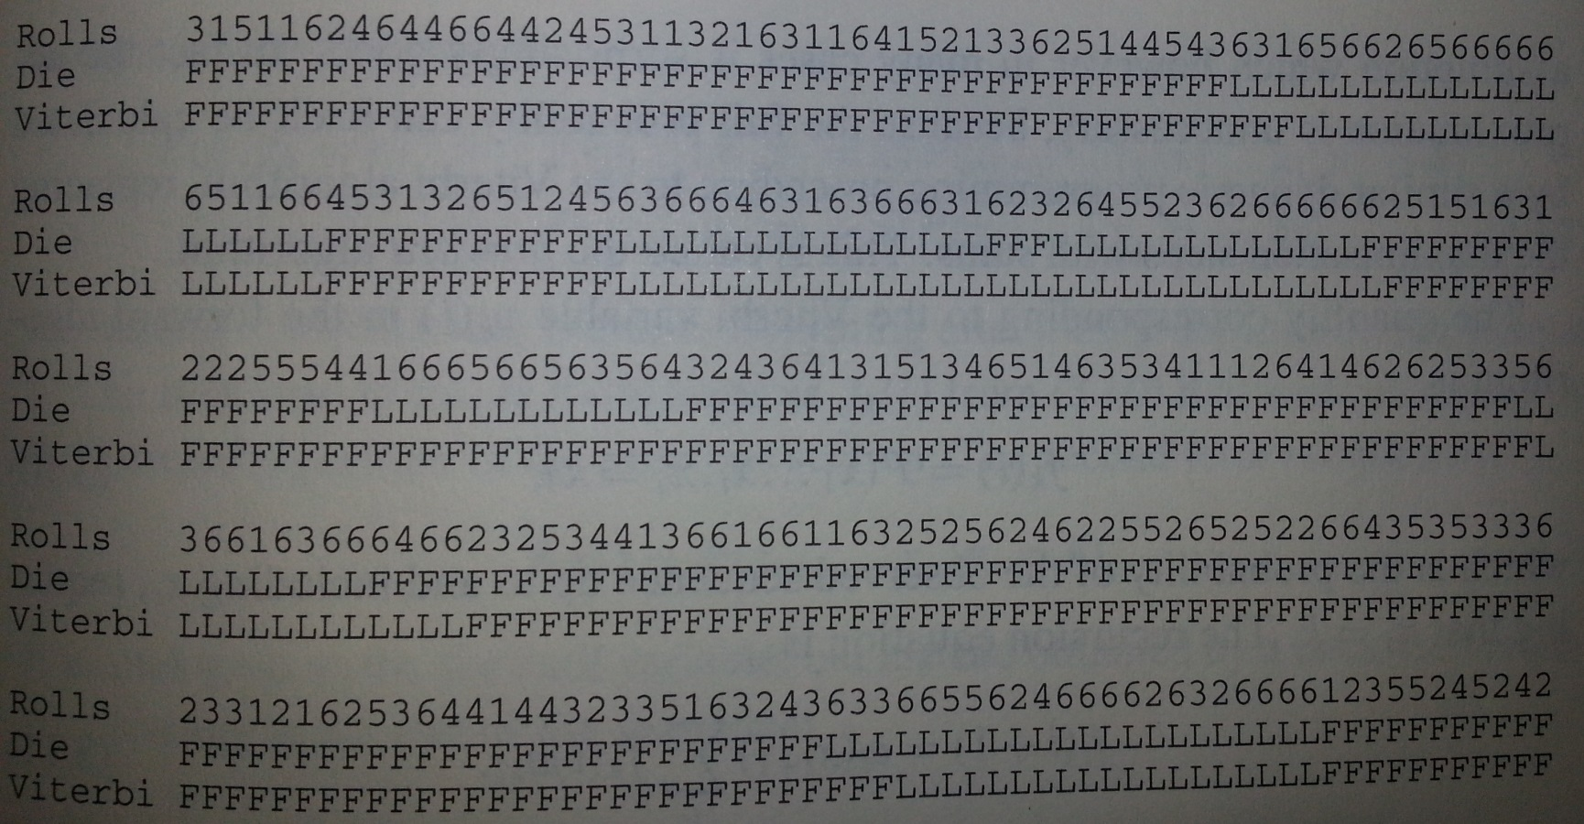
Can this really work? Here’s a real example.
An HMM model of fair and loaded dice:
from Durbin et al.
Reconstructing which was used when, using the Viterbi algorithm:
Edward Marcotte/Univ. of Texas/BIO337/Spring 2014

Slide 31
How do we calculate the probability of a sequence given our HMM model?
→ The forward algorithm
Subtle difference from Viterbi:
Viterbi gives the probability of the sequence being derived from the model given the optimal state path.
The forward algorithm takes into account all possible state paths.
Again, it does this recursively using dynamic programming.
Edward Marcotte/Univ. of Texas/BIO337/Spring 2014

Slide 32
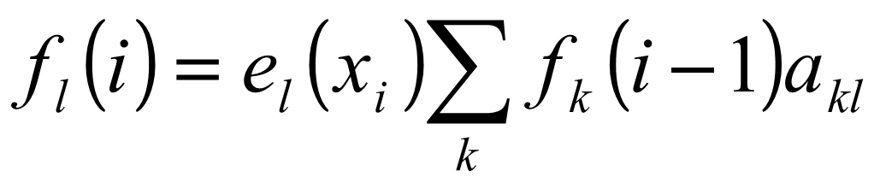
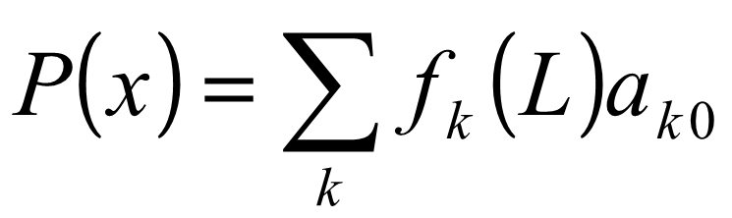
The rules (stated formally):
f is an entry in the forward algorithm path matrix
Initialization (i=0): f₀(0) = 1, f_{k}(0) = 0 for k>0
Recursion (i=1 to L):
Termination:
Same idea as Viterbi, but ADD the scores leading to the current position (not MAX)
Note: No pointer! Just to calculate the probability of seeing this sequence from this model.
For each Viterbi matrix entry:
We try to maximize the product of prior score and transition from that state to this one.
We then multiply that score times the emission probability for the current character.
Edward Marcotte/Univ. of Texas/BIO337/Spring 2014

Slide 33
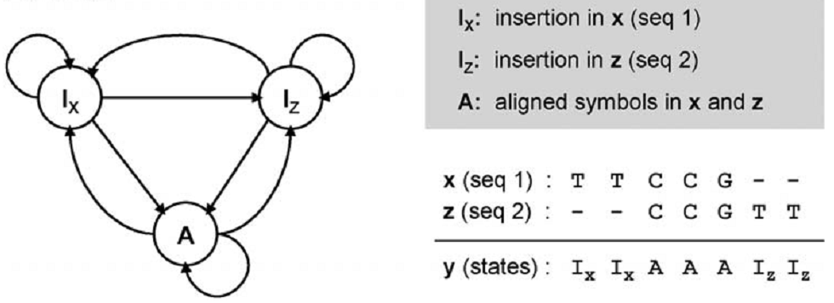
A toy HMM for sequence alignment
Gap
Gap
Match
Is this global or local alignment?
How could you change the model to perform the other kind of alignment?
Curr Genomics (2009) 10(6): 402–415
Edward Marcotte/Univ. of Texas/BIO337/Spring 2014cc

Slide 34
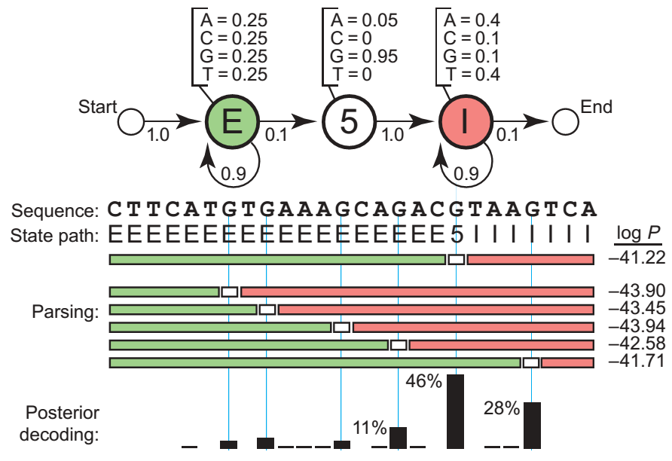
A toy HMM for 5′ splice site recognition (from Sean Eddy’s NBT primer
linked on the course web page)
Could we do better?
Edward Marcotte/Univ. of Texas/BIO337/Spring 2014cc

Slide 35
How might you design an HMM to recognize a given type of protein domain?
Edward Marcotte/Univ. of Texas/BIO337/Spring 2014cc

Slide 36
How might we design HMMs to recognize sequences of a given length?
Edward Marcotte/Univ. of Texas/BIO337/Spring 2014cc

Slide 37
What would this HMM produce?
1-p
1-p
1-p
1-p
1-p
Amino
acid
p
Amino
acid
p
Amino
acid
p
Amino
acid
p
Amino
acid
p(Ala)=…
p(Cys)=…
p(Asp)=…
p(Glu)=…
p(Phe)=…
p(Gly)=…
…
p(Ala)=…
p(Cys)=…
p(Asp)=…
p(Glu)=…
p(Phe)=…
p(Gly)=…
…
p(Ala)=…
p(Cys)=…
p(Asp)=…
p(Glu)=…
p(Phe)=…
p(Gly)=…
…
p(Ala)=…
p(Cys)=…
p(Asp)=…
p(Glu)=…
p(Phe)=…
p(Gly)=…
…
p(Ala)=…
p(Cys)=…
p(Asp)=…
p(Glu)=…
p(Phe)=…
p(Gly)=…
…

